Slide 1

Social structure Part 1
Dr. Salih A Abdulla Sociology for Nurses Fall Semester Week 2 2025-2026

Slide 2
LEARNING OBJECTIVES
After reading this chapter, students will be able to:
• Develop good knowledge on social structure
• Implement the same in their clinical practice
• Learn about basic concepts of society, community, association or institution

Slide 3
Outline
Introduction
Meaning of Social Structure Basic Concepts of Society, Community, Association and Institution Social Structure Characteristics of Social Structure Elements of Social Structure Forms of social Processes Nature of society
Types of societies
Advantages & Disadvantages of society

Slide 4
Introduction
The term “structure” refers to a series of relationships between elements that have some degree of coherence and stability.
Therefore, it is a concept that in principle, we could apply to any part of reality in which we perceive a certain order.

Slide 5
Structure refers to the pattern within the culture and organization through which social action takes place.
It is the arrangements of roles, organizations, institutions and cultural symbols that remain stable over time, often go unnoticed, and change almost invisibly.

Slide 6
In the social sciences, social structure refers to the regular social arrangements that develop from and are determined by human behaviors.
Similarly, society is thought to be divided into structurally related groups or roles, each having its own function, meaning, or purpose.
Family, religion, law, economy, and class are all examples of social structure.

Slide 7
BASIC CONCEPTS OF SOCIETY, COMMUNITY,
ASSOCIATION AND INSTITUTION
Society
Man is a Social Animal and he always lives in society. Society is like a social organization and is a web of social relationships.

Slide 8
Human society is consisting of people, it has control over the behavior of individual, it has similarities and differences too and each society has its own way of life called culture.
Man has a soul, intelligence, and ability to speak, has sociability and hence, all these features are attributed to the sole factor of culture

Slide 9
Community
Community is a group or collection of groups that inhabits a common locality.
It is the group of people who begins to reside in a definite territory. They form strong bond of solidarity.
For example: in rural locality, there is a unity because the people reside in a definite locality. They have ‘we’ feelings means feeling of belongingness, they share common culture and way of life.

Slide 10
Association
A group of people coming together with a specific purpose in mind, certain aims and goals, once the objectives are achieved; association may or may not continue with activities.
In association, there are formal relationships exist which are of short duration. There is no ‘we’ feeling and specific territory. They may write or have unwritten rules.

Slide 11
Institution
The way in which people act on the basis of rules/norms the following ongoing practice of this is called “Institution”.
Institution, like society is an abstract, not any building but the practices and principles of those activities.
For example, School is organization, whereas schooling is an institution, similarly marriage, family, kinship are institutions.

Slide 12
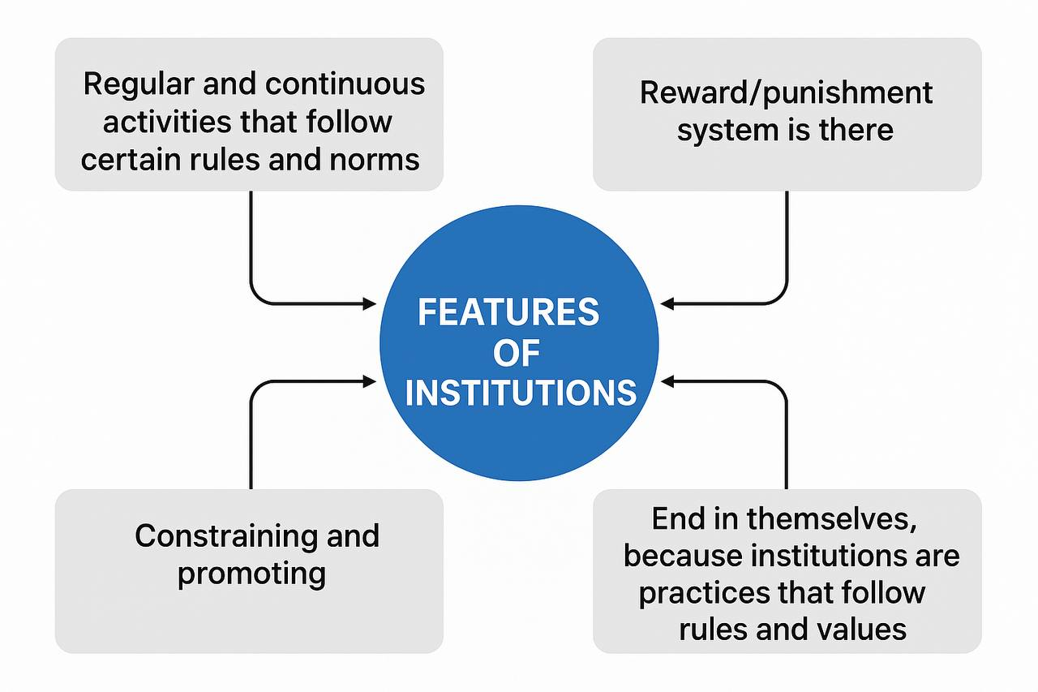

Slide 13
SOCIAL STRUCTURE
Social structure deals with the inter-connectedness of parts, due to which society functions in harmonious manner. Institutions, organizations, and communities are all parts of social structure.

Slide 14
CHARACTERISTICS OF SOCIAL STRUCTURE
• Social structure does not change and relatively permanent.
• It is not universal as every society has its own social structure.
• Social structure is abstract which can only be felt.
• It has different parts and has patterned arrangement.

Slide 15
CHARACTERISTICS OF SOCIAL STRUCTURE
• Parts has definite place in social structure.
• Every social structure has sub structures and they are arranged in hierarchy.
• Social structure is a product of social interaction

Slide 16
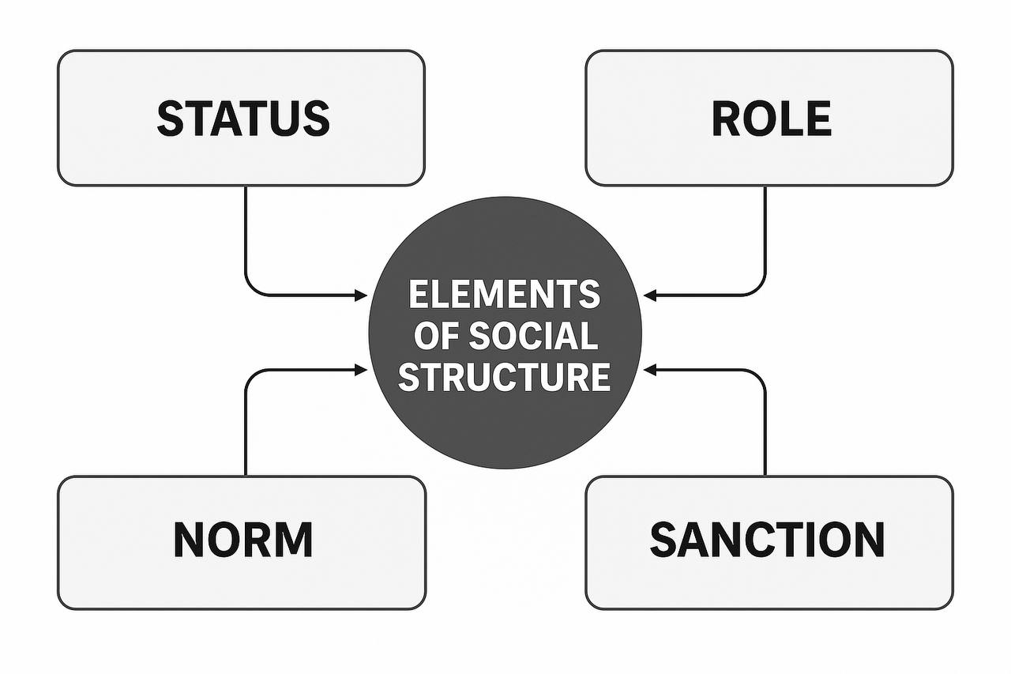
ELEMENTS OF SOCIAL STRUCTURE

Slide 17
1.Status: Status refers to an individual’s social position in society.
Simply defined, a status is a socially defined position in a group or a social system, such as female, student, teacher, child, mother, father, etc. Different types of statuses exist, and they all contribute to our identity; therefore, a person can have multiple statuses at the same time. For example: a person can be a parent, journalist, organizer, and partner all at the same time.

Slide 18
2.Role: Each person of a certain social rank is required to take on certain societal responsibilities.
‘Social Roles’ are the expectations placed on people of a certain social position in terms of behavior, obligations, and rights.

Slide 19
3. Norms: The unwritten standards of ideas, attitudes, and behaviors that are regarded acceptable in a specific social group or culture are referred to as social norms.
Norms give us a set of expectations for how we should act and help to maintain order and predictability in society.
For example, we expect students to be on time for class and to finish their assignments.

Slide 20
4. Sanction: Sanctions are mechanisms of social control.
In contrast to forms of internal control, such as cultural norms and values, sociologists view sanctions as a form of external control.

Slide 21
Sanctions can be positive, like Reward or negative like Punishment and are the results of formal or informal control. For example: if you steal anything you get punishment from parents and if you help your friend your parents appreciate your actions.

Slide 22
SOCIAL PROCESSES
A Society is the system of social relationships. The term, ‘social relationship’ denotes the relationship which exists among the people such as the relation exists between father and son, teacher and student, etc.

Slide 23
The Social relationships were studied by the kind or the mode of interaction that they exhibit. The various kinds of interaction modes are called Social Processes. This is said to be the basic way in which the humans interact and maintain the relationships.

Slide 24
Definitions of social process • The “Social Processes are merely the characteristic ways in which interaction occurs”.
The term social processes refers to the “repetitive forms of behavior which are commonly found in social life”.

Slide 25
Forms of Social Processes
Cooperation is most basic and continuous social process.
It means working together for the pursuit of common goal.
Cooperation derived from the Latin words ‘Co’ means together and ‘operari’ means to work.

Slide 26
It means joint work or working together for common rewards. There are certain types of direct, indirect, primary, secondary and tertiary cooperation

Slide 27
Competition and opposition can be defined as the struggle against another. Opposition is divided into competition and conflict. Competition is a less violent form of opposition in which two or more persons or groups struggle to achieve some end or goal.

Slide 28
Competition is continuous and universal, may be constructive or destructive. It is of various types, like social, political and cultural competition.

Slide 29
Conflict, in this, the persons or group thwarts, injures, or destroys an opponent in order to secure a goal or a reward.
Conflict is the more disruptive, disjunctive social process. Conflict is an ever-present process in human relations.

Slide 30
Accommodation is responsible for maintaining social order in society. Social organization is a result of accommodation existing in the conflicting elements.
Accommodation is defined as the process of getting along with others in spite of differences.

Slide 31
SOCIETY
Humans are a basic component of the society. Humans interact with each other to derive a social group.
The social groups interact with each other and make a society. Humans depend on the society for their basic needs such as food, education, shelter, clothing, water, etc.

Slide 32
Meaning The term, ‘Society’ has been derived from Latin word, ‘socious’ which means association or companionship.
Definitions
A society consists of individuals belonging to groups which may vary in size.’
‘A Society is defined as group of interacting humans who share the same territory and participating in a culture’

Slide 33
Nature of Society
Abstract in nature: Social relationships are not visible as onlyexternal features are said to be observed and so it is considered as abstract one.
Presence of both similarities and differences: There will be differences among people in terms of preferences, interest, capacity, aptitude, etc. and at the same time, there will be certain similarity among them.

Slide 34
Division of labor: Group of members will share their tasks or work toward the common goal.
• Composed of people: Society doesn’t exist without the group of persons or people.

Slide 35
Types of Societies
• Foraging societies: When the human beings were not aware of cultivating the land and domesticating the animals, they were involved in hunting animals.
They had their own tribal leaders but the decisions used to be made by the members.

Slide 36
• Pastoral societies: Humans begin to domesticate animals for the food and transportation. They domesticated the animals and felt the animals are useful for creating milk, wool and fertility.

Slide 37
• Agricultural societies: Due to the inventions of agriculture, farmers started setting up villages.
• Horticultural societies: Humans cultivate plants, fruits and vegetables.
• Industrial societies: Humans started using the machines and the recent advanced technology in all fields.

Slide 38
Advantages of Society
It promotes team work, teaches Cooperation, caring and sharing, creates behavior norms for peaceful living and give physical/psychological protection.
Disadvantages of Society
Society uses the coercive method for compliance of social norms and the coercion may be physical or mental, as it determines the general health of individual.

Slide 39
THANKS

