Slide 1
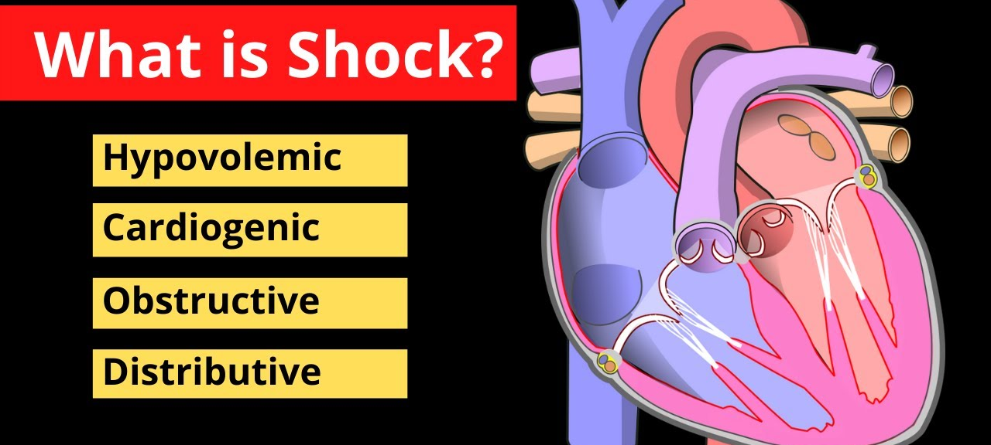
Clinical Findings in Stages of Shock
Hilal Farouq Hussein
Ismail Kahlid Tofiq

Slide 2
1. Hypovolemic Shock
Cause: Severe blood or fluid loss leads to inadequate tissue perfusion.
Examples: Hemorrhage (trauma, surgery, GI bleeding), dehydration (vomiting, diarrhea, burns).
Key Nursing Interventions: Rapid IV fluid replacement, oxygen therapy, monitor vitals, and treat underlying cause.

Slide 3
2. Cardiogenic Shock
Cause: The heart fails to pump sufficient blood to the body.
Examples: Myocardial infarction (heart attack), arrhythmias, severe heart failure.
Key Nursing Interventions: Oxygen, vasopressors, inotropes (e.g., dobutamine, dopamine), and monitoring for worsening symptoms.

Slide 4
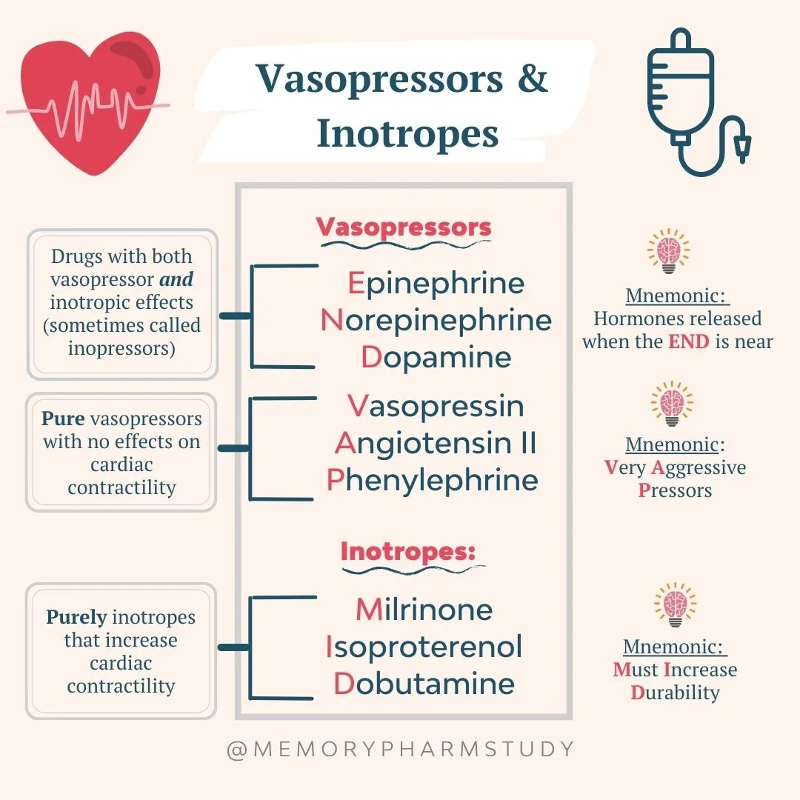

Slide 5
3. Obstructive Shock
Cause: Physical obstruction of blood flow prevents adequate circulation.
Examples: Pulmonary embolism, cardiac tamponade, tension pneumothorax.
Key Nursing Interventions: Remove obstruction (e.g., pericardiocentesis for tamponade), oxygen therapy, and hemodynamic support.

Slide 6
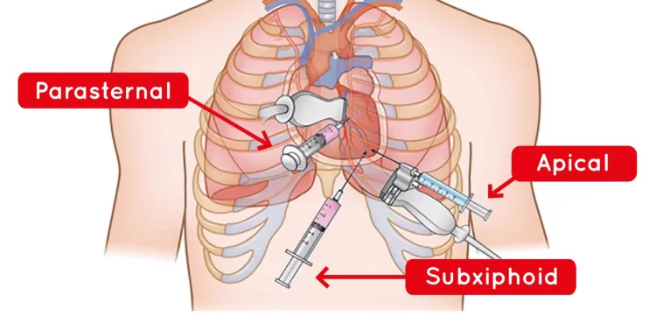

Slide 7
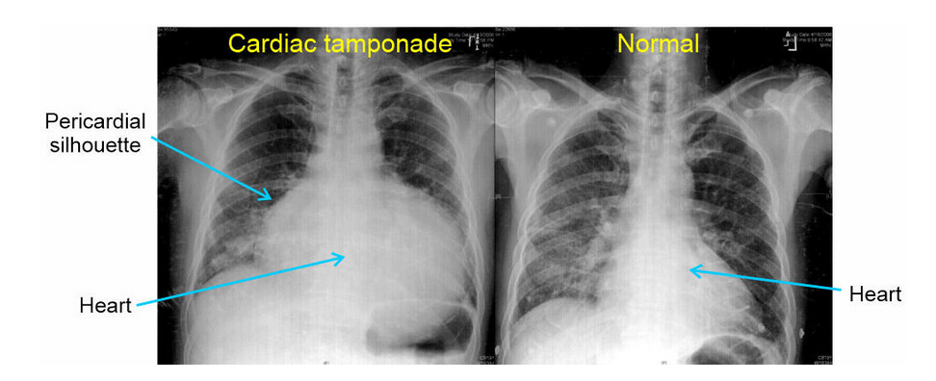

Slide 8
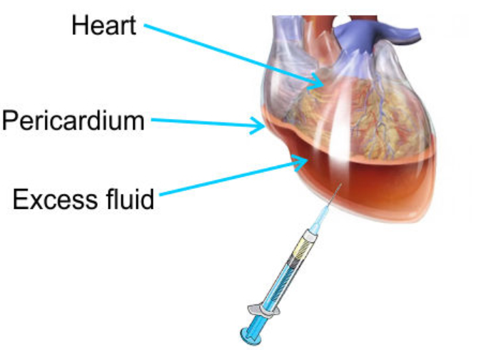

Slide 9
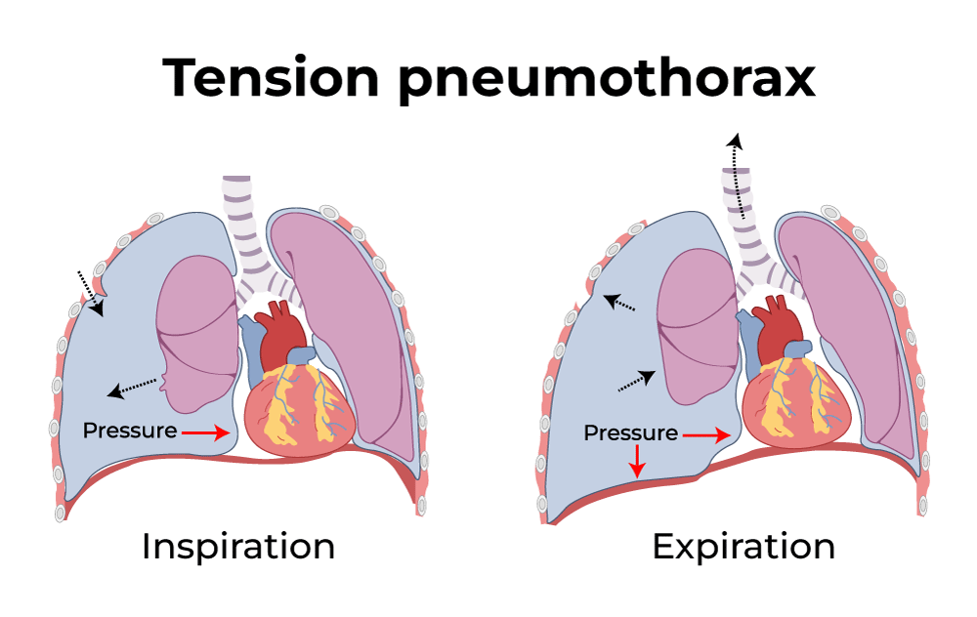

Slide 10
4. Distributive Shock
Distributive shock occurs when there is widespread vasodilation, leading to inadequate blood return to the heart.
a. Septic Shock
Cause: Severe infection causing systemic inflammatory response and hypotension.
Treatment: IV fluids, broad-spectrum antibiotics, vasopressors (e.g., norepinephrine).

Slide 11
4. Distributive Shock
b. Anaphylactic Shock
Cause: Severe allergic reaction causing airway swelling and hypotension.
Treatment: Epinephrine, antihistamines, steroids, IV fluids, oxygen.
c. Neurogenic Shock
Cause: Spinal cord injury leading to loss of vascular tone and hypotension.
Treatment: IV fluids, vasopressors, atropine for bradycardia.

Slide 12
Stages of Shock in Nursing
Recognizing stages of shock helps nurses intervene before irreversible damage occurs.
Compensatory Stage: Body tries to maintain perfusion (increased heart rate, cool skin, restlessness).
Progressive Stage: Organ dysfunction begins (hypotension, metabolic acidosis, confusion, weak pulses).
Irreversible Stage: Irreversible damage (multiple organ failure, unconsciousness, death).

Slide 13
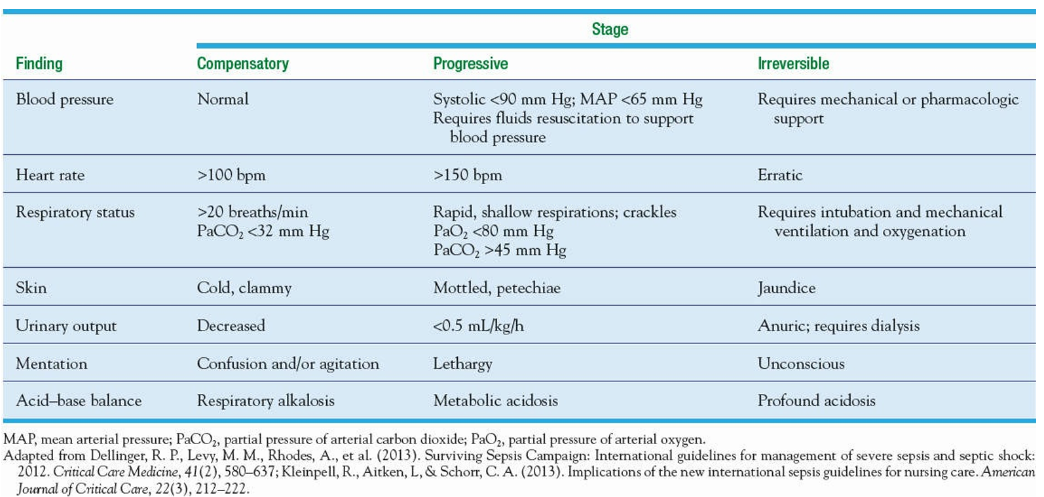
Clinical Findings in Stages of Shock

Slide 14
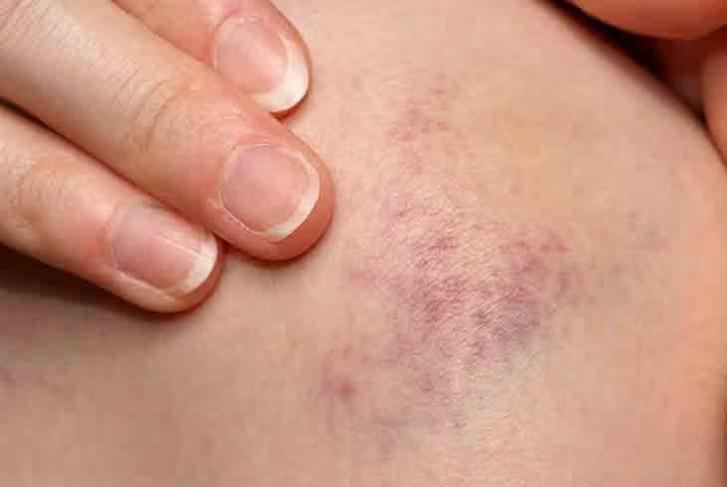
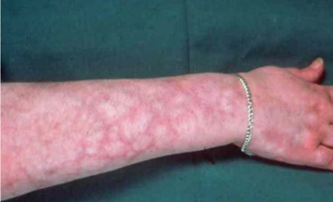
Petechiae
Mottled

Slide 15
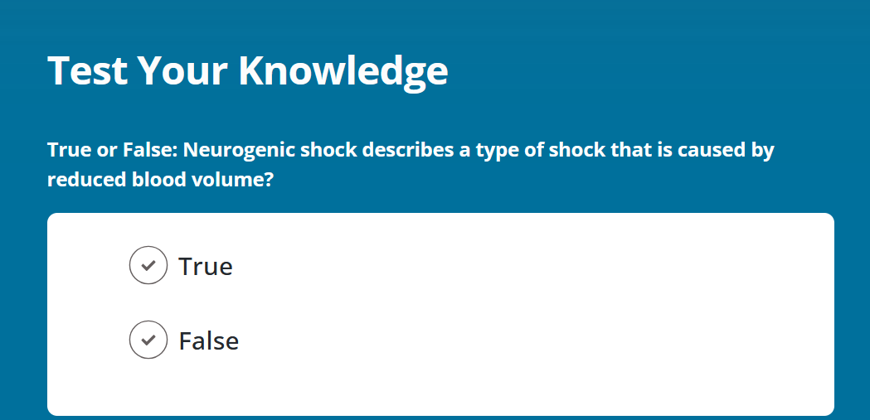

Slide 16
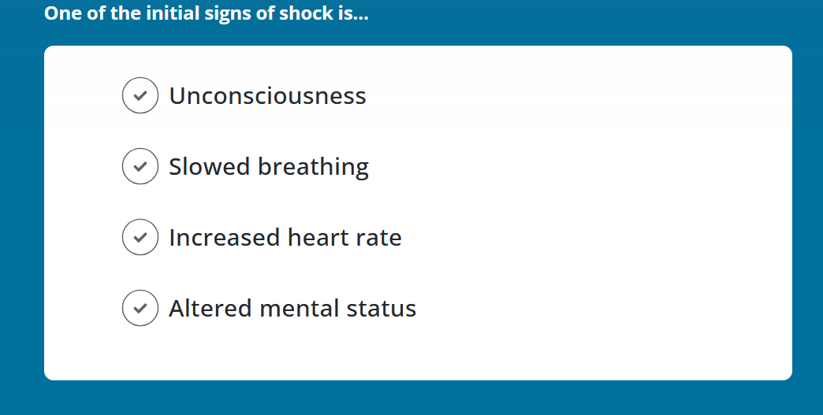
Compensatory

Slide 17
Reference
https://simplenursing.com/nclex-review-for-shock/
Hinkle, J.L. and Cheever, K.H. (eds.) (2022) Brunner & Suddarth’s textbook of medical-surgical nursing. 15th edn. Philadelphia: Wolters Kluwer.p.931

Slide 18


