Slide 1

Starter Unit Zainab Nizar Karam Advanced English
ELT 203/I 2025 – 2026 First Semester
Week 1

Slide 2

Outline
Vocabulary
Technology
Feeling
Language in action
Present simple and present continuous
Present simple for future
Vocabulary
Music
Language in action
Past simple
Reading
A message on an app
Writing
A review on an app

Slide 3
Objectives:
Identifying vocabulary related to technology and feelings.
Comparing and contrasting the use of present simple and present continuous.
Identifying vocabulary related to musical instruments.
Applying past simple rules.
Understanding words and phrases meaning from context.
Enhancing critical thinking and using vocabularies related to technology.

Slide 4
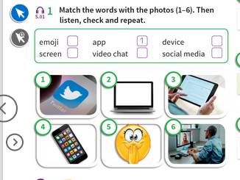
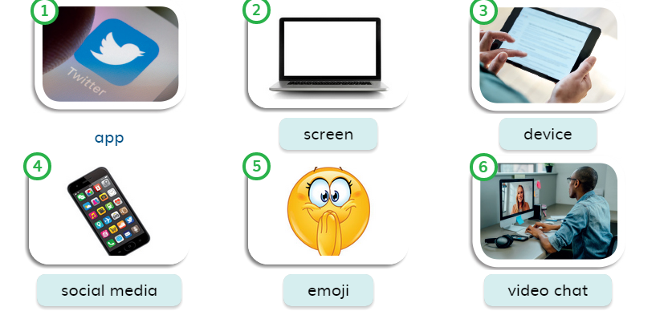
Vocabulary Technology

Slide 5
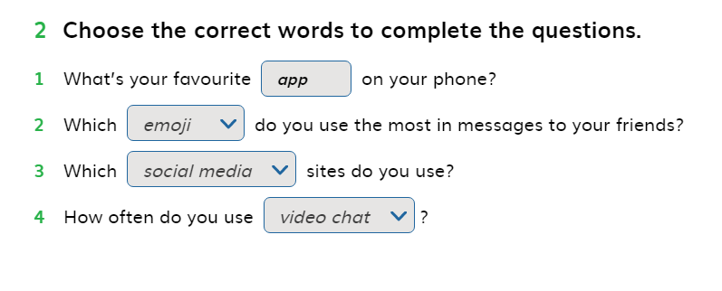
Ex. Page 4

Slide 6
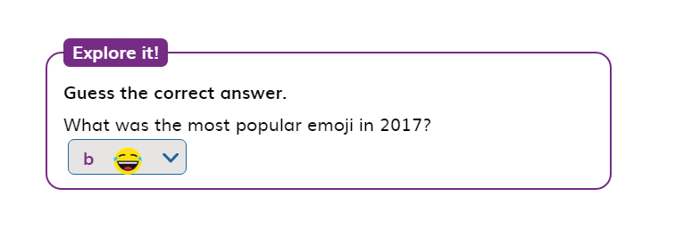
Explore it Page 4

Slide 7
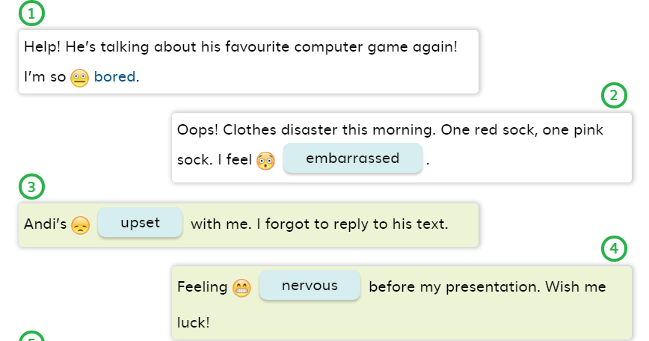
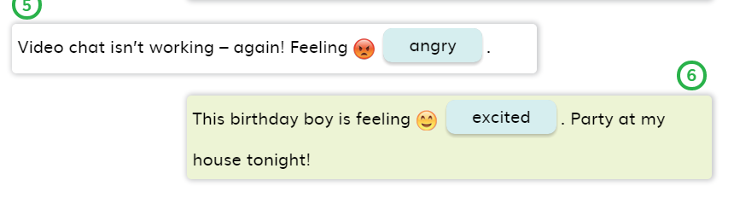
EX.3 Page 4

Slide 8
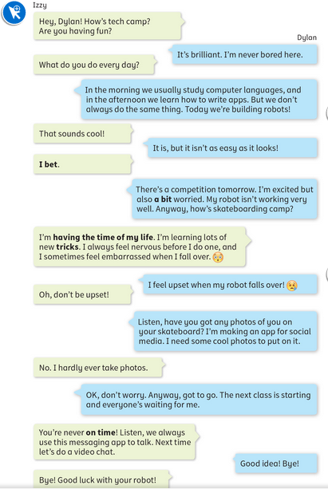
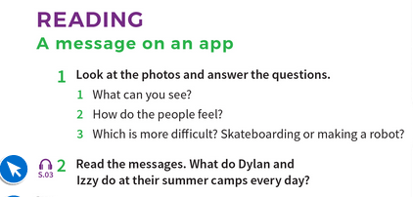
Page 5
We use “anyway” to change the topic.
I wasn’t able to go to work yesterday. Anyway, lets hang out tonight.

Slide 9
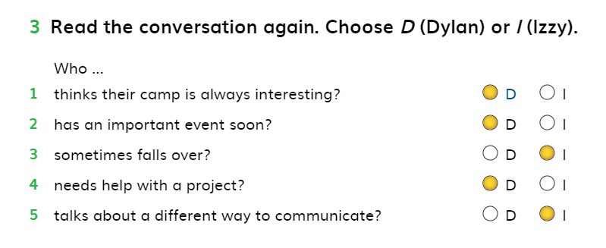
Ex.3 Page 5

Slide 10
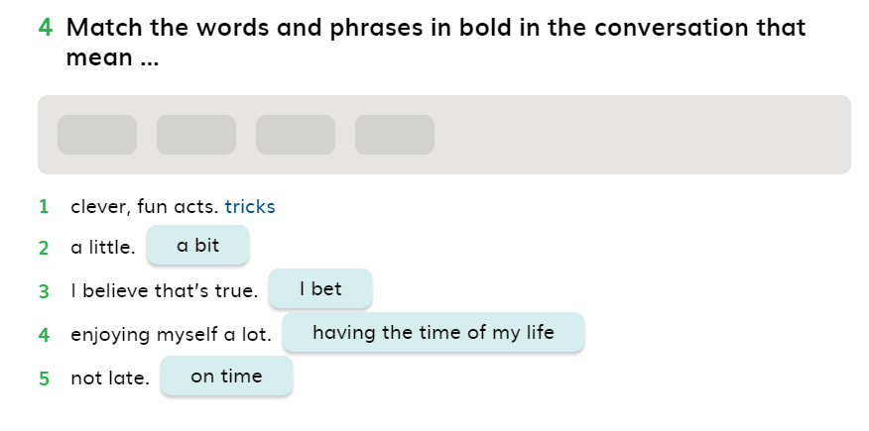
Ex.4 page 5

Slide 11
Present Simple and Present Continuous with Adverbs of Frequency
In which situations do we use Present Simple?
We use the Present Simple tense to:
Talk about daily routine and habits.
Talk about facts.
Talk about jobs.

Slide 12
Examples
I come to university 5 days a week.
We have two foundation lessons every day.
The earth is round.
Water boils at 100 C.
He is an engineer.
They are accountants.

Slide 13
PRESENT SIMPLE WITH VERB TO BE” Affirmative / Positive sentences
Noun
Name
Place
Time
Adj.
SUB. + (is/are/am) +
She is a student.
They are Sara and Hani.
The engineers are in the factory.
The interview is at 10:00 am.
Your project is amazing.
We never use a verb after verb to be in the present simple.
I am work ✗
I work ✓
I am at work ✓

Slide 14
Negative sentences with verb to be:
We just add not to the verb to be to make our sentence negative:
He is in the library.
The engineers are active every Sunday.
Questions with verb to be
Yes/no questions
He is not in the library.
The engineers are not active every Sunday.
Is
Are + Sub. + ….
Am
Is the presentation good enough? Yes, it is / no. it isn’t.
Are the managers at the meeting room? Yes, they are/ no they aren’t.
Am I selfish? Yes, you are/ no, you aren’t.

Slide 15
Wh-questions with verb to be:
Starts with a question word, such as, what, why, where, when, how … etc.
Wh.+ verb to be + sub. + …..?
Where are you from?
Why is it difficult to get good marks?
How are your grades in the first semester?

Slide 16
Present simple with other verbs : Affirmative / Positive sentences
I
We
You
They
I speak English and Turkish.
They study civil engineering.
We have free time.
You look great.
The students have some homework.
V. Base

Slide 17
Affirmative / Positive sentences
He
She
It
Sally speaks Spanish.
He drives fast.
The cat drinks the milk.
She listens to music.
V. + s/es

Slide 18
Negative Sentences
I
We
You
They
I don’t speak English and Turkish.
They don’t study civil engineering.
We don’t have free time.
You don’t look great.
The students don’t have any homework.
+ don’t + V. Base

Slide 19
Negative Sentences
He
She
It
Sally doesn’t speak Spanish.
He doesn’t drive fast.
The cat doesn’t drink the milk.
She doesn’t listen to music.
+ doesn’t + V. Base

Slide 20
Questions with Present Simple
YES/NO-QUESTIONS
Do
Does
I teach English.
He lives in the UK.
+ Sub. + V. Base
Yes, I do.
Do you teach English?
No, I don’t
Yes, he does.
Does he live in the UK?
No, he doesn’t

Slide 21
Questions with the Present Simple
Wh-QUESTIONS
Wh. +
They use their phones in the class.
Sally lives in the US.
do
+ Sub. V. Base
does
What do they use in the class?
Where does Sally live?

Slide 22
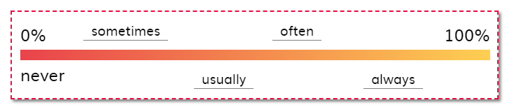
Adverbs of Frequency
To add adverbs of frequency to a sentence, we need to check the verb:
If we have verb to be (is, are, am), we add adv. of frequency after them.
I am usually late for my classes.
He is sometimes angry with his friends.
If we have other verbs, such as, come, go, speak, take, give…etc, we add adv. Of frequency before the verb.
I always use my phone to take notes.
He never smokes inside the building.

Slide 23
Present continuous
We use the present continuous for things that are happening at the moment of speaking.
I am writing some sentences now.
We are learning present continues at the moment.
Key words for present simple:
Now
At the moment
These days
Look
Listen
Any word refers to the current time.

Slide 24
Positive form of present Continuous
I + am + (v+ing) …. .
We
You
They
He
She
It
I am teaching present continuous now.
He is using his phone at the moment.
Look, they are fighting.
+ are + (v+ing)+ …..
+ is + (v+ing) + … .

Slide 25
Negative form of Present Continuous
I + am not + ( v+ing ) … .
We
You
They
He
She
It
I am not leaving the class.
You are not writing anything at the moment.
She is not texting anyone.
+ are not + ( v+ing) + … .
+ is not + (v+ing) + … .

Slide 26
Vocabulary and listening Music
Bass : a simple folk instrument. It is generally believed to have derived from the African ground bow.
Jazz: a type of modern music originally developed by African-Americans, with a rhythm in which the strong notes often come before the beat.
Reggae: a type of popular music from Jamaica, with a strong second and fourth beat.
Folk: traditional music from a particular country or region, or modern music and songs that are in a similar style.
Heavy metal: a style of rock music with a strong beat, played very loudly using electric guitars.
Rap: a type of popular music with a strong rhythm in which the words are spoken, not sung.

Slide 27
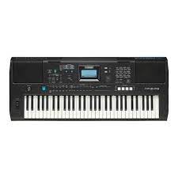
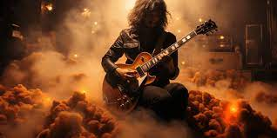
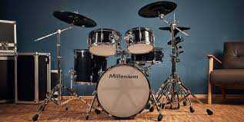
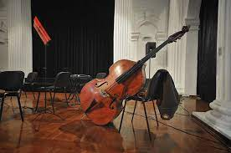
Vocabulary and listening
Keyboard
Heavy metal
Drums
Bass

Slide 28
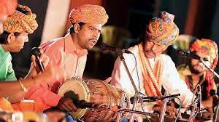

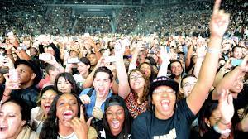

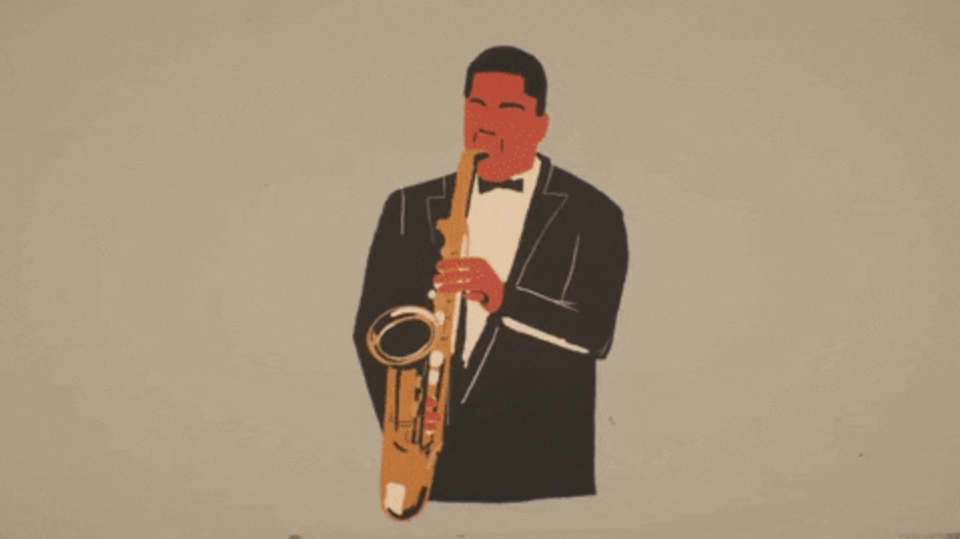
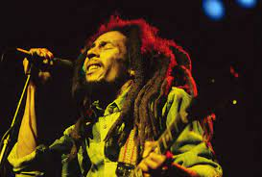
Folk
DJ
Fans
Rap
Jazz
Reggae

Slide 29
PAST SIMPLE
We use past simple for finished actions in the past
Repeated actions in the past.
Routine in the past.
key words for past simple:
Yesterday
Ago
Last year/month/week …etc.
Any time expression in the past.

Slide 30
Types of verbs
Regular verbs:
We just add –d/-ed to change the verb to past form, such as:
Work + ed =worked
Want + ed =wanted
Prepare + d =prepared
Irregular verbs:
We change the form of the verb to get the past form of it.
See – saw
Come – came
sleep- - slept
Cut – cut
Ride – rode

Slide 31
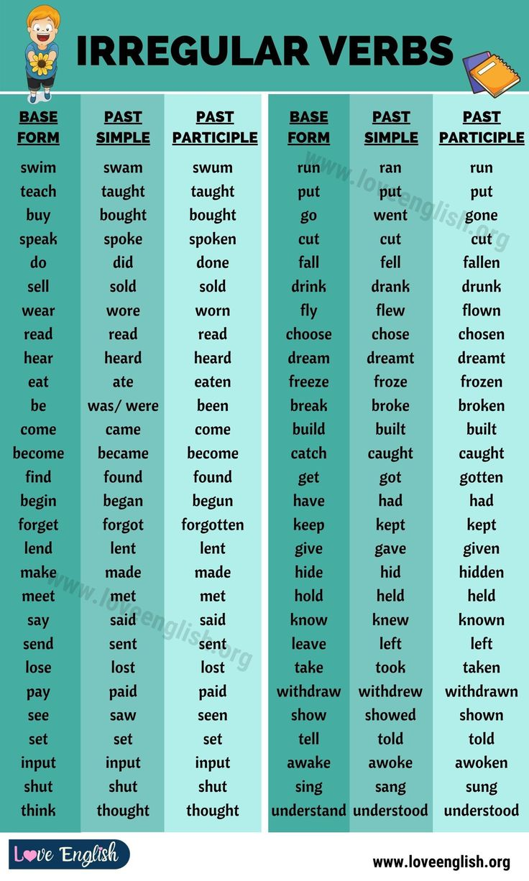

Slide 32
Past simple sentence formation:
Positive sentences:
Sub + V. (past form) + ….
I passed all the exams last year.
We conducted a study about the most common grammatical mistakes of the students.
The man forgot about his problems.
Negative sentences:
Sub + Didn’t + V. Base + …
They didn’t attend last week’s lectures.
He didn’t have time to explain everything.
The girl didn’t understand the topic.

Slide 33
Past simple sentence formation
Wh -Questions:
Wh +did + Sub + V. base …?
When did they arrive to the airport?
How did you feel about the results of your study?
How much did you spend on your car?
How many articles did you publish last year?
Yes/No-Question
Did + Sub + V. base …?
Did you get my point?
Did the car work properly?
Did the experiment work?
Did you publish any new article?

Slide 34
Change the following sentences to the past tense:
He attends the lectures on time.
They don’t understand the topic.
The lecturer forgets to upload the marks.
His family arrives at 10 pm.
Sally doesn’t allow him to take any photos of her.
We are never late for the class.
The researcher submits his new study to the journal.
They like his performance.
We understand it clearly.
The design is amazing.
He attended the lectures on time.
They didn’t understand the topic.
The lecturer forgot to upload the marks.
His family arrived at 10 pm.
Sally didn’t allow him to take any photos of her.
We were never late for the class.
The researcher submitted his new study to the journal.
They liked his performance.
We understood it clearly.
The design was amazing

Slide 35
Writing
For writing a review on an app you need to include the following points:
What is the app?
Is it an app for contacting people? Taking photos? Editing vidos?
what is good about the app? The pros or the positive points about it.
What is bad about the app? The cons or the negative points.
Your general opinion.

Slide 36

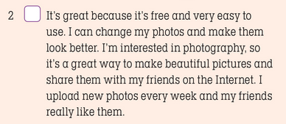
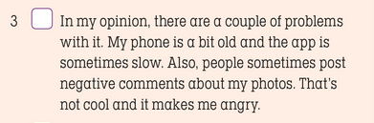

What is the app
Good points about the app
Bad points about the app
Your general opinion

Slide 37
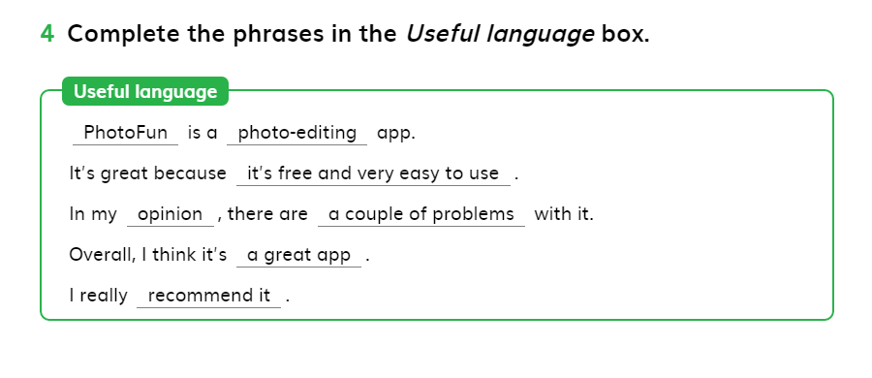
Useful Language Page 9

Slide 38
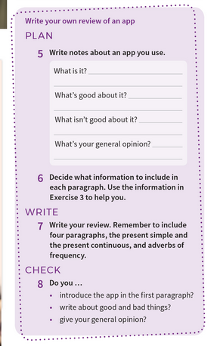
A plan that you can follow for writing your paragraph

