Slide 1

Students’ book Starter and Unit one Exercises answer key Zainab Nizar Karam Advanced English - ELT 203/I 2024 – 2025 First Semester week 3

Slide 2

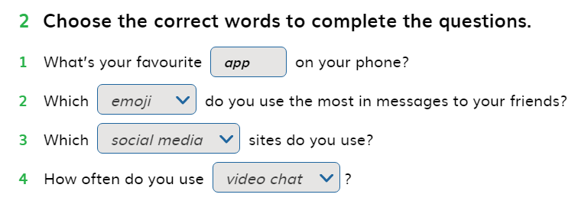
Ex. 2 page 4

Slide 3
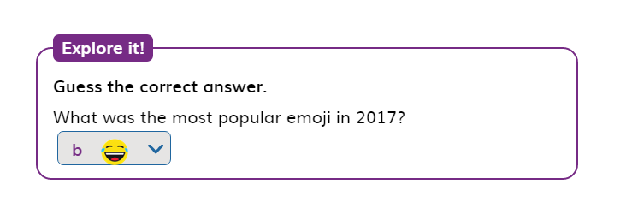
Explore it Page 4

Slide 4
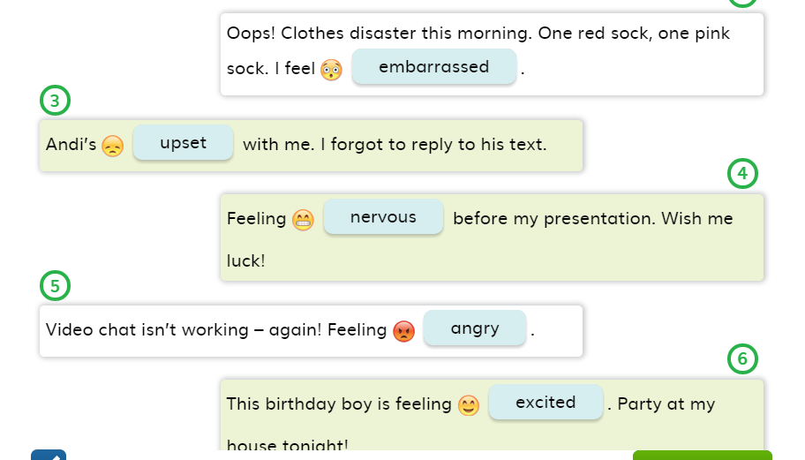
Ex. 3 Page 4

Slide 5
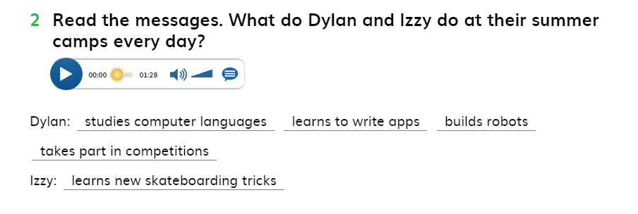
Ex. 2 Page 5

Slide 6
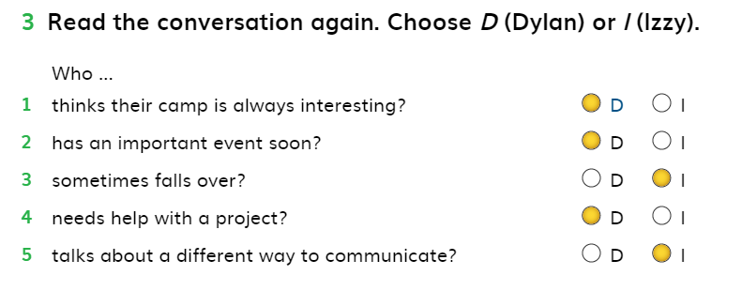
Ex.3 Page 5

Slide 7
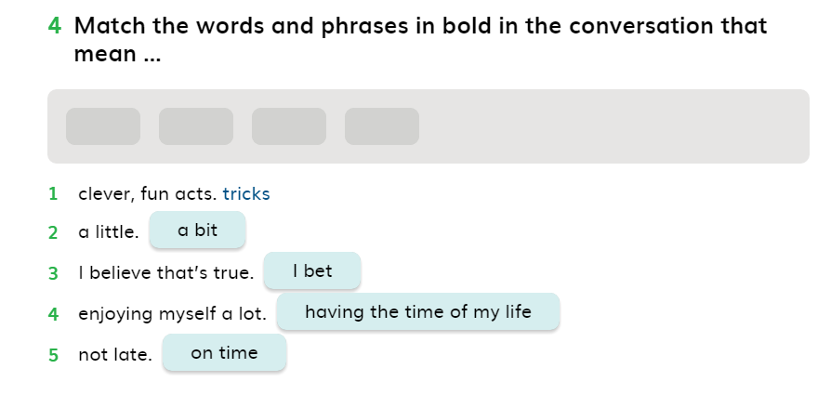
Ex.4 Page 5

Slide 8
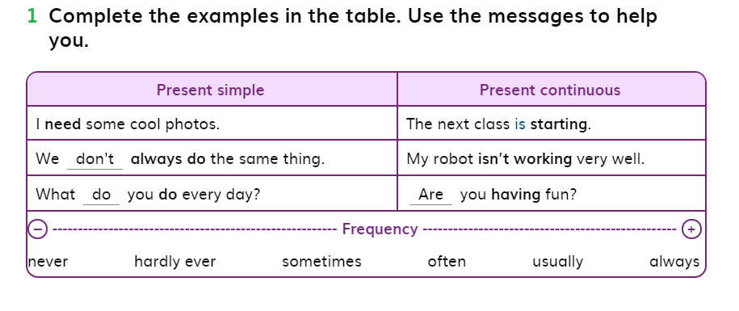
Ex.1 Page 6

Slide 9
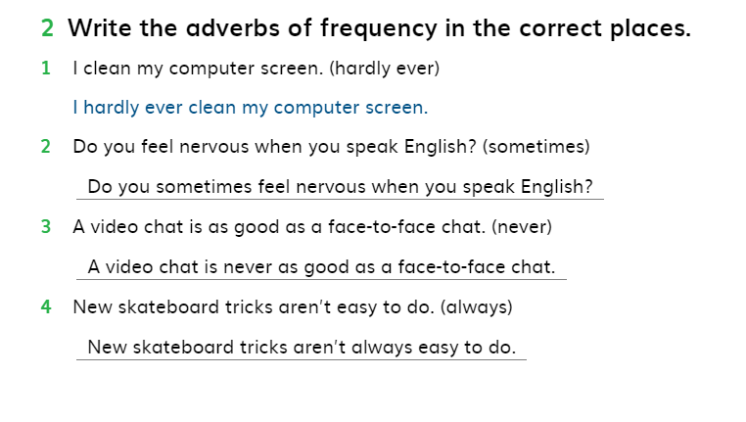
Ex.2 Page 6

Slide 10
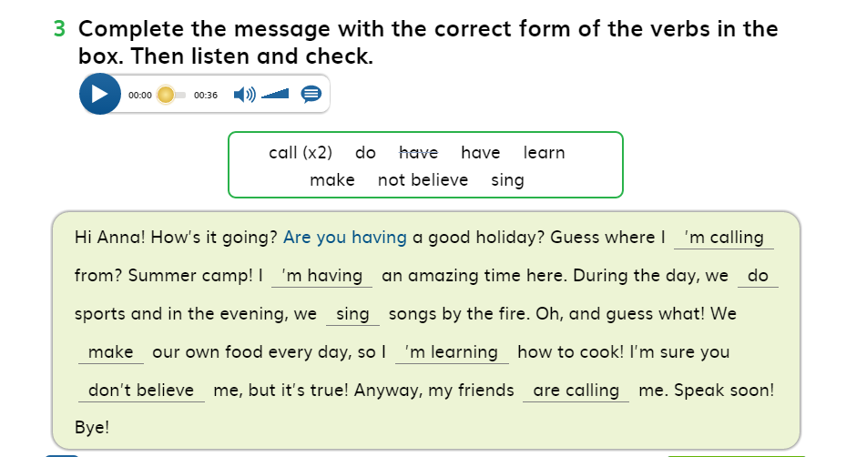
Ex. 3 Page 6

Slide 11
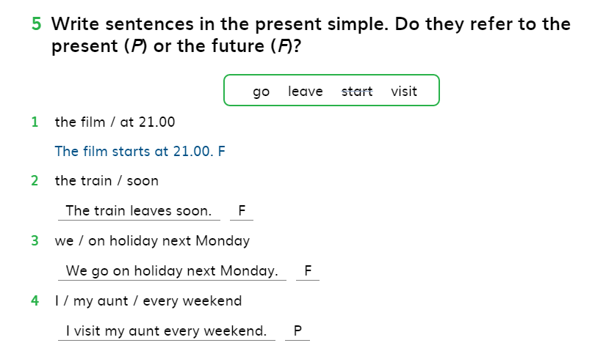
Ex. 5 Page 6

Slide 12
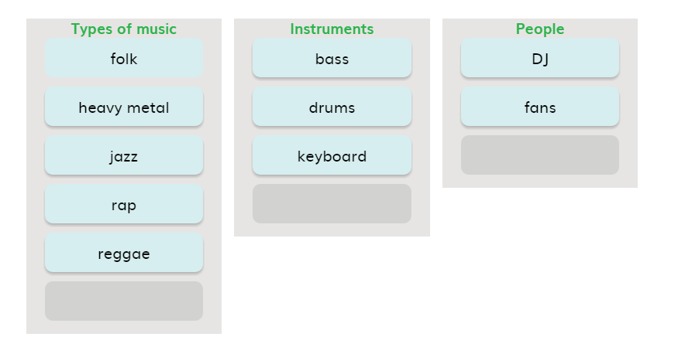
Ex.3 Page 7

Slide 13
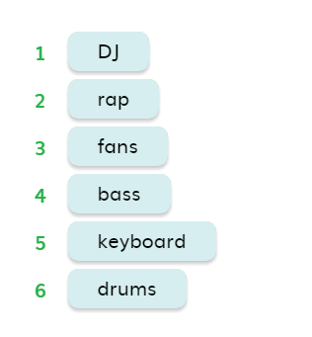
Ex.6 Page 7

Slide 14
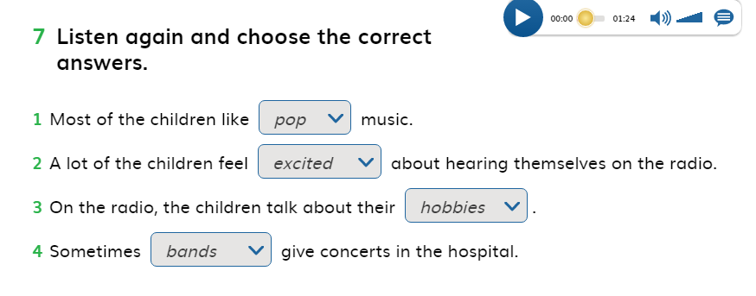
Ex.7 Page 7

Slide 15
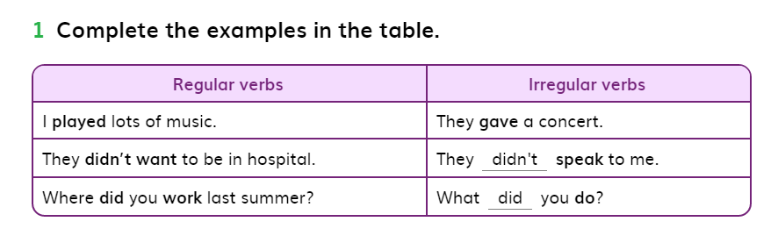
Ex.1 Page 8

Slide 16
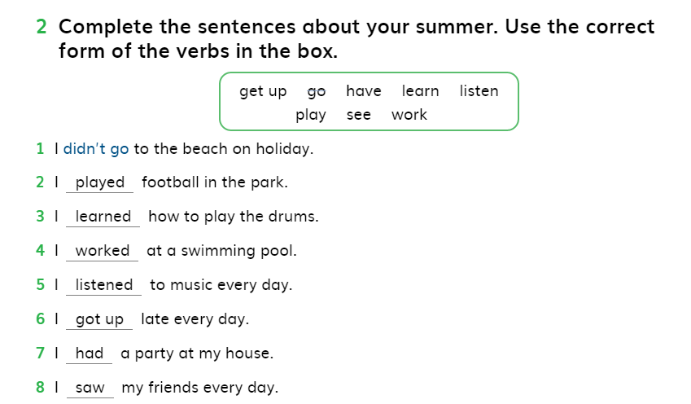
Ex.2 Page 8

Slide 17
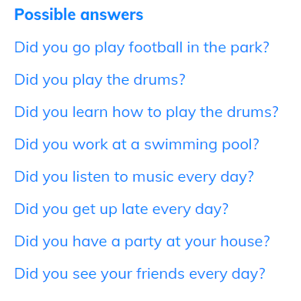
Ex.3 Page 8

Slide 18
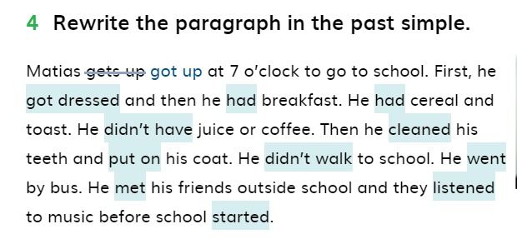
Ex.4 Page 8

Slide 19
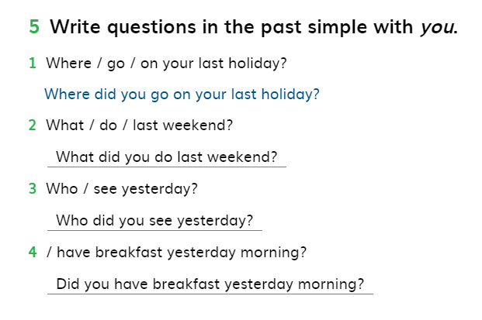
Ex.5 Page 8

Slide 20
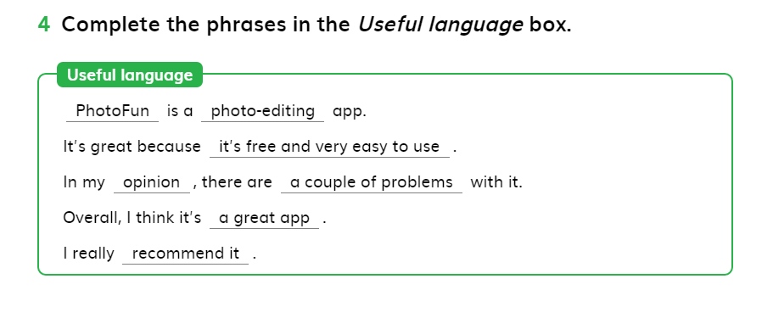
Ex.4 Page 9

Slide 21
Unit one

Slide 22
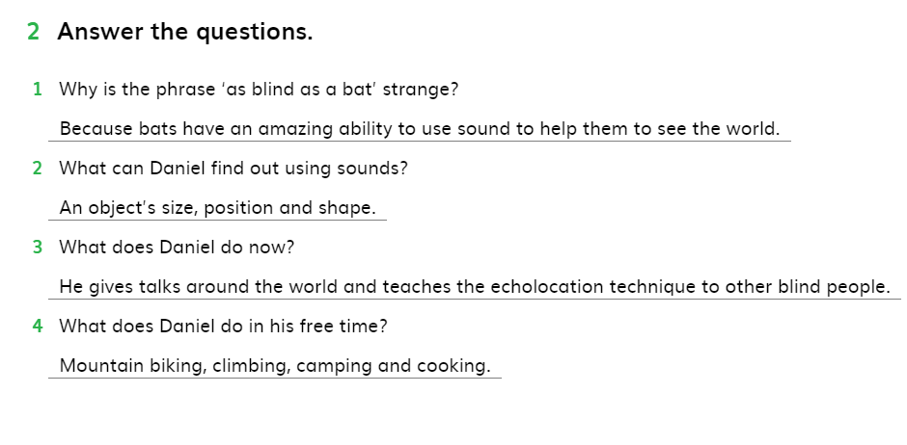
Ex.2 Page 12

Slide 23
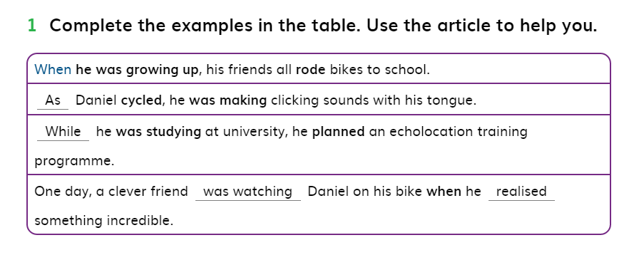
Ex.1 Page 13

Slide 24
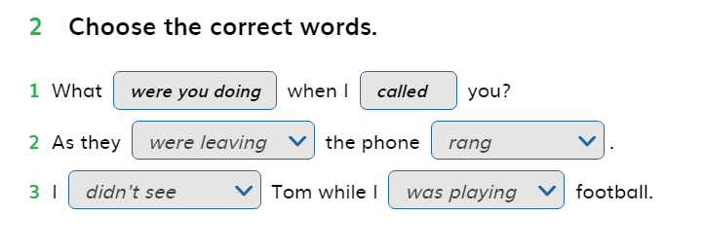
Ex.2 page 13

Slide 25
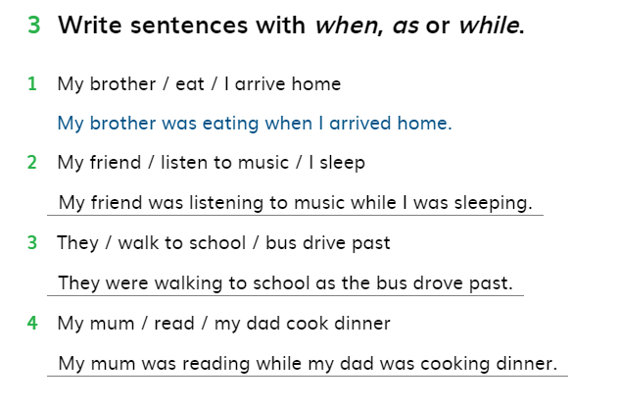
Ex.3 Page 13

Slide 26
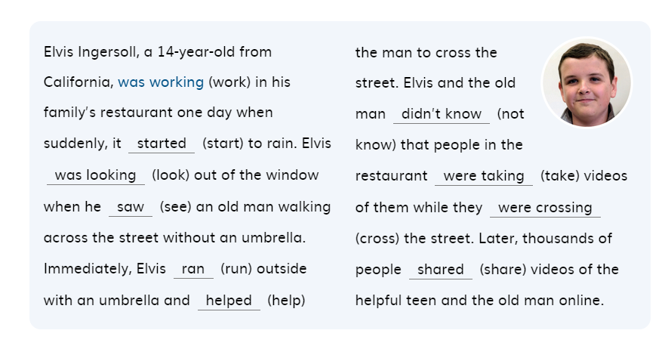
Ex.4 Page 13

Slide 27
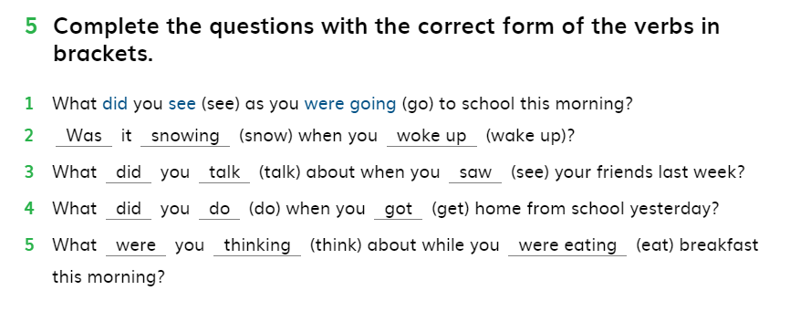
Ex.5 Page 13

Slide 28
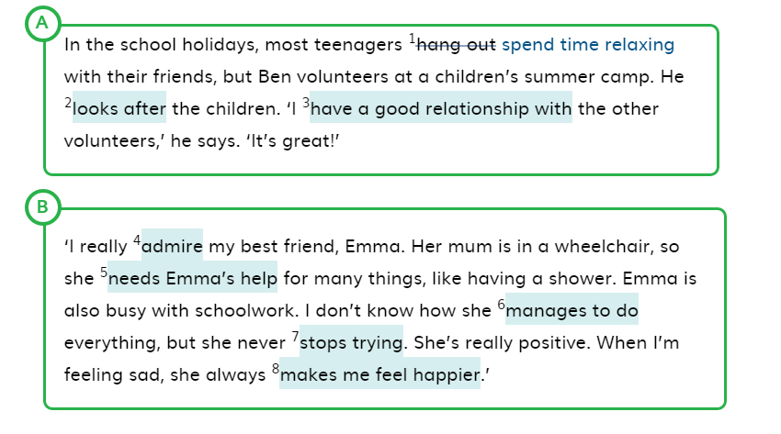
Ex. 1 Page 14

Slide 29
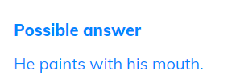
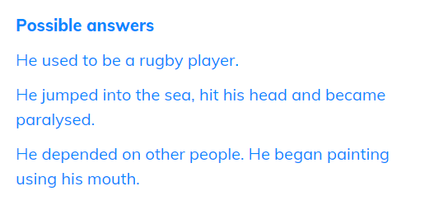
Ex.3 Page 14
Ex.4 Page 14

Slide 30
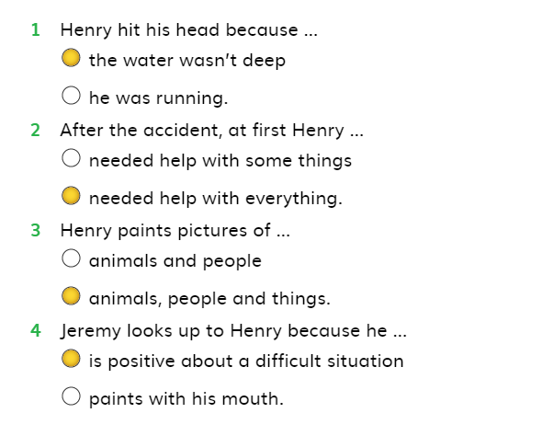
Ex. 5 Page 14

Slide 31
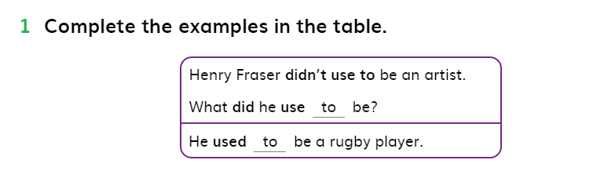
Ex.1 Page 15

Slide 32
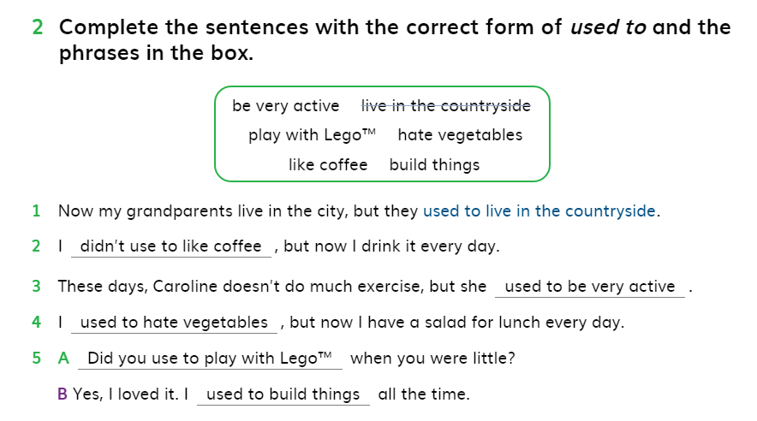
Ex.2 Page 15

Slide 33
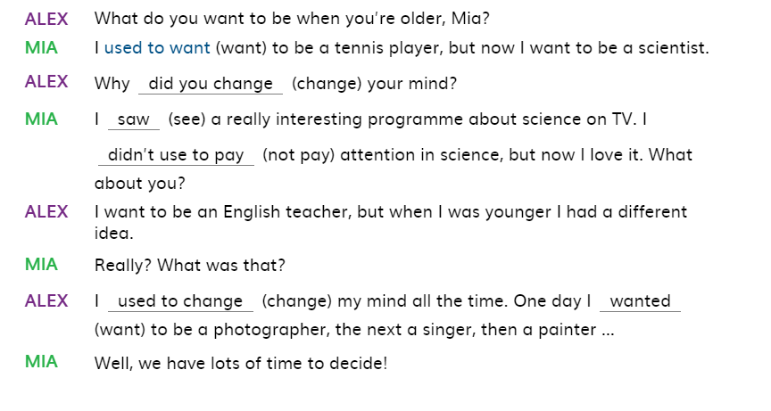
Ex. 3 Page 15

Slide 34
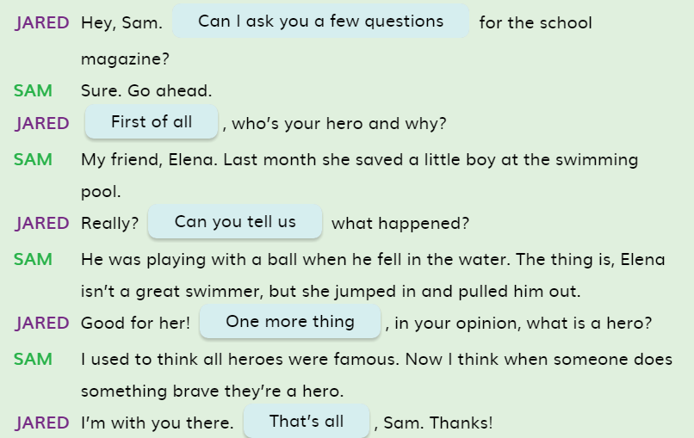
Ex.2 Page 16

Slide 35
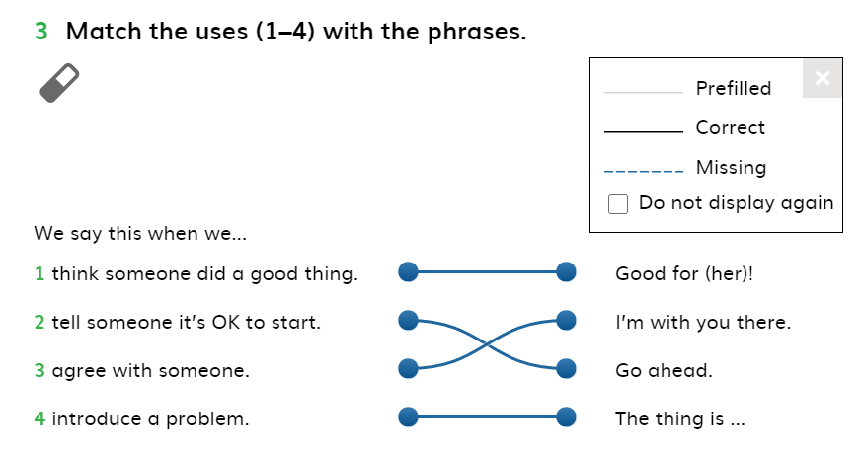
Ex.3 Page 16

Slide 36
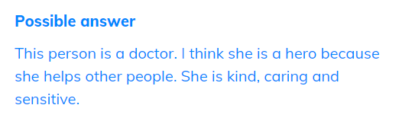
Ex.4 Page 16

Slide 37
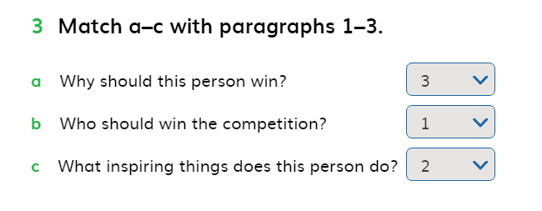
Ex.3 Page 17

Slide 38
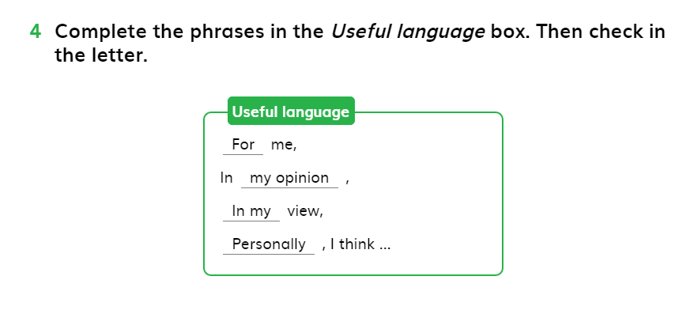
Ex.4 Page 17

Slide 39
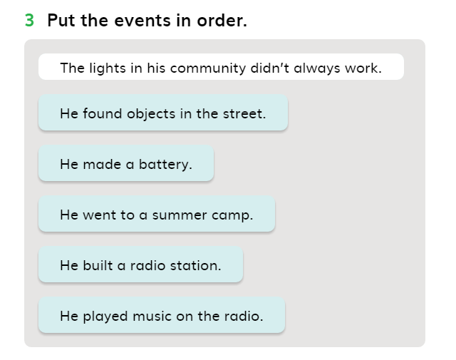
Ex.3 Page 18

Slide 40
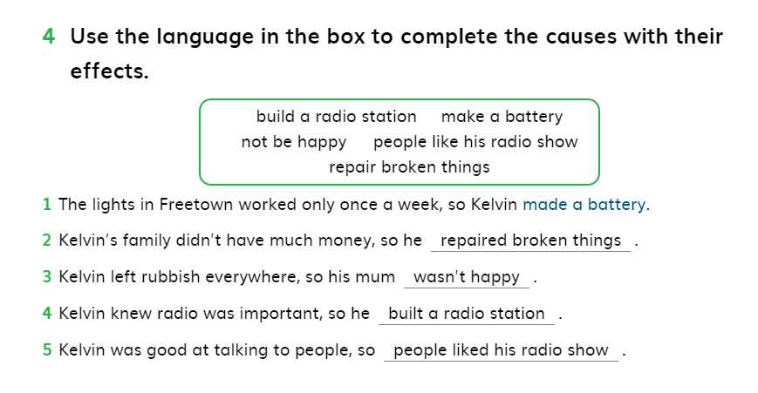
Ex.4 Page 19

Slide 41
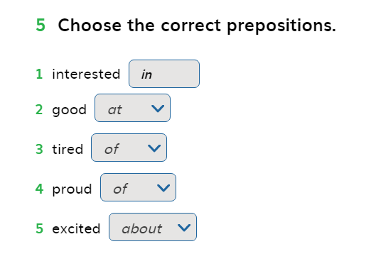
Ex.5 Page 19

Slide 42
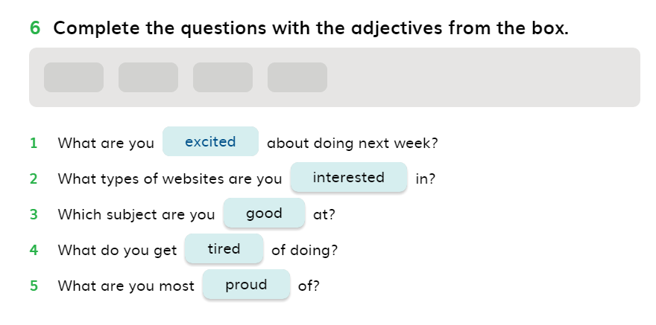
Ex.6 Page 19

Slide 43
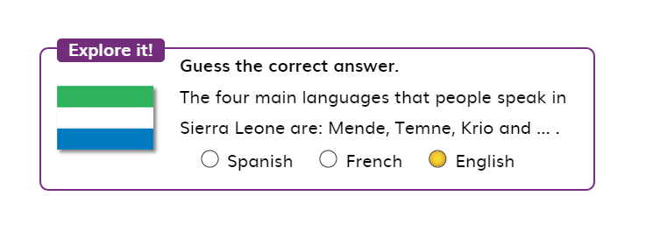
Explore it Page19

Slide 44
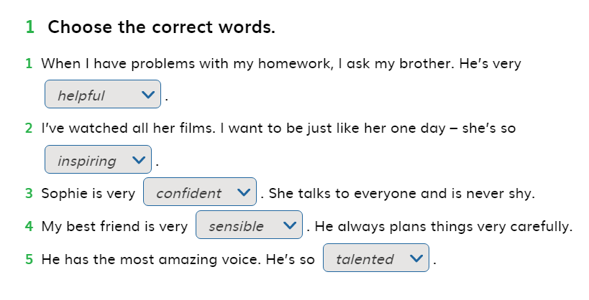
Ex.1 Page 20

Slide 45
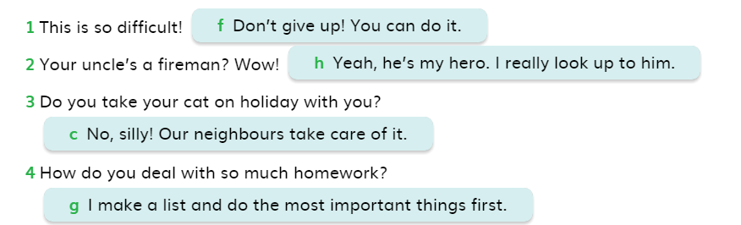
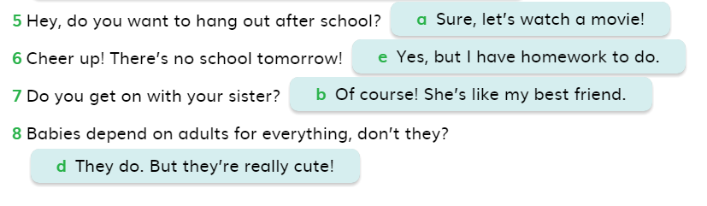
Ex.2 Page 20

Slide 46
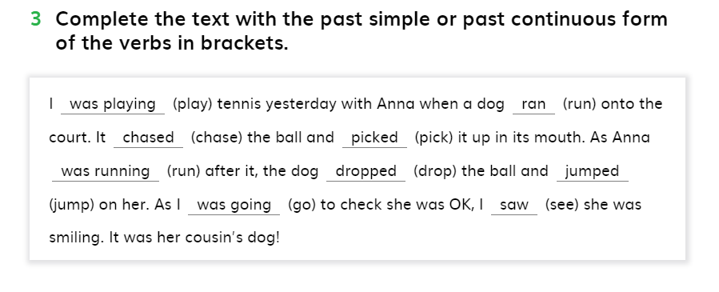
Ex.3 Page 20

Slide 47
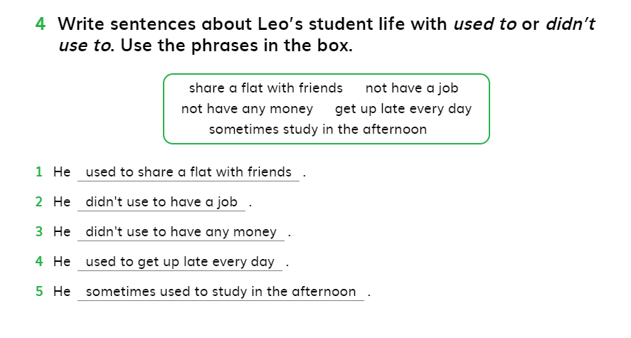
Ex.4 Page 20

Slide 48
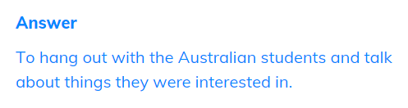
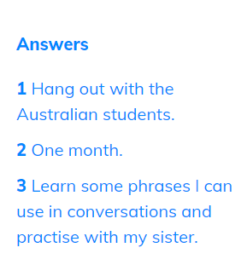
Ex.1 Page 21
Ex.2 Page 21

Slide 49
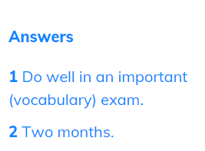

Ex. 3 Page 21
Ex.4 Page 21

