Slide 1

Unit One Workbook answer key
Zainab Nizar Karam
Advanced English - ELT 203/I
2024 – 2025
First Semester
Week 4

Slide 2

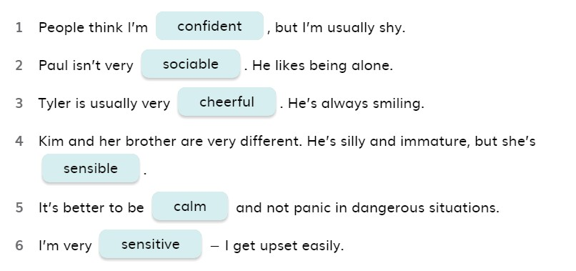
Ex. 2 Page 8
,.

Slide 3
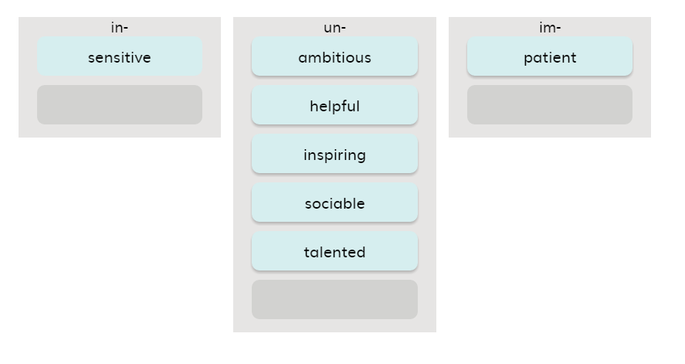
Ex. 3 Page 8
,.

Slide 4
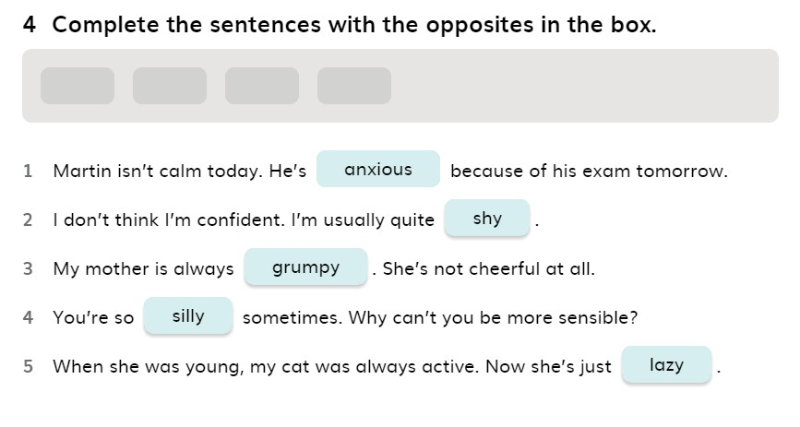
Ex. 4 Page 8
,.

Slide 5
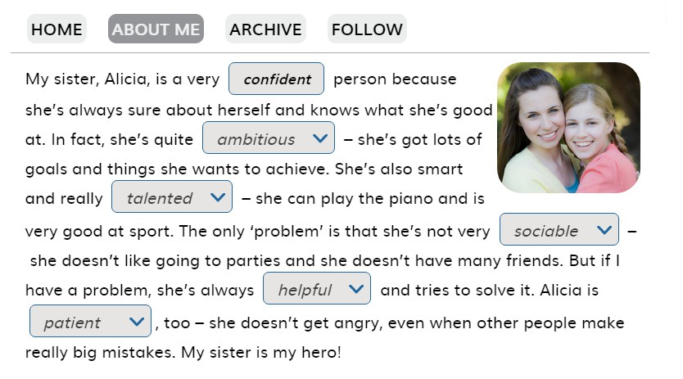
Ex. 5 Page 8
,.

Slide 6

Explor,.e it Page 8

Slide 7
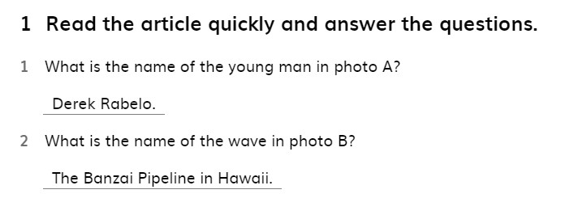
Ex. 1 Page 9
,.

Slide 8
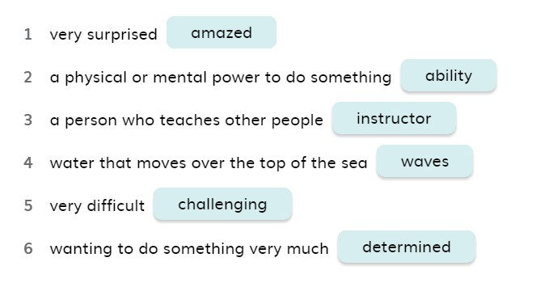
Ex. 2 Page 9
,.

Slide 9
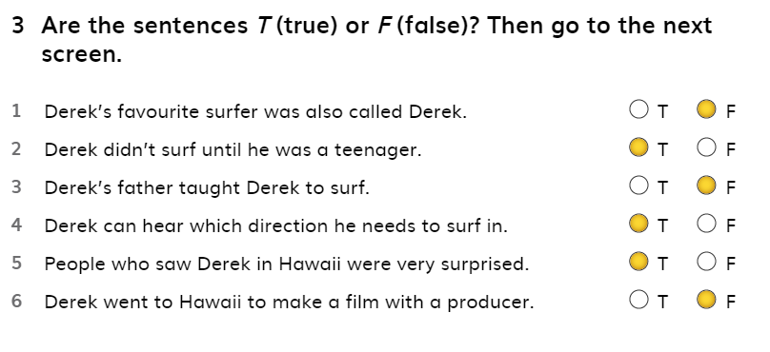
,,. Ex. 3 Page 9

Slide 10
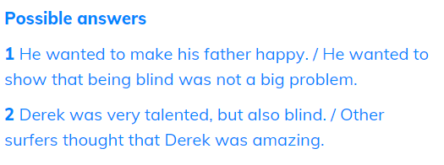
Ex.4 Page 9
,.

Slide 11
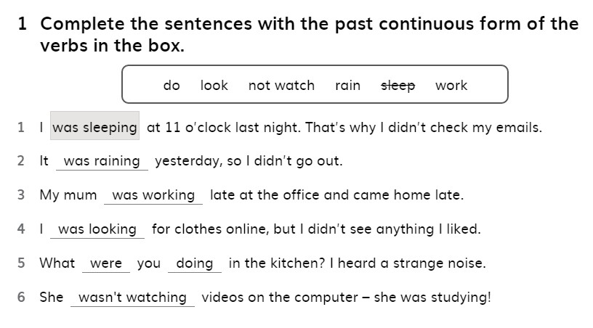
Ex. 1 Page 10
,.

Slide 12
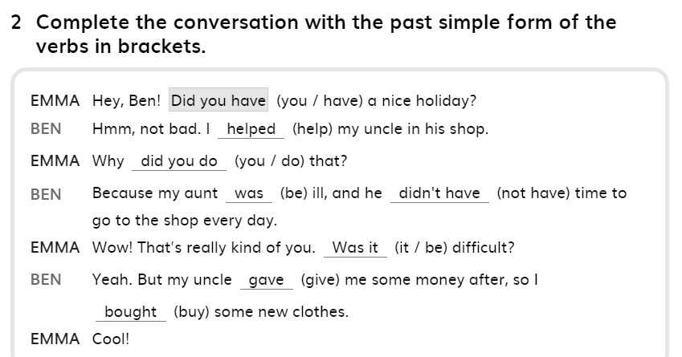
Ex. 2 Page 10
,.

Slide 13
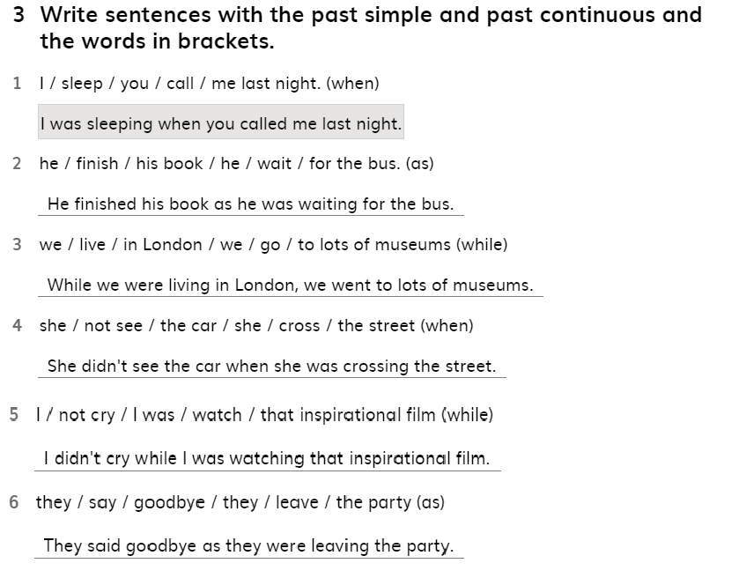
Ex. 3 Page 10
,.

Slide 14
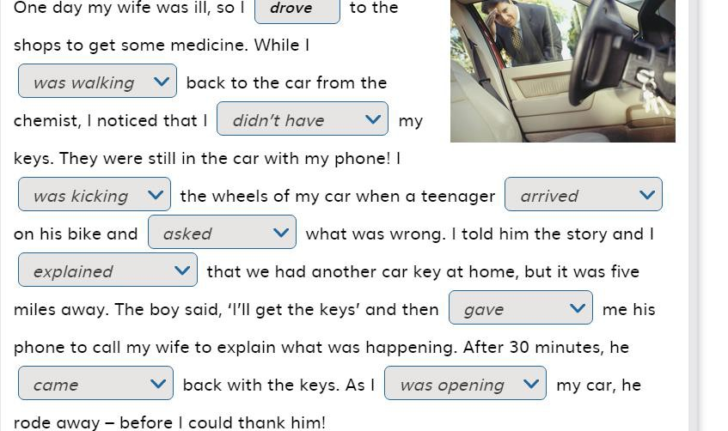
Ex. 4 Page 10
,.

Slide 15
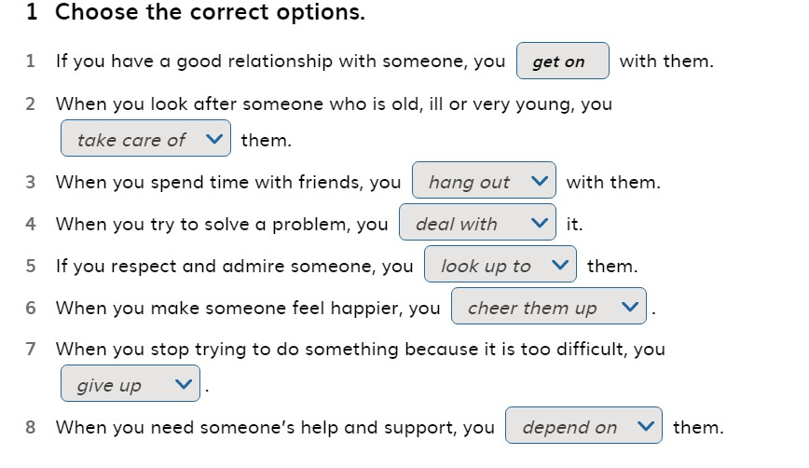
Ex. 1 Page 11
,.

Slide 16
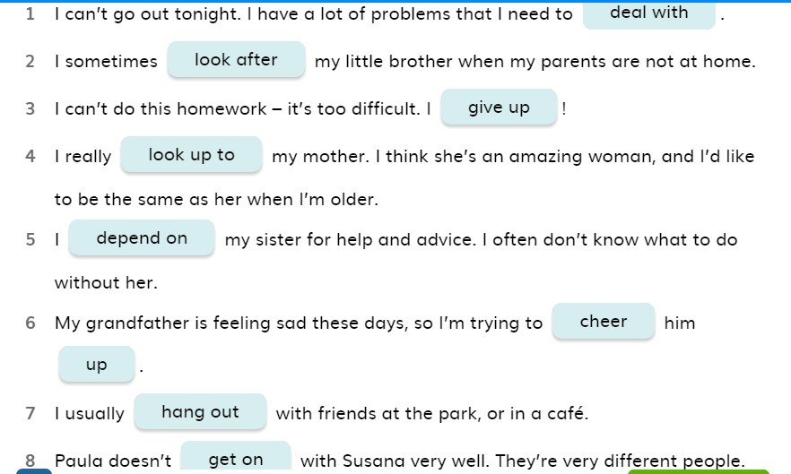
Ex. 2 Page 11
,.

Slide 17
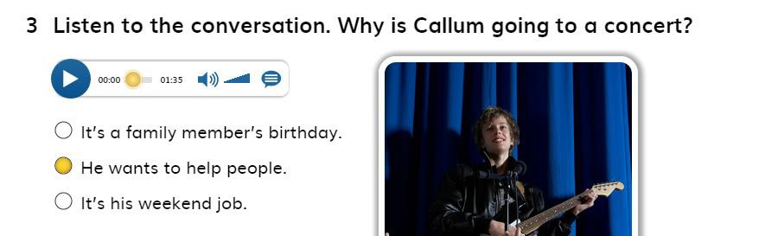
Ex. 3 Page 11
,.

Slide 18
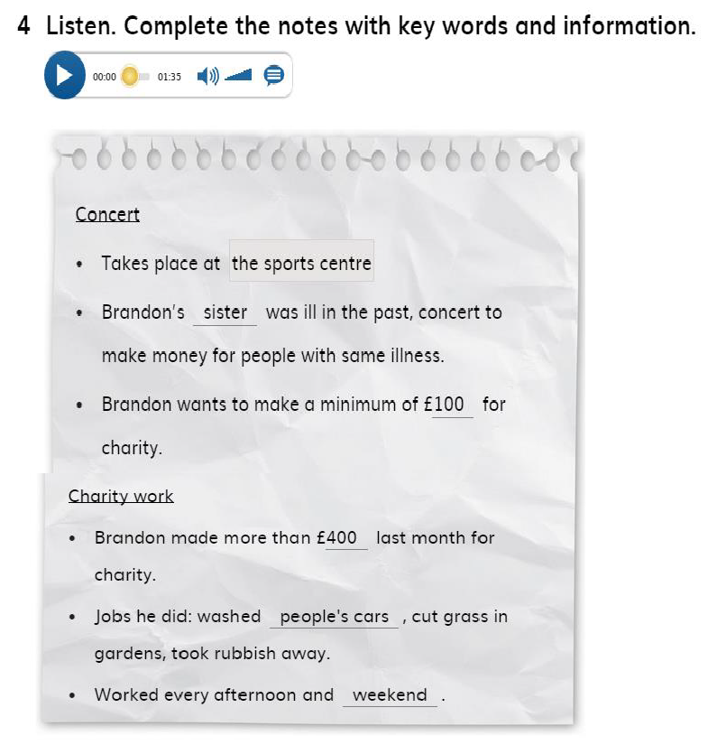
Ex. 4 Page 11
,.

Slide 19
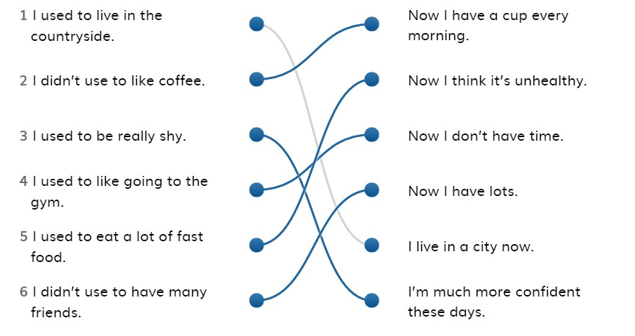
Ex. 1 Page 12
,.

Slide 20
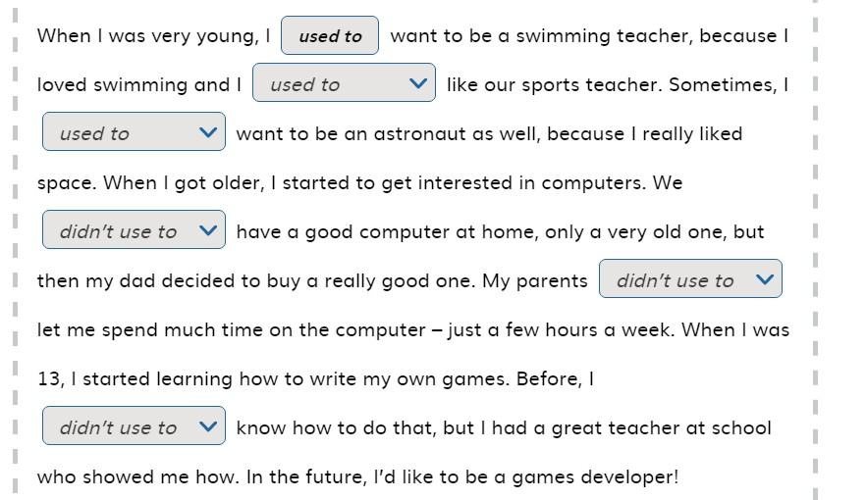
Ex. 2 Page 12
,.

Slide 21
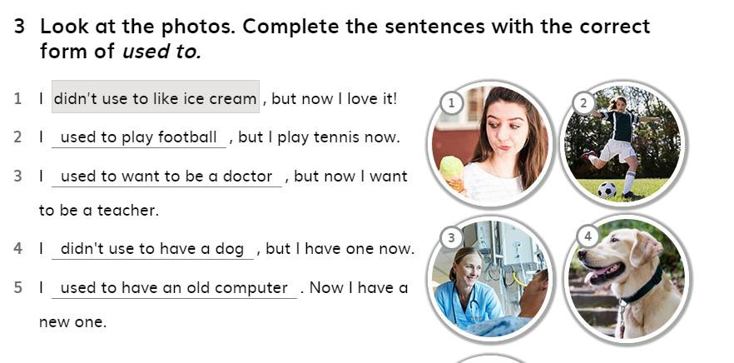
Ex. 3 Page12
,.

Slide 22
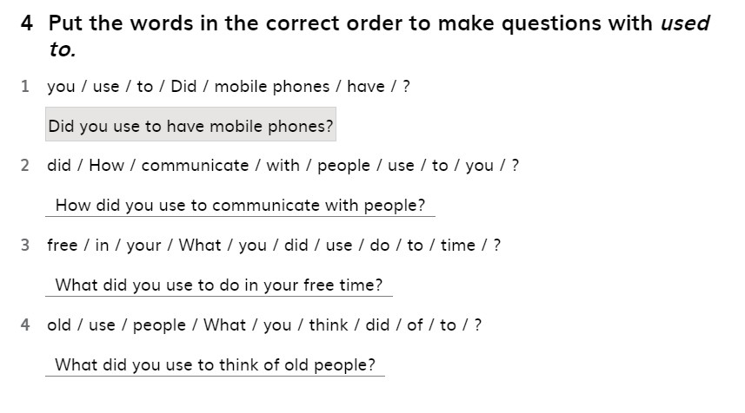
Ex. 4 Page 12
,.

Slide 23
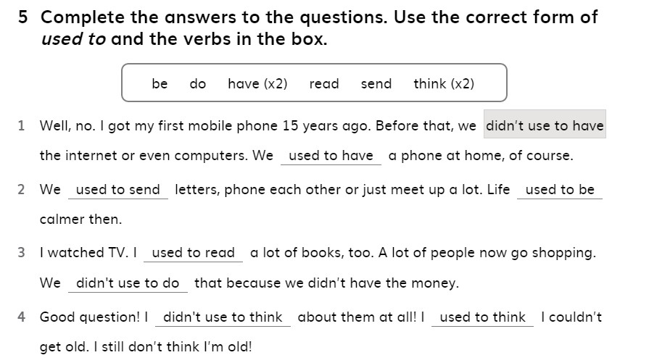
Ex. 5 Page 12
,.

Slide 24
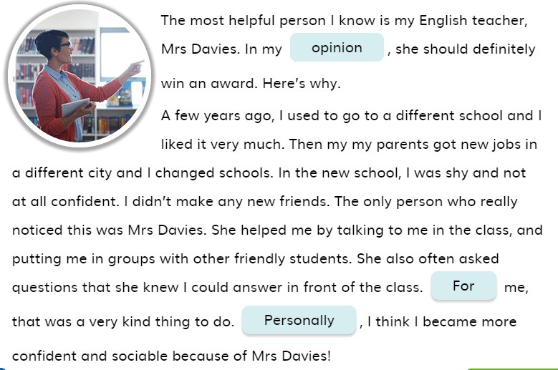
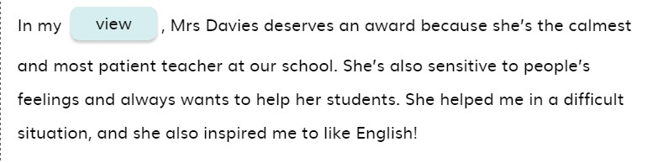
Ex. 3 Page 13
,.

Slide 25
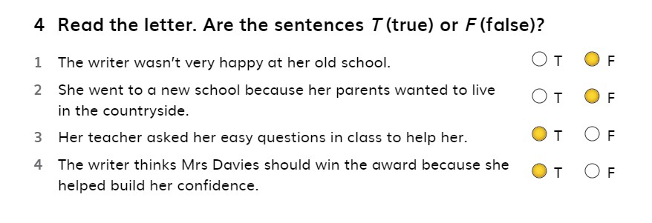
Ex. 4 Page 13
,.

Slide 26
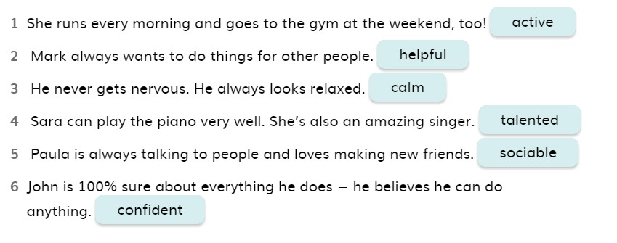
Ex. 1 Page 14
,.

Slide 27
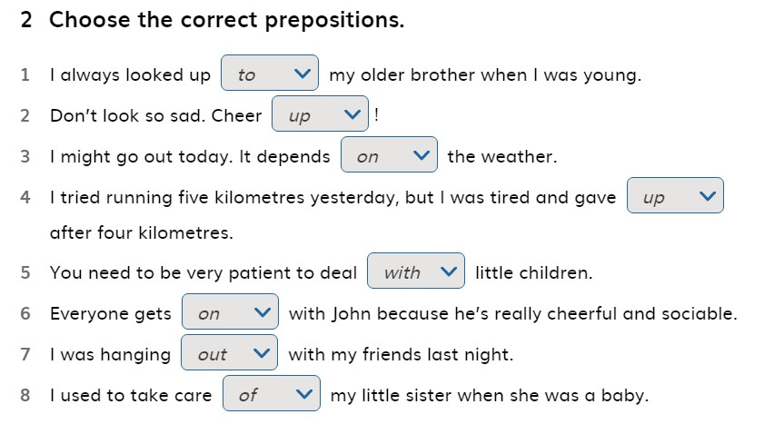
Ex. 2 Page 14
,.

Slide 28
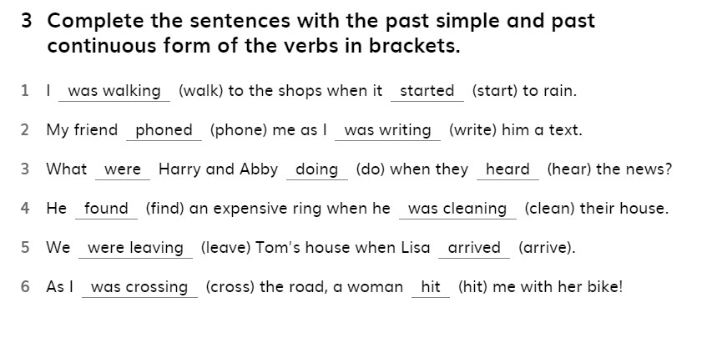
Ex. 3 Page 14
,.

Slide 29
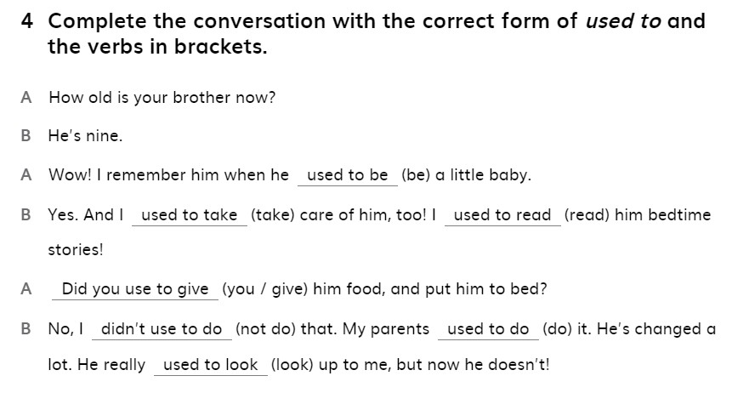
Ex. 4 Page 15
,.

Slide 30
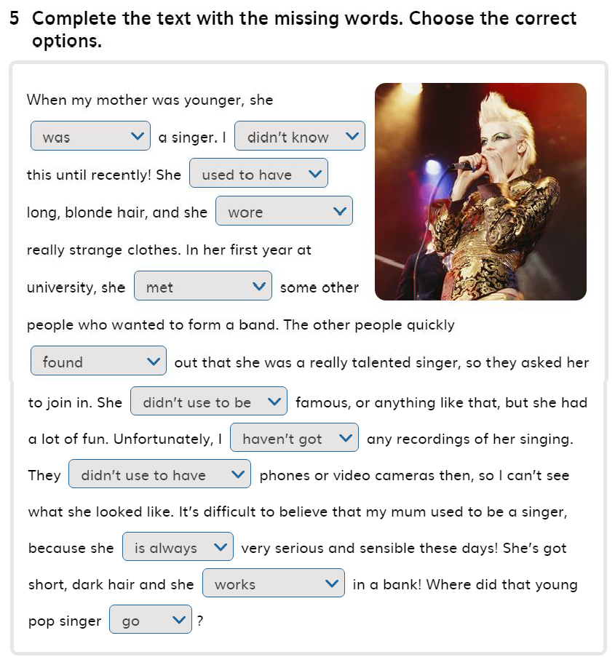
Ex.5 Page 15
,.

