Slide 1

1. Introduction to acoustic
Lecture Outcomes:
Some historical overview of architectural acoustics.
The importance of acoustics in architecture.
Aspects of acoustic in space.
Lecturer: Hawbir Omar M.
4th stage / 2023-2024

Slide 2


1.1 Architectural acoustics: Definition and goal
The science which is concern with controlling sound in all types of architectural space/ building design. In order to achieve a good sound/ optimize environment for many functions, including: Learning, communications, business, entertainment, worship, broadcasting….etc.
This is multidisciplinary field, and is the bridge between the architecture and the physics. Acoustics and noise control play an important role in modern buildings, especially for schools, hospitals, universities…etc.
Architecture acoustic
In brief, the main goal of acoustic in architecture is to achieve the best quality audible sound to audience and reduce the noise.
Best quality audible sound
and reduce the noise
Light and Acoustic in Architecture Hawbir Omar M. 3rd stage 2024-2025

Slide 3
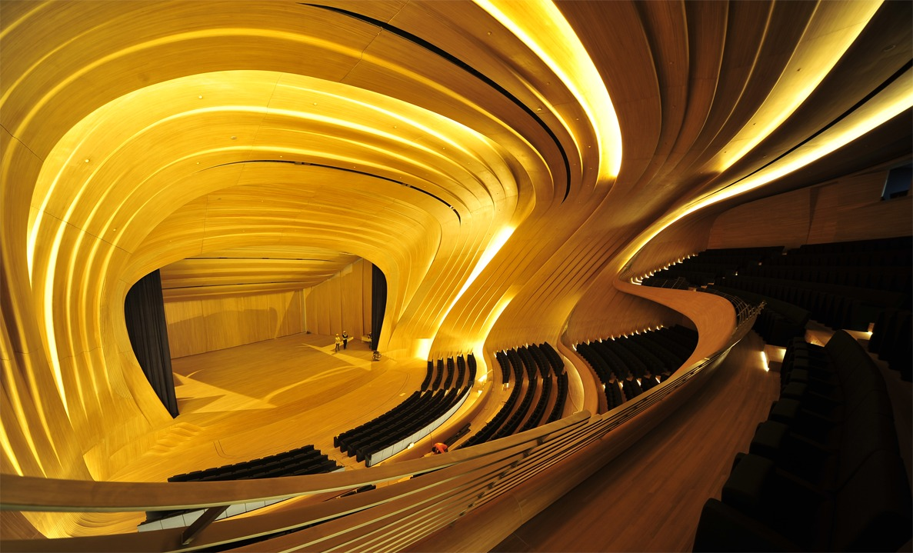
1.1 Why do we need architectural acoustic?
Acoustics are fundamentally important to learning environments.
Learning is intrinsically linked with communication, and aural (sound), learning is about concentration, and external noise is a major distracting factor in education.
The importance of acoustics is not limited to classrooms. Noise in corridors and public spaces can soar if they are too reverberant (too much echo), with voices raised louder and louder to overcome the background echo, just like shouting conversations at a noisy cocktail party or restaurant. So to come over this problems of sounds we need acoustics.
Light and Acoustic in Architecture Hawbir Omar M. 3rd stage 2024-2025

Slide 4
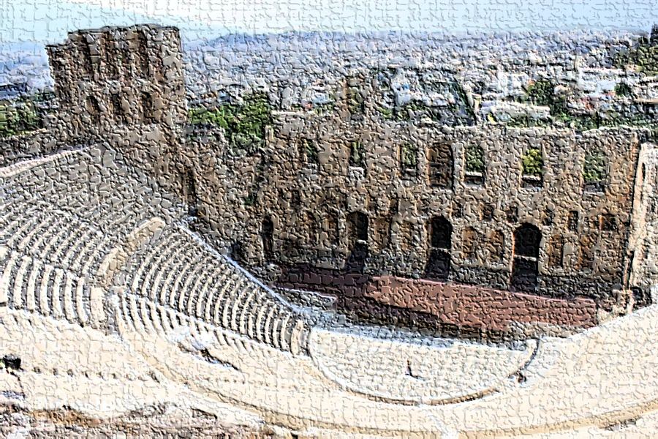
Historical overview:
Acoustic is dealing with the generation, propagation, and properties of sound waves.
It is derived from the Greek word meaning ready to hear. So, the Greeks and the Romans were actually the pioneers of this particular subject. Aristotle was the first to establish that anything which vibrates can produce sound. The historical development of architectural acoustics is similar to other fields of building design, in comprising two parallel strands of ideas :
The science and mathematics of the subject on the one hand, leading to improved understanding of the phenomena.
The methods used by designers when faced with the challenge of a new building or a space how they could get benefit from the existing elements of surrounding. Acoustics deals with all kinds of mechanical waves.
Light and Acoustic in Architecture Hawbir Omar M. 4th stage 2023-2024

Slide 5
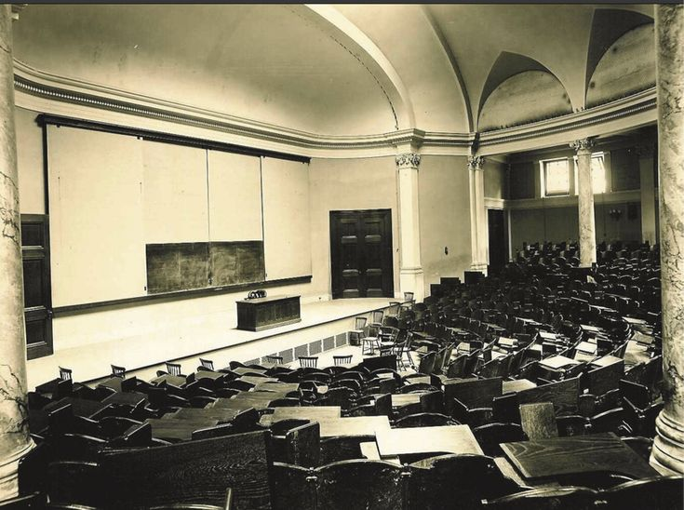
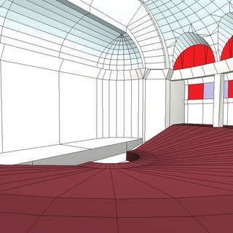
Historical overview:
Wallace Clement Sabine (1868-1919) – The
man who has no rival in being called “the father of architectural acoustics” was
In 1895, the senior staff of the Physics Department at Harvard determined it necessary to improve the acoustics of the Fogg Lecture Theatre, part of the recently constructed Fogg Art Museum. Generally considered an impossible task, the assignment was passed down the line to a young physics professor, Wallace Sabine, set himself the task of determining what made the Fogg Lecture Hall so different from other acoustically acceptable facilities, in particular Harvard’s Sanders Theatre. This lecture theatre had been designed to emulate a classical Greek theatre. These addressed the need of intelligibility by focusing mainly on maintaining the volume of the direct sound that reached the listener’s ear.
Wallace Clement Sabine.
Light and Acoustic in Architecture Hawbir Omar M. 4th stage 2023-2024

Slide 6
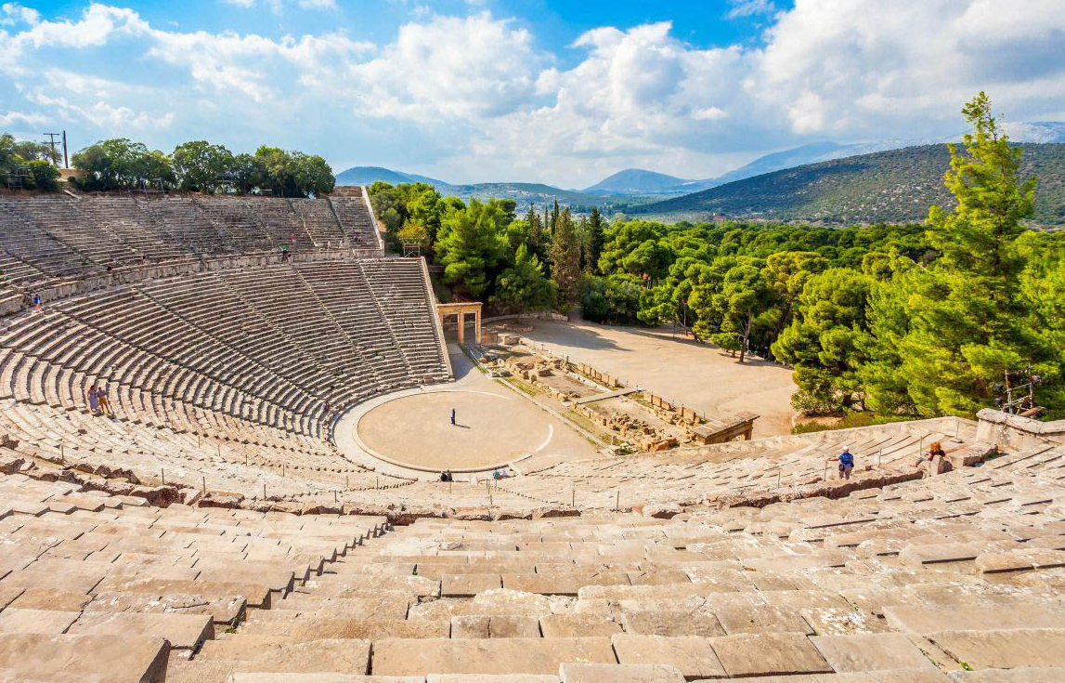
Sabine’s Formula:
Tr= 0.161 V/ A
Tr : reverberation time ,
V :is the total volume of the room/ hall
A : is total absorption by different materials.
In the earliest meeting places (e.g. great Hellenistic Theatre Epidaurus of 330 BC is the earliest outdoor amphitheaters) where the concept of sound was being examined, where the open areas was in the midst of natural forms. People were meeting for some political discussions, for some military purposes or for some performances. The people had experimented several spaces, but they discover that hillsides along the sea where the best locations
for getting better audibility; probably because of the wind direction. The wind carried the sound and limestone material was chosen because good sound reflections. The sounds were heard at all these locations. Here you can see the steep slope and the seating area how this has been made with stones.
Light and Acoustic in Architecture Hawbir Omar M. 4th stage 2023-2024

Slide 7
Types of architectural acoustics:
Architectural acoustics is a part/ discipline of the building physics, which consist several disciplines such as, acoustics, construction, aerodynamics, hydrodynamics, water-proofing technology, optics, and isolation of buildings, etc. Architectural acoustics, generally there are two types/ categories of architectural acoustics.
The first type is called indoor or room acoustics or it is also known as the building acoustics. It includes the design fundamentals, the acoustical material treatment, the noise reduction of the indoor acoustics, sound transmission from one point to another.
Architectural acoustics
Indoor acoustics /
Room acoustics
Outdoor acoustics /
Open air acoustics or
Environmental acoustics
-Sound Transmission
-Noise Reduction
-Mechanical Vibration Control
-Noise control
-City Planning
The second type is called outdoor acoustics / open-air acoustics (environmental acoustics), it includes noise control in open-air space and city planning
Light and Acoustic in Architecture Hawbir Omar M. 4th stage 2023-2024

Slide 8
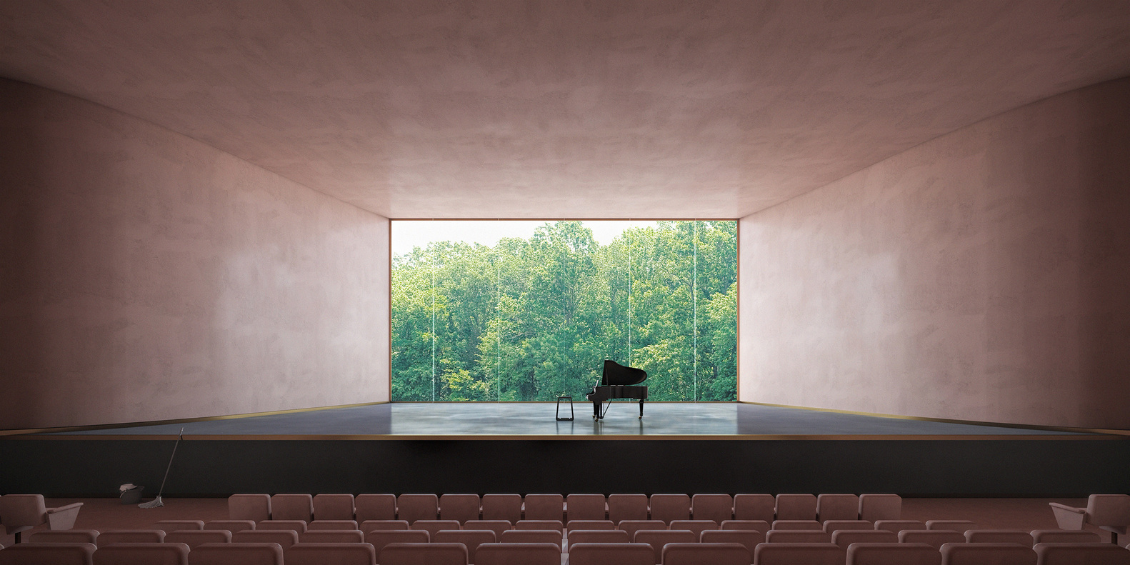
Important acoustics in architecture design
Nowadays, the subject of acoustics in architecture become much more important than before, because of existing many sources of strong noise. Acoustics are fundamentally important to learning environments. Learning is intrinsically linked with communication, and aural (sound) communication is acoustics. Large specialized rooms like auditoriums, theaters; studio ….etc needs careful acoustical engineering. Architectural acoustics (also known as building acoustics) involves the scientific understanding of how to achieve a good sound within a building. It typically involves the study of speech intelligibility, speech privacy and music quality in the built environment. All these factors explain the importance of acoustics in architecture design buildings.
Light and Acoustic in Architecture Hawbir Omar M. 4th stage 2023-2024

Slide 9
The formal specifications for a space designated for audio activity include the following concepts:
Form
Shape
Size
Dimensions
Ratio
Materials and interior finishing .
As for the efficiency of the audio performance, it relates to the extent to which the auditory space achieves an appropriate rating for a number of objective audio standards in a way that is compatible with the nature of the auditory function, in addition to giving it a comfortable sound from a sensory standpoint.
Light and Acoustic in Architecture Hawbir Omar M. 4th stage 2023-2024

Slide 10
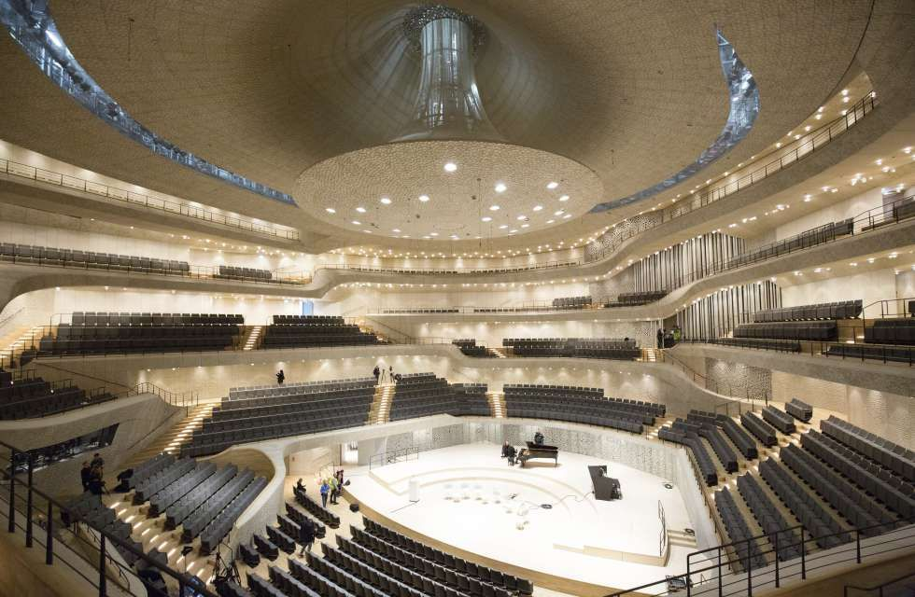
The explanation of the acoustic phenomenon in closed space includes more than one aspect:
The physical aspect , which relates to the following :
The nature of the audio source: It is classified into verbal sources (the human voice) and musical sources (mechanical and technical sounds of musical instruments), and each has its own characteristics and limits within the frequency range.
The loudness of the sound source.
The intensity of the direct sound energy of the sound source .
The location of the sound source and its height relative to the listeners​.
The architectural aspect:
It is related to the nature of the formal and spatial composition of the space:
Light and Acoustic in Architecture Hawbir Omar M. 4th stage 2023-2024

Slide 11
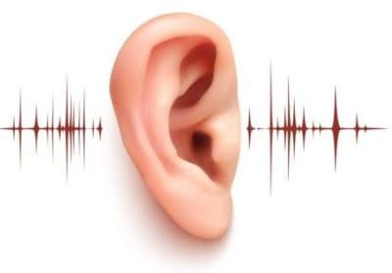
1. The size, dimensions, and proportions, which affect the paths of the reflected sound rays, the time period for their arrival with the direct sound, and the possibility of the appearance of acoustic defects.
2. The nature of the interior treatment : which determines the amount of absorption and then the degree of preservation of the amount of reflected sound energy relative to the amount falling from it.
The biological aspect, which deals with the mechanics of the human ear in receiving the audio signal, both direct and reflected, within an appropriate period of time, in order to carry out the process of integration and interpretation correctly, otherwise a clear audio defect appears, which distorts the audio purity. This mechanism is important in determining the value of the required time period and according to the type of audio signal (verbal or musical). If it is within the correct limits, the ear receives the audio signals of natural vibratory tendencies and reverberating audio reflections as a harmonious frequency mixture.
Light and Acoustic in Architecture Hawbir Omar M. 4th stage 2023-2024

