Slide 1
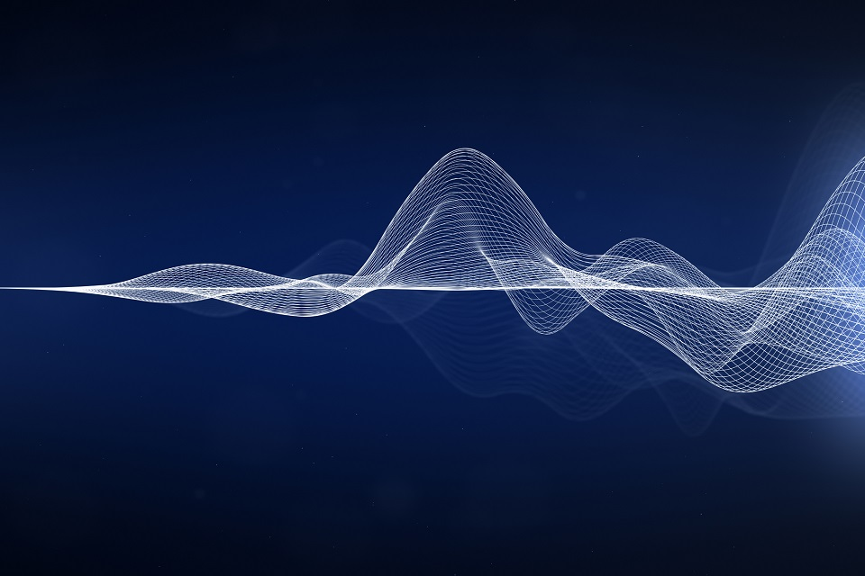
Basic Principle, Propagation and Isolation of acoustic
Lecture Outcomes:
Types of sound and properties.
Reverberation and it’s remedy through building .
Factors Affecting Acoustics of Buildings
Lecturer: Hawbir Omar M.
4th stage / 2023-2024

Slide 2
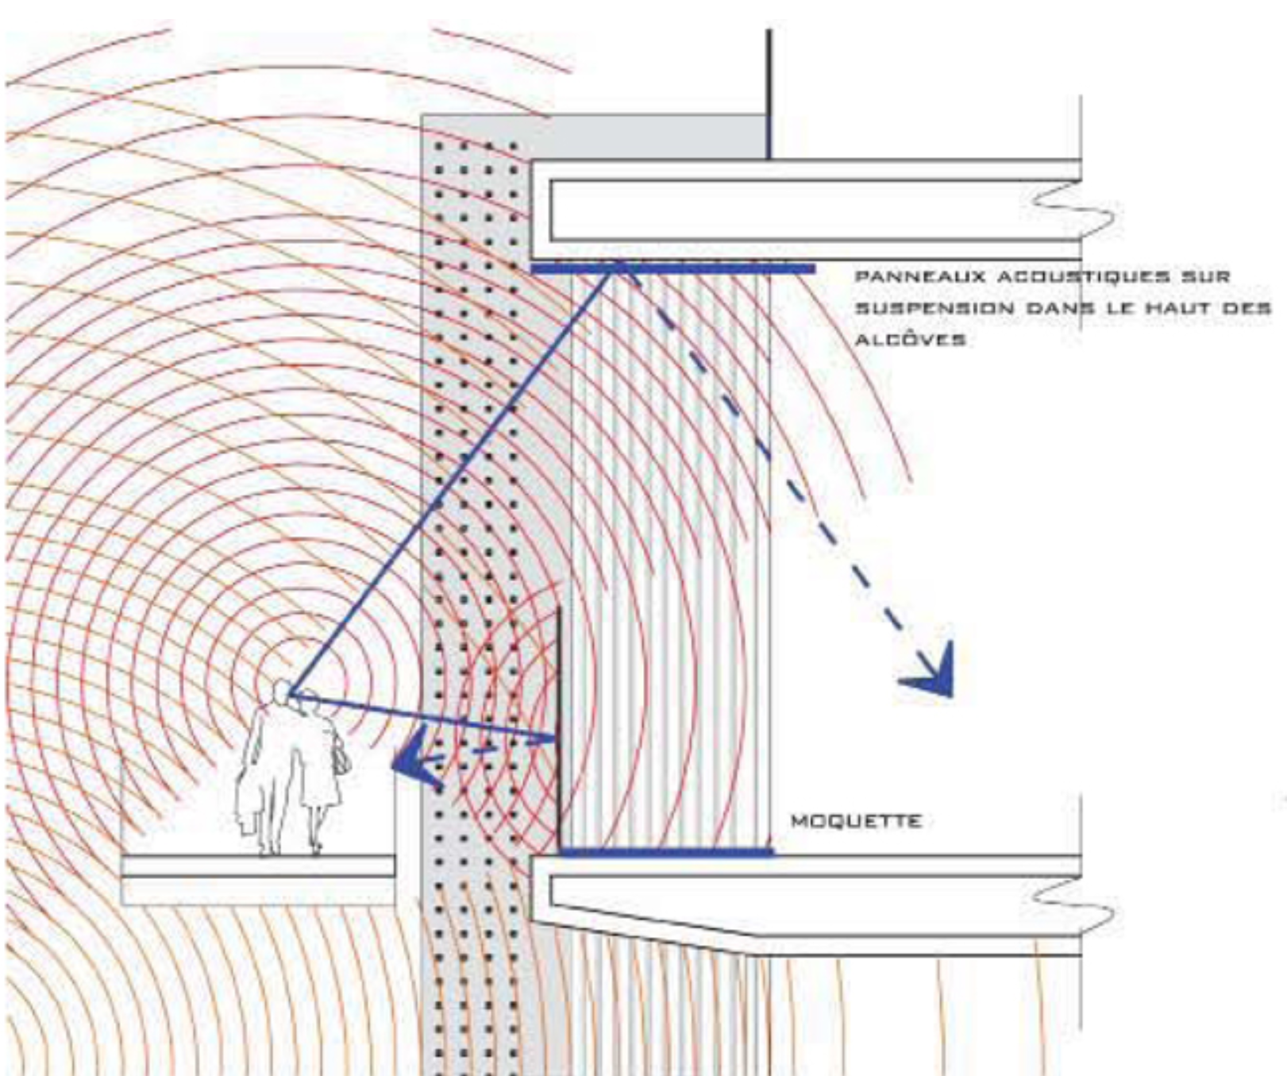
In the case of a free, open field, sound waves spread in all directions without colliding with an obstacle. The sound waves are spherical in shape, and they travel from the center of the sound (the ball) in all directions, causing expansion and contraction of the air molecules surrounding the center. These expansions and contractions are transmitted away from the center.
Classification of sound
Infrasound f<20hz
Audible sound 20hz<f<20khz
Ultrasound f >20khz
Light and Acoustic in Architecture Hawbir Omar M. 4th stage 2023-2024

Slide 3
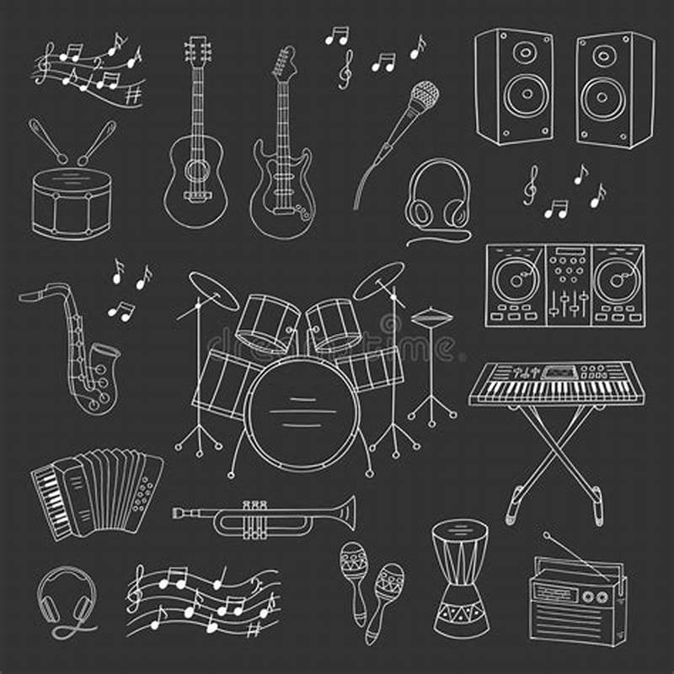
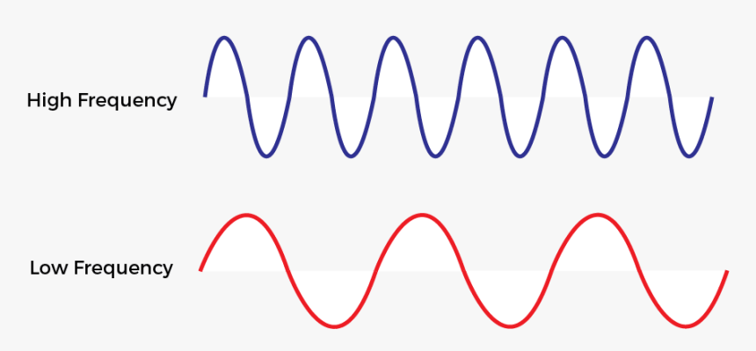
1) Musical sound
The sound which produces pleasing effect on the ear is called musical sound.
Classification of Audible Sound:
Example: Sound produced by musical instruments like gitar, violin, flute, piano etc.
Properties of Musical Sound:
The musical sound waveforms are regular in shape, have definite periodicity and they do not undergo a sudden change in amplitude, as shown in figure.

Slide 4
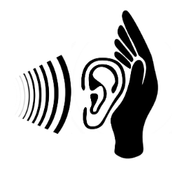

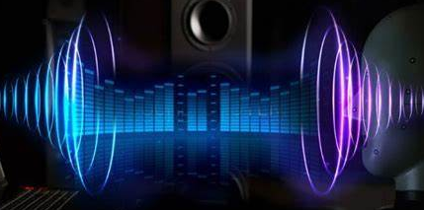
1) Pitch 2) Loudness 3) Timber Related to frequency Related to intensity Related to quality
Characteristics of Musical Sound:
Pitch: It is a sensation that depends upon the frequency. The sound produced by ladies & children is of high pitch type because the frequency is heigh. Similarly, the sound produced by a bee or mosquito is of high pitch due to high frequency.
Loudness: is a degree of sensation produced on ear. Thus, loudness varies from one listener to another. Loudness depends upon intensity and also upon the sensitiveness of the ear.
It is the quality of sound which enables us to distinguish between two sounds having the same loudness and pitch. It depends on the presence of overtones.
* It helps us to distinguish between musical notes emitted by different musical instruments and voice of different persons even though the sounds have the same pitch and loudness.

Slide 5
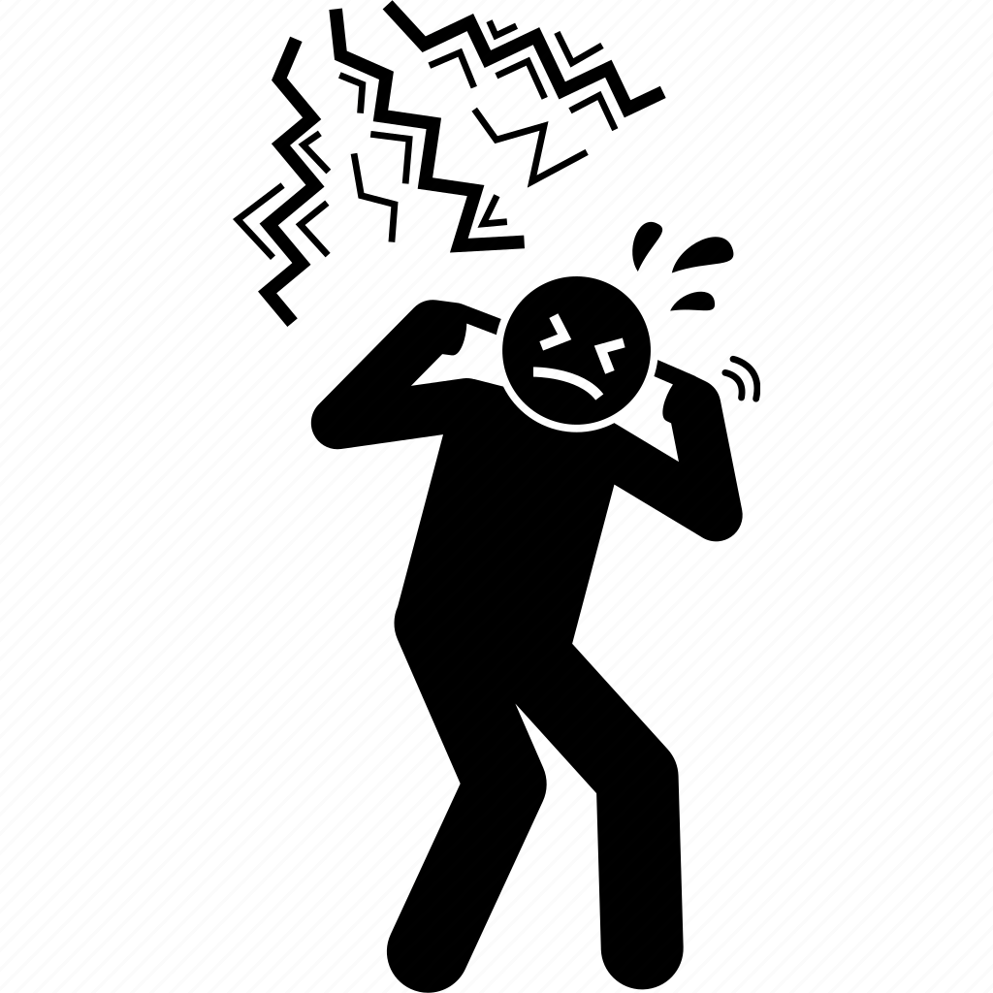


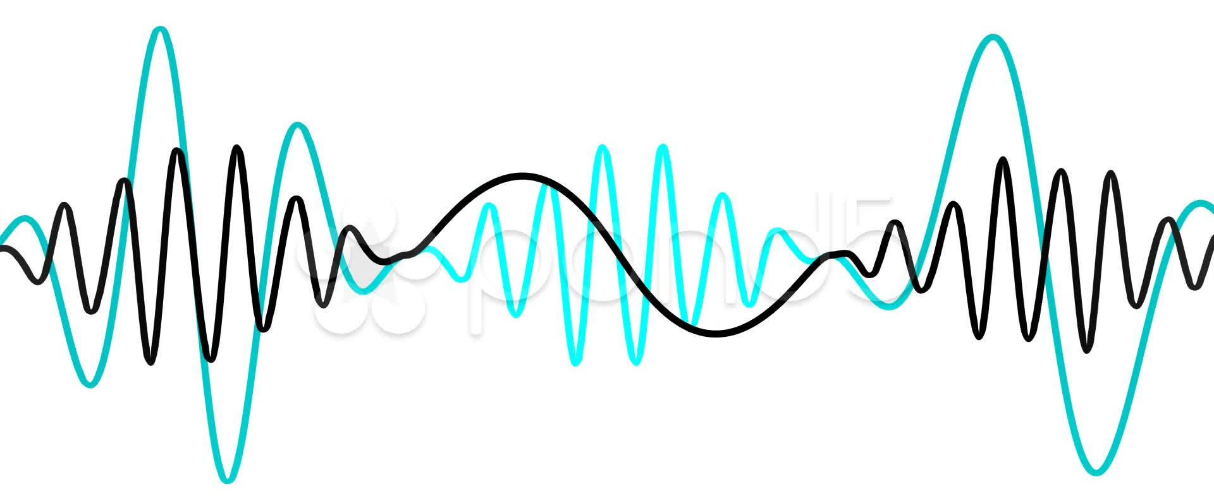
2) Noise
The sound that produces a jarring effect on the ear and is unpleasant to hear is called noise. Example: Sound produced by flying airplane , road traffic , crackers and etc.
Classification of Audible Sound:
Properties of Noise:
The noise waveforms are irregular in shape, they do not have definite periodicity and they undergo a sudden change in amplitudes, as shown in figure.

Slide 6
Sound absorbing materials broadly classified into four categories:
Porous absorbents
Cavity resonators
Resonant absorbent & panel absorber
Composite absorber

Slide 7
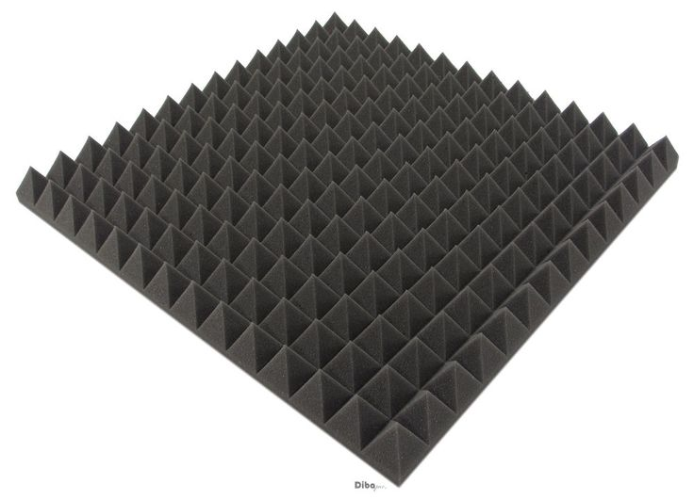
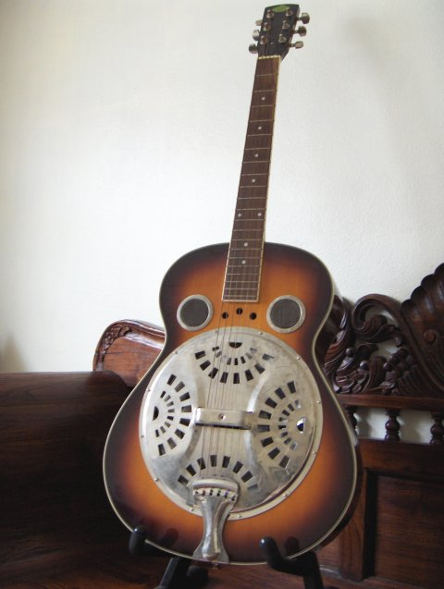
Porous absorbent:
The waves of sound strike the surface of the porous material; a part of the waves get reflected and other part is entered into the porous material . The part of waves enter into the porous material is converted into the heat energy and reduce the energy of the reflected waves.
Examples:-mineral wools, wood wool, etc.
Cavity resonators:
When the sound waves enter the resonator, due to the multiple reflection sound waves are absorbed and the music waves will be produced.

Slide 8
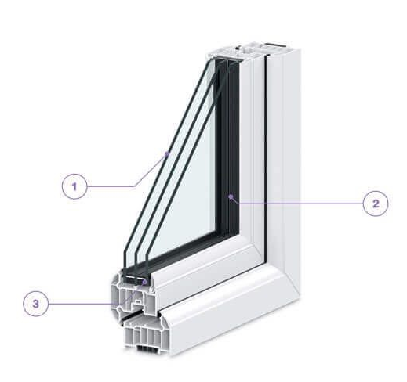
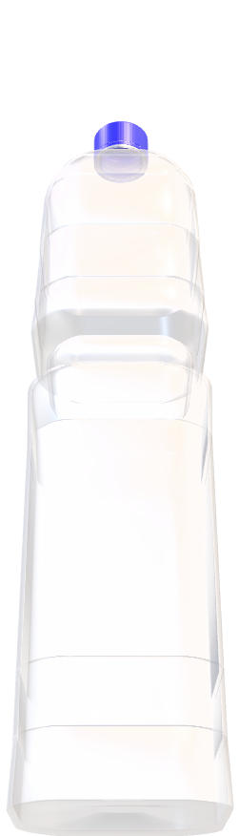
3)Resonant absorber & panel absorber:
The absorbent material fixed on a framing with an air space between framing and the other layer or the wall. Due to the flexural vibration of panel, waves are absorbed by the panels which converted into the heat energy. Examples: Doors, Windows and etc.
Enhanced Security
Noise Reduction
Energy
Protection
4)Composite:
The composite absorber is the single unit that does the function of the other three absorber. Examples:-airplane or empty jar bottle, etc.

Slide 9
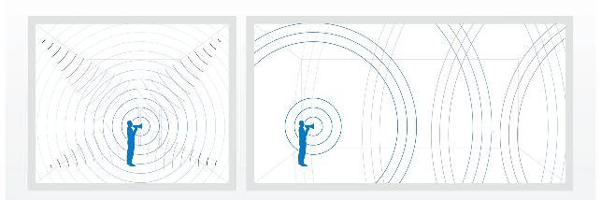
Reverberation and Reverberation Time:
Reverberation:-
The persistence or prolongation of sound in a hall even though the source of sound is cut off is called reverberation.
Reverberation time:-
The time taken by the sound to fall below the minimum audibility level after the source stopped sounding is called reverberation time.
Reverberation
Echo

Slide 10
Factors Affecting Acoustics of Buildings and Their Remedies
a. Reverberation Time:-
It is the persistence or prolongation of sound in a hall even after the source stopped emitting sound.
The reverberation time is the time taken by the sound to fall below the minimum audibility level.
In order to have a good acoustic effect, the reverberation time has to be maintained at optimum value. If not, it will lead to more confusion due to mixing of different syllables.

Slide 11
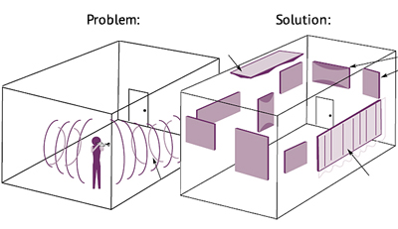
REMEDIES
By providing windows and openings.
By having full capacity of audience in the hall or room.
By using heavy curtains with folds.
By covering the floor with carpets.
By decorating the walls with beautiful pictures, maps, etc.
By covering the ceiling and walls with good sound- absorbing materials like felt, fiber board false roofing, etc.

Slide 12
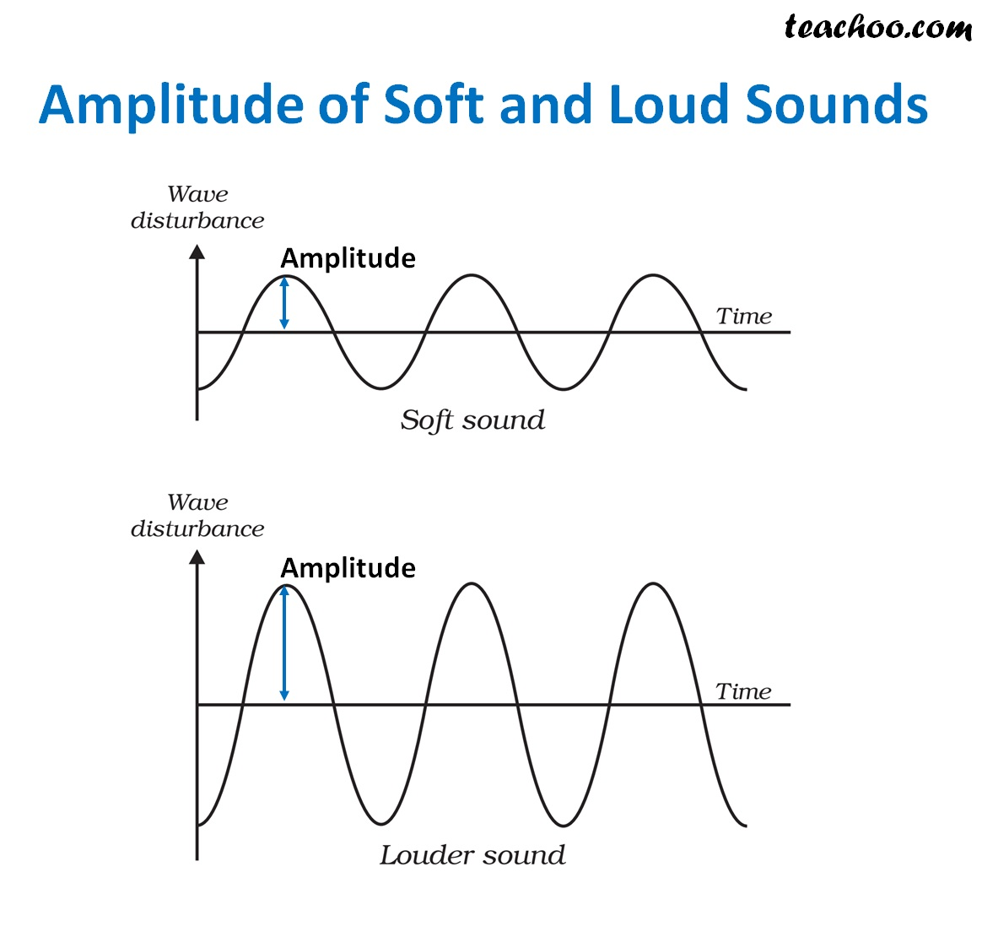
b. Loudness:-
The uniform distribution of loudness in a hall or a room is an important factor for satisfactory hearing.
REMEDIES
By using suitable absorbent Materials at places where noise is high.
By constructing low ceilings for the reflection of sound towards the listener.
By using large sounding boards behind the speaker & facing the audience.
While it makes the sound larger and clearer.
5. By using public address system like loudspeaker.
SOFT SOUND
LOUD SOUND

Slide 13
Thank You

