Slide 1

Acoustic Materials, their Absorption and Reflection of Sound
Lecture Outcomes:
Reverberation and it’s remedy through building.
Acoustic and materials comparison between old era and new era.
Lecturer: Hawbir Omar M.
4th stage / 2023-2024

Slide 2
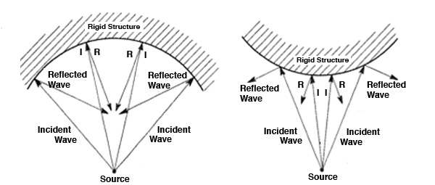
c. Focusing and interference:-
The presence of any concave surface or any other curved surface in the hall or room may make the sound to be concentrated at this focus region.
As a result, the sound may not be heard at all other regions.
REMEDY
Curved surfaces can be avoided or concave to be upside down or giving a slight straightness to the face in order to make sound scattering or sound focusing.
Focus Reflection
Scatters Reflection

Slide 3
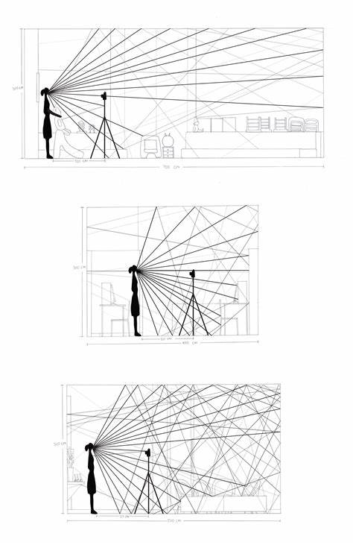
d. Echo:-
It is heard due to reflection of sound from a distant reflecting object.
Remedy:
it can be avoided by converting ling distance walls and high ceiling with suitable sound absorbing material.
e. Echelon effect
It refers to the generation of a new separate sound due to multiple echos.
Remedy:
The remedy to avoid it is to cover such surfaces with sound absorbing materials.
e. Resonance:-
It occurs due to the matching of frequency.
Remedy
The resonance may be avoided by fixing the windows and applied panels properly.

Slide 4
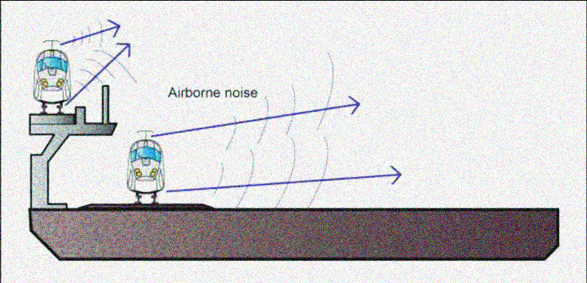
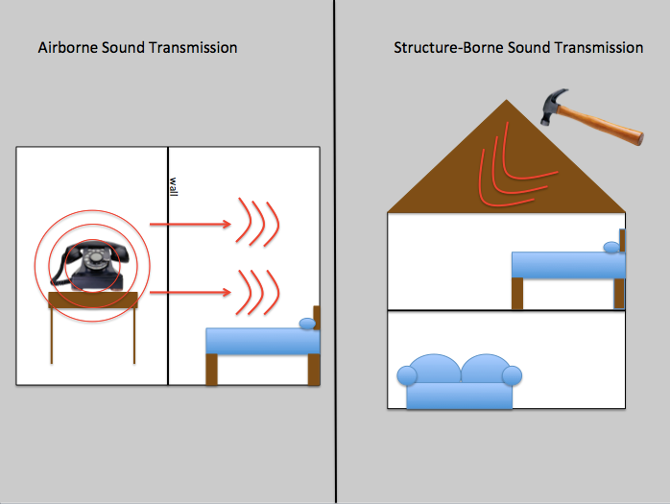
f. Noise:
The unwanted sound is called a noise, which they are classified into three types:
1-Air born noise, 2-Structure born noise, 3-Inside noise
Types of noise:-
1. Air born noise:-
Extraneous noise which are coming from outside through open windows, doors, and ventilators are known as air born noise.
Remedy:-
The hall or room can be made by using sound separation materials
as a specification through different applied materials.
2. Structure born noise:-
Is the sound which spreads in solid bodies such as walls of houses, heaters, pipes, etc.
Remedy:-
This noise can be eliminated by using double walls with air space between them.

Slide 5
3. Inside noise:-
The noise which are produce inside the hall or room is called inside noise.
Remedy:-
By using curtains of sound absorbing materials.
Conditions for good Acoustics:-
There should not be any overlapping sound.
Resonance effect should be avoided.
The hall should have a proper reverberation time.
There should not be any echelon effect.
The presence or absence of audience should not affect the quality of sound.
Reverberation time in seconds | Acoustics
0.50-1.50 | Excellent
1.50-2.00 | Good
2.00-3.00 | Fairly Good
3.00-5.00 | Bad
Above 5.00 | Very Bad

Slide 6






What is acoustic materials?
Is a material designed to control, direct, and manipulate sound waves as these might occur in gases, liquids, and solids. Among materials used for these functions are polyurethane and melamine foams, fiberglass, wood, plastic and synthetic tiles.
Types of Materials:
SOUND ABSORBER
SOUND DIFFUSERS
NOISE BARRIERES
SOUND REFLECTORS

Slide 7
1. Sound Absorbers:
Sound absorbing acoustical panels and soundproofing materials are used:
To eliminate sound reflections
To improve speech intelligibility,
Reduce standing waves and prevent comb filtering.
Typical materials are open cell polyurethane foam, cellular melamine, fiberglass, fluffy fabrics and other porous materials.
A wide variety of materials can be applied to walls and ceilings depending on your application and environment.
These materials vary in thickness and in shape to achieve different absorption ratings.

Slide 8
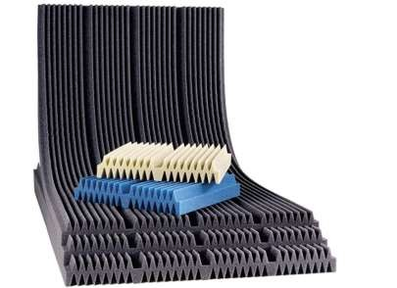
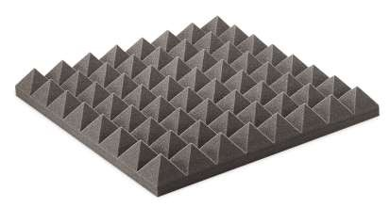
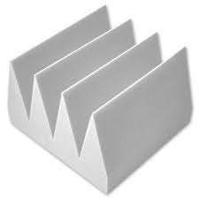
Acoustical foam panels
These acoustical foams are used in a wide variety of applications ranging from recording and broadcast studios to commercial and industrial . These products can be applied directly to walls, hung as baffles or used as freestanding absorbers.
Stackable foam enables space to:
Increase thickness quickly by nesting layers instead of buying incompatible products.
Traditional foam patterns standard patterns include wedge, pyramid, max wedge
For low frequency absorption, Ceiling, Bermuda and triangle corners.
Stackable foam
Traditional foam patterns
Anechoic Wedges designed for
Controlling low frequency sound
Anechoic wedges

Slide 9


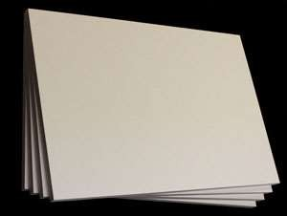
B. White paintable acoustical panels
Have a soft textured appearance. Their sizes are manageable and provide installers the flexibility to mount acoustical panels around existing objects. In addition to reducing echo and reverberation, these acoustical panels are used to create unique designs and patterns.
For use in recording studios, home theaters, offices, broadcast facilities, telemedicine, conference rooms, restaurants, salons, coffee shops, computer gaming systems or anywhere

Slide 10
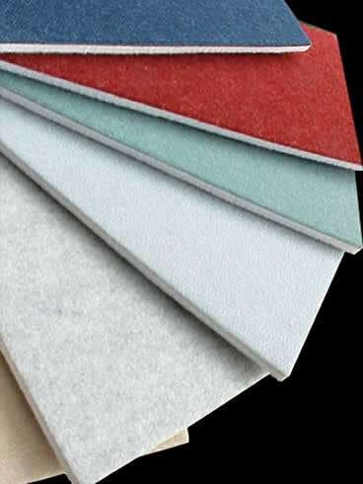
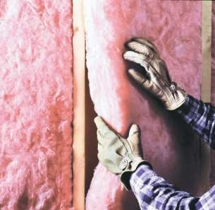
C. Acoustical wall coverings
Is a dimensional fabric that offers excellent acoustical properties, like:
Class A they are:
•resistant to moisture, mildew, rot, fire/ smoke retardant, bacteria and is non-allergic.
•easy to install
•passes corner burn test
•available in many colors
•durable / abuse resistant
•improves speech intelligibility
D. Fiberglass Blankets And Rolls
quilted fiberglass blankets, rolls & panel curtains combine absorption and barrier material for use in areas that require tough, flexible materials and provide a surface that can be wiped clean. These can be great for machine and industrial enclosures and can be hung as temporary acoustical panels. The quilted fiberglass materials are available in panels or in rolls for easy to hang absorption.

Slide 11


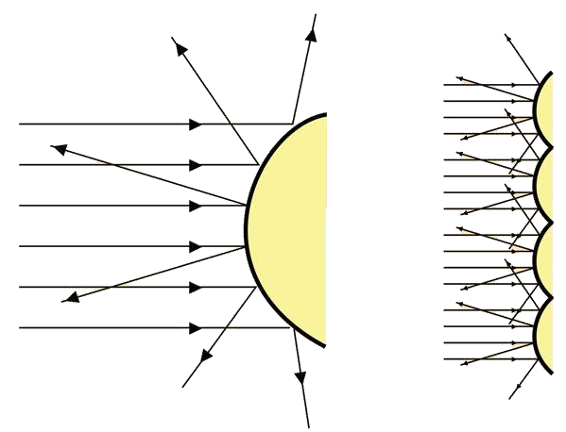
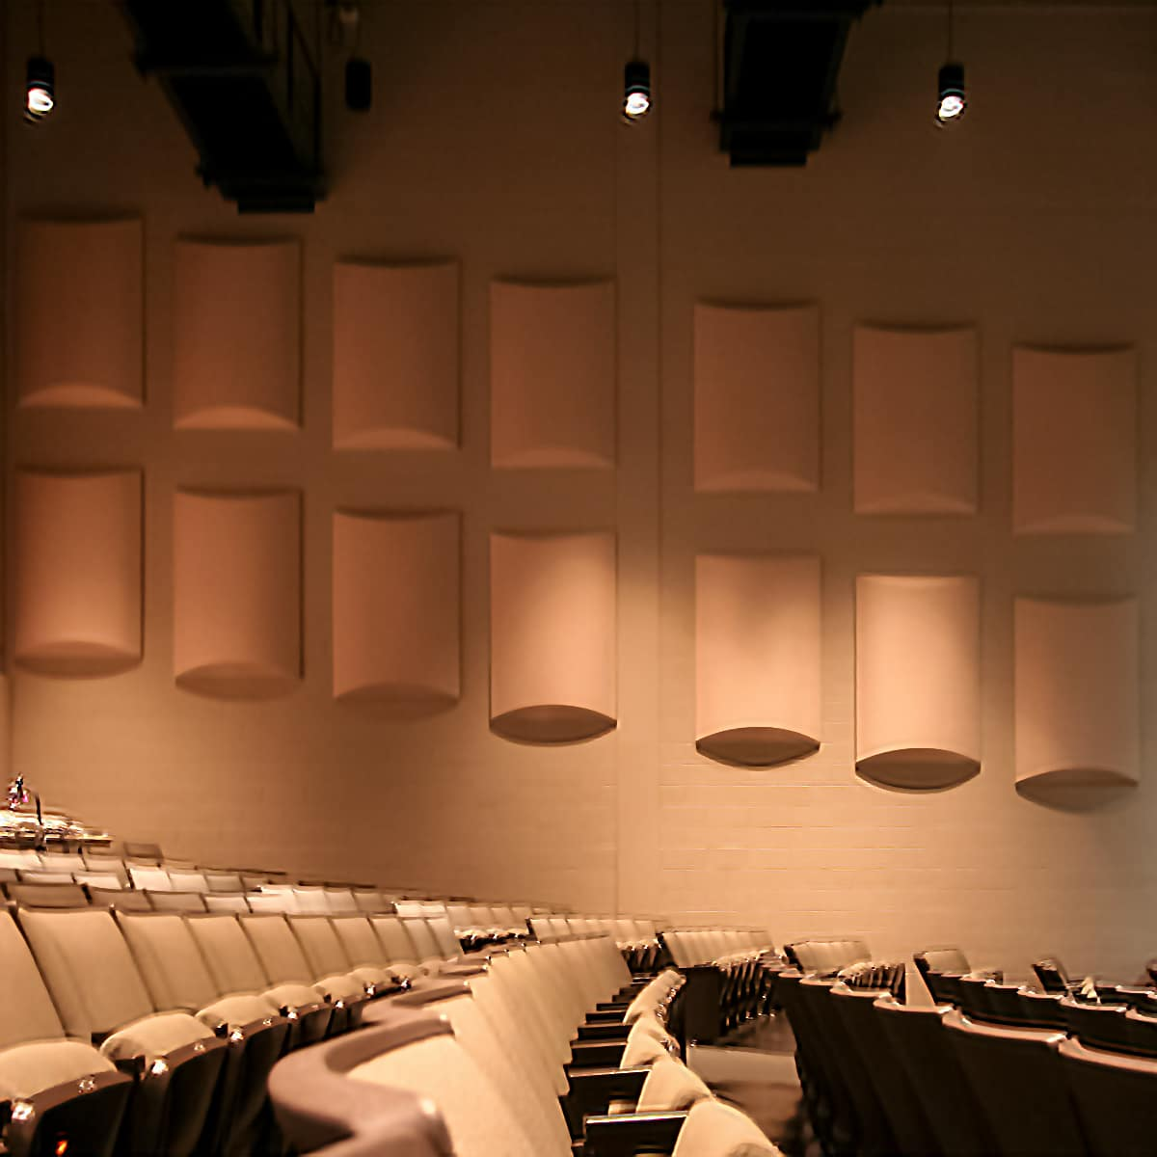
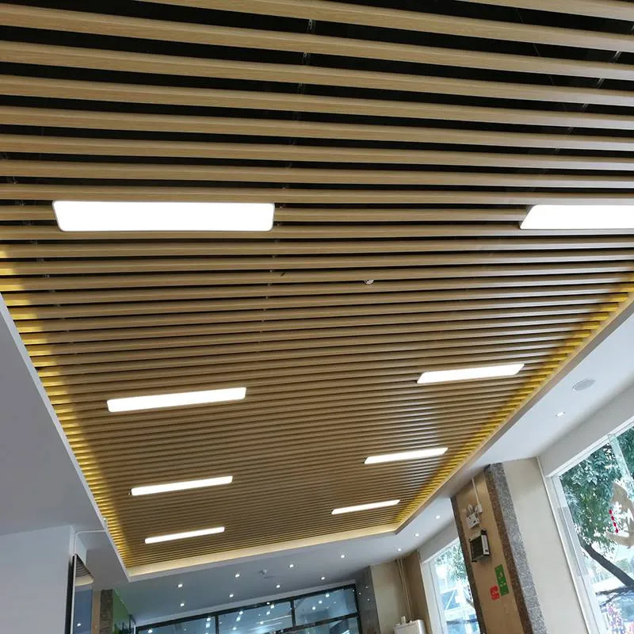
2. Sound diffusers
This device reduces the intensity of sound by scattering it over an expanded area, rather than eliminating the sound reflections as an absorber.
Double duty diffuser
These polyclinical diffuser do twice the work. They scatter and function as a bass trap.
Quadratic diffuser
A true quadratic residue diffuser designed improving sound quality by disrupting standing sound waves that occur between parallel surfaces such as ceilings and floors.

Slide 12
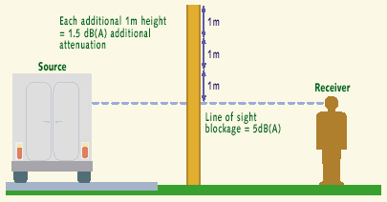
3. Noise barrier
Noise barriers are solid obstructions built between roadways and residential areas.
These barriers do not block all noise, they only reduce the overall noise level.
Effective noise barriers typically reduce noise levels by 5 to 10 decibels (dba).
What type are the best for a noise barrier?
-Concrete -Masonry -Wood
How does a noise barrier work? A noise barrier must be tall enough and long enough to block the view of a highway from the area that is to be protected, the "receiver.“
-Metal -Foams

Slide 13
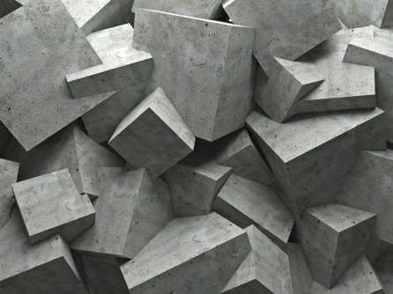
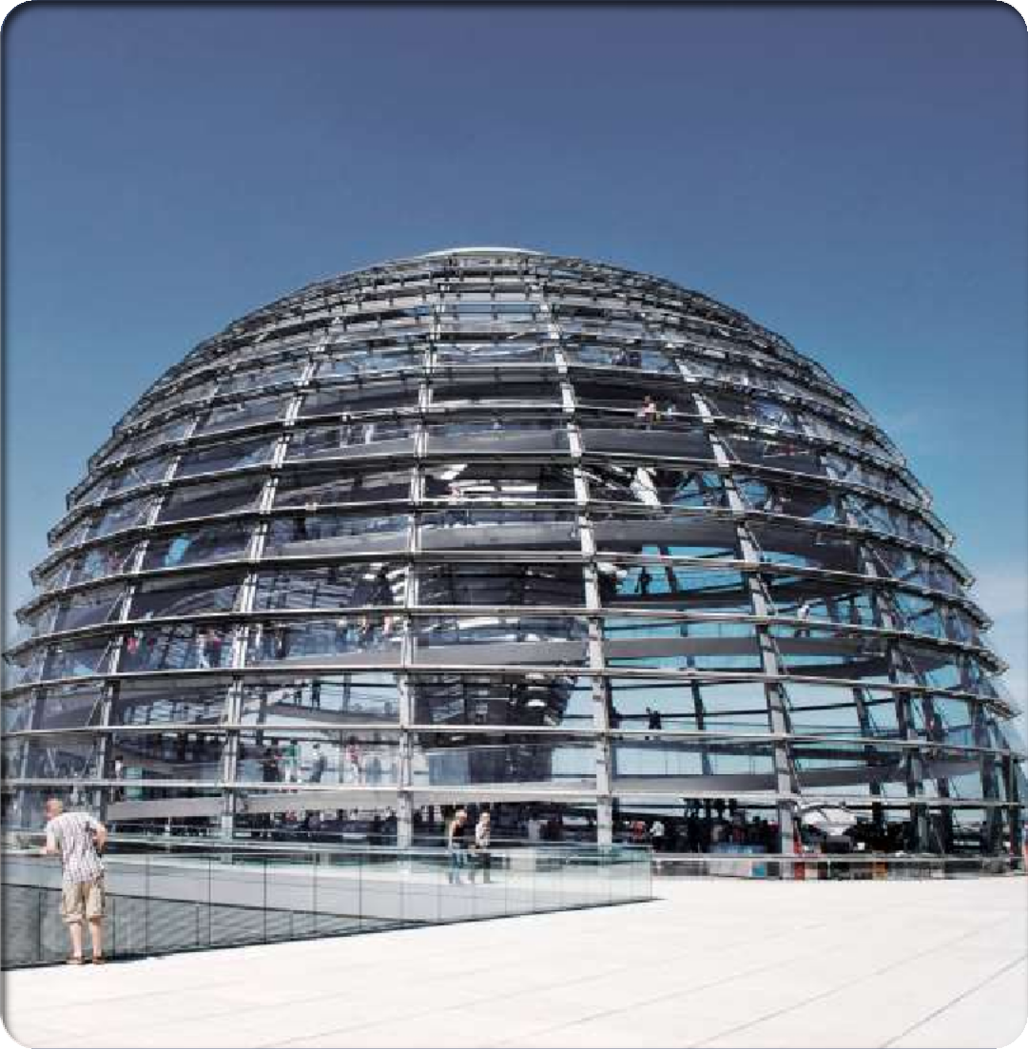

4. Sound Reflector
In order to hear a loud, clear echo, hearer must also be far enough away from the solid surface due to the sound wave is bouncing off, the hearer has to have space from the reverberate
Hard materials
A hard, relatively nonporous material, such as concrete, The hard materials such as: rocks, man made concrete and asphalt
Smooth Materials
When a sound wave, which is made up of kinetic energy, collides with a smooth surface, it will release its kinetic energy as heat.

Slide 14
Acoustics Then and Now
Material Used:
THEN
NOW
The materials used in the old
churches were mainly stones, Mud and Bricks.
These items were the wall materials for the spaces had ability to absorb and control sound as well.
The current spaces are mainly built of blocks and concrete, and padded with
sound insulation/absorptive materials, Sound barriers and reflectors, e.g. acoustic foam panels.

Slide 15
Acoustics then and Now
Design and Materials Application Techniques:
THEN
NOW
The shapes of Halls of the past were mainly
rectangular irrespective of the capacity.
They also had curved ceiling shapes.
Materials application techniques were crude as opposed to technology aided application techniques of today.
The new Halls come with varieties of shapes
depending on size and capacity of the Hall, e.g. semi-circular shape, Hexagonal shapes, sloppy floors and ceilings, etc..
Materials application techniques are technology aided and of high quality.

Slide 16
Acoustics then and Now
Quality and Durability of Materials Used:
THEN
NOW
Materials are quality and durable as they are mostly factory treated with a guaranteed life span.
Materials were largely very natural with little or no proper industrial chemical treatments to improve their quality and prolong life span.

Slide 17
Acoustics then and Now
Materials Functionality in terms of Sound control and Amplification:
THEN
NOW
Materials were to some extent performing well, but were largely limited by the quality of production and installation.
They perform better due to well calculated architectural designs, the use of microphones, loudspeakers to amplify and control sound. They use HVAC (Heat, ventilation, and air- conditioning) technology for comfort.

Slide 18
Acoustics then and Now
Aesthetics of Materials Used:
THEN
NOW
Walls were mostly bare with little or no decorative touches, and where it existed was old fashioned.
The new Halls are better decorated and comfortable as some of the acoustic materials also serve as decorative elements.

Slide 19
Thank You

