Slide 1









Non-verbal Communication
Tishk International University
Faculty of Administrative Sciences and Economics
Business and Management Department
Business and Professional Speaking

Slide 2
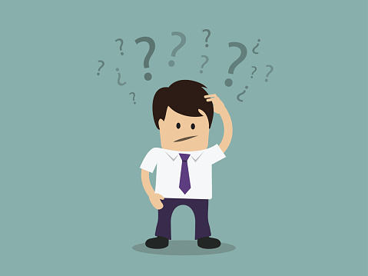
Non-verbal Communication
Tishk International University
Faculty of Administrative Sciences and Economics
Business and Management Department
The First question is what is meant by Non-verbal?

Slide 3
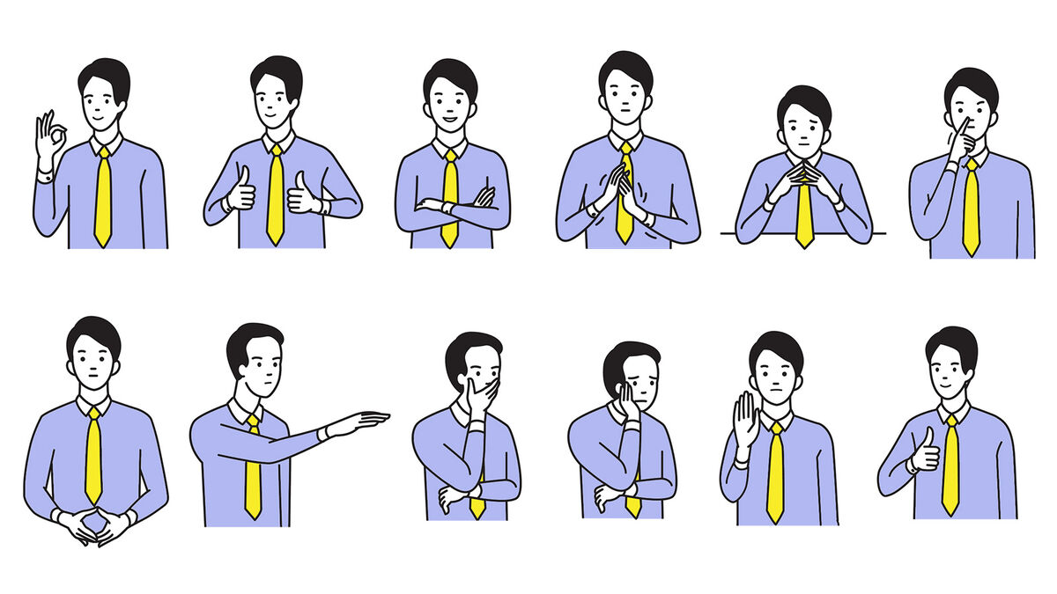
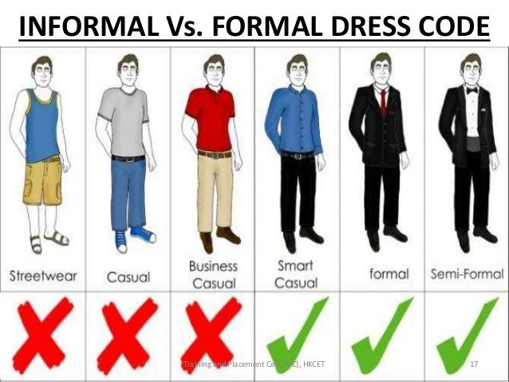
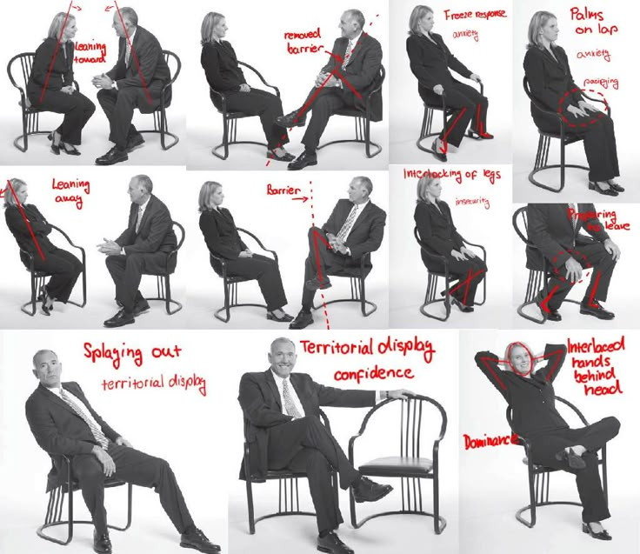
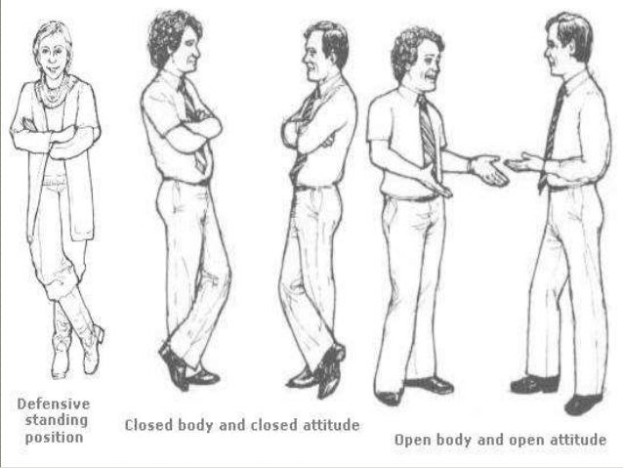
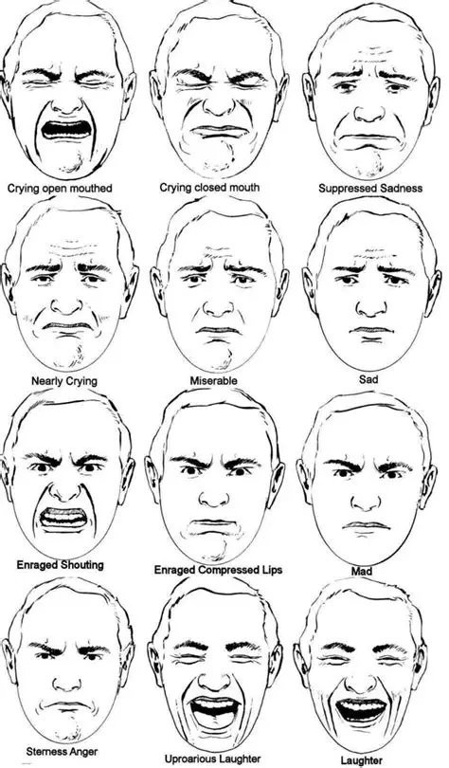
Non-verbal Communication

Slide 4
Do they mean the same???
Tishk International University
Faculty of Administrative Sciences and Economics
Business and Management Department

Slide 5
As you saw, Non-verbal is something we should not ignore
In General, Non-verbal includes..
Gestures: The Language of Movement
Facial Expressions: Windows to Emotion
Body Language & Posture: Conveying Confidence
Movement and Space
Presence: The Overall Aura
Even Time and clothes

Slide 6
These Non-verbal tools = they STAY telling on you
People read vibes before words
Try saying “I am fine” in a different tone and facial expression
'I'm fine' can mean 50+ things depending on your face

Slide 7

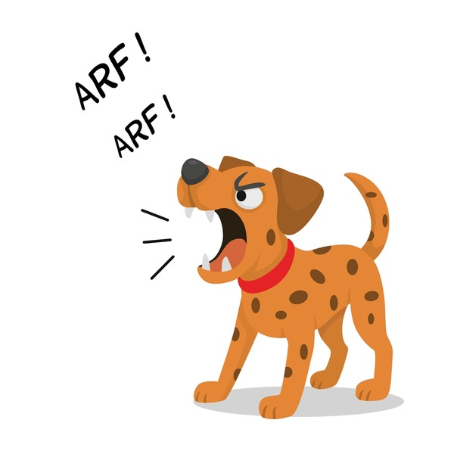
Non-verbal communication is more than just body language; it's a deeply rooted biological system that predates spoken language, vital for survival.
Think about how an infant communicates its needs without words, or how animals signal danger or comfort.
Do you know that?
According to groundbreaking research by Albert Mehrabian,
93 % of emotional communication occurs non-verbally, with at least 55 % attributed to facial expressions alone.
This means that if you're trying to convey excitement, but your facial expression is flat, your audience will likely pick up on the disconnect.

Slide 8
People instinctively trust nonverbal messages more than spoken words
When your body language contradicts your verbal message.
For instance, saying "I'm perfectly fine" with crossed arms and a tense jaw – audiences will almost always believe your actions over your words.
Hence,
First impressions = mostly non-verbal
Your vibe enters the room before you do

Slide 9
Key Principles of Nonverbal Communication
Tishk International University
Faculty of Administrative Sciences and Economics
Business and Management Department

Slide 10
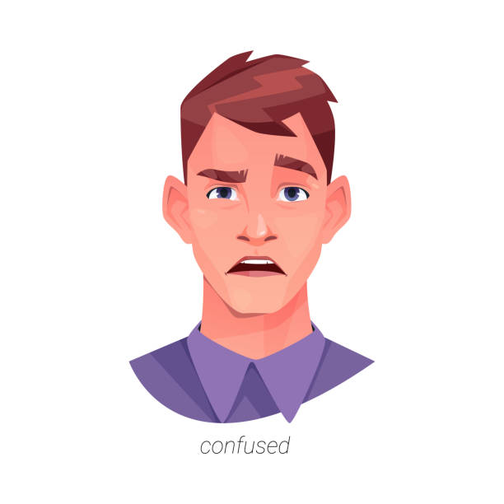
Nonverbal Communication Is Fluid
Nonverbal communication is always moving and changing.
You can’t look at just one gesture and know what it means — you must look at the whole situation.
Example
If someone raises their eyebrows, it could mean they’re surprised, confused, or questioning something.
You don’t know which meaning is correct until you see their facial expression, tone, or the situation they’re in.

Slide 11

Nonverbal Communication Is Irreversible
Once people see your body language, they remember it.
You cannot “undo” how it made them feel.
(LIKE THE WRITTEN COMMUNICATION)
Example
If an employee rolls their eyes when the manager gives instructions, even if he/she say “I didn’t mean it,” the manager already feels disrespected.

Slide 12

Nonverbal Communication Can Add to or Replace Verbal Communication
Nonverbal communication can support what you say—or take the place of words entirely.
Emblems are gestures with a specific, agreed-on meaning (like a thumbs up).
Regulators are nonverbal messages that control, maintain, or discourage interaction (like raising your hand to signal someone to stop talking).
Example
If someone asks, “Are you okay?” Saying nothing, but giving a thumbs up, communicates “Yes” without speaking. This is using an emblem to replace speech.

Slide 13

Non-verbal Communication Is Universal
Nonverbal communication occurs in many contexts throughout daily life — at work, at home, with friends, with family.
Everyone uses nonverbal communication, no matter where they are from.
Example
A smile is recognized worldwide as friendliness or warmth, even if people speak different languages.

Slide 14

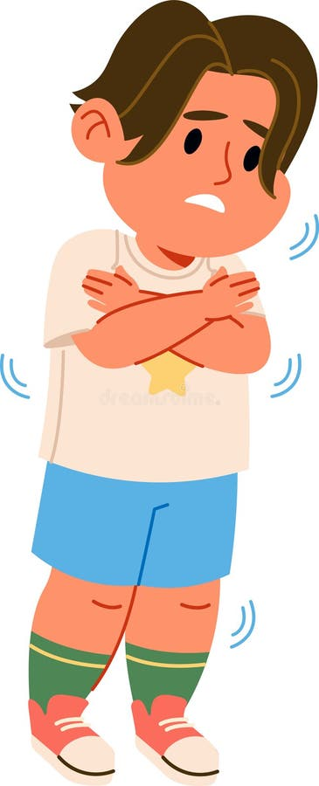
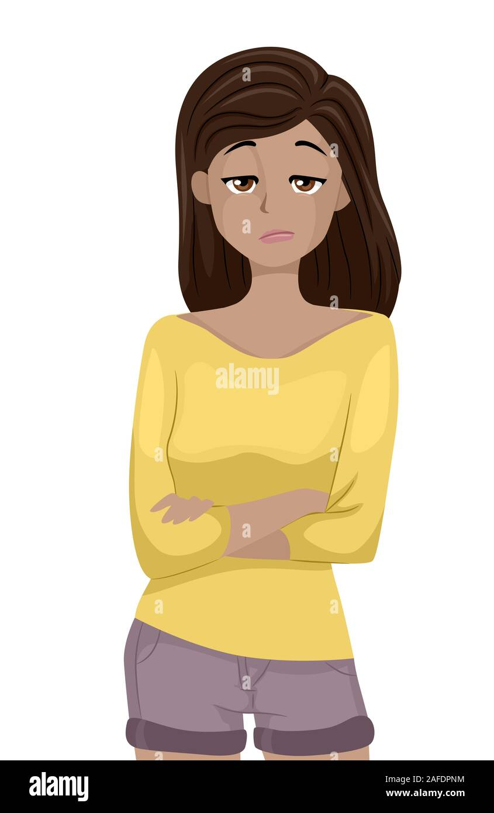
Nonverbal Communication Is Confusing and Contextual
Nonverbal communication can be confusing. You need context to understand a gesture or movement.
You must interpret nonverbal messages based on the situation and prior knowledge of the person.
Example
Crossed arms: Cold? Bored? Upset?
You can’t know unless you understand the context.
Can you recall a misunderstanding or an interesting observation due to differing nonverbal cues in a new environment or culture?

Slide 15
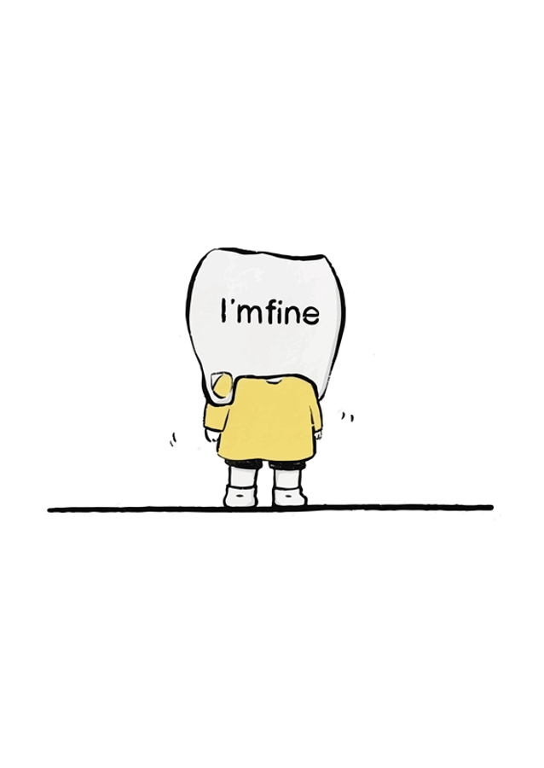
Nonverbal Communication Can Be Intentional or Unintentional
Sometimes we send nonverbal messages on purpose, and sometimes we send them without meaning to.
A person may try to appear pleasant, yet their facial expression may still reveal frustration unintentionally.
Example
You say “I’m fine,” but your tone and expression show annoyance, even if you didn’t mean to.

Slide 16
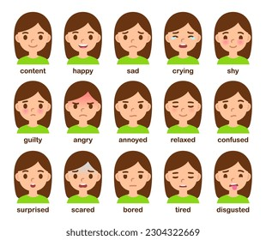
Nonverbal Messages Communicate Feelings and Attitudes
According to a previous study, most emotional meaning in communication comes from nonverbal cues such as facial expressions, tone, and posture.
People understand how you feel more from your body language than your words.
Example
Someone saying “I’m happy to be here” while looking bored
The audience believes the body, not the words.

Slide 17

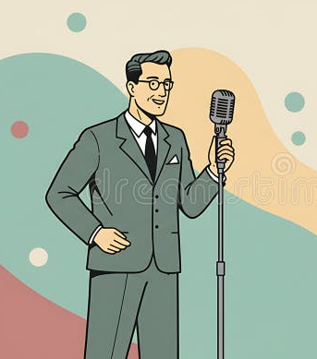
Nonverbal Communication Is Key in the Speaker/Audience Relationship
When a speaker and audience first meet, nonverbal communication like posture, eye contact, dress, and movement influence first impressions.
These impressions contribute to the relationship and interaction between the speaker and audience.
Example
A speaker who stands confidently and makes eye contact seems prepared - even before speaking.

Slide 18
Types of Nonverbal Communication
Tishk International University
Faculty of Administrative Sciences and Economics
Business and Management Department
Space
Time
Physical characteristics
Body movements
Touch
Paralanguage
Artifacts
Environment

Slide 19
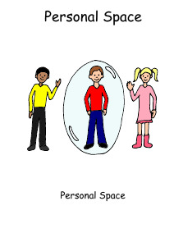
Space (The Personal Bubble)
Space is what???
The physical distance between people
Too close = awkward 😬
Too far = distant 😐
Different cultures and settings expect different personal space boundaries

Slide 20
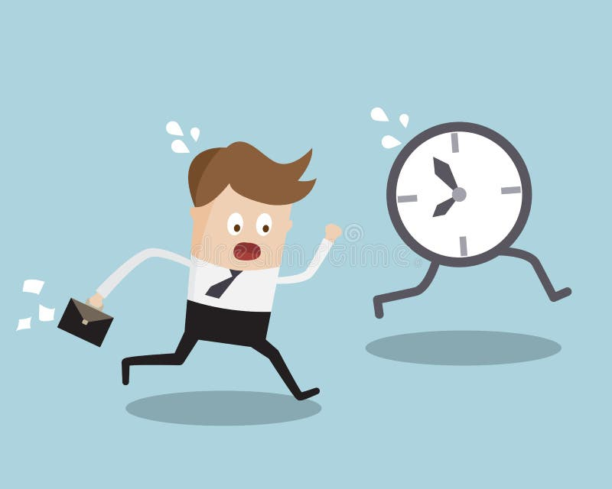
Time (Chronemics)
While some cultures view time as strict and punctual, others are more flexible.
In both cases:
How someone handles time shows how they feel about the situation or people.
Showing up late = sends a message
Ending late = also sends a message
Time = respect + priorities

Slide 21
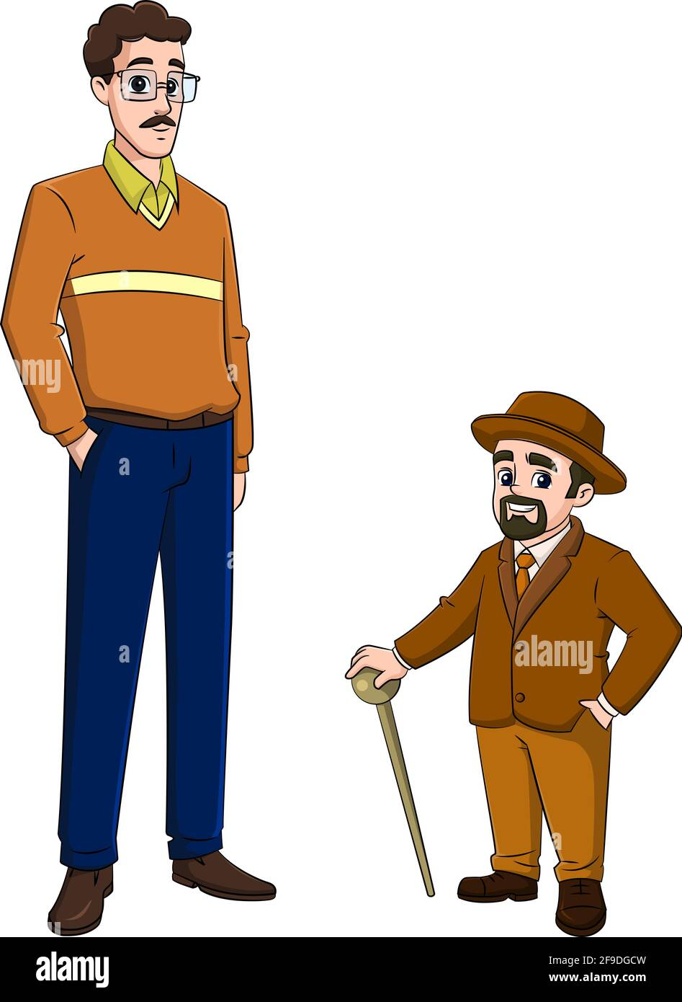
Physical Characteristics
Physical traits like eye color, height, or hair are mostly genetic, but people try to enhance appearance.
While you cannot choose many traits, confidence and comfort with yourself affect how others perceive you.
Example:
Someone who stands confidently and smiles appears more approachable, regardless of height or hair color.

Slide 22
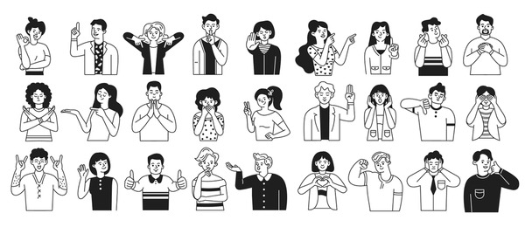
Body Movements
Gestures, posture, and facial expressions can repeat, support, or replace spoken words.
They can also help control conversations.
Your body “talks” along with your words.
Move with purpose
Example:
Nodding while someone is speaking communicates “I’m listening.”
Raising your hand, palm out, to someone signals “Stop for a moment.”

Slide 23
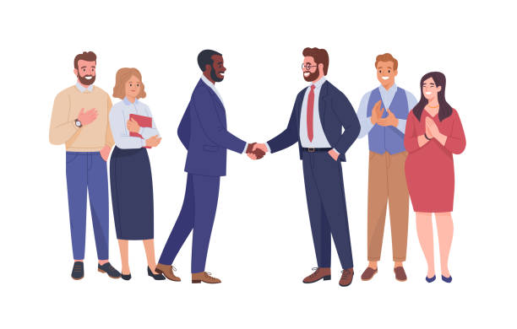
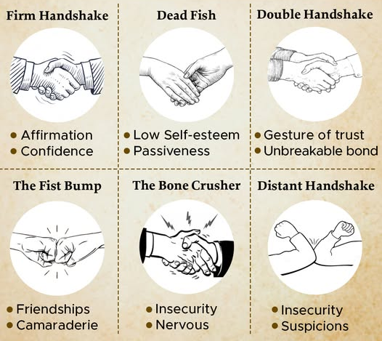
Touch (Haptics)
Touch communicates comfort, trust, or connection.
In professional speaking, touch typically occurs before or after presentations (handshakes), not during.
Clear Example:
Shaking hands before presenting helps establish trust and respect.

Slide 24
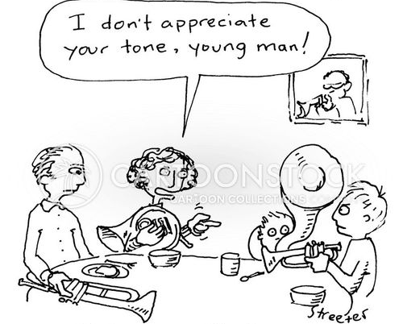
Paralanguage
Paralanguage refers to vocal elements such as tone, volume, pitch, speed, and silence.
How you say something affects what it means.
Example:
Saying “I’m great” in a flat, quiet voice means something different than saying it cheerfully.

Slide 25
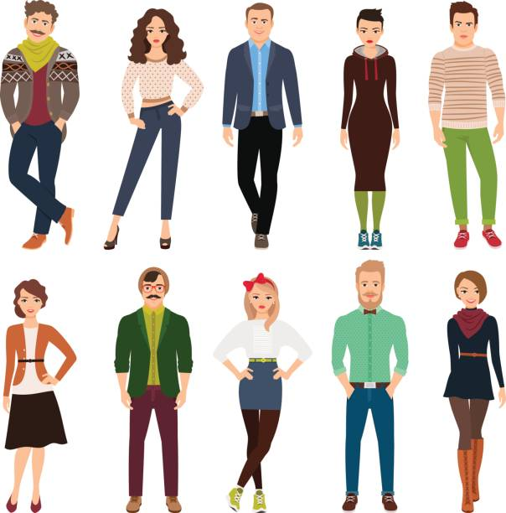
Artifacts
Artifacts are items or accessories that express identity — like clothing, jewelry, tattoos, brand logos, or personal style.
They communicate personality or group membership.
What you wear and carry says something about you.

Slide 26


Environment
Environment includes the physical and psychological setting of communication.
The design of a place affects how people behave and interact.
Google’s offices are designed with open spaces and bright colors to encourage creativity and teamwork.

Slide 27

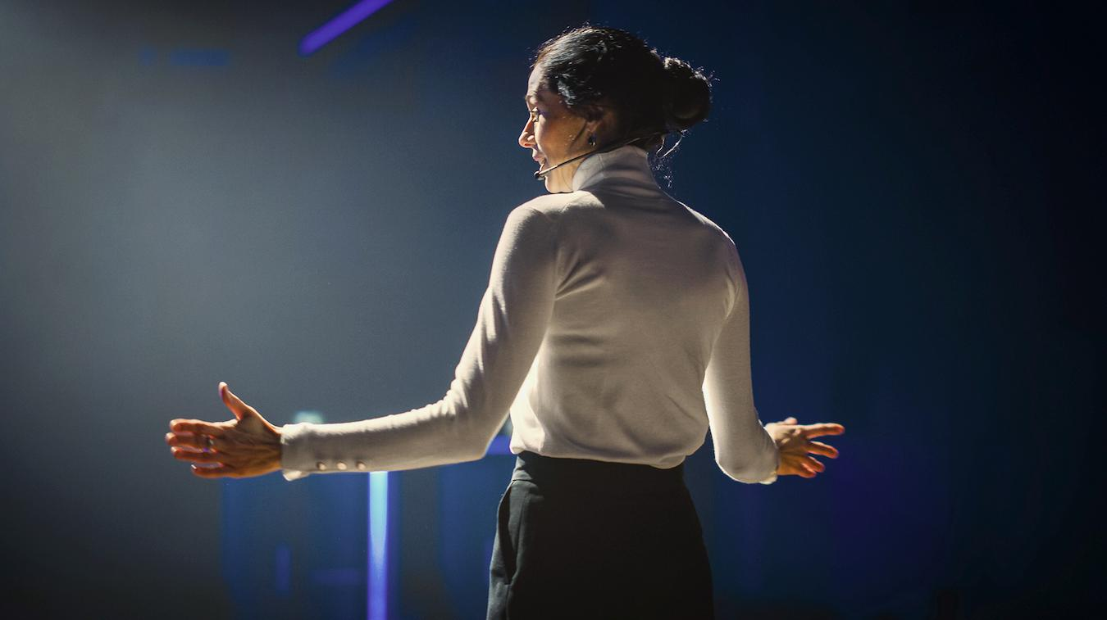
Movement in your speech
Speech is inevitable (gonna happen)
Movement plays a meaningful role in public speaking because it affects how confident, credible, and engaging you appear.
Audience can listen or ignore based on the movement

Slide 28



Behaviors to
Some physical habits can undermine your message.
For example:
Staying rigidly behind a podium or clinging to it
Crossing your arms defensively
Shuffling your feet or pacing aimlessly
Rocking back and forth
These behaviors can signal nervousness or discomfort, causing the audience to focus on your movements instead of your ideas.

Slide 29

Using Movement Purposefully
Effective movement is intentional.
This may include:
Stepping toward the audience to emphasize an important point.
Moving to a different position to shift between main ideas.
Adjusting your distance from the audience based on setting and context.

Slide 30
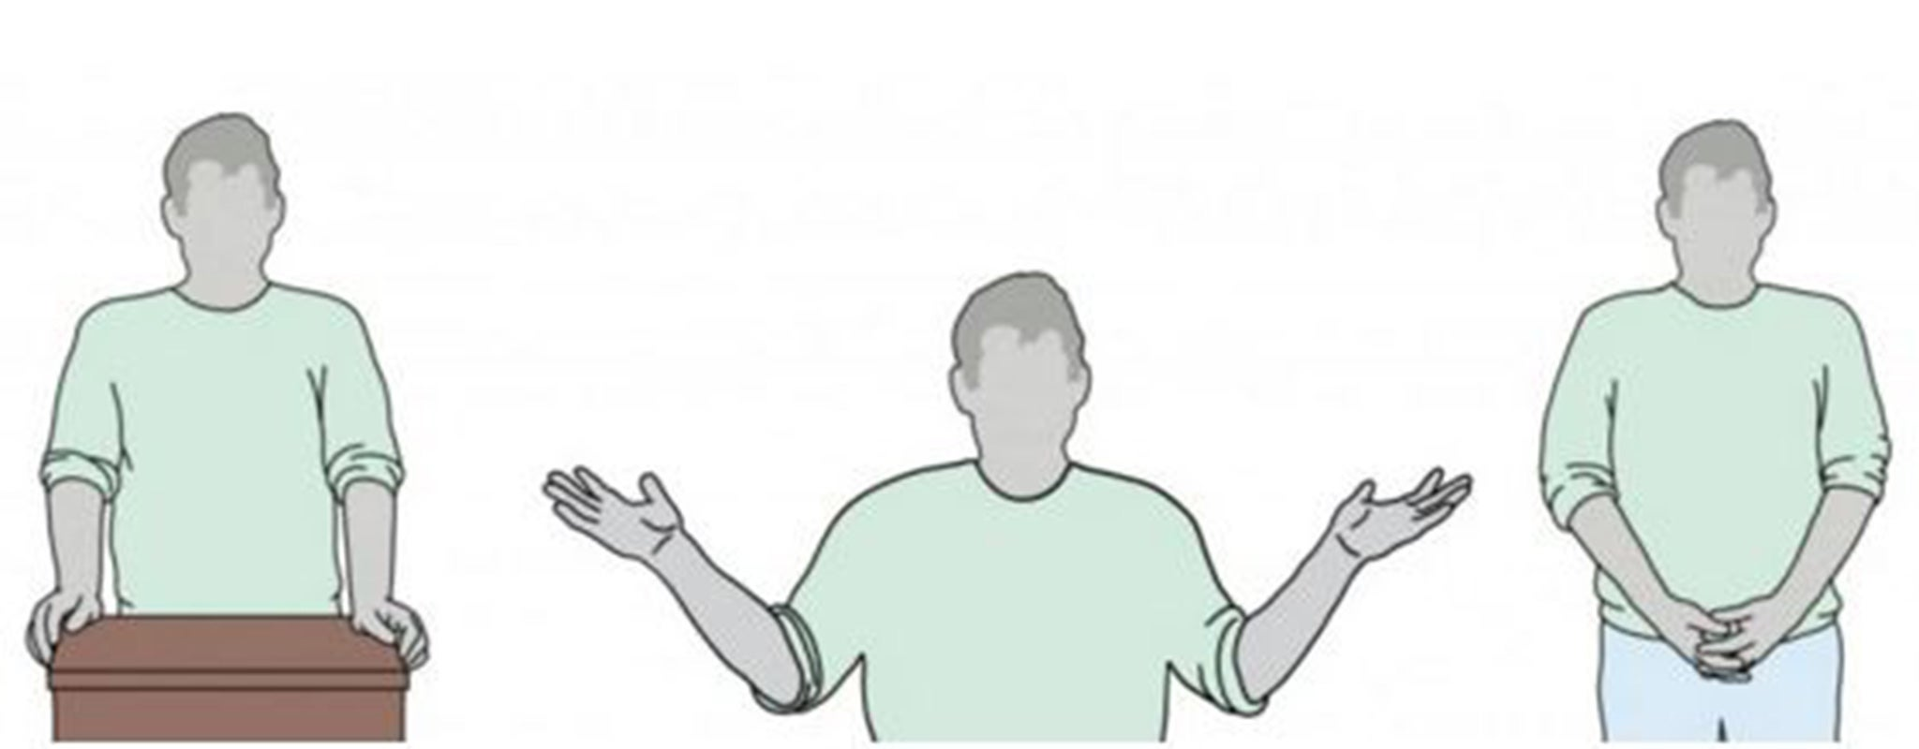
Gestures
In speeches, gestures can:
Reinforce main points
Help direct audience attention
Release physical tension in a productive way.
Professional speakers often use a three-step approach:
Anticipation: Slightly raising the hand before the key point
Implementation: Making the gesture to highlight the idea (e.g., raising the palm forward to signal “stop”)
Relaxation: Gently lowering the hand to rest position

Slide 31
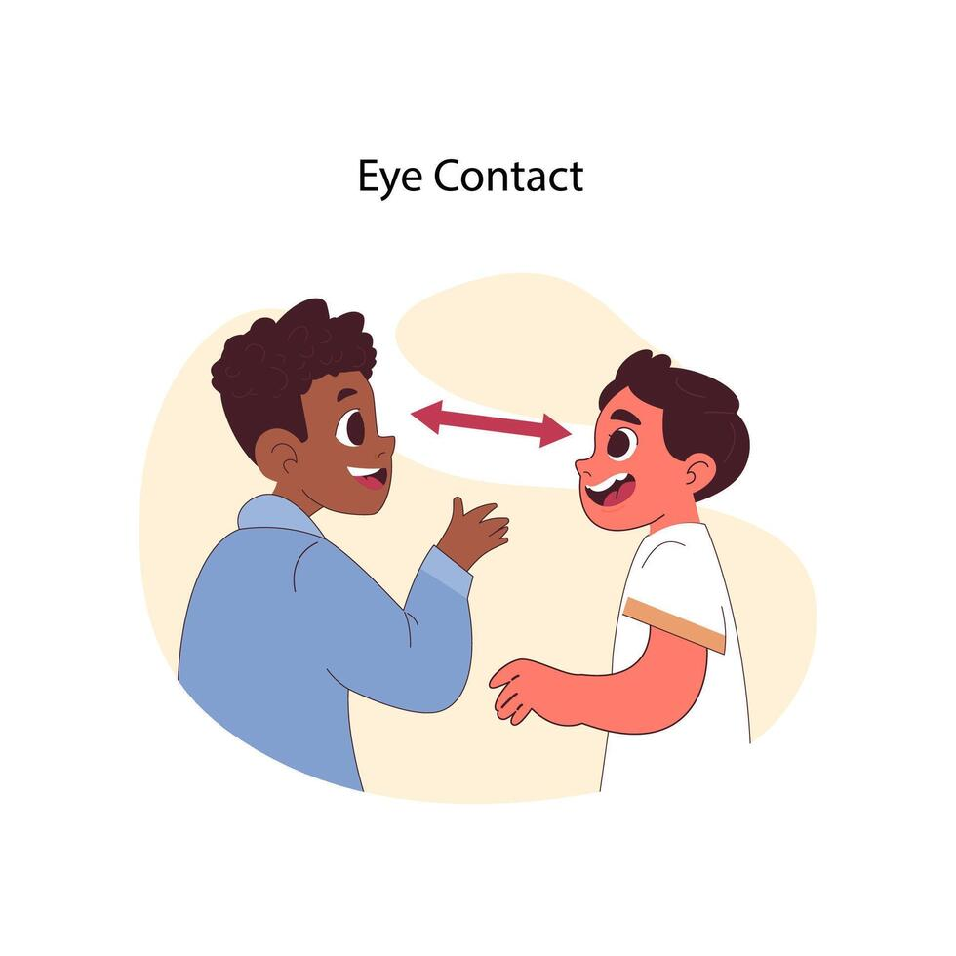
Facial Gestures and Eye Contact
Our facial expressions communicate emotion, tone, and attitude. They can enhance, contradict, or soften your spoken message.
For example:
Smiling supports humor or friendliness
A serious expression supports solemn or sensitive subjects
Eye contact helps create connection and conveys that you are engaged with your audience.
However, what is considered “appropriate” eye contact depends on cultural expectations. When speaking:
Avoid staring at only one person
Do not look above the audience or at the floor
Let your eyes move naturally across the room

Slide 32
Non-verbal Strategies
1. Watch Reactions
Observing your audience helps you understand how they respond to your message. Their posture, facial expressions, and engagement cues can tell you whether your message is reaching them.
2. Enroll an Observer
Ask a colleague or trusted listener to watch your presentation and offer feedback. They may notice distracting habits or missed opportunities for stronger connection.
3. Focus on One Nonverbal Behavior at a Time
It can be overwhelming to change everything at once. Choose one element—such as pacing, gesture use, or eye contact—and work on improving it first. Gradual adjustment leads to more natural and lasting improvement.

