Slide 1

PRINCIPLE OF CRYPTOGRAPHY
NAME: Assistant Prof. Dr. Saman Mirza Abdualalh saman.mirza@tiu.edu.iq
This Photo by Unknown Author is licensed under CC BY-SA

Slide 2
Course Book Information
This course has been planed for 14 weeks:
One week as midterm exam. (25%)
Two weeks for Final-Exam. (40%)
A week for monthly Quiz Exam. (10%)
The week after midterm exam (not be repeated).
Other activities:
Class Participation. (5%)
Lab and Code. (Group) (10%)
Submission and discussion.
Lab Quiz. (Will be assigned) (10%)

Slide 3

Google Class Code

Slide 4
The plan of this course
Providing enough background on the principle of the cryptography in the field of the information security.
CompTIA Security+ Certificate.
The course deigned to introduce and discus:
Symmetric Key Encryption methods. (Some).
Asymmetric Key Encryption methods. (Major).
Cryptographic Data Integrity methods. (Few but major)
Key Distribution systems (Mutual Trust). (If time allowed)

Slide 5
Course Objectives
Introducing the concept of Encryption under Cybersecurity.
Categorizing the Symmetric and and Asymmetric Encryption algorithms.
Describing and designing message authentication and digital signature security services.
Presenting Cryptographic Key Management and Distribution.

Slide 6
Objectives / Class 1-A
Defining the terms cybersecurity, information security and network security.
Describe the three key objectives that at the hart of the information and network security.
Presenting the security OSI layers and standards.
Security attack, security mechanisms, and security services.

Slide 7
Cybersecurity Definition.
It is the protection of information that is stored, transmitted, and processed in a networked system of computers, other digital devices, and network devices and transmission lines, including the Internet.
Protection includes confidentiality, integrity, availability, authenticity, and accountability.
Methods of protection include:
Organizational policies and procedures, as well as
Technical means such as encryption and secure communications protocols.

Slide 8
Introduction Network Security & Information Security
They are subsets of cyber security.
Information security : This term refers to preservation of confidentiality, integrity, and availability of information. In addition, other properties, such as authenticity, accountability, nonrepudiation, and reliability can also be involved.
Network security : This term refers to protection of networks and their services from unauthorized modification, destruction, or disclosure, and provision of assurance that the network performs its critical functions correctly and there are no harmful side effects.
Notes:
Network security means keeping a computer network and its services safe so nobody can change, destroy, or steal its data, and making sure the network keeps working correctly with no harmful surprises.

Slide 9
Second Objectives
Describe the three key objectives that at the hart of the information and network security.

Slide 10
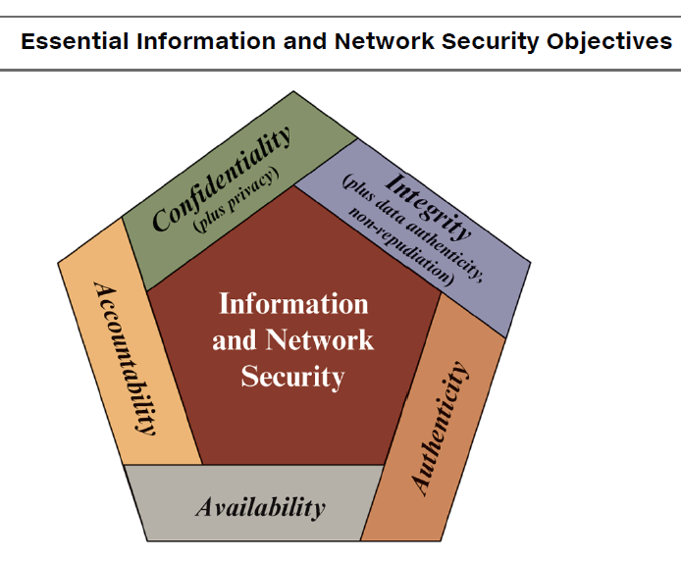
Security Objectives
The cybersecurity definition introduces three key objectives that are at the heart of information and network security:
Confidentiality.
Integrity.
Availability
It calls (CIA) triad or level.

Slide 11
Security Objectives Confidentiality
Covers two concepts:
Data Confidentiality :
Assures that private or confidential information is not made available or disclosed to unauthorized individuals.
Data Privacy:
Assure that individuals can control and influence the information related to them, and only them can collect and store their information.
Moreover, only them can decide by whom and to whom their information may be disclosed.
Notes:
Privacy:
You can decide what information others collect about you.
You can decide who stores that information.
You can decide who is allowed to see or receive it.

Slide 12
Security Objectives Integrity
Covers three concepts:
Data Integrity:
Assures that data (both stored and in transmitted packets) and programs are changed only in a specified and authorized manner.
Data Authenticity:
Assures that the sender of information is provided with proof of delivery and the recipient is provided with proof of the sender’s identity, so neither can later deny having processed the information. (Nonrepudiation)

Slide 13
Security Objectives Integrity
System Integrity:
Assures that a system performs its intended function in an unaffected manner, free from unintended and unauthorized manipulation of the system

Slide 14
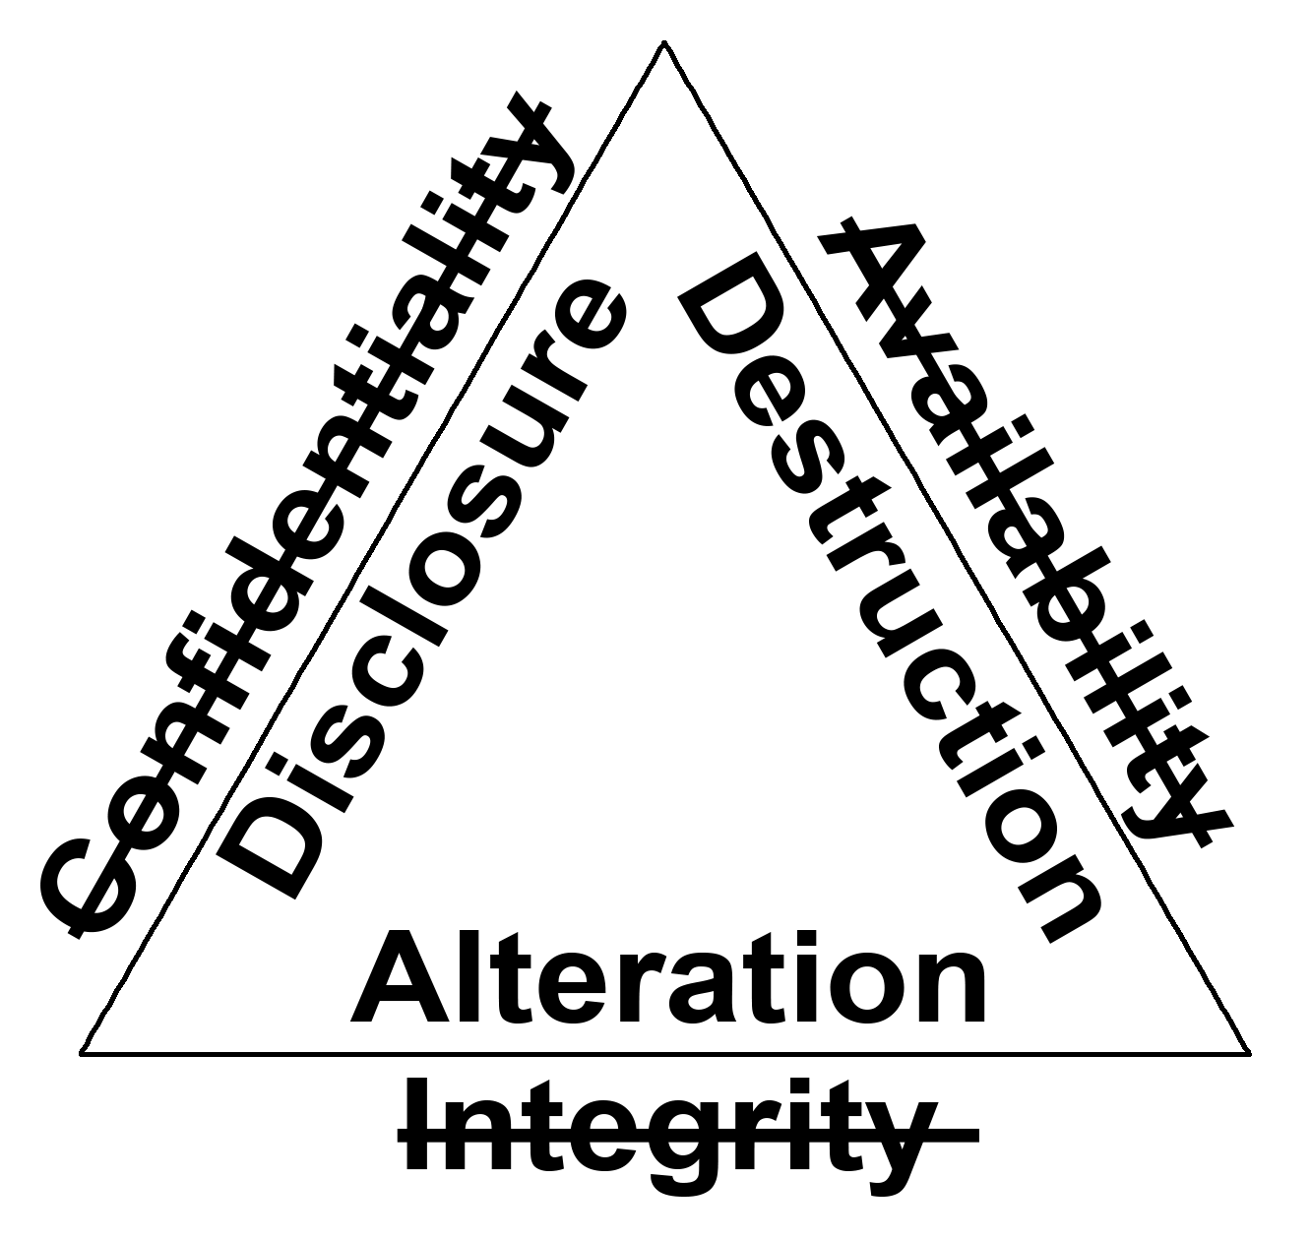
Loss of CIA
Confidentiality: A loss of confidentiality is the unauthorized disclosure of information.
Integrity: A loss of integrity is the unauthorized modification or destruction of information.
Availability: A loss of availability is the disruption of access to or use of information or an information system.

Slide 15
Third Objectives
Presenting the security OSI layers and standards.
Security attack, security mechanisms, and security services.

Slide 16
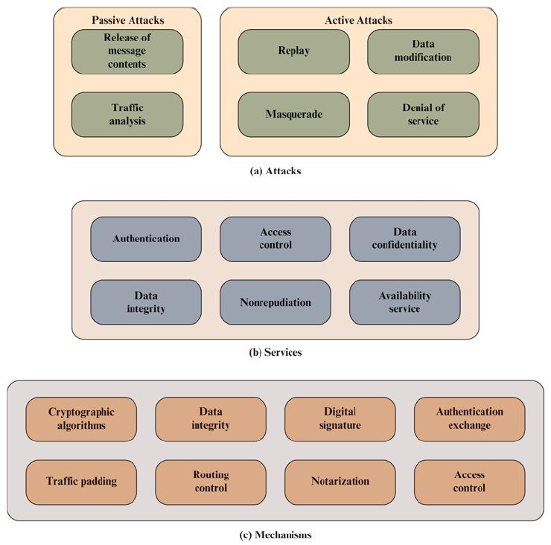
Security Architecture Model OSI (Open System Interconnection)
Any security system is consisting of three levels:
Security attack : Any action that compromises the security of information owned by an organization.
Security mechanism : A process (or a device incorporating such a process) that is designed to detect, prevent, or recover from a security attack.
Security service : A processing or communication service that enhances the security of the data processing systems and the information transfers of an organization. The services are intended to counter security attacks, and they make use of one or more security mechanisms to provide the service.

Slide 17
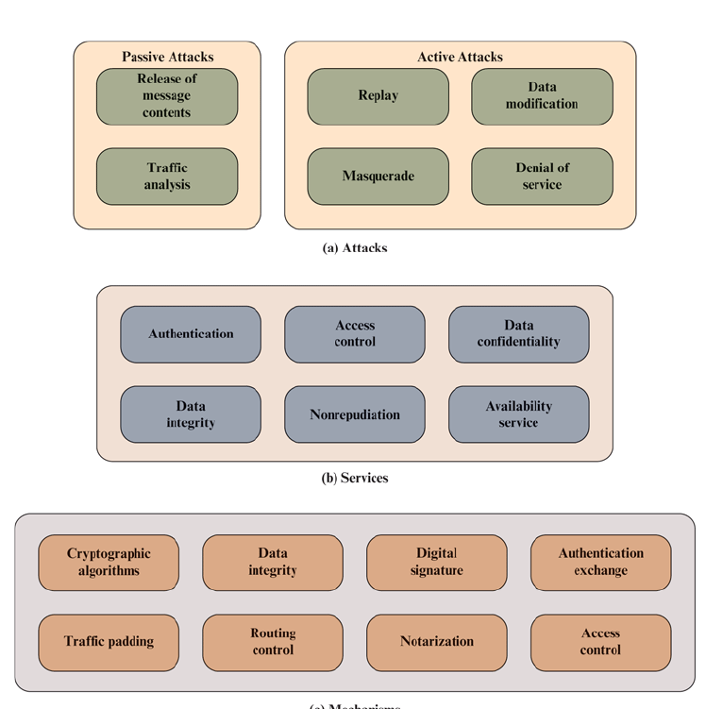
Threats VS Attack
Attacks are any kind of malicious activity that attempts to collect, disrupt, deny, degrade, or destroy information system resources or the information itself.
Threats are weaknesses, faults, or vulnerabilities that misused by unauthorized user for malicious purposes.

Slide 18
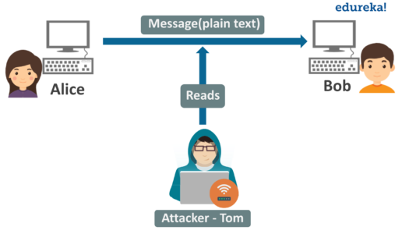
Security Attacks
Security attack has two types:
Passive attacks are eavesdropping on, or monitoring of, transmissions. The goal of the opponent is to obtain information that is being transmitted.
They do:
Release of message contents.
Traffic monitoring.

Slide 19
Security Attacks Passive Attacks
Can see the message.
Can analyze traffic to understand or predict something about the message.
It is very hard to detect, as no changes detected from the message.
Encryption can prevent such attacks.
It uses to understand or to know the possible threats.

Slide 20
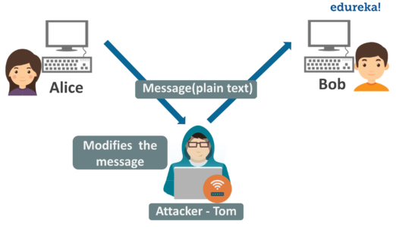
Security Attacks
Security attack has two types:
Active attacks
Involve some modification of the data stream or the creation of a false stream and can be subdivided into four categories:
Masquerade.
Replay.
Modification of messages.
Denial of service.

Slide 21
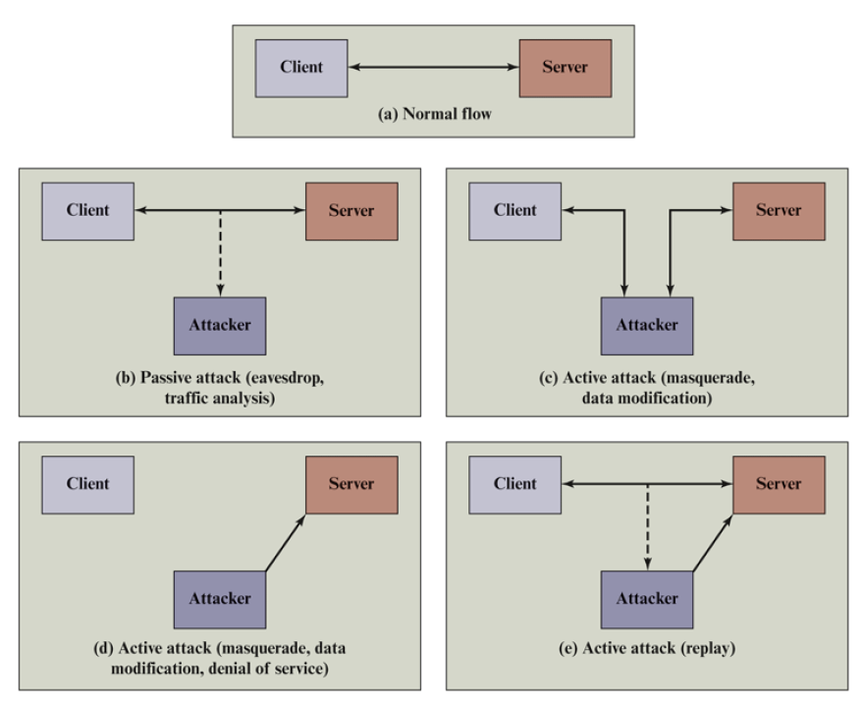
Types of Attack
Eavesdrop attack
Traffic analysis (sniffing)
Masquerade attack.
Data modification attack.
Man in the middle attack
Denial of service.
Replay

Slide 22
Security Services
A security service is a capability that supports one or more of the security requirements (confidentiality, integrity, availability, authenticity, and accountability).
Security services:
Implement security policies, and are
Implemented by security mechanisms.

Slide 23
Security Services Authentication
This service is concerned with assuring that a communication is authentic.
The service must assure that The communicated entities are authenticated.
The service must assure that the connection is not interfered.
Preventing Masquerading or replay attack.

Slide 24
Security Services Access Control
In the context of network security, access control is the ability to limit and control the access to host systems and applications via communications links.
Preventing denial of service attacks.

Slide 25
Security Services Data Confidentiality
Data Confidentiality is the protection of transmitted data from passive attacks.
Transmitted information.
Information related to packets.
Preventing sniffing attacks.

Slide 26
Security Services Data Integrity
Data integrity service deals with a stream of messages, assures that messages are received as sent with no duplication, insertion, modification, reordering, or replays
Preventing data modification attacks.

Slide 27
Security Services Nonrepudiation
Nonrepudiation prevents either sender or receiver from denying a transmitted message.
Preventing replay attacks.

Slide 28
Security Services Availability Service
Availability is the property of a system, or a system resource being accessible and usable upon demand by an authorized system entity, according to performance specifications for the system
This means, a system is available if it provides services according to the system design whenever users request them.
Preventing denial-of-service attacks.

Slide 29
Security Mechanisms
Security mechanisms are techniques or tools employed to detect, prevent, or respond to security attacks and ensure the protection of data and systems.
Cryptographic algorithms : Makes messages unreadable.
Reversible cryptographic mechanisms and
Irreversible cryptographic mechanisms.

Slide 30
Security Mechanisms
Data integrity : This category covers a variety of mechanisms used to assure the integrity of a data unit or stream of data units.
Digital signature: Data appended to, or a cryptographic transformation of, a data unit that allows a recipient of the data unit to prove the source and integrity of the data unit and protect against forgery.
Authentication exchange : A mechanism intended to ensure the identity of an entity by means of information exchange.
Traffic padding: The insertion of bits into gaps in a data stream to frustrate traffic analysis attempts.

Slide 31
Security Mechanisms
Routing control : Enables selection of physically or logically secure routes for certain data and allows routing changes, especially when a breach of security is suspected.
Notarization : The use of a trusted third party to assure certain properties of a data exchange.
Access control : A variety of mechanisms that enforce access rights to resources.

Slide 32

CLASS is Over

