Slide 1

PRINCIPLE OF CRYPTOGRAPHY
NAME: Assistant Prof. Dr. Saman Mirza Abdualalh
saman.mirza@tiu.edu.iq
This Photo by Unknown Author is licensed under CC BY-SA

Slide 2
Class Objective
After this class, you should be able to:
Present an overview of the main concepts of Encryption Systems.
Explain the difference between cryptanalysis and brute-force attack.
Understanding the requirements and characterizes of symmetric cipher systems.
Defining two different type of attacks on symmetric systems.
Describing the main transforming process.
Explaining Caesar ciphering, deciphering, and possible attacks.

Slide 3
Introduction
Cryptography
The branch of cryptology dealing with the design of algorithms for encryption and decryption, intended to ensure the secrecy and/or authenticity of messages.
It is a branch of mathematics that deals with the transformation of data.
Cryptographic algorithms are used in many ways in information security and network security.
  Securing storage data.
  Securing transmitted data.
  Securing the communication between two parties.

Slide 4
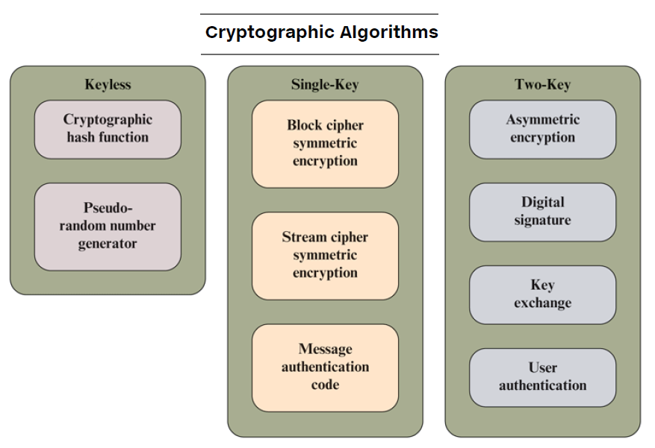
Cryptography
Is technique of securing information and communications using codes so that only those person for whom the information is intended can understand and process it.
Cryptography can be classified based on:
  Reversible and irreversible.
  Transposition and Substitution.
  Single-key, two-key, and less key.
  Block ciphering and stream ciphering.
  Symmetric and Asymmetric.

Slide 5
Introduction
Symmetric Encryption
Single-key encryption, also known as Symmetric encryption , or referred to as conventional encryption.
Symmetric encryption is a cryptographic method where the same key is used for both encrypting and decrypting information.
  This key must be kept secret and shared only between authorized parties.
  Symmetric encryption is known for being fast and efficient, making it suitable for encrypting large volumes of data.
Key Features:
  Single Key: The same key is used for both encryption and decryption.
  Fast Processing: Ideal for encrypting large datasets due to its speed.
  Shared Secret: The key must be securely distributed and kept confidential to ensure security.
Common Algorithms:
  AES (Advanced Encryption Standard)
  DES (Data Encryption Standard)
  3DES (Triple DES)

Slide 6
Terminology
Cryptography: is the study of algorithms that used for Encryption.
The system that used one or more algorithms covered by Cryptography studies, called Cryptographic System or Cipher.
Techniques used for deciphering a message without any knowledge of the enciphering details fall into the area of Cryptanalysis.
The areas of cryptography and cryptanalysis together are called Cryptology.
A process that converts the plaintext to ciphertext
ABC
Original Message
Enciphering
OR
Encryption
#@?
Coded Message
Plaintext
Ciphertext
Deciphering
OR
Decryption
The process that restoring the ciphertext to plaintext

Slide 7
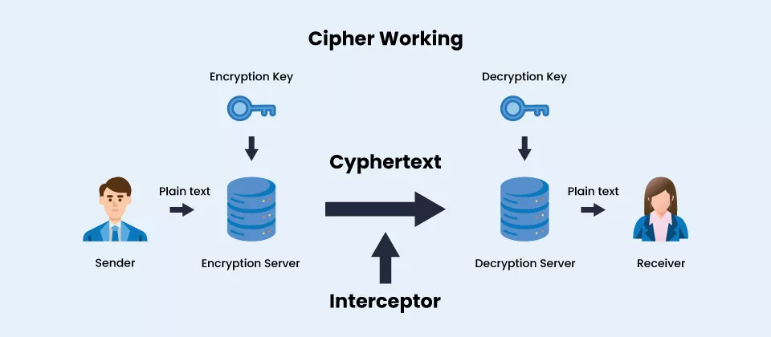

Slide 8
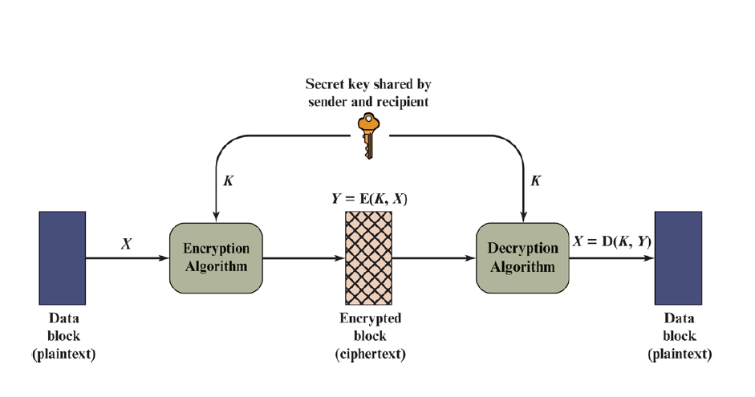
Introduction (Symmetric Ciphering Model)
Symmetric Cipher model, as shown in the figure, has five components:
  Plaintext: This is the original intelligible message or data that is fed into the algorithm as input.
  Encryption algorithm: The encryption algorithm performs various substitutions and transformations on the plaintext.

Slide 9
Introduction (Symmetric Ciphering Model)
Secret key: The secret key is also input to the encryption algorithm.
    The key is a value independent of the plaintext and of the algorithm.
    The algorithm will produce a different output depending on the specific key being used at the time.
    The exact substitutions and transformations performed by the algorithm depend on the key.

Slide 10
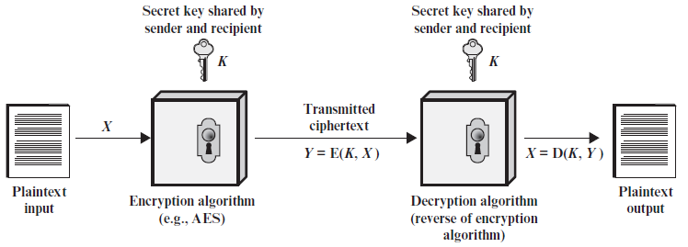
Introduction (Symmetric Ciphering Model)
Ciphertext: This is the scrambled message produced as output.
  It depends on the plaintext and the secret key.
  For a given message, two different keys will produce two different ciphertexts.
  The ciphertext is an apparently random stream of data and, as it stands, is unintelligible.

Slide 11
Introduction (Symmetric Ciphering Model)
Decryption algorithm: This is essentially the encryption algorithm run in reverse.
  It takes the ciphertext and the secret key and produces the original plaintext.

Slide 12
Introduction
(Securing Symmetric Systems)
Two requirements are necessary for making Symmetric Systems securable.
We need a strong encryption algorithm.
  The opponent couldn’t discover the key if he/she knows the algorithm and plaintext with many ciphertexts.
Sender and receiver must have obtained copies of the secret key in a secure fashion and must keep the key secure.
  If someone can discover the key and knows the algorithm, all communication using this key is readable.

Slide 13
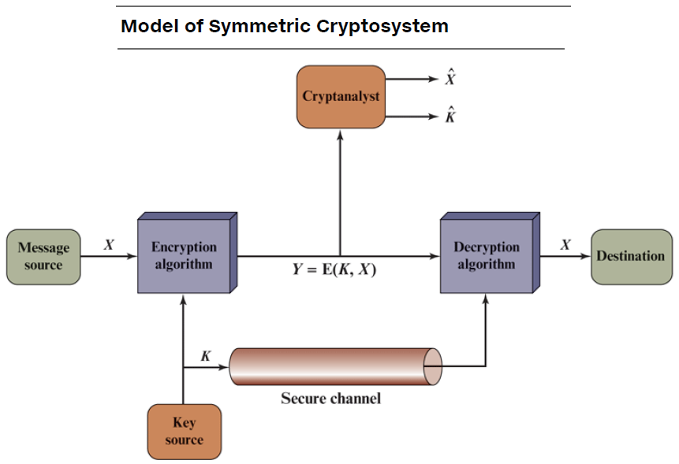
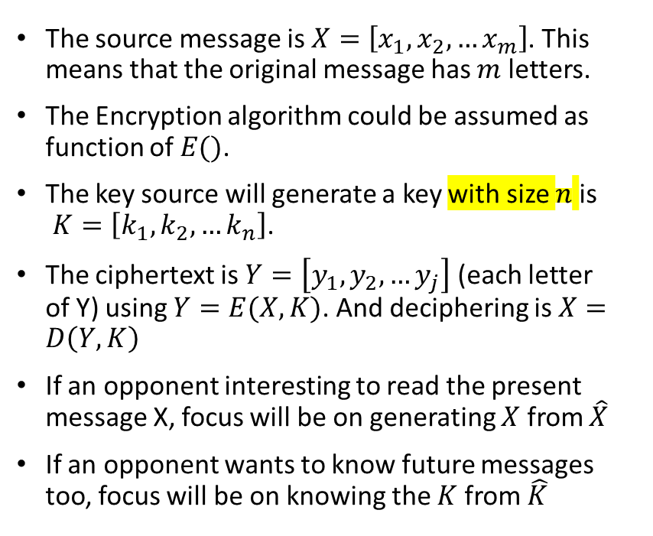
Introduction
Mathematical Notion of Symmetric Systems
The source message is $X=\left[x_{1}, x_{2}, …x_{m}\right]$. This means that the original message has $m$ letters.
The Encryption algorithm could be assumed as function of $E()$.
The key source will generate a key with size $n$ is
$K=\left[k_{1}, k_{2}, …k_{n}\right]$.
The ciphertext is $Y=\left[y_{1}, y_{2}, …y_{j}\right]$ (each letter of Y) using $Y=E(X,K)$. And deciphering is $X=D\left(Y,K\right)$
If an opponent interesting to read the present message X, focus will be on generating $X$ from $\hat{X}$
If an opponent wants to know future messages too, focus will be on knowing the $K$ from $\hat{K}$

Slide 14
Characteristics of Cryptographic Systems
Cryptographic systems are characterized along three independent dimensions: (How to differentiate an encryption algorithm from the others?).
  1. The type of operations used for transforming plaintext to ciphertext.
    All encryption algorithms are based on two general principles: substitution or transposition.
      Substitution; each element in the plaintext (bit, letter, group of bits or letters) is mapped into another element.
      Transposition, elements in the plaintext are rearranged.
    The fundamental requirement is that no information be lost (i.e., that all operations are reversible).
    Most algorithms, referred to as product systems, involve multiple stages of substitutions and transpositions.

Slide 15
Characteristics of Cryptographic Systems
2. The number of keys used. (Not the size of Key)
  If both sender and receiver use the same key, the system is referred to as symmetric, single-key, secret-key, or conventional encryption.
  If the sender and receiver use different keys, the system is referred to as asymmetric, two-key, or public-key encryption.
3. The way in which the plaintext is processed.
  A block cipher processes the input one block of elements at a time, producing an output block for each input block.
  A stream cipher processes the input elements continuously, producing output one element at a time, as it goes along.

Slide 16
Attack Type on Conventional Encryption
Cryptanalysis: Such attacks rely on
  The nature of the algorithm.
  Knowledge of the general characteristics of the plaintext.
  Some sample plaintext–ciphertext pairs.
    This type of attack exploits the characteristics of the algorithm to attempt to deduce a specific plaintext or to deduce the key being used.
Brute-force attack: The attacker tries every possible key on a piece of ciphertext until an intelligible translation into plaintext is obtained. On average, half of all possible keys must be tried to achieve success.

Slide 17
Transforming Process
Classical Ciphers
In the classical ciphering, there are two types of transforming Process:
  Substitution: Letters replaced with other letters or symbols. If the message is a stream of bits, a pattern of bits will be replaced with other pattern of bits.
  Transposition. Position or index of the plaintext letters will be changed.

Slide 18
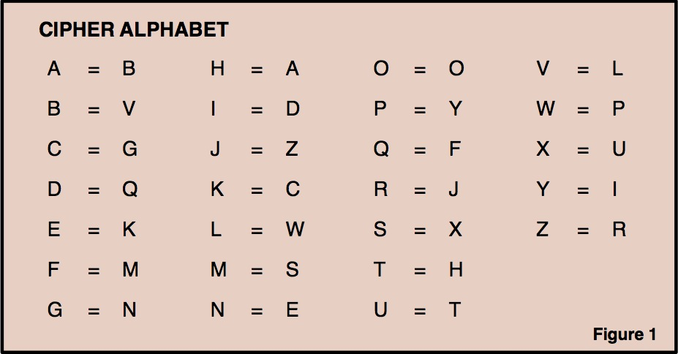
Transforming Process
Classical Ciphers-Substitution
Security
We need a table, as shown in Figure 1.
Assume we have “Security” as input to such process.
What output you expect?
Using more stages, this process could become more complex

Slide 19
Transforming Process
Classical Ciphers-Transposition
Security
1 | 2 | 3 | 4 | 5 | 6 | 7 | 8
We need a table, as shown in Figure.
Assume we have “Security” as input to such process.
What output you expect?
Using more stages, this process could become more complex
1 | 2 | 3 | 4 | 5 | 6 | 7 | 8

Slide 20

Caesar Cipher
Is a classical substitution cipher process.
The earliest known, and the simplest, use of a substitution cipher.
The Caesar cipher involves replacing each letter of the alphabet with the letter standing three places further down the alphabet.
Example

Slide 21
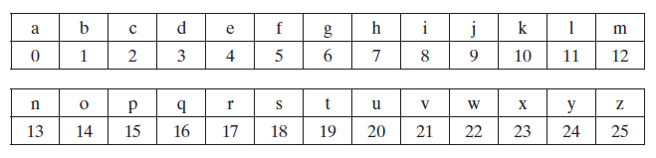
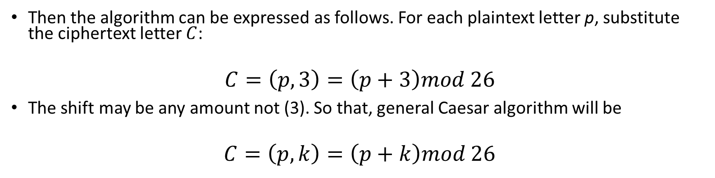
Caesar Cipher
If we assign a numeric for each letter:
Then the algorithm can be expressed as follows. For each plaintext letter p, substitute the ciphertext letter $C$:
$$C=\left(p,3\right)=\left(p+3\right)mod 26$$
The shift may be any amount not (3). So that, general Caesar algorithm will be
$$C=\left(p,k\right)=\left(p+k\right)mod 26$$

Slide 22
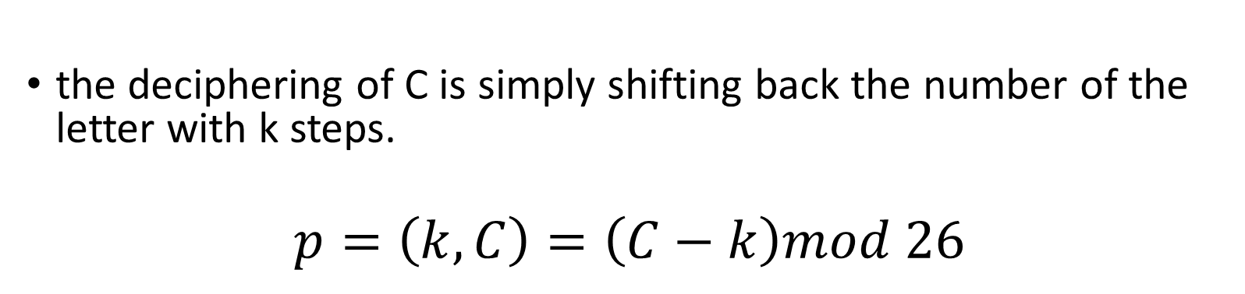
Caesar Decipher
If we assign a numeric for each letter:
the deciphering of C is simply shifting back the number of the letter with k steps.
$$p=\left(k,C\right)=\left(C−k\right)mod 26$$

Slide 23
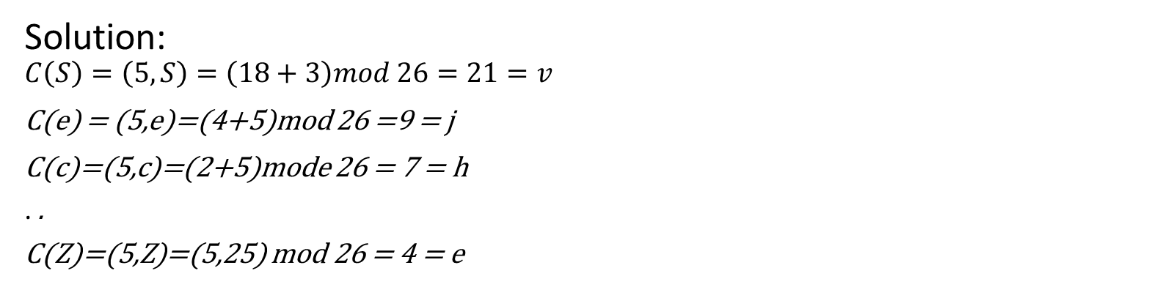
Caesar Cipher
Example: Encrypt the word “SecurityZM” using Caesar Cipher algorithm with $k=5$
Solution:
$$C\left(S\right)=\left(5,S\right)=\left(18+3\right)mod 26=21=v$$
C(e) = (5,e)=(4+5)mod 26 =9 = j
C(c)=(5,c)=(2+5)mode 26 = 7 = h
. .
C(Z)=(5,Z)=(5,25) mod 26 = 4 = e

Slide 24
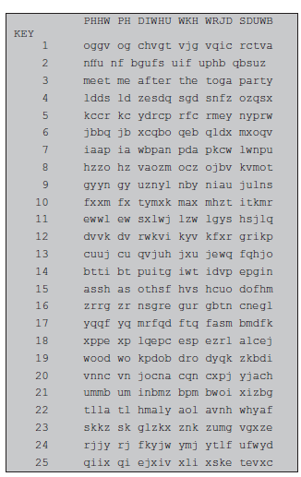
Possible Attack on Caesar Ciphering
With Caesar ciphering, the following is known:
  The algorithm (Mostly)
  There are only 25 possible keys.
  The language of plaintext is known and easily recognizable. (This one can make Caesar stronger?)
The Brute-force cryptanalysis is perfect.

Slide 25

CLASS is Over

