Slide 1

PRINCIPLE OF CRYPTOGRAPHY
NAME: Assistant Prof. Dr. Saman Mirza Abdualalh saman.mirza@tiu.edu.iq
This Photo by Unknown Author is licensed under CC BY-SA

Slide 2
Class Objective
The main objectives of this class are:
To show the weaknesses of Caesar, accordingly, introducing the Monoalphabetic method.
To explain the possible attacks on the Monoalphabetic method.
To introduce ciphering methods that accepts message size as two or more characters. (Playfair and Hill Ciphering methods )

Slide 3

Why not Caesar Ciphering?
With only 25 possible keys, the Caesar cipher is far from secure.
If “data security” ciphered with Caesar using key range “k=1,26” same cipher text will be generated.
Plaintext = datasecurity, K=1 , ciphertext=ebubtfdvsjuz
Plaintext= datasecurity, k=27, ciphertext=ebubtfdvsjuz
Caesar ciphering is not securable.
A brute-force attack can easily recover the key and plaintext.
There are many securable algorithms than Caesar, such as Monoalphabetic.

Slide 4
Monoalphabetic Ciphering (Introduction)
25 key space of Caesar in not adequate number.
We need to increase and expand the space of the key.
We can expand each key of Caesar ciphering to more than 26! (Factorial of 26).
For this expansion, we need to define Permutation.

Slide 5
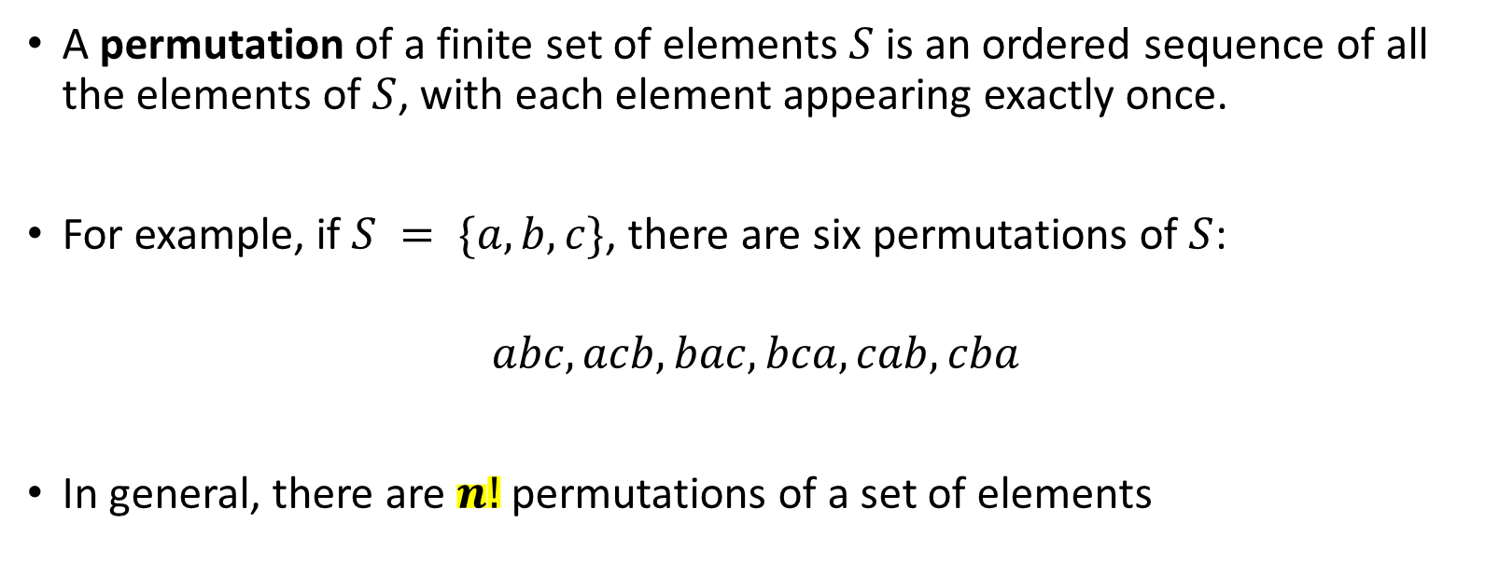
Monoalphabetic Ciphering (Introduction)
A permutation of a finite set of elements $S$ is an ordered sequence of all the elements of $S$, with each element appearing exactly once.
For example, if $S = \{a, b, c\}$, there are six permutations of $S$:
$$abc, acb, bac, bca, cab, cba$$
In general, there are $n!$permutations of a set of elements

Slide 6
Where is the idea?
The keys are not changed regularly; they are changed randomly.
The difference between k=3 to k=4 could be shown below:
Normal alphabet
A | B | C | D | E | F | G | H | I | J | K | L | M | N | O | P | Q | R | S | T | U | V | W | X | Y | Z
Caesar with k=3
X | Y | Z | A | B | C | D | E | F | G | H | I | J | K | L | M | N | O | P | Q | R | S | T | U | V | W
Caesar with k=4
W | X | Y | Z | A | B | C | D | E | F | G | H | I | J | K | L | M | N | O | P | Q | R | S | T | U | V
One permutation Monoalphabetic
Q | A | X | T | B | R | I | C | N | Y | H | S | D | G | L | J | E | K | M | F | O | V | Z | W | U | P

Slide 7
Attacks on Monoalphabetic
Because with monoalphabetic, there are more than 4x10²⁶ keys, brute-force is not adequate attack.
However, another line of attack , known as cryptanalyst, knows the nature of the plaintext (e.g., non-compressed English text), then the analyst can exploit the regularities of the language
If the nature of the language is known, the regularities of the language may be used for breaking the ciphertext.

Slide 8

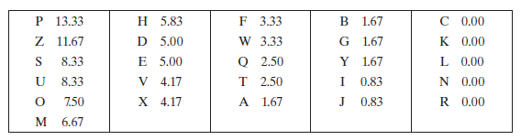
Example of Monoalphabetic attack
First, we will compute the frequency of each letter in the ciphertext.
F (P) = (16/120)x 100
F (P) = 13.33

Slide 9
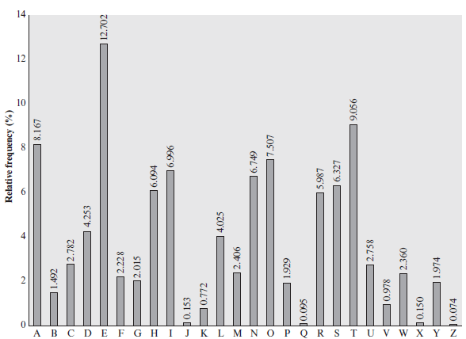
Example of Monoalphabetic attack
Compare ciphertext frequency with regular English language.

Slide 10
Disadvantages of Caesar and Monoalphabetic
Caesar and Monoalphabetic can read only one letter from the plaintext and encode it to ciphertext.
Therefore, the coding is having high time complexity and need memory spaces.
The solution is to read more than one letter at a time.
Playfair is the best-known multiple-letter encryption letter ciphering.

Slide 11
Introduction (Playfair Ciphering)
With Caesar and Monoalphabetic ciphering
Can read only one letter in the ciphertext.
Each letter in plaintext affect only one letter in the ciphertext.
Order of letters in the plaintext has no effect on the ciphertext.
Still attacks can reveal or disclose the plaintext.
We need a ciphering method that can
Keep the impact of the word structure on the encryption process.
can read multiple letters at a time.
One of the method is Playfair ciphering.

Slide 12
Keeping the impact of the word structure?
Changes of the plaintext’s word structure could be seen in the ciphertext through one of the following approaches:
One approach is to encrypt multiple letters of plaintext, such as (Playfair).
The other is to use multiple cipher alphabets

Slide 13
Playfair Method
The best-known multiple-letter encryption cipher is the Playfair, which treats digrams in the plaintext as single units and translates these units into ciphertext digrams.
Digram = Bigram = sequence of two letters.
Each time it reads two letters from the plaintext and encrypt them to two letters as ciphertext.

Slide 14
Playfair Method Procedure
Transforming the letters of the plaintext: (First Step)
Replace all J letters to I letters.
Write the plaintext in pairs of letter.
Separate any identical letters by a X.
If there is an odd letter at the end of plaintext add a X to the end.
Example:
Transform the given plaintext bellow so that it becomes ready for Playfair method encryption.
M= “datasecurityjournal”
1.a →datasecurityiournal
1.b → da ta se cu ri ty io ur na l
1.d → da ta se cu ri ty io ur na lx

Slide 15
Playfair Method Procedure
Create a (5 x 5) metrics, as below, for replacing letters
A | B | C | D | E
F | G | H | I / J | K
L | M | N | O | P
Q | R | S | T | U
V | W | X | Y | Z
S | E | C | U | R
I/J | T | Y | A | B
D | F | G | H | K
L | M | N | O | P
Q | V | W | X | Z
Without using key
While using “security” as key

Slide 16
Playfair Method Procedure
We have the following possibilities:
If letters on the same row.
If letters on the same column.
If letter on the different rows / columns.
Encryption process with THREE rules
da
ta
se
cu
ri
ty
io
ur
na
lx
hi
yb
ec
ur
sb
ya
al
rs
oy
qo
S | E | C | U | R
I/J | T | Y | A | B
D | F | G | H | K
L | M | N | O | P
Q | V | W | X | Z

Slide 17
How Playfair better than Monoalphabetic?
Playfair depends on pair of letters not single.
With Playfair, 26 x 26 = 676 digrams are possible.
Therefore, we can say that Playfair is 676 times are securable than Monoalphabetic ciphering against
However, still statistic frequency of letters can be used by attackers for revealing the original message.

Slide 18
Feature | Monoalphabetic Cipher | Playfair Cipher
Encryption Unit | Single letters (e.g., A → D) | Letter pairs (digraphs, e.g., HE → GR)
Key Space | 26! (extremely large) | Smaller, depends on the 5x5 matrix, (25!).
Frequency Patterns | Retains single-letter frequency patterns | Breaks single-letter patterns but retains digraph patterns
Ease of Breaking | Easily broken using single-letter frequency analysis | Harder to break, but digraph frequency analysis can still be effective
Key Structure | Substitution table (simple mapping for 26 letters) | 5x5 matrix derived from a keyword
Vulnerability to Brute Force | Large key space makes brute force infeasible but irrelevant due to frequency patterns | Smaller key space but more secure due to encryption of digraphs
Repetition Handling | Does not break repeated letters (e.g., LL → KK) | Breaks repetitions using filler letters (e.g., LL → KF)
Security Level | Low, due to clear patterns in ciphertext | Moderate, due to digraph encryption masking patterns
Practical Use | Rarely used due to low security | More secure than monoalphabetic but obsolete for modern encryption
Here's a simple comparison between Monoalphabetic Cipher and Playfair Cipher in table format:

Slide 19

Hill Ciphering Algorithm
Playfair can take only two letters. If we need m letter, this algorithm doesn't work.
Hill ciphering algorithm is the solution.
The concept is $K^{−1}×K=I$
It is a mathematical based algorithm.
it can replace m letters of plaintext to m letters of ciphertext using metrics operations.
The substitution is determined by m linear equations in which each character is assigned a numerical value (a = 0, b = 1, c, z = 25).

Slide 20

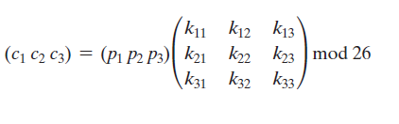
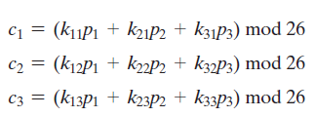
Hill Ciphering Algorithm
For m = 3, the system can be described as.

Slide 21
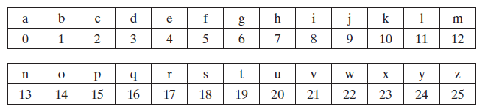
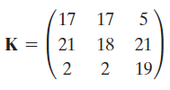

Example:
We still using the index of each alphabet. A=0, B=1, C=2…Z=25
Build the input metrics. Look at the size of the key to know the value of m.
Replace each letter with its index. Find the metrics P.
The metrics K is given always.
Find C.
Use Hill ciphering algorithm to encrypt “paymoremoney”
based on the key given below.

Slide 22
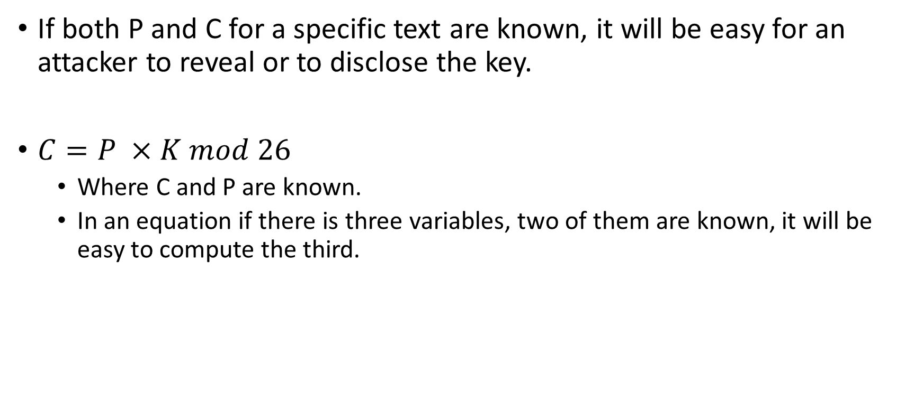
Attack on Hill Ciphering
If both P and C for a specific text are known, it will be easy for an attacker to reveal or to disclose the key.
$C=P ×K mod 26$
Where C and P are known.
In an equation if there is three variables, two of them are known, it will be easy to compute the third.

Slide 23
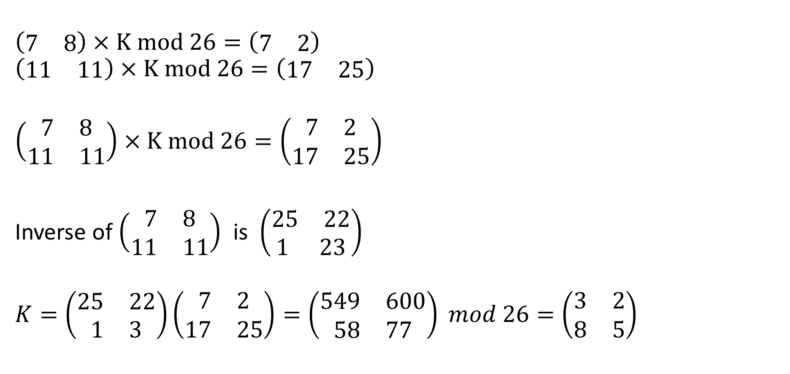
Attack on Hill Ciphering _ Example
$$\left(\begin{matrix}7 & 8\end{matrix}\right)×K mod 26=\left(\begin{matrix}7 & 2\end{matrix}\right)$$
$$\left(\begin{matrix}11 & 11\end{matrix}\right)×K mod 26=\left(\begin{matrix}17 & 25\end{matrix}\right)$$
$$\left(\begin{aligned}\begin{matrix}7 & 8\end{matrix} \\ \begin{matrix}11 & 11\end{matrix}\end{aligned}\right)×K mod 26=\left(\begin{aligned}\begin{matrix}7 & 2\end{matrix} \\ \begin{matrix}17 & 25\end{matrix}\end{aligned}\right)$$
Inverse of $\left(\begin{aligned}\begin{matrix}7 & 8\end{matrix} \\ \begin{matrix}11 & 11\end{matrix}\end{aligned}\right)$ is $\left(\begin{aligned}\begin{matrix}25 & 22\end{matrix} \\ \begin{matrix}1 & 23\end{matrix}\end{aligned}\right)$
$$K=\left(\begin{aligned}\begin{matrix}25 & 22\end{matrix} \\ \begin{matrix}1 & 3\end{matrix}\end{aligned}\right)\left(\begin{aligned}\begin{matrix}7 & 2\end{matrix} \\ \begin{matrix}17 & 25\end{matrix}\end{aligned}\right)=\left(\begin{aligned}\begin{matrix}549 & 600\end{matrix} \\ \begin{matrix}58 & 77\end{matrix}\end{aligned}\right) mod 26=\left(\begin{aligned}\begin{matrix}3 & 2\end{matrix} \\ \begin{matrix}8 & 5\end{matrix}\end{aligned}\right)$$
This is the key

Slide 24

CLASS is
END

