Slide 1

Social Structure Part 2
Dr. Salih A Abdulla
Sociology for Nurses
Fall Semester
Week 3
2025-2026

Slide 2
LEARNING OBJECTIVES
After reading this chapter, students will be able to:
• Develop good knowledge on basics of personal disorganizations
• Be also to implement the knowledge in their clinical practice
• Know about characteristics of conflict
• Learn the effects of conflict
• Become aware of the types and characteristics of social group

Slide 3
Outline
Introduction
Personal disorganization
Conflict
Social groups

Slide 4
PERSONAL DISORGANIZATION
Personal disorganization represents the behavior of an individual, when the behavior of any person deviates from social norms, where the individual is not able to adjust with society anymore and it disturbs the life of an individual, the condition is called personal disorganization.

Slide 5
Definition
Personal disorganization is defined as the individual’s behavior which deviates from the social norms results in the social disapproval.

Slide 6
Types of Personal Disorganization
• Situational disorganization
A student fails an important exam and feels confused and stressed for a while
• Habitual disorganization
A worker always forgets deadlines because of poor time management.
• Historical disorganization
A person who grew up in a violent home struggles to trust others in adulthood

Slide 7
Comparison table of the three types of personal
disorganization
Type | Cause | Nature | Example
Situational Disorganization | Sudden or unexpected life events (crisis, accident, loss) | Temporary; person can recover after situation improves | Losing a job and feeling unstable until a new one is found
Habitual Disorganization | Poor habits, lack of planning, negligence | Continuous; becomes part of daily lifestyle | Always late to work due to poor time management
Historical Disorganization | Past traumatic experiences, broken family background, unresolved conflicts | Deep-rooted; long-term and may need therapy | A person from an abusive childhood struggling to form healthy relationships

Slide 8
Effects of Personal Disorganization
• Physical health effects: Hypertension, Heart attack, Headache, Heart diseases, Gastro-intestinal problems, etc.
• Psychological effects: Fear of uncertainty, Anxiety, Lack of concentration or Absent mindedness, Depression, Poor sleep pattern, etc.

Slide 9
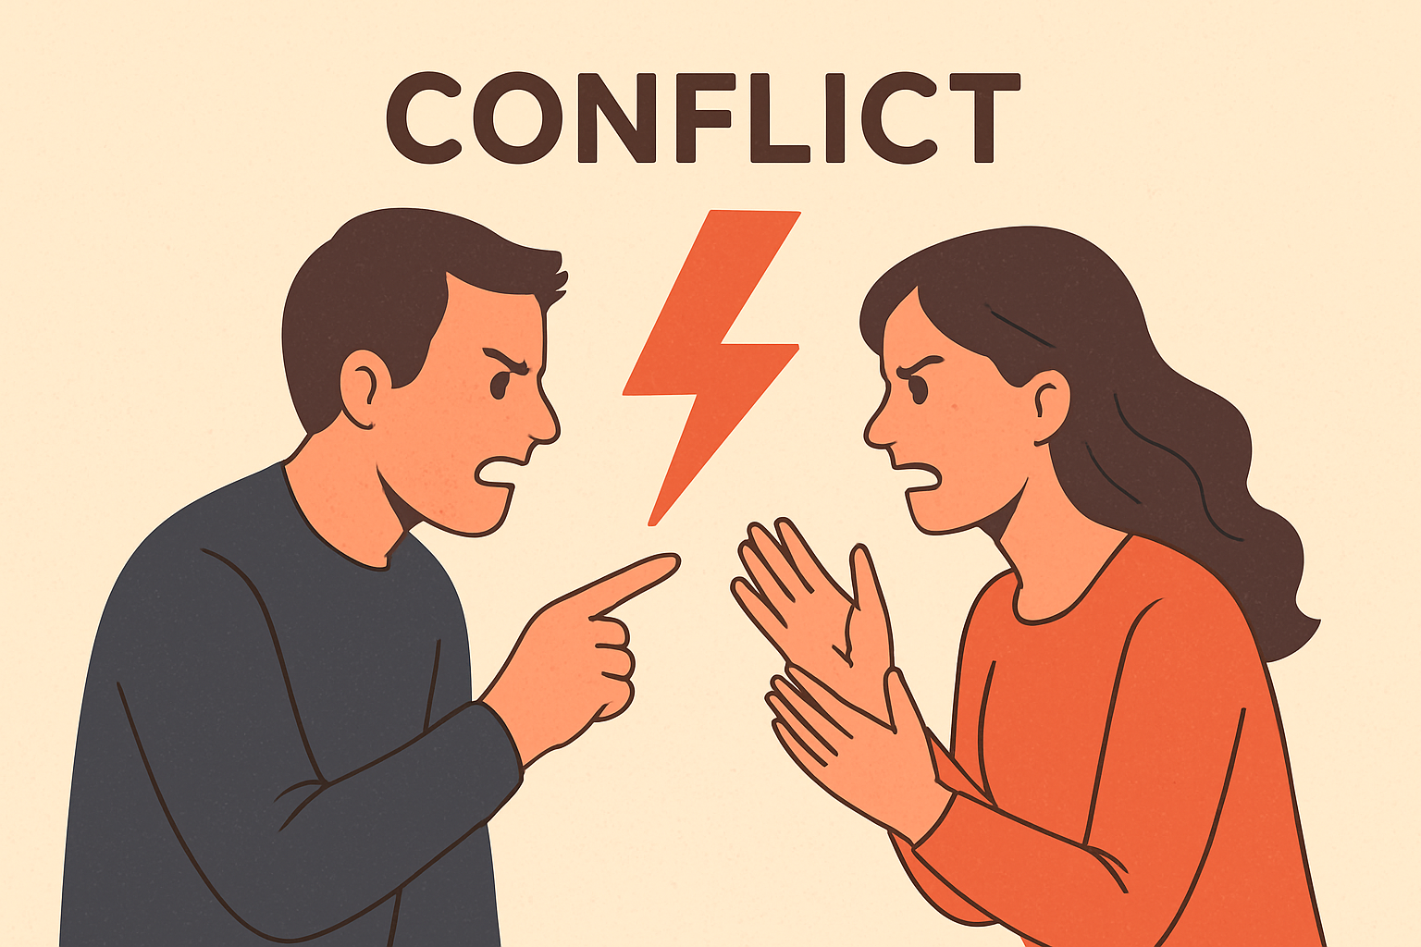
CONFLICT
Definitions
“Conflict is the two opposing ideas exist among the two individuals.”

Slide 10
Characteristics
• Universality: Conflicts present in all places and at all times.
• A part of life: Conflict is normally seen among individuals, groups in organization. Hence, it a normal part of life.

Slide 11
• Personal in nature: Conflict exists only due to strong personal ideas of the individuals’ opposing others.
• Deliberate conscious activity: Individual or group involves in conflicts knowingly, deliberately and consciously.

Slide 12
Conflict is a process: Conflicts happens in the stages.
Stage I: Misunderstanding (or) Understand at different point of view from another person
Stage II: Having differences of opinions
Stage III: Competing, negotiating or avoiding the situation

Slide 13
• Conflict is dimensional: Conflict presents at the various degrees of capacity or seriousness.
• Unavoidable: Conflict is unavoidable since the ideas will often vary from person to person.

Slide 14
On the basis of perception rather than reality:
Conflict always relies on how the individual perceives rather than ground level reality.

Slide 15
• Need interventions to resolve: Conflict resolution requires the systematic interventions performed in step-by-step manner.
• Lacks continuity and intermittent process: Unlike the cooperation and competition, conflict lacks continuity since it may take place all of the sudden and may end soon.

Slide 16
Causes of Conflict
• Struggle for existence and survival of the fittest
• Inmate aggressive tendency
• Desire for the social change
• To follow right moral values and expectations
• Differences of opinions
• Struggle for materials and goods

Slide 17
Effects of Conflict
Positive Effects
• It promotes solidarity of in-group and feelings of patriotism.
• It helps to establish the intimate relations.
• It will empower the decision-making skills.

Slide 18
• It enlarges the victorious group.
• It might allow the reconciliation of both groups.
• It enhances the group Cooperation and accommodation.

Slide 19
• It gives chance to find the novel solutions to the problems.
• It helps to share and respect the opinions of others.
• Conflict exists within the institution might give chance for the further resolution of conflicts in future.

Slide 20
Negative Effects
• It may weaken the solidarity and causes social disorder.
• It may aggravate violence.
• It may lower the moral values.
• It reduces the productive functions or ability.
• It affects the psychological health of the members.

Slide 21
SOCIAL GROUPS
Society consists of groups. No man lives alone, as man is social creature he lives in aggregation.
Social groups exist when two or more people are in direct or indirect contact and communication.

Slide 22
Social group is used to refer to entire human group, sometimes used to mean a small group which consists of two or more individuals.

Slide 23
Definitions
“Social group is defined as an aggregate of individuals which persists in time, which has one or more interests and activities in common and which is organized.”

Slide 24
“Social group is defined as the collection of humans who get into the social relationship with one another. It involves some level of reciprocity and mutual awareness among the group members.”

Slide 25
Types:
• Involuntary and voluntary groups:
Involuntary groups include family, community, city, state, race, etc. Voluntary groups youth association, political party, religious association, trade unions, etc.

Slide 26
• Institutional (permanent) and non-institutional (temporary):
Institutional groups are permanent one mostly. These include school, caste, church, etc. Non-institutional groups are mostly temporary and it includes public audience, crowd, etc.

Slide 27
• Horizontal and vertical groups: Horizontal groups are large such as religious organization, nation and political parties. Vertical groups are the small divisions such as social status, etc.

Slide 28
Horizontal Group (Same Level)
-----------------------------
[Person] [Person] [Person]
| | |
Equal Status, same rank
Example: Classmates
Vertical Group (Different Levels)
-------------------------------
[Chief Executive Officer (CEO)]
|
[Manager]
|
[Worker]
Different Status, hierarchy
Example: Company Team

Slide 29
• Formal and Informal groups:
In the formal group, membership is defined and the entry is made under the written rules/regulation. Informal group the membership is not well defined and individuals can enter or leave the group as per their wishes.

Slide 30
• Territorial and non-territorial groups: Territorial group includes states and communities. Nonterritorial group includes, crowd, classes and public.
Type | Basis of Group | Example
Territorial | Geographic location | Neighborhood residents
Non-Territorial | Shared interest/goals | Online forum, professional association

Slide 31
• Genetic and congregate group: Genetic groups are involuntary in nature and the persons are born in them. For example, ethnic group, family group and racial group. Congregate groups are voluntary in nature and the persons have their own liberty to join or not, e.g., political parties, genetic groups and trade unions.

Slide 32
Genetic Group (By Blood/Family)
--------------------------------
[Grandparents]
|
[Parents] - [Uncle/Aunt]
|
[Children]
Congregate Group (Temporary Gathering)
-------------------------------------
[Person] [Person] [Person] [Person]
(e.g., Concert audience, bus passengers)

Slide 33
Characteristics
• Collection of individuals: Social group consists of people. Without individuals there can be no group. Just as college without students is nothing but only a building.
• Social interactions: Interaction among members is the basis of group life. Members must have interactions.

Slide 34
• Feel of unity: ‘We’ feeling, refers to the tendency on the part of the members to identify themselves with the group, it represents group unity and fosters cooperation.
• Common interest: Groups are mostly formed for the fulfilment of certain interests.

Slide 35
• Group norms: Every group has some norms and values which the members of group must follow.
• Influence on personality: Social groups, directly or indirectly, shape the personality of their members. They also provide opportunities for the expression of individuality.

Slide 36
Classification
Social groups are complex in nature. That is why sociologists have classified social groups on the basis of different criteria, like class, occupation, religious beliefs and territory.

Slide 37
Ingroup and outgroup:
WG Sumner classified groups in ingroup and outgroup where in group is we-group on the other hand outgroup is they-group. For example, for a Hindu, people believed in Hinduism which is their ingroup, whereas people of other religions are of outgroup.

Slide 38
• Primary group and secondary group: CH Cooley classified groups in these categories. Groups in which interaction is face to face and intimate is primary group like family (Table 8). On the other hand, groups in which formal interaction takes place and less intimate, known as secondary group.
TABLE 8: Differences between the primary group and secondary group

Slide 39
Aspects | Primary group | Secondary group
Size | Small | Large
Area | Limited to the small area | Extended to large area
Durability | Durable | Short lasting
Relationship | Close | Distant
Purpose based relationship | No | Yes
Type of relationship | Personal | Impersonal and nominal
Blood relatives | Mostly | Not so
Concept | Olden | New concern
Process of socialization | Play significant role | Not very important
Personality of the individual involved in the relationship | As a whole | Limited aspects

Slide 40
• Small group and large group: George Simmel introduced this classification in which small group includes ‘Dyad’, ‘triad’ and other small groups. Whereas large groups represent racial, political and other

Slide 41
• Homogeneous and heterogeneous groups: Homogeneous group is uniform in composition or character (i.e., color, shape, size, weight, height, distribution, texture, language).

Slide 42
When people with similar attributes come together and form group it is known as Homogeneous group, like Religious group and in contrast when people with different attributes come together and form group, it is known as Heterogeneous group like classroom.

Slide 43
THANKS

