Slide 1

Health Promotion Part 1
Dr. Salih A Abdulla Geriatric and gerontology Fall Semester Week 7 2025-2026

Slide 2
Learning outcome
To introduce Health promotion
To define health promotion
To understand objectives of health promotion
To identify Barrier to health promotion
To identify Component of health promotion

Slide 3
OUTLINE
Introduction
Definition of health promotion
Objectives of health promotion
Barrier to health promotion
Component of health promotion

Slide 4
Health promotion programs are essential for Maintaining and improving the health of the elderly not only prevent chronic diseases but also greatly contribute to their independence and participation in family and social activities.

Slide 5
Even though, health promotion interventions are cost effective ways of preventing disease and disability and improving functioning and quality of life for older adults.

Slide 6
Health promotion is essential for older adults because they have more chronic conditions, have complex health care needs, and use more health care services than younger adults.

Slide 7
Definition of health promotion:
It is the science and art of enabling people to change their life and move toward a state of optimum health.

Slide 8
Or
It is the development of individual, group, institutional, community and systemic strategies to improve health knowledge, attitudes, skills and behavior.
.

Slide 9
N.B: Nota Bene (Latin phrase) means “note well.
The focus of health promotion is on changing pattern of behavior to promote health rather than simply to avoid illness.

Slide 10
Objectives of health promotion:
Extended life expectancy by reducing mortality caused by chronic and acute illness.
2. Maintain functional independence.
3. Enhance the quality of life.

Slide 11
4. Maximize the contribution of elderly people to society.
5. The effects of illness or disability in older people will be lessened.

Slide 12
Barrier to health promotion:
• Barriers related to health professionals
Negative attitude regarding ageing.
2. Lack of knowledge regarding benefits of screening.
3. Limited screening standards specific to the elderly.

Slide 13
4. Lack of consistent guidelines and screening standards specific to the elderly exist. 5. Increased time spent with elders.

Slide 14
• Barriers related to elders 1. Fatalism regarding own health. 2. Limited access (transportation, convenience, lack of facility). 3. Misperception of information regarding benefits of screening.

Slide 15
4. Reliance on physician to make screening recommendations.
5. Emotional concerns (e.g. fears, embarrassment).
6. Costs of screening programs.

Slide 16
Component of health promotion: 1. Physical exercise. 2. Nutrition.

Slide 17
3. Rest and sleep. 4. Periodic medical examination.

Slide 18
5. Immunizations. 6. High risk behaviors

Slide 19
7. Psychosocial wellbeing 8. Spiritual wellbeing.

Slide 20
Physical exercise:
Physical activity is central component of health promotion for elderly.
Physical activity is important to maintain health and improve the general quality of life.
Physical inactivity is associated with many age-related medical conditions such as heart diseases, hypertension, diabetes mellitus, and musculoskeletal disorders.

Slide 21
Benefits of exercise:
Physical benefits of exercise
• Increase blood flow and keeps tissues health.
• Improve sense of well-being &relaxation.
• Maintains the mind's function& promotes sense of normality.

Slide 22
• Declines maximal oxygen uptake and improve functional reserve.
• Increase peristaltic movement and decrease constipation.
• It is the key for consumption of body fat.

Slide 23
• Improve the cardiovascular capacity.
• Controls hypertension &blood sugar.
• Improve respiratory function and joint flexibility.
• Improve pattern of rest & sleep.

Slide 24
Psychological benefits of exercise:
• Improve mood state.
• Improve self-image.
• Improve depressive state of elderly.
• Reduce stress and enhance sleep.

Slide 25
Social benefits of exercise:
• Improve social interaction
• Improve relation with others

Slide 26
Types of exercises:
There are many types of exercises that can be practiced by older people as walking, swimming, gardening, general household work, stair climbing, aerobic and resistance exercise.

Slide 27
Isotonic exercises:
which involve muscle contraction with body movement. In which there is shortening & lengthening of muscle, causing joint to move. They make muscle better to work and increase strength.

Slide 28
For Example: Walking for 20- 30 minutes, three to four times per week is suggested as a general exercise program for maintaining bone mass in postmenopausal women.
Range of motion exercise is another type of isotonic exercise

Slide 29
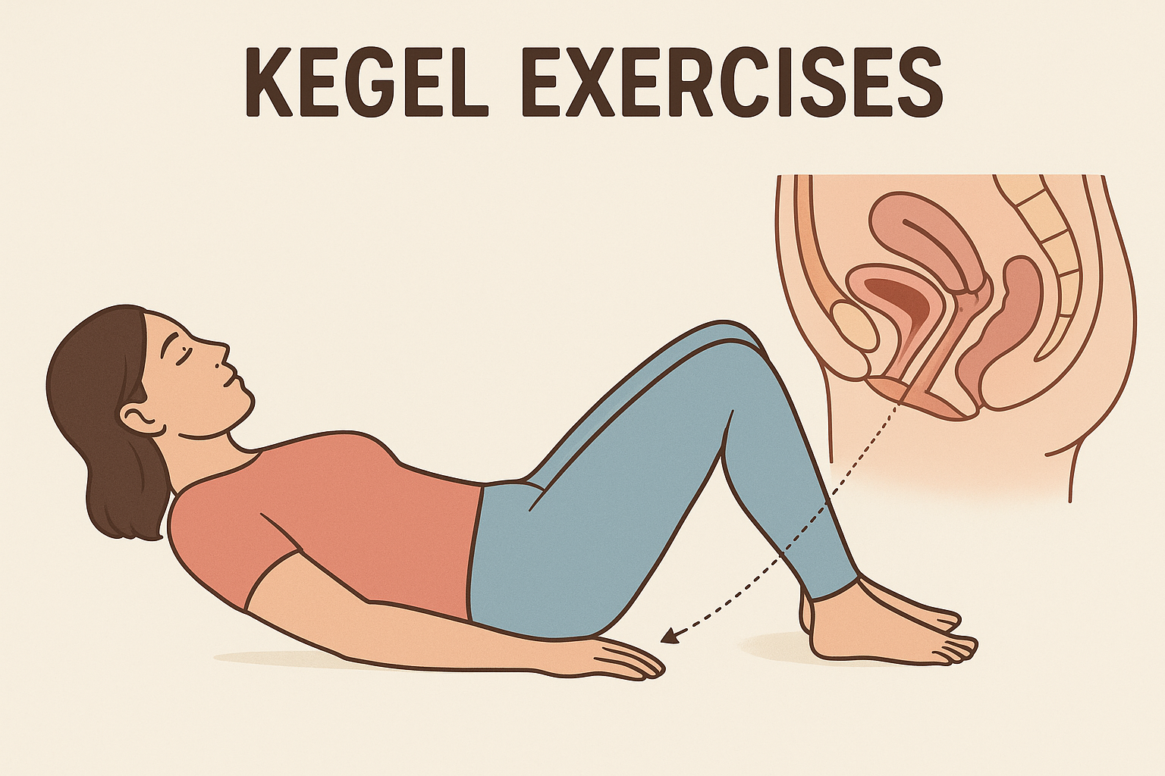
• Isometric exercises: which involve muscle contraction without body movement. Muscles are contracted without changing their length or causing joint movement.
For Example: Kegel's exercises

Slide 30
Role of the nurse during exercise program:
Assessment done at the beginning of exercise program include:
• History & physical examinations (cardiovascular, respiratory, musculoskeletal & neurological system).
• Renal & liver function tests.
• ECG &exercise stress test.

Slide 31
• Assess the use of assistive devices.
• Assess environmental hazards.
• Assess muscle strength and tone.
• Examine reflexes.

Slide 32
2) Set a regular time to exercise each day.
3) Before starting exercise the nurse should advice the elderly about:
• Document baseline resting function status (HR, resp. rate, blood sugar).
• 10 minutes warms up stretching exercise.
• Drink water before and after exercise is important as water will be lost during exercise.

Slide 33
• Clothes worn during exercise should allow for easy movement and perspiration.
• Athletic shoes provide both support and protection.
• Outdoor exercise should be avoided in extremely hot or cold weather.

Slide 34
4) During exercise:
• Monitor heart & respiratory rate.
• Stop exercise if elderly has fatigue, chest pain

Slide 35
5) After exercise:
• Give the elderly 10 minutes for rest at end of exercise
• Monitor pulse rate during cooling down for returning to resting heart rate.

Slide 36
THANKS

