Slide 1
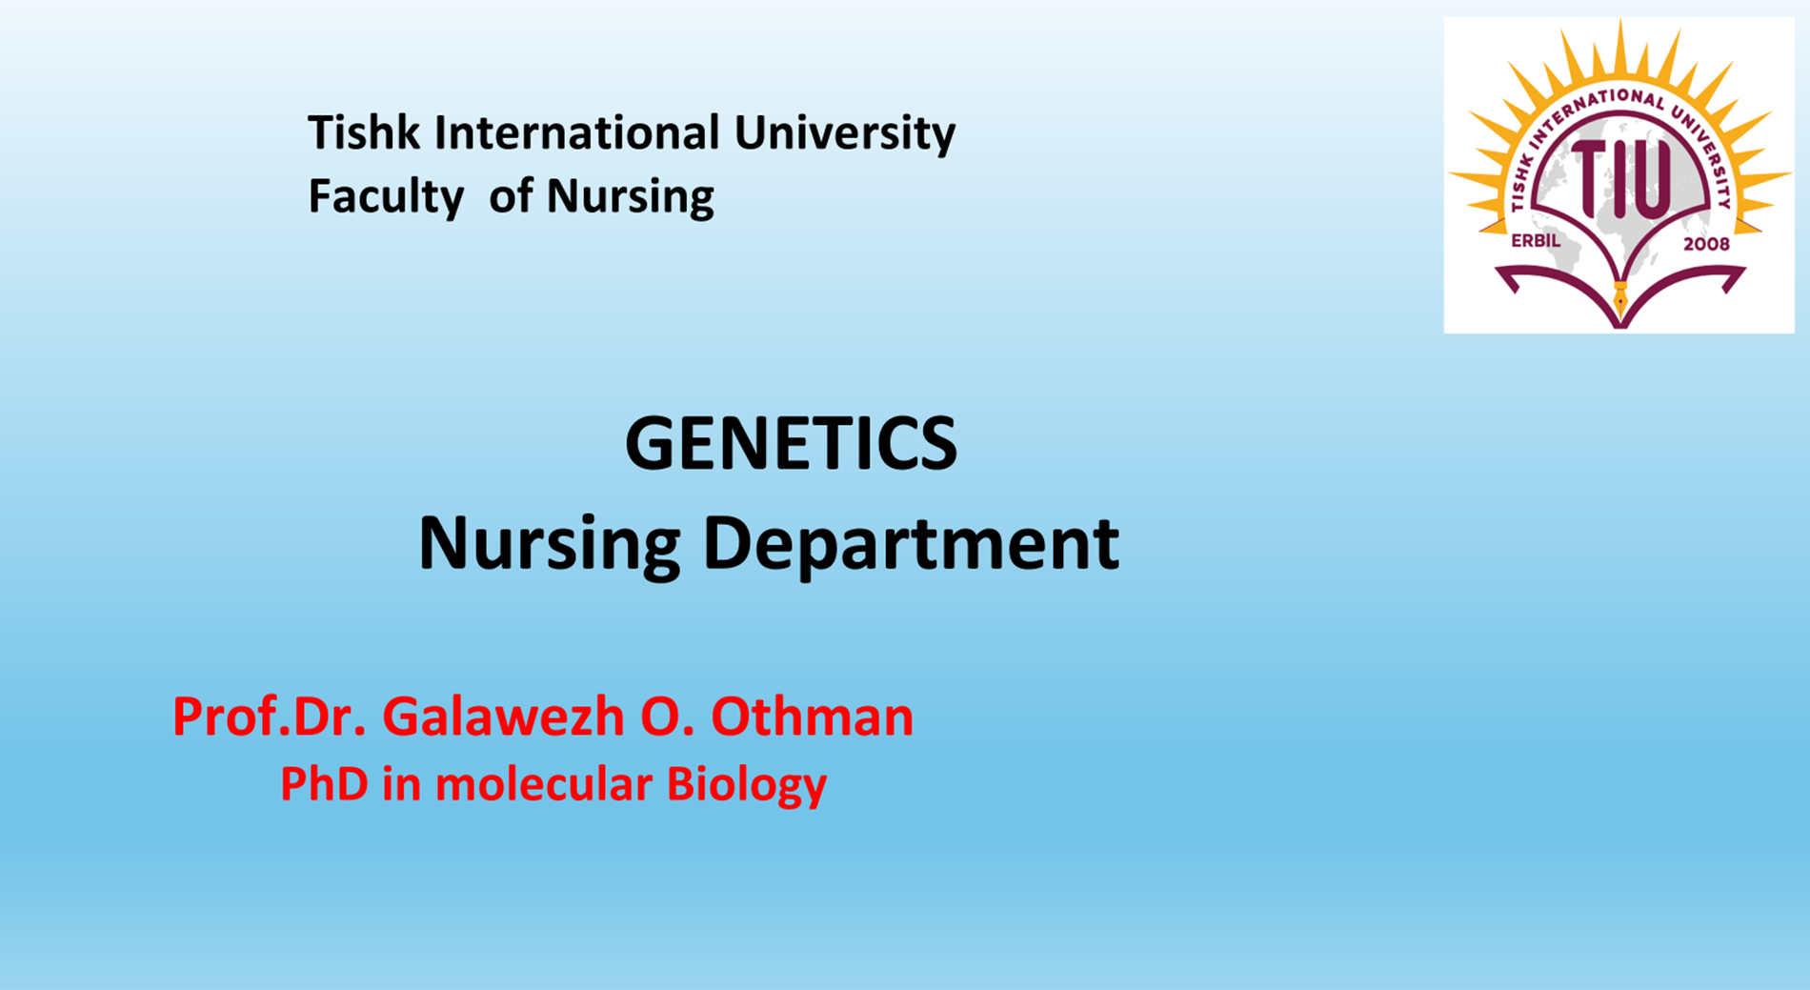

Slide 2
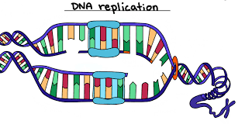
DNA Replication and Repair Mechanisms:

Slide 3

DNA Replication and Repair Mechanisms:
Are two essential processes that ensure genetic information is accurately passed on from one cell generation to the next.
DNA replication allows for the faithful copying of genetic material during cell division,
DNA repair mechanisms correct damage that could otherwise lead to mutations.

Slide 4

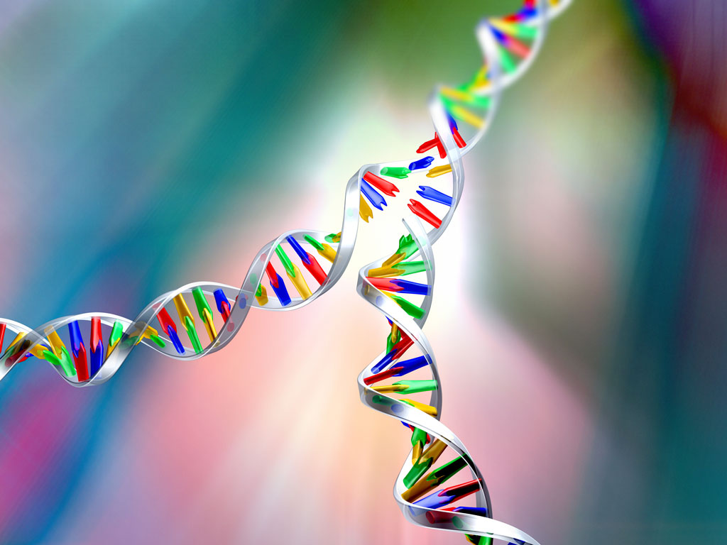
DNA Replication:
Is the process of copying the entire genome before cell division, ensuring that each daughter cell inherits an identical copy of the DNA.
This process occurs during the S-phase of the cell cycle in both eukaryotes and prokaryotes.

Slide 5
Features of DNA Replication:
Semiconservative: Each new DNA molecule consists of one old strand and one newly synthesized strand.
Bidirectional: Replication proceeds in both directions from the origin of replication.
Highly Accurate: The process is highly regulated, and multiple proofreading mechanisms ensure that errors are corrected.

Slide 6
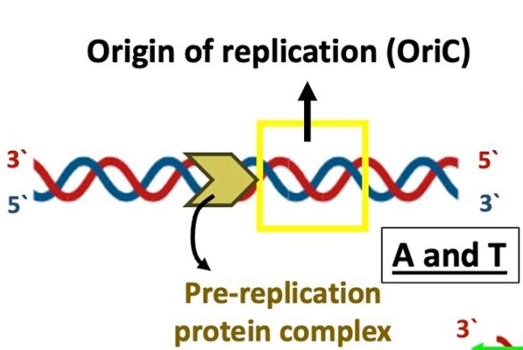
Stages of DNA Replication:
Initiation:
Replication begins at specific sequences called origins of replication.

Slide 7
Certain proteins bind to the origin of replication while an enzyme called helicase unwinds and opens up the DNA helix.
As the DNA opens up, Y-shaped structures called replication forks are formed .
Two replication forks are formed at the origin of replication, and these get extended in both directions as replication proceeds.
There are multiple origins of replication on the eukaryotic chromosome, such that replication can occur simultaneously from several places in the genome.

Slide 8
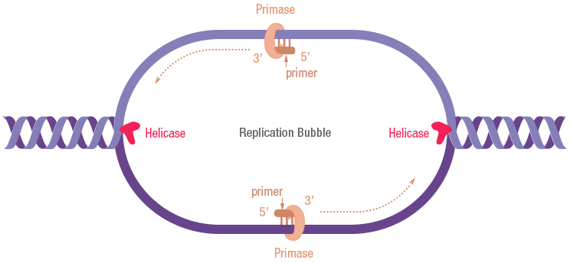
2. Elongation:
The enzyme helicase unwinds the DNA double helix, creating the replication fork.

Slide 9
During elongation, an enzyme called DNA polymerase adds DNA nucleotides to the 3' end of the template.
Because DNA polymerase can only add new nucleotides at the end of a backbone, a primer sequence, which provides this starting point, is added with complementary RNA nucleotides.
This primer is removed later, and the nucleotides are replaced with DNA nucleotides.
One strand, which is complementary to the parental DNA strand, is synthesized continuously toward the replication fork so the polymerase can add nucleotides in this direction.
This continuously synthesized strand is known as the leading strand.

Slide 10
BecauseDNA polymerase can only synthesize DNA in a 5' to 3' direction, the other new strand is put together in short pieces called Okazaki fragments.
The Okazaki fragments each require a primer made of RNA to start
the synthesis.
The strand with the Okazaki fragments is known as the lagging strand. As synthesis proceeds, an enzyme removes the RNA primer, which is then replaced with DNA nucleotides,
and the gaps between fragments are sealed by an enzyme called DNA ligase.

Slide 12
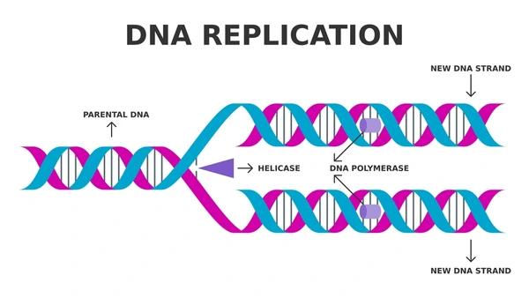
3. Termination.
Replication ends when the replication forks meet or when the entire DNA molecule is replicated.
In eukaryotes, special enzymes called telomerase add repetitive sequences to the ends of chromosomes to prevent loss of genetic material during replication.

Slide 13
DNA Replication Enzymes:
Helicase
Single-Strand Binding Proteins (SSB)
Primase
DNA Polymerase III
DNA Polymerase I
Telomerase

Slide 14
DNA Repair Mechanisms:
Despite the high accuracy of DNA replication, errors can still occur due to damage from environmental factors (e.g., UV radiation, chemicals) or normal cellular processes.
DNA repair mechanisms are crucial for correcting these errors and maintaining genome stability..

Slide 15
Types of DNA Damage:
Base mismatches
Thymine dimers
Strand breaks
Crosslinking

Slide 16
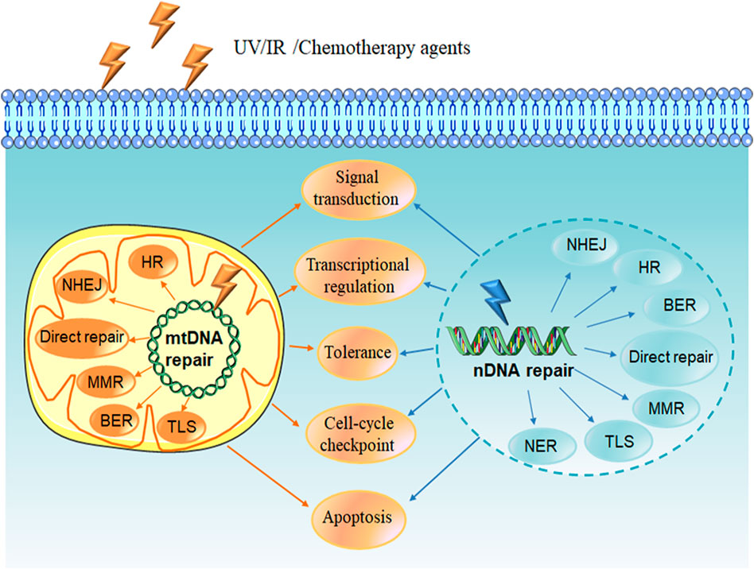
DNA Repair Pathways:
Proofreading Mechanism
Mismatch Repair
Base Excision Repair (BER)
Nucleotide Excision Repair (NER)
Double-Strand Break Repair
Telomere Maintenance

Slide 17
References
Griffiths, A. J. F. et al. (2012). Introduction to Genetic Analysis. 11th Edition. W.H. Freeman and Company.
Klug, W.S., Cummings, M.R., et al. (2019). Concepts of Genetics. 12th Edition. Pearson.
Hartl, D. L., & Jones, E. W. (2009). Genetics: Analysis of Genes and Genomes. 7th Edition. Jones & Bartlett Learning.
Snustad, D. P., & Simmons, M. J. (2015). Principles of Genetics. 7th Edition. Wiley.

