Slide 1






Culture and Society
Tishk International University
Faculty of Administrative Sciences and Economics
Business and Management Department
Ms.Zainab Hassan
zainab.hassan@tiu.edu.iq
Fall Semester
December 2025

Slide 2
Contents of the Course
Introduction to the Culture and Society
Group and Inter-Group Relations
Education in a Social Context
Media and Society
Diversity and Social Cohesion
Tishk International University
Faculty of Administrative Sciences and Economics
Business and Management Department

Slide 3
Course Assessment
Class Participation: 10
Project: 10
Presentation: 10
Quizzes (2): 10
Mid-Term Exam: 20
Total = 60 Marks
Final Exam = 40
Tishk International University
Faculty of Administrative Sciences and Economics
Business and Management Department

Slide 4
Chapter One: Objectives
To acknowledge that we are part of a culture,
To know how culture operates,
To be able to define our own culture,
To know different groups within your own culture.
Tishk International University
Faculty of Administrative Sciences and Economics
Business and Management Department

Slide 5
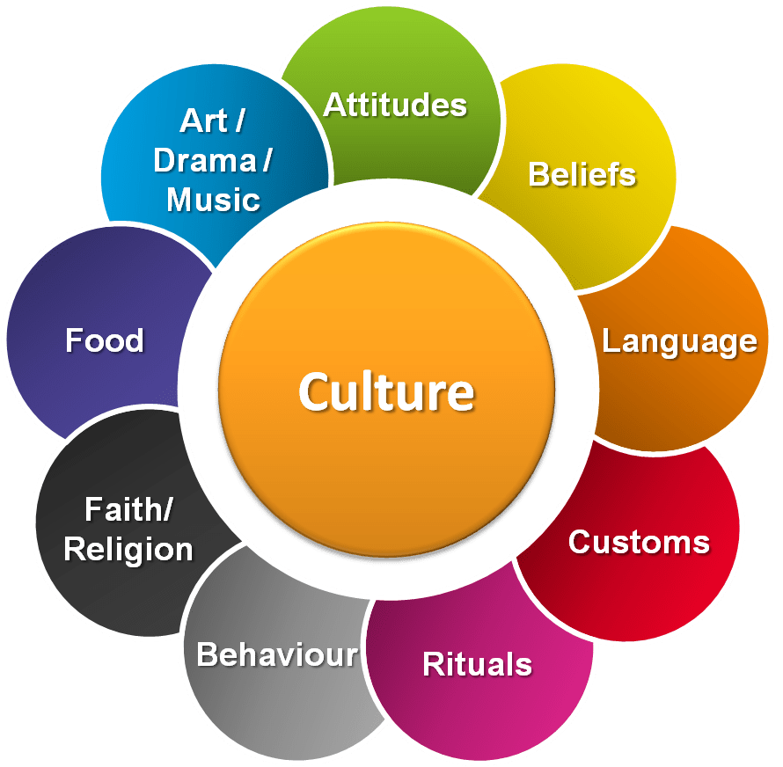
Culture: Definition
Culture is a shared experience. It is the experience of living in a certain time in a certain place with a certain bunch of people.
Tishk International University
Faculty of Administrative Sciences and Economics
Business and Management Department

Slide 6
Culture: Definition
Sociologically, it is to examine in which situation and context acertain behavior is expected, and in which situations perhaps it is not. These rules are created and enforced by people who interact and share culture.
Tishk International University
Faculty of Administrative Sciences and Economics
Business and Management Department

Slide 7
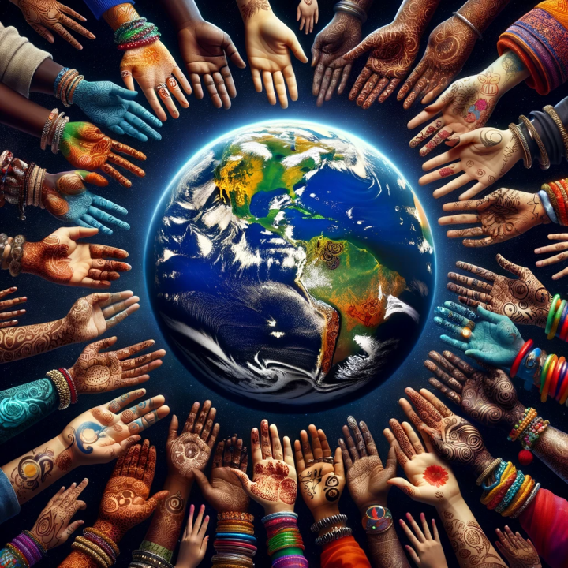
Culture vs. Society
In everyday conversation, people rarely distinguish between the terms culture and society, but the terms have slightly different meanings, and the distinction is important to a sociologist.
A society describes a group of people who share a community and a culture. By “community,” sociologists refer to a definable region—as small as a neighborhood (Brooklyn, or “the east side of town”), as large as a country (Ethiopia, the United States, or Nepal.
Tishk International University
Faculty of Administrative Sciences and Economics
Business and Management Department

Slide 8
Culture vs. Society
To clarify, a culture represents the beliefs and practices of a group, while society represents the people who share those beliefs and practices. Neither society nor culture could exist without the other. In this chapter, we examine the relationship between culture and society in greater detail and pay special attention to the elements and forces that shape culture, including diversity and cultural changes.
Tishk International University
Faculty of Administrative Sciences and Economics
Business and Management Department

Slide 9
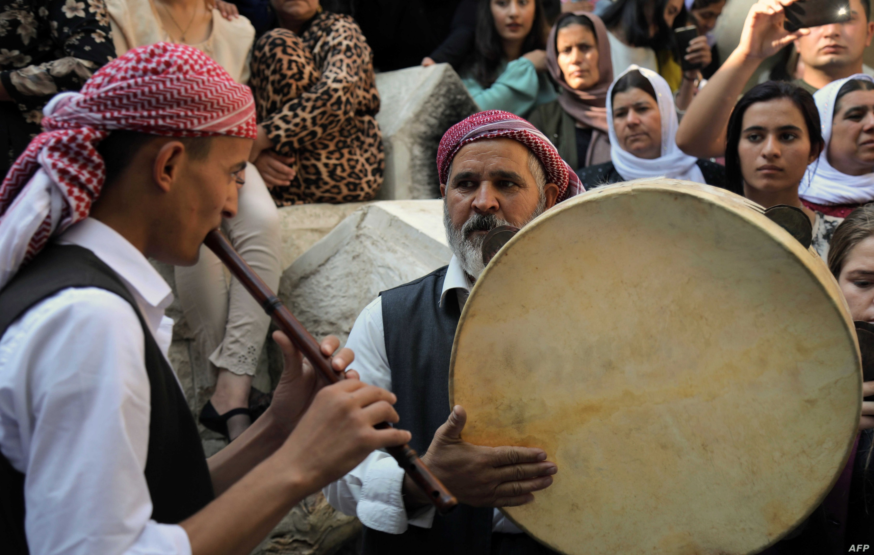
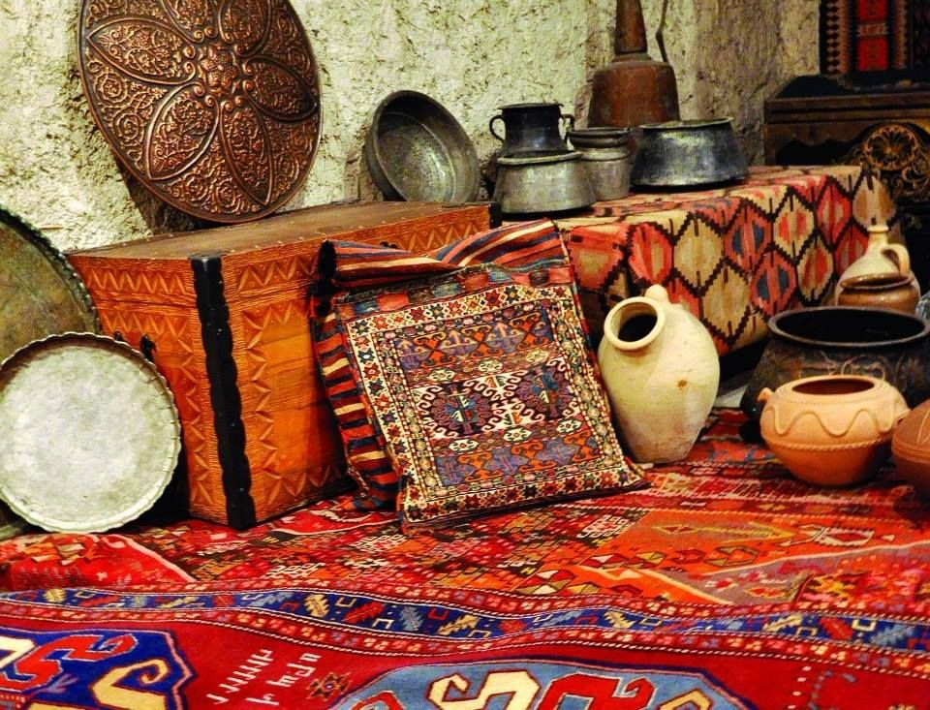
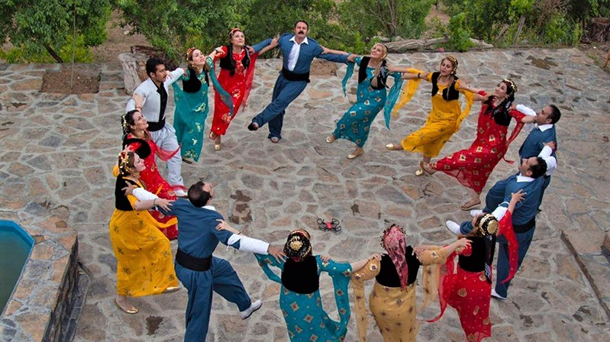
What comes to you mind when you see these photos?
Which parts of culture do you see here?
Tishk International University
Faculty of Administrative Sciences and Economics
Business and Management Department

Slide 10

Tishk International University
Faculty of Administrative Sciences and Economics
Business and Management Department

Slide 11
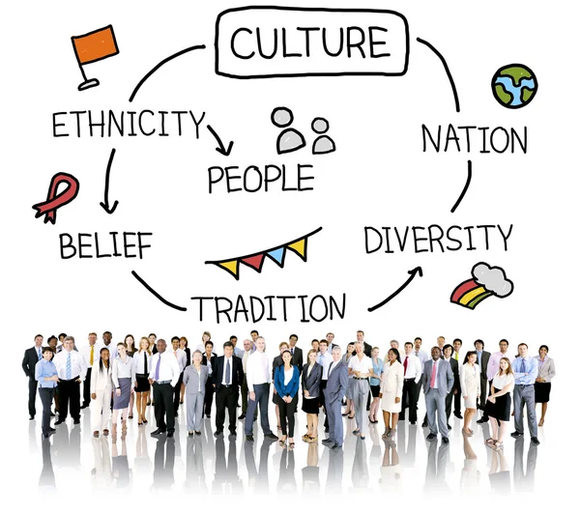
First Impressions
What are the first words or images that
you associate with the following cultures?
Australian
American
Chinese
Italian
Japan
Tishk International University
Faculty of Administrative Sciences and Economics
Business and Management Department

Slide 12


