Slide 1

PRINCIPLES OF Management
Lecturer: Kadhim Saeed
Course Code: 111
Semester: Fall
2025-2026

Slide 2

content
“Coke Cola CEO – CASE STUDY”
Organizations
Importance of Managers
Management
Management Levels
Organization's Environment
Management process and its functions
Organizational Resources
Efficiency and Effectiveness
Management Skills
Management Career

Slide 3
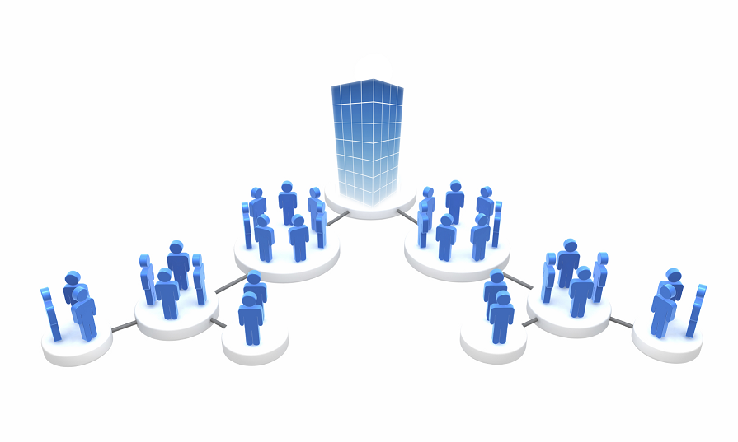
Organizations
Organization - An arrangement of people assembled to accomplish specific goals.
ex. (University, Business, Government, etc.).
Business – An organization that produces or distributes goods or service for profit.

Slide 4
Manager and employee
Who is a manager?
Who is an employee?
Who is a CEO? (Chief Executive Officer)

Slide 5
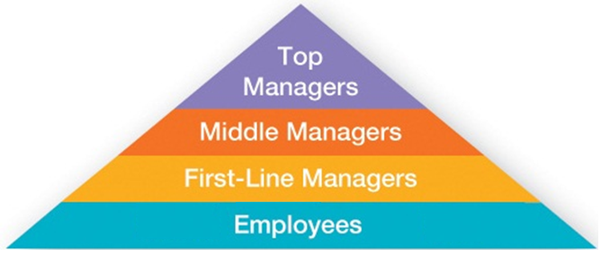
Management Levels
Top Managers - Individuals who are responsible for making organization-wide decisions and establishing plans and goals that affect the entire organization.
Middle Managers - Individuals who manage the work of first-line managers.
First-line/Supervisory Managers - Individuals who manage the work of non-managerial employees.

Slide 6
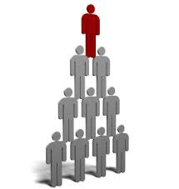
The Importance of Managers
The products and services around us.
They are critical to getting things done and increase productivity in organizations.
As Peter Drucker stated, “The productivity of work is not the responsibility of the worker but of the manager.”
Ex. Gallup’s 2025 State of the Global Workplace report found that global employee engagement dropped from 23 % in 2023 to 21 % in 2024, and this decline, cost the world economy an estimated US $438 billion in lost productivity. The main driver of this drop was lower engagement among managers, and Gallup warns that manager engagement strongly influences team engagement and overall productivity.
Society’s need for good Management.
Notes:
2- They are critical to getting things done. A manager in a restaurant is not the person greeting and taking orders and cooking meals, but she was the person who creates and coordinates the workplace so that others can perform those tasks. She is the one who will come win when something does not work and the one who will find a way to get things back on truck. Gallup example. For employee productivity and loyalty they have surveyed 1 Million and thousands of managers, they found the most important variable to increase employee productivity and loyalty is not financial or benefits, it’s the quality of the relationship between employees and their direct supervisors.

Slide 7
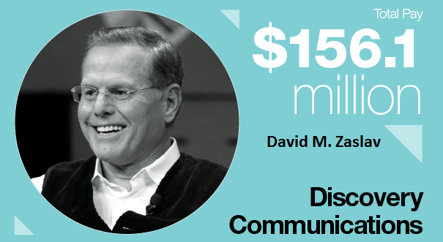
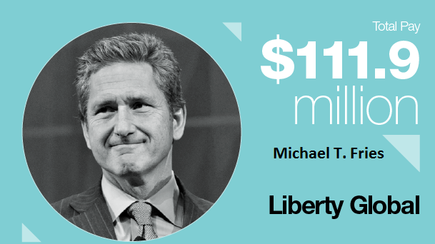
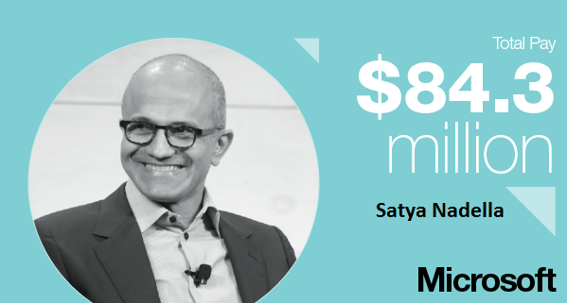
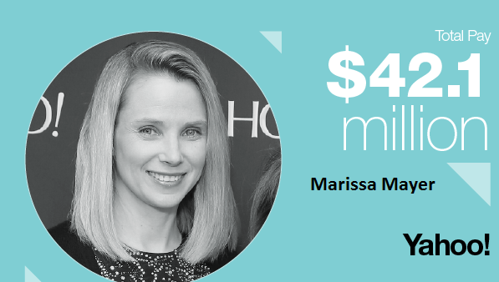
CNN’s annual report of best paid CEO’s in 2015

Slide 8
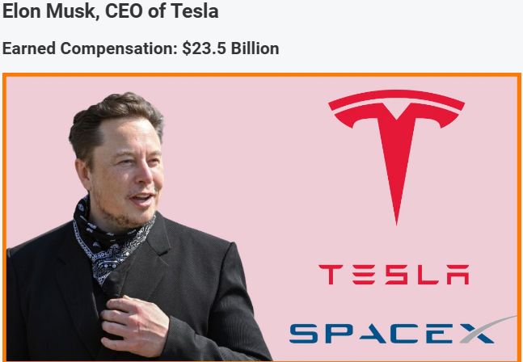
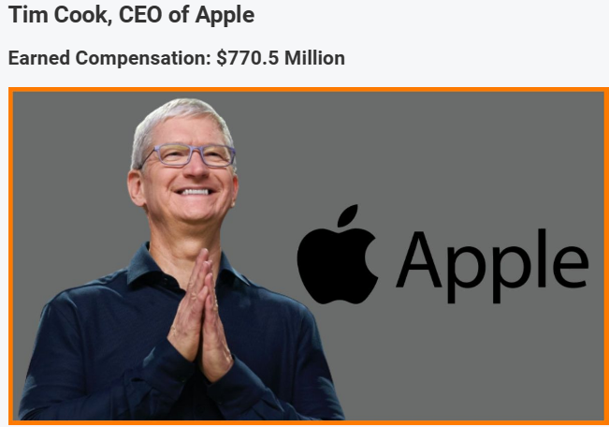
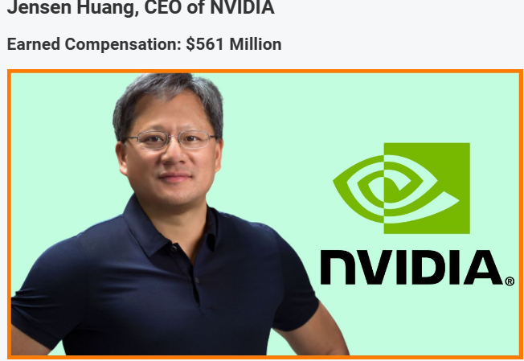
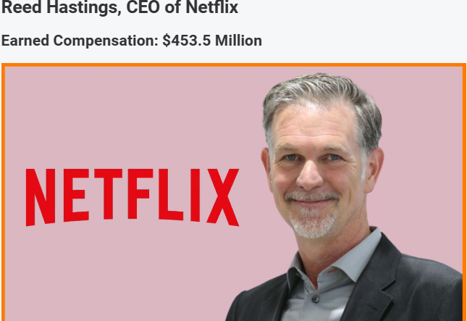
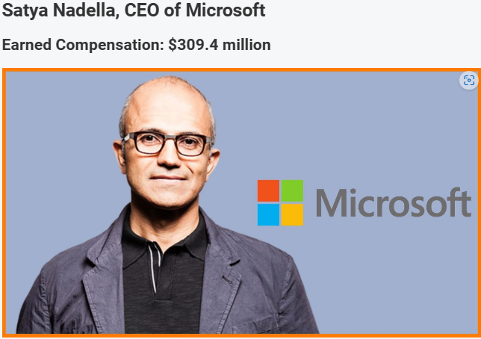
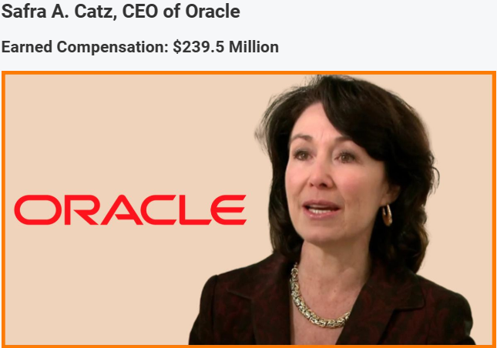
Highest paid ceo for 2023
Source: startuptalky.com

Slide 9
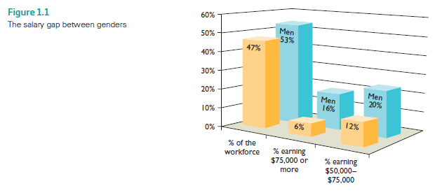
Salary gap between male and female in USA

Slide 10
The role of managers
Every organization exist for a goal or purpose.
The roles of Managers are mainly to:
Guide the organizations toward the goal accomplishment.
Combing and using the organizational resources.
To encourage activities that lead to achievement of goals and vice versa.

Slide 11
MANAGEMENT DEFINED
Management is defined:
“The process of reaching organizational goals by working with and through people and other organizational resources” (Certo & Certo, 2019).

Slide 12
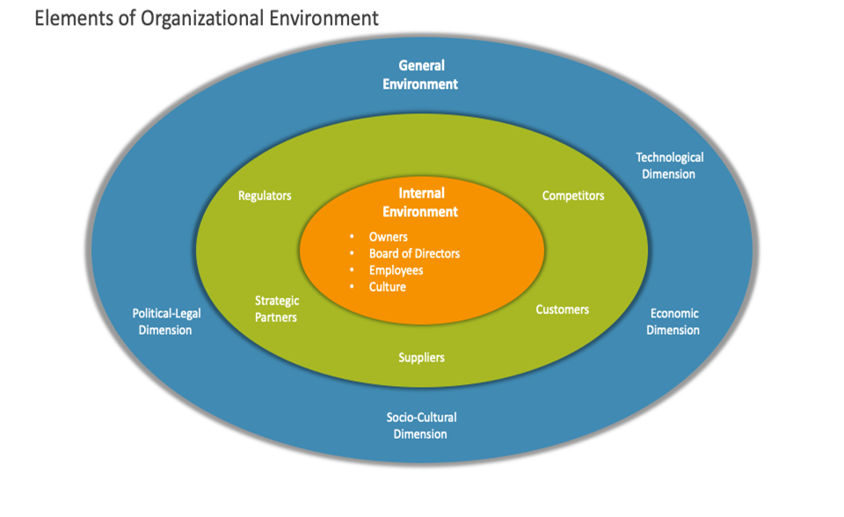
Organizational environment

Slide 13
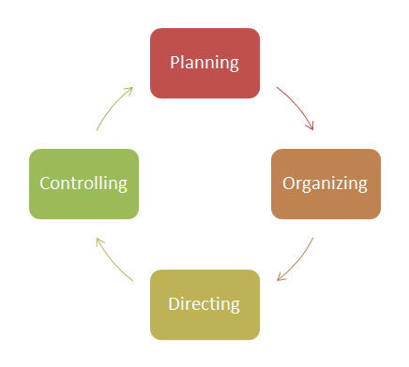
MANAGEMENT PROCESS: MANAGEMENT FUNCTIONS
Four Basic Management Functions:
Planning
Organizing
Influencing, motivating, leading, directing.
Controlling

Slide 14

PLANNING
To Set organizational goal and performance
Standards.
To choose tasks that must be performed.
To Outline how and when to do the tasks.
It is essential to getting the “ right” things done.
Planning is concerned about (short term) and (long term) plans.

Slide 15
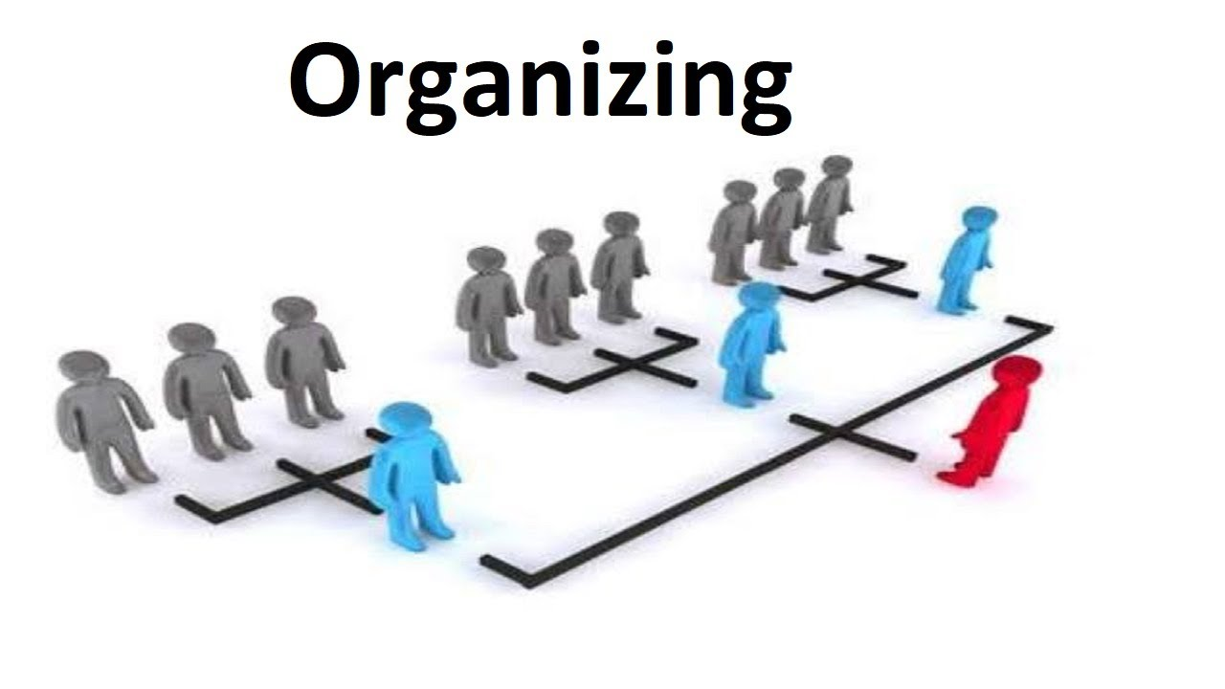
ORGANIZING
To Assign the task to various individuals and groups
To Establish a structure of the organization and indicate the lines of communication and authority.
To link the tasks to contribute to the success of the organization.
Organizing should be flexible to meet the challenges as the environment changes.

Slide 16
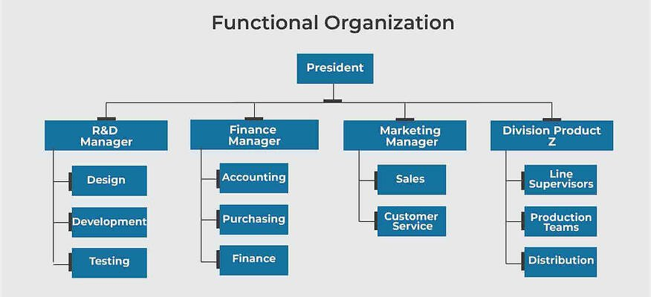
Simple organizational structure

Slide 17


INFLUENCING
It is also called, motivating, directing, leading and actuating.
Guiding the activities of organization members in appropriate directions.
Ultimate purpose of influencing is to increase productivity through Rewarding and recognition.

Slide 18

CONTROLLING
Gather information that measures recent performance in the organization.
Compare performances of recent and predetermined performance standards.
Determine whether organization to be modified to meet the performance standards.
It is ongoing process.

Slide 19
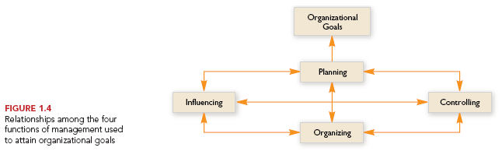
Relationships among Management Functions

Slide 20
Organizational Resources
    Human.
    Monetary.
    Raw materials.
    Capital.

Slide 21
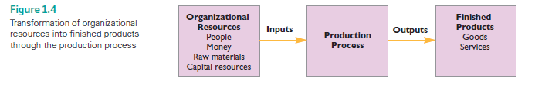
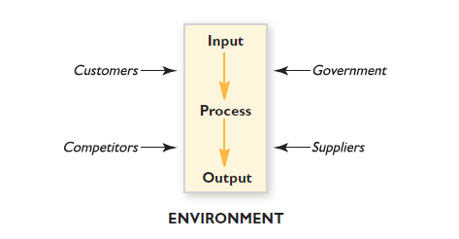
Organizational resources to finished products
The Environment of an organization

Slide 22
EFFECTIVENESS
Refers to how well management uses organizational resources in meeting organizational goals.
The closer an organization comes to achieve its goal, the more effective its managers considered.

Slide 23

EFFICIENCY
  Is the proportion of total organizational resources that contribute to productivity during the manufacturing process.
  The higher the proportion, the more efficient is the manager.
The less resources wasted during the production process the more efficient the manager and vice versa.

Slide 24
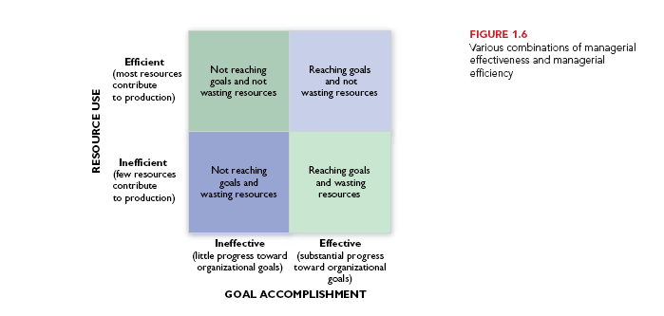
Managerial Effectiveness and Efficiency combination

Slide 25
Management Skills: The Key to Management Success
Is the ability to reach organizational goals and use organizational resources effectively and efficiently.
Classical View – Robert Katz
Modern view of Management Skills
Notes:
Skill is he ability to translate knowledge into action

Slide 26
Management Skills
Management Skill : Robert Katz states that managers ability is to perform is a result of their managerial skills.
Robert Katz indicates three types of skills
- Technical Skills – Specialized Knowledge.
- Human Skills – Cooperation and human related skills
- Conceptual Skills – a holistic view of the organization, how parts of the organization depend on one another and are related to the environment, and to understand and solve problems.

Slide 27
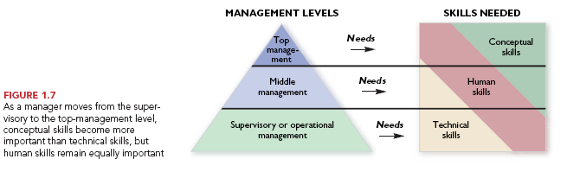
Management Skill: The Key to Management Success

Slide 28
MODERN VIEW OF MANAGEMENT SKILLS
Expansion of class view. The expansion can be achieved through two steps:
Define the Major activities the manager performs.
Task related, ex. (Planning, clarify jobs, and monitor performance, etc.).
People related. (Provide support, empowerment, recognition, etc.)
Change related. (Monitor org. Environment, take risks, propose new strategies etc.)
2. List of skills needed.
Notes:
Besides the Katz skills, there is a missing skills majority of managers lack. Is Political skills. Normally, not only those they have these three skills are promoted. In Fact, due to the conflict, than collaboration. Managers have to fight for a limited pot of their organization’s time, money, and budget. Power can be put to good use or bad use. Power is gained from Control and trust.
Decision making skills, No manager makes the right decision all the time. Effective managers make good decisions most of the time. And if they make a bad decision, they usually recognize their mistakes quickly and then make good decision to recover with least cost or damage to the organization.
Working under pressure, why is it important? Changes and unexpected events, problems or challenges can - and do - often occur, regardless of how well-planned or organized you are. The ability to respond effectively to pressure and stress is therefore extremely important in any line of work. Respond varies from a person to another. Having the ability to work under pressure improves your confidence to deal with any situation arises.

Slide 29
List of skills
Communication
Effectively sharing information with others.
Critical Thinking
Assessing situations to identify and solve problems.
Creativity
Generating new ideas that contribute to organizational success.
Collaboration
Understanding and working with a group.
Personal Ethics
Dealing with people, problems, and situations with honesty and integrity.
Adaptability
Working independently or as part of a team.
Socially Responsiblility
Contributing to the welfare of the community.

Slide 30

Management Careers
What is a Career?
Career is Cumulative, Similar to Steppingstones.
Career path planning.
(Ascending hierarchy, profession)
Leader matters!.

Slide 31
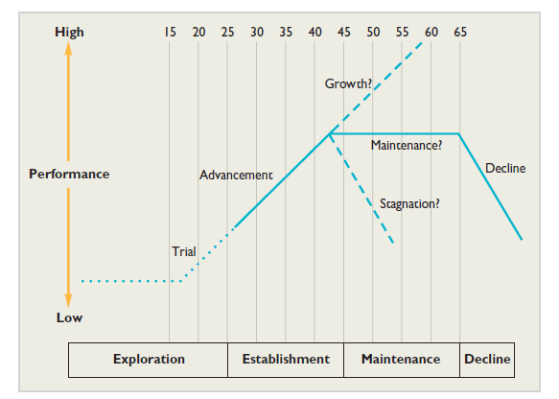
RELATIONSHIP AMONG CAREER STAGES, LIFE STAGES AND PERFORMANCE

Slide 32
Terms to learn
Management Entrepreneurship
Organization Maintenance
Function Skills
Planning Innovation
Organization Theory
Influencing Characteristics
Controlling Effectiveness
Resources Efficiency
Universality Monetary
Career Attainment
Promoting Criticism
Contemporary Flexible and Adaptable

Slide 33
References
Certo, S. C. and Certo, S. T. (2019). Modern Management, 15th Ed. Prentice Hall, New Jersey (Main reference)
Stephen P. Robbins, David, A. DeCenzo 2009. Fundamentals of Management, Prentice Hall
Stephen P. Robbins, Mary Coulter, 2013, Management, 12th Ed. Prentice Hall
Daft, R. L., 2009. Management. 8th ed. Mason: Thomson South-Western
Schermerhorn, J. R. (2014). Exploring Management. New Jersey: Wiley & sons Inc.
Bateman, S. T., & Snell, S. A. (2013). Management. New York: McGraw-Hill.

Slide 34
THANK YOU

