Slide 1

Academic Research and Writing
Plagiarism, Citation and Referencing styles
Omar Farouk Al Mashhour
Academic Research And Writing (Bus 149)
2024-2025
Week Twelve
Sunday 2nd Of February 2025

Slide 2
Learning Outcomes
By the end of this guide, you should be able to...
Understand the various reasons why we reference
Recognise some of the main differences between referencing styles
Know where to look for further guidance on formatting your references
Decide when it is appropriate to quote, paraphrase or summarise

Slide 3
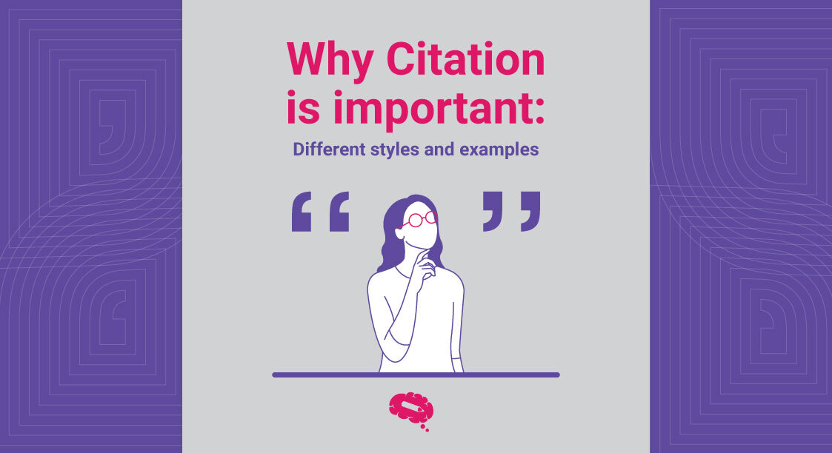
Why Referencing Is Important?
There is a significant difference between academic and non-academic.
One of these major differences are the use of citation and referencing of published authors. (Dibley & Machanick, 2021)
Academic writing relies heavily on the ideas and research of scholars including, books, journal articles, websites and others to build upon their ideas or criticize others. (Uzuegbu & Onyenachi, 2015)
We use reference to tell the reader where ideas from other sources have been used in your arguments.

Slide 4
To show that we have read and understood the research published in our area of interest.
To demonstrate our academic integrity
To help the reader finding and check the sources we have used.
To avoid plagiarism so that we are not falsely claiming someone else’s work or ideas as our own.
To support our argument by showing the sources of the information from which we have formed our own ideas.
To fulfil our moral and legal obligations to recognize the ideas of others.
Reasons for Referencing Sources in Academic writing
Source: (Dawe, Stevens, Hoffman, & Quilty, 2021)

Slide 5
Strategies To Use Referencing
In order to acknowledge properly the details from your reading material, we should all take care of the following:
1. Take notes and keep record of the information found.
2. Record the details of the resource being used on the notes.
3. Set up a table to keep tracking of all the details of any source used by you and the content of that cited sources.
4. Learn about the correct citation and referencing styles
5. Asses the information required for citation (Book, article, website etc..)
Source: (Liu & Rousseau, 2013)

Slide 6
How To Integrate Sources Into Writing Process?
The sources may be used in Four ways: (Brime & Bajalan, 2017)
Summarizing: collecting the major points of the passage, article or section and condense several pages of a source or even a whole document. Although you use your own words. But you must cite the source both in-text and reference.
Synthesizing: A form of summary that summarize several sources. Here, you combine sources that agree on a specific points. You are required to cite all the sources used.

Slide 7
3. Paraphrasing: Use your own words, however, paraphrases focus on a small part of text while summaries focus on a larger portion. Paraphrase cannot be synthesized. You also required to cite the original source.
4. Quoting: Your paper must not be all quoted. It is encouraged to use your own words to express the idea, rather than using the exact words of others. Quotation should be used only to analyze text that cannot be written in your own words (definitions, Essential and irreplaceable words) . You are also required to provide the citation with the page number so the reader can refer to the original sources.
Source: (Brime & Bajalan, 2017)

Slide 8
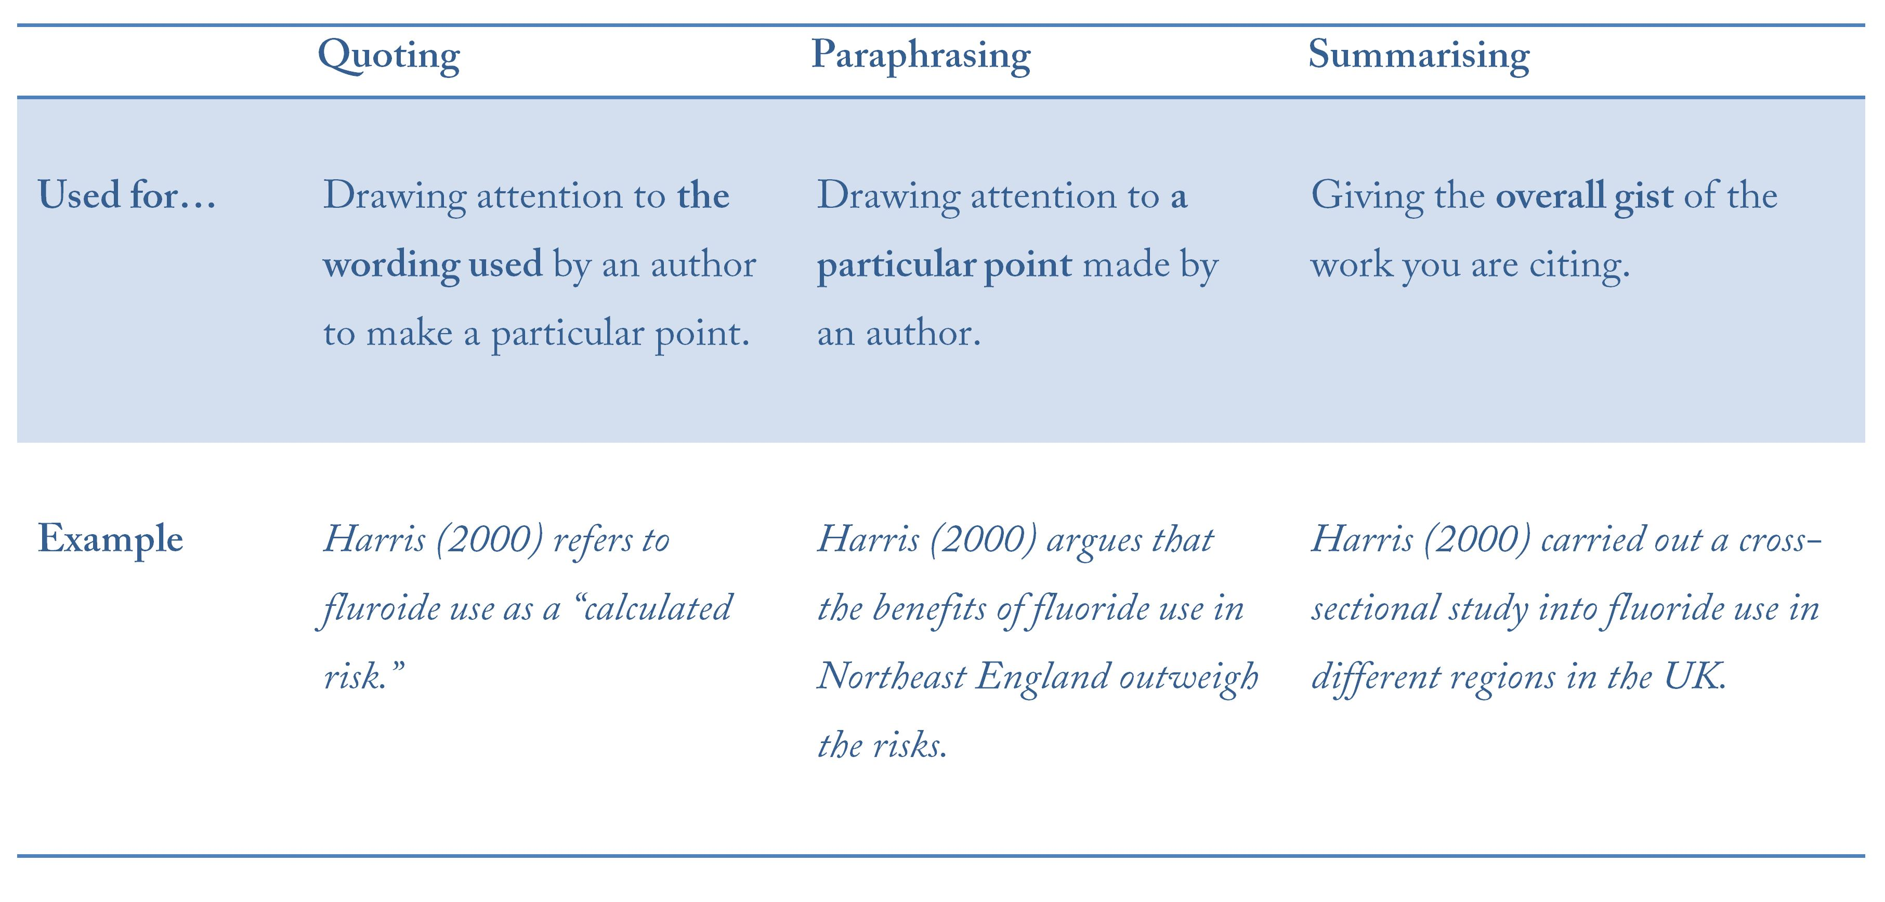

Slide 9
When and what to cite?
Within & at the end of the text when you use ideas from, or refer to, another person’s
Applies to facts, figures, ideas & theories
From: books, journals, internet, videos, lecture notes etc.
Exception: common knowledge work

Slide 10
Referencing Styles
To make sure your citations are formatted correctly and consistently, you should make sure you follow a referencing style. (Damini, & Kaur, 2018)
Some of the most common are Harvard, Chicago, MLA and Vancouver.
These styles look quite different but mostly contain the same information and have the same purpose

Slide 11
How to cite – Method vs Style
Method
• Harvard method - in-text (author, date)
• Footnotes
• Endnotes
-Check our department thesis handbook to have information about the citation and guidelines.
Style
• APA 6th • Chicago • Harvard • OSCOLA • etc.
Caution: Harvard method ≠ Harvard style

Slide 12
Books and Journal examples
APA In-text: (Bryson, 1995, pp. 12-15) or (Bryson, 1995) Reference: Bryson, B. (1995). Notes from a small island. London, England: Black Swan.
Chicago In-text: (Bryson 1995, 12-15) or (Bryson 1995) Reference: Bryson, Bill. 1995. Notes From a Small Island. London : Black Swan
APA In-text: (Secker, 1997, p. 56) or (Secker, 1997) Reference: Secker, J. (1997). The digital library: A new perspective. Journal of Documentation, 13(2), 53-65.
Chicago In-text: (Secker 1997, 56) or (Secker 1997) Reference: Secker, Jane. 1997. “The Digital Library: A New Perspective.” Journal of Documentation 13(2):53-65.

Slide 13


“In-text” styles
When using an in-text style, you include part of the reference (often the author’s surname and the year) as you write, like this:
You then provide a Reference List at the end of the document with more complete information about the source:
Hall notes that genetic disorders can be effectively studied by following 20-30 affected individuals over the course of their lives. (Hall, 2017)
Hall, J.G. 2017, "The Clinic Is My Laboratory: Life as a Clinical Geneticist", Annual Review of Genomics and Human Genetics, vol. 18, no. 1, pp. 1-29.

Slide 14
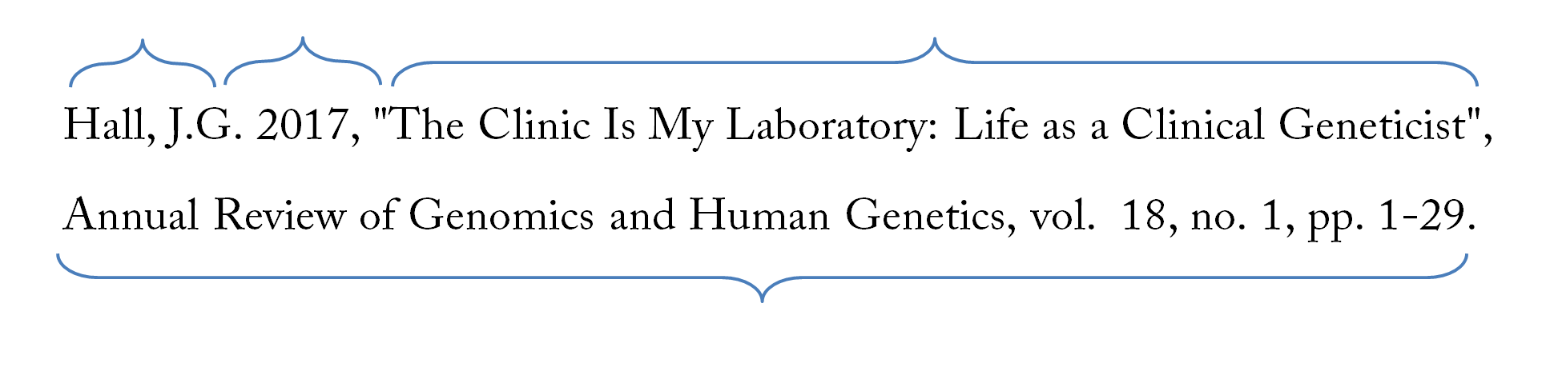
“In-text” styles
In-text styles tell us the Who and When in the text itself. Eg. (Hall, 2017)
The Reference List then gives us the rest of the information we need to find the source.
This is an in-text reference for a journal article.
Who
(author)
When
(year)
What
(title of article)
Where
(title, volume, issue number and page range of journal)

Slide 15
“Footnote” styles
When using a footnote style, you insert a superscript number into the text after you make a reference...
...and then you include a full citation at the bottom of the page.
Valenzuela finds a strong correlation between occupational
Status and party support in the national elections of 1970.⁸
A. Valenzuela, The Breakdown of Democratic Regimes: Chile (Baltimore, MD: Johns Hopkins University Press, 1988), pp.86-87.

Slide 16

“Footnote” styles
This is how a footnote style reference for a book tells us everything we need to know to find the source.
Who
(author)
What
(title of article)
Where
(place of publication)
Where cont.
(name of publisher)
When
(year)

Slide 17
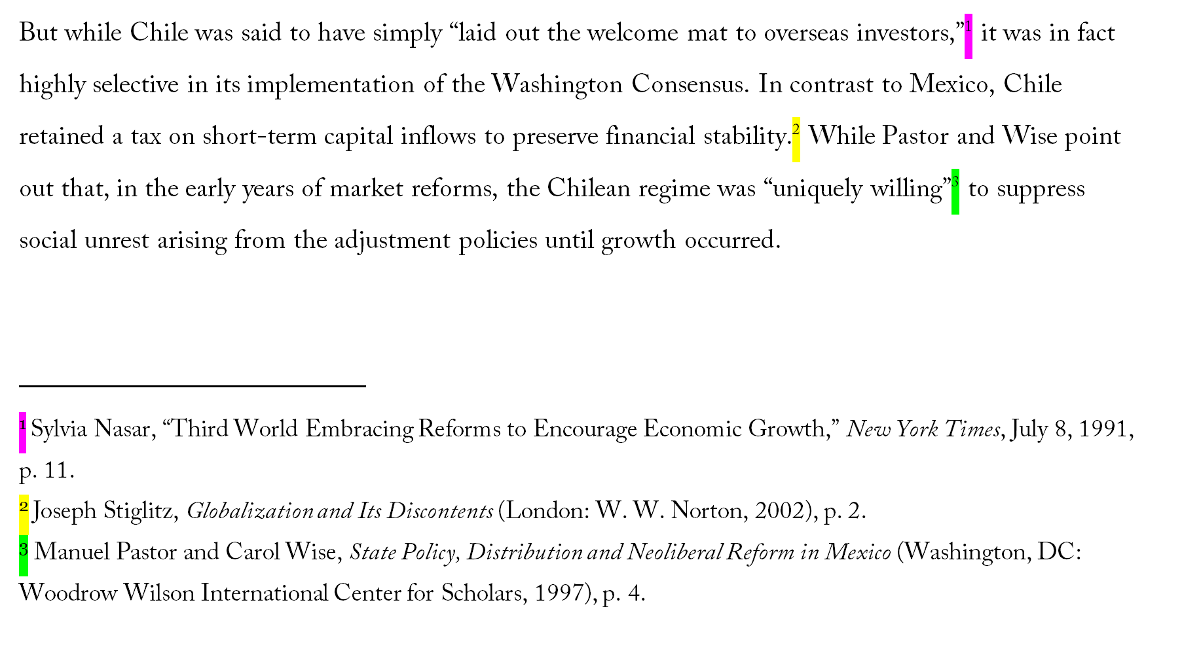
Footnote Referencing
Here’s how you would reference that same passage in a footnote style.
Footnotes
“Superscript” numbers after the punctuation correspond to the number of the footnote.
References
Full details of the source included at the foot of the page.

Slide 18
Quoting and Paraphrasing — In-text referencing
Direct quotations
The author’s exact words in quotation marks integrated into the student’s own sentence
Introductory phrase
The student’s own ideas provides the framing of the sentence
But while Chile was said to have simply “laid out the welcome mat to overseas investors,” (Nasar 1991, p. 11) it was in fact highly selective in its implementation of the Washington Consensus. In contrast to Mexico, Chile retained a tax on short-term capital inflows to preserve financial stability (Stiglitz, 2002). While Pastor and Wise (1997) point out that, in the early years of market reforms, the Chilean regime was “uniquely willing” (p. 4) to suppress social unrest arising from the adjustment policies until growth occurred.
Paraphrase/ summary
A point from another source, explained in the student’s own words
In-text reference
Surname and year. Full information on the source is located in the Reference List
Page numbers
Used to show the exact location of a quote or paraphrased point

Slide 19
Reference List — In-text referencing
Reference List
Provides complete information for all of the in-text citations at the end of the assignment
Formats
Different formats (books, journals etc.) require slightly different pieces of information. Consult Cite Them Right Online or a good style guide for information about what to include and in what order.
Reference
Nasar, S. (8th July 1991) Third World Embracing Reforms to Encourage Economic Growth. The New York Times [online]. Available from: http://query.nytimes.com/gst/fullpage.html?res=9D0CE0DD1F3DF93BA35754C0A967958260 [Accessed 20th January 2020]
Pastor, M., Wise, C. (1997) State Policy, Distribution and Neoliberal Reform in Mexico. Washington, DC, Woodrow Wilson International Center for Scholars.
Stiglitz, J. E. (2002) Globalization and Its Discontents. London, W.W. Norton.
Sources
Listed in alphabetical order by lead author’s surname

Slide 20

Reference Management Tools
Reference Management software program that simplify the process of reference management by allowing the user to collect, store, and organize references, insert citations at the appropriate place in the body of the manuscript, and generate a list of the references in an appropriate format of bibliographic styles.
E.g. EndNote, Mendeley, RefME
Source: (Saxena & Kaushik, 2021)

Slide 21
Ignoring the need to acknowledge the work of other would result one of the serious academic offence, Plagiarism

Slide 22

Plagiarism
If you don’t acknowledge sources, you may be accused of plagiarism
Plagiarism is the act of using another person's ideas as if they are your own regardless of whether he is a scientist or a student.
Examples of Plagiarism
Turning in someone else's work as your own.
Copying large pieces of text from a source without citing that source.
Taking passages from multiple sources, piecing them together, and turning in the work as your own.
Copying from a source but changing a few words and phrases to disguise plagiarism.
Paraphrasing from a number of different sources without citing those sources.
Buying an essay or paper and turning it in as your own work.
Source: (Hua-ying, 2008)

Slide 23
It does not matter if the person whose work you have cited is alive or dead. If it is not your own idea, you must cite your source!
If you translate or paraphrase something, you must still give a citation.
If you use a picture from the Internet, you must cite the source.

Slide 24
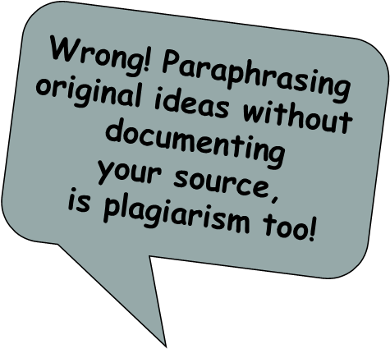
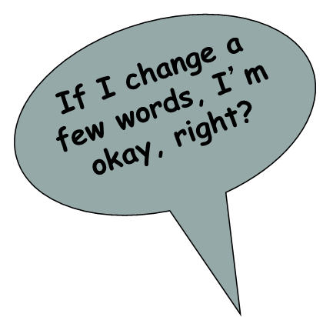
You may have been told that if you put something into your own words, you need not cite. This is incorrect. The material is still someone else’s idea and requires acknowledgement.
Paraphrasing requires a citation.

Slide 25
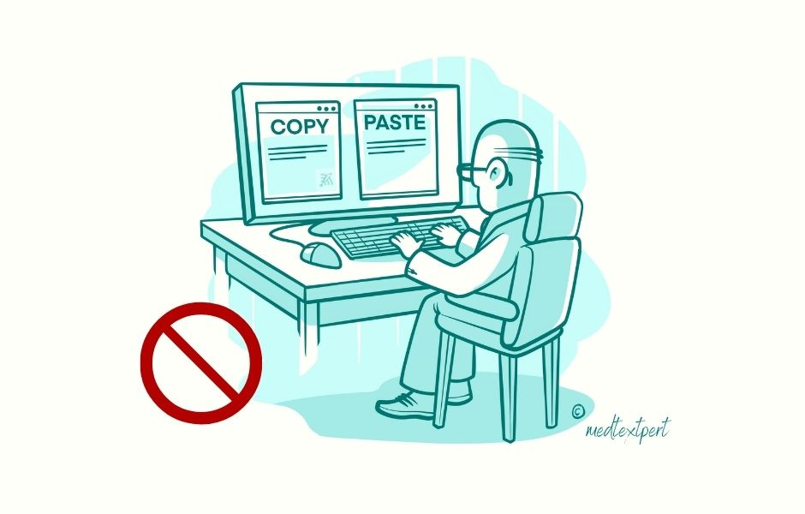

Plagiarism
Intentional
  Copying a friend’s work
  Buying or borrowing papers
  Cutting and pasting blocks of text from electronic sources without documenting
  Media “borrowing” without documentation
Unintentional
  Careless paraphrasing
  Poor documentation
  Failure to use your own “voice”

Slide 26
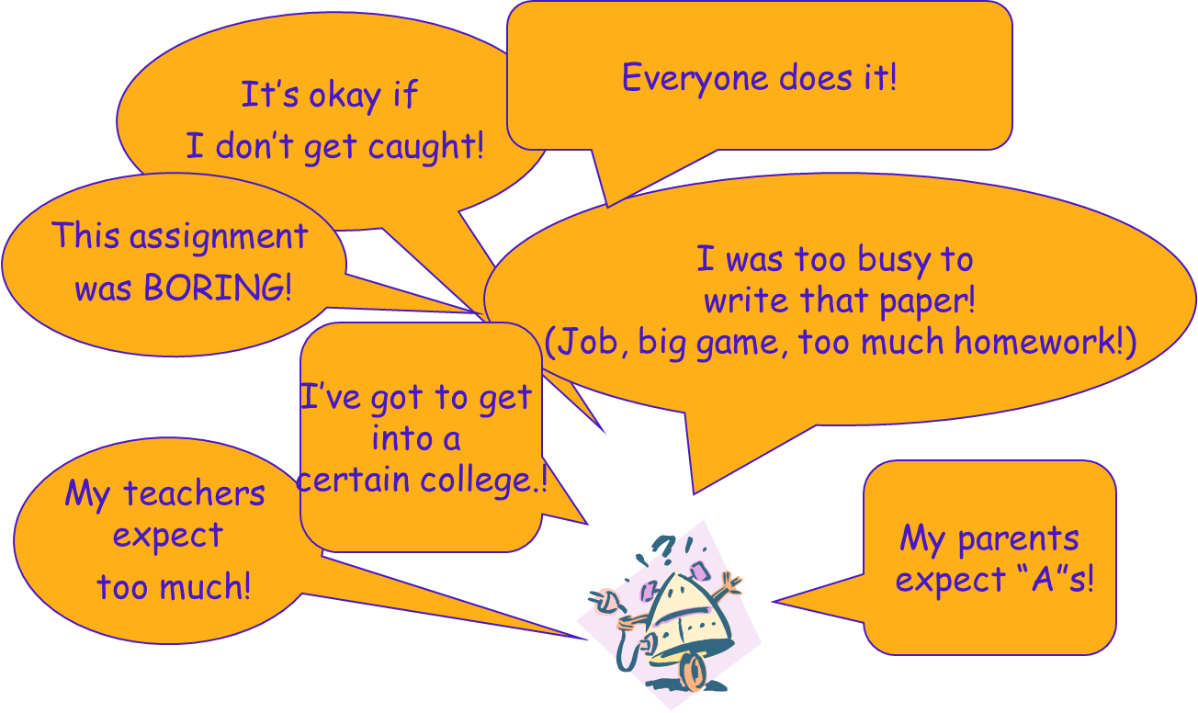
Why did you copy?

Slide 27
Is this important?
What if:
  Your architect cheated his way through math class. Will your new home be safe?
  Your lawyer paid for a copy of the bar exam to study. Will the contract she wrote for you stand up in court?
  The accountant who does your taxes hired someone to write his papers and paid a stand-in to take his major tests? Does he know enough to complete your tax forms properly?
      (Lathrop and Foss 87)

Slide 28
Do I have to cite everything?
Facts that are widely known, or
Information or judgments considered “common knowledge”
Do NOT have to be documented.

Slide 29
Consequences
Scholarly reputation
Grades
Dissertation not accepted
Expulsion from university/no degree
Expulsion from professional organizations
Loss of job (GA/faculty)
Source: (Hua-ying, 2008)

Slide 30
Reference And Sources To Expand Your Knowledge
Uzuegbu, C. P., & Onyenachi, J. C. (2015). BIBLIOGRAPHIC CITATION AND REFERENCING METHOD. InAhiaomaIbegwam, Fundamentals of library and information science education. Ibadan, Nigeria: Stirling-Horden, 97-120.
Dibley, J., & Machanick, P. (2021). Citation and referencing guidelines. South African Computer Journal, 33(2), 72-78.
Dawe, L., Stevens, J., Hoffman, B., & Quilty, M. (2021). Citation and referencing support at an academic library: Exploring student and faculty perspectives on authority and effectiveness. College & Research Libraries, 82(7), 991.
Liu, Y., & Rousseau, R. (2013). Interestingness and the essence of citation. J. Documentation, 69, 580-589. https://doi.org/10.1108/JD-07-2012-0082.
Teufel, S., Siddharthan, A., & Tidhar, D. (2006). Automatic classification of citation function. , 103-110. https://doi.org/10.3115/1610075.1610091.
Brime, A., & Bajalan, F. (2017). Incorporating Outside Sources in Kurdish EFL Students’ Academic Writing. European Scientific Journal, ESJ, 13, 307-307. https://doi.org/10.19044/ESJ.2017.V13N31P307.
, D., & Kaur, P. (2018). Reference Styles: Implications of Citation Standards. International Journal of Current Engineering and Technology. https://doi.org/10.14741/ijcet/v.8.4.18.
Saxena, R., & Kaushik, J. (2021). Referencing Made Easy: Reference Management Softwares. Indian Pediatrics, 59, 245-249. https://doi.org/10.1007/s13312-022-2478-5.
Hua-ying, Z. (2008). The concept and legal nature of plagiarism. Journal of Xinyang Agricultural College.

