Slide 1

Fundamentals of Academic Paragraphs
Omar Farouk Al Mashhour
Academic Research and Writing (BUS 149)
Semester Fall
Week Three
Sunday12th of January 2025

Slide 2
Outline
Objectives
Fundamental vocabulary in writing process
The six steps of process writing
Pre-writing
Choosing and narrowing your topic
Gathering ideas
Making a list
Free-writing
Mapping
Edit ideas
The structure of a paragraph
Paragraph organization
The development of a paragraph
Concluding sentences

Slide 3
Objectives
Identify the essential components of academic paragraphs including topic sentences, supporting details, and concluding sentences.
Understand the importance of coherence and unity in constructing academic paragraphs.
Learn techniques for effectively developing and organizing ideas within a paragraph.
Apply strategies for varying sentence structure to enhance readability and interest.
Analyze examples of effective academic paragraphs across disciplines.
Practice writing and revising paragraphs to meet academic standards

Slide 4
Let’s practice some of the main vocabulary related to writing process

Slide 5
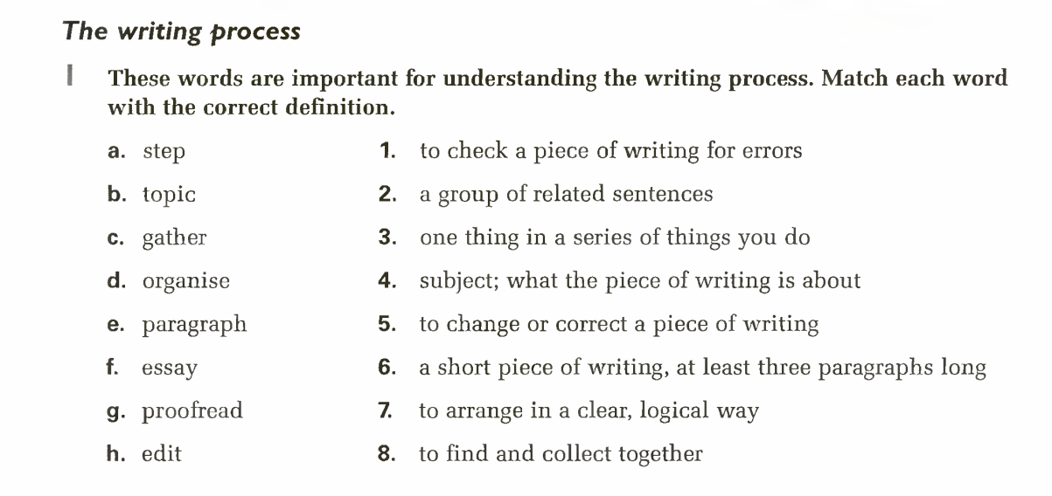

Slide 6
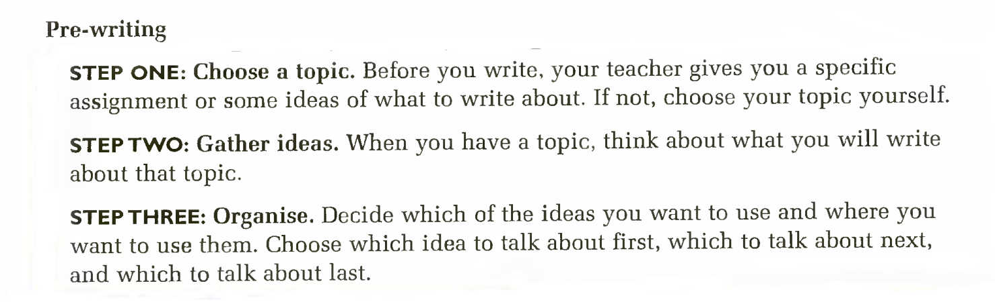
The Six Steps Of Process Writing
When we write, we do more than just put words together to make sentences. Good writers go through several steps to produce an academic piece of writing
Now, let’s Start with Pre-Writing

Slide 7
Step Four (Drafting)
Write your paragraph or essay from start to finish. Use your notes about your ideas and organization.

Slide 8
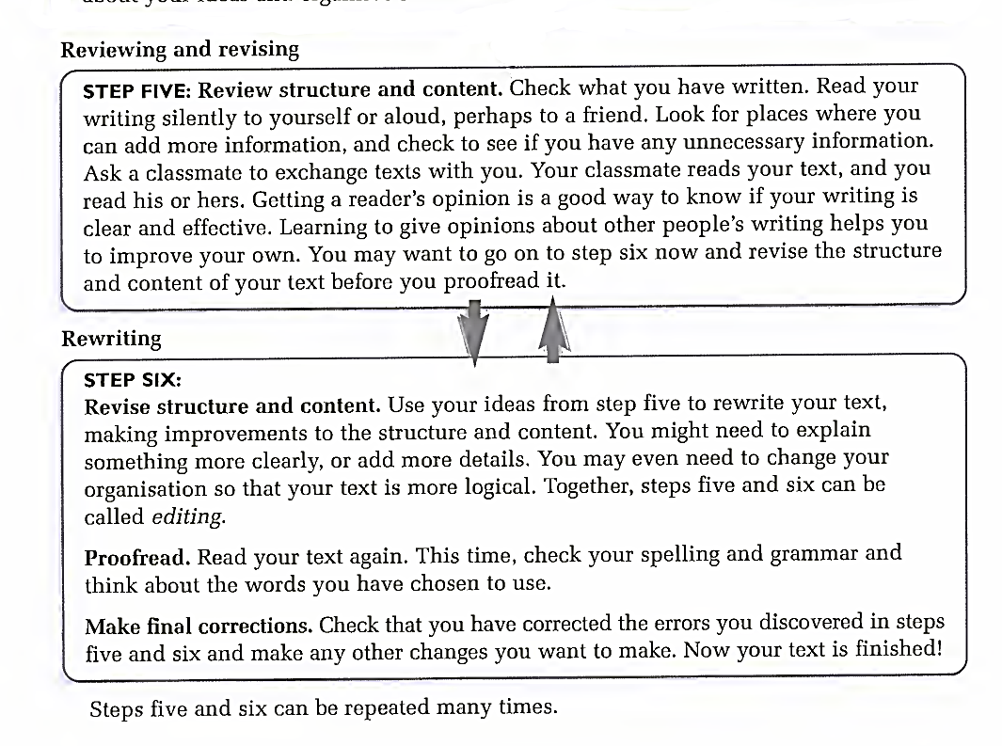
Step Five and Six

Slide 9
Pre-Writing
Before you begin writing, you decide what you are going to write about. Then, you plan what you are going to write. This process of called pre-writing.
These steps involves:
1. Choosing and narrowing the topic
2. Gathering ideas
3. Edit ideas

Slide 10
Choosing and narrowing a topic
(How to choose a topic for a paragraph)
A paragraph is a group of five to ten sentences that give information about a topic.
Before you write, you must choose a topic.
Choose a topic that isn’t too narrow (limited, brief). A narrow topic will not have enough ideas to write about. The ages of my brother and sisters is too narrow. You cannot write much about it.
Choose a topic that isn’t too much broad (general). A broad topic will have too many ideas for just one paragraph. Most paragraphs are five to ten sentences long. Schools is too general. There are thousands of thing you can say about it.
A student could narrow this topic by choosing one aspect of schools to discuss.
School could be narrowed …… Secondary school in my country / popular school club etc.

Slide 11
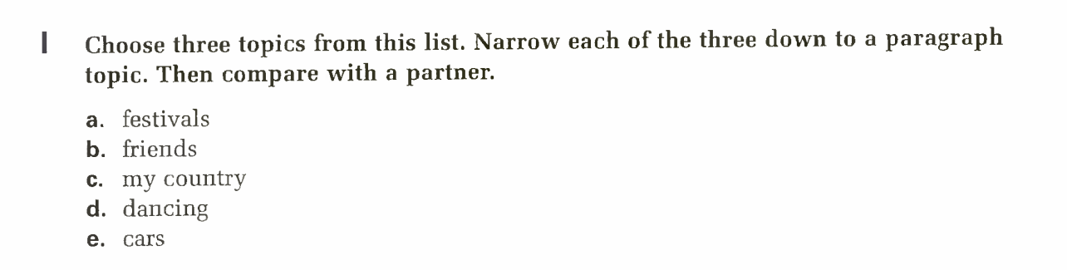
Exercise

Slide 12
Gathering ideas
Brainstorming is a way of gathering ideas about a topic. Think of a storm; thousands of drops of rain, all coming down together.
Now, imagine thousands of ideas ‘raining’ down onto your paper!
When you do brainstorm, write down every idea that comes to you.
Don’t worry now about whether the ideas are good or silly, useful or not.
You can decide that later. Right now, you are gathering as many ideas as you can.
We have three types of brainstorming
Making a list
Freewriting
Mapping

Slide 13
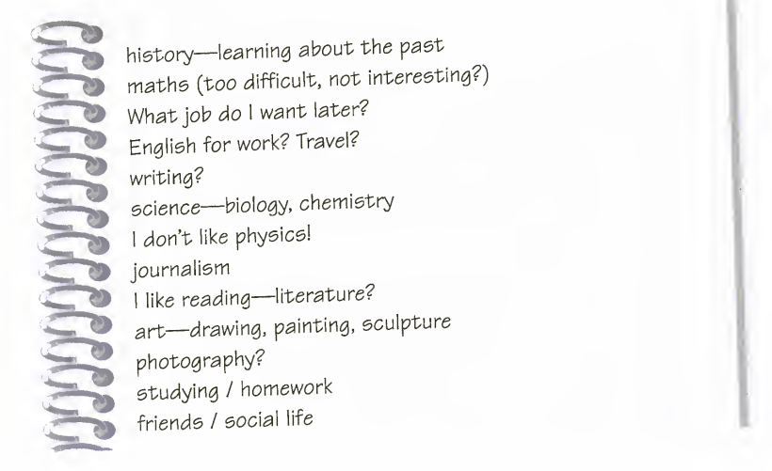
Making a list
Write single words, phrases, or sentences that are connected to your topic.
Look at this list a student made when brainstorming ideas to write about his/her topic “what should I study at university”

Slide 14
Activity (1)
Choose one of these topics. List down as many ideas as you can in five minutes .
A) Teenage fashion
B) Things to do at the beach
C) Driving a motorbike

Slide 15
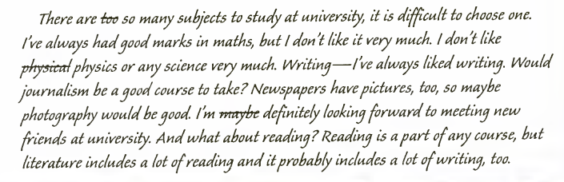
Freewriting
When you free write, you write whatever comes into your head about your topic, without stopping. Most freewriting exercises are short – just five to ten minutes.
Freewriting helps you practice fluency (writing quickly and easily). When you free write, you don’t need to worry about accuracy (having correct grammar and spelling). Don’t check your dictionary when you free write. Don’t stop if you make a mistake. Just keep writing! Here is an example of a student’s freewriting;

Slide 16
Freewriting
Notice how the writer’s ideas jump around. When he/she makes a mistake, she/he just crosses it out and continues writing. One thought (writing) leads to another (journalism), and then to another (photography).
There are some details that are not exactly about the topic (looking forward to meeting new friend), but that’s okay in freewriting. You want to get as many ideas on paper as you can.
You can take out unnecessary words and sentence later.

Slide 17
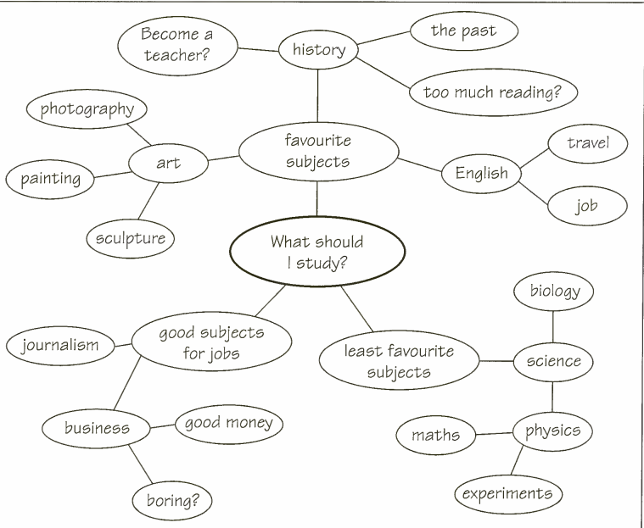
Mapping
To make a map, use a whole sheet of paper, and write your topic in the middle with a circle around it. Then, put the next idea in a circle above or below your topic and connect the circles with lines. The lines show that the two ideas are related.
The example shows a map of ‘what should I study at university?’ the writer connected favorite subjects to the main ideas. Art and English are connected to favorite subjects to show that they are related.

Slide 18
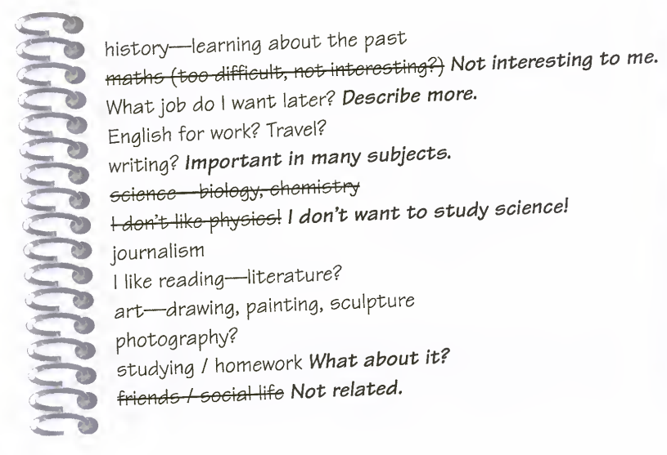
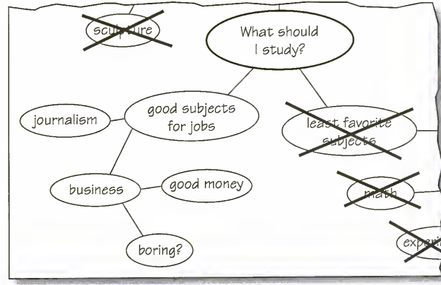
Edit Ideas
After you have gathered plenty of ideas, you will need to go back and edit them. This is the time to choose which ideas are the most interesting, and which are the most relevant to (important or necessary for) your topic. Of course, you can still add new ideas if you think of something else while you are re-reading your list.
to edit freewriting, cross out sentences or parts of sentences that are related. You can add more ideas in the margin or add more ideas in the margin or add more sentences at the bottom. To edit a map, cross out circles that don’t belong, and add new ones of you get more ideas. You might also change the lines you have drawn.

Slide 19
The Structure Of A Paragraph
What is a paragraph?
Paragraph is a group of sentences about a single topic. Together, the sentences of the paragraph explain the writer’s main idea (most important idea) about the topic. In academic writing, a paragraph is often between five and ten sentence long, but it can be longer or shorter, depending on the topic. The first sentence of a paragraph is usually indented (moved in) a few spaces.

Slide 20
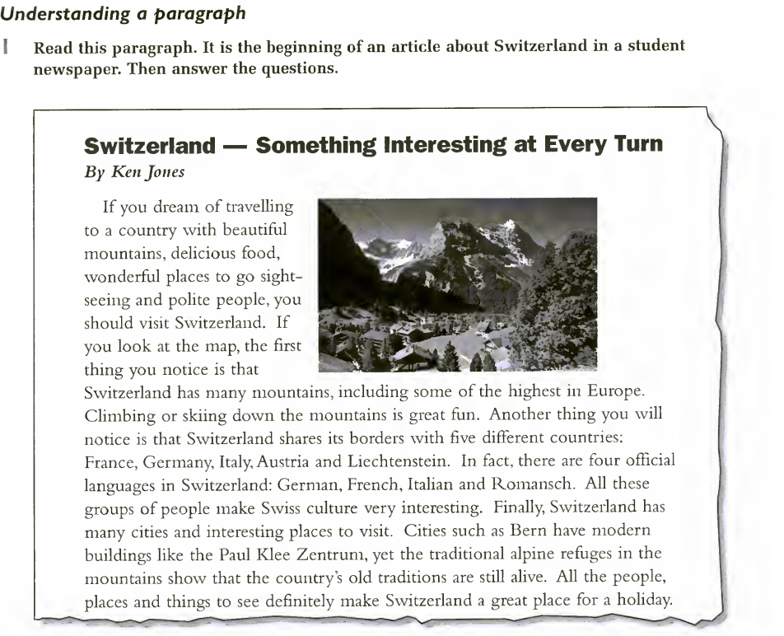
What is the main topic of the paragraph ?
What is the main idea about the topic?
What ideas help explain the main idea?

Slide 21
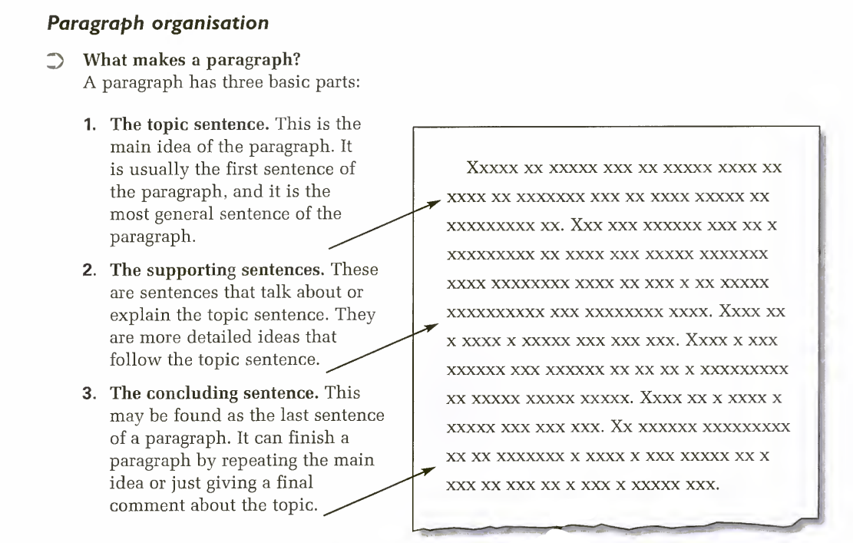
Paragraph Organization

Slide 22
Read the paragraph about Switzerland. Circle the topic sentence, put one line under the supporting sentences, and put two lines under the concluding sentence

Slide 23
The Development Of A Paragraph
After you have chosen a topic and written a topic sentence, you develop your main idea by adding more information to explain what you mean. There are three common ways to develop a paragraph: giving details, giving an explanation, and giving an example.
Details
Details are specific points that tell more about a general statement.
Explanation
An explanation tell the reader what something means or how something works.
Example
An example is a specific person, place, thing, or event that supports an idea or statement.

Slide 24
Concluding sentences
How to end a paragraph
The final sentence of a paragraph is called the concluding sentence. It sums up the main points or restates the main idea on a different way. A sentence that sums up the paragraph reminds the reader of what the writer’s main idea and supporting points were.
A sentence that restates the main idea should given the same information in a slightly different way, perhaps by using different words order. A concluding sentence should not introduce a new point.

Slide 25
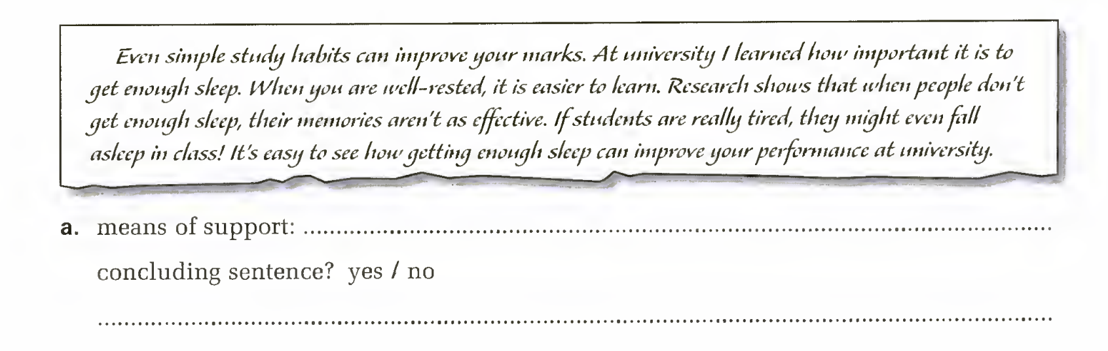
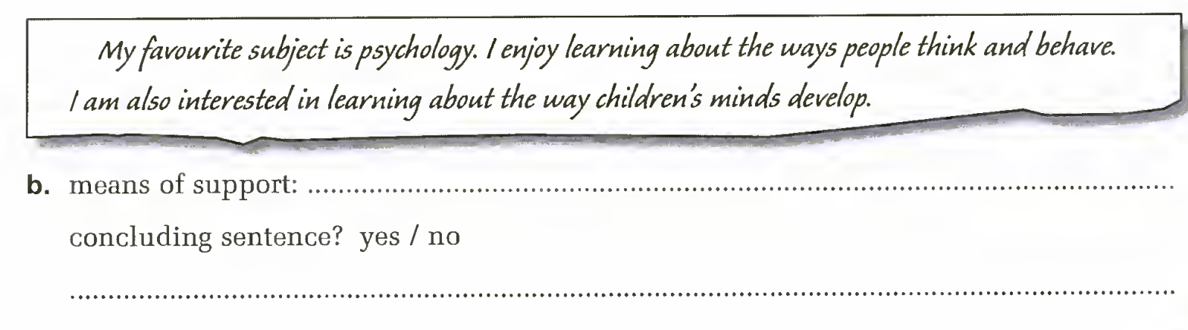

Slide 26
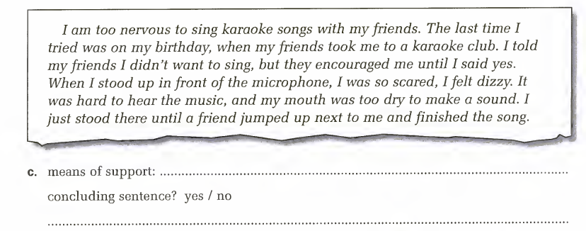
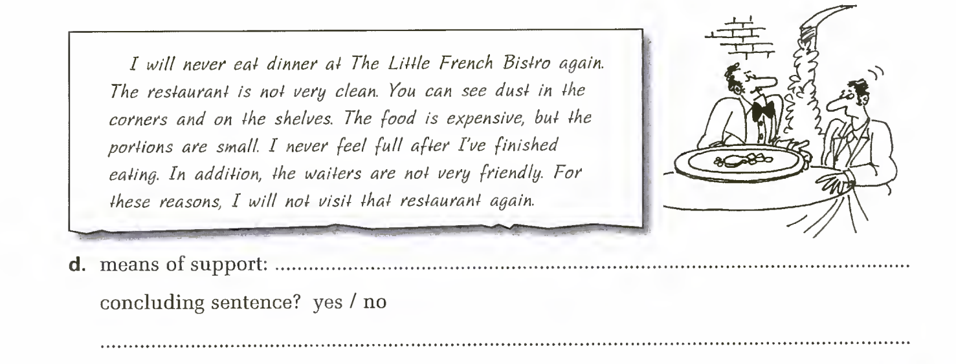

Slide 27
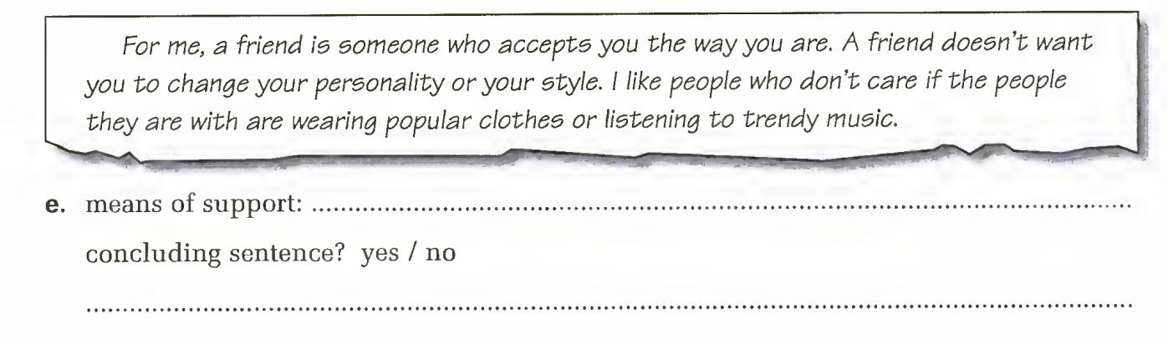

Slide 28
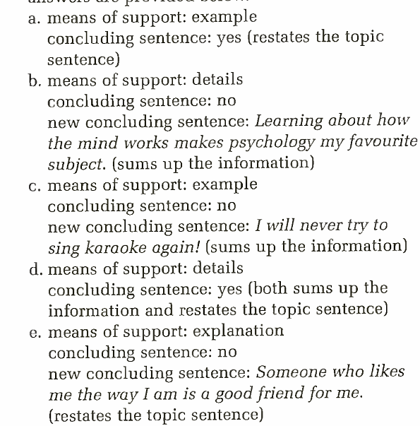
Answers

Slide 29
References (in APA style)
Coursebook: Zemach, D. E., & Rumisek, L. A. (2005). Academic Writing – from paragraph to essay. Macmillan.

