Slide 1

Academic Research and Writing
Genre of Academic Writing
Omar Farouk Al Mashhour
Academic Research And Writing (Bus 149)
2023-2024 Fall
Week Two
Sunday, 22nd Of December 2025

Slide 2

Outline
Recap
The significance of Academic Writing
Be careful, Formal language is essential
The purpose of academic writing
Different type of academic writing
Can I use more than one form of writing together
Form VERSUS Types of Academic Writing
Forms of academic writing
The format of short and long writing tasks
Exercises
Reference

Slide 3
Learning Outcome
Students will be able to define what constitutes academic research and articulate the differences between academic and non-academic research.
Students will identify and describe four major genres of academic writing (e.g., descriptive, analytical, persuasive, critical) and outline the structural components of different forms of academic writing (e.g., essays, research papers, reports) with examples by the end of the course.
Students will critically analyze and reflect on the types and structures of academic writing, identifying key characteristics and effectiveness of the form and type used by the end of the semester.

Slide 4

Recap
What are the differences between academic and non-academic writing?
What are the meaning of Academic, Research and Writing?

Slide 5
Be Careful, Formal Language Is Essential
You can make your writing more formal through the vocabulary that you use. For academic writing:
Choose formal instead of informal vocabulary. For example ‘somewhat’ is more formal that ‘a bit” and ‘insufficient’ is more formal that ‘not enough’.
Avoid contractions. For example, use ‘did not’ instead of ‘didn’t”
Avoid emotional language. For example, instead of strong words such as ‘wonderful’ or ‘terrible’ use more moderate words such as ‘helpful’ or ‘problematic’
Instead of using absolute positives and negative, such as ‘proof’ or ‘wrong’, use more cautious evaluation, such as ‘strong evidence’ or ‘less convincing’
Source: (Ruiz-Garrido et al., 2010)

Slide 6

The Purpose Of Academic Writing
To report on a piece of research the writer has conducted
To answer a question the writer has been given or chosen
To discuss a subject of common interest and give the writer's view
To synthesize research done by others on a topic
Source: (Ferreira, 2020)

Slide 7
Different Type Of Academic Writing
Descriptive
Analytical
Persuasive
Critical

Slide 8
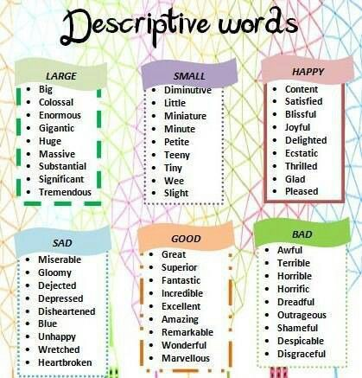
Descriptive Writing
Descriptive writing is one of the simplest and most used academic writing types.
The main purpose of descriptive writing is to state facts and inform the audience.
Therefore, when you hear these terms in any academic piece – report , summarize, identify, record, define- know that is descriptive writing, which is mostly used for school level writing and completely theory-based projects.

Slide 9
Descriptive Writing
A lab report that inform the reader about the result of an experiment is an example of descriptive writing.
Descriptive writing is also used for describing people, place, situations, events, etc.

Slide 10
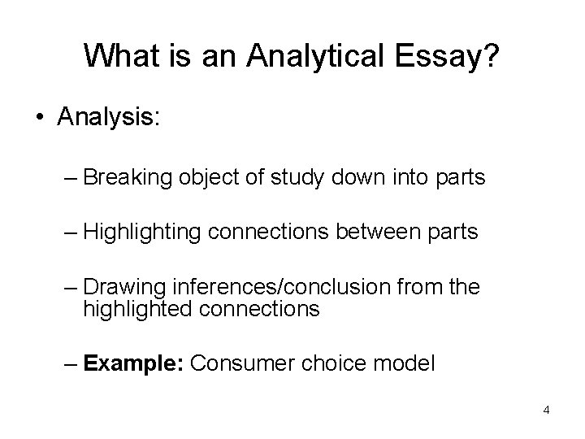
Analytical Writing
When you are working on an academic study, you usually do not only use descriptive writing.
You must mix and match different types of writing to convery your message to your target group.
Therefore, aside form simply informing, you need to also organize your information in a way that allows you readers to understand content better.
Analytical writing includes descriptive writing, but also requires you to re-organize the facts and information you describe into categories, groups, parts, types or relationships.

Slide 11
Analytical writing
If you’re comparing two theories, you might break your comparison into several parts.
Ex, how each theory deals with the social context, how each theory deals with the language learning, how each theory can be used in practice.
Phrase such as examine , compare, relate, contrast, analyze are the most common words used in analytical writing.

Slide 12
How to get better at analytical writing
Spend plenty of time planning. Brainstorm the facts and ideas, and try different ways of grouping them, according to patterns, parts, similarities and differences.
Create a name for the relationship and categories you find. For example, advantages and disadvantages.
Build each section and paragraph around one of the analytical categories.
Make the structure of your paper clear to your reader, by using topic sentence and a clear introduction.

Slide 13
Persuasive Writing
Percussive writing has all the features of analytical writing (that is, information, plus re-organizing the information), with the addition of your own point of view.
Most essays are persuasive and there is a persuasive elements in at least the discussion and conclusion of a research article.
Points of view in academic writing can include an argument, a recommendation, interpretation of your finding or evaluation of the work of others. In persuasive writing, each claim you make needs to be supported by some evidence, for example, a reference to research finding or published sources.
The kinds of instructions for a persuasive assignment include, argue, evaluate, discuss, take a position.

Slide 14
To help reach your own point of view on the facts or ideas
Read some of other researchers’ points of view on the topic. Who do you feel is the most convincing?
Look for patterns in the data or references. Where is the evidence strongest?
List several different interpretations. What are the real-life implications of each one? Which ones are likely to be most useful or beneficial? Which ones have some problems?

Slide 15
Critical Writing
Critical writing is common for research, postgraduate and advanced undergraduate writing.
It has all the features of persuasive writing, with the added feature of at least one other point of view. While persuasive writing requires you to have your own point of view on an issue or topic, critical writing requires you to consider at least two points of view including your own.
For example, you may explain a researcher’s interpretation or argument and then evaluate the merits of the argument, or give your own alternative interpretation.
Example of critical writing assignment include a critique of a journal article, a literature review that identifies the strengths and weaknesses of existing research. The kinds of instructions for critical writing include: “critique, debate, disagree, evaluate”

Slide 16
To write critically, you need to:
Accurately summaries all or part of the work. This could include identifying the main interpretations, assumptions or methodology.
Have an opinion about the work. Appropriate types of opinion could include pointing out some problems with it, proposing an alternative approach that would be better, and/or defending the work against the critiques of others.
Provide evidence for your point of view. Depending on the specific assignment and the discipline, different types of evidence may be appropriate, such as logical reasoning, reference to authoritative sources and/or research data.

Slide 17
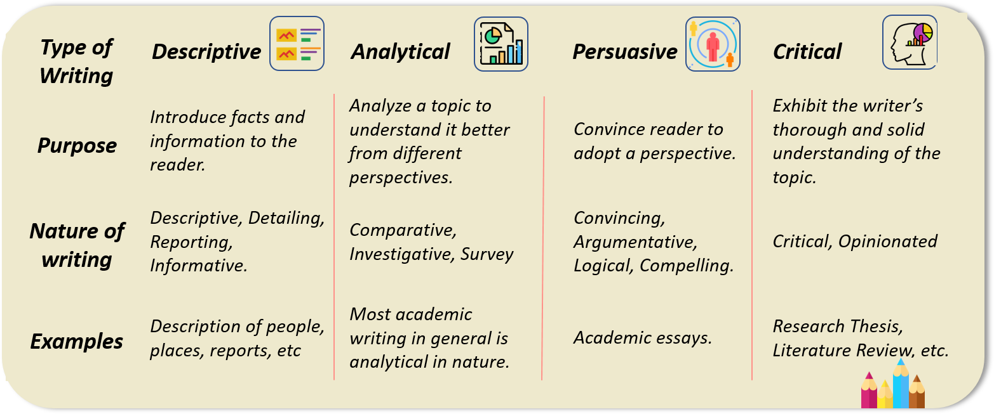
Source: (Yadav, 2020)

Slide 18
Can I use more than one form of writing together
In many academic texts you will need to use more than one type.
For example, in a thesis:
You will use critical writing in the literature review to show where there is a gap or opportunity in the existing research.
The methods section will be mostly descriptive to summarizes the methods used to collect and analyze information.
The results section will be mostly descriptive and analytical as you report on the data you collected
The discussion section is more analytical as you relate your findings back to your research questions, an also persuasive, as you propose your interpretation of the finding.

Slide 19
Form VERSUS Types of Academic Writing
Aspect | Forms of Academic Writing | Types of Academic Writing
Definition | Refers to the overall format and organization of the document. | Refers to the purpose, style, and approach of the writing.
Examples | - Essays- Research papers- Reports- Theses/Dissertations | - Descriptive- Analytical- Persuasive- Critical
Structure | Dictates specific sections and order. | Affects presentation and argumentation within the sections.
Purpose | Guides the physical layout and coverage of the topic. | Focuses on conveying, analyzing, persuading, or critiquing content.
Example of Form | Research Paper: Abstract, Introduction, Method, Results, Discussion, Conclusion | Persuasive: Starts with a thesis, presents evidence, concludes with a strong position
Characteristic | More rigid and predictable. | More flexible, varies according to the goal of writing.

Slide 20
Form | Definition | Example
Notes | Records documenting key information and main points from various sources. informal but essential part of the academic process | Key points from a lecture on business.
Essays | A piece of writing on a particular subject presenting the author's argument. | Expository essay on the impact of climate change on agriculture.
Research Papers | In-depth study and analysis of a particular topic, issue, or problem based on primary or secondary research. | Study on the effects of a new teaching method on student performance.
Reports | Structured documents conveying information, findings, or recommendations from research or analysis. | Business report analyzing quarterly sales data.
Projects | Extensive tasks demonstrating applied knowledge and skills, often culminating in a tangible product. | Designing and constructing a prototype of an energy-efficient vehicle.
Theses/ Dissertations | Long-form piece of academic writing based on original research submitted for an academic degree. | Doctoral (PhD) dissertation investigating internet use and mental health of teenagers.

Slide 21
Short Vs. Long writing tasks

Slide 22
Short essays (including exam answers) generally have this pattern:
Introduction
Main body
Conclusion

Slide 23
Longer essays and reports may include
Introduction
Main body
Literature review
Case study
Discussion
Conclusion
References
Appendices

Slide 24
Dissertations and journal articles may have:
Abstract
List of contents
List of tables
Introduction
Main body
Literature review
Case study
Findings
Discussion
Conclusion
Acknowledgments
Notes
References
Appendices
In addition to these sections, books may also include:
Foreword
Preface
Bibliography/Further reading

Slide 25
Let's Practice Reviewing What We've Learned.

Slide 26
Discuss the meanings of the preceding terms
Do some research and I will pick a student randomly to explain to us.

Slide 27
Match the following definitions to terms in the preceding lists:
a) A short summary which explains the paper’s purpose and main findings.
b) A list of all the sources the writer has mentioned in the text.
c) A section, after the conclusion, where additional information is included.
d) A short section where people who have helped the writer are thanked.
e) Part of the main body in which the views of other writers on the topic are discussed.
f ) A section where one particular example is described in detail.
g) A preliminary part of a book usually written by someone other than the author.

Slide 28
Reference
Description and discussion of types of writing reproduced, with permission, from "Types of Academic Writing" by University of Sydney Learning Centre https://sydney.edu.au/students/writing/types-of-academic-writing.html ↵
Ruiz-Garrido, M., Palmer-Silveira, J., & Fortanet-Gómez, I. (2010). English for professional and academic purposes. . https://doi.org/10.1163/9789042029569.
Ferreira, J. (2020). Writing Is Seeing – towards a Designerly Way of Writing. The Design Journal, 23, 697 - 713. https://doi.org/10.1080/14606925.2020.1806521.
Yadav, K. (2020). Types of Content Writing. Retrieved from https://www.evelynlearning.com/types-of-content-writing/

