Slide 1
Ishik International University Nursing Department Fundamental of Nursing Infection Control
Assist. Prof: Halmat Authman Rasheed

Slide 2
Infection control

Slide 3
Introduction
Nurses are responsible for providing quality care that incorporates infection-control principles. These principles are a major component of a safe environment.

Slide 4
Microorganisms exist everywhere: in water, in soil, and on body surfaces such as the skin, intestinal tract, and other areas open to the outside (e.g., mouth, upper respiratory tract, vagina, and lower urinary tract).

Slide 5
FLORA
Flora are microorganisms that occur or have adapted to live in a specific environment, such as intestinal, skin, vaginal, or oral flora.
There are two types of flora: resident and transient.

Slide 6
Resident (normal) flora are microorganisms that are always present, usually without altering the client’s health; an example would be propionibacterium on the skin. Resident flora prevent the overgrowth of harmful microorganisms.

Slide 7
Transient flora are microorganisms that are episodic (of limited duration); an example would be staphylococcus aureus.
They attach to the skin for a brief period of time but do not continually live on the skin.
Transient flora are usually acquired from direct contact with the microorganisms on environmental surfaces.

Slide 8
PATHOGENICITY AND VIRULENCE
Disease-producing microorganisms are called pathogens.
pathogenicity refers to the ability of a microorganism to produce disease.
Virulence refers to the frequency with which a pathogen causes disease.

Slide 9
The factors affecting virulence are
The strength of the pathogen to adhere to healthy cells.
The ability of a pathogen to damage cells or interfere with the body’s normal regulating systems.
and the ability of a pathogen to evade the attack of white blood cells (WBCs).

Slide 10
Pathogenic microorganisms
1- Bacteria
2- Viruses
3- Fungi
4- Protozoa
5- Rickettsia

Slide 11
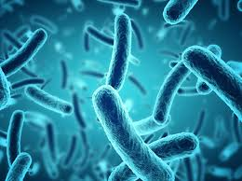
Bacteria
Bacteria are small, one-celled microorganisms that lack a true nucleus.
Bacteria can be found in all environments, yet not all bacteria are harmful or cause disease. Only a small percentage of bacteria are actually pathogenic

Slide 12
Common bacterial infections include diarrhea, pneumonia, sinusitis, urinary tract infections, cellulitis, meningitis,

Slide 13
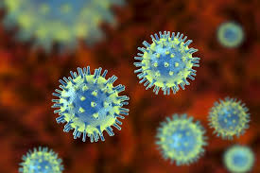
Viruses
Viruses are organisms that can live only inside cells.
They cannot get nourishment or reproduce outside cells.
Viruses contain a core of deoxyribonucleic acid (DNA) or ribonucleic acid (RNA) surrounded by a protein coating.

Slide 14
Common viral infections include influenza, measles, common cold, chickenpox, hepatitis B, genital herpes, and HIV.

Slide 15
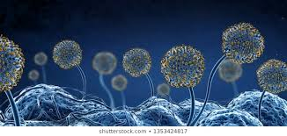
Fungi
Fungi grow in single cells, as in yeast, or in colonies, as in molds.
Most fungi are not pathogenic and make up many of the body’s normal flora.
Disease from fungi is found mainly in
individuals who are immunologically impaired.

Slide 16
Fungi can cause infections of the hair, skin, nails, and mucous membranes.

Slide 17
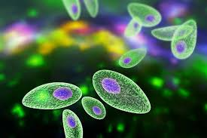
Protozoa
Protozoa are single-celled parasitic organisms.
Most protozoa obtain their nourishment
from dead tissues.
Infection is spread through ingestion of contaminated food or water or through insect bites.
Common protozoan infections include
malaria, gastroenteritis, and vaginal infections.

Slide 18
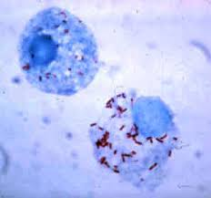
Rickettsia
Rickettsia are intracellular parasites that need to be in living cells to reproduce.
Infection from rickettsia is spread through fleas, mites, and lice.
Common rickettsia infections include Typhus.

Slide 19
COLONIZATION AND INFECTION
Colonization is the multiplication of microorganisms on or within a host that does not result in cellular injury; an example of colonization is the normal flora (microorganisms) in the intestines.
Notes:
The functions of the normal flora include digestion of substrates, production of vitamins, stimulation of cell maturation, stimulation of the immune system, aid in intestinal transit and colonization resistance

Slide 20
Infection
An infection is the growth of microorganisms in body tissue where they are not usually found. Such a microorganism is called an infectious agent.
Notes:
Infectious agents capable of being
transmitted to a client by direct or indirect contact, through
a vehicle (or vector) or airborne route are called communicable
agents. Diseases produced by these agents are referred
to as communicable diseases.

Slide 21
Infectious agents capable of being transmitted to a client by direct or indirect contact, through airborne route are called communicable agents. Diseases produced by these agents are referred to as communicable diseases.

Slide 22
CHAIN OF INFECTION
Agent
Susceptible Host
Reservoir
Chain of Infection
Portal of Entry
Portal of Exit
Mode of Transmission

Slide 23
Agent
An agent is an entity that is capable of causing disease. Agents that cause disease may be as follows:
Biological agents: Living organisms that invade the host, causing disease, such as bacteria, viruses, fungi, protozoa, and rickettsia

Slide 24
Chemical agents: Substances that can interact with the body, causing disease, such as food additives, medications, pesticides, and industrial chemicals
Physical agents: Factors in the environment that are capable of causing disease, such as heat, light, noise, and radiation.

Slide 25
Reservoir
is a place where the agent can survive. Colonization and reproduction take place while the agent is in the reservoir.

Slide 26
A reservoir that promotes growth of pathogens must contain the proper
nutrients (such as oxygen and organic matter),
maintain proper temperature, contain moisture,
maintain a compatible pH level (neither too acidic nor too alkaline),
and maintain the proper amount of light exposure.

Slide 27
The most common reservoirs are
Humans
Animals
Environment
Fomites

Slide 28
Fomites (objects contaminated with an infectious agent, such as bedpans, urinals, bed linens, instruments, dressings, specimen containers, and other equipment).

Slide 29
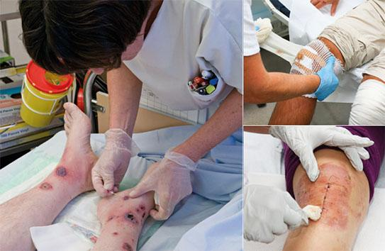
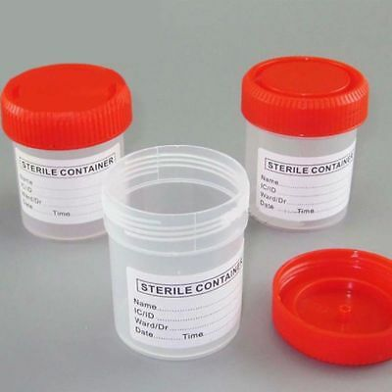

Slide 30
Humans and animals can have symptoms of the infectious agents or can be carriers of the agent.
Notes:
Carriers have the infectious agent but are symptom free. The agent can
be spread to others in both instances

Slide 31
Portal of Exit
The portal of exit is the route by which an infectious agent leaves the reservoir to be transferred to a susceptible host.

Slide 32
The agent leaves the reservoir through body secretions including:
Sputum
Semen, vaginal secretions, or urine
Saliva and feces
Blood
Tears

Slide 33
Modes of Transmission
Contact Transmission
contact transmission. This involves the transfer of an agent from an infected person to a host by direct contact with the infected person,
indirect contact with the infected person through a fomite, or close contact with contaminated secretions
Sexually transmitted diseases are spread by direct contact.

Slide 34
Airborne Transmission
Airborne transmission occurs when a susceptible host contacts droplet nuclei or dust particles that are suspended in the air.

Slide 35
Vehicle Transmission
Vehicle transmission occurs when an agent is transferred to a susceptible host by contaminated inanimate objects
such as water, food, milk, drugs, and blood. Cholera is transmitted through contaminated drinking water,

Slide 36
Vector-Borne Transmission
Occurs when an agent is transferred to a susceptible host by animate means such as mosquitoes, fleas, ticks, lice, and other animals. Lyme disease, malaria,

Slide 37
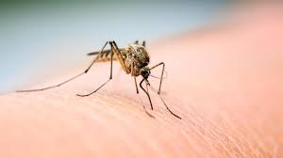
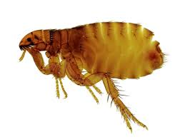
mosquitoes, fleas

Slide 38
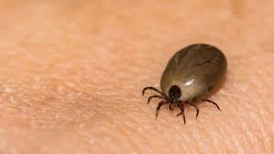
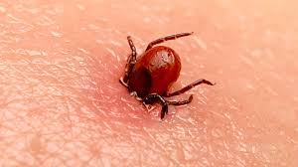
ticks

Slide 39
Portal of Entry
A portal of entry is the route by which an infectious agent enters the host.

Slide 40
Portals of entry include the following:
Integumentary system
Respiratory tract
Genitourinary tract
Gastrointestinal tract
Circulatory system
Transplacental
Notes:
• Integumentary system, through a break in the integrity of
the skin or mucous membranes (e.g., infections of surgical
wounds)
• Respiratory tract, by inhaling contaminated droplets (such
as cold, influenza, measles)
• Genitourinary tract, through contact with infected
vaginal secretions or semen (as in sexually transmitted
diseases)
• Gastrointestinal tract, by ingesting contaminated food or
water (e.g., typhoid, hepatitis A)
• Circulatory system, through the bite of insects (such as
mosquito bites resulting in malaria)
• Transplacental, through transfer of microorganisms from
mother to fetus via the placenta and umbilical cord
(including HIV, hepatitis B)

Slide 41
Host
A host is an organism that can be affected by an agent. A human being is usually considered a host.
A susceptible host is a person who has no resistance to an agent and thus is vulnerable to disease
for example, an individual who has not received the measles vaccine.

Slide 42
Characteristics of the host influence the susceptibility to and severity of infections
Age
Stress
Immunization/vaccination status
Lifestyle
Occupation
Nutritional status
Heredity

Slide 43
BREAKING THE CHAIN OF INFECTION
Nurses focus on breaking the chain of infection by applying proper infection-control practices to interrupt the transmission of microorganisms.

Slide 44
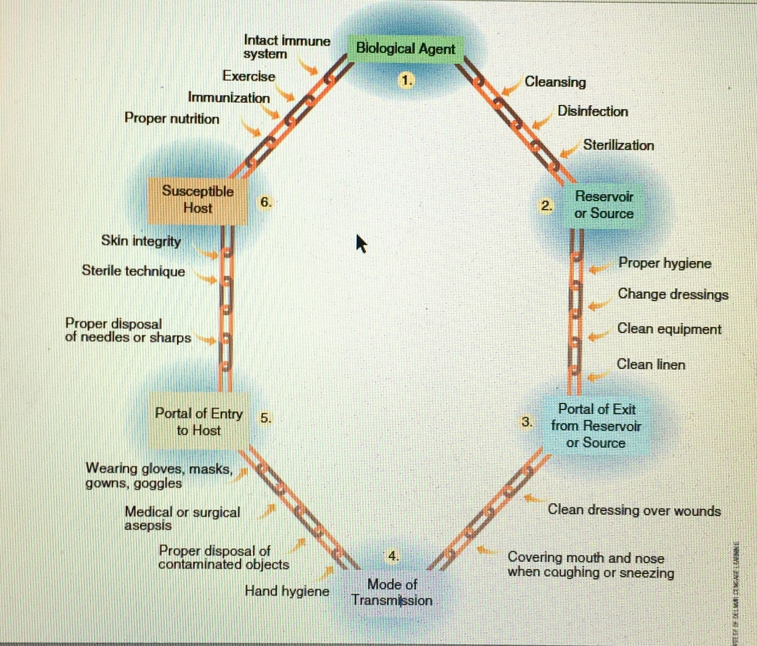

Slide 45
Between Agent and Reservoir
The keys to eliminating infection at this point in the chain are
cleansing,
disinfection,
and sterilization

Slide 46
Cleansing
Cleansing is the removal of soil or organic material from instruments and equipment used in providing client care.
Nurses often cleanse instruments after assisting or performing invasive procedures.
the objects are cleansed before sterilization or disinfection.

Slide 47
The steps for proper cleansing are:
Wet the object with cold water; warm water coagulates the proteins in organic material and makes them stick.
Apply detergent and scrub the object under running water using a soft-bristled brush.
Rinse the object under warm running water.
Dry the object before sterilization or disinfection.

Slide 48
Disinfection
Disinfection is the elimination of pathogens, except spores, from inanimate objects.
Disinfectants are chemical solutions used to clean inanimate objects.
Common disinfectants are alcohol, sodium hypochlorite,

Slide 49
Sterilization
Sterilization is destroying all microorganisms including spores. Equipment that enters normally sterile tissue or blood vessels must be sterilized.
Methods of achieving sterilization are moist heat (steam), dry heat, and ethylene oxide gas.

Slide 50
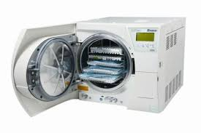
Autoclave
Autoclaving sterilization, which uses moist heat or steam, is the most common sterilization technique used in the hospital setting

Slide 51
Between Reservoir and Portal of Exit
Proper Hygiene
Clean skin, hair, and nails maintain the body’s normal flora and eliminate transient flora from the client’s system
Bathing and hand hygiene are important ways to eliminate the potential for infection.
Clients should be encouraged to practice daily bathing and teeth brushing.

Slide 52
Change Dressings
Any open injury or other break in skin integrity represents a potential reservoir for infectious agents and portal of exit for a pathogen to be transferred to another individual.
Dressings on open wounds must be changed regularly.

Slide 53
Clean Linens
Bed linens, gowns, and towels are catchalls for bodily secretions. Infectious agents can be easily transferred from one individual to the next through contact with a client’s linens.
Linens must be changed regularly, and soiled linens must be properly disposed.

Slide 54
Clean Equipment
All equipment used in the care of a client must be cleansed and disinfected after each use.
Although many items such as disposable gowns can be discarded after use,
items such as beds must be thoroughly cleansed after each use. Clients should be instructed never to share care items.

Slide 55
Between Portal of Exit and Mode of Transmission
The goal in breaking the chain of infection between the portal of exit and the mode of transmission is to prevent the exit of the infectious agents.
Clean dressings must be maintained on all wounds.
Clients should be encouraged to cover their mouths and noses when sneezing or coughing,

Slide 56
Between Mode of Transmission and Portal of Entry
asepsis must be ensured and barrier protection worn.
Gloves, masks, gowns, and goggles are barrier protection that can be used.
Proper hand hygiene

Slide 57
disposal of contaminated equipment and linens are ways to prevent transmission of microorganisms to other clients and health care workers.

Slide 58
Between Portal of Entry and Host
Maintaining skin integrity and using sterile technique for client contacts are methods of breaking the chain of infection between portal of entry and host.
Avoiding needle sticks by properly disposing of sharps also reduces the potential for infection by denying a portal of entry.

Slide 59
Between Host and Agent
Breaking the chain of infection between host and agent means eliminating infection before it begins.
There are many ways to reduce the risk of acquiring infection: Proper nutrition, exercise, adequate rest and sleep, and immunizations.

Slide 60
Proper Nutrition
Proper nutrition assists the body’s immune system to function properly.
Clients need adequate amounts of protein in their diets to maintain and repair tissue as well as to produce the antibodies needed to fight infection.
A balanced diet also allows the body to maintain appropriate acid–base balance.

Slide 61
Exercise
Exercise maintains the body’s metabolic rate and, therefore, allows the body to maintain the antibodies and energy necessary to ward off infection

Slide 62
Rest and Sleep
Rest and sleep are basic to a client’s health and well-being. The quality of rest and sleep can have a significant impact on a person’s health.
Adequate levels of rest and sleep provide a restorative function needed for physiological and psychological healing.

Slide 63
Immunization
Immunization is the process of creating immunity, or resistance to infection, in an individual.
Many immunizations are given in early childhood (e.g., measles, mumps, and rubella). Immunization for the flu must be given every year

Slide 64
BODY DEFENSES
A host’s immune system is a defense against infectious agents. The immune system is able to recognize “self ” and “nonself ”;
the immune system recognizes what is not consistent with the genetic composition of the host (self).

Slide 65
These agents are called antigens (nonself). An immune response against an antigen protects the body from infection.

Slide 66
Nonspecific Immune Defense
The nonspecific immune defense protects the host from all microorganisms.
Nonspecific immune defenses are skin and normal flora; mucous membranes; coughing, sneezing, and tearing reflexes; elimination and acidic environment; and inflammation.

Slide 67
Specific Immune Defense
The specific immune defense is a response specific to the invading antigen.
It is activated when phagocytes fail to completely destroy the antigen.

Slide 68
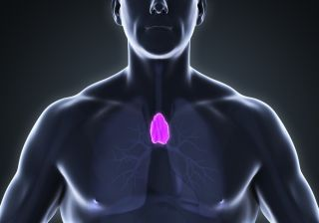
This causes production of T lymphocytes (T cells), which regulate the immune response by activating other cells.
The T cells move to the injured area and release chemical substances called lymphokines.
Notes:
Hematopoietin Thymus gland/ neutrophil

Slide 69
Lymphokines attract other phagocytes and lymphocytes to the injured area and assist in antigen destruction.
The T cells also stimulate the production of B cells, which become plasma cells, producing antibodies specific to the antigen.

Slide 70
Antibodies are protein substances that destroy the antigen. The stimulation of B cells and the production of antibodies are collectively known as humoral immunity.

Slide 71
Memory B cells are formed to remember the antigen and prepare the host for future antigen invasion. When the antigen enters the body again, the immune response occurs faster by rapidly producing antibodies.

Slide 72
TYPES AND STAGES OF INFECTIONS
1- Localized infections are limited to a defined area or single organ with symptoms that resemble inflammation.
(redness, tenderness, and swelling), such as a cold sore.
2- Systemic infections affect the entire body and involve multiple organs, such as AIDS.

Slide 73
HOSPITAL-ACQUIRED INFECTIONS
A hospital-acquired infection is an infection acquired in a hospital or other health care facility that was not present or incubating at the time of the client’s admission.
They also include those infections that become symptomatic after the client is discharged and infections passed among medical personnel.

Slide 74
Hospital-acquired infections are also called nosocomial infections or health care–associated infections. These types of infections typically fall into four categories: urinary tract, surgical wounds, pneumonia, and septicemia.

Slide 75
Most hospital-acquired infections are transmitted by health care personnel who fail to practice proper hand hygiene or who fail to change gloves between client contacts.

Slide 76
NURSING PROCESS
The health history and physical examination data correlated with the laboratory results identify those clients at risk for infection.

Slide 77
Assessment
Subjective Data
Objective Data
Relevant data regarding the client at risk for infection are obtained in the health history.
Reviewing such factors as work environment, immunization status, and other health related issues may help identify actual or possible infection risks.
Objective data are gathered through the physical examination and the diagnostic and laboratory findings.

Slide 78
physical examination, generally conducted from head to toe, to obtain objective data relative to the client’s health status and presenting problems.
When assessing the client to determine the level of risk for infection, focus the physical examination on:

Slide 79
Range of motion and mobility (A client with limited mobility is at risk for developing joint contractures, skin breakdown, and muscle atrophy).
Localized redness, warmth, swelling, and pain.
Secretions or exudate of the skin or mucous membranes; hydration status.
Auscultation of the lungs for crackles or wheezes

Slide 80
Diagnostic and Laboratory Data
An elevated leukocyte (white blood cell [WBC]).
Neutrophils: Increased in acute, severe inflammation
Lymphocytes: Increased in chronic bacterial and viral infections
Monocytes: Increased in some protozoan and rickettsial infections and TB
Eosinophils and basophils: Unaltered in an infectious process

Slide 81
An elevated erythrocyte sedimentation rate (ESR): increased in the presence of inflammation
An elevated pH of involved body fluids (gastric, urine, or vaginal secretions): indicative of microorganism presence
Positive cultures of involved body fluids (blood, sputum, urine, or other drainage): indicative of microorganism growth

Slide 82
Nursing Diagnosis
Risk for Infection related to (broken skin, traumatized tissue, decrease in ciliary action, stasis of body fluids, change in pH of secretions, and altered peristalsis)
Chronic disease, Malnutrition, Invasive procedures
Immunosuppression

Slide 83
Nursing Diagnosis
Imbalanced Nutrition: Less Than Body Requirements
Impaired Skin Integrity
Deficient Knowledge

Slide 84
Planning
The nurse collaborates with the client and other health care providers to determine goals, outcomes, and interventions to reduce the risk of infection.

Slide 85
Implementation
Nurses are responsible for providing the client with a safe environment, including prevention of hospital-acquired infections.
Nursing interventions to reduce the risk of infection center around ensuring asepsis and properly disposing of infectious materials to reduce or eliminate infectious agents

Slide 86
Asepsis refers to the absence of microorganisms.
Aseptic technique is the infection-control practice used to prevent the transmission of pathogens.
The use of aseptic technique decreases the risk and spread of hospital-acquired infections.

Slide 87
Evaluation
Evaluation of the effectiveness of nursing care is based on the achievement of goals and expected outcomes
It is important for the client to remain free of infection during hospitalization as well as develop a true awareness of the factors that increase the risk for infection.

