Slide 1

Introducing Modern Management : Concepts and Skills
Lesson 01
Chapter 01
Week 01
Introduction to
IRD/Business & Management
IRD 123/BUS 103
Fall 2025
TIU

Slide 2
Background Knowledge Probe

Slide 3
Learning Objectives
An understanding of a manager’s task
Knowledge about the management process and organizational resources
An understanding of management skill as the key to management success
Insights concerning what management careers are and how they evolve

Slide 4
Introduction
Defining Management
Management is the process of reaching organizational goals by working with and through people and other organizational resources.
Notes:
https://www.youtube.com/watch?v=i5zg1fG7m88&t=15s

Slide 5
Introduction
Defining Management
Management encompasses the following three main characteristics:
It is a process or series of continuing and related activities.
It involves and concentrates on reaching organizational goals.
It reaches these goals by working with and through people and other organizational resources
Notes:
https://www.youtube.com/watch?v=i5zg1fG7m88&t=15s

Slide 6
Management Process: Management Functions

Slide 7
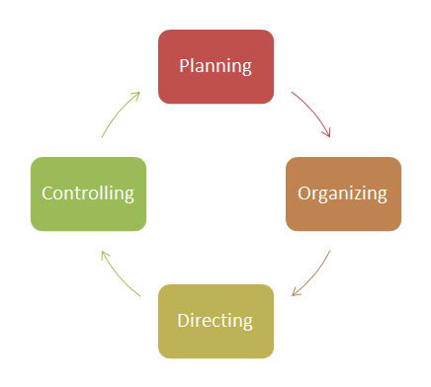
Management Process: Management Functions
The four basic management functions—activities that make up the management process—.
Planning
Organizing
Directing (Influencing, motivating, leading)
Controlling

Slide 8

Planning
To Set organizational goal and performance
Standards
To choose tasks that must be performed
To outline how and when to do the tasks.
It is essential to getting the “ right” things done
Planning is concerned about (short term) and (long term) plans

Slide 9
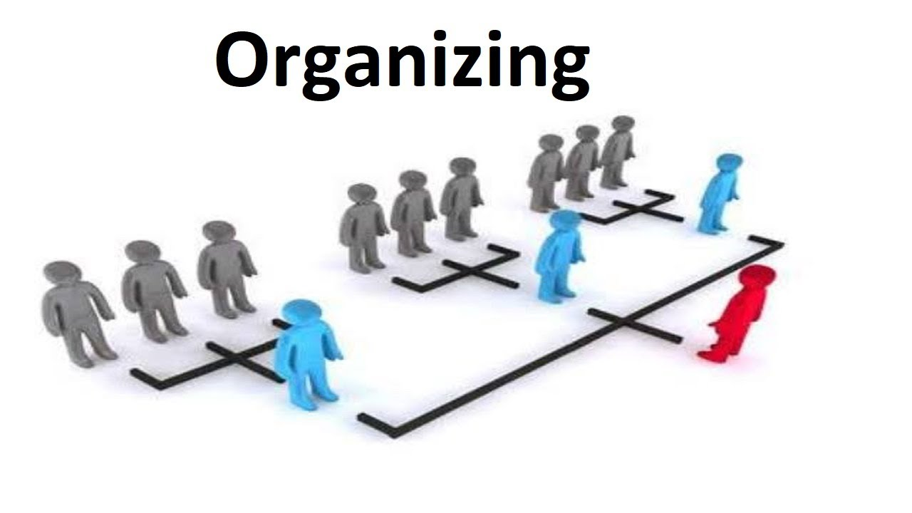
Organizing
To Assign the task to various individuals and groups
To Establish a structure of the organization and indicate the lines of communication and authority.
To link the tasks to contribute to the success of the organization.
Organizing should be flexible to meet the challenges as the environment changes

Slide 10


Directing/Influencing
It is also called, motivating, influencing, leading and actuating.
Guiding the activities of organization members in appropriate directions.
Ultimate purpose of influencing is to increase productivity through rewarding and recognition

Slide 11

Controlling
Gather information that measures recent performance in the organization.
Compare performances of recent and predetermined performance standards.
Determine whether organization to be modified to meet the performance standards
It is ongoing process

Slide 12
Management Process and Organizational Resources

Slide 13
Management Process and Organizational Resources
Although we have discussed the four functions of management individually, planning, organizing, influencing, and controlling are integrally related and therefore cannot be separated in practice.
Figure 1.4 illustrates this interrelationship and also indicates that managers use these activities solely for reaching organizational goals
Basically, these functions are interrelated because the performance of one depends on the performance of the others
To be effective, a manager must understand how the four management functions are practiced, not simply how they are defined and related.

Slide 14
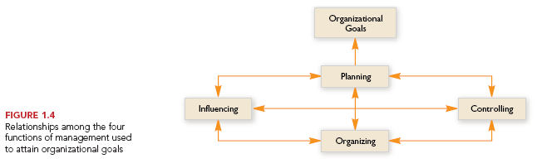
Relationships among the four management functions

Slide 15
Management & Organizational Resources
Organizational resources, composed of all assets available for activation during the production process, are of four basic types:
Human
Monetary
Raw materials
Capital

Slide 16
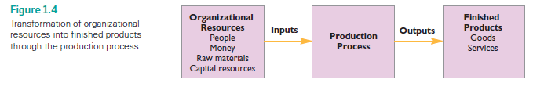
Organizational resources to finished products

Slide 17
Organizational resources to finished products
Figure shows the-Transformation of organizational resources into finished products through the production process

Slide 18
Effectiveness
Refers to how well management uses organizational resources in meeting organizational goals
The closer an organization comes to achieve its goal, the more effective its managers considered

Slide 19
Efficiency
Is the proportion of total organizational resources that contribute to productivity during the manufacturing process
The higher the proportion, the more efficient is the manager
The less resources wasted during the production process the more efficient the manager and vice versa

Slide 20
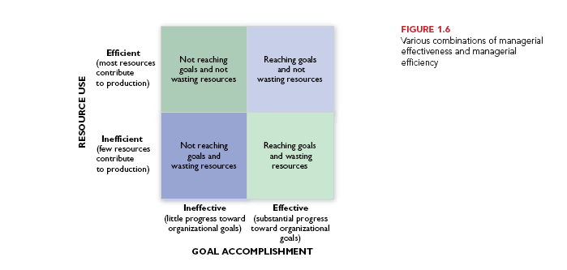
Managerial Effectiveness and Efficiency combination

Slide 21
Management Skill: The Key to Management Success

Slide 22
Management Skill: The Key to Management Success
Defining Management Skill
Management skill is the ability to carry out the process of reaching organizational goals by working with and through people and other organizational resources effectively and efficiently
Management skills are so critical to the success of an organization, companies commonly focus on possible steps that can be taken to improve the skills of their manager

Slide 23
Management Skills: The Key to Management Success
Classical View – Robert Katz
Modern view of Management Skills
Notes:
Skill is he ability to translate knowledge into action

Slide 24
Management Skills
Management Skill : Robert Katz states that managers ability is to perform is a result of their managerial skills
Robert Katz indicates three types of skills
Technical Skills – Specialized Knowledge
Human Skills – Cooperation and human related skills
Conceptual Skills – a holistic view of the organization

Slide 25
Management Skills
Technical skills involve the ability to apply specialized knowledge and expertise to work-related techniques and procedures.
Examples of these skills are engineering, computer programming, and accounting. Technical skills are mostly related to working with “things”—processes or physical objects.
Human skills build cooperation within the team being led.
They involve working with attitudes and communication, individual and group interests—in short, working with people.
Conceptual skills involve the ability to see the organization as a whole.
A manager with conceptual skills is able to understand--
how various functions of the organization complement one another,
how the organization relates to its environment, and
how changes in one part of the organization affect the rest of the organization

Slide 26
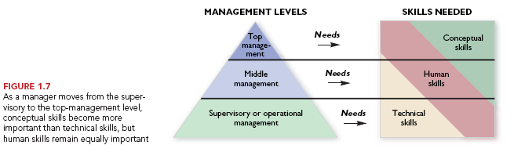
Management Skill: The Key to Management Success

Slide 27
Modern View of Management Skills
Expansion of class view. The expansion can be achieved through two steps:
Define the Major activities the manager performs.
Task related, ex. (Planning, clarify jobs, and monitor performance, etc.).
People related. (Provide support, empowerment, recognition, etc.)
Change related. (Monitor org. Environment, take risks, propose new strategies etc.)
2. List of skills needed.
Notes:
Besides the Katz skills, there is a missing skills majority of managers lack. Is Political skills. Normally, not only those they have these three skills are promoted. In Fact, due to the conflict, than collaboration. Managers have to fight for a limited pot of their organization’s time, money, and budget. Power can be put to good use or bad use. Power is gained from Control and trust.
Decision making skills, No manager makes the right decision all the time. Effective managers make good decisions most of the time. And if they make a bad decision, they usually recognize their mistakes quickly and then make good decision to recover with least cost or damage to the organization.
Working under pressure, why is it important? Changes and unexpected events, problems or challenges can - and do - often occur, regardless of how well-planned or organized you are. The ability to respond effectively to pressure and stress is therefore extremely important in any line of work. Respond varies from a person to another. Having the ability to work under pressure improves your confidence to deal with any situation arises.

Slide 28
List of Skills
Communication
Effectively sharing information with others.
Critical Thinking
Assessing situations to identify and solve problems.
Creativity
Generating new ideas that contribute to organizational success.
Collaboration
Understanding and working with a group.
Personal Ethics
Dealing with people, problems, and situations with honesty and integrity.
Adaptability
Working independently or as part of a team.
Socially Responsiblility
Contributing to the welfare of the community.

Slide 29
Management Careers
Definition of Career
A career is a sequence of work-related positions occupied by a person over the course of a lifetime.
As people accumulate successful experiences in one position, they generally develop abilities and attitudes that qualify them to hold more advanced positions.
In building a career, an individual should be focused on developing the skills necessary to qualify for the next planned job and not simply taking a job with the highest salary.

Slide 30
Case Example
Coke’s New CEO Battles a Changing Market

Slide 31
Classroom Assessment Techniques (CATs): The Minute Paper
1. What are the two [three, four, five] most significant [central, useful, meaningful, surprising, disturbing] things you have learned during this session?

Slide 32
Classroom Assessment Techniques (CATs) : The Muddiest points
2. What has been the “muddiest” [most unclear or most confusing] point so far in this session? That is, what topic remains the least clear to you?

Slide 33
Acknowledgement and Thanks
Certo, S. C. and Certo, S. T. (2019). Modern Management, 15th Ed. Prentice Hall, New Jersey (Main reference)
Stephen P. Robbins, David, A. DeCenzo 2009. Fundamentals of Management, Prentice Hall
Stephen P. Robbins, Mary Coulter, 2013, Management, 12th Ed. Prentice Hall
Daft, R. L., 2009. Management. 8th ed. Mason: Thomson South-Western
Schermerhorn, J. R. (2014). Exploring Management. New Jersey: Wiley & sons Inc.
Bateman, S. T., & Snell, S. A. (2013). Management. New York: McGraw-Hill.

