Slide 1

Plans & Planning Tools
Lesson 02
Chapter 07
Introduction to
IRD 123
Fall 2025
TIU

Slide 2
Learning Objectives
An understanding of the general characteristics of planning
Knowledge regarding different types of plans
Insights about the major steps of the planning process
An understanding of the relationship between planning and organizational objectives
An appreciation for the potential of a management by objectives (MBO) program
Knowledge about different types of planning tools

Slide 3
Content
Wal-Mart Case Study
Meaning of Planning
The benefits of Planning
Organizational Goals and its Areas
Development of Organizational Goals - Timeframe
Types of Organizational Goals – Levels
Guidelines for establishing Quality Goals
Planning Process
Planning Tools

Slide 4
Background Knowledge Probe

Slide 5
Defining Planning
Planning is the process of determining how the organization can get where it wants to go and what it will do to accomplish its objectives
Notes:
https://www.youtube.com/watch?v=i5zg1fG7m88&t=15s

Slide 6
Purposes of Planning
Over the years, management writers have presented several different purposes of planning
Organizational planning has two types of purposes: protective and affirmative.
The protective purpose of planning is to minimize risk by reducing the uncertainties surrounding business conditions and clarifying the consequences of related management actions
The affirmative purpose is to increase the degree of organizational success
[Example: Whole Foods Market, a leading provider of natural and organic foods, relies on the affirmative purpose in its planning. The company uses planning to ensure its success, as measured by the systematic opening of new stores. Currently, Whole Foods has approximately 500 stores in the United States, Canada, and the United Kingdom. Whole Foods’s CEO, John Mackey, believes that increased company success is not an accident but a direct result of careful planning]

Slide 7
The benefits of Planning
Helps Managers to be future-oriented
Enhances the coordination of decisions
To better understand what the organization wants to achieve (goals)
Efficiently allocate resources.
Reduces risk and uncertainty.

Slide 8
Types of Plans
With the repetitiveness dimension as a guide, organizational plans are usually divided into two types: standing and single-use
A standing plan is used over and over again because it focuses on organizational situations that occur repeatedly
A single-use plan is used only once—or, at most, a few times—because it focuses on unique or rare situations within the organization

Slide 9
Types of Plans
Figure 7.2 illustrates,
Standing plans can be subdivided into policies, procedures, and rules, and
Single-use plans can be subdivided into programs and budgets.

Slide 10
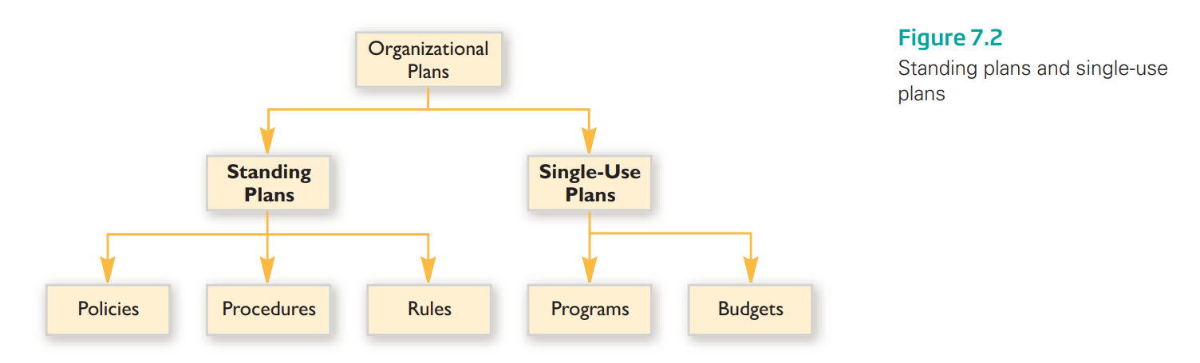
Types of Plans

Slide 11
Types of Plans
Standing Plans:-Policy, Procedure & Rule
A policy is a standing plan that furnishes broad guidelines for taking action that is consistent with reaching organizational objectives
[For example, an organizational policy relating to personnel might be worded as follows: “Our organization will strive to recruit only the most talented employees.” This policy statement is broad, giving managers only a general idea of what to do in the area of recruitment]
A procedure is a standing plan that outlines a series of related actions that must be taken to accomplish a particular task. In general, procedures outline more specific actions than policies do.
[As an example, Apple changed its manufacturing procedures to integrate green principles into its operations]
A rule is a standing plan that designates specific required actions. In essence, a rule indicates what an organization member should or should not do and allows no room for deviation.
[An example of a rule that many companies are now establishing is no smoking]

Slide 12
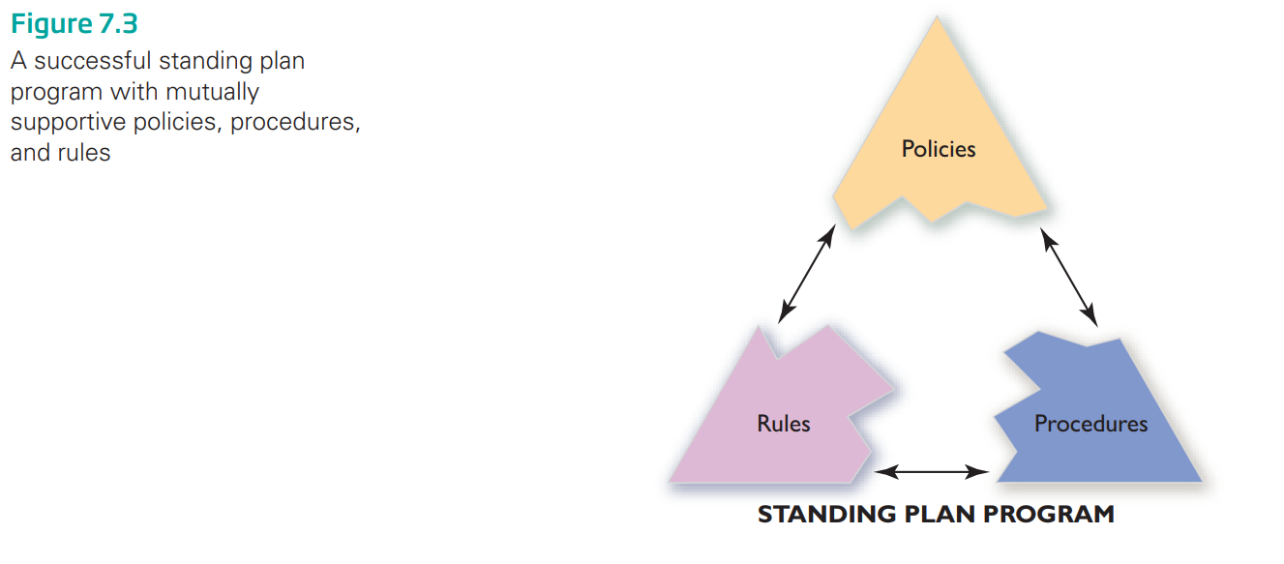
Types of Plans:
Standing Plans:-Policy, Procedure & Rule

Slide 13
Types of Plans
Single-Use Plans: Programs and Budgets
A program is a single-use plan that is designed to carry out a special project within an organization
[A common example is the management development program found in many organizations. This program exists to raise managers’ skill levels in one or more of the following areas: technical, conceptual, or human relations skills]
A budget is a single-use financial plan that covers a specified length of time. It details how funds will be spent on labor, raw materials, capital goods, information systems, marketing, and so on, as well as how the funds will be obtained

Slide 14
Organizational Goals and its Areas
Organizational Goal is a target the organization wants to achieve.
Areas of Organizational Goals:
Profitability
Innovation
Production
Market Standing
Human Resources performance, attitude and development
Public Responsibility

Slide 15
Development of Organizational Goals - Timeframe
A Manager should develop three types of goals:
Short-term Goals – 1 year or less
Intermediate-term Goals – 2 to 3 years
Long-term Goals – to be achieved in 4 to 5 years.

Slide 16
Types of Organizational Goals - Levels
Strategic Goals – Top Managers
Tactical Goals – Middle Managers
Operational Goals – First Line/Operations Managers

Slide 17

Guidelines for Establishing Quality Goals
Goals must be set mutually with people responsible for attaining them
State specific and clear Goals
Set challenging Goals
Deadlines and timeframe must be specified
Goals must be coordinated to avoid conflict

Slide 18
Steps in the Planning Process
State organizational objectives—
List alternative ways of reaching objectives
Develop premises on which to base each alternative
Choose the best alternative for reaching objectives
Develop plans to pursue the chosen alternative—
Put the plans into action

Slide 19
Alternative ways or strategies
Controlling or being your own Distributor
Controlling or being your own Supplier
Acquire, influence or merger with Competitor
Diversification
Product Development
Market Development/Expansion
Market Penetration/ Marketing
Retrenchment
Divestiture
Liquidation

Slide 20
Planning Tools
Forecasting, to predict the possibilities of uncertain events or changes occur in the future and effect the organization.
Ex. Sales, Economic, Technology, Social forecast.
Scheduling, to formulate the list of activities with their timeframe to achieve a goal.
Ex. Gantt Chart and Project Management

Slide 21
Management by Objectives (MBO)
Some managers regard organizational objectives as such an important and fundamental part of management that they use a management approach based exclusively on objectives.
This approach, called management by objectives (MBO), was popularized mainly through the writings of Peter Drucker.
Although mostly discussed in the context of profit-oriented companies, MBO is also a valuable management tool for nonprofit organizations such as libraries and community clubs.

Slide 22
Management by Objectives (MBO)
The MBO strategy has three basic parts
All individuals within an organization are assigned a specific set of objectives that they try to reach during a normal operating period. These objectives are mutually set and agreed upon by individuals and their managers
Performance reviews are conducted periodically to determine how close individuals are to attaining their objectives
Rewards are given to individuals on the basis of how close they come to reaching their goals

Slide 23
Management by Objectives (MBO)
The MBO process consists of five steps (see Figure 7.6):
Review organizational objectives
Set worker objectives—
Monitor progress—
Evaluate performance—
Give rewards

Slide 24
Management by Objectives (MBO)
The MBO process consists of five steps (see Figure 7.6):
1. Review organizational objectives—The manager gains a clear understanding of the organization’s overall objectives.
2. Set worker objectives—The manager and the worker meet to agree on worker objectives to be reached by the end of the normal operating period.
3. Monitor progress—At intervals during the normal operating period, the manager and the worker check to see whether the objectives are being reached.
4. Evaluate performance—At the end of the normal operating period, the worker’s performance is judged by the extent to which the worker reached the objectives.
5. Give rewards—Rewards given to the worker are based on the extent to which the objectives were reached.

Slide 25
Case Example
Wal-Mart Case Study [Page no. 174, Text Book]

Slide 26
Classroom Assessment Techniques (CATs):
The Minute Paper
1. What are the two [three, four, five] most significant [central, useful, meaningful, surprising, disturbing] things you have learned during this session?

Slide 27
Classroom Assessment Techniques (CATs) :
The Muddiest points
2. What has been the “muddiest” [most unclear or most confusing] point so far in this session? That is, what topic remains the least clear to you?

Slide 28
Acknowledgement and Thanks
Reference:
Book:- Certo, S. C. and Certo, S. T. (2019). Modern Management, 15th Ed. Prentice Hall, New Jersey

Slide 29

Thank you!

