Slide 1


Principles of Organizing
Lesson 03
Chapter 10
Principles of Management

Slide 2
Content
Microsoft Tries to Program Unity with Its New Structure (Case Study) | Meaning of Organizing
Division of Labor and Specialization | Authority, Delegation and Coordination
Bob and Amanda's, a restaurant Organization stages (Case study) | Centralization and Decentralization
Span of Management and Chain of Command | Organization Structure (Formal and Informal) and chart
Vertical and Horizontal differentiation | Flat and Tall Organizational structures
Types of Organizational Structures

Slide 3
Background Knowledge Probe

Slide 4
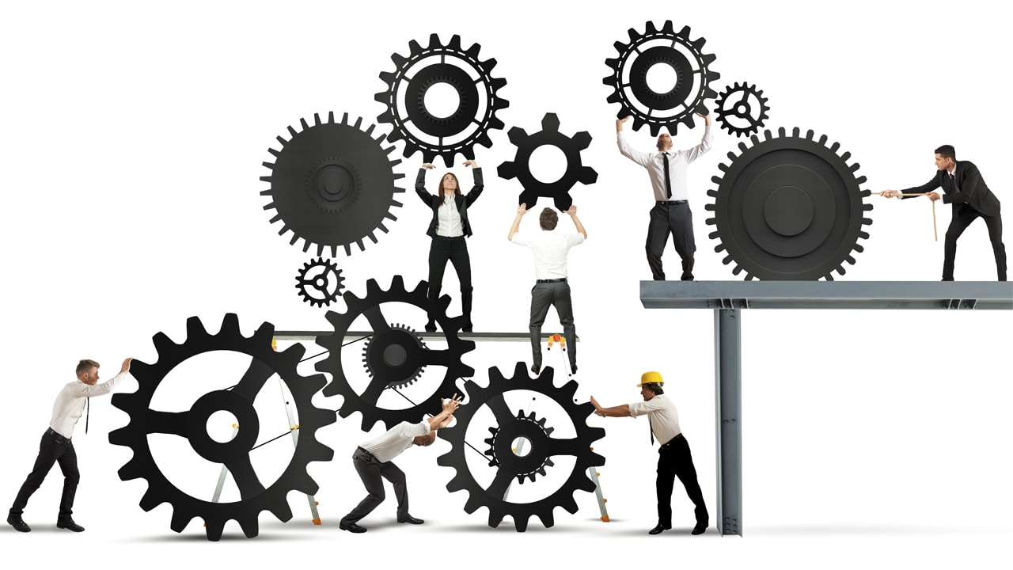
Meaning of Organizing
Organizing is the process of arranging/assembling people and resources (Financial, Machines, materials, and information) so that they can work together to achieve goals
To establish major tasks and to
divide them to sub-tasks
Aim of organizing is turn plans into action.

Slide 5
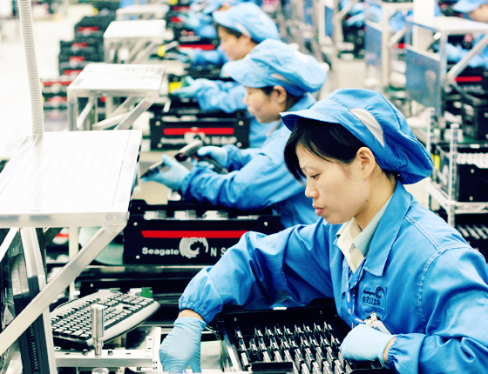
Division of Labor
Division of Labor is to distribute different parts of a particular task among members of an organization.
Specialization to work separately and specialize in one clearly defined task, to be an expert, improve productivity and innovation.

Slide 6
Authority, Delegation, and Coordination
Authority is the power to hold people accountable for their actions and to directly influence what they do and how they do it.
Delegation to assign authority to a lower manager to perform a specific task.
Coordination refers to the process of aligning the activities and efforts of different individuals or departments within an organization to achieve a common goal.

Slide 7
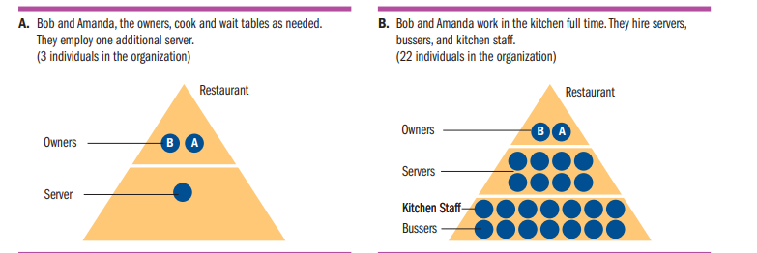
Bob and Amanda's Restaurant (stage 1)

Slide 8
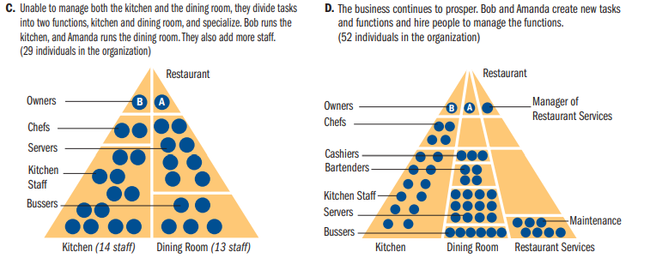
Bob and Amanda's Restaurant (Stage 2)

Slide 9
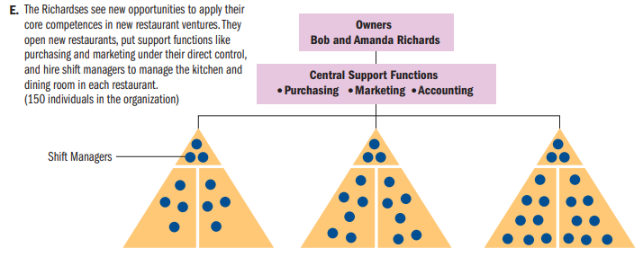
Bob and Amanda's Restaurant (Stage 3)

Slide 10

Span of Control and Chain of command
Span of Management is the number of individuals a manager supervises.
Span of Management is affected by Similarity or complexity of functions, physical distance, and coordination.
Chain of Command is a set of formal relationships that indicates who directs and reports to whom.

Slide 11
Formal and Informal Structure
Formal Structure is the relationship among organizational members outlined by management and represented by organizational chart.
Max Weber’s Bureaucracy.
Informal Structure is the relationship that develop because of the informal activities of organization members.

Slide 12
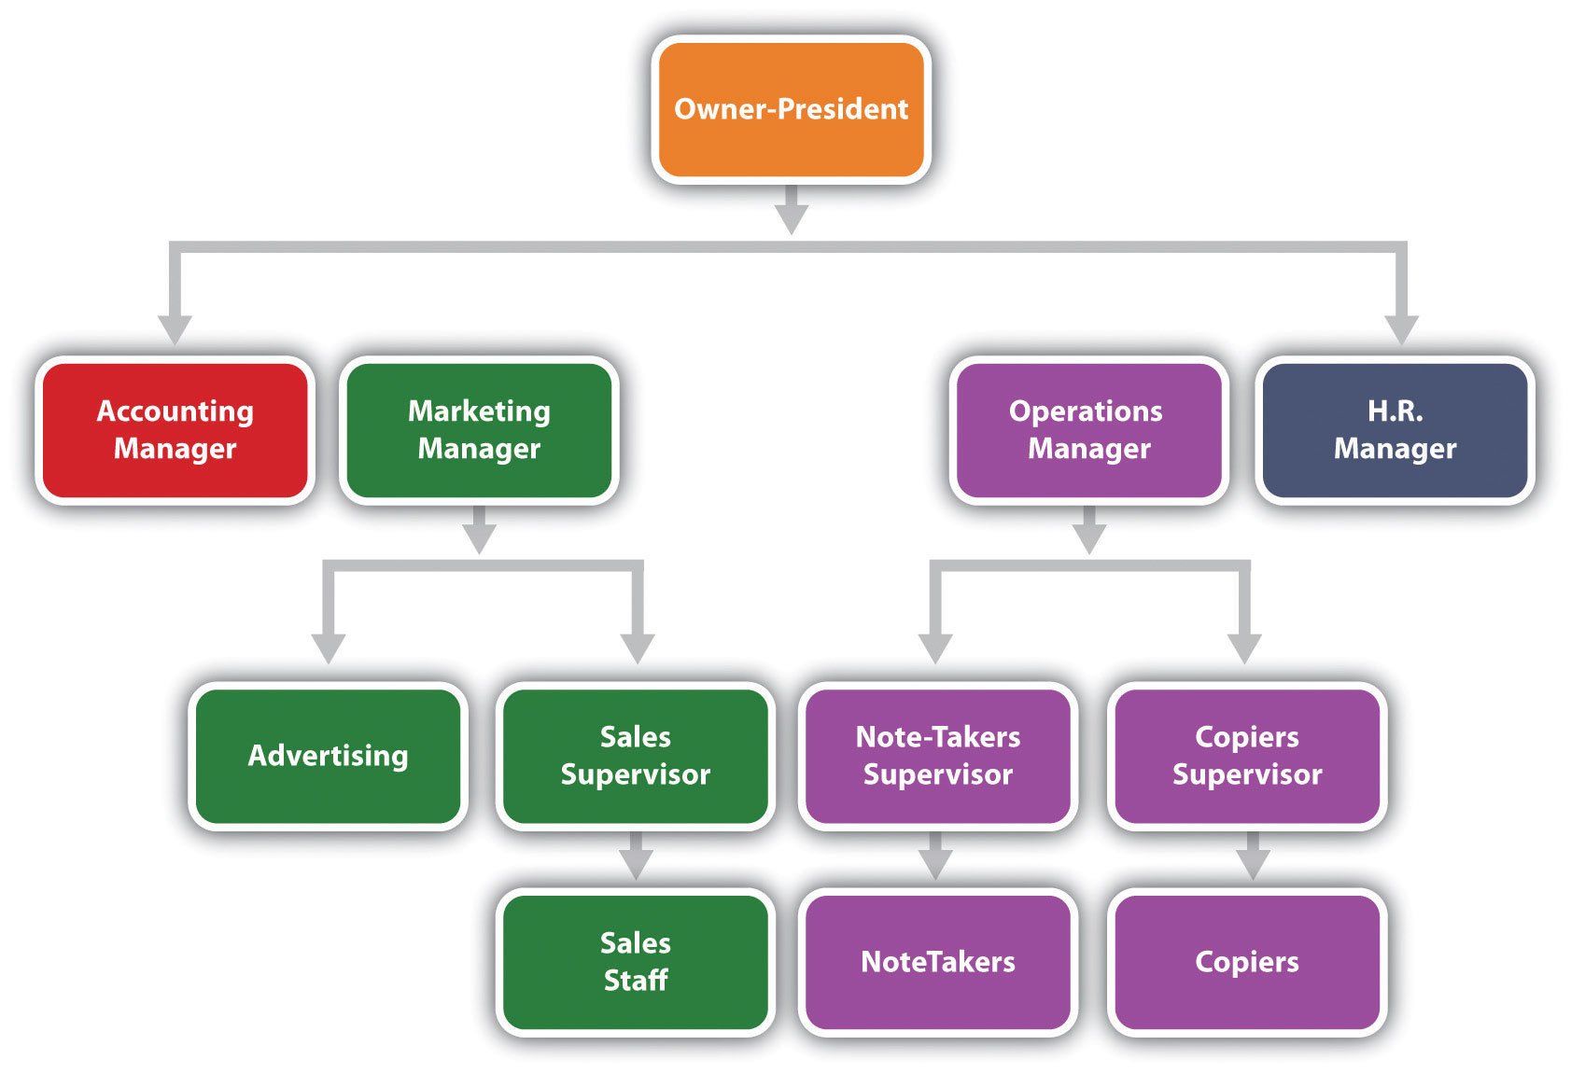
Organizational Structure (Formal)

Slide 13
Vertical and Horizontal Differentiation
An organization’s expansion leads to expansion in its organization structure.
Expansions in organizational chart and structure called Differentiation.​
Two types of Dimensioning, ​
1- Vertical Dimensioning ​
2- Horizontal Dimensioning

Slide 14
Vertical Differentiation
Vertical Differentiation Is used to separate job responsibilities and tasks, through division of labor and establishing different level of authority.
​Example, (Marketing Department) to two sub-departments (Sales) and (Promotion).
Unit of Command, the principle, recommends that an individual
have only one boss.
​
​
CEO
Marketing
Accounting
Production
Promotion
Sales

Slide 15
Horizontal Differentiation
Horizontal Differentiation It involves the creation of different unit or department. Such as Finance, Marketing, Operations, and Human resources.
CEO
Marketing
Production
Finance
Human Resources

Slide 16
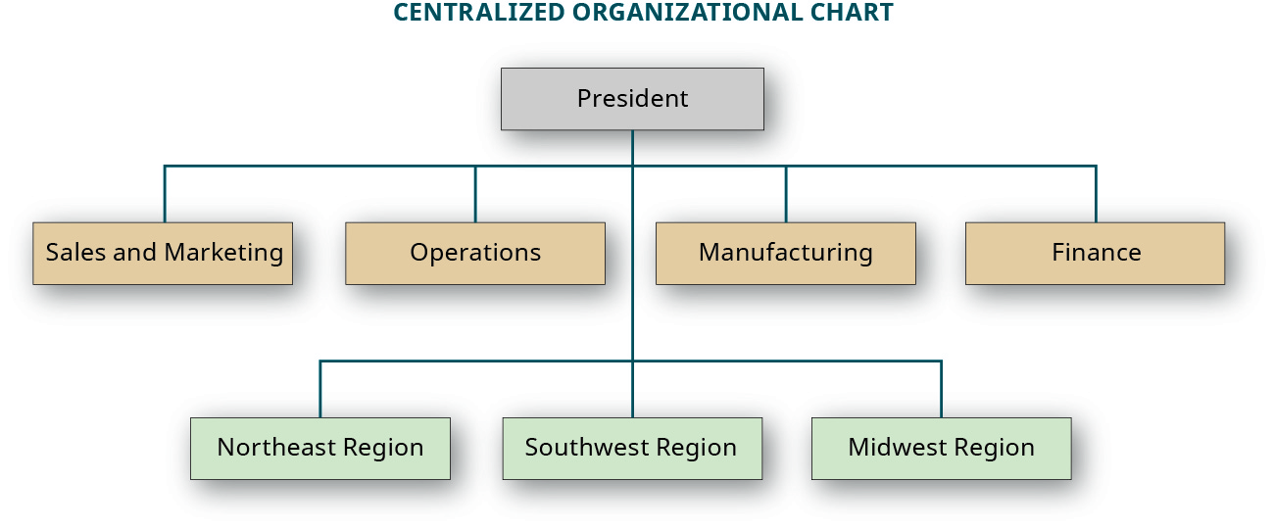
Centralization and Decentralization
Centralization refers to the degree to which decision-making is concentrated in the hands of a few individuals or a single person at the top of the organization's hierarchy.
Decentralization refers to the degree to which decision-making is dispersed throughout the organization.

Slide 17
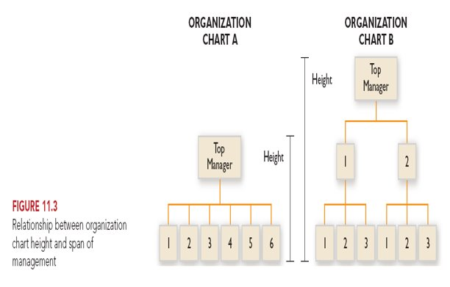
Flat and Tall Organizations

Slide 18
Types of Organizational Structures
Functional Structure
Divisional Structure (Product and Geography)
Matrix Structure

Slide 19
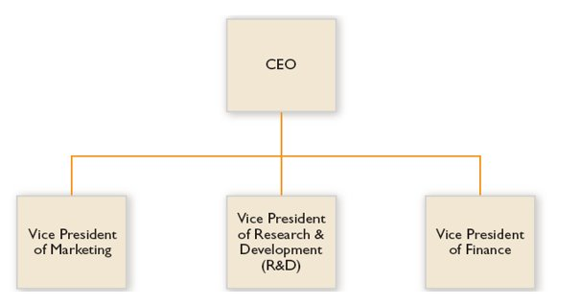
Functional Structure

Slide 20
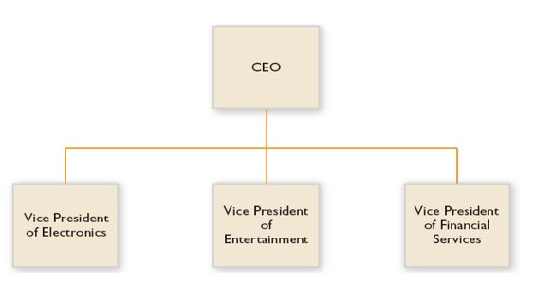
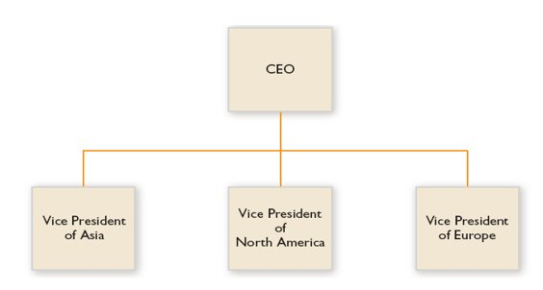
Divisional Structures

Slide 21
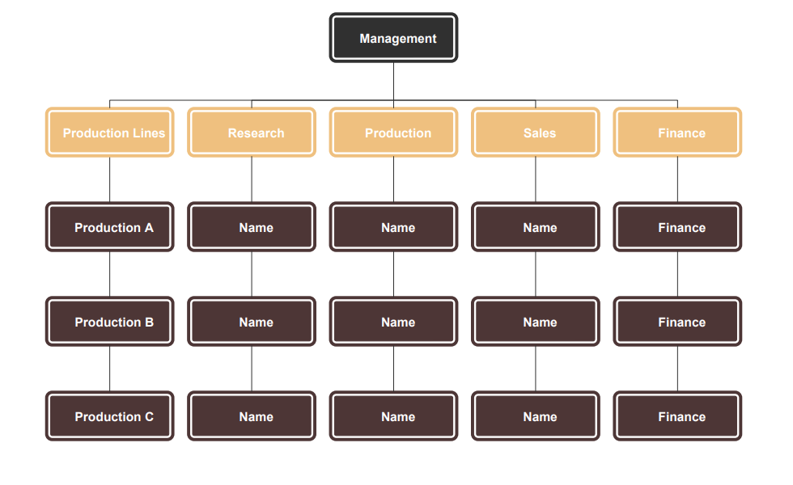
Matrix Structure

Slide 22
Case Study
Case Study: Microsoft Tries to Program Unity with Its New Structure (Page no. 245)

Slide 23
Classroom Assessment Techniques (CATs):
The Minute Paper
1. What are the two [three, four, five] most significant [central, useful, meaningful, surprising, disturbing] things you have learned during this session?

Slide 24
Classroom Assessment Techniques (CATs) :
The Muddiest points
2. What has been the “muddiest” [most unclear or most confusing] point so far in this session? That is, what topic remains the least clear to you?

Slide 25
Thank you !

