Slide 1

Hematocrit
Peshraw S. Hamadamin
Human Physiology Lab
First semester
Week 6
Date 27/11 2025

Slide 2
Hematocrit (Htc
The hematocrit (also called volume of packed red cells, VPRC, or packed cell volume, (PCV)
Hematocrit is defined The percentage by volume of packed red blood cells in a given sample of blood after centrifugation
When whole blood is centrifuged using a special hematocrit centrifuge, the cells, which are denser, settle to the bottom of a heparinized capillary tube. The straw-colored plasma is on top
The percentage of RBCs in the sample is measured using an ADAMS Microhematocrit Reader

Slide 3
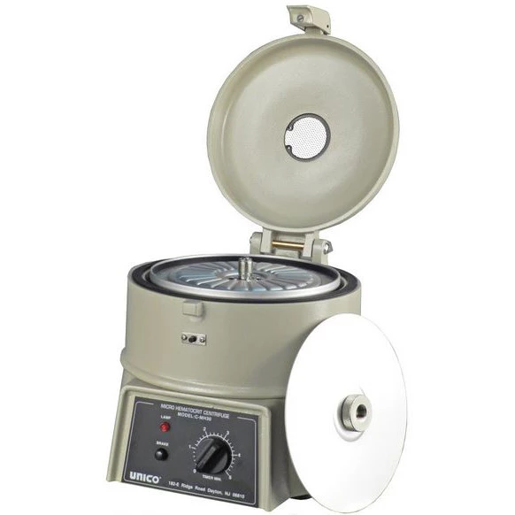
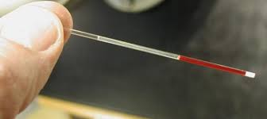
Hematocrit (Hct)

Slide 4
WHO lists the following ranges for normal hematocrit (Hct) values:
Children under 5 years of age Hct 38-44% ,
Women Hct 37-48% , Men Hct 40-55%
Newborns: 55-65 %. Why ?
Abnormal values may suggest either deficiencies (anemias) or excesses (erythrocytosis or polycythemia).
Cut-off levels for hemoglobin and hematocrit must be shifted upwards for people living at higher altitudes and for those who smoke

Slide 5
Hematocrit Procedure:
Hematocrit Procedure (Brief)
1. Fill the capillary tube
  Use heparinized capillary tube (if using capillary blood).
  Fill the tube two-thirds (2/3) full with blood.
2. Seal the tube
  Seal one end with clay/sealant.
3. Centrifuge
  Place the tube in the microhematocrit centrifuge with sealed end outward.
  Centrifuge at 10,000–12,000 rpm for 3–5 minutes.
4. Read the hematocrit
  After centrifugation, three layers appear:
    RBCs (bottom)
    Buffy coat (WBCs + platelets, thin white layer)
    Plasma (top)
  Place the tube on the hematocrit reader card.
  Measure the percentage of RBC column relative to the total blood column.
5. Report the result as % (percentage).

Slide 6


Slide 7
Clinical implications:
PCV is affected by the shape, & the number of the RBCs & the plasma volume.
High PCV either indicates either increase in number of circulating RBCs or decrease in plasma volume seen in cholera due to loss of water in the stool
A low PCV indicates either decrease in RBC or increase in plasma volume

