Slide 1



Tishk International University
Faculty of Applied Science
Nutrition and Dietetics Department
An Introduction to the Human Body
Human Biology / 1st Lecture
1st Grade / Fall Semester
December 17. 2025
Instructor: Adam Jalal Mohammed
Email: adam.jalal@tiu.edu.iq
Mob: +964 7774522622
Human Biology
2025 - 2026

Slide 2
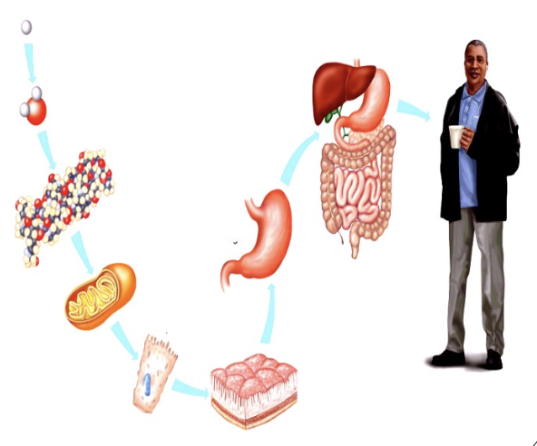
Outline
Levels of Structural Organization
Characteristics of the Living Human Organism
Basic life Processes
Human Biology
2

Slide 3
Outcomes
Human Biology
3

Slide 4
Introduction
Human Biology
4

Slide 5
Human Biology
5

Slide 6
Human Biology
6

Slide 7
Human Biology
7

Slide 8
Human Biology
8

Slide 9
Human Biology
9

Slide 10
Human Biology
10

Slide 11
Human Biology
11

Slide 12
Human Biology
12

Slide 13
Human Biology
13

Slide 14
Human Biology
14

Slide 15
Human Biology
15

Slide 16
Human Biology
16

Slide 17
Human Biology
17

Slide 18
Human Biology
18

Slide 19
Human Biology
19

Slide 20
Human Biology
20

Slide 21
Human Biology
21

Slide 22
Human Biology
22

Slide 23
Human Biology
23

Slide 24
Human Biology
24

Slide 25
Human Biology
25

Slide 26
Human Biology
26

Slide 27
Human Biology
27

Slide 28




