Slide 1







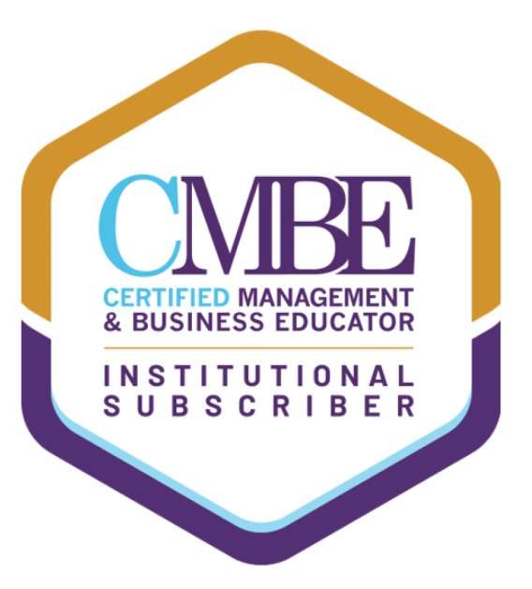

Developing the Presentation (Inform / Persuade)
Tishk International University
Faculty of Administrative Sciences and Economics
Business and Management Department
Business and Professional Speaking

Slide 2

What is the meaning of a presentation?
Tishk International University
Faculty of Administrative Sciences and Economics
Business and Management Department
A presentation is a structured way (follows steps) of delivering information to an audience.

Slide 3
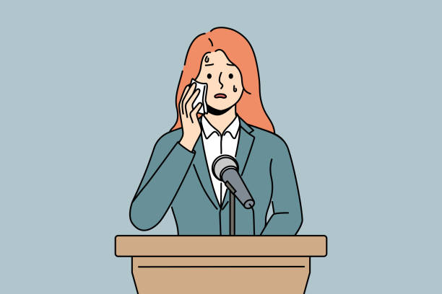

Having information vs Having confidence
The stress affected her presentation vs Good presenter but without content

Slide 4
Research shows that public speaking is one of the most common fears, often ranked even higher than death. Many People can write a perfect speech, but cannot present it.
Tishk International University
Faculty of Administrative Sciences and Economics
Business and Management Department

Slide 5
Let’s Dive at the Method Of Presentation
Impromptu presentation
Manuscript presentation
Extemporaneous presentations
Memorized presentation

Slide 6

Impromptu Speaking
A short speech delivered without any advance preparation.
Common in everyday situations, such as self-introductions or answering unexpected questions.
You construct your ideas as you speak.
Advantages:
Spontaneous and natural.
Fits well in informal group discussions.
Drawbacks:
Little or no time to think or organize ideas. (which might escalate)
The message can become disorganized or unclear. (The message will be affected if no experience)
Tips for giving an impromptu speech:
Pause briefly to collect your thoughts. (not more than few seconds)
Thank the person who invited you to speak and thank all for attending.
Introduce yourself and state your main point clearly and briefly. (Today, I am pleased to be here to …… I think …. is one of )
Use a simple structure (e.g., “two reasons,” “three parts”). To make your ideas organize.
Conclude simply and thank the audience again. (Not to make it long … / To put it in a nutshell, )

Slide 7
Manuscript Presentations
The speaker reads the speech word for word from a written script.
Ensures the exact message is delivered, which is important in formal or sensitive situations (e.g., shareholder reports, legal statements).
Advantages:
Guarantees wording is accurate and precise.
Useful when exact phrasing is required. (sometime using synonyms or missing a word changes everything)
Drawbacks:
Can sound dull or uninteresting if not rehearsed with vocal expression.
Limits eye contact and audience engagement. (One way message)
Audience must already be interested for it to hold attention. (like the legal speech or as we said shareholder meeting etc..)
Often used by professionals (news reporters, politicians) with a teleprompter, which allows reading while maintaining eye contact. (To grab attention)
But to make the presentation effective with teleprompters, you need:
A speaker skilled at sounding conversational while reading.
A script written in natural, spoken (not overly edited) language.

Slide 8
Extemporaneous Presentations
A well-prepared and rehearsed speech delivered in a conversational style.
Speaker uses brief notes instead of a full script.
Allows the presenter to:
Maintain eye contact and monitor audience understanding. (as you are already prepared)
Speak naturally without reading. (shows the confidence)
Adjust the message slightly based on audience or context.
Advantages:
Makes the speaker appear knowledgeable and credible.
More engaging both verbally and nonverbally.
Flexible, easy to modify wording on the spot.
Drawbacks:
Requires substantial preparation and practice.
Cannot be mastered last minute. (need a time frame for preparation)
This is the most common style in business presentations. (Highly needed)

Slide 9
Memorized Speaking
A fully written speech delivered entirely from memory, without notes.
Often used by actors performing scripts, or speakers who need precise wording.
Advantages: (Many positive points , as the focus has shifted)
Full eye contact with the audience.
Freedom to move around and use gestures naturally.
Works especially well with visual aids since hands and eyes aren't tied to notes.
Drawbacks: (Be careful not to look fake)
Requires memorizing EVERYTHING not just words, but also tone, pitch, gestures, pauses, otherwise the speech may sound flat..
Risk of completely “blanking out,” which is hard to fix mid-presentation.
A typical 7-minute speech takes significant time and effort to memorize.
Most people realistically cannot memorize an entire speech perfectly. (So the margin of error is high)
With enough practice, memorized speaking can still feel natural and appear extemporaneous.

Slide 10
Which one is the best?
All are equally important and sometimes we use more than once.

Slide 11
Impromptu Speaking
Everyday conversation (introductions, quick explanations)
Responding to unexpected questions
Participating in meetings or discussions where you’re suddenly called upon
Practicing quick thinking and communication skills
Best for: Informal settings, discussions, Q&A sessions
Manuscript Presentations
When the wording must be exact and precise
Formal or ceremonial situations
Legal, policy, or safety statements
Reports to shareholders or administrative boards
When miscommunication could have serious consequences
Best for: High-stakes or formal contexts where every word matters
Extemporaneous Presentations
Most classroom presentations
Business and professional presentations
Conference talks and academic speeches
Anytime the speaker needs structure + natural delivery
Best for: Communicating clearly while engaging the audience
Memorized Speaking
Acting, theater, performances
Motivational speeches with exact phrasing
Speeches where the speaker needs to move freely around the stage
Short speeches such as introductions or toasts
Best for: Speeches requiring precision and strong stage presence

Slide 12
To Prepare Perfectly For The Presentation, You Need The Following
Using Lecterns
Lecterns add formality but can tempt you to hide behind them.
Use them only to hold your notes, not as a barrier.
Standing confidently beside or behind a lectern helps maintain eye contact and frees your hands for gestures.
Large Spaces (Auditoriums, Halls)
These can feel intimidating, but practice and preparation greatly improve performance.
Rehearsing in the actual space (if possible) reduces nervousness.
Speak more slowly so your voice carries and doesn’t get lost in echo.
Adjust visual aids so even those in the back can see clearly.
Small Spaces (Meeting Rooms, Classrooms)
Easier to manage, but details matter—your audience can see everything you do.
Use note cards and visual aids carefully so they don’t distract.
Arrive early to organize materials and avoid fumbling during your presentation.

Slide 13
To Prepare Perfectly For The Presentation, You Need The Following
Outdoors
Background noise (cars, wind), insects, weather, and lighting can all interfere.
Choose a location that is quiet and sheltered when possible.
Project your voice strongly without shouting.
Using a Microphone
Always rehearse or test the microphone beforehand to prevent issues.
Speak clearly and enunciate every word.
Maintain a consistent distance, usually a few inches—from the microphone.
Small Audience Size
Small groups allow more eye contact but may lead to frequent interruptions.
Be polite when handling questions; you may ask to answer them at the end.
Set expectations early: explain whether questions should be asked during or after the presentation.

Slide 14
How can I prepare very well for the presentation
Tishk International University
Faculty of Administrative Sciences and Economics
Business and Management Department
Practice out Loud: Mispronunciation, weaknesses, Tone level. - allow to fix before the problem happens
Practice always standing: Make it more natural practicing, allow you to create similar situation, train muscles.
Practice with any audience: Bring family members/ friends / people can provide your mistake and issues you did not see.
Practice with a time restriction: Make it less than required. To succeed in delivering the presentation.
Practice by Filming yourself: This is the best method to really see yourself by yourself, but from another len.

Slide 15
During the presentation
Tishk International University
Faculty of Administrative Sciences and Economics
Business and Management Department
Look carefully to the following:
Hands: (look at the setting , audience and purpose and act accordingly)
Feet: Stand shoulder-width apart, keeping your knees slightly bent. Walk (if there is a space / based on the nature of the presentation)
Objects: Make sure to turn on devices and being what is essential to that presentation.

Slide 16
During the presentation
Tishk International University
Faculty of Administrative Sciences and Economics
Business and Management Department
Clothing: Based on the culture of the organization, but being professional is universal language
Eye Contracts: 80% percent of the speech must be spent with eye contract (with audiences)
Volume must fit the size of the room and the number of the audience in the room. (Look for the pace and tone, rhythm)
Rate: Make sure not to speak too fast or say the word unclearly (that is why you need to practice and record yourself)
Vocalized pause: (Ummmm , Uhh, You know, like) – Don’t over use them.

Slide 17
Final Advice
Tishk International University
Faculty of Administrative Sciences and Economics
Business and Management Department
Don’t Let them know or make it obvious.
Continue your presentation normally. Odds are that they will never realize unless you tell them

