Slide 1

RESEARCH Process
Omar Farouk Al Mashhour
Week eight
BUS 149 – Academic Research and Writing
Semester Fall
Sunday 26th of January 2025

Slide 2
The Research Process
After discussing the Difference between academic and non-academic, Genre of academic writing, Fundamental of Paragraphing and Research Methodology.
It is the time to dive deeper into the research process.
Let’s revise the meaning of a research

Slide 3
What is a research
A systematic search for knowledge through a specific method or mix methods(s) of study.
What is a research process
Series of various actions or steps, which are necessary to follow in order to reach a sound, effective and academic research.

Slide 4
The Research Process
Selecting the research topic
Define the decision problem or opportunity
Specify the research questions and objectives
Develop your research design
Specify the method of data collection information
Design the data collection instruments
Collecting data
Reviewing and preparing for analysis
Analyze and interpret the results.
Integrate the Information Appropriately and Effectively in Your Writing

Slide 5
Selecting The Research Topic
Selecting a research topic is considered a basic and core step in any research.
Choosing an interesting research topic is your first challenge. Here are some tips:
Choose a topic that you are interested in! The research process is more relevant if you care about your topic.
Narrow your topic to something manageable.
If your topic is too broad, you will find too much information and not be able to focus.
Background reading can help you choose and limit the scope of your topic.
Talk about research ideas with some experts. They may be able to help focus your topic by discussing issues that didn't occur to you at first.

Slide 6
Selecting the research topic
Think of the who, what, when, where and why questions:
WHY did you choose the topic? What interests you about it? Do you have an opinion about the issues involved?
WHO are the information providers on this topic? Who might publish information about it? Who is affected by the topic? Do you know of organizations or institutions affiliated with the topic?
WHAT are the major questions for this topic? Is there a debate about the topic? Are there a range of issues and viewpoints to consider?
WHERE is your topic important: at the local, national or international level? Are there specific places affected by the topic?
WHEN is/was your topic important? Is it a current event or an historical issue? Do you want to compare your topic by time periods?

Slide 7
Selecting The Research Topic
Your topic is too specific? Generalize what you are looking for. For example: if your topic is genetic diversity for a specific ethnic group in Ghana, Africa, broaden your topic by generalizing to all ethnic groups in Ghana or in West Africa.
Your topic is too new for anything substantive to have been written. If you're researching a recently breaking news event, you are likely to only find information about it in the news media. Be sure to search databases that contain articles from newspapers. If you are not finding enough in the news media, consider changing your topic to one that has been covered more extensively.

Slide 8
Selecting The Research Topic
You are using less common words or too much jargon to describe your topic. When reading background information, note how your topic is expressed in these materials.
When you find citations in an article database, see how the topic is expressed by experts in the field.

Slide 9

Research Problem
The formulation of a problem is often more essential than its solution, which may be merely a matter of mathematical or experimental skill.
Albert Einstein

Slide 10
Identifying the Research Problem
The first and foremost task in the entire process of scientific research is to identify a research problem.
A research problem is of primary concern to a researcher.
A research problem is a definite or clear statement about an area of concern, a condition to be improved upon, a difficulty to be eliminated, or a troubling question that exists in scholarly literature, in theory, or within existing practice that points to a need for meaningful understanding and deliberate investigation.
It is not always easy to formulate the research problem simply and clearly.
A well-identified problem will lead the researcher to accomplish all-important phases of the research process, from setting objectives to selecting the research methodology.

Slide 11
Statement of the Problem
A clear and well-defined problem statement is considered the foundation for developing the research proposal.
It enables the researcher to systematically point out why the proposed research on the problem should be undertaken and what he hopes to achieve with the study’s findings.
A well-defined statement of the problem will lead the researcher to formulate the research objectives, understand the background of the study, and choose a proper research methodology.
A good problem statement begins by introducing the broad area in which your research is centered, gradually leading the reader to the more specific issues you are investigating.

Slide 12
Some sources of Research Problems may be identified as follows:
Personal experiences
Media: Documentation done on various issues, live coverage, panel discussions etc.
Resources: Literature such as books, journals, news articles, periodicals etc may facilitate the researcher to identify a relevant problem based on the area of interest.
Government / official records: The orders passed by government. The decisions given in various cases by courts, the petitions and surveys conducted become important sources to shortlist finer prints in abrader problem.
People: A group of individuals may be studied to understand how they behave, how tiny respond to a particular situation do or what responses are generated when they are influenced from within or outside the group.

Slide 13
Some sources of Research Problems may be identified as follows:
Discussion: A researcher may be able to come to a conclusion to identify a research problem by discussing the perspectives with peers, colleagues, seniors in the field, guides etc.
Problems: It may be decided to examine the existence of certain issues or problems relating to society, sciences or any subjects in reference.
Programs: These may be used to evaluate the effectiveness of an interference, involvement or intrusions.
Phenomena: To establish the existence of regularity and to understand if a procedure would yield similar results overtime when used repetitively. This includes causes and effects and relationships between variables.
Ideas form external sources

Slide 14
A Problem Will Qualify As A Potential Research Problem When The Following Three Conditions Exist:
There should be a perceived discrepancy between “what it is” and “what it should have been.” This implies that there should be a difference between “what exists” and the “ideal or planned situation”
A question about “why” the discrepancy exists. This implies that the reason(s) for this discrepancy is unclear to the researcher (so that it makes sense to develop a research question)
There should be at least two possible answers or solutions to the questions or problems.
The third point is important. If there is only one possible and plausible answer to the question about the discrepancy, then a research situation does not exist. (Fisher, 1993)

Slide 15
Research Problem Examples
While visiting a rural area, the UNICEF team observed that some villages have female school attendance rates as high as 75%, while some have as low as 10%, although all villages should have a nearly equal attendance rate. What factors are associated with this discrepancy?
We may enumerate several reasons for this:
Villages differ in their socio-economic background.
In some villages, the Religion and traditions affects a large proportion of the total population. Religion might play a vital role.
Schools are far away from some villages. The distance thus may make this difference.
Because there is more than one answer to the problem, it is considered a research
problem, and a study can be undertaken to find a solution.

Slide 16
Justifying the Problem
Once the problem situation has been identified and clearly stated, it is important to justify the importance of the problem. (persuasive).
In justifying the problems, we ask such questions as why the problem of the study is important.
How large and widespread the problem is, and whether others can be convinced about the importance of the problem (whether it is possible to be resolved)

Slide 17
For A Problem Statement To Be Effective It Should Have The Characteristics Listed Below (Andrew & Hildebrand 1982):
The problem reflects felt needs
The problem is non-hypothetical, ie it must be based on factual evidence
It should suggest meaningful and testable hypotheses - to avoid answers that are of little or no use to the alleviation of the problem
The problems should be relevant and manageable

Slide 18
Specify The Research Questions And Objectives
If you do not know, what are you looking for, you will not find it
In the process to find your research objectives, the researcher must answer a few questions
I) What specific information should the research provide?
II) If more than one type of information will be developed from the study, which is the most important?
III) What are the priorities?

Slide 19
Research Aim
The research aim(s) is a statement that reflects the broad overarching goal(s) of the research project. Research aims outline the general direction of the research and what it’s trying to achieve.
Research aims usually start with the wording “this research aims to…”, “this research seeks to…”, and so on.
For example:
“This research aims to explore employee experiences of digital transformation in retail HR.
“This study sets out to assess the interaction between student support and self-care on well-being in Business graduate students”
These research aims provide a high-level description of what the study is about and what it seeks to achieve. They’re clear about what the study’s focus is and what is being investigated.

Slide 20
Research Objectives
Research objectives: describe what your research project intends to accomplish. The research objectives need to be far more specific and actionable than the research aims.
Why are research objectives important?
Establish the scope and depth of your project: This helps you avoid unnecessary research. It also means that your research methods and conclusions can easily be evaluated.
Contribute to your research design: When you know what your objectives are, you have a clearer idea of what methods are most appropriate for your research.
Indicate how your project will contribute to extant research: They allow you to display your knowledge of up-to-date research, employ or build on current research methods, and attempt to contribute to recent debates.

Slide 21
How To Write Research Aims And Objectives?
Once you’ve established a research problem you want to address, you need to decide how you will address it. This is where your research aim, and objectives come in.
Step 1: Decide on a general aim
Your research aim should reflect your research problem and should be relatively broad.
Step 2: Decide on specific objectives
Break down your aim into a limited number of steps that will help you resolve your research problem. What specific aspects of the problem do you want to examine or understand?
Step 3: Formulate your aims and objectives
Once you’ve established your research aim and objectives, you need to explain them clearly and concisely to the reader.
You’ll lay out your aims and objectives at the end of your problem statement, which appears in your introduction.

Slide 22
Example
Research Question
How do employees perceive digital transformation in retail HR?
What are the barriers and facilitators of digital transformation in retail HR?
Research Aim
“This research aims to explore employee experiences of digital transformation in retail HR.
Research Objective
To observe the retail HR employees throughout the digital transformation.
To assess employee perceptions of digital transformation in retail HR.
To identify the barriers and facilitators of digital transformation in retail HR.

Slide 23
The Significance of a Study
The significance of a study is its importance. It refers to the contribution(s) to and impact of the study on a research field. The significance also signals who benefits from the research findings and how.
A good significance statement may be written in different ways. The approach to writing it also depends on the study area. In the arts and humanities, the significance statement might be longer and more descriptive. In applied sciences, it might be more direct.

Slide 24
Suggested Sequence For Writing The Significance Statement
Think of the gaps your study is setting out to address.
Look at your research from general and Specific angles in terms of its (potential) contribution.
Once you have these points ready, start writing them, connecting them to your study as a whole.

Slide 25
Some ways to begin your statement(s) of significance
Here are some opening lines to build on:
The particular significance of this study lies in the…
We argue that this study moves the field forward because…
This study makes some important contributions to…
Our findings deepen the current understanding about…
Don’ts of writing a significance statement
Don’t make it too long.
Don’t repeat any information that has been presented in other sections.
Don’t overstate or exaggerate the importance; it should match your actual findings.

Slide 26
Example of significance of a study
The effects of Miyawaki forests on local biodiversity in urban housing complexes remain poorly understood. No formal studies on negative impacts on insect activity, populations or diversity have been undertaken thus far. In this study, we compared the effects that Miyawaki forests in urban dwellings have on local pollinator activity. The findings of this study will help improve the design of this afforestation technique in a way that balances local fauna, particularly pollinators, which are highly sensitive to microclimatic changes.

Slide 27
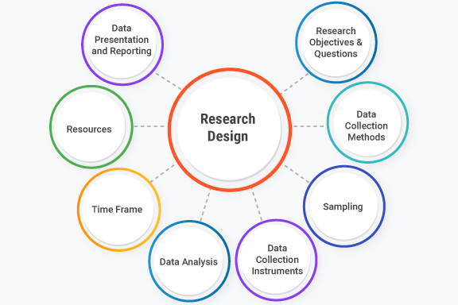
Research Design
A research design is defined as the overall plan or structure that guides the process of conducting research.
It is a critical component of the research process and serves as a blueprint for how a study will be carried out, including the methods and techniques that will be used to collect and analyze data.

Slide 28
Research Design
Key elements of research design include:
Research Objectives
Research Questions or Hypotheses
Data Collection Methods
Sampling
Data Collection Instruments
Data Analysis
Time Frame
Ethical Considerations
Resources
Data Presentation and Reporting
There are several types of research designs, each tailored to answer specific research questions and achieve particular objectives.
There are various research designs, such as experimental, observational, survey, case study, and longitudinal designs, each suited to different research questions and objectives. The choice of research design depends on the nature of the research and the goals of the study.

Slide 29

Literature Review
Literature review means a systematic evaluation of previous research works or publications that a researcher carries out in order to use in his or her research work, hence identifying gaps and justifying the need for the conduct of the research. (Chigbu, Atiku, & Plessis, 2023)
Literature review is also a well-integrated discussion and critical evaluation of the different points of view on a given research topic, as found in the relevant previous studies, highlighting their strengths, weaknesses and indicating how the research will contribute to knowledge on the topic. (Paul & Criado, 2020)

Slide 30
Reviewing of Literature
A review of relevant literature is an integral part of the research process. It enables the researcher to formulate his problem in terms of the specific aspects of the general area of his interest that has not been researched so far.
Importance Of Reviewing Literature
It avoids duplication of the work that has been done in the recent past.
It helps the researcher discover what others have learned and reported on the problem.
It enables the researcher to become familiar with the methodology followed by others.
It allows the researcher to understand what concepts and theories are relevant to his area of investigation.
It helps the researcher to understand if there are any significant controversies, contradictions, and inconsistencies in the findings.
It allows the researcher to understand if there are any unanswered research questions.

Slide 31
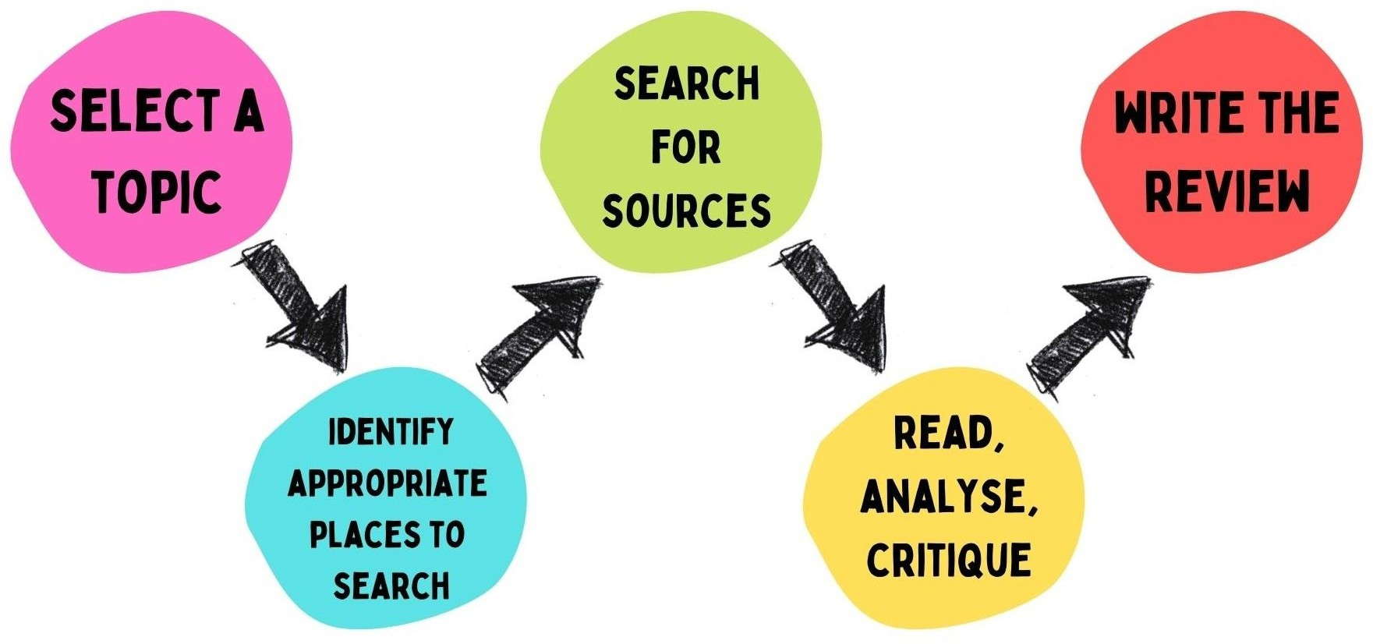
Steps for Literature Review

Slide 32
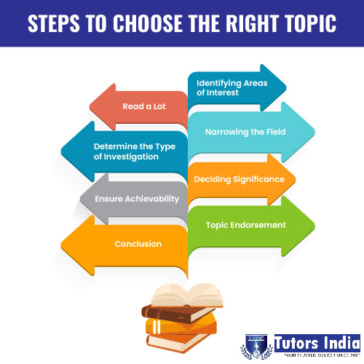
Selecting a Topic
Must be something Interesting to you (ideally, you should have come across a series of recent papers related to your line of work that call for a critical summary),
An important aspect of the field (so that many readers will be interested in the review and there will be enough material to write it),
A well-defined issue (otherwise you could potentially include thousands of publications, which would make the review unhelpful).

Slide 33

Developing A Search Strategy
Strategy involves figuring out where the information might be and identifying the best tools for finding those types of sources.
The search strategy combines the key concepts of your search question in order to retrieve accurate results.
Your search strategy will account for all:
Possible search terms
Keywords and phrases
Subject headings (where applicable)

Slide 34


Searching and Locating Literature
Aim to be as comprehensive as possible when conducting a literature review. Knowing exactly where to search for information is important.
Start with research databases: Google Scholar, Scopus and Web of Science are good databases to start with for any research topic and literature review.
Focus your search with specific databases, Select two or three discipline/specialist databases to conduct your search for comprehensive results.
Finding books, eBooks and theses

Slide 35
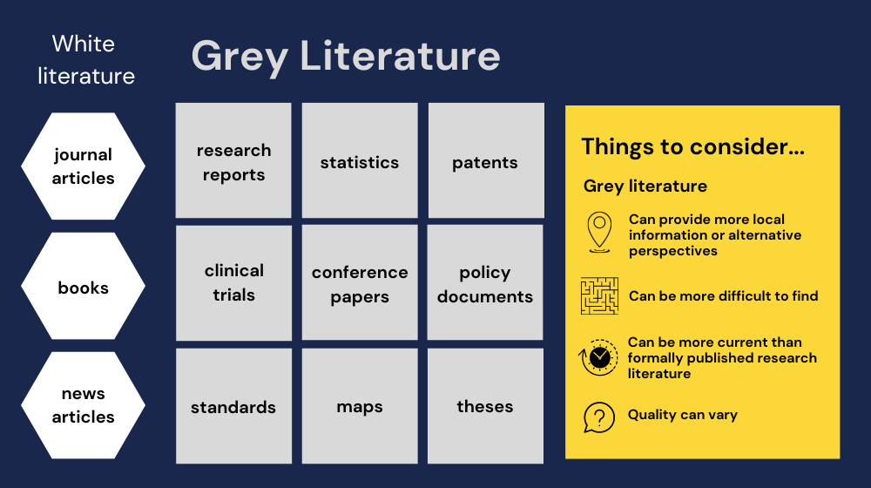
Literature Resources
Books (printed or e-books)
Journals (both)
Research reports (both)
Institutional publications (both)
Government publications (both)
Various NGO’s/INGO’s publications
Internet (Online resources)
Grey Literature (wide range of different information that is produced outside of traditional publishing and distribution channels, and which is often not well represented in indexing databases.)

Slide 36

Data Collection
Data collection is the methodological process of gathering information about a specific subject in order to find answers to research problems, trends and probabilities and to evaluate possible outcomes.
It’s crucial to ensure your data is complete during the collection phase and that it’s collected legally and ethically. If not, your analysis won’t be accurate and could have far-reaching consequences.
During data collection, the researchers must identify the data types, the sources of data, and what methods are being used
Data can be qualitative (meaning contextual in nature) or quantitative (meaning numeric in nature).
For research in science, medicine, higher education and other fields, data collection is often a more specialized process, in which researchers create and implement measures to collect specific sets of data.

Slide 37

Primary & Secondary Sources
Primary sources A primary source is a firsthand account of a topic, generally created by someone who had direct knowledge of the event or topic described and created during the time period being studied. Examples of primary sources include Interview, Survey, questionnaires, observation, Focus group.
Secondary sources analyze, interpret, and synthesize primary sources. Examples include books, and scholarly and magazine articles that interpret or analyze previous findings.

Slide 38
Well-designed data collection processes
Include the following steps:
Identify a business or research issue that needs to be addressed and set goals for the project.
Gather data requirements to answer the business question or deliver the research information.
Identify the data sets that can provide the desired information.
Set a plan for collecting the data, including the collection
methods that will be used.
Collect the available data and begin working to prepare it for analysis.

Slide 39
Data Analysis
Research data analysis is a process used by researchers to reduce data to a story and interpret it to derive insights. The data analysis process helps reduce a large chunk of data into smaller fragments, which makes sense.
As mentioned before:
A simple example of data analysis can be seen whenever we take a decision in our daily lives by evaluating what has happened in the past or what will happen if we make that decision.
There are many types of data analysis which was mentioned in the previous topic such as Content analysis, Narrative analysis, Grounded theory etc…

Slide 40
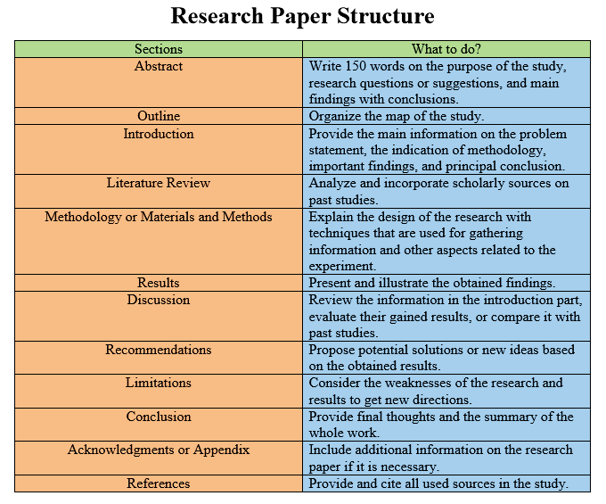

Slide 41
Reference
Thyer, B. A. (2001). What is the role of theory in research on social work practice?. Journal of Social Work Education, 37(1), 9-25.
Kothari, C. R. (2004). Research methodology: Methods and techniques. New Age International.
Jharotia, A. K., & Singh, S. (2016). Use of Research Methodology in Research: An Overview. International Journal of Social Science, Journalism & Mass Communication, 2(2), 44-51.
Creswell, J. W. (2008). Educational research: Planning, conducting, and evaluating quantitative and qualitative research (3rd ed.). Upper Saddle River, NJ: Pearson Education, Inc.
Chigbu, U. E., Atiku, S. O., & Du Plessis, C. C. (2023). The Science of Literature Reviews: Searching, Identifying, Selecting, and Synthesising. Publications, 11(1), 2.
Paul, J., & Criado, A. R. (2020). The art of writing literature review: What do we know and what do we need to know?. International business review, 29(4), 101717.

