Slide 1

Academic Research and Writing
Omar Farouk Al Mashhour
Academic Research And Writing (Bus 149)
2024-2025
Week One
Sunday, 15th Of December, 2024

Slide 2
Learning Outcomes
1 | Students will be able to define what constitutes academic research and articulate the differences between academic and non-academic research.
2 | Students will demonstrate the ability to select appropriate research methodologies (qualitative, quantitative, case studies, etc.) for various research questions and contexts.
3 | Students will acquire the skills to structure a research paper effectively, including creating a coherent thesis statement, developing a logical argument, and writing clear and concise academic prose.
4 | Students will learn and apply different citation styles (APA, MLA, Chicago) accurately in their writing, demonstrating an understanding of the importance of citations in academic integrity.
5 | Students will demonstrate the ability to critically analyze sources, synthesize information, and evaluate arguments in academic writing.

Slide 3

I have some questions for you

Slide 4

Have you ever thought about how big discoveries and ideas are shared and proven?
What makes a strong, well-researched point of view different from just a personal opinion?
How do experts from all over the world add to our knowledge, and how do we know which information we can trust?
Why do some research findings change how we see the world, while others are quickly forgotten?
How can you, as a student and someone new to research, learn to join in and add your own valuable ideas to this world of study?

Slide 5
How Much you know about the following?

Slide 6


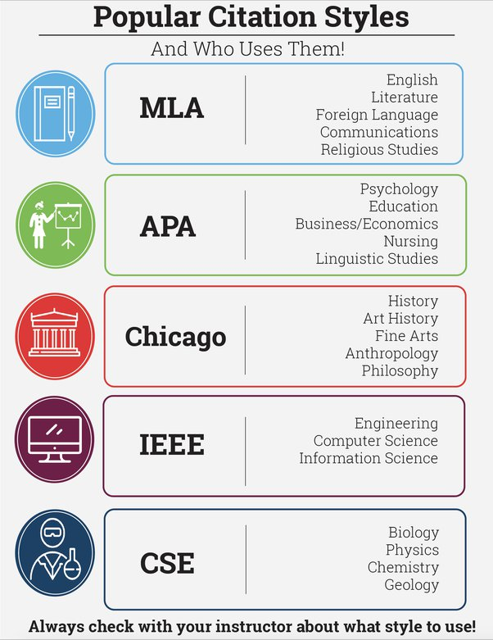

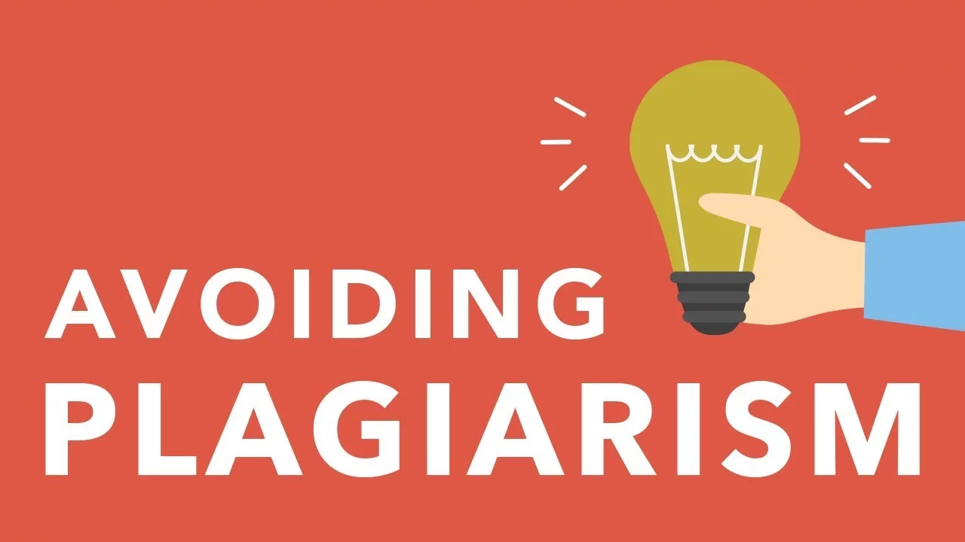

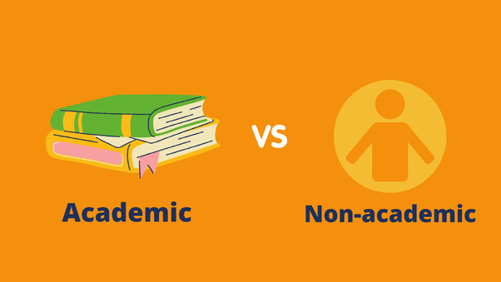

Slide 7
What are these and how do they impact our life? Well, the answer is more complicated that you think.
It entails a long , precise, and systematic process Which is highly enjoyable for those who are looking to be special.

Slide 8
Why Academic Research and Writing
At its heart, academic research and writing is more than just an academic exercise; it's a powerful tool for discovery, innovation, and contributing to the vast sea of human knowledge.
Whether you're aspiring to be a scientist, a historian, an educator, or any professional in the myriad fields that rely on solid research, mastering this skill is pivotal.
This course will not only equip you with these skills but also teach you how to articulate your ideas with clarity and precision, an invaluable asset in any professional or academic setting.

Slide 9

Now, Let’s Have An Exercise
-Don’t forget to take some notes

Slide 10
Read The Following Extract
I've noticed a big change in how I connect with my friends and family since I started using social media. Before, I used to pick up the phone and call someone if I wanted to catch up or share news. Now, I just post a status update or share a photo on Instagram, and it feels like everyone's in the loop. It's convenient, sure, but sometimes I miss the personal touch of a real conversation. I remember the long talks I used to have with my best friend, but now, we mostly comment on each other's posts. It's great for staying connected, but I can't help feeling that something's missing – that warmth of hearing someone's voice or seeing their expressions. Social media has definitely made the world smaller, but I wonder if it's also made our personal connections shallower."

Slide 11
Now, read this extract

Slide 12
In the realm of sociological research, the advent of social media has been a focal point for analyzing its transformative effects on social interaction and identity formation. Pioneering studies, such as those conducted by Baxter and Clark (2021), have elucidated how platforms like Facebook and Twitter have not only increased the frequency of interpersonal communications but have also redefined their very nature. These platforms act as conduits for what Baym and Boyd (2018) describe as 'networked individualism', a paradigm shift where traditional group-based interactions are supplanted by more fluid, individual-centric connections.
This shift is further explored in the work of Zhao (2020), who posits that social media facilitates a unique blend of public and private spheres, allowing for the simultaneous exhibition and concealment of personal identities. Such a phenomenon has significant implications for self-conception and socialization processes, challenging traditional notions of community and belonging. Moreover, empirical evidence provided by Kim and Lee (2019) suggests a correlation between intensive social media use and the alteration of social behaviors, highlighting a complex interplay between virtual engagement and real-world social dynamics. As these platforms continue to permeate everyday life, their influence extends beyond mere communication, shaping the very fabric of social interaction and the construction of modern identities.

Slide 13

Have you noticed any difference ?

Slide 14
The Differences Can Be Seen In Several Aspects Of Writing
Tone and Language
Content and Structure
Purpose and Audience
References and Citations

Slide 15
Non-Academic
First-Person Narrative:
  This paragraph is written from a personal perspective, using "I" to express individual experiences and reflections.
Subjective and Anecdotal Content:
  It focuses on personal observations and feelings, rather than presenting objective facts or research findings.
Conversational Tone:
  The language is informal and conversational, intended to engage the reader on a personal level.
Absence of Formal Structure and Citations:
  Unlike academic texts, this paragraph does not follow a formal structure or include citations. It is more about personal storytelling.
Emotional and Reflective:
  The paragraph explores emotional responses and personal reflections, which is a hallmark of many non-academic texts.

Slide 16
Academic
Third-Person and Impersonal Tone:
  The paragraph is written in the third person, maintaining an objective and formal tone. Focusing on presenting research findings and theoretical analysis without personal bias or subjective interpretation.
Emphasis on Research and Theory:
  References to research studies (Baxter and Clark, Baym and Boyd, Zhao, Kim and Lee) are integrated to support the argument, demonstrating a deep engagement with existing scholarly work.
Structured and Formal Language:
  The paragraph is organized logically, starting with a general statement about the research area, then discussing specific studies and theories, and finally presenting the implications of these findings.
  Evidence-Based:
  The argument is built upon empirical studies and evidence, showcasing a reliance on data and research rather than anecdotal or personal observations.
  Citations and References:
  Formal citations are used throughout the paragraph to reference the work of other scholars, adhering to academic standards of scholarship and research integrity.

Slide 17
Aspect | Academic Paragraph | Non-Academic Paragraph
Narrative Style | Third-person, impersonal | First-person, personal narrative
Content Focus | Research findings, theoretical perspectives | Personal experiences, reflections
Language and Tone | Formal, complex, academic vocabulary | Conversational, simple, accessible language
Structure and Rigor | Structured approach, formal citations, evidence-based argumentation | Flexible structure, anecdotal, less emphasis on evidence
Purpose | To contribute to scholarly understanding and discourse, focusing on objective analysis | Personal expression, emotional engagement with the reader, focusing on subjective experiences
Audience | Scholars, researchers, students in relevant academic fields | General public, readers without specialized knowledge in the topic
Evidence and Argumentation | Empirical evidence, data analysis, logical reasoning, supported by research findings and citations | Often anecdotal, based on personal stories or opinions, with minimal or no use of formal citations or evidence
Tone | Objective, detached (no personal feeling involved) | Subjective, engaging

Slide 18
Now, What is “Academic Research And Writing”?
Let’s break up the words

Slide 19
What is the meaning of Academic
Academia or Academics an inevitable part of the society
Academia or Academics is that part of the society which is engaged in this pursuit of knowledge.
In every sphere of life, be it social, economical, philosophical, ecological, or whatever sphere if life it many be, the pusuit of knowledge drives and controls present and shapes the future too.

Slide 20
Academia is a lifelong journey where researchers bring knowledge, experience, and sociocultural background to contribute to knowledge in a given research area.
Universities (main source for future academicians and scholars) are crucial organizations in the knowledge society, playing a developmental role in regional development by combining and mobilizing knowledge and relational resources for collective action.
Academics are knowledge providers, passionate researchers, and holders of values, beliefs, and life principles.)

Slide 21
According to Blythe and Monk (2018) Academics can refer to occupations (Job) in universities, or to people who study a particular field.
Academics are considered "experts" in their fields of specialization and play multiple roles in higher education institutions. Lee, M. (2003).

Slide 22
Now, What is the meaning of “Academic Research”

Slide 23
Academic Research
We’ve all heard the phrase “according to a new study” or “research shows” but have you ever wondered what that actually means?
It’s obvious that research is important because we hear about it all of the time in all parts of life.
Research comes in all different forms and places. And whether we know it or not, it affects most things that we deal with in our lives.
From the technology that we use to the medicine we take. Research is vital to improvement.

Slide 24
Be careful, there is a profound distinction between casual research and academic research (Smith, 2021).
As was mentioned before, academic research is usually intended for the sole purpose of creating knowledge.
Distinct from industry-specific inquiries, academic research is not crafted to cater to the interests of a particular company or organization.
Instead, its primary aim is to provide Logical, evidence-based insights that can significantly alter (change) perceptions and understandings related to the subject matter (Knowledge) under investigation (Oldfield, 2016).

Slide 25
Academic research follows the scientific method as a way to ensure that objectivity is kept at all times. (Systematic)
The scientific method follows the same pattern from beginning to end in order to find the most logical conclusion for the question at hand.
The point of research is to find ways to improve our understanding of what is being studied or to verify that our understanding of the subject.

Slide 26
So once the experiment has been completed and the conclusion found, what happens next? How does the researcher share what they’ve learned?
Most often, the researcher will publish their study and findings as an academic paper in a journal. These are established publications with a reputation for bringing valuable, valid information to the public.
When a researcher writes up the findings from their experiment, they have to use an academic writing style in order to be published.

Slide 27
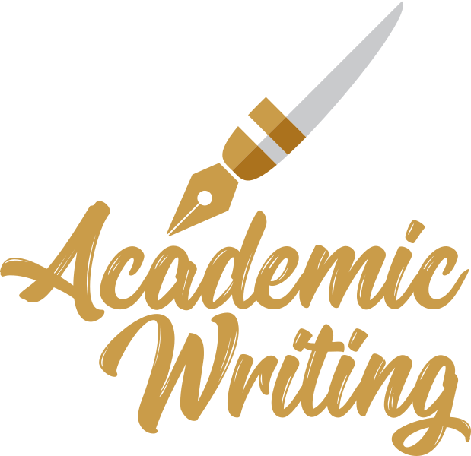
What is Academic Writing?

Slide 28
Academic writing is the kind of writing used in high school and college classes.
Academic writing is different from creative writing, which is the kind of writing you do when you write stories.
It is also different from personal writing, which is the kind of writing you do when you write letters or e-mails to your friends and family.
Creative writing and personal writing are informal, so you may use slang, abbreviations, and incomplete sentences. However, academic writing is formal, so you should not use slang or contractions. Also, you should take care to write complete sentences and to organize them in a certain way

Slide 29
There is no common narrative, instead just the methods, facts or data and conclusions are presented. The technical jargon of that discipline, such as chemistry, or their industry is used as well.
The whole goal of the academic writing style is to articulate (write up) exactly what was done and exactly what was found. These articles are very straight-forward to read, especially if you understand that area of expertise and its technical words.
It’s also very important to explain the findings in a clear and straight forward way with no added opinions.

Slide 30
Definitions for Academic Writing
Academic writing can be re-conceptualized as a dynamic set of activities and practices, constructing, deconstructing, and reconstructing knowledge, connecting concepts, and shaping ideas.
According to Badley, G. (2009). Academic writing as shaping and re-shaping.
According to Trajanoska, I., & Andonova, M. (2019). Academic writing is an "informed, logical, clear, well structured, and based on evidence" prose style that describes, understands, and further investigates the world around us.

Slide 31

Academic writing – an Art or a Science ?
Academic writing is an Art as well as a science at the same time.
It has to follow a focused well-knit pattern like an artwork, but also has to be based on facts and logical arguments resulting into conclusions and results which are verifiable, which is a science.

Slide 32

Writing Is A Medium Of Expression
Writing is a medium of expression.
Academic writing is also a type of medium of expression of your knowledge.
Academic writing is a vehicle to transport your thoughts, comments, arguments and knowledge about a subject to the reader. It’s the most important tool to pass on knowledge from one to the other – from one generation to the next one.
If you look at the development of civilization, people used academic writing to reach and provide knowledge and pass to other genereation to be acquired or developed.

Slide 33

Impact and Importance
The impact of academic research is vast:
Advancing Knowledge: It contributes to the body of knowledge in various fields.
Societal Benefits: Many research projects aim to address societal issues, improve quality of life, and inform policy.
Economic Development: Research can lead to new technologies, processes, and innovations that drive economic growth.
Educational Value: It forms the basis of much of the content taught in educational institutions.

Slide 34

Features Of Academic Writing
Specific Purpose: To expand knowledge, solve complex problems, test theories, and develop new understandings.
Planning and focus: It is important to answer the research questions and demonstrates knowledge of subject. To achieve that, you need to plan you writing in advance, in order for your research to become valid, clear, and precise – otherwise, the writing will be disorganized and convery bad impression to the reader such as lack of knowledge)
Planning not only the main topic, but each paragph as well.
It also must be focused on a specific topic of study. If you don’t have a focus, the reader will lose the interest , consequently, losing the value of the research.
Source : (Staples et al., 2016)

Slide 35

Features Of Academic Writing
Structured: it must be well-organized, follows a logical flow, and brings together relevant ideas and information.
When you have plan what you write, you need to structure your writing, so you create a smooth reading and logical flow of ideas to present a very academic content where the ideas are sequential.
Lack of structure, the paper will deviate from the topic.

Slide 36
Features of academic writing
Proven: Demonstrate domain expertise, support opinion and claims with evidence and reference appropriately.
What ever you are trying to say , you should always bring the evidence to support your arguments and thoughts. Reliance on data, observations, and experiments.
It prove your expertise and the hard work to review the previous literature.
This must also comes with a proper reference , and that no evidence is there without a proper reference.

Slide 37
Features Of Academic Writing
Forms and style: Academic writing is a formal writing. It uses precise timing and terminology , and be clear, concise, and balanced.
Critical and Analytical Thinking: Essential for assessing existing knowledge and generating new insights.
Systematic Approach: It involves a structured method to ensure reliability and validity of findings.

Slide 38
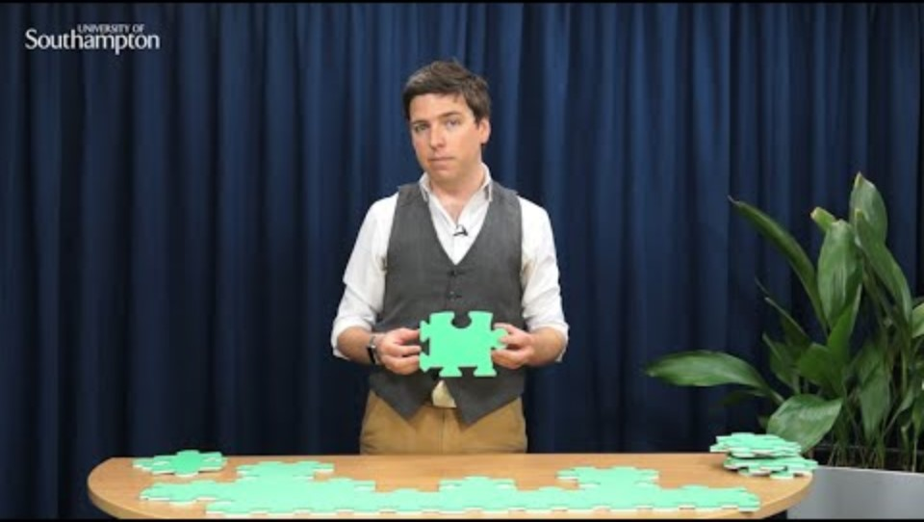

Slide 39
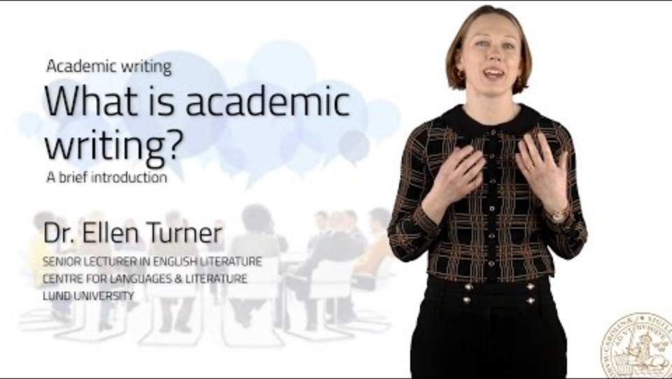

Slide 40
Reference And Source To Expand Your Knowledge
Blythe, M., & Monk, A. (2018). Funology 2: Critique, Ideation And Directions. Funology 2: From Usability To Enjoyment, 3-13. Lee, M. N. (2003). The Academic Profession In Malaysia And Singapore: Between Bureaucratic And Corporate Cultures. In The Decline Of The Guru: The Academic Profession In The Third World (Pp. 135-165). New York: Palgrave Macmillan Us.
Oldfield, C. (2016). Another Look At Research. Teaching Public Administration, 34, 40 - 53. Https://Doi.Org/10.1177/0144739415597971.
Badley, G. (2009). Academic Writing As Shaping And Re-shaping. Teaching In Higher Education, 14(2), 209-219.
Trajanoska, I., & Andonova, M. (2019). The Challenges Of Developing Effective Writing Skills For Academic Purposes In Students In The Republic Of North Macedonia. Knowledge-international Journal, 32(4), 455-459.
Staples, S., Egbert, J., Biber, D., & Gray, B. (2016). Academic Writing Development At The University Level. Written Communication, 33, 149 - 183. Https://Doi.Org/10.1177/0741088316631527.

