Slide 1
Accounting’s Concepts, principles and policies
Farhad Al-Kake
Farhad.Alkake@tiu.edu.krd

Slide 2
Objectives
By the end of the lecture (and with private study) students should be able to:
Discuss the objectives of general purpose financial statements.
Explain the nature of the reporting period, going concern and accounting entity concepts.
Outline the recognition criteria required before transactions can be included in financial statements.
Explain the nature of measurement bases, accounting policies and estimation techniques.
Describe the objectives against which an entity should judge the appropriateness of accounting policies, that is, relevance and faithful representation.
Describe the constraints that an entity should take into account in judging the appropriateness of accounting policies.
Describe the requirements of IAS 8 – Accounting Policies, Changes in Accounting Estimates and Errors (IASB, 2023a) with regard to the selection, review, change in and disclosure of accounting policies, estimation techniques and errors.

Slide 3
The objective of general purpose financial statements
The statement of financial performance:
Income and Expenses
The Statement of financial position:
Assets, liabilities and equity
Other statements and notes:
Nature and risks associated with recognized assets, liabilities, equity, income and expenses
Nature and risks associated with unrecognized assets, liabilities
Cash flows
Contributions from holders of equity claims and distributions to them
Methods, assumptions and judgements used in estimating the amounts disclosed and changes in the methods, assumptions and judgements

Slide 4
Accounting concepts
‘Broad basic assumptions which underlie the periodic financial accounts of business enterprises.’
(ASSC, SSAP2, 1971)
The Conceptual Framework singles out accounting concept that it describes as being fundamental for ensuring that financial statements meet their objective (providing useful information).

Slide 5
Reporting period assumption
The time period concept, otherwise known as the time interval or periodicity concept, refers to the practice of dividing the life of a reporting entity into discrete periods for the purpose of preparing financial statements..
Users can assume that financial statements represent a period of time, typically one year (company law requires financial statements to be prepared yearly).

Slide 6
Going concern
This concept is the assumption that the business will continue operating into the foreseeable future.
The implication of this is that assets will normally be valued, and shown in the statement of financial position, at their historical cost (or fair value).
However, if there is reason to believe that the entity will not be able to continue in business, the assets should be valued on a cessation basis. That is, at their net realisable value.

Slide 7
Going concern (cont.)
Information based on break-up values tends not to be relevant to users seeking to assess an entity’s cash-generation ability and financial adaptability.
Hence, it is important that financial statements are prepared on a going concern basis (so long as appropriate).
When financial statements are not prepared on a going concern basis, this fact should be disclosed. In addition, the reasons for assuming the entity is not a going concern and the measurement basis used should be explained.

Slide 8
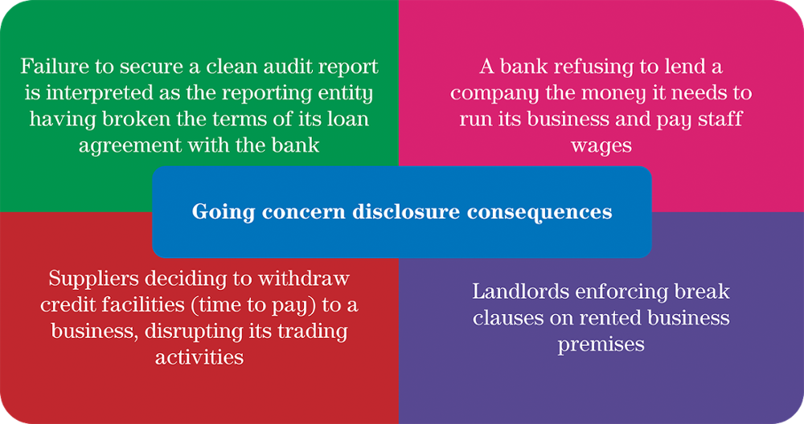
Possible consequences of going concern disclosures

Slide 9
Entity concept
The assumption that the financial statements for an entity represent the transactions of that entity as a unit in its own right and do not contain any assets, liabilities, income or expenditure that do not relate to the entity.

Slide 10
Recognition
Items should be recognised in the statement of financial position or the statement of comprehensive income if:
The item meets the definition of an element OR
The item meets the criteria for recognition

Slide 11
Elements
Assets:
‘resources controlled by an entity as a result of past events and from which future economic benefits are expected to flow to the entity’.
Liabilities:
'present obligations of an entity arising from past events, the settlement of which is expected to result in an outflow from the entity of resources embodying economic benefits’
Ownership Interest:
'the residual interest in the assets of the entity after deducting all its liabilities'

Slide 12
Elements
Income:
'increases in economic benefits during the accounting period in the form of inflows or enhancements of assets or decreases of liabilities that result in increases in equity, other than those relating to contributions from equity participants' (owners).
Expenses:
'decreases in economic benefits during the accounting period in the form of outflows or depletions of assets or incurrences of liabilities that result in decreases in equity, other than those relating to distributions to equity participants' (owners).

Slide 13
Other criteria for recognition
In addition to meeting the definition of an element, recognition is required if:
‘it provides users of financial statements with information that is useful, that is, relevant information about the element and the element can be faithfully represented.’
(Conceptual Framework, 2018)

Slide 14
Duality concept
Otherwise known as double entry.
Assumes that every transaction affects two accounts in a set of financial statements in such a manner as to keep the accounting equation in balance.

Slide 15
The matching principle
The matching principle refers to the assumption that in the measurement of profit, costs should be set against the revenue which they generate at the point in time when this arises.
For example – Inventory
‘When inventories are sold, the carrying amount of those inventories shall be recognised as an expense in the period in which the related revenue is recognised’ (IAS 2, Inventories)

Slide 16
Conflict between relevance and verifiability
Sometimes information that is the most relevant is not the most verifiable.
Leaving information out of the financial statements because of verifiability concerns may affect the completeness, and therefore faithful representation of the information that is provided.
It is appropriate to use the information that is the most relevant or whichever information is verifiable

Slide 17
Conflict between timeliness and verifiability
On the one hand, if there is undue delay in the reporting of information making it out of date, then this will affect its relevance. On the other hand, recognizing transactions and other events before all the uncertainties involved are resolved may affect the information’s verifiability.
In achieving a balance between timeliness and relevance and verifiability, the reporting entity should take all steps possible to produce verifiable information in a timely manner.
The overriding consideration affecting the timing of reporting should be ‘how best to satisfy the information needs of users for economic decision-making’.

Slide 18
Conflict with understandability
It may not always be possible to present relevant information in a way that can be understood by all users.
Information that is relevant and reliable should not be excluded from the financial statements simply because it is too difficult for some users to understand.

Slide 19
Conflict with consistency and faithful representation
Consistency should not be confused with mere uniformity.
Consistency should not be allowed to become an impediment to the introduction of improved accounting practices/standards.
It is not appropriate to keep accounting for an item in the same manner as before, when a new treatment emerges which is more relevant and provides a better faithful representation of the phenomena.

Slide 20
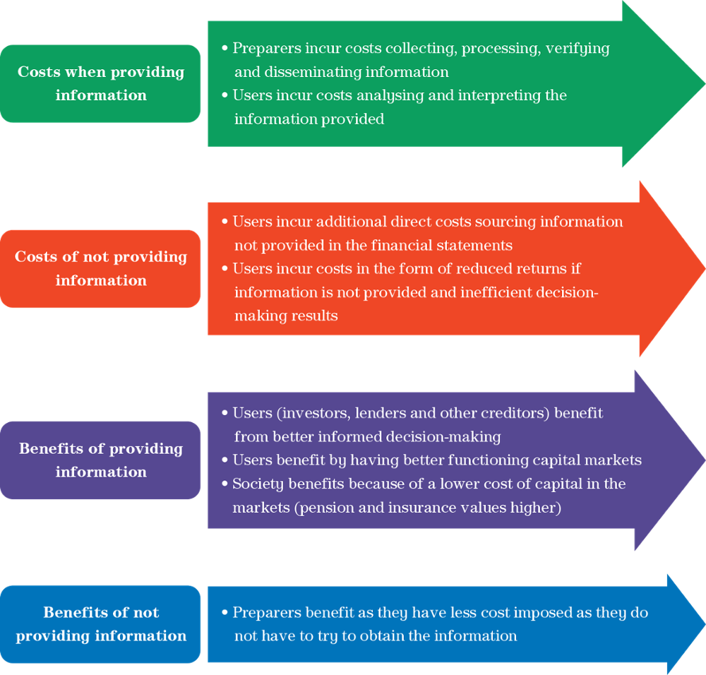
Balance between benefit and cost

Slide 21
Measurement
Methods used to determine the monetary value of assets, liabilities, income and expenditure.

Slide 22
Measurement bases
The methods used to determine the monetary value:
Historical cost (concept) (CF)
Current value (market value) (CF)
Fair value
Value in use for assets/fulfilment value for liabilities
Current cost

Slide 23
Historical cost concept
Transactions in financial statements reflect the actual cost incurred, or revenue earned.
The statement of financial position can be regarded as a history of management’s past decision making.

Slide 24
Fair value
Fair value is defined by the IASB in paragraph 9 of IFRS 13 ‘Fair Value Measurement’ as ‘the price that would be received to sell an asset, or paid to transfer a liability, in an orderly transaction between market participants at the measurement date’.

Slide 25
Money measurement concept
The information provided in the financial statements is expressed in monetary amounts (typically the currency of the country where the entity is registered).

Slide 26
Effective communication
Effective communication of information in financial statements is foundational to the qualitative characteristics of information.
The Conceptual Framework states that effective communication is achieved by emphasising presentation and disclosure objectives and principles instead of rules, organising information by grouping similar items and consolidating information to avoid excessive detail or aggregation.
(IASB, 2018)
Finally, the benefit from presenting or disclosing information should outweigh the costs involved.

Slide 27
Classification/aggregation
Under the Conceptual Framework, to assist understandability groups of similar items are aggregated and classified as an asset, liability, income or expenditure.
In addition, the Conceptual Framework, IAS 1 Presentation of Financial Statements and company law typically do not allow assets and liabilities to be offset against each other when presenting financial information. This is known as the separate determination concept.

Slide 28
Separate determination concept
A user can assume that assets and liabilities and income and expenses have not been netted off against each other, except in some limited instances, when the substance of the transaction is that it should be netted (for example, trade discounts).
Netting is also not allowed under the Companies Act 2006.

Slide 29
Capital maintenance
How an entity measure profit.
Only surpluses after capital value has been maintained is profit.
Hence expenses and a charge for capital maintenance is required to be deducted when determining profit.

Slide 30
Accounting policies
‘The specific principles, bases, conventions, rules and practices applied by an entity in preparing and presenting financial statements. An accounting policy will deal with three issues: recognising, selecting measurement bases for, and presenting assets, liabilities, income, expenses and changes to owners funds.’
(IASB, IAS 8, 2018 edition)

Slide 31
Estimation techniques
The methods used to apply accounting policies.
For example, if it is the policy to depreciate assets, then an estimation technique is the method chosen to depreciate, such as straight line, sum of digits, etc.

Slide 32
Accounting Policies: application
An accounting policy for a particular type of expenditure may specify:
whether an asset or a loss is to be recognised;
the basis on which it is to be measured; and
where in the statement of profit or loss or statement of financial position it is to be presented.

Slide 33
Objectives in selecting accounting policies
‘Management should develop and apply an accounting policy that results in information that is:
(a) Relevant to the economic decision making needs of users; and
(b) Reliable (faithful representation, neutral, prudent and complete)’
(IASB, IAS 8, 2018 version)
This is discussed in depth later ....

Slide 34
Consistency concept
Allows the user to look at a set of financial statements and assume that the same policies, methods and estimation techniques have been used from year to year.
So performance can be monitored over time and with other entities (all entities disclose how they account for material transactions).

Slide 35
Changing accounting policies
‘An entity shall change an accounting policy only if the change:
is required by an IFRS; or
results in the financial statements providing reliable and more relevant information about the effects of transactions, other events or conditions on the entity’s financial position, financial performance or cash flows’
(IASB, IAS 8, 2018 edition)

Slide 36
If a change is permitted
Amend the comparatives
Amend the opening balances for the cumulative impact of the change
Disclose the reasons for the change
Disclose the impact on the profit, or loss for the period
Two years amended comparatives are required under IAS 1 (2018) for the statement of financial position

Slide 37
The disclosure of accounting policies and estimation techniques
An entity should:
‘Select and apply accounting policies in accordance with IAS 8 and to present information, including accounting policies, in a manner that provides relevant, reliable, comparable and understandable information’
(IAS 1, 2018)

Slide 38
The disclosure of accounting policies and estimation techniques
IAS 1 recommends that each entity has a section in its financial statements called the 'summary of significant accounting policies’, which should highlight
‘the measurement basis (or bases) used in preparing the financial statements and the other accounting policies used that are relevant to an understanding of the financial statements’

Slide 39
Summary – some key points
There are several assumptions which apply to every transaction and every set of financial statements. These are called the accounting concepts.
The going concern is the most important concept as it is highlighted in the conceptual framework.
Recognition is required when a transaction meets the definition of an element (assets, liabilities, equity, income and expenditure) and if it can be measured reliably.
Every entity should include a statement of their material accounting policies with their financial statements.
The accounting policy should highlight the recognition criteria, measurement basis and presentation details.

Slide 40
Study action
Then - try to explain the key terms and concepts (check your answer with the chapter and the online glossary).
Try the review questions (check your answers with the chapter).
Try the exercise questions with an asterisk (solutions are available in the appendix).
Try the exercise questions required by your tutor (solutions to be provided by the tutor at their discretion).

