Slide 1
Accounting Principles
Chapter 2
The Recording Process
Farhad Al-Kake
farhad.alkake@tiu.edu.krd

Slide 2
Chapter Outline
  Learning Objectives
  L O 1 Describe how accounts, debits, and credits are used to record business transactions.
  L O 2 Indicate how a journal is used in the recording process.
  L O 3 Explain how a ledger and posting help in the recording process.
  L O 4 Prepare a trial balance.

Slide 3
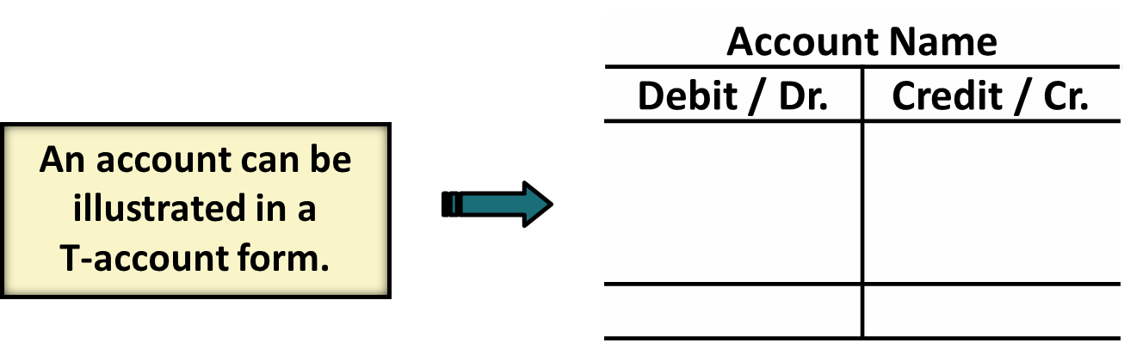
Accounts, Debits, and Credits (1 of 4)
The Account
    Record of increases and decreases in a specific asset, liability, or owner’s equity item.
    Debit = “Left”
    Credit = “Right”

Slide 4
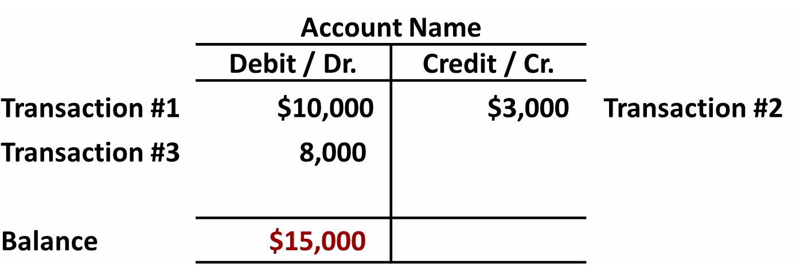
Debits and Credits (1 of 3)
If the sum of Debit entries are greater than the sum of Credit entries, the account will have a debit balance.

Slide 5
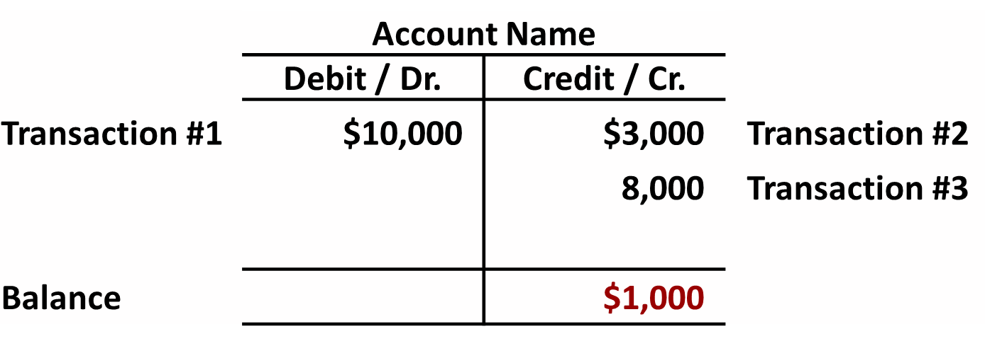
Debits and Credits (2 of 3)
If the sum of Credit entries are greater than the sum of Debit entries, the account will have a credit balance.

Slide 6
Debits and Credits (3 of 3)
Debit and Credit Procedure
Double-entry system
    Each transaction must affect two or more accounts to keep basic accounting equation in balance
    Recording done by debiting at least one account and crediting at least one other account
    DEBITS must equal CREDITS

Slide 7
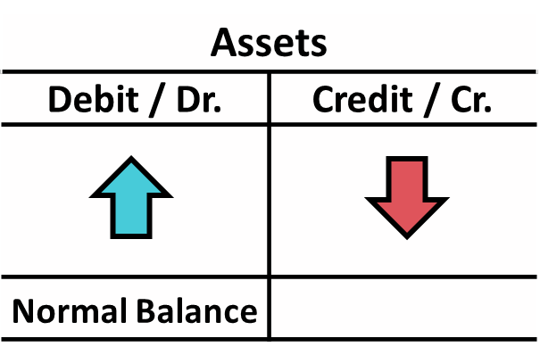
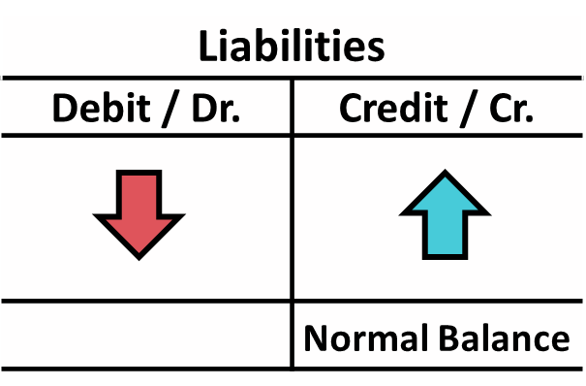
Accounts, Debits, and Credits (2 of 4)
    Asset – accounts normally show debit balances
    Liabilities – accounts normally show credit balances
    Normal balance is on the increase side

Slide 8
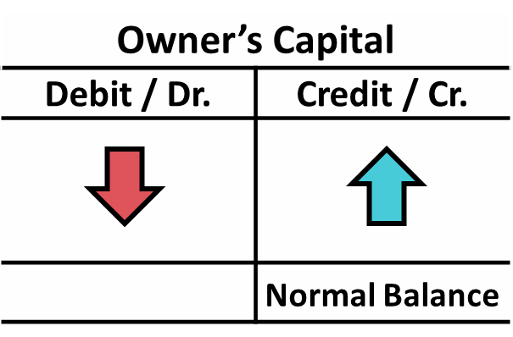
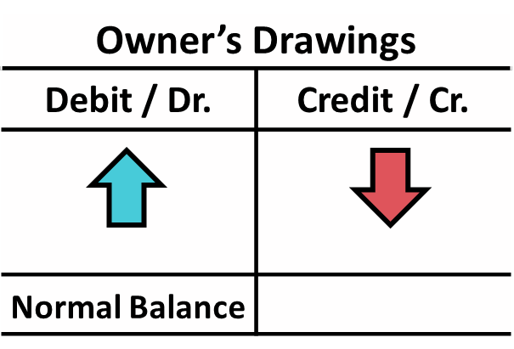
Accounts, Debits, and Credits (3 of 4)
    Owner’s investments and revenues increase owner’s equity (credit)
    Owner’s drawings and expenses decrease owner’s equity (debit)

Slide 9
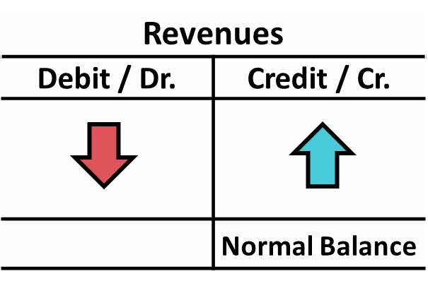
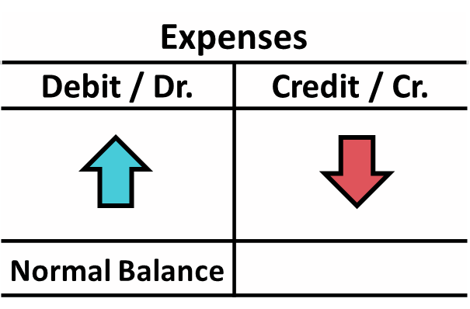
Accounts, Debits, and Credits (4 of 4)
    Earning revenues is to benefit owner(s)
    Effect of debits and credits on revenue accounts is the same as effect on Owner’s Capital
    Expenses have opposite effect

Slide 10
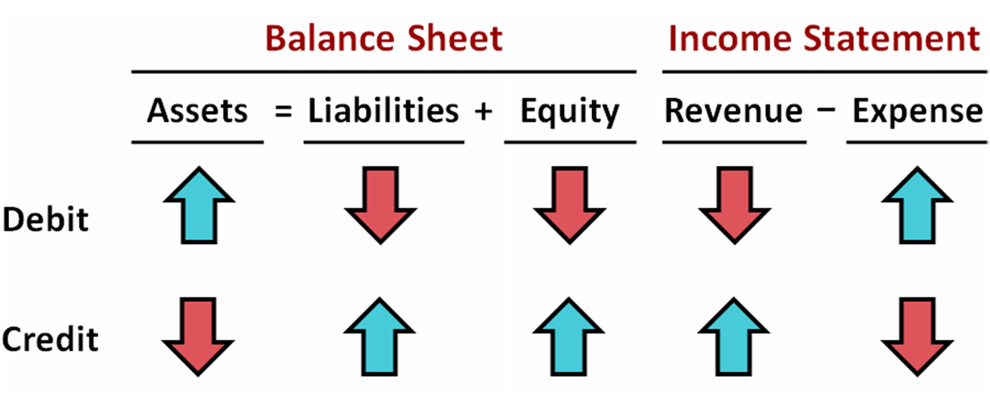
Summary of Debit / Credit Rules (1 of 2)

Slide 11
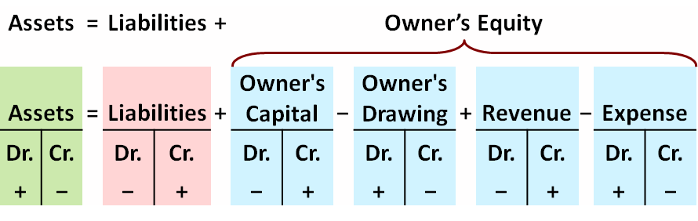
Summary of Debit / Credit Rules (2 of 2)
Debit/credit rules and effects on each type of account.
Equation must be in balance after every transaction. Total Debits must equal total Credits.

Slide 12
Debit / Credit Rules (1 of 4)
  Debits:
  a. increase both assets and liabilities
  b. decrease both assets and liabilities
  c. increase assets and decrease liabilities
  d. decrease assets and increase liabilities

Slide 13
Debit / Credit Rules (2 of 4)
  Debits:
  a. increase both assets and liabilities
  b. decrease both assets and liabilities
  c. Answer: increase assets and decrease liabilities
  d. decrease assets and increase liabilities

Slide 14
Debit / Credit Rules (3 of 4)
  Accounts that normally have debit balances are:
  a. assets, expenses, and revenues
  b. assets, expenses, and equity
  c. assets, liabilities, and owner’s drawing
  d. assets, owner’s drawing, and expenses

Slide 15
Debit / Credit Rules (4 of 4)
  Accounts that normally have debit balances are:
  a. assets, expenses, and revenues
  b. assets, expenses, and equity
  c. assets, liabilities, and owner’s drawing
  d. Answer: assets, owner’s drawing, and expenses

Slide 16
Do It! 1: Normal Account Balance
Kate Browne has just rented space in a shopping mall. She will open a hair salon to be called “Hair It Is.” A friend has advised Kate to set up a double-entry set of accounting records in which to record all of her business transactions.
Identify the balance sheet accounts that Kate will likely need to record the transactions needed to open her business. Indicate whether the normal balance of each account is a debit or a credit.
Assets | Liabilities | Equity
Cash (debit) | Notes payable (credit) | Owner's Capital (credit)
Supplies (debit) | Accounts payable (credit)
Equipment (debit)

Slide 17
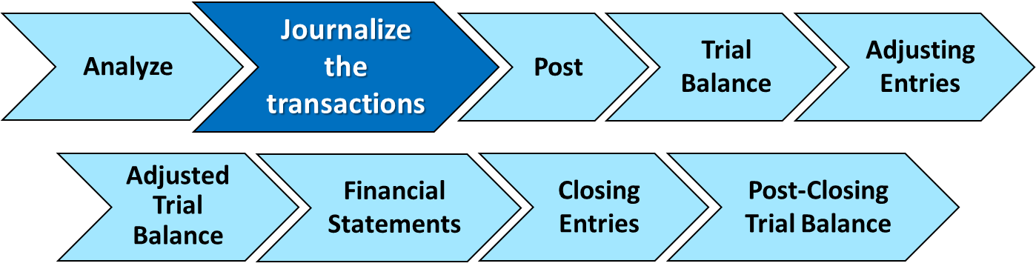
The Journal (1 of 2)
The Recording Process
  Analyze transaction
  Enter transaction in journal
  Transfer journal information to ledger accounts

Slide 18
The Journal (2 of 2)
    Book of original entry
    Transactions recorded in chronological order
    Contributions to the recording process:
  Discloses in one place the complete effects of a transaction
  Provides a chronological record of transactions
  Helps to prevent or locate errors because the debit and credit amounts for each entry can be easily compared

Slide 19
Journalizing (1 of 2)
Journalizing - Entering transaction data in the journal.
Illustration: On September 1, Ray Neal invested $15,000 cash in the business, and Softbyte purchased computer equipment for $7,000 cash.
 | General Journal |  |  | J1
Date | Account Titles and Explanation | Ref. | Debit | Credit
2020 Sept. 1 | Cash |  | 15,000
 | Owner's Capital (Owner’s investment of cash in business) |  |  | 15,000
1 | Equipment |  | 7,000
 | Cash (Purchase of equipment for cash) |  |  | 7,000

Slide 20
Journalizing (2 of 2)
Simple and Compound Entries
Illustration: On July 1, Butler Company purchases a delivery truck costing $14,000. It pays $8,000 cash now and agrees to pay the remaining $6,000 on account (to be paid later).
 | General Journal |  |  | J1
Date | Account Titles and Explanation | Ref. | Debit | Credit
2020 July 1 | Equipment |  | 14,000
 | Cash |  |  | 8,000
 | Accounts Payable (Purchased truck for cash with balance on account) |  |  | 6,000

Slide 21
Do It! 2: Recording Business Activities (1 of 2)
Kate Browne engaged in the following activities in establishing her salon, Hair It Is:
Opened a bank account in the name of Hair It Is and deposited $20,000 of her own money in this account as her initial investment.
Purchased equipment on account (to be paid in 30 days) for a total cost of $4,800.
Interviewed three people for the position of hair stylist.
Prepare the journal entries to record the transactions.

Slide 22
Do It! 2: Recording Business Activities (2 of 2)
Prepare the journal entries to record the transactions.
Opened a bank account and deposited $20,000.
Cash
20,000
Owner’s Capital
(Owner’s investment of cash in business)
20,000
Purchased equipment on account (to be paid in 30 days) for a total cost of $4,800.
Equipment
4,800
Accounts Payable
(Purchase of equipment on account)
4,800
Interviewed three persons for the position of hair stylist.
No entry because no transaction has occurred.

Slide 23
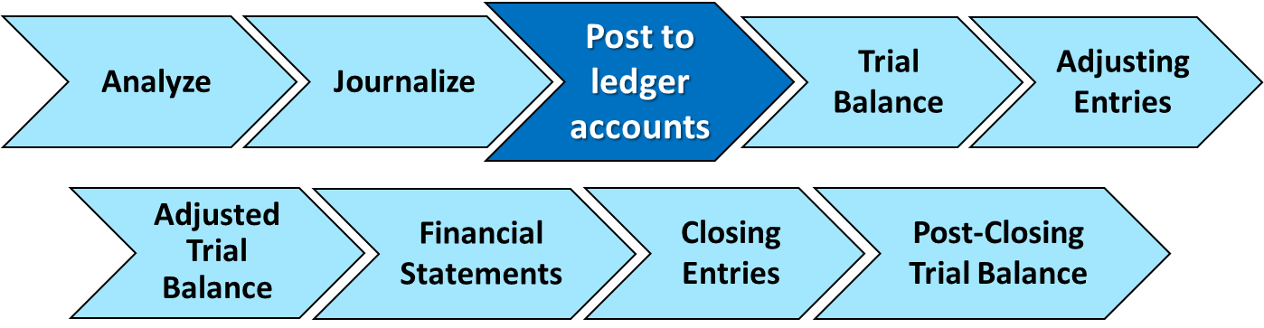
The Journal and Posting
The Ledger
  Entire group of accounts maintained by a company
  Provides the balance in each account
  Keeps track of changes in account balances

Slide 24
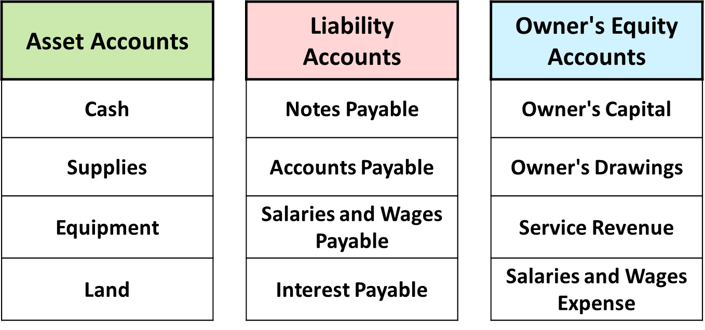
The Ledger (1 of 3)
General ledger contains all asset, liability, and owner’s equity accounts

Slide 25
The Ledger (2 of 3)
Standard Form of Account
 | Cash |  |  |  | NO. 101
Date | Explanation | Ref. | Debit | Credit | Balance
2020 June 1 |  |  | 25,000 |  | 25,000
2 |  |  |  | 8,000 | 17,000
3 |  |  | 4,200 |  | 21,200
9 |  |  | 7,500 |  | 28,700
17 |  |  |  | 11,700 | 17,000
20 |  |  |  | 250 | 16,750
30 |  |  |  | 7,300 | 9,450

Slide 26
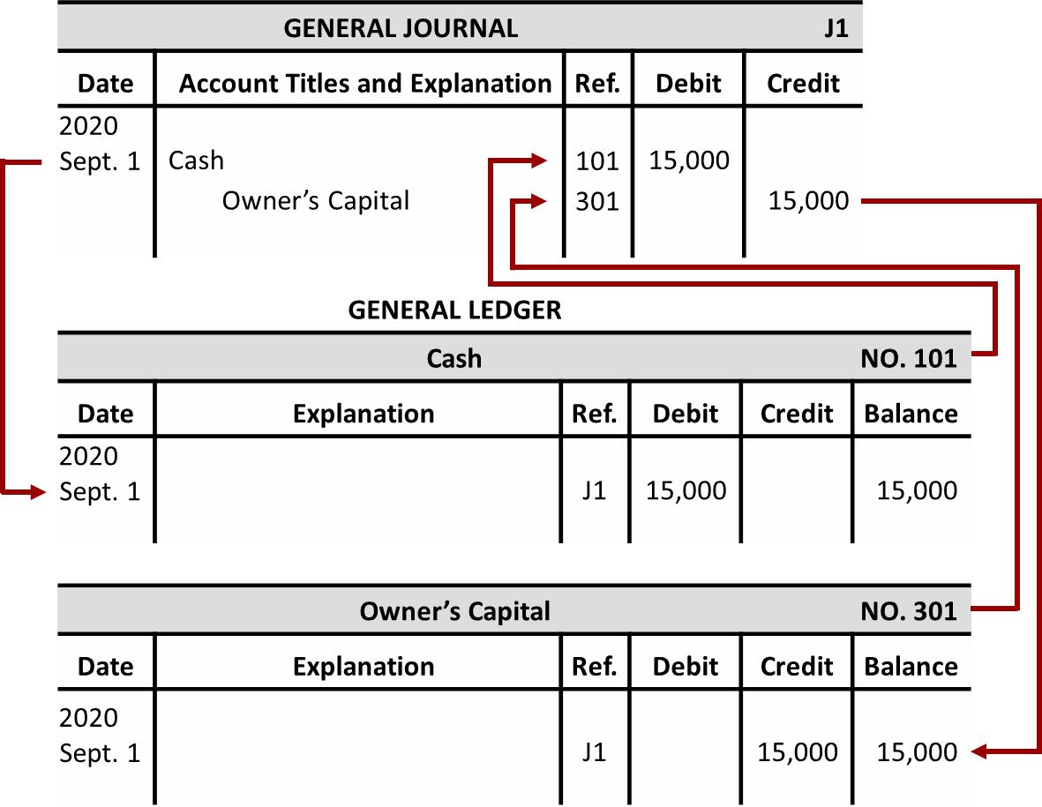
The Ledger (3 of 3)

Slide 27
Posting (1 of 2)
  Posting:
  a. normally occurs before journalizing
  b. transfers ledger transaction data to the journal
  c. is an optional step in the recording process
  d. transfers journal entries to ledger accounts

Slide 28
Posting (2 of 2)
  Posting:
  a. normally occurs before journalizing
  b. transfers ledger transaction data to the journal
  c. is an optional step in the recording process
  d. Answer: transfers journal entries to ledger accounts

Slide 29
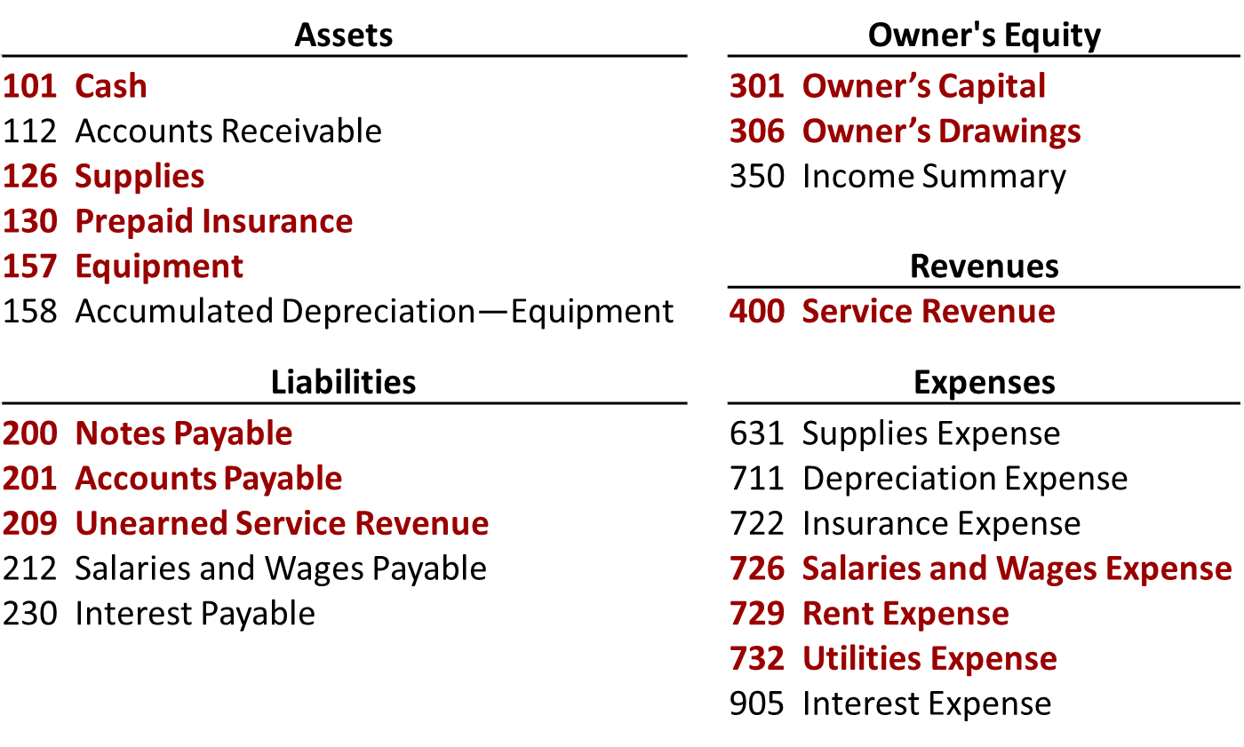
Chart of Accounts
Accounts in Red are used in this chapter.

Slide 30
The Recording Process Illustrated (1 of 10)
Follow these steps:
Determine what type of account is involved.
Determine whether the account increased or decreased and by how much.
Translate the increases and decreases into debits and credits.

Slide 31
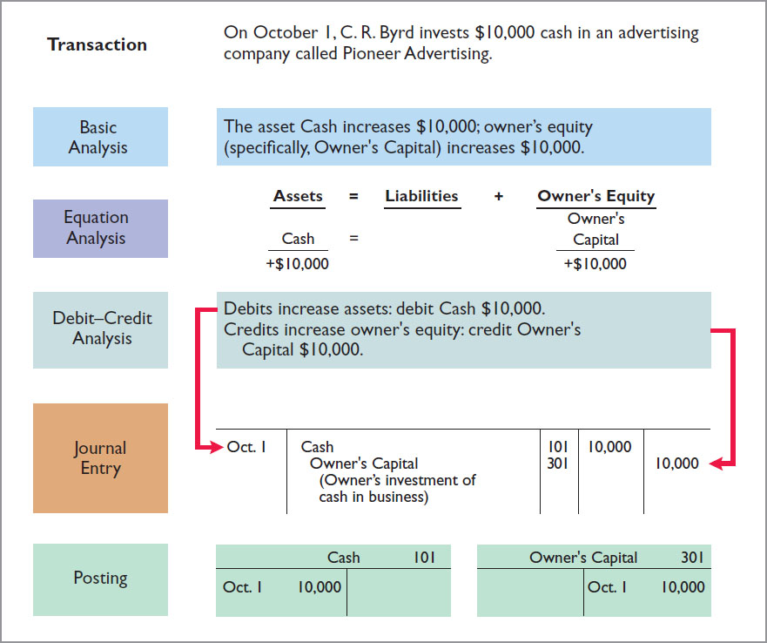
The Recording Process Illustrated (2 of 10)

Slide 32
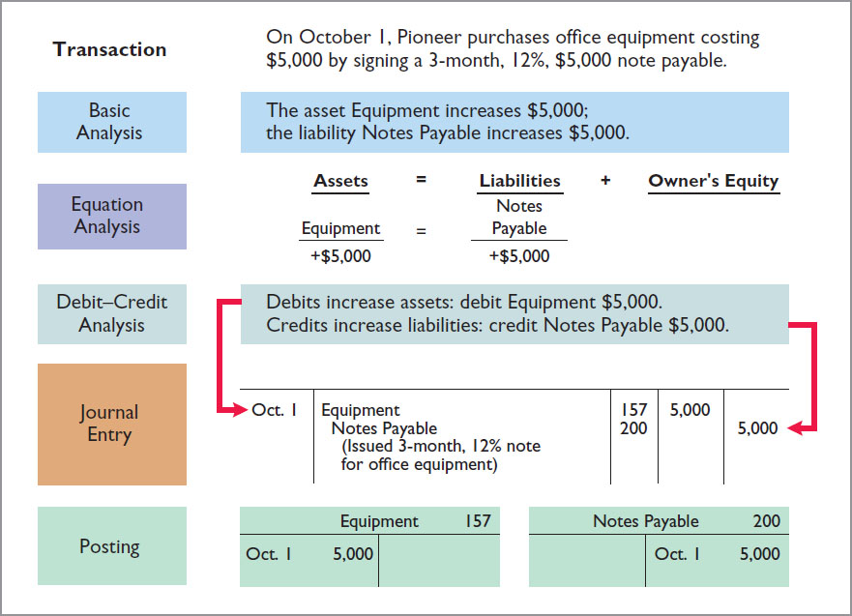
The Recording Process Illustrated (3 of 10)

Slide 33
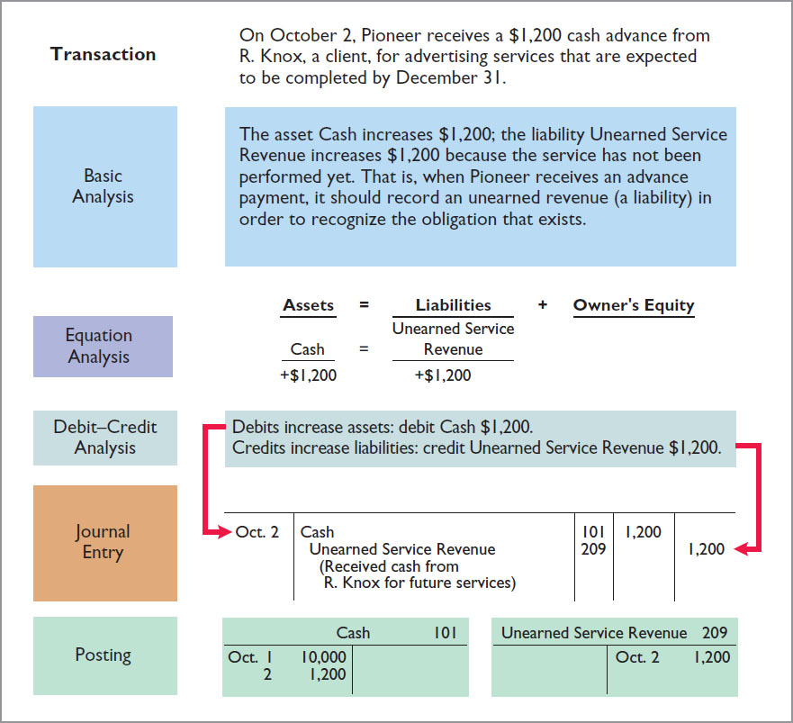
The Recording Process Illustrated (4 of 10)

Slide 34
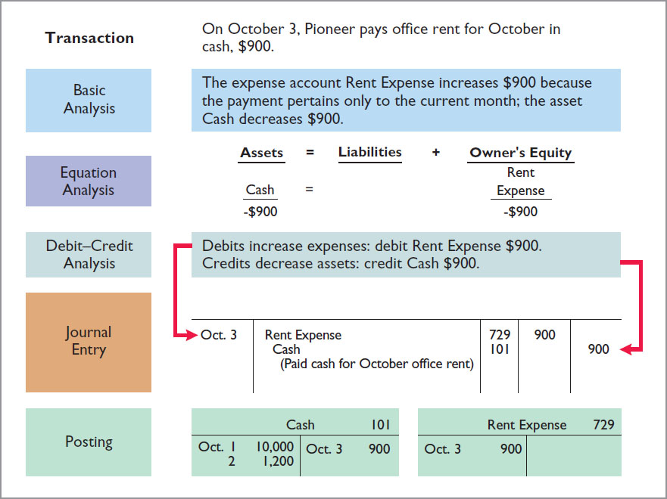
The Recording Process Illustrated (5 of 10)

Slide 35
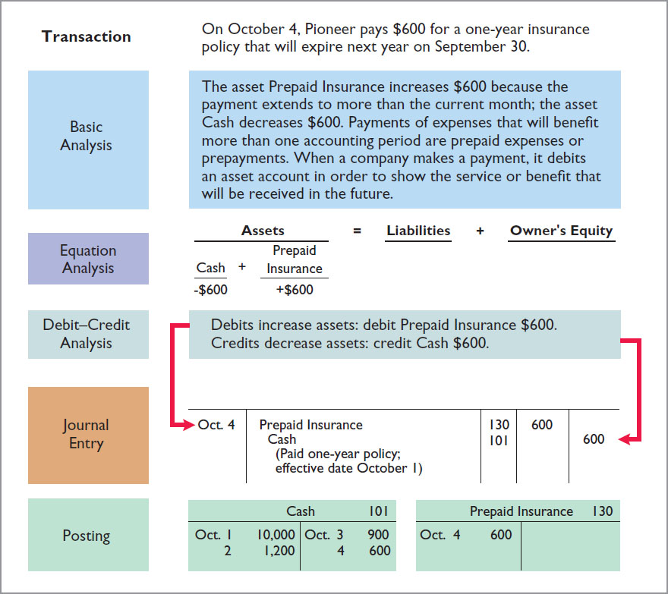
The Recording Process Illustrated (6 of 10)

Slide 36
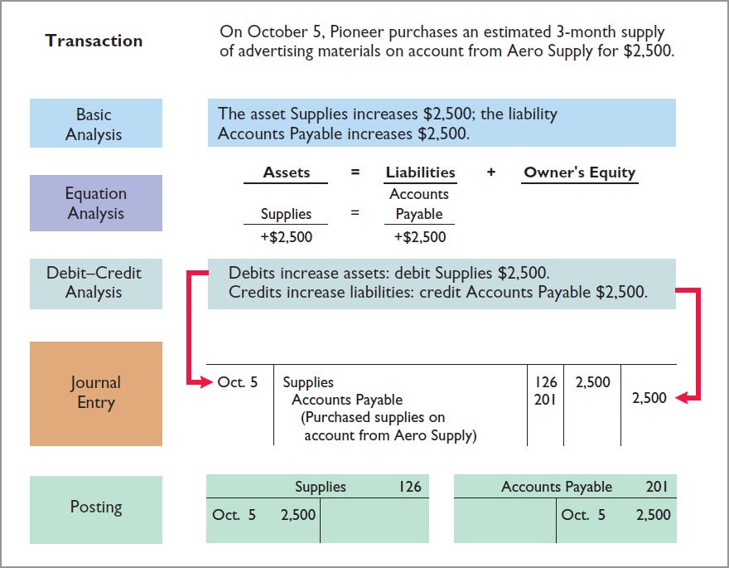
The Recording Process Illustrated (7 of 10)

Slide 37
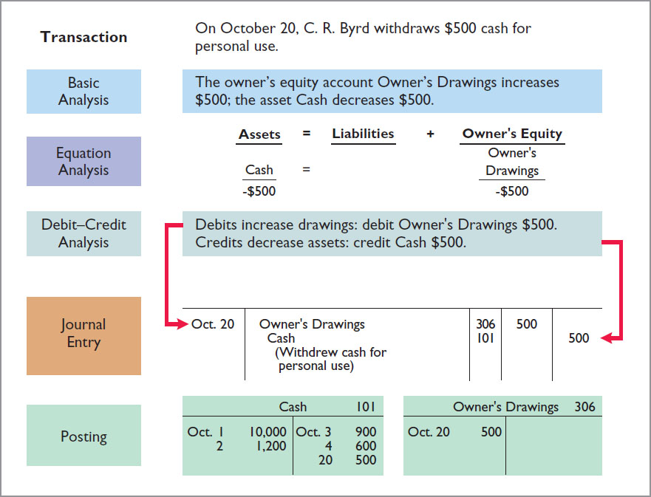
The Recording Process Illustrated (8 of 10)

Slide 38
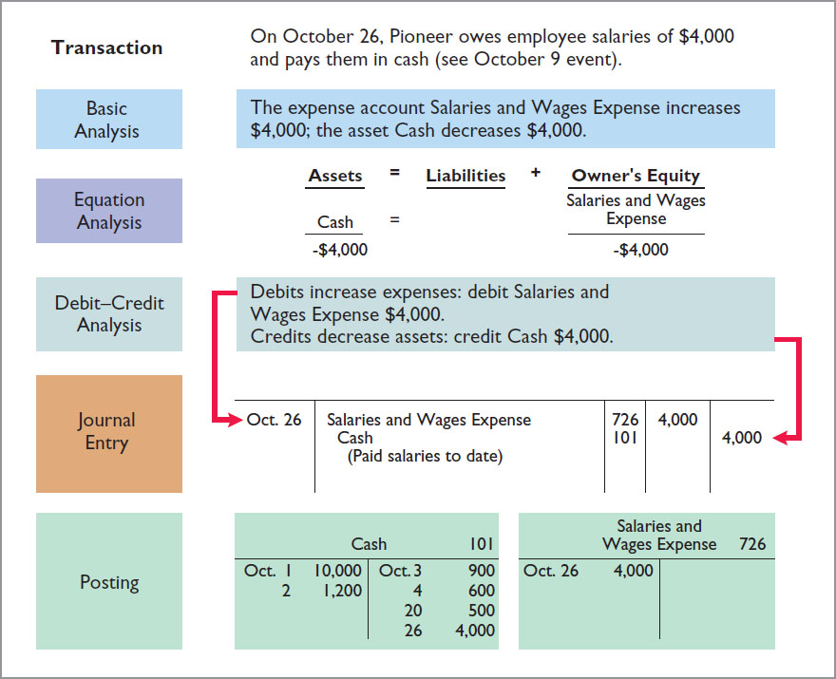
The Recording Process Illustrated (9 of 10)

Slide 39
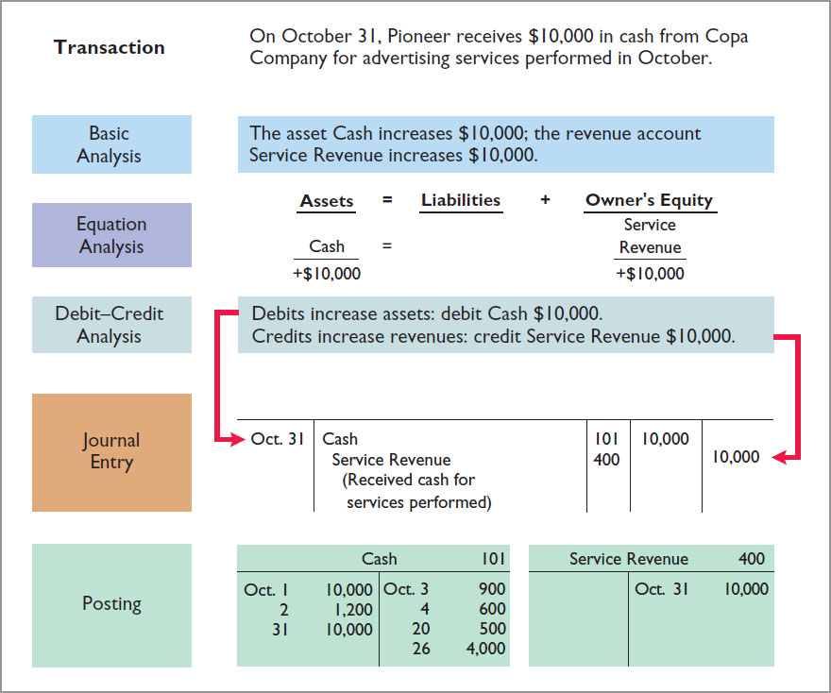
The Recording Process Illustrated (10 of 10)

Slide 40
Journalizing and Posting Summary (1 of 3)
 | General journal |  |  | Page J1
Date | Explanation | Ref. | Debit | Credit
2020 Oct. 1 | Cash | 101 | 10,000
 | Owners’ Capital (Owner’s investment of cash in business) | 301 |  | 10,000
1 | Equipment | 157 | 5,000
 | Notes Payable (Issued 3-month, 12% note for office equipment) | 200 |  | 5,000
2 | Cash | 101 | 1,200
 | Unearned Revenue (Received cash from R. Knox for future services) | 209 |  | 1,200
3 | Rent Expense | 729 | 900
 | Cash (Paid cash for October office rent) | 101 |  | 900

Slide 41
Journalizing and Posting Summary (2 of 3)
 | General journal |  |  | Page J1
Date | Explanation | Ref. | Debit | Credit
2020 Oct. 4 | Prepaid Insurance | 130 | 600
 | Cash (Paid one-year policy; effective date October 1) | 101 |  | 600
5 | Supplies | 126 | 2,500
 | Accounts Payable (Purchased supplies on account from Aero Supply) | 201 |  | 2,500
20 | Owner’s Drawings | 306 | 500
 | Cash (Withdrew cash for personal use) | 101 |  | 500
26 | Salaries and Wages Expense | 726 | 4,000
 | Cash (Paid salaries to date) | 101 |  | 4,000
31 | Cash | 101 | 10,000
 | Service Revenue (Received cash for services performed) | 400 |  | 10,000

Slide 42
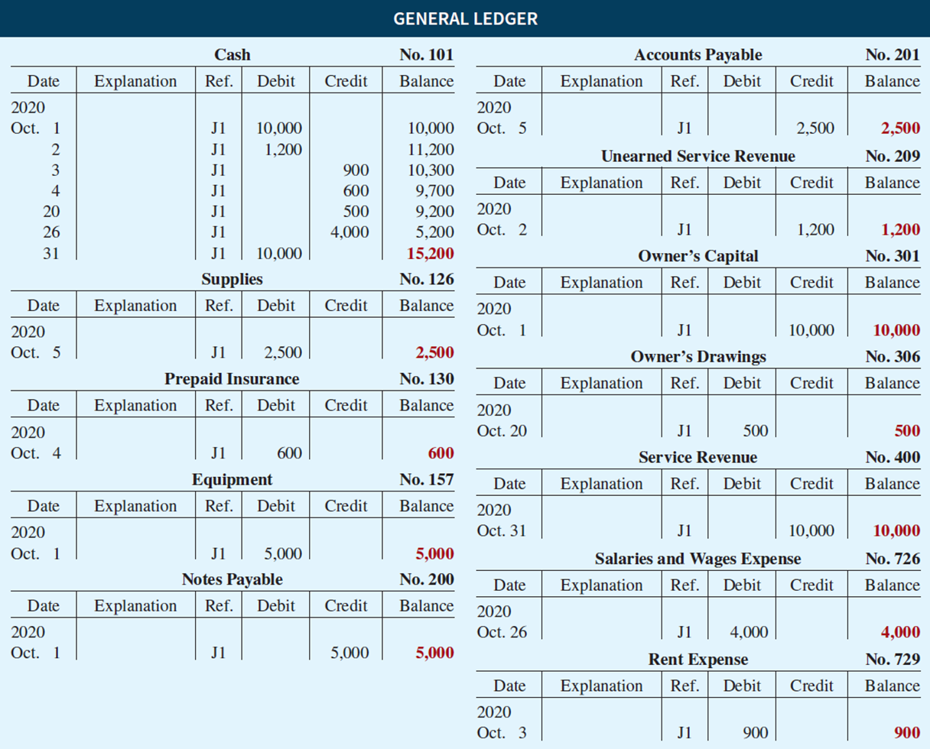
Journalizing and Posting Summary (3 of 3)

Slide 43
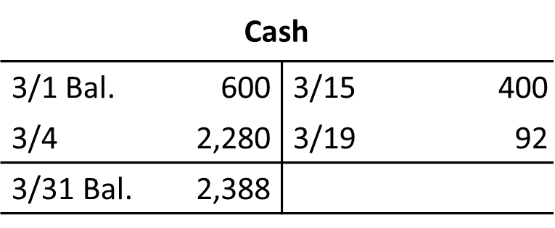
Do It! 3: Posting (1 of 2)
Kate Browne recorded the following transactions in a general journal during the month of March.
Mar. 4
Cash
2,280
Service Revenue
2,280
15
Salaries and Wages Expense
400
Cash
400
19
Utilities Expense
92
Cash
92

Slide 44
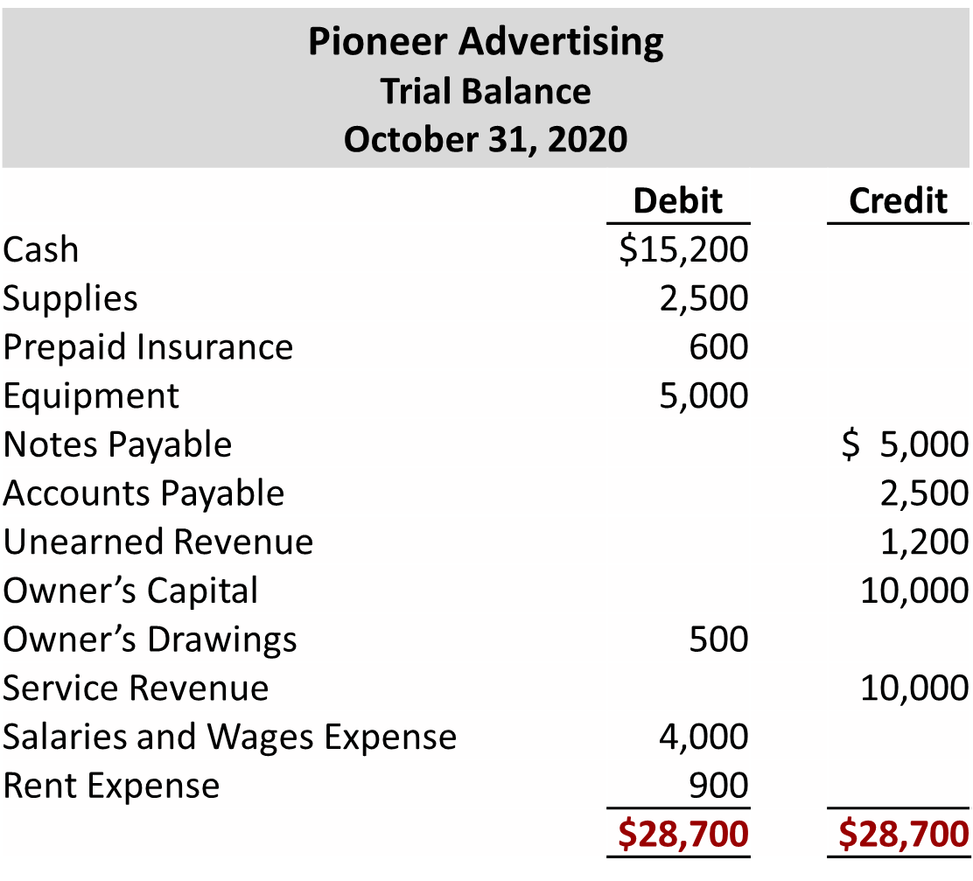
Do It! 3: Posting (2 of 2)

Slide 45
Limitation of a Trial Balance
Trial balance may balance even when:
  A transaction is not journalized.
  A correct journal entry is not posted.
  A journal entry is posted twice.
  Incorrect accounts are used in journalizing or posting.
  Offsetting errors are made in recording the amount of a transaction.

Slide 46
Trial Balance (1 of 4)
Locating Errors
Errors in a trial balance generally result from
mathematical mistakes,
incorrect postings,
or simply transcribing data incorrectly.

Slide 47
Trial Balance (2 of 4)
Dollar Signs
Do not appear in journals or ledgers
Typically used only in the trial balance and the financial statements
Shown only for first item in the column and for the total of that column
Underlining
Single line is placed under column of figures to be added or subtracted
Totals are double-underlined

Slide 48
Trial Balance (3 of 4)
  A trial balance will not balance if:
  a. a correct journal entry is posted twice.
  b. the purchase of supplies on account is debited to Supplies and credited to Cash.
  c. a $100 cash drawing by the owner is debited to Owner’s Drawing for $1,000 and credited to Cash for $100.
  d. a $450 payment on account is debited to Accounts Payable for $45 and credited to Cash for $45.

Slide 49
Trial Balance (4 of 4)
  A trial balance will not balance if:
  a. a correct journal entry is posted twice.
  b. the purchase of supplies on account is debited to Supplies and credited to Cash.
  c. Answer: a $100 cash drawing by the owner is debited to Owner’s Drawing for $1,000 and credited to Cash for $100.
  d. a $450 payment on account is debited to Accounts Payable for $45 and credited to Cash for $45.

Slide 50
Do It! 4: Trial Balance (1 of 2)
The following accounts come from the ledger of SnowGo Company at December 31, 2020.
157 | Equipment | $88,000 | 301 | Owner’s Capital | $20,000
306 | Owner’s Drawings | 8,000 | 212 | Salaries and Wages Payable | 2,000
201 | Accounts Payable | 22,000 | 200 | Notes Payable (due in 3 months) | 19,000
726 | Salaries and Wages Expense | 42,000 | 732 | Utilities Expense | 3,000
112 | Accounts Receivable | 4,000 | 130 | Prepaid Insurance | 6,000
400 | Service Revenue | 95,000 | 101 | Cash | 7,000
Prepare a trial balance in good form.

Slide 51
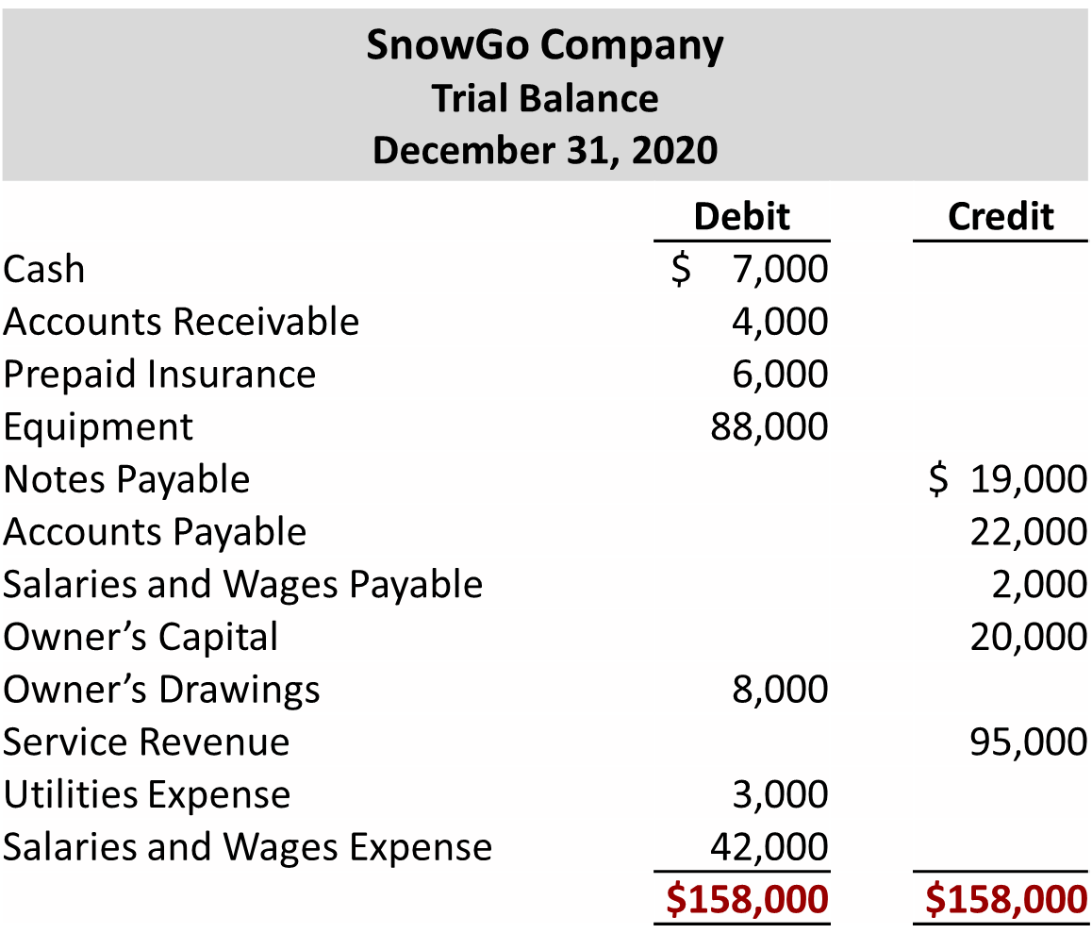
Do It! 4: Trial Balance (2 of 2)

