Slide 1
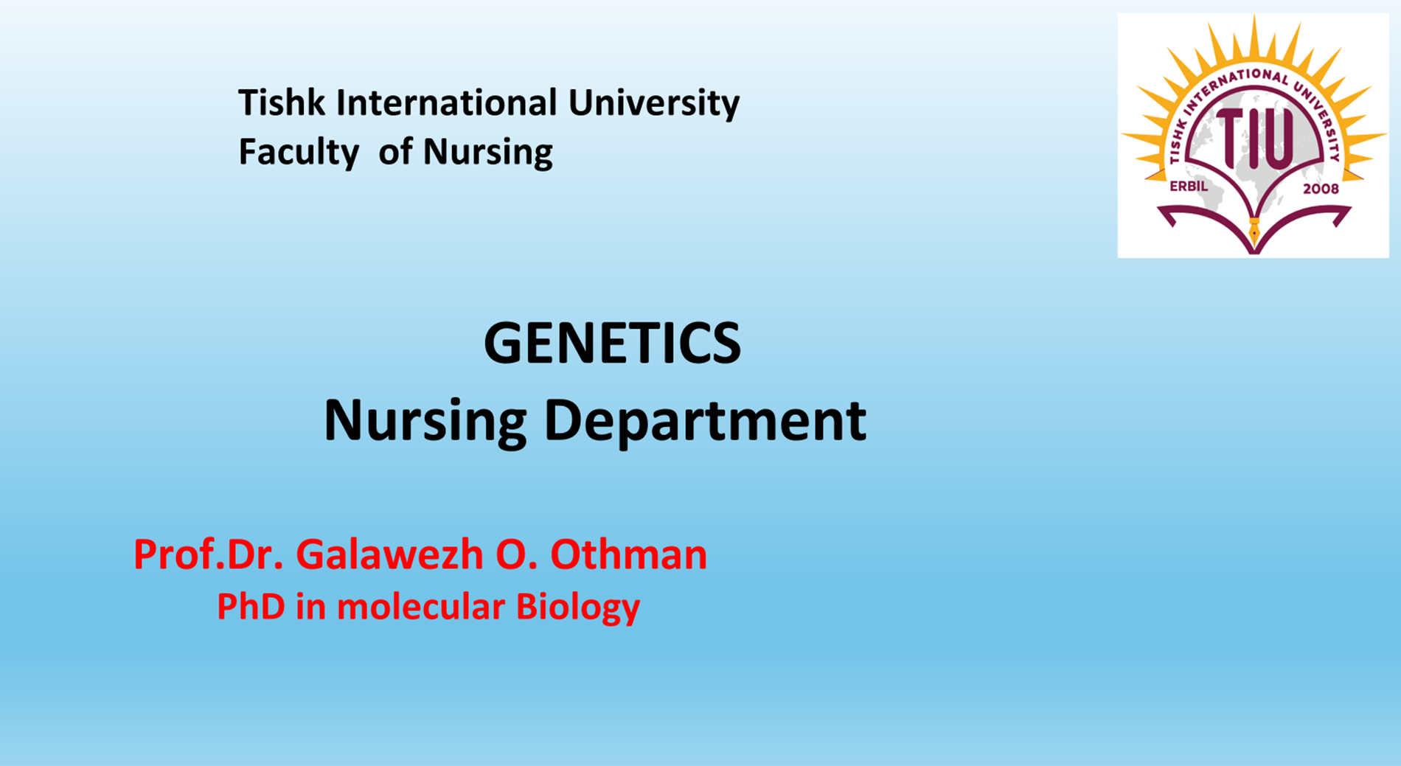

Slide 2
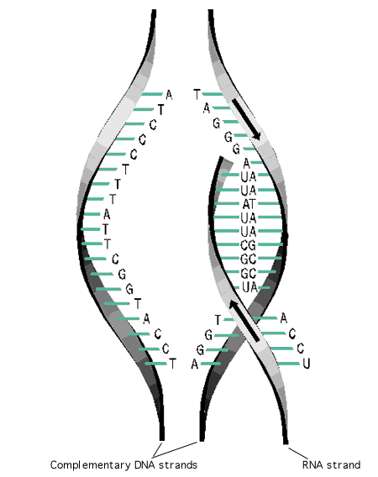
Transcription week 7

Slide 3
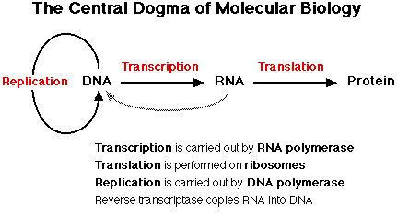
Central Dogma of Molecular Biology
The flow of information in the cell starts at DNA, which replicates to form more DNA. Information is then ‘transcribed” into RNA, and then it is “translated” into protein. The proteins do most of the work in the cell.

Slide 4
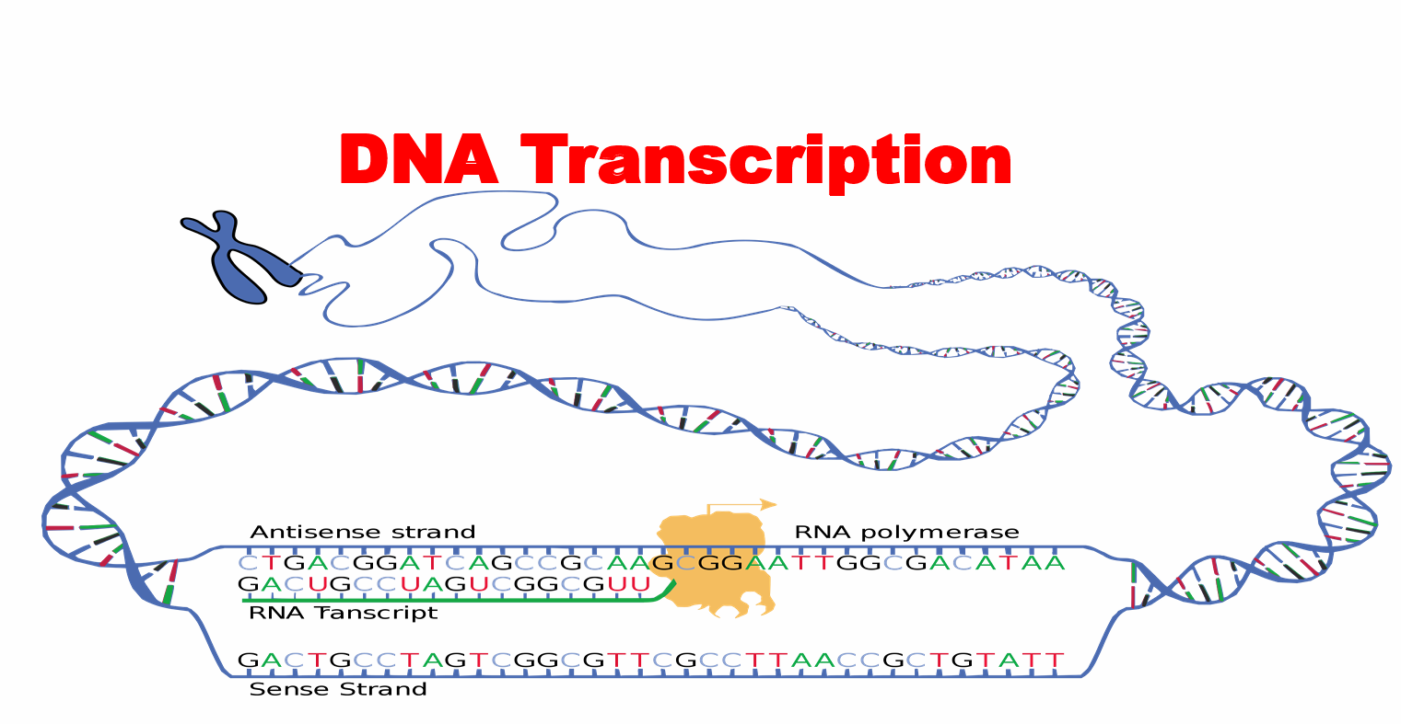

Slide 5
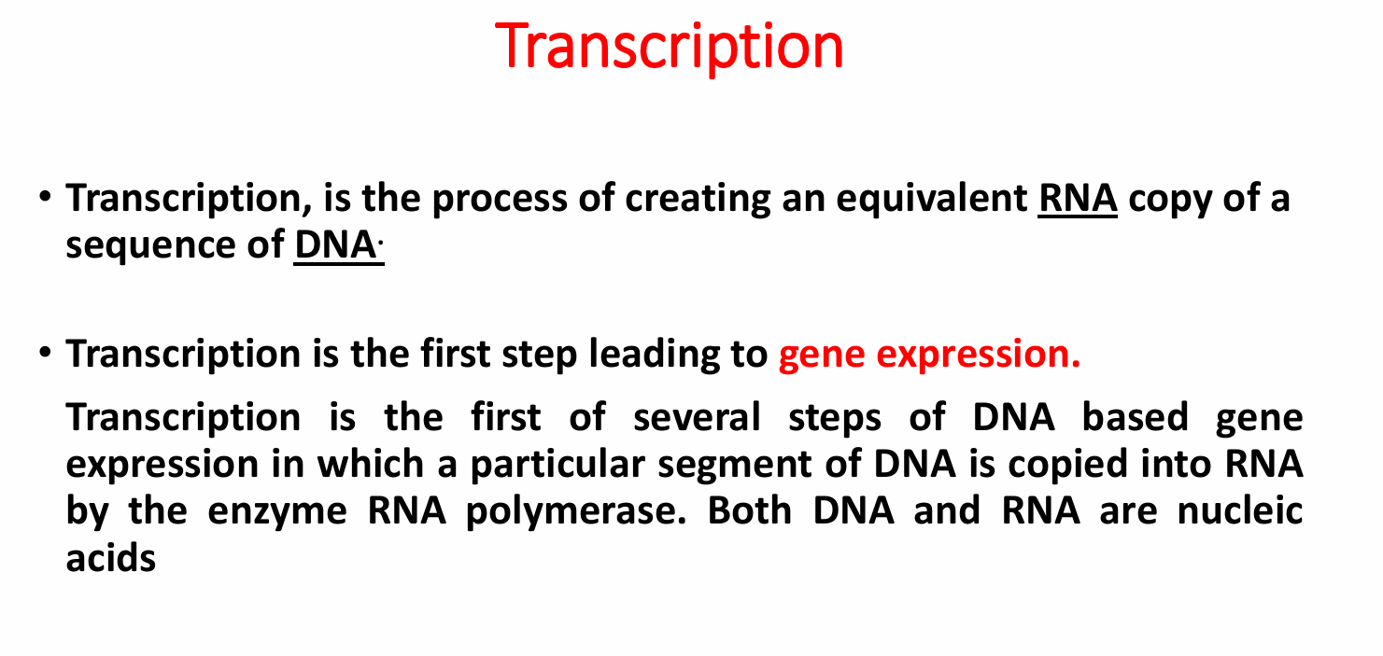

Slide 6
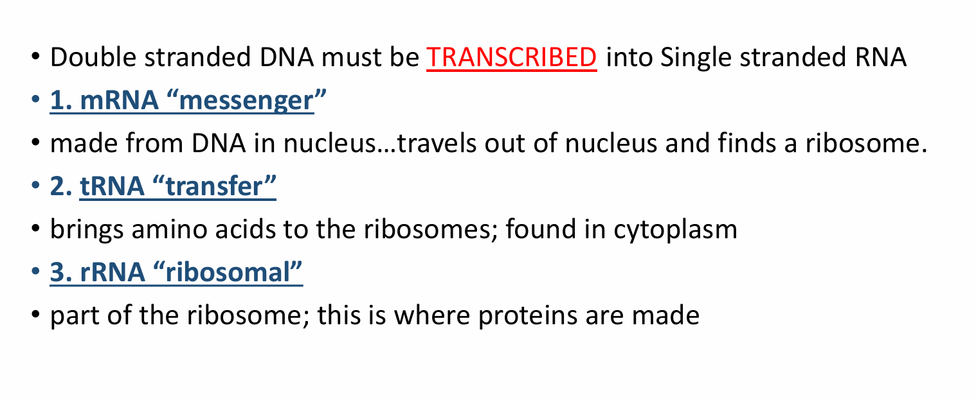

Slide 7
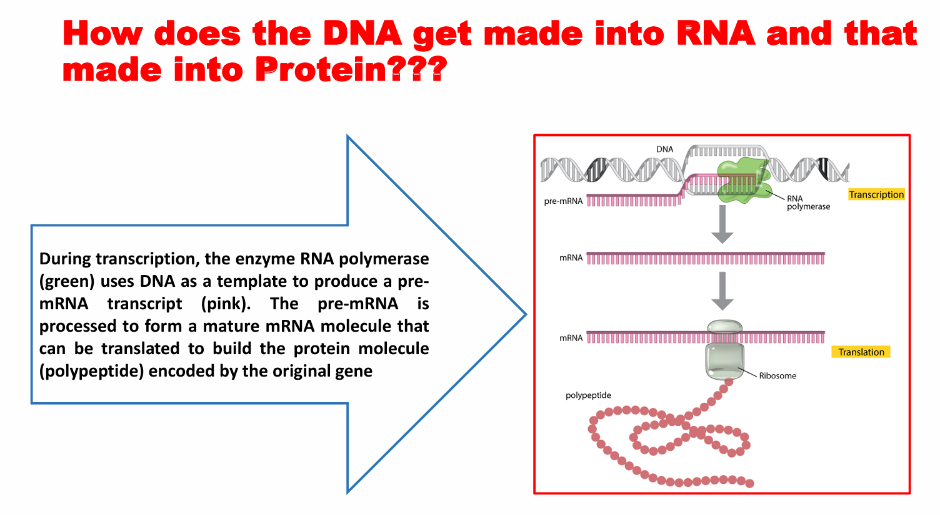

Slide 8
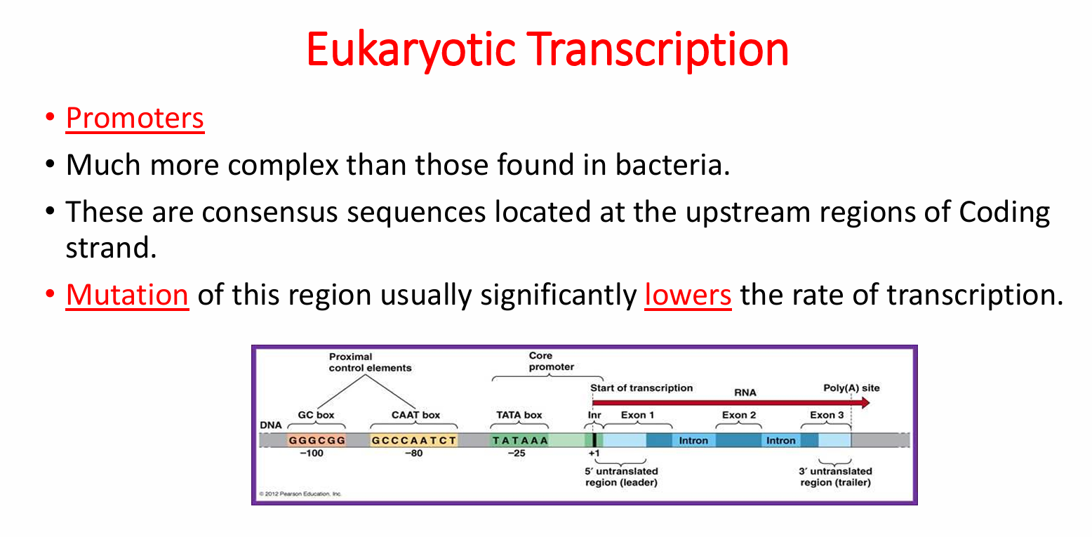

Slide 9
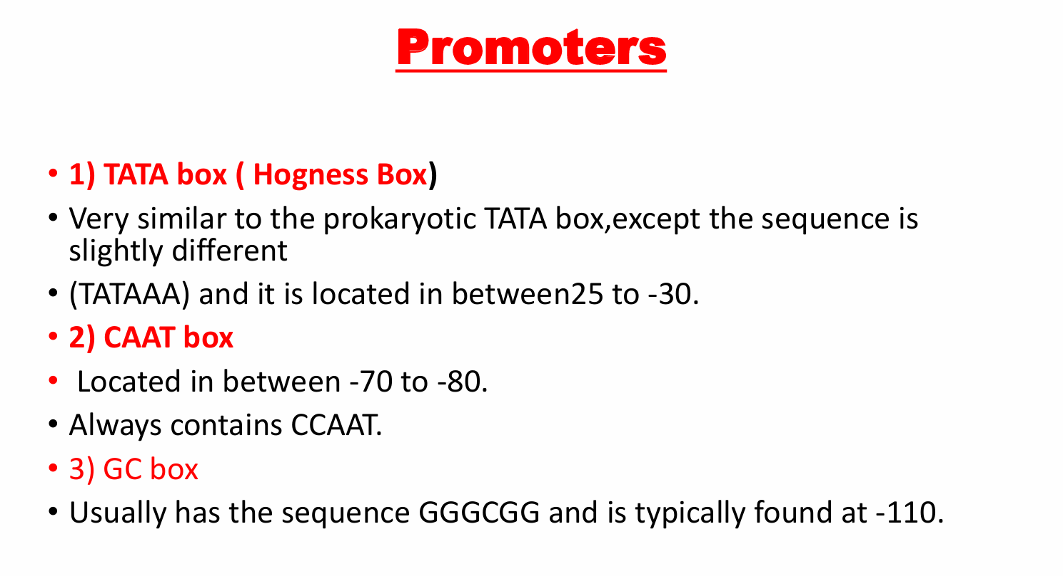

Slide 10
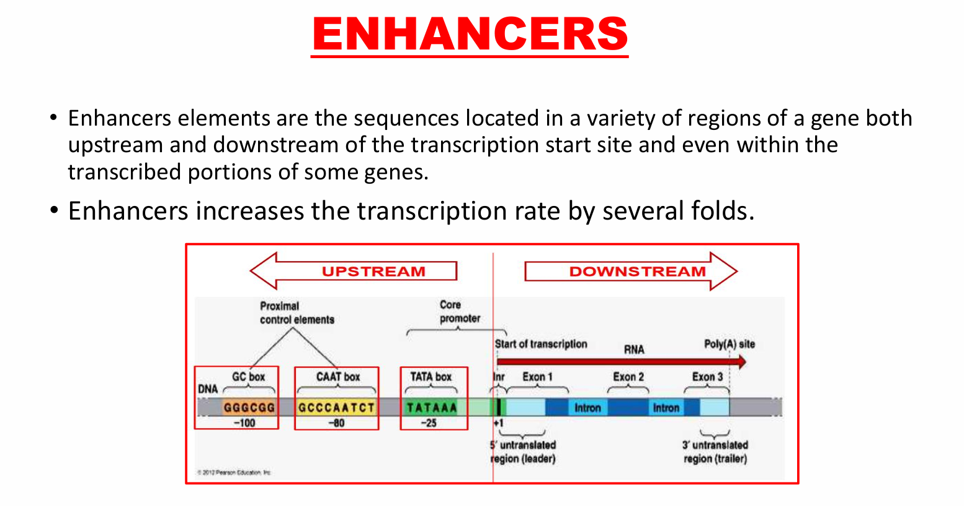

Slide 11
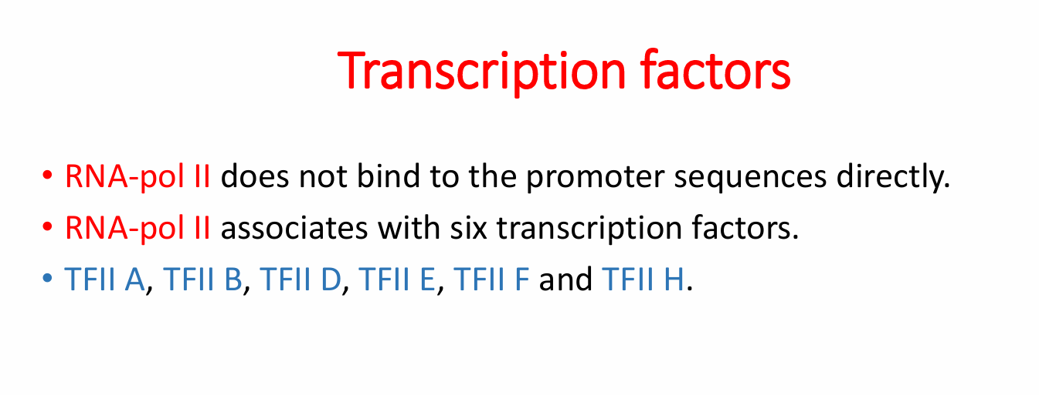

Slide 12
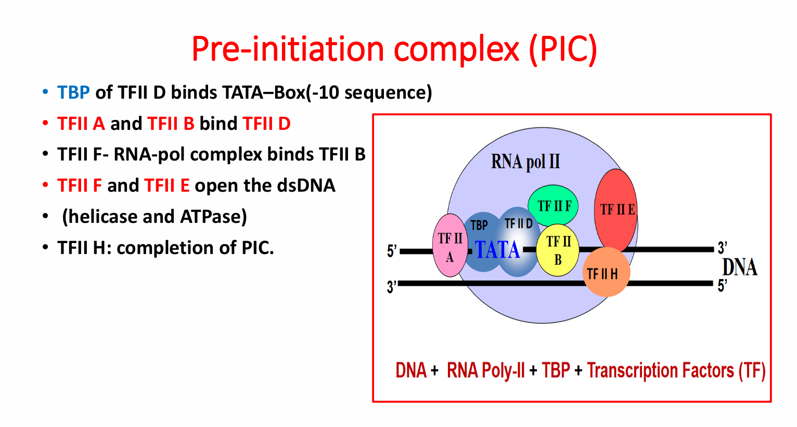

Slide 13
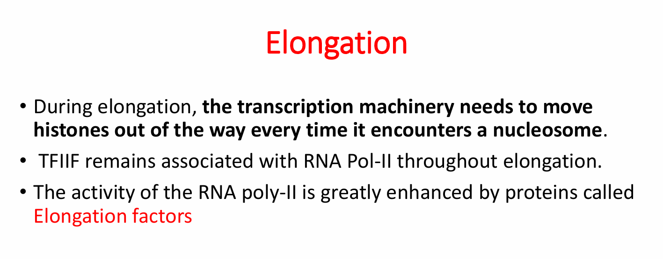

Slide 14
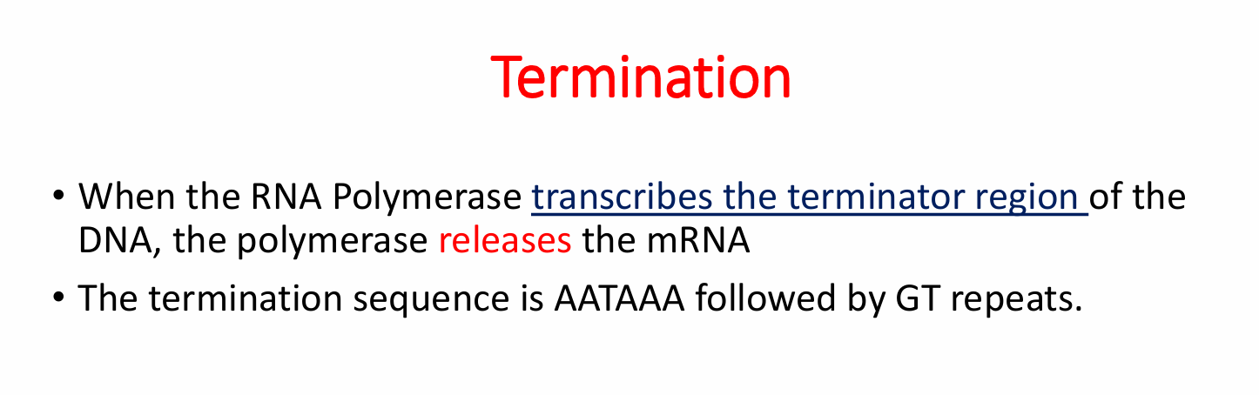

Slide 15
Post Transcription
In prokaryotes, the RNA copy of a gene is messenger RNA, ready to be translated into protein. In fact, translation starts even before transcription is finished.
In eukaryotes, the primary RNA transcript of a gene needs further processing before it can be translated. This step is called “RNA processing”. Also, it needs to be transported out of the nucleus into the cytoplasm.
Steps in RNA processing:
1. Add a cap to the 5’ end
2. Add a poly-A tail to the 3’ end
3. splice out introns.

Slide 16
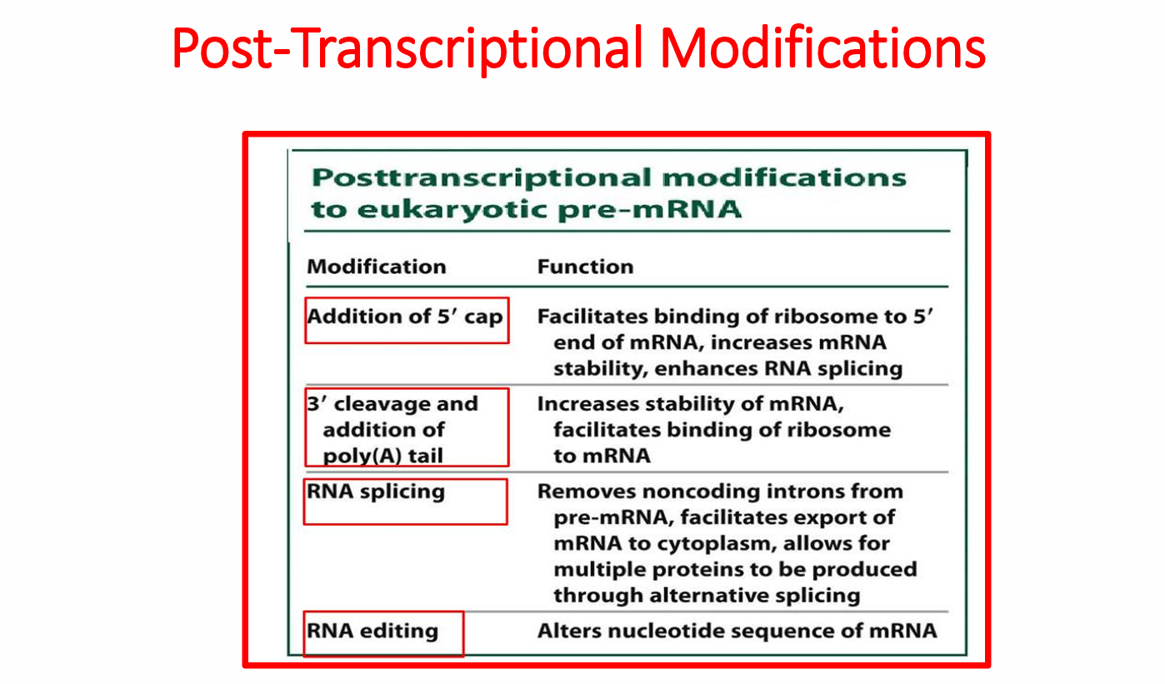

Slide 17
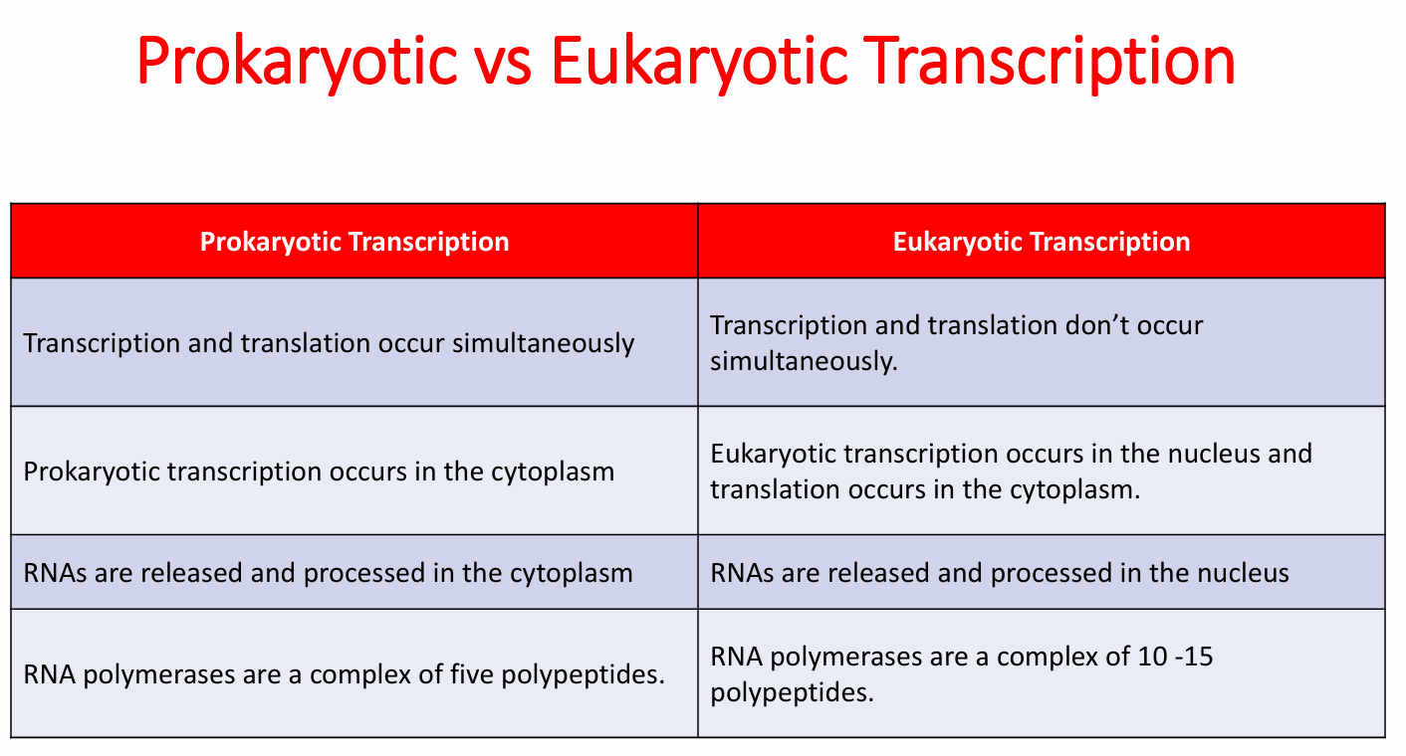

Slide 18
Transcription is done…what now?
Now we have mature mRNA transcribed from the cell’s DNA. It is leaving the nucleus through a nuclear pore. Once in the cytoplasm, it finds a ribosome so that translation can begin.
We know how mRNA is made, but how do we “read” the code?

Slide 19
