Slide 1
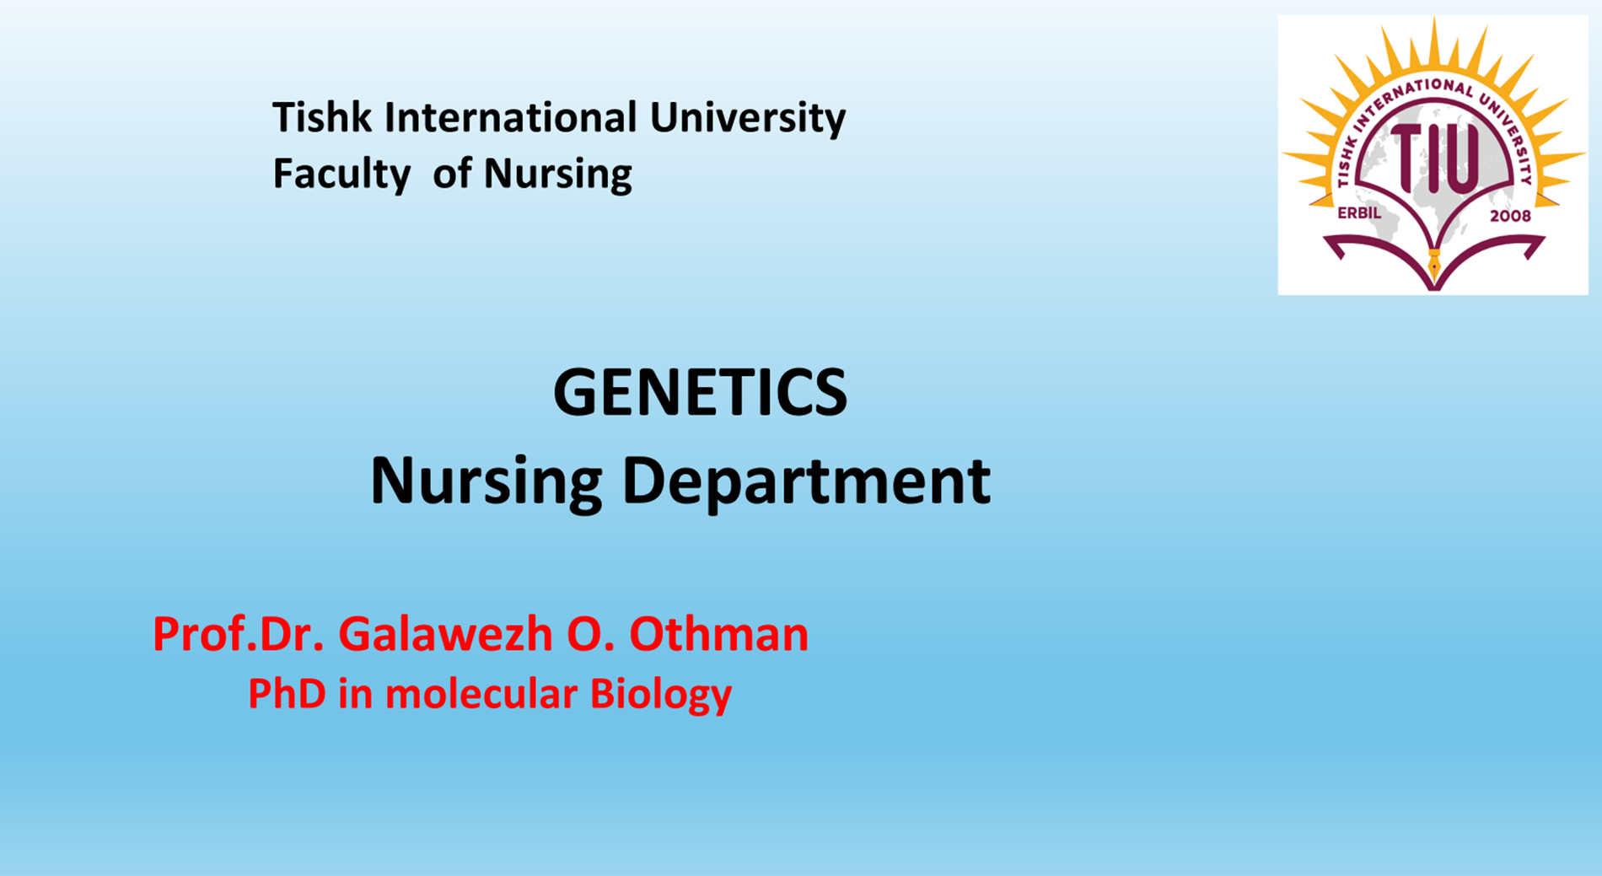

Slide 2
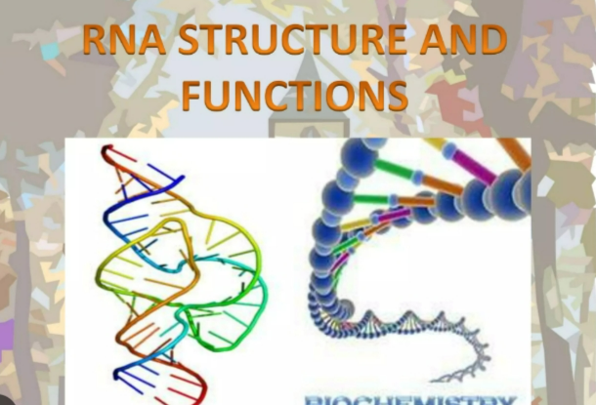

Slide 3
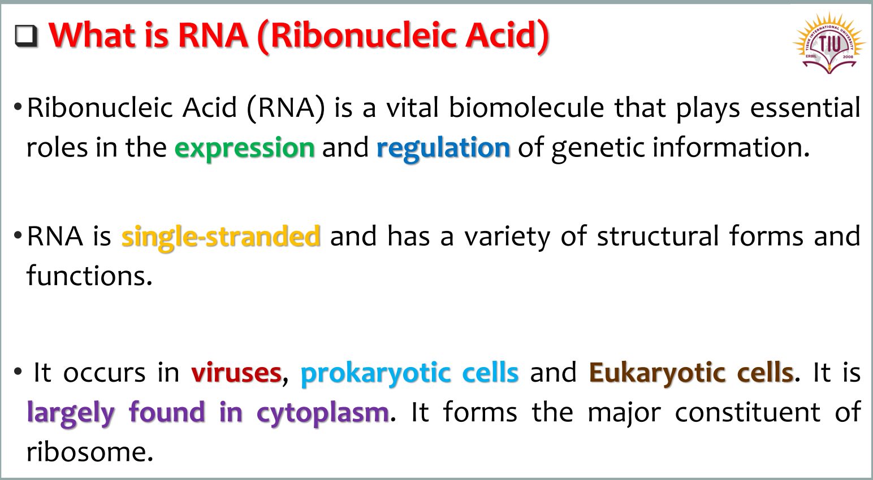

Slide 4
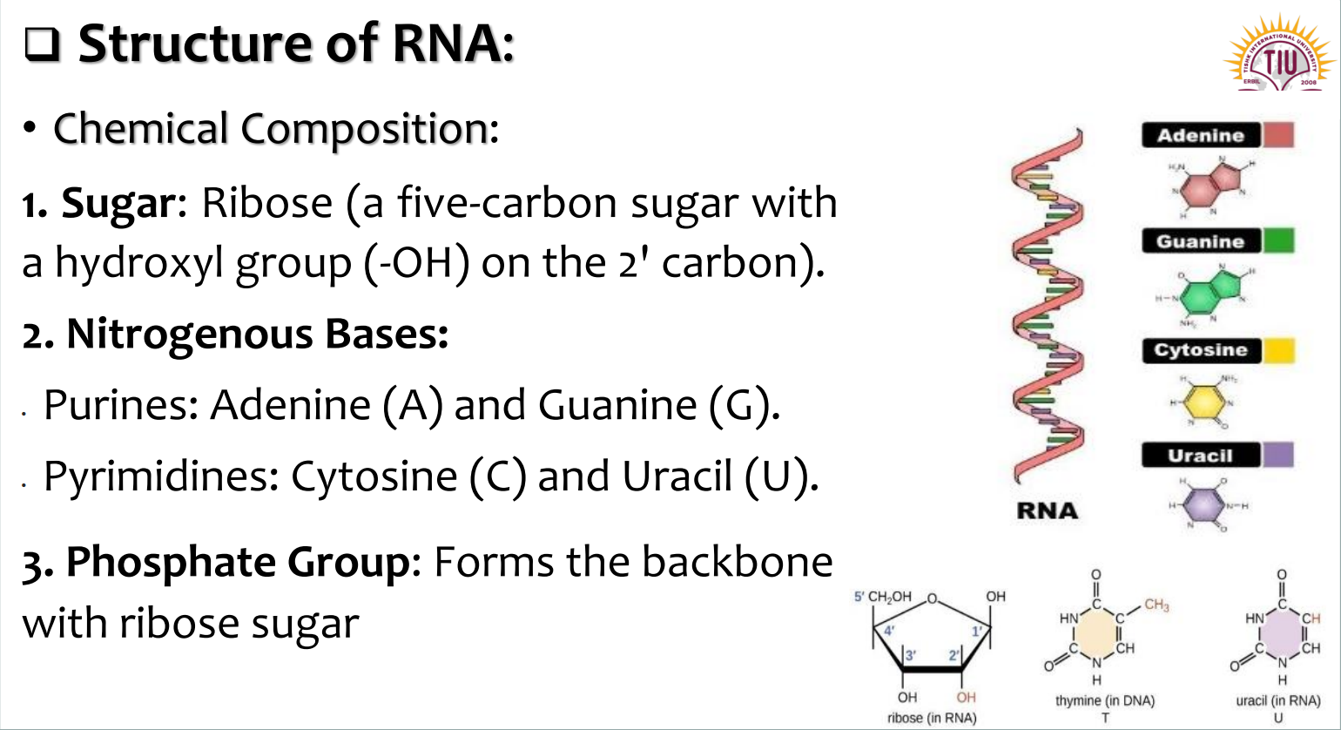

Slide 5
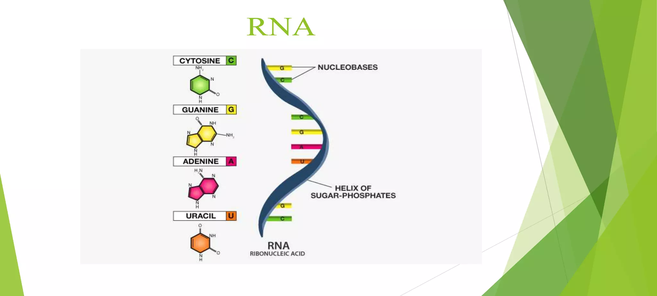

Slide 6
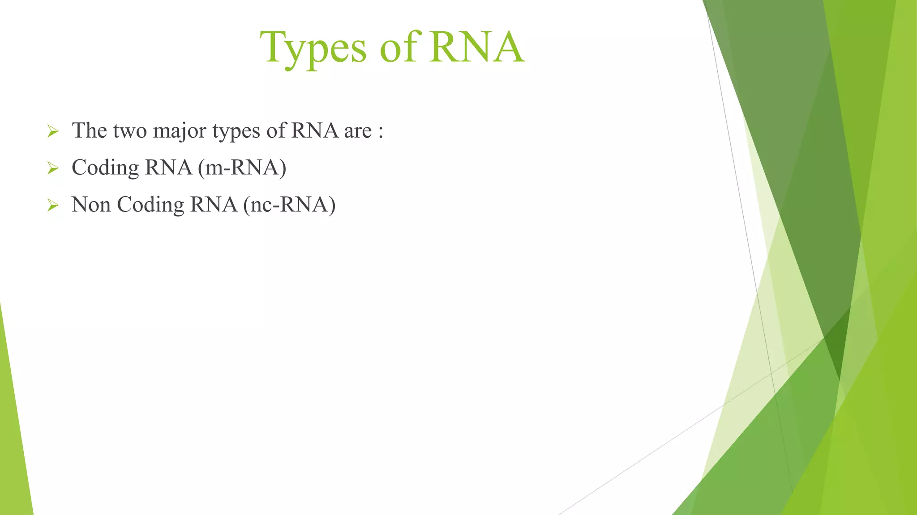

Slide 7
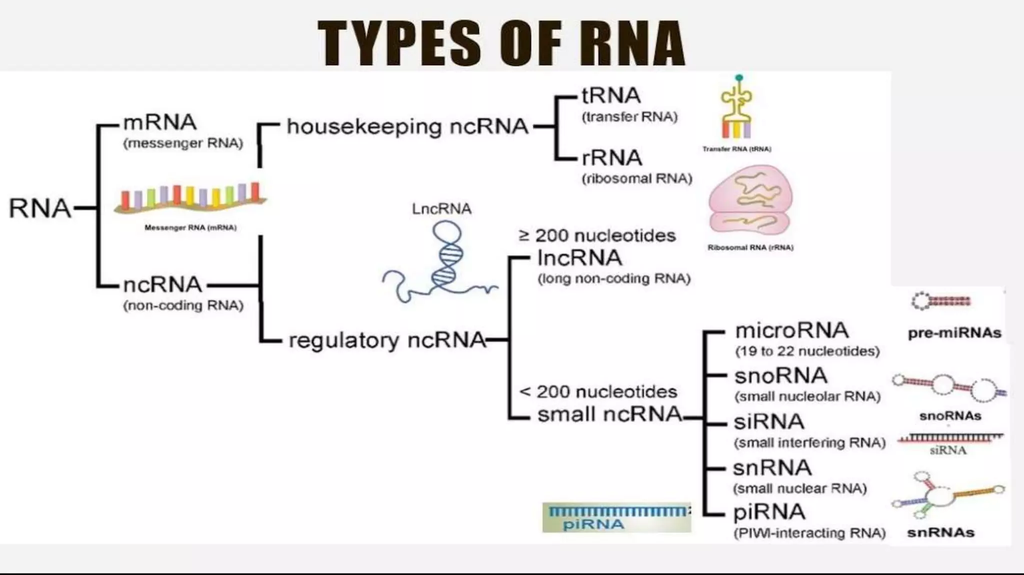

Slide 8
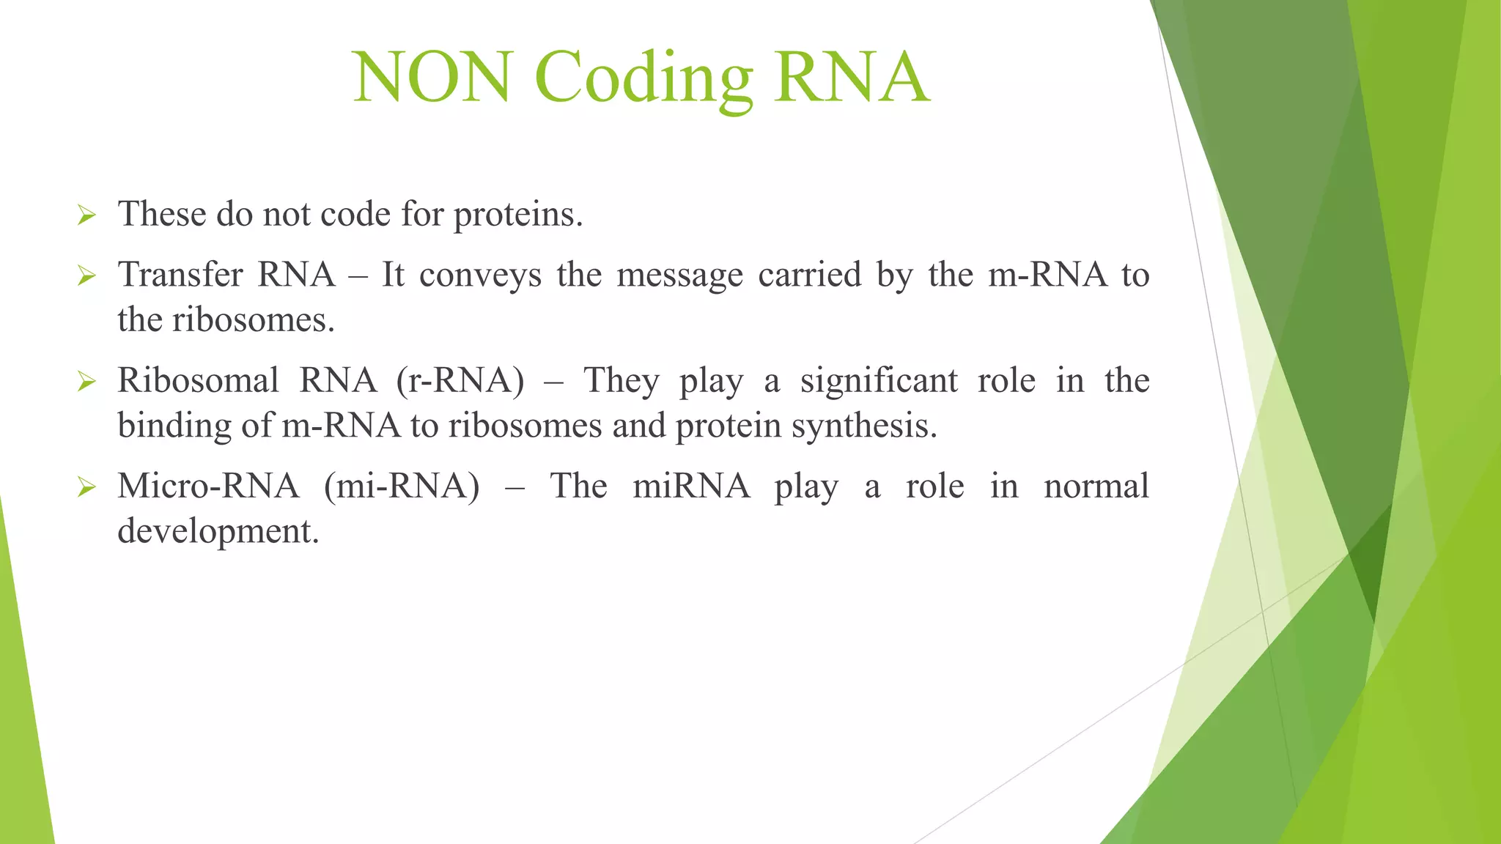

Slide 9
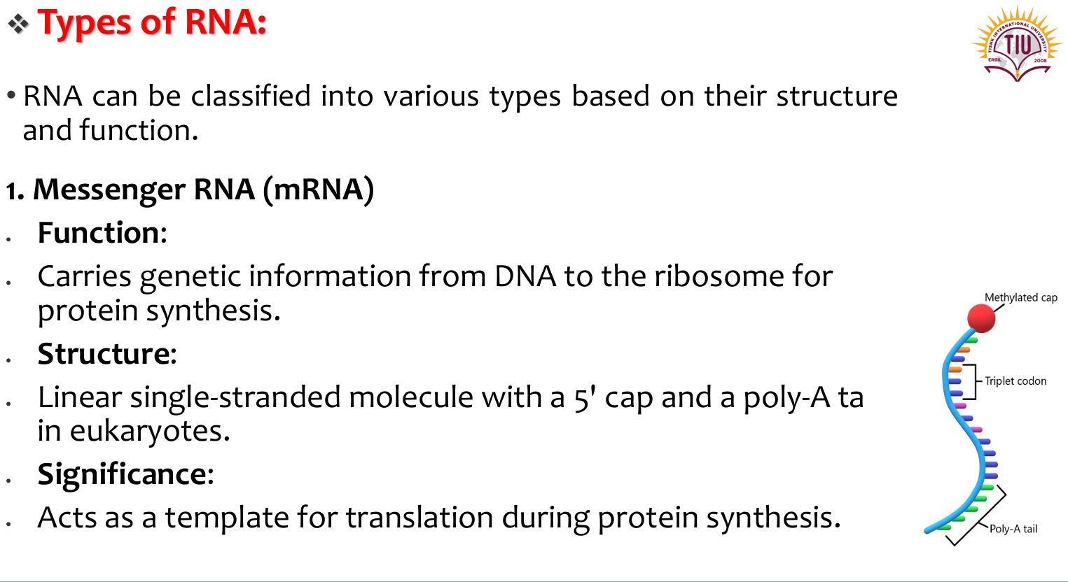

Slide 10
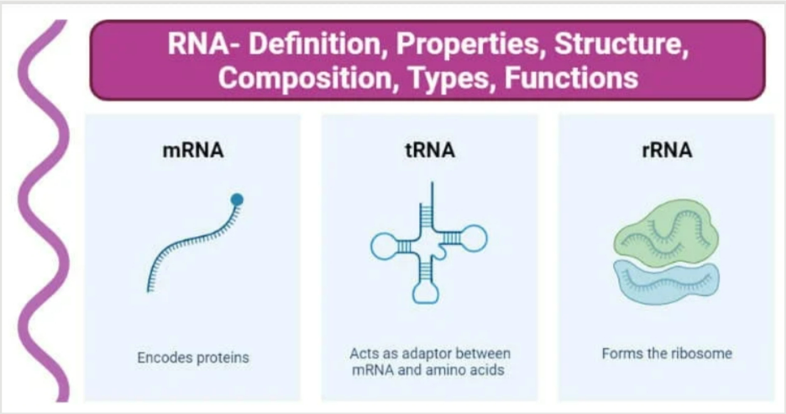

Slide 11
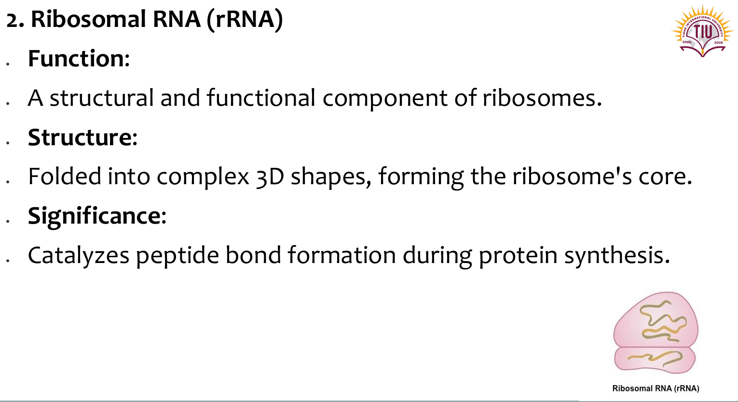

Slide 12
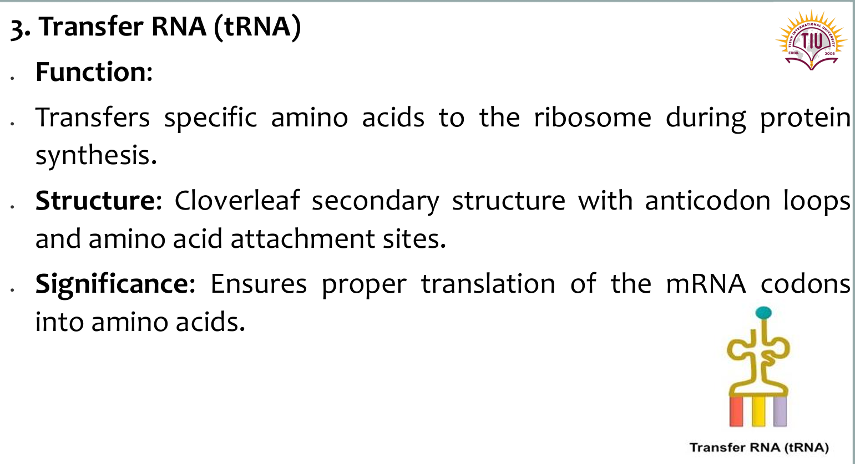

Slide 13
Function
Protein Synthesis: RNA is central to protein synthesis, which involves three main types:
Messenger RNA (mRNA): Carries the genetic instructions from DNA to ribosomes to be translated into a specific protein sequence.
Ribosomal RNA (rRNA): Forms the structural and catalytic core of ribosomes, the cellular machinery where protein synthesis takes place.
Transfer RNA (tRNA): Acts as an adapter molecule, bringing the correct amino acid to the ribosome during translation, based on the codons in mRNA.
Gene Regulation: Various other RNAs, like microRNAs (miRNAs) and small interfering RNAs (siRNAs), have crucial roles in regulating gene expression by targeting and controlling specific mRNA molecules.

Slide 14
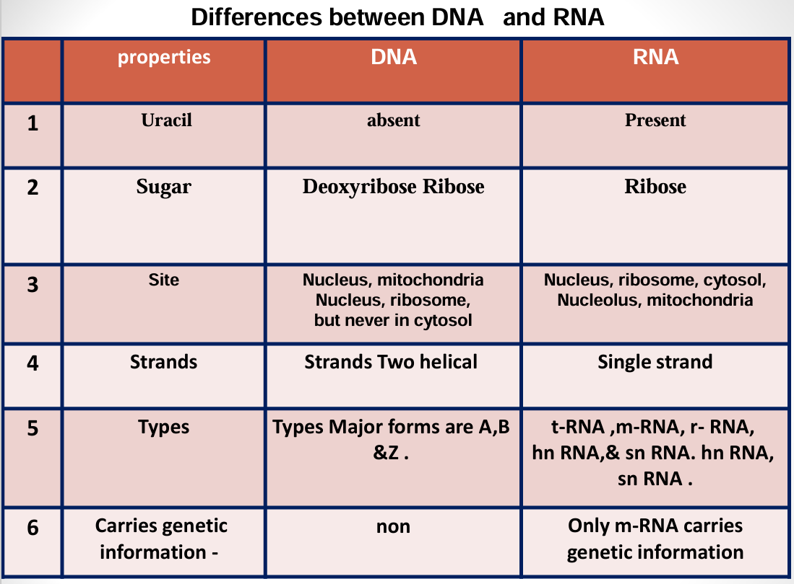

Slide 15
