Slide 1






Academic English
Tishk International University
Faculty of Administrative Sciences and Economics
Business and Management Department
Ms. Zainab Hassan
Msc. English Language & Applied Linguistics
Fall Semester
January 2026

Slide 2
Chapter Three
Tishk International University
Faculty of Administrative Sciences and Economics
Business and Management Department
Sentence to Paragraphs

Slide 3
Activities…
Sentence Structure
Paragraph Organization
Grammer and Punctuation
Tishk International University
Faculty of Administrative Sciences and Economics
Business and Management Department

Slide 4
Sentence Structure
English Sentences
Subject
(MUST)
Verb
(MUST)
Object (Optional)
In English there are THREE main parts of any sentence; two of them are BASIC and MUST be in any sentence. One of the is OPTIONAL but needed sometimes.
Subject and Verb: MUST BE USED
Object: Optional (needed for some sentences)
Tishk International University
Faculty of Administrative Sciences and Economics
Business and Management Department

Slide 5
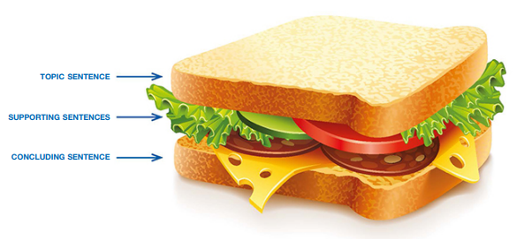
Paragraph Organization
A paragraph is like a sandwich: two pieces of bread (the topic and concluding sentences) holding the key ingredients (the supporting sentences).
Tishk International University
Faculty of Administrative Sciences and Economics
Business and Management Department

Slide 6
Paragraph Organization
A paragraph is a group of related sentences about a single topic. The topic of a paragraph contains only one, idea.
A paragraph has three main parts, and they appear in this order:
The topic sentence: names the topic and tells what the paragraph will say about it. This sentence is usually the first sentence in a paragraph.
The supporting sentences: the middle sentences or the body of the paragraph. They give examples or other details about the topic. In some cases, they tell a story to clarify the topic sentence.
The concluding sentence: the last sentence in a paragraph. The concluding sentence often restates the topic sentence in different words or summarizes the main points.
Tishk International University
Faculty of Administrative Sciences and Economics
Business and Management Department

Slide 7
Descriptive Adjectives
When you write about people, you need to use words that describe a person's personality and feelings. Learning synonyms for common adjectives is a good way to expand your vocabulary and improve your writing. Synonyms are especially helpful when you want to write more than one sentence about a particular part of someone's personality.
Examples:
My teacher almost never gets angry with us. I've only seen her lose her temper once, and even she didn't stay mad for more than a few seconds.
Rainy days make me feel sad. When the sun is out, I never feel unhappy.
Tishk International University
Faculty of Administrative Sciences and Economics
Business and Management Department

Slide 8
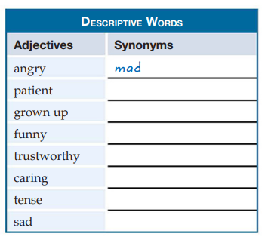
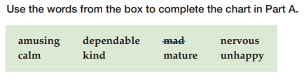
Descriptive Adjectives
Match the words in the box of B, to the chart in A:
A
B
Answers:
Patient: calm
Grown up: mature
Funny: amusing
Trustworthy: dependable
Caring: kind
Tense: nervous
Sad: unhappy
Tishk International University
Faculty of Administrative Sciences and Economics
Business and Management Department

Slide 9
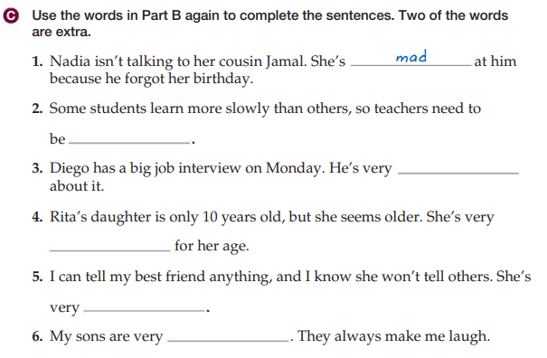
Descriptive Adjectives
Answers:
2. kind
3. nervous
4. mature
5. dependable
6. amusing
Tishk International University
Faculty of Administrative Sciences and Economics
Business and Management Department

Slide 10

Page Formatting
In academic writing, instructors require students to use correct format for paragraphs. There are guidelines and models for handwritten and computer-written work. Your instructor may have requirements based on those guidelines, so be sure to follow them.
Tishk International University
Faculty of Administrative Sciences and Economics
Business and Management Department

Slide 11
Page Formatting: Hand-Writing
The Paper: Write on one side of the paper only.
The Ink: Use black or dark blue ink only. Do not use pencil.
The Heading: Write your full name in the upper left corner in the wide, unlined area at the top of the page. Under it, write the course name and number. Below that, write the date the assignment is due in the order month-day-year, with a comma after the day.
The Title: Center the title of your paragraph on the first line.
The Paragraph: Skip one line, and start your paragraph on the third line. Remember to indent the first word about ½ inch from the left margin. (Indent means to leave some space at the beginning of the line.)
Margins: Leave a 1-inch margin on the left and right sides of the paper. Also leave a 1-inch margin at the bottom of the page. Your instructor may use these empty spaces to write comments to you.
Spacing: Leave a blank line between each line of writing. You and your instructor can use this space for corrections, comments, and revisions.
Tishk International University
Faculty of Administrative Sciences and Economics
Business and Management Department

Slide 12
Page Formatting: Computer Works
The Paper: white paper.
The Font: Use a standard font style and size, such as Times New Roman font, 12 points font size. Do not use underlining, italics, or bold type to emphasize words. It is not correct style in academic writing.
The Heading: Type your full name in the upper left corner. On the next line, type the course number. On the third line, type the date the assignment is due in the order month-day-year, with a comma after the day.
The Title: Center the title of your paragraph on the first line.
The Paragraph: Skip one line and start typing on the next line. Indent the first word by using the ENTER key. (Indent means to leave some space at the beginning of the line. You can set the enter-tab for about 0.4 inches, which gives you an indent of about 5 spaces.)
Margins: Leave a 1-inch margin on the left and right margins.
Spacing: Double-space your paragraph.
Tishk International University
Faculty of Administrative Sciences and Economics
Business and Management Department

Slide 13

Tishk International University
Faculty of Administrative Sciences and Economics
Business and Management Department

