Slide 1

Entrepreneurship
Lecturer: Kadhim Saeed
Course Code: 111
Semester: Fall
2025-2026
Prepared By Karwan H. Saeed

Slide 2
Content
Professor becomes Restaurateur – Case Study
Meaning of Entrepreneurship.
Why people become entrepreneurs?
Characteristics of Successful Entrepreneurs.
Stages of Entrepreneurship and Opportunity.
Opportunity Identification.
Opportunity Evaluation.
Opportunity Exploitation.
Financing Exploitation.
Corporate and Social Entrepreneurship.

Slide 3
What is Entrepreneurship?
Definitions of Entrepreneurship:
"Entrepreneurship is the process of identification, evaluation, and exploitation of opportunities." (Certo and Certo)
"Entrepreneurship is the art of turning an idea into a business."
(Fred Wilson)
Entrepreneurs:
People who take risk and turn useful ideas into practice.

Slide 4
Sustainability of new businesses
Starting a business might be hard, but sustaining it is much harder.
According to a research monthly 550,000 new businesses open in USA, however, 20% of them can't sustain for one year, and 40% of them can't sustain for past four years.

Slide 5
Why Become an Entrepreneur?
Desire to be their own boss and independent
Desire to pursue their own ideas
Lack of progress and promotion
Financial rewards

Slide 6

Characteristics of Successful Entrepreneurs
Passion for the Business
1- Ex. John Wood, Leaving Microsoft to change the world.
Room to Read educational company.
Room to Read had built over1,440 schools
and distributed over 36 million books
in developing parts of the world. Now
in 2023, they provide education for 32
million children worldwide.

Slide 7

Characteristics of Successful Entrepreneurs (Cont.)
Product/Customer Focus
An entrepreneur’s strong focus on products/customers.
Steve jobs journey to Xerox in 1980s. They decided to create a more user-friendly computers called “Macintosh”.

Slide 8
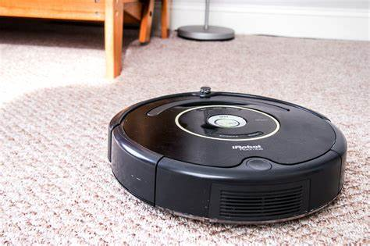
Characteristics of Successful Entrepreneurs (Cont.)
Tenacity Despite Failure
Entrepreneurship is a marathon and failure rate is high.
Ex. “Roomba Vacuuming by IRobot "tenacity for success.

Slide 9
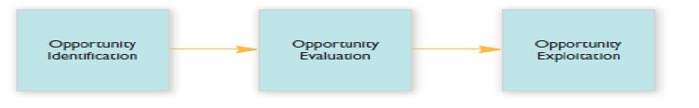
Stages of the Entrepreneurship

Slide 10
Business Idea and Opportunity
Business Idea
Is a concept to that can be turned to a product or service that generates money.
Opportunity
Is a favorable set of circumstances that creates a need for a new product, service, or business.

Slide 11



Opportunity Identification how to identify an opportunity
Observing Trends – Economic, social, technological, lifestyle, Regulations.
Solving a problem or filling a gap in market – Plus size clothes, colored cars, home gyms.
Discovery of new geographical markets and franchises.
Recycle of used products. Paper, plastic, cans, etc.

Slide 12
Opportunity Identification
Following factors increase entrepreneur's ability to identify opportunities:
Entreprenurial alertness – noticing trends.
Social networks - extended and narrow (Entreprenurial Family).
Cross-cultural experience.
Establish means-ends – Online delivery, payment, taxi, TV as projectors.

Slide 13
Opportunity Evaluation
To evaluate whether a business idea is viable/Practical and worth pursuing by conducting Feasibility Analysis to measure Entrepreneurial risk​.
Using Feasibility Analysis:
Product and Service analysis. (Price, demand, etc.)
Organization analysis. (staff, equipment, structure, etc.)
Industry and Competitor analysis. (location, trend, etc.)
Financial analysis. (Total Cost, profit, etc.)

Slide 14
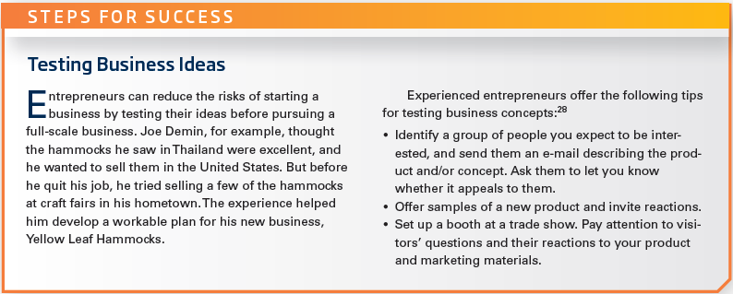

Opportunity Evaluation example

Slide 15
Opportunity Exploitation
The activities and investments that are committed to make profit from the product or service arising from the opportunity.
Ex. (Hiring, marketing, production, etc.)
Several factors can support entrepreneurs to exploit an opportunity:
Customer value of product or service
Stakeholder support (Investors, suppliers, government)
Capable Management team

Slide 16
Financing Exploitation
Consider self-financing first.
Angel Investors – individuals invest in new business ideas. Ex. Ford Motors from (41,500 to 145 Million) in 15 years.
There are 9 billion investments globally each year to 25,000 businesses. Passive in control, and start-up focused.
Venture Capitalists – firms fund startups. Ex. Intel and Microsoft.
70 Billion investment globally each year. Controlling, and post startup focused.
Example entrepreneurs and investors platform is Shark Tank Show
https://www.youtube.com/watch?v=nn-uMBLuTk0

Slide 17
Financing Exploitation
Bank financing - in form of loans, but banks are not investors, rather expect repayment of loans with interest.
Crowdfunding - to raise money from a crowd to finance a project in return for a share of profit.
Business Incubators – Protected environment for small businesses with low rent, services, shared staff, and consultation.

Slide 18
Corporate/Commercial Entrepreneurship
Individuals in an existing corporation create a new organization or bring renewal or innovation within the organization. (Certo and Certo, 2019).
New company and the parent company.
Innovation and renewal as case of 3M.

Slide 19


Social Entrepreneurship
Involves entrepreneurship in a social context.
Promote Social Values – the basic needs of society. Such as schools, shelter, education, food, etc.
EX. Muhammad Yunus- 2006 Nobel peace prize - Grameen Bank. to give microfinance to entrepreneurs in underdeveloped countries with low-interest rates.

Slide 20
Question
How do Commercial and Social Entrepreneurship differ?
Mission, Social value vs Profit
Resources (Funds and Employees).
Performance Measurement, Quantity vs Impact.

Slide 21
Questions?

