Slide 1



Tishk International University
Faculty of Applied Science
Nutrition and Dietetics Department
Homeostasis
Human Biology / 2nd Lecture
1st Grade / Fall Semester
04.01.2026
Instructor: Adam Jalal Mohammed
Email: adam.jalal@tiu.edu.iq
Human Biology
2025 - 2026

Slide 2
Outline
Homeostasis
Importance of Homeostasis
Human controlling systems of Homeostasis
Feedback (Positive and Negative feedback)
Thermoregulation
Human Biology
2

Slide 3
Outline
Define Homeostasis
Familiarize students with the importance of Homeostasis in our lives
Understanding the controlling systems of homeostasis
Understanding negative and positive feedback loops
Explaining glucose homeostasis
Understanding the Homeostasis of body temperature during Hot and cold stresses
Human Biology
2

Slide 4
Homeostasis
Human Biology
2

Slide 5
Homeostasis
Human Biology
2

Slide 6
Homeostasis
Human Biology
2

Slide 7
Human Biology
2

Slide 8
Human Biology
2

Slide 9
Dynamic equilibrium
Human Biology
2

Slide 10
Why is homeostasis important?
Human Biology
2

Slide 11
Why is homeostasis important?
Human Biology
2

Slide 12
Important variables within the body:
Human Biology
2

Slide 13
Human controlling systems of Homeostasis
Human Biology
2

Slide 14
1-Autoregulation
Human Biology
2

Slide 15
2- Extrinsic regulation
Human Biology
2

Slide 16
Hormonal regulation control system
Human Biology
2

Slide 17
B-Hormonal regulation
Human Biology
2

Slide 18
Components of Homeostasis controlling systems
Human Biology
2

Slide 20
Feedbacks:
Human Biology
2

Slide 21
Negative Feedback
Human Biology
2

Slide 22
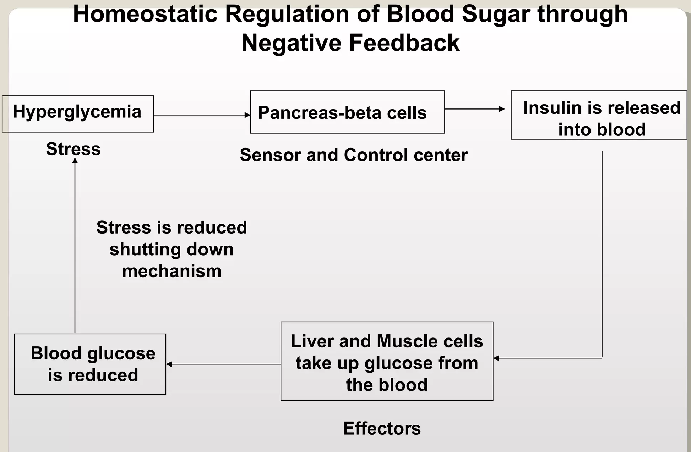

Slide 24
Thermoregulation
Human Biology
2

Slide 26
Response to Heat Stress
Human Biology
2

Slide 27
Response to Heat Stress
Human Biology
2

Slide 28
Response to Heat Stress
Human Biology
2

Slide 29
Response to Cold Stress
Human Biology
2

Slide 30
Response to Cold Stress
Human Biology
2

Slide 31
Summary of thermoregulation
Human Biology
2

Slide 32
Positive feedback
Human Biology
2

Slide 33
Positive Feedback in Childbirth
Human Biology
2

Slide 34
Human Biology
2

Slide 35
References
Human Biology
2

