Slide 1

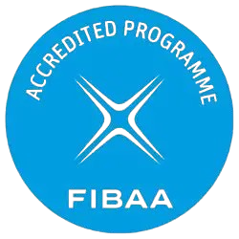




Academic English
Tishk International University
Faculty of Administrative Sciences and Economics
Business and Management Department
Ms. Zainab Hassan
Msc. English Language & Applied Linguistics
Fall Semester
January 2026

Slide 2
Chapter Three
Tishk International University
Faculty of Administrative Sciences and Economics
Business and Management Department
Sentence to Paragraphs

Slide 3
Activities…
Sentence Structure
Paragraph Organization
Grammer and Punctuation (Reading & Speaking)
Tishk International University
Faculty of Administrative Sciences and Economics
Business and Management Department

Slide 4

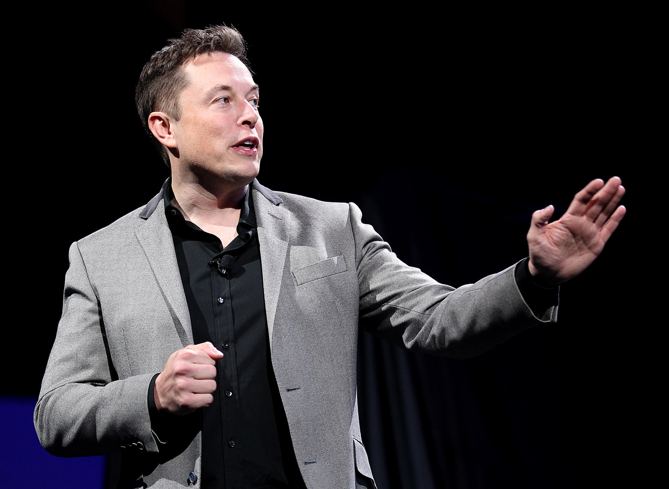
The Secret of Giants
What is the one habit they share?
Tishk International University
Faculty of Administrative Sciences and Economics
Business and Management Department

Slide 5
The joy of reading a Kurdish book
Ayşe Sadun was born in 1954 in the village of Kuldîman in Dêrîk. She lives surrounded by nature and she collects grass to graze animals in the village. Ayşe said that she loves the Kurdish language and that her longing for it has not ended. “Our children and grandchildren who grew up with the revolution are learning their native language easily. They read, write and speak Kurdish. Now my grandchildren can live comfortably what I longed for.“Sadun said that she could not continue reading and writing after getting married at the age of 22. She stated “My husband did not accept me writing. Around that time, I received Hemîdê Hecî Derwêş's book. I wanted to read the book, but my husband did not allow me to read it. He even said that he would never let me keep that book. Back then it was not tolerated and shameful for a woman to read or write. After that discussion, I could never open a book again until he passed away. After his death in 2003, I started reading Cigerxwîn and Hemîdê Hecî Derwêş again. That was, some 30 years after that first time.”
Tishk International University
Faculty of Administrative Sciences and Economics
Business and Management Department

Slide 6
The joy of reading a Kurdish book
Read the text twice
Highlight 5 new vocabularies
Mention only one moral message from the text
What would you do if you replace Ayshe?
Tishk International University
Faculty of Administrative Sciences and Economics
Business and Management Department

Slide 7
Discussion…
If you could only read one type of thing for the rest of your life to be successful (News, Fiction, Textbooks, or Biographies), which would you choose and why?
Write few notes and discuss it with us.
Tishk International University
Faculty of Administrative Sciences and Economics
Business and Management Department

Slide 8

Reading: The Ultimate Success Hack
Read the text in front of you on the handout,
Find 3 specific ways reading helps the brain,
Find 2 ways it helps a person’s career,
Let’s compare the answers and discuss them.
Tishk International University
Faculty of Administrative Sciences and Economics
Business and Management Department

Slide 9

Reading: The Ultimate Success Hack
Three Ways Reading Helps the Brain:
Strengthens neural networks (makes it easier to process ideas).
Increases focus and concentration.
Reduces stress/ lowers heart rate.
Tishk International University
Faculty of Administrative Sciences and Economics
Business and Management Department

Slide 10

Reading: The Ultimate Success Hack
Two Ways it Helps a Career:
Expands professional vocabulary (makes you look confident).
Allows you to learn from experts (gain knowledge/avoid mistakes).
Tishk International University
Faculty of Administrative Sciences and Economics
Business and Management Department

Slide 11

Tishk International University
Faculty of Administrative Sciences and Economics
Business and Management Department

