Slide 1






Culture and Society
Tishk International University
Faculty of Administrative Sciences and Economics
Business and Management Department
Ms.Zainab Hassan
zainab.hassan@tiu.edu.iq
Fall Semester
January 2026

Slide 2
Chapter Three
Diversity and Social Cohesion
Tishk International University
Faculty of Administrative Sciences and Economics
Business and Management Department

Slide 3
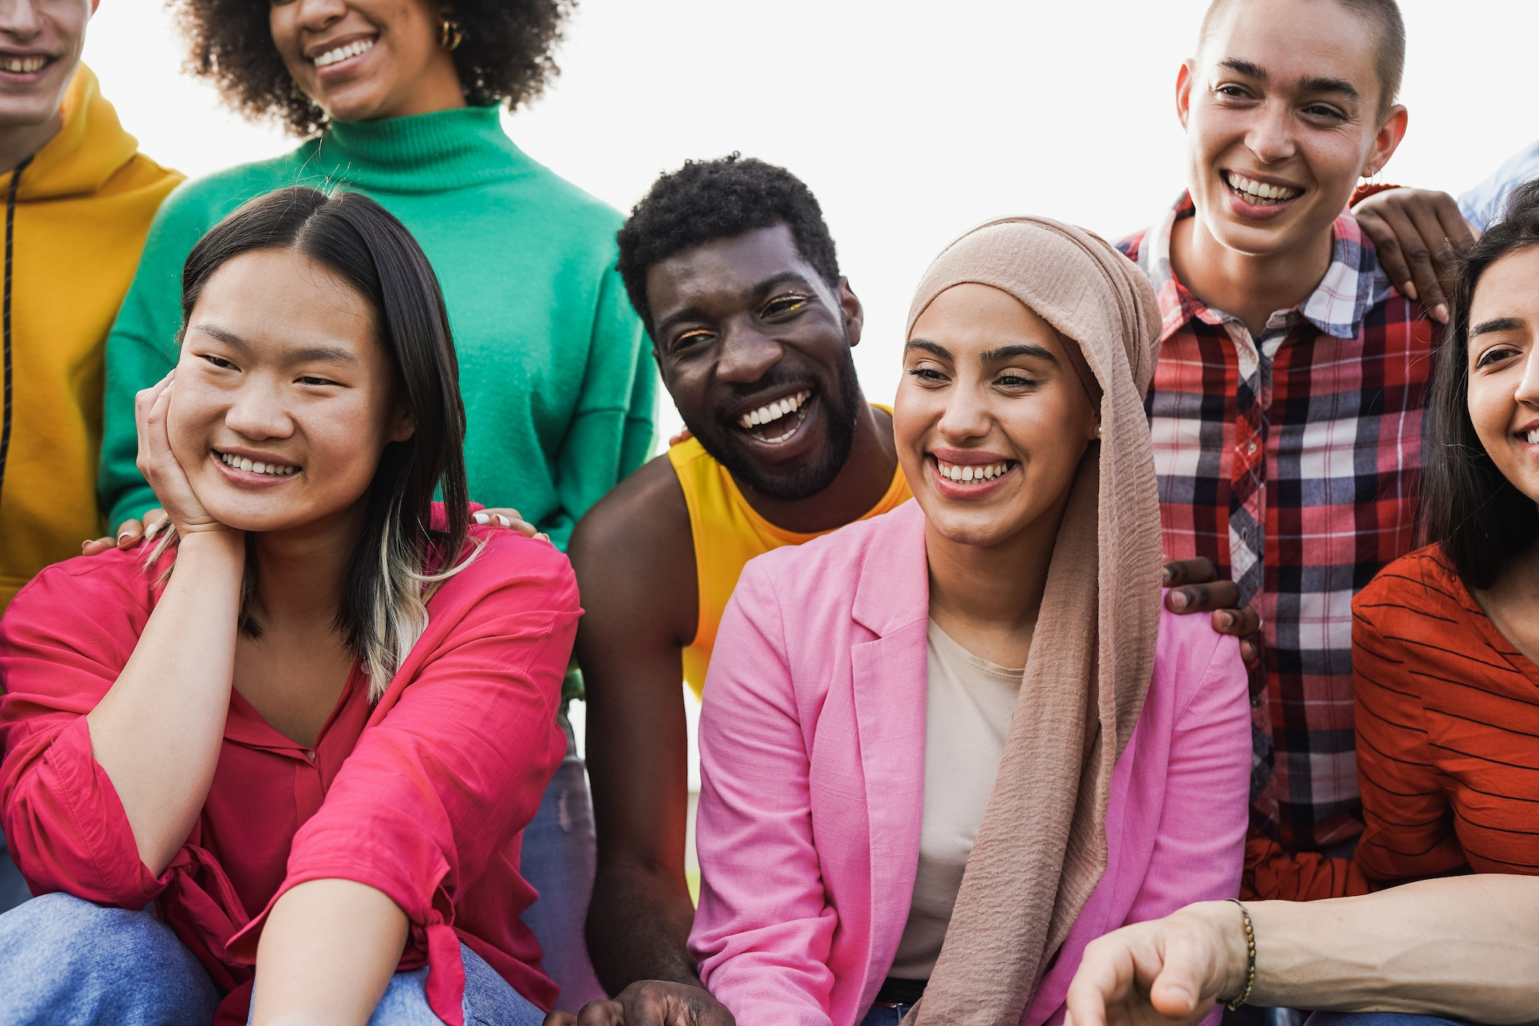

Contents…
Diversity
Inclusion
Social Cohesion
Tishk International University
Faculty of Administrative Sciences and Economics
Business and Management Department

Slide 4
Diversity
The diversity definition refers to the existence of variations of different characteristics in a group of people.
These characteristics could be everything that makes us unique, such as our cognitive skills and personality traits, along with the things that shape our identity (e.g. race, age, gender, religion, sexual orientation, cultural background).
Tishk International University
Faculty of Administrative Sciences and Economics
Business and Management Department

Slide 5
Examples of Diversity
To better understand and define diversity, we can think about it in a social context:
At work, you might interact with co-workers of different genders, age groups, faiths and etc.
At school, students may come from different socio-economic classes and have different personalities and physical abilities.
While the first things that come to mind when we talk about diversity are race and gender, it’s more than that.
Tishk International University
Faculty of Administrative Sciences and Economics
Business and Management Department

Slide 6
Diversity in workplace
To come up with a workplace diversity definition, we have to think about all the different characteristics that employees may have.
First, we have the protected characteristics, such as race, age, gender and sexual orientation.
Secondly, we have different: Experiences, Talents, Skills, Opinions, Personalities. These differences, are less obvious and require the organization’s effort and proactivity to show up.
Tishk International University
Faculty of Administrative Sciences and Economics
Business and Management Department

Slide 7
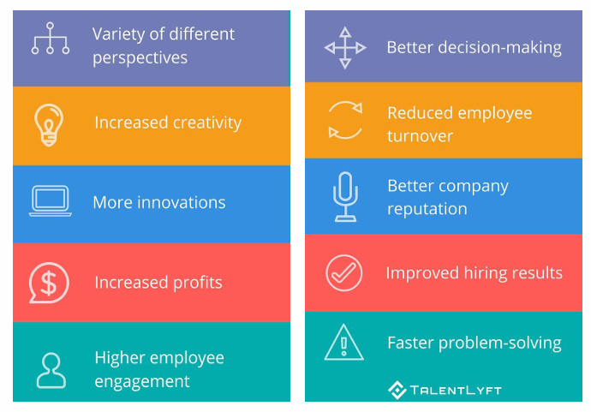
The importance of diversity in the workplace
Tishk International University
Faculty of Administrative Sciences and Economics
Business and Management Department

Slide 8

Diversity and Discrimination
Diversity in the workplace is also closely tied with discrimination. Bias and discriminatory employment practices exclude people who have specific characteristics, making it difficult for organizations to achieve and maintain diversity.
Tishk International University
Faculty of Administrative Sciences and Economics
Business and Management Department

Slide 9

Diversity and Discrimination
Some examples of diversity in the workplace along with ways to tackle discrimination:
Hiring women in the tech space
Bringing gender diversity in sales
Fighting gender inequality in leadership roles
Dealing with age and gender discrimination
Building the case for disability inclusion
Removing unconscious bias from the hiring process
Tishk International University
Faculty of Administrative Sciences and Economics
Business and Management Department

Slide 10

Inclusion
Inclusion in the workplace is a collaborative, supportive, and respectful environment that increases the participation and contribution of all employees. As a matter of fact, true inclusion removes all barriers, discrimination, and intolerance. When applied properly in the workplace, it is natural for everyone to feel included and supported.
Tishk International University
Faculty of Administrative Sciences and Economics
Business and Management Department

Slide 11
What is Inclusion?
Examples of inclusion in the workplace and classroom:
Workplace
Ensuring meeting materials are available in multiple formats (e.g., text, audio, large print).
Encouraging everyone to share ideas during team discussions, not just the most vocal members.
Celebrating cultural and religious holidays of all team members.
Classroom
Using teaching methods based on different learning styles (visual, auditory, kinesthetic).
Pairing students for group work to promote peer learning and respect for differences.
Providing extra time or alternative assessments for students with learning needs.
Tishk International University
Faculty of Administrative Sciences and Economics
Business and Management Department

Slide 12
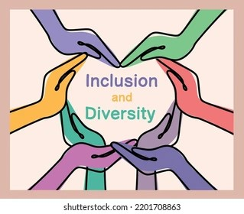
Diversity and inclusion
Diversity strategies, and inclusion are company’s practices to support a mission, and to achieve a competitive business advantage. Companies that create diverse and inclusive work environments are more adaptable, creative, and become magnets that attract top talents.
Tishk International University
Faculty of Administrative Sciences and Economics
Business and Management Department

Slide 13

Diversity and inclusion: Practices
The best practices of diversity and inclusion:
fair treatment
equal access to opportunities
teamwork and collaboration
organizational flexibility, and responsiveness
conflict resolution processes that are collaborative
evidence of leadership’s commitment to diversity
representation of diversity at all levels of the organization
diversity education and training
Tishk International University
Faculty of Administrative Sciences and Economics
Business and Management Department

Slide 14
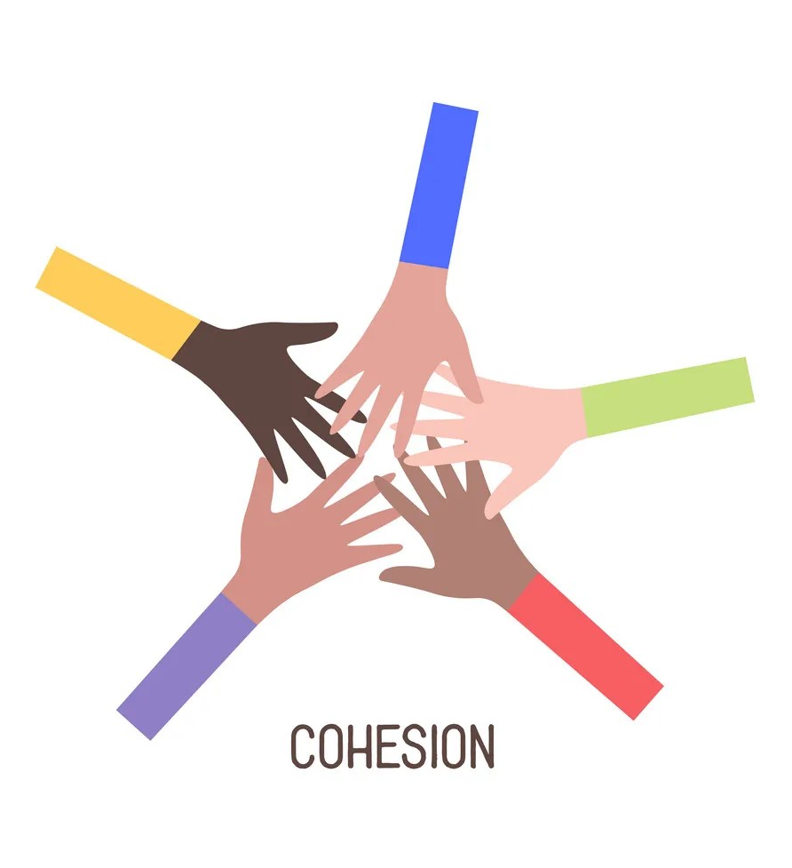
Social Cohesion
Social cohesion refers to the extent of connectedness and solidarity among groups in society. It identifies two main dimensions: the sense of belonging of a community and the relationships among members within the community itself.
Tishk International University
Faculty of Administrative Sciences and Economics
Business and Management Department

Slide 15
Social Cohesion
Social cohesion is a social process which aims to unite plurality of citizenship by reducing fractures and socioeconomic inequality in the society. It reflects people’s needs for both personal development and a sense of belonging. Further, it links together individual freedom and social justice.
Tishk International University
Faculty of Administrative Sciences and Economics
Business and Management Department

Slide 16
Social Cohesion
Cultural Festivals: Events like local fairs or parades celebrate diversity and promote unity by bringing various groups together through shared cultural experiences.
Volunteer Programs: Engaging in volunteer work not only benefits those in need
but also strengthens bonds among volunteers who share a commitment to helping others.
Disaster Response Teams: In times of crisis, such as natural disasters, communities
often come together to form response teams, showcasing the strength of unified
action and mutual support.
Tishk International University
Faculty of Administrative Sciences and Economics
Business and Management Department

Slide 17


