Slide 1






Academic English
Tishk International University
Faculty of Administrative Sciences and Economics
Business and Management Department
Ms. Zainab Hassan
Msc. English Language & Applied Linguistics
Fall Semester
February 2026

Slide 2
Chapter Four
Tishk International University
Faculty of Administrative Sciences and Economics
Business and Management Department
The Writing Process

Slide 3
Contents…
Prewriting
The first draft
Revise and edit
A new draft
The Longman Writing Series-2
Pages: 27-30
Tishk International University
Faculty of Administrative Sciences and Economics
Business and Management Department

Slide 4

The Writing Process
Good writing is more than just sitting down and "talking" on a piece of paper. It involves thinking, planning, writing, and revising. You become a good writer by always using these four steps:
Prewrite to get ideas
Write the first draft
Revise and edit the first draft
Write a new draft
Tishk International University
Faculty of Administrative Sciences and Economics
Business and Management Department

Slide 5
STEP 1: Prewrite to get ideas
In the prewriting step, you get ideas to write about. Taking notes is one way to get ideas. You did this kind of prewriting for the paragraph you wrote about a classmate. Another way to get ideas is freewriting.
To free write, choose a topic and write it at the top of a piece of paper. Then write whatever sentences and words come into your mind about the topic.
Write horizontally across the paper as you do when you write a letter. After you have run out of ideas, reread your freewriting. Choose one main idea for your paragraph. Then cross out ideas that aren't related to the one main idea.
Tishk International University
Faculty of Administrative Sciences and Economics
Business and Management Department

Slide 6
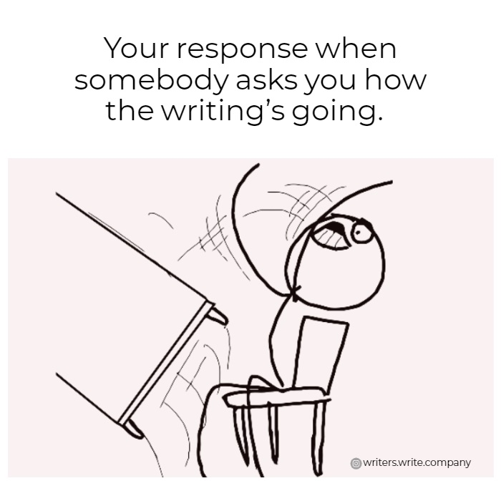
STEP 2: Write the first draft
In the second step, you write your paragraph in rough form without worrying too much about errors. This first writing is called the first draft or the rough draft.
Tishk International University
Faculty of Administrative Sciences and Economics
Business and Management Department

Slide 7
STEP 3: Revise and edit the draft
n the third step, you revise and edit your paragraph. When you revise, you make changes to make your ideas clearer and better organized. When you edit, you check and correct the language, grammar, punctuation, format, and spelling.
When a writer revises and edits their first draft, they make their corrections directly on the first draft. These are the types of corrections they may make:
She/he crossed out unnecessary sentences.
She/he added missing subjects and verbs.
She/he changed the concluding sentence to make it more like the topic sentence.
Tishk International University
Faculty of Administrative Sciences and Economics
Business and Management Department

Slide 8
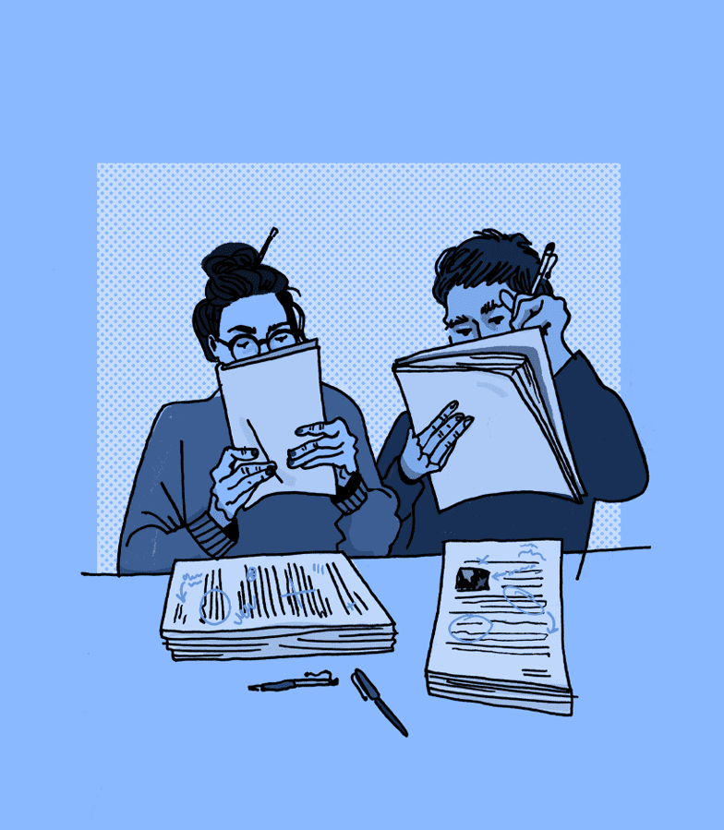
Peer-Review
Sometimes you might want to ask a classmate (a "peer") to read your work and make suggestions about how to improve your writing. This is called a "peer review." This feedback is often useful for showing you which parts of your paragraph you could improve.
Tishk International University
Faculty of Administrative Sciences and Economics
Business and Management Department

Slide 9

STEP 4: Write a new draft (FINAL)
In the last step, you look at the revisions and edits you made to your first draft in Step 3 and you make a clean copy of your paragraph to hand in to your instructor.
Tishk International University
Faculty of Administrative Sciences and Economics
Business and Management Department

Slide 10
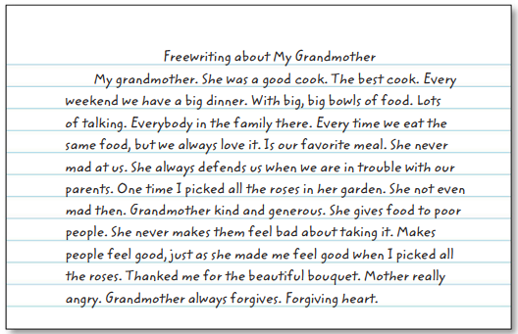
Examples for each step:
Step-1
Tishk International University
Faculty of Administrative Sciences and Economics
Business and Management Department

Slide 11
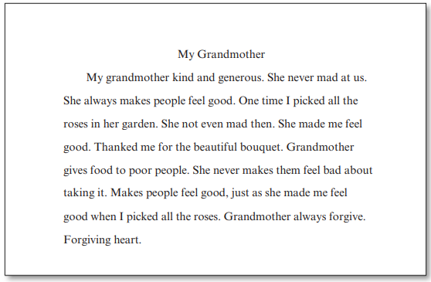
Step-2
Tishk International University
Faculty of Administrative Sciences and Economics
Business and Management Department

Slide 12
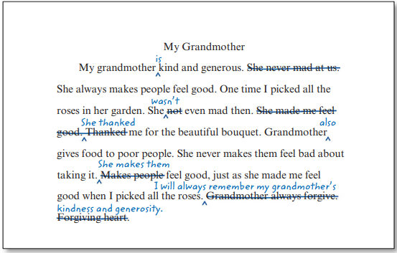
Step-3
Tishk International University
Faculty of Administrative Sciences and Economics
Business and Management Department

Slide 13
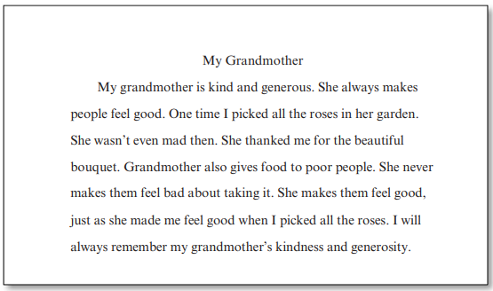
Step-4
Tishk International University
Faculty of Administrative Sciences and Economics
Business and Management Department

Slide 14

Class Task ☺
Choose a topic to write a paragraph about,
Write the first draft,
Revise and edit it (the instructor will choose the peer-reviewers),
Re-write the final copy and submit it,
30 minutes
Tishk International University
Faculty of Administrative Sciences and Economics
Business and Management Department

Slide 15

Tishk International University
Faculty of Administrative Sciences and Economics
Business and Management Department

