Slide 1

Corporate Social Responsibility & Ethics
Lecturer: Kadhim Saeed
Course Code: 111
Semester: Fall
2025-2026
Prepared By Karwan H. Saeed

Slide 2
Content
IKEA case study
Corporate Social Responsibility
Arguments on Social Responsibility
Sustainability
Ethics
Benefits of Ethical Management
List of unethical practices
Code of ethics
Whistle-blowers

Slide 3
Questions About (IKEA)
1. What kind of company is IKEA?
2. What does IKEA do to protect the environment?
3. Why does IKEA try to reduce packaging and energy use?
4. Who does IKEA help through the IKEA Foundation?
5. Do you think companies should care about the environment? Why?
6. How does IKEA benefit from being environmentally responsible?
7. What might happen if IKEA did not care about the environment?
8. Would you prefer to buy from a socially responsible company? Why?

Slide 4

Corporate Social Responsibility
Corporate Social Responsibility (CSR) is to take action that protects and improves both the welfare of society as a whole and the interests of the organization.

Slide 5
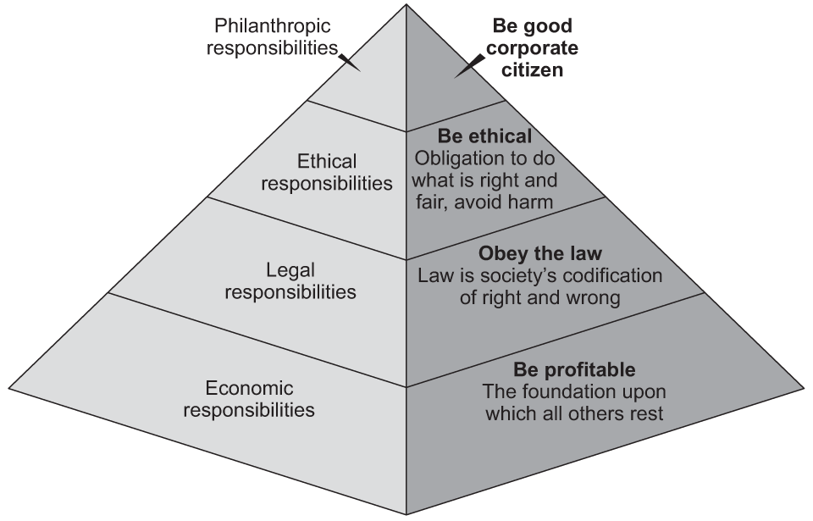
Caroll's Pyramid of CSR

Slide 6
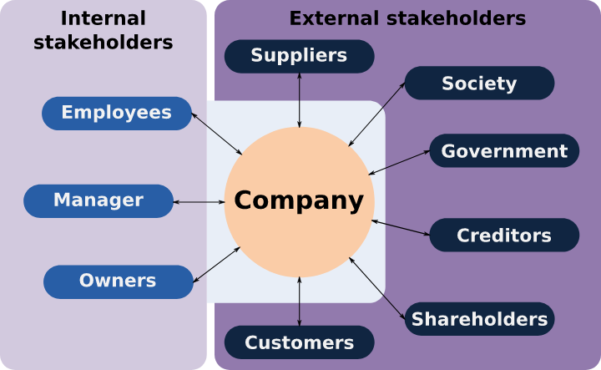
Organization's stakeholders

Slide 7
Areas of Corporate Social Responsibility
Philanthropy.
Pollution (Air, water, land, and sound)
Natural resources conservation (Water, tree, oil, etc.)
Natural and man-made Disasters.
Improve Education
Reduce Poverty
Consumer and worker rights protection
Health cautious products

Slide 8
Arguments on Social Responsibility
Should business be responsible for social concerns beyond its own profit concern?
Yes, Why?
No, Why?

Slide 9

Sustainability
The degree to which an entity can meet its present needs without compromising the ability of others to meet their needs.
Best example is UN Sustainable Development Goals (SDGs)

Slide 10

Sustainable Development Goals (SDGs)

Slide 11
Ethics
The moral principles and standards that guide the behavior of an individual or group. By Bateman and Snell
Business ethics is to pursue the moral principles and standards when operating a business.

Slide 12
Benefits of Ethical Management practices
Increases Productivity.
Stakeholder Relations
Government regulations.

Slide 13
Types of unethical Business practices
What are the types of unethical business practices?
Corruption
Bribery
Nepotism
Insider trading
Sexual Harassment
Sale of expired or fake products
Tax Evasion – Panama Papers
Ponzi Scheme

Slide 14
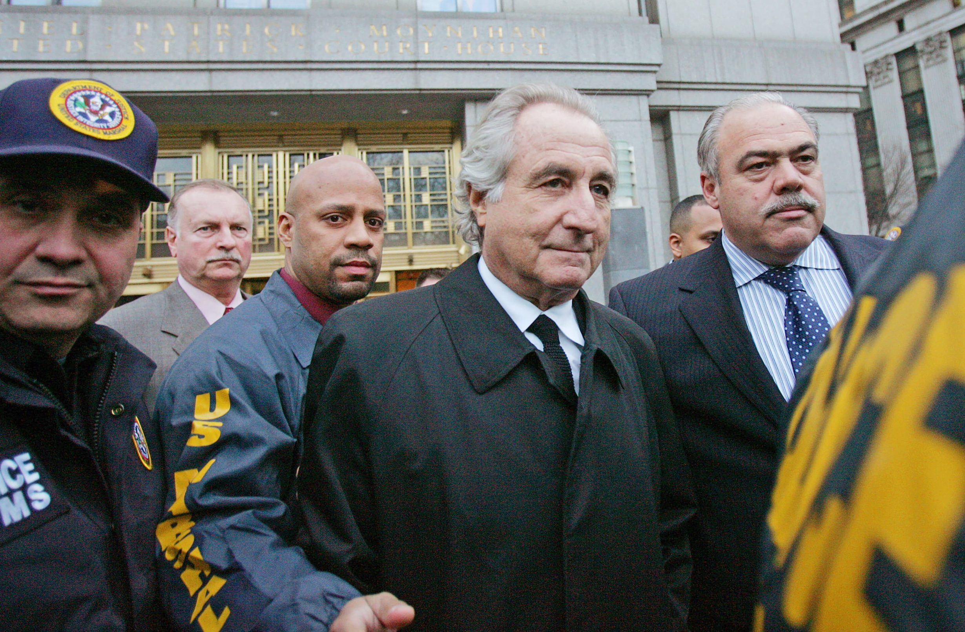

Examples of Unethical conduct
Bernie Madoff is arrested and charged with masterminding a long-running Ponzi scheme of 64 Billion. Sentenced for 150 Years in prison.
Larry Nassar is an American convicted serial child molester who was the USA Gymnastics national team doctor at Michigan State University.

Slide 15
Code of Ethics
A formal statement that acts as a guide for the ethics of how people in an organization should act and make decisions.
Conflict of interest
Privacy of information
Receiving and giving information
Going out for dinner or lunch with customers.

Slide 16
Example of Code of ethics
A sample from an organization
Exercise due care to protect the mental and physical safety of students, colleagues, and subordinates.
Keep in confidence legally confidential information as they may secure.
Staff are discouraged from accepting gifts from students, or partners.
Avoid political agenda in the Education process.
Staff who repeatedly or deliberately fail to follow the University’s code of ethics will meet an appropriate disciplinary action.

Slide 17
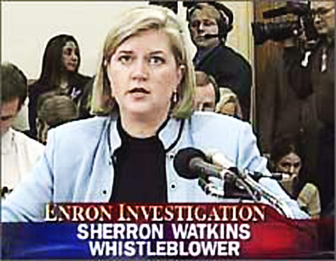

Whistle-Blowing
is act of an employee reporting suspected unethical practice or corruption believed to exist within the organization.
Law and Whistle-Blowers.
Sherron Watkins
Edward Snowden

Slide 18
Questions?

