Slide 1

Introduction To Psychiatric
MSc. Hilal Farouq Hussein
12th Feb 2026

Slide 2
Learning Outcome
By the end of this lecture, students will be able to:
Define mental health and mental illness according to the World Health Organization and differentiate between wellness and mental disorders.
Describe the historical evolution of mental illness treatment, from ancient religious explanations to modern psychiatric approaches.
Explain the contributions of key figures such as Philippe Pinel, William Tuke, Dorothea Dix, and Sigmund Freud in the development of mental health care.
Identify and describe the major neurotransmitters (dopamine, serotonin, norepinephrine, GABA, acetylcholine, glutamate, and histamine) and their roles in mental disorders.
Discuss the relationship between neurotransmitter imbalances and psychiatric conditions, including the basic mechanisms of psychotropic medications.

Slide 3
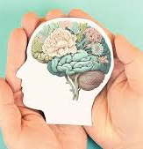
Mental Health
The World Health Organization defines health as a state of complete physical, mental, and social wellness, not merely the absence of disease.

Slide 4
Con..
Mental Health is a state of Emotional, Psychological, and Social Wellness Evidenced By:
Satisfying Interpersonal Relationships.
Effective Behavior And Coping.
Positive Self-concept.
Emotional Stability.

Slide 5
Mental illness
Mental illness includes disorders that affect mood, behavior, and thinking, such as depression, schizophrenia, anxiety disorders, and addictive disorders.
Mental disorders often cause significant distress or impaired functioning or both.
Individuals experience:
  Dissatisfaction With Self and Relationships.
  Ineffective Coping.
  Daily Life Seem Overwhelming Or Unbearable.
  Individuals May Believe That Their Situation Is Hopeless.

Slide 6
TREATMENT OF MENTAL ILLNESS –
Ancient Times
In ancient times, mental illness was commonly interpreted through religious and supernatural explanations. Illness of any kind was believed to represent divine displeasure and was viewed as punishment for sin or wrongdoing. Consequently, individuals with mental disorders were often categorized as either divine or demonic, depending on their observable behavior.

Slide 7
Con..
Those perceived as divinely inspired were revered, worshipped, and socially valued, whereas individuals believed to be demonic were stigmatized, socially excluded, punished, and, in some cases, executed, including being burned at the stake. These responses reflect early societal fear, misunderstanding, and moral judgment toward mental illness.

Slide 8
Con..
A shift toward biological and medical explanations emerged with Aristotle (382–322 BC), who proposed that mental disorders were linked to physical imbalances in the body.
Aristotle’s theory was based on the concept of the four bodily humors: blood, water (phlegm), yellow bile, and black bile. Each humor was believed to regulate specific emotional states.

Slide 9
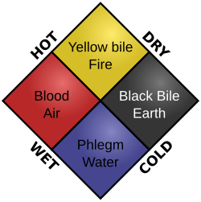
Humoral Theory Components
Blood — happiness
Water(phlegm) — calmness
Yellow bile — anger
Black bile — sadness

Slide 10
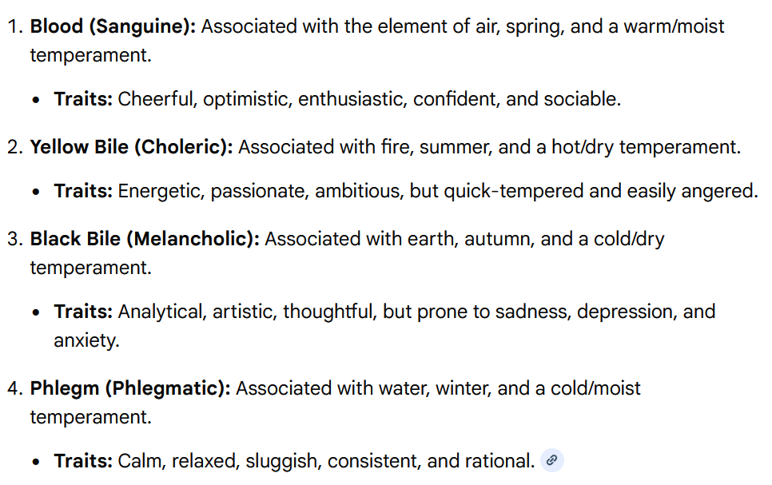

Slide 11
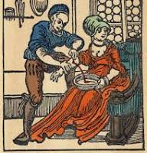
Con..
According to this humoral theory, imbalances among the four humors were thought to be the primary cause of mental disorders. Treatment therefore focused on restoring humoral equilibrium using physical interventions such as bloodletting, starvation, and purging.
Although scientifically unfounded, these methods remained in use well into the 19th century.

Slide 12
Christian Times
In early Christian times (1–1000 AD), primitive beliefs and superstitions were strong.
All diseases were again blamed on demons, and the mentally ill were viewed as possessed.
Priests performed exorcisms to rid sufferers of evil spirits. When that failed, they used more severe and brutal measures, such as incarceration in dungeons, flogging, and starving.

Slide 13
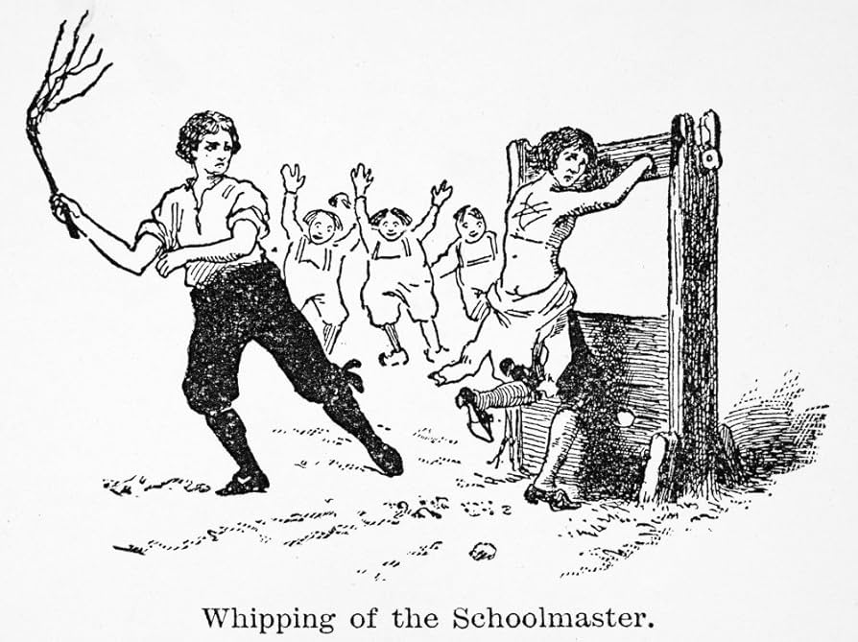


incarceration in dungeons & flogging

Slide 14

Renaissance
In England during during Renaissance (1300–1600), people with mental illness were distinguished from criminals. Those considered harmless were allowed to wander the countryside or live in rural communities, but the more “dangerous lunatics” were thrown in prison, chained, and starved.

Slide 15

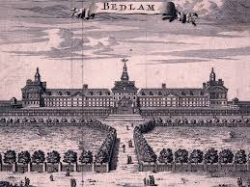
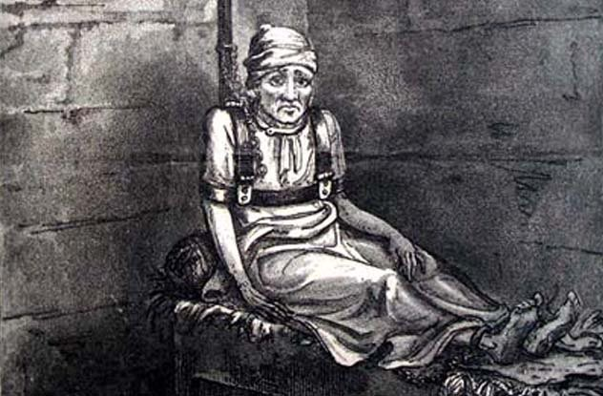
First Psychiatric Hospital
In 1547, the Hospital of St. Mary of Bethlehem was officially declared a hospital for the insane, the first of its kind.
By 1775, visitors at the institution were charged a fee for the privilege of viewing and ridiculing the inmates, who were seen as less than human animals.

Slide 16
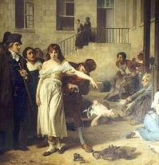
Period of Enlightenment
In the 1790s, a period of enlightenment concerning persons with mental illness began.
Philippe Pinel in France and William Tuke in England formulated the concept of asylum as a safe refuge or haven offering protection at institutions where people had been whipped, beaten, and starved because they were mentally ill.
French psychiatrist Philippe Pinel (1745-1826) releasing lunatics from their chains at the Salpêtrière asylum in Paris in 1795

Slide 17
United state during Enlightenment
With this movement began the moral treatment of the mentally ill. In the United States, Dorothea Dix (1802–1887) began a crusade to reform the treatment of mental illness after a visit to Tuke’s institution in England.
She was instrumental in opening 32 state hospitals that offered asylum to the suffering.
Dix believed that society was obligated to those who were mentally ill; she advocated adequate shelter, nutritious food, and warm clothing.

Slide 18
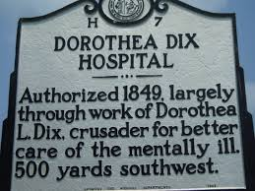
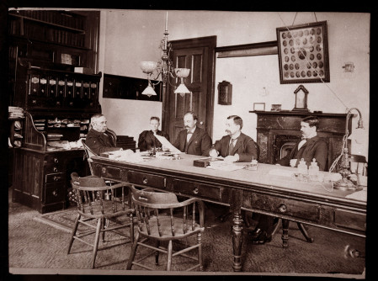
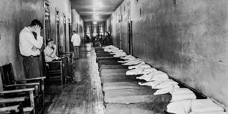
Dorothea Dix Hospital

Slide 19
The Decline of Early Asylums
The period of enlightenment was short-lived. Within 100 years after the establishment of the first asylum, state hospitals were in trouble.
Attendants were accused of abusing the residents, the rural locations of hospitals were viewed as isolating patients from their families and homes, and the phrase insane asylum took on a negative connotation.

Slide 20
Sigmund Freud and Treatment of Mental Disorders
The period of scientific study and treatment of mental disorders began with Sigmund Freud (1856–1939) and others, such as Emil Kraepelin (1856–1926) and Eugen Bleuler (1857–1939).
With these men, the study of psychiatry and the diagnosis and treatment of mental illness started in earnest.
He studied the mind, its disorders, and their treatment as no one had done before. Many other theorists built on Freud’s pioneering work.
Kraepelin began classifying mental disorders according to their symptoms.

Slide 21
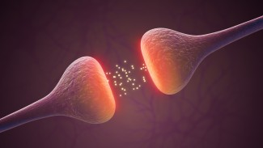
Neurotransmitters
Neurotransmitters are the chemical substances manufactured in the neuron that aid in the transmission of information throughout the body.
They either excite or stimulate an action in the cells (excitatory) or inhibit or stop an action (inhibitory).

Slide 22
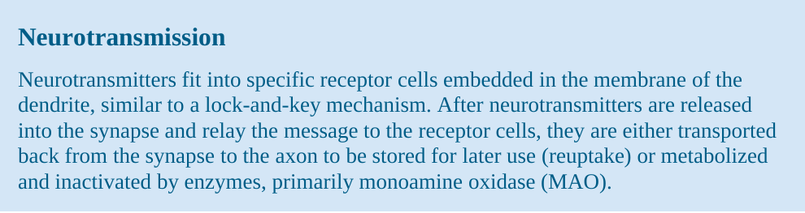

Slide 23
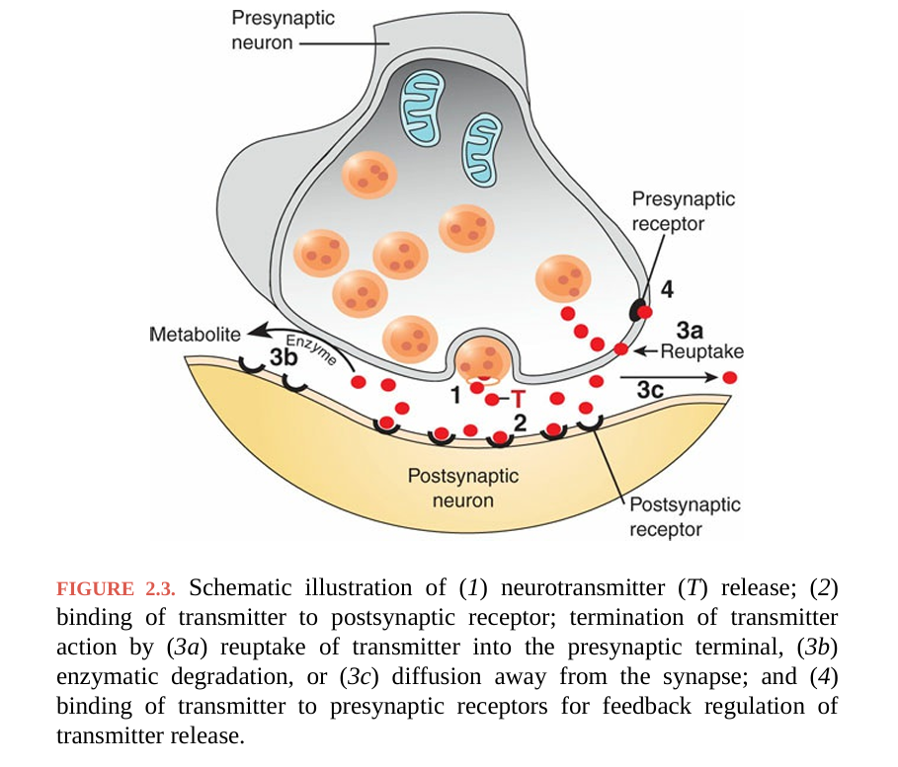

Slide 24
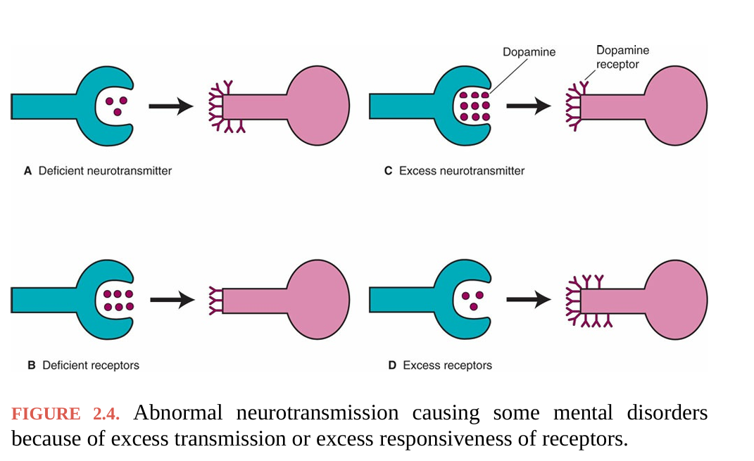

Slide 25
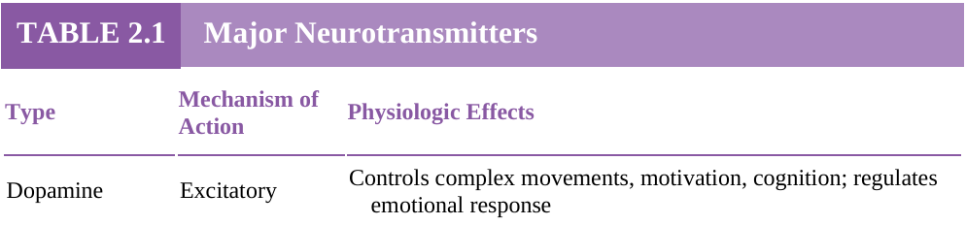
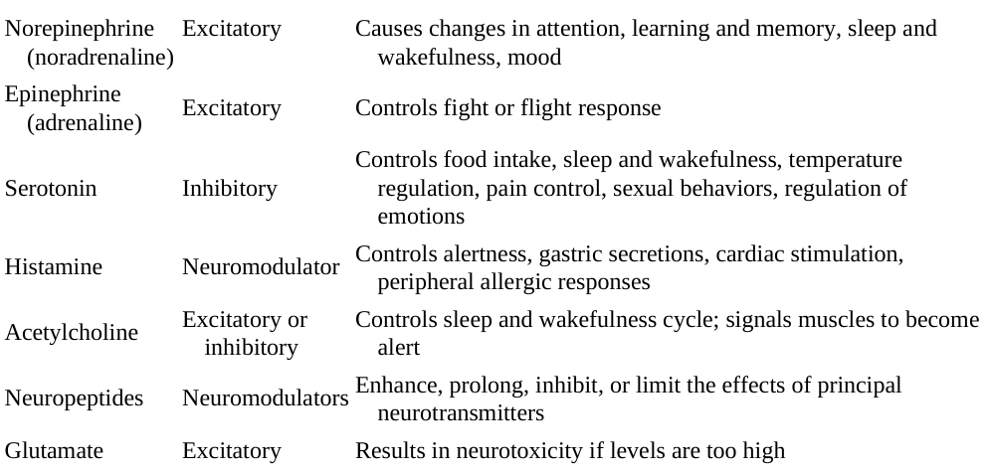

Slide 26

Dopamine
Dopamine, a neurotransmitter located primarily in the brain stem, has been found to be involved in the control of complex movements, motivation, cognition, and regulation of emotional responses.
Dopamine is implicated in schizophrenia and other psychoses as well as in movement disorders such as Parkinson disease.
Antipsychotic medications work by blocking dopamine receptors and reducing dopamine activity.

Slide 27

Norepinephrine and Epinephrine
Norepinephrine, the most prevalent neurotransmitter in the nervous system, is located primarily in the brain stem and plays a role in changes in attention, learning and memory, sleep and wakefulness, and mood regulation.
Excess norepinephrine has been implicated in several anxiety disorders.
Deficits may contribute to memory loss, social withdrawal, and depression.

Slide 28
Con..
Some antidepressants block the reuptake of norepinephrine
Others inhibit MAO from metabolizing it.
Epinephrine has limited distribution in the brain but controls the fight or flight response in the peripheral nervous system.

Slide 29
Serotonin
Serotonin is derived from tryptophan, a dietary amino acid.
The function of serotonin is mostly inhibitory, and it is involved in the control of food intake, sleep and wakefulness, temperature regulation, pain control, sexual behavior, and regulation of emotions.
Serotonin is often considered a "general inhibitor" of behavior and is associated with regulating satiety, reducing anxiety, and suppressing aggressive, impulsive, or fearful responses.

Slide 30
Con..
Serotonin plays an important role in anxiety, mood disorders, and schizophrenia.
Some antidepressants block serotonin reuptake, thus leaving it available longer in the synapse, which results in improved mood.

Slide 31
Histamine
The role of histamine in mental illness is under investigation.
It is involved in peripheral allergic responses, control of gastric secretions, cardiac stimulation, and alertness.
Some psychotropic drugs block histamine, resulting in weight gain, sedation, and hypotension

Slide 32
Acetylcholine
Acetylcholine is a neurotransmitter found in the brain, spinal cord, and peripheral nervous system, particularly at the neuromuscular junction of skeletal muscle.
Has been found to affect the sleep–wake cycle and to signal muscles to become active.
Studies have shown that people with Alzheimer disease have decreased acetylcholine secreting neurons.

Slide 33
Glutamate
Glutamate is an excitatory amino acid that can have major neurotoxic effects at high levels.
It has been implicated in the brain damage caused by stroke, hypoglycemia, sustained hypoxia or ischemia, and some degenerative diseases such as Alzheimer.

Slide 34
Gamma-Aminobutyric Acid
Gamma-aminobutyric acid (GABA), an amino acid, is the major inhibitory neurotransmitter in the brain and has been found to modulate other neurotransmitter systems rather than to provide a direct stimulus.
Drugs that increase GABA function, such as benzodiazepines, are used to treat anxiety and to induce sleep.

Slide 35

Videbeck, S. L. (2020). Psychiatric–Mental Health Nursing (8th ed.). Philadelphia, PA: Wolters Kluwer.

Slide 36


