Slide 1

Introduction to Psychology
Hilal Farouq Hussien
M.Sc. In Psychiatric Nursing
9th Feb 2026

Slide 2
What will you learn in this lecture?
Meaning of psychology
Development of psychology Scope, branches, and methods of psychology
Relationship with nursing filed
Significance of psychology in nursing
Applied psychology to solve everyday issues in nursing

Slide 3
Introduction
Many times, you may have wondered why certain people behave the way they do.
Why is it that your brother prefers to be always with his friends whereas you love being alone?
What motivates your friend to top in the class?
How is it that your patient is able to smile at you despite her severe illness?
Psychology seeks to answer these and many such questions.

Slide 4
MEANING OF PSYCHOLOGY
Psychology is the scientific study of the mind and behavior.
It began in ancient Greece (400–500 BC) as part of philosophy.
Early philosophers”Big Three of Greek Philosophy” like Socrates, Plato, and Aristotle explored ideas about the logic, ethics, and human behavior.

Slide 5
Origin of the Term “Psychology”
First used in 1590 by German philosopherRudolf Goclenius.
Derived from Greek words:
Psyche = soul
Logos = study
Initially meant the study of the soul.

Slide 6
Development as a Science
Wilhelm Wundt and William James helped establish psychology as a scientific field.
In 1890, William James defined psychology as the study of the mind.

Slide 7
Shift to Behavior
John B. Watson introduced behaviorism in the early 20th century.
Focused on observable and measurable behavior, removed the concept of consciousness.
Psychology became known as the study of behavior.

Slide 8
Modern definition
Psychology evolved from studying the soul → mind → behavior.
Today, the American Psychological Association defines psychology as the study of the mind and behavior.

Slide 9
William James comment
“psychology first lost its soul, then it lost its mind, and finally it lost its consciousness and still has behavior of a sort.”
This helps us understand the gradual shift from the definition of psychology as a study of the “soul” to a study of the “mind” and finally a study of “behavior.”

Slide 10
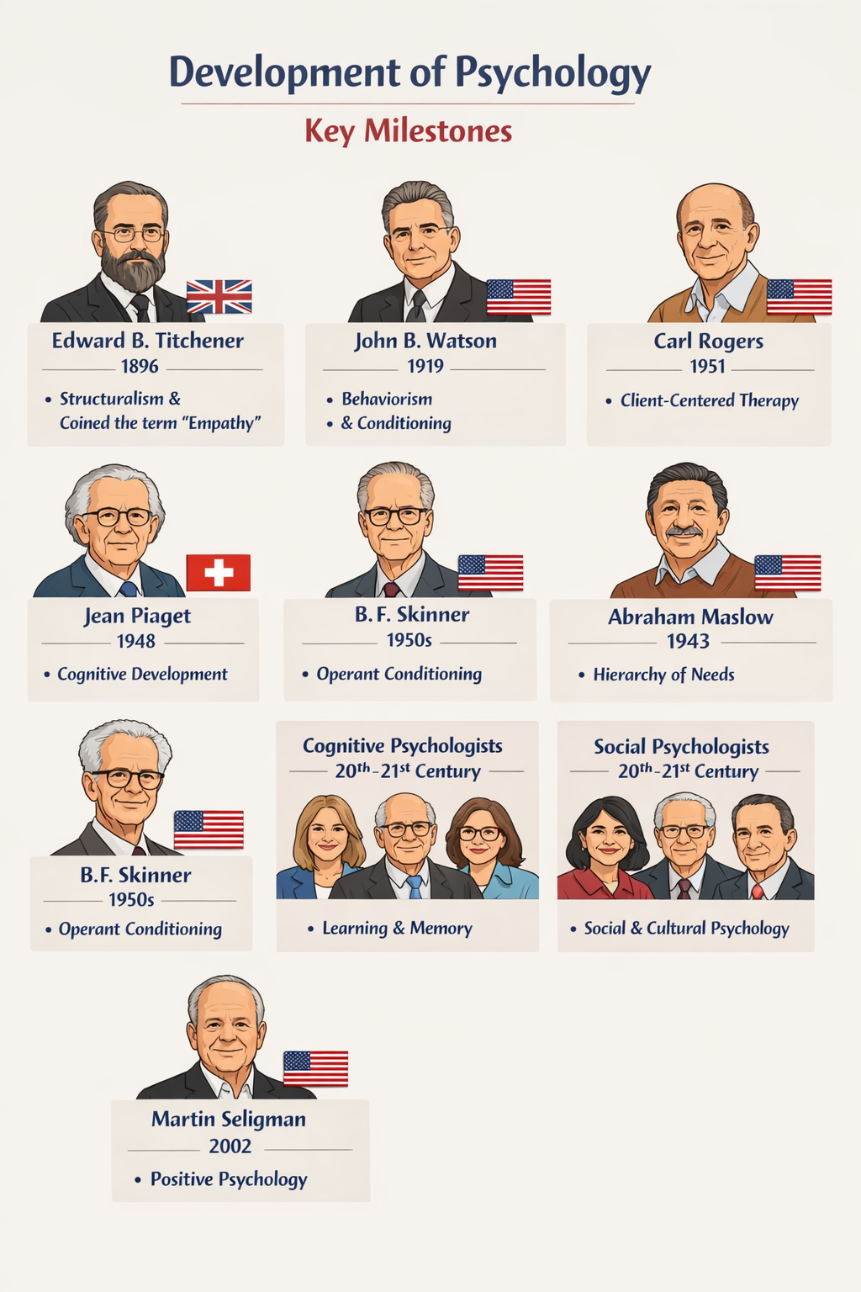
DEVELOPMENT OF PSYCHOLOGY

Slide 11


History
There was evidence of trephination (cutting holes into a skull to let evil spirits out) back in the stone age.

Slide 12

The goal of psychology
The ultimate goal of psychology is to explore, understand, describe, interpret and explain, predict, and control behavior.

Slide 13
WHAT IS BEHAVIOR?
The behavior occurs in three domains. They are as follows:
1. Cognitive: Any function of the brain such as memory, critical thinking, judging, planning, etc.
2. Conative: Any motor activity, movement such as walking, running, eating, combing one’s hair, writing, etc.
3. Affective: Emotions such as joy, sorrow, anger, fear, etc.

Slide 14
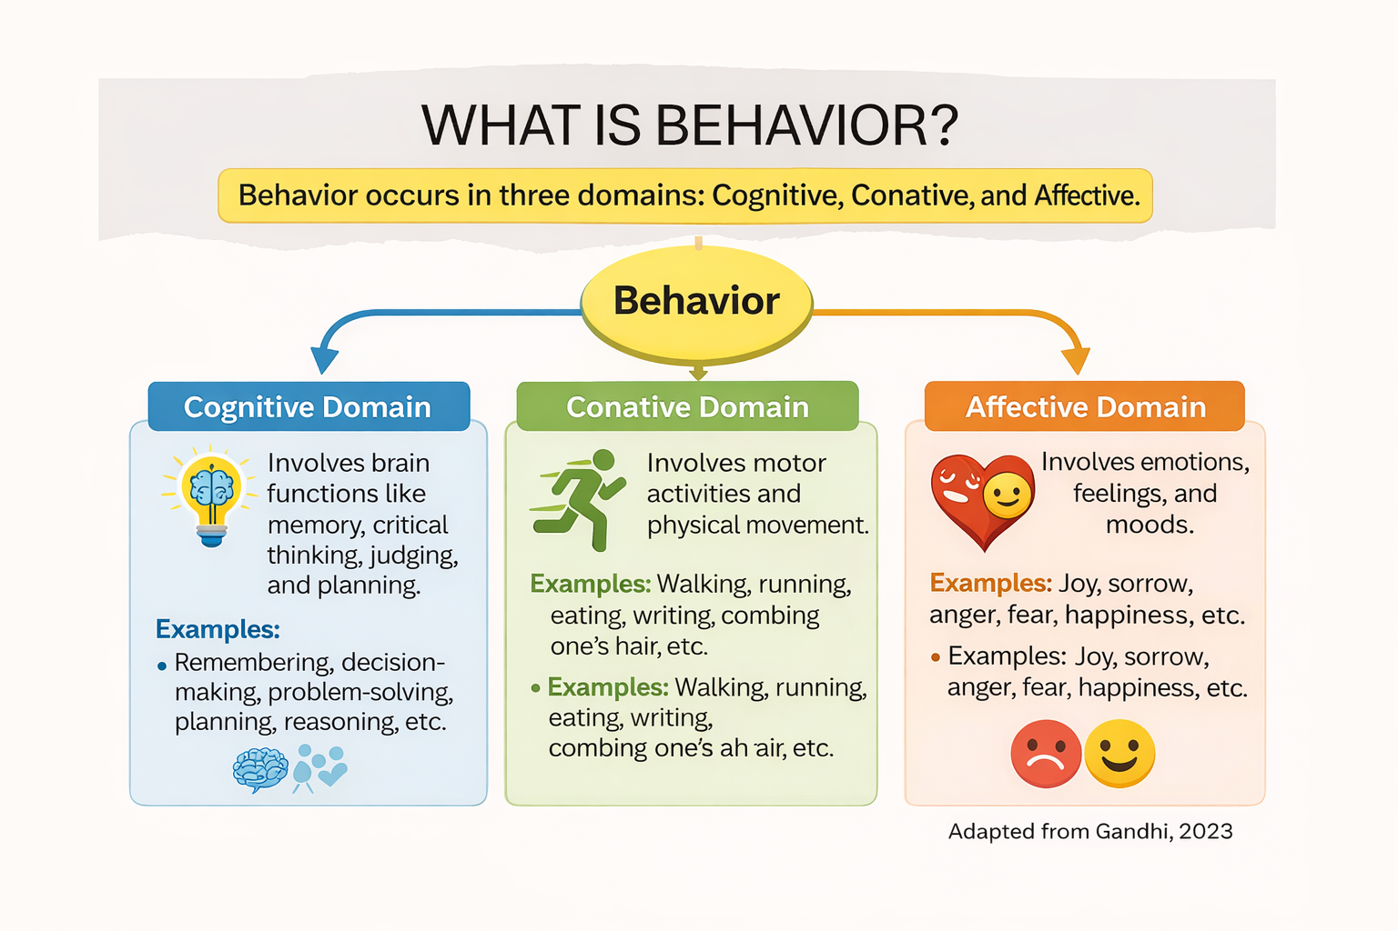

Slide 15
Behaviour definition
Any internal or external activity in a person that occurs as a reaction or response to an internal or external stimulus is known as behavior.

Slide 16
Internal stimulus
Thoughts, anxiety, fear, anger, panic, joy, fever, body pain, headache, etc., could be internal stimuli. These arise from within one’s mind or body.

Slide 17
Internal activity
The body and mind respond to internal stimulus. Examples are tensing the muscles, feeling butterflies in your stomach just before the exam, etc. Internal activity is not visible to others.
However, the effect on body language can be visible. For example, the internal activity may be tensing the muscles when the individual is anxious. This can be reflected in the body language too—face looks dull and strained, eye contact keeps shifting, the shoulder may be drooping

Slide 18
External stimulus
Stimuli from the external environment could also lead to behavioral changes. Examples are examinations, getting scolded by your teacher, bad news, an accident, an intramuscular injection, etc.

Slide 19
External activity
When there are external stimuli, the individual can respond in behavior that is visible to others. Examples are shouting, running, writing, breaking things, etc.

Slide 20
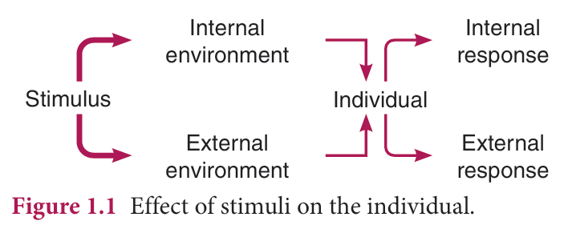

Slide 21
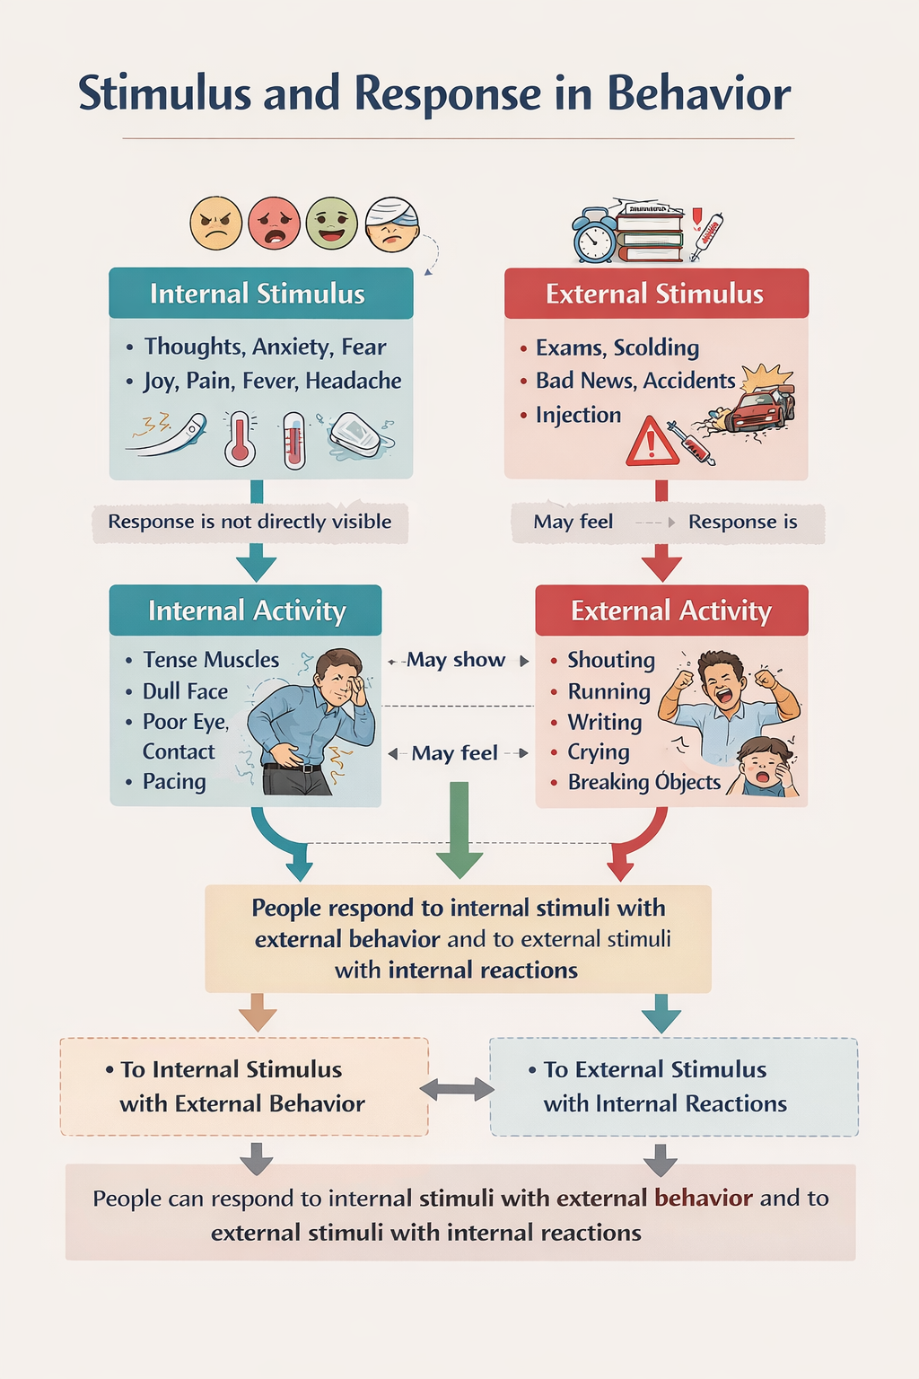

Slide 22
Con
Remember that behavior occurs not only when a person is conscious but also in different stages of consciousness.
For example, an unconscious patient moves her/his arm when an intramuscular injection is administered or when you are suctioning secretions from the endotracheal tube. S/he may even wince or cry with the pain.

Slide 23
SCOPE OF PSYCHOLOGY
Psychology has a very wide scope considering that it is a science that studies the mind and behavior of all living things be it human beings, animals, plants, etc.
It has relevance in illness, wellness, education institutes, correctional institutes, prison systems, occupations, etc.

Slide 24
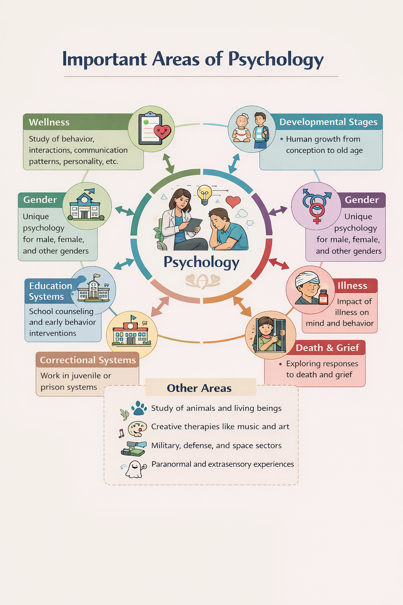

Slide 25
1. A patient screaming after an injection is demonstrating:
A. Internal activity
B. External activity
C. Cognitive processing
D. Emotional repression

Slide 26
2. Which situation best represents internal stimulus affecting behavior?
A. Crying after hearing bad news
B. Nervousness before an exam
C. Running after hearing an alarm
D. Laughing at a joke

Slide 27
3. A patient experiencing fear before an injection demonstrates which domain?
A. Cognitive
B. Conative
C. Affective
D. Motor

Slide 28
4. Which of the following best illustrates the cognitive domain of behavior?
A. Crying due to pain
B. Writing a report
C. Solving a clinical problem
D. Running to respond to an emergency

Slide 29
5. Behavior occurring in unconscious patients supports the idea that:
A. Behavior requires awareness
B. Consciousness is essential for response
C. Behavior can occur without conscious control
D. Learning stops when unconscious

Slide 30
MAJOR SCHOOLS OF THOUGHT
IN PSYCHOLOGY
When psychology branched out from philosophy as a separate discipline, many schools of thought originated as different psychologists from various parts of the world had their own opinion about the best method to study the mind.

Slide 31
School of Thought | Major Thinkers | Summary
Structuralist School | Wilhelm Wundt, Edward Titchener | First school of psychology; focused on experimental self-observation (introspection) and breaking mental processes into basic elements.
Functionalist School | William James, John Dewey, James R. Angell, Harvey Carr | Emphasized the functions and purpose of the mind, thoughts, and behaviors.
Gestalt School | Max Wertheimer, Wolfgang Köhler, Kurt Koffka | Focused on the whole experience; believed the whole is greater than the sum of its parts.
Behaviorist School | John B. Watson, Ivan Pavlov, B.F. Skinner | Focused on observable behavior; introduced classical and operant conditioning; behavior shaped by environment, reward, and reinforcement.
Psychoanalytic School | Sigmund Freud, Anna Freud, Otto Rank, Erik Erikson, Alfred Adler | Explained behavior through id, ego, and superego; emphasized unconscious processes, talk therapy, and psychosexual development.
Humanistic School | Abraham Maslow, Carl Rogers, Clark Moustakas | Emphasized free will, self-actualization, and hierarchy of needs; influenced positive psychology.
Cognitive School | Jean Piaget | Focused on mental processes such as thinking, memory, and learning; proposed stages of cognitive development; influenced CBT.

Slide 32
BRANCHES OF PSYCHOLOGY
There are two main branches or fields of psychology, which have sub-branches.
These are as follows:
1. Pure psychology
2. Applied psychology

Slide 33
Pure Psychology | Applied Psychology
General / Basic Psychology | Health Psychology
Biological / Physiological Psychology | Educational Psychology
Developmental Psychology | School Psychology
Social Psychology | Sports Psychology
Abnormal Psychology | Community Psychology
Geographical Psychology | Industrial Psychology
Animal (Comparative) Psychology | Consumer Psychology
Parapsychology | Legal Psychology
 | Political Psychology
 | Military Psychology
 | Clinical Psychology
 | Clinical Neuropsychology
 | Forensic Psychology
 | Aerospace Psychology
 | Psychometrics
 | Correctional Psychology
 | Organizational Psychology

Slide 34

INTROSPECTION
Psychology promotes nonjudgmental self-introspection in student nurses.
Helps students identify and understand personal fears, anxieties, and concerns.
Enables recognition of the causes of thoughts and emotions and supports positive change.
Increases awareness of attitudes toward health, illness, and patients.
Positive attitudes improve quality of nursing care.
Assists students in evaluating aptitude for nursing and making informed career decisions.

Slide 35


Slide 36

Reference
Gandhi, S. (2023). Basic and applied psychology for nurses (pp. 1–6). Wolters Kluwer (India) Pvt. Ltd.

Slide 37


