Slide 1
Regional Economic Integration
Lesson-06
Chapter-09
Session 1 & 2
Spring 2025

Slide 2
Learning Objectives
Describe the different levels of regional economic integration.
Understand the economic and political arguments for regional economic integration.
Explain the history, current scope, and future prospects of the world's most important regional economic agreements.
Understand the implications for business that are inherent in regional economic integration agreements

Slide 3
Introduction
This lesson takes a close look at the arguments for regional economic integration through the establishment of trading blocs [alliance/federation]-
such as the European Union (EU)
the North American Free Trade Agreement (NAFTA)

Slide 4
Introduction
Growth in Trade Blocs
The past two decades have witnessed an unprecedented [exceptional/unique] proliferation[expand/increase] of regional trade blocs that promote regional economic integration
World Trade Organization (WTO) members are required to notify the WTO of any regional trade agreements in which they participate.

Slide 5
Introduction
What is Regional Economic Integration?
Regional economic integration : agreements among countries in a geographic region to reduce tariff and non-tariff barriers to the free flow of goods, services, and factors of production between each others.
[Examples, Tariff barriers-taxes imposed by a government on imports or exports of goods. Nontariff barriers include quotas, embargoes, sanctions, and levies]
Notes:
While the move toward regional economic integration is generally seen as a good thing, some observers worry that it will lead to a world in which regional trade blocs compete against each other.
In this possible future scenario, free trade will exist within each bloc, but each bloc will protect its market from outside competition with high tariffs.
The specter of the EU and NAFTA turning into economic fortresses that shut out foreign producers with high tariff barriers is worrisome to those who believe in unrestricted free trade. If such a situation were to materialize, the resulting decline in trade between blocs could more than offset the gains from free trade within blocs.
The Opening Case: I Want my Greek TV explores how one broadcast subscriber took on the industry in an effort to get the pricing that was available in Greece, but unavailable in the United Kingdom.

Slide 6
Levels of Economic Integration

Slide 7
Levels of Economic Integration
Several levels of economic integration are possible in theory (see Figure 9.1)
From least integrated to most integrated, they are a free trade area, a customs union, a common market, an economic union, and, finally, a full political union

Slide 8
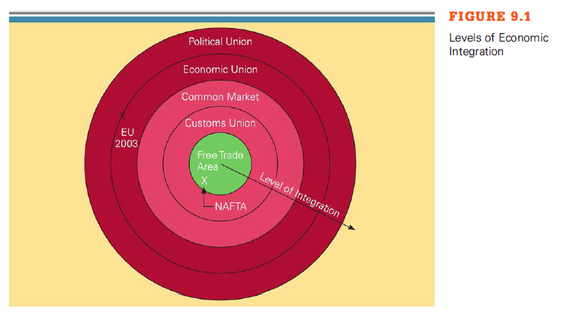
Levels of Economic Integration

Slide 9
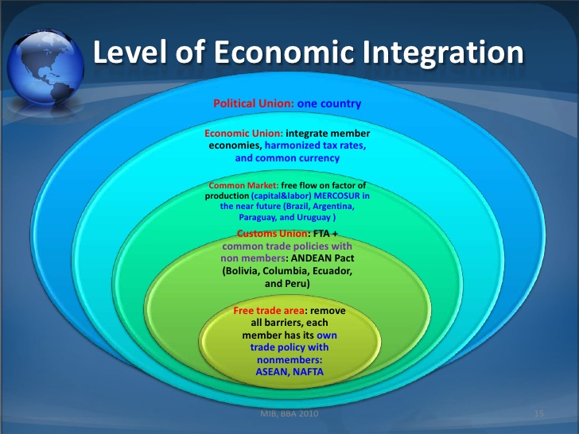

Slide 10
Levels of Economic Integration
Free Trade Area (FTA):
removes tariffs among members
members retain own trade policies toward others
Customs Union (CU): FTA+
common trade policy toward others
Common Market (CM): CU+
eliminates intra-market factor of production movements
Economic Union (EU): CM+
full integration of member economies (common policy)
Political Union: EU+
political and economic integration

Slide 11
Levels of Regional Economic Integration
Free Trade Area: Eliminates all barriers to the trade of goods and services among member countries.
removes tariffs among members.
members keep own trade policies toward others.
European Free Trade Association (EFTA) - Norway, Iceland, Liechtenstein, and Switzerland
North American Free Trade Agreement (NAFTA) - USA, Canada, and Mexico

Slide 12
Levels of Regional Economic Integration
Customs Union: Eliminates trade barriers between member countries, and adopts a common external trade policy.
Andean Community (Bolivia, Columbia, Ecuador, and Peru).
Common Market : has no barriers to trade between member countries, a common external trade policy, and the free movement of the factors of production.
Gulf Cooperation Council (GCC)

Slide 13
Levels Of Regional Economic Integration
Economic Union :
An economic union entails even closer economic integration and cooperation than a common market.
Like the common market, an economic union involves the free flow of products and factors of production between members, a common external trade policy, a common currency, a harmonized tax rate, and a common monetary and fiscal policy.
European Union (EU)
Mercosur, the South American grouping of Argentina, Brazil, Paraguay, and Uruguay
Notes:
The European Union (EU) is an economic union, although an imperfect one since not all members of the EU have adopted the euro, and differences in tax rates across countries still remain

Slide 14
Levels of Regional Economic Integration
Political Union :
The move toward economic union raises the issue of how to make a coordinating bureaucracy accountable to the citizens of member nations.
Political union in which a central political apparatus [structure/framework] coordinates the economic, social, and foreign policy of the member states.
The EU is on the road toward at least partial political union
The United States provides an example of even closer political union; in the United States, independent states are effectively combined into a single nation
Ultimately, the EU may move toward a similar federal structure.

Slide 15
Regional Economic Integration in Europe

Slide 16
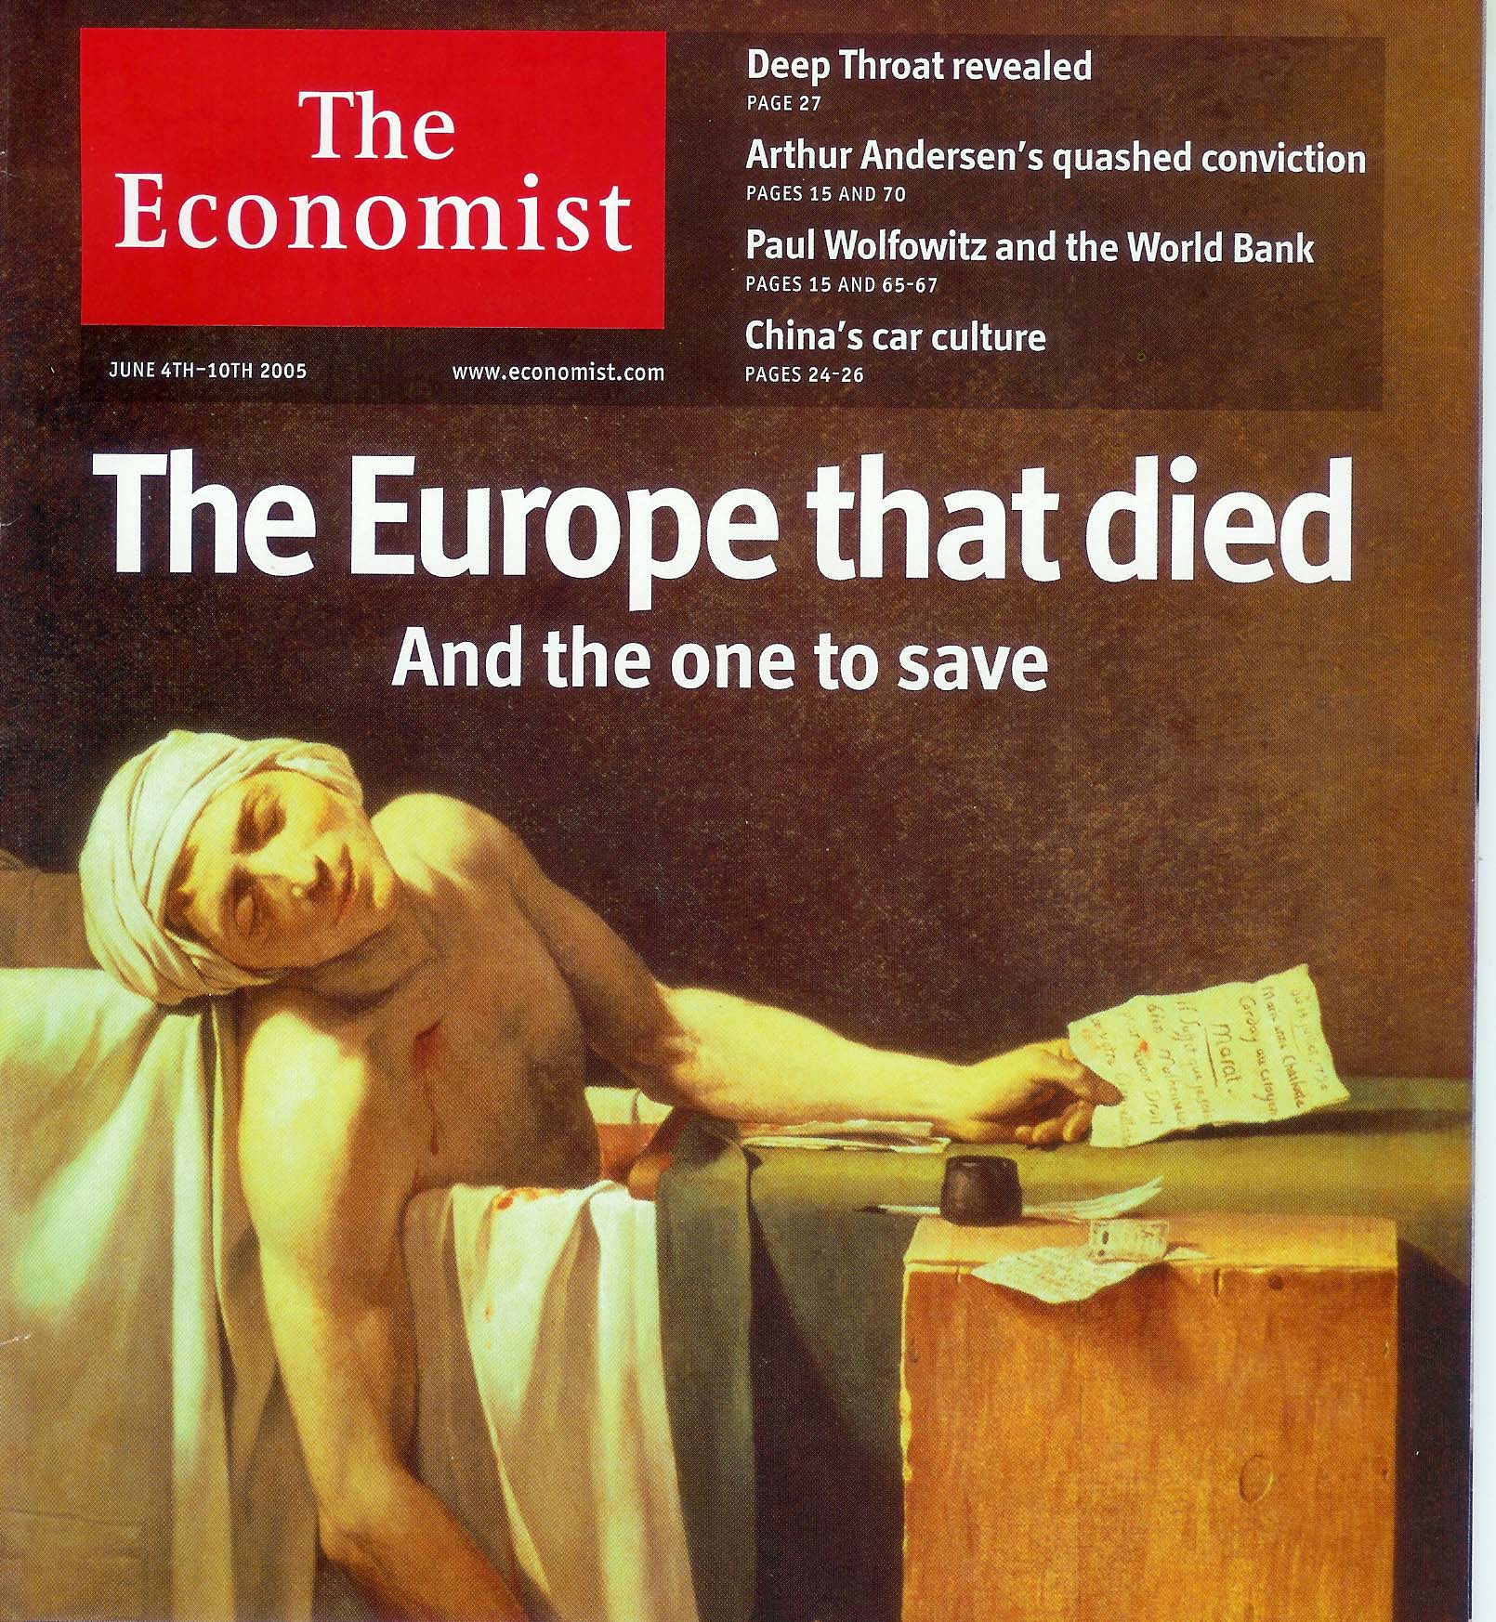

Slide 17
Regional Economic Integration in Europe
What is the Status of Regional Economic Integration In Europe?
Europe has two trade blocs:
The European Union (EU) with 27 members
The European Free Trade Area (EFTA) with 4 members Iceland, Liechtenstein, Norway, Switzerland
The EU is seen as the world’s next economic and political superpower
Notes:
LO4: Explain the history, current scope, and future prospects of the world’s most important regional economic agreements.

Slide 18
European Union (EU)
Pop: 485 million
GDP: $9.5 trillion
Members: 27
Economic Union
Began: 1951

Slide 19
Political Structure of The European Union
What Is The Political Structure of The European Union?
The main institutions in the EU include:
The European Council - the ultimate controlling authority within the EU.
The European Commission - responsible for recommending EU legislation, implementing it, and monitoring compliance with EU laws by member states
The European Parliament - debates legislation proposed by the commission and forwarded to it by the council.
The European Court of Justice.
Notes:
Management Focus: The European Commission and Media Industry Mergers explores the efforts of the European Commission to influence the strategies of media companies as they joined forces in Europe. The European Commission, concerned that proposed joint ventures and mergers between companies would negatively affect competition within the industry, demanded that some companies alter their plans to work together, and indeed abandon relationships all together. Discussion of the feature can begin with the following questions.

Slide 20
The Status of Economic Integration In The Americas
What Is The Status of Economic Integration In The Americas?
The most significant attempt is the North American Free Trade Agreement (NAFTA)
NAFTA : an agreement that came into effect in January 1994 between the US, Canada, and Mexico to remove barriers to trade between the three countries over a ten-year period
In addition to NAFTA, several other trade blocs are in the offing in the Americas, the most significant of which appear to be the Andean Community (Bolivia, Columbia, Ecuador, and Peru) and Mercosur (Argentina, Brazil, Paraguay, and Uruguay)
Notes:
LO4: Explain the history, current scope, and future prospects of the world’s most important regional economic agreements.

Slide 21
North American Free Trade Agreement [NAFTA]
Pop: 420 million
GDP: $12 trillion
Members: 3
Free-Trade Area
Began: 1994

Slide 22
The Status of Economic Integration In The Americas
Benefits of NAFTA :
Eliminated tariffs on 99% of the goods traded among members.
Removed barriers on the cross-border flow of services.
Protects intellectual property rights.
Removes most restrictions on FDI between members.
Allows each country to apply its own environmental standards.
Notes:
LO4: Explain the history, current scope, and future prospects of the world’s most important regional economic agreements.

Slide 23
The Andean Community
What Is The Andean Community?
The Andean Pact : A trade association formed in 1969 by the South American countries of Bolivia, Columbia, Ecuador, and Peru that aimed to develop industry in the area
formed in 1969 using the EU model,but was far less successful at achieving its stated goals.
was re-launched in 1990, and now operates as a customs union
renamed the Andean Community in 1997.
[Notes: Andean culture is a collective term used to refer to the indigenous peoples of the Andes mountains especially those that came under the influence of the Inca Empire]
Notes:
LO4: Explain the history, current scope, and future prospects of the world’s most important regional economic agreements.
Notes: Andean culture is a collective term used to refer to the indigenous peoples of the Andes mountains especially those that came under the influence of the Inca Empire

Slide 24
Andean Community
Internal tariff reduction
Common external tariff
Common transport policies
Impaired by ideological conflict
Pop: 97 million
GDP: $216 billion
Members: 4
Customs Union
Began: 1969

Slide 25
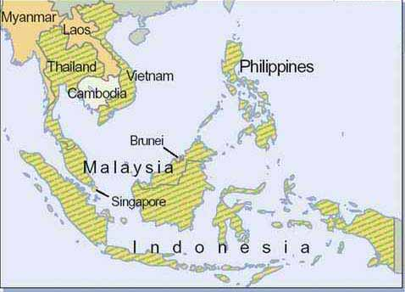
Association of Southeast Asian Nations [ASEAN]
ASEAN
1. Economic, social, and cultural development
2. Safeguard economic and political stability
3. Serve as a forum to resolve disputes
Pop: 500 million
GDP: $740 billion
Members: 10
General Cooperation
Began: 1967

Slide 26
Association of Southeast Asian Nations [ASEAN]
Formed in 1967. the Association of Southeast Asian Nations (ASEAN) includes Brunei, Cambodia, Indonesia, Laos, Malaysia, Myanmar, Philippines, Singapore, Thailand, and Vietnam.
The basic objective of ASEAN is to foster freer trade among member countries and to achieve cooperation in their industrial policies.

Slide 27
Asia-Pacific Economic Cooperation (APEC)
The Asia-Pacific Economic Cooperation (APEC) was founded in 1990 at the suggestion of Australia.
APEC currently has 21 member states, including such economic powerhouses as the United States, Japan, and China.
Collectively, the member states account for about 55 % of the world's GNP, 49 % of world trade, and much of the growth in the world economy.
The stated aim of APEC is to increase multilateral cooperation in view of the economic rise of the Pacific nations and the growing interdependence within the region.

Slide 28
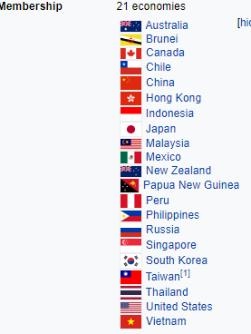
Asia-Pacific Economic Cooperation (APEC)

Slide 29
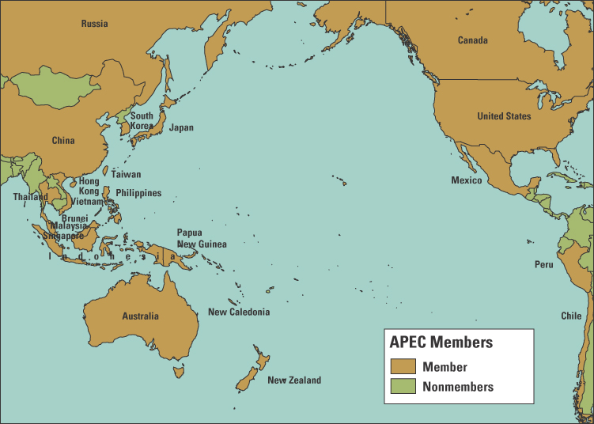

Slide 30
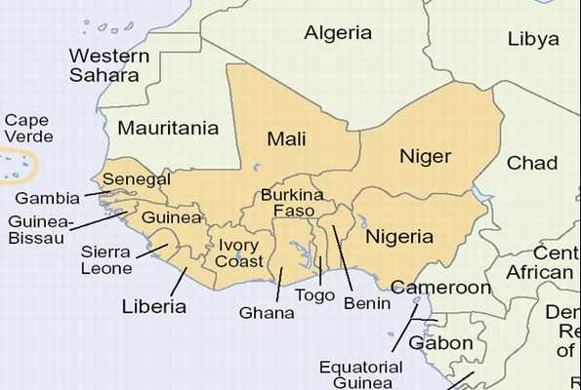
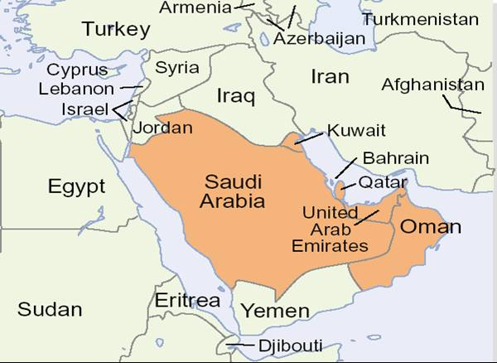
Middle East and Africa
Gulf Cooperation Council
(GCC)
Six Arab nations (1980)
Economic and political aims
Free travel; property rights
Economic Community of
West African States
(ECOWAS)
Common market hopes (1975)
Little progress to date

Slide 31
Impediments to Integration
Despite the strong economic and political arguments in support, integration has never been easy to achieve or sustain for two main reasons.
First, although economic integration aids the majority, it has its costs.
While a nation as a whole may benefit significantly from a regional free trade agreement, certain groups may lose.
A second impediment [barrier] to integration arises from concerns over national sovereignty
Concerns about national sovereignty arise because close economic integration demands that countries give up some degree of control over such key issues as monetary policy, fiscal policy (e.g., tax policy), and trade policy.

Slide 32
Implications for Managers
What Does Economic Integration Mean For Managers?
Regional Economic Integration:
opens new markets.
allows firms to realize cost economies by centralizing production in those locations where the mix of factor costs and skills is the best
But
within each grouping, the business environment becomes competitive.
Notes:
LO5: Understand the implications for businesses that are inherent in regional economic integration agreements.

Slide 33
Implications for Managers
Opportunities
Less protectionism; higher economic growth
Lower cost of doing business (fewer borders)
Threats
Cultural differences persist
Increased price competition within blocks
Across-trading-block rivalry can increase barriers
Improvement of competitiveness of many local firm within the blocks

Slide 34
Case
Case 08: The Push toward Free Trade in Africa (Page no. 281-282)

Slide 35
Classroom Assessment Techniques (CATs): The Minute Paper
1. What are the two [three, four, five] most significant [central, useful, meaningful, surprising, disturbing] things you have learned during this session?

Slide 36
Classroom Assessment Techniques (CATs) : The Muddiest points
2. What has been the “muddiest” [most unclear or most confusing] point so far in this session? That is, what topic remains the least clear to you?

Slide 37
Acknowledgement and Thanks
Book: International Business: Competing in the Global Marketplace
Author : Charles W. L. Hill
Published by McGraw-Hill/Irwin,

