Slide 1

Summer Air-Conditioning Cycle
Dr Hassan Hassoon ALDelfi
Sustainability and Human Response
INDS 328
Semester 2
Week 5
Date

Slide 2
Outline
Know the principles of air-conditioning to achieve thermal comfort
Indicating the air states on the psychrometric chart.
Draw the summer cycle

Slide 3
objectives
After completion this lecture student is able to:
1-Locate air state points on the chart
2-fix the air mixing point tm
3- draw the processes on due to humidifying coil.
4-complete the summer cycle using Room ratio line from protractor
5- fix the room air supply point ts

Slide 4
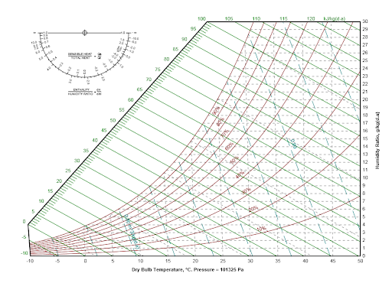
Chart for use

Slide 5
Examples of Psychrometric Calculations for Summer
Example 1. Summer Cycle
A room is to be maintained at 22ºC dry-bulb temperature, 50% saturation, when the sensible heat gain is 10.8 kW in summer.
The latent heat gain is 7.2 kW.
Determine the cooling coil and reheater outputs required by using a psychrometric chart if the plant schematic is as shown below.
DATA: Outdoor condition is 28ºC, 80% saturation. The outdoor air and recirculated air ratio is 20%/80%. The Apparatus Dew Point ADP is 8ºC Neglect the cooling coil contact factor.

Slide 6
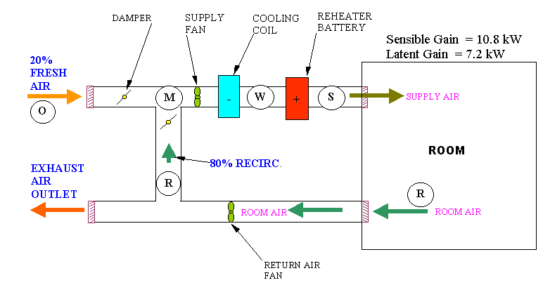
Example 1. Summer Cycle

Slide 7
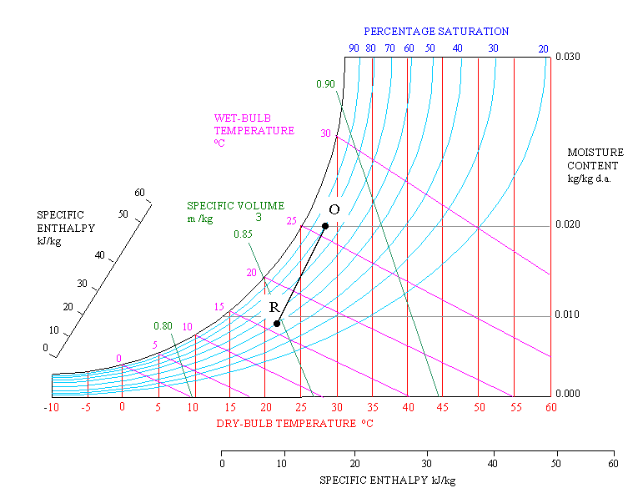
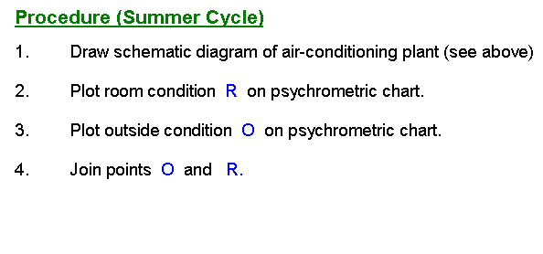
Procedure Summer Cycle

Slide 8
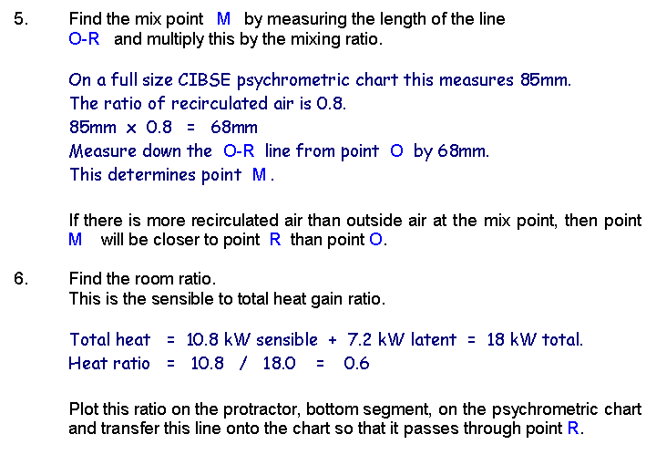
Procedure Summer Cycle

Slide 9
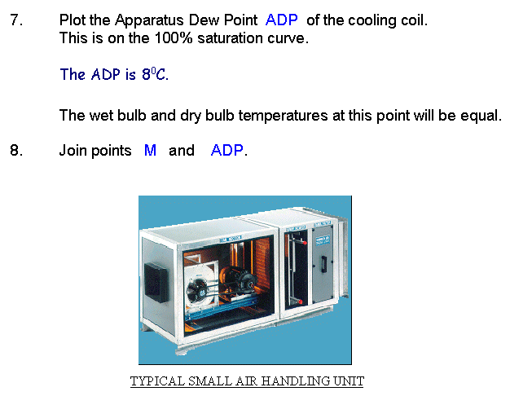
Procedure Summer Cycle

Slide 10
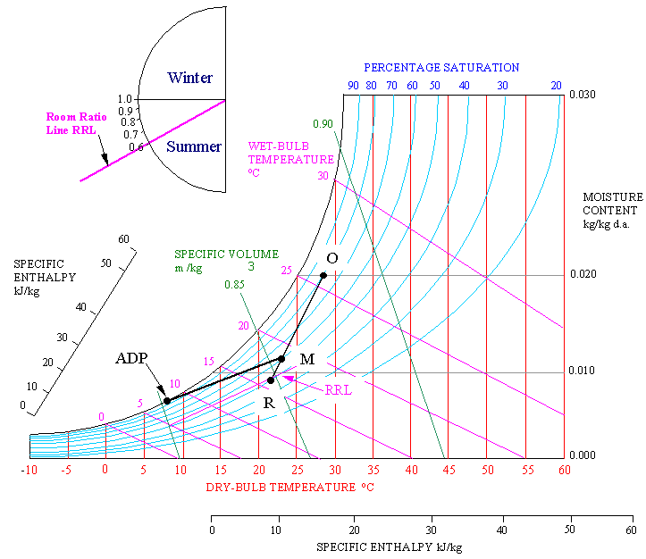
Using Protractor-Procedure Summer Cycle

Slide 11
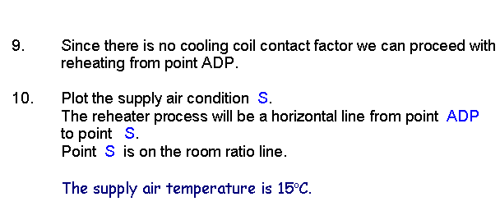
Procedure Summer Cycle

Slide 12
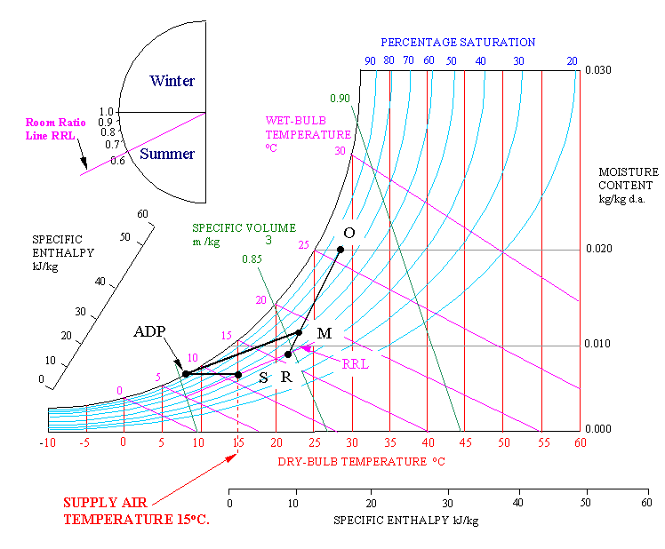
Finding Supply air Temperature ts- Using Room Ratio Line

Slide 13
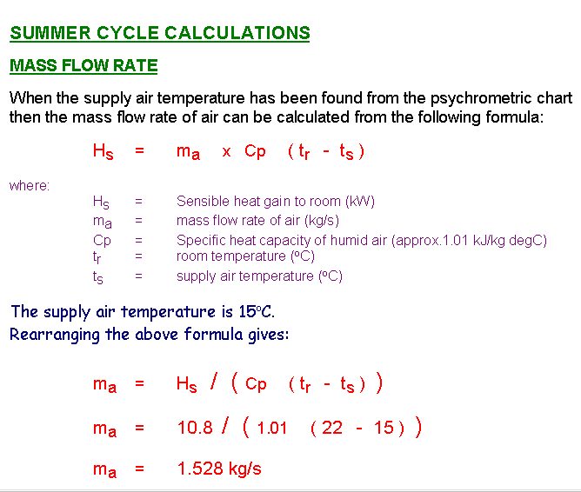
Summer cycle calculation- air mass flow rate to room …..ma

Slide 14
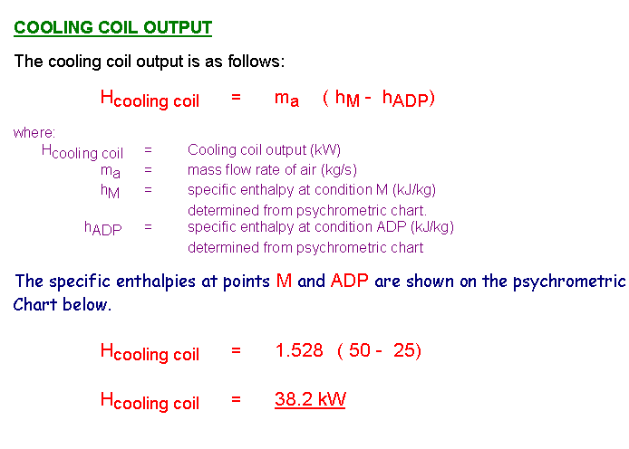
Cooling coil output

Slide 15
Note:
The cooling coil output of 38.2 kW is a much higher value than the sensible heat gain of 10.8 kW.
It should be remembered that the difference is these two values is mostly from the fresh air cooling load.
It takes quite a lot of energy in summer to cool fresh air coming into air handling units.
This can be minimised by bringing in minimum fresh air but not too little otherwise the building will suffer from lack of oxygen and feel stuffy.
Sometimes mistakes are made when sizing cooling apparatus.
If a cooling coil or indoor cooling unit is sized on the sensible heat gain only without allowing for fresh air load then it will be grossly undersized.
That is why psychrometric charts are required to calculate cooling coil output including fresh air loads.

Slide 16
So, don’t size cooling coil and indoor cooling units on sensible heat gain only if there is fresh air coming into the plant.
Size these items of plant using a psychrometric chart.

Slide 17
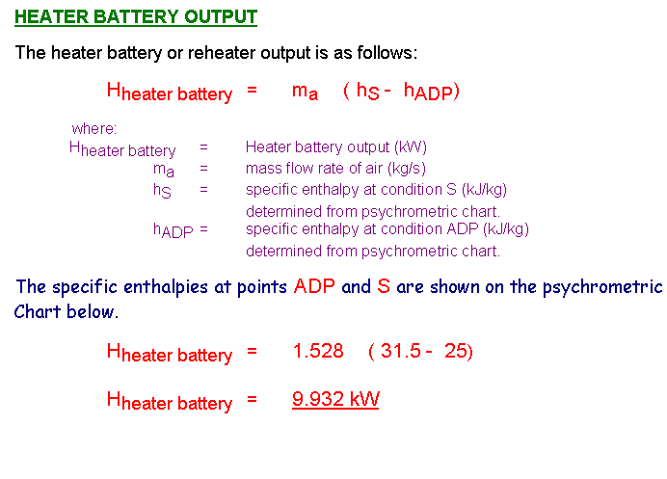
HEATER OUTPUT

Slide 18
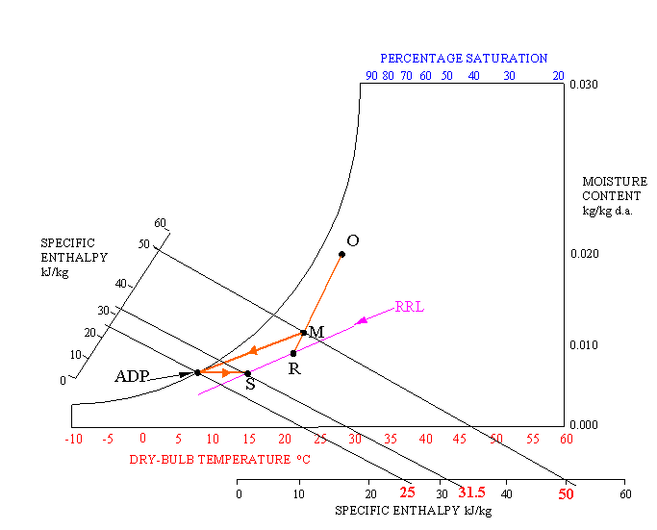
SUMMER CYCLE COMPLETEION

