Slide 1
Animal Structure and Function
(Part 2)

Slide 2
Objectives
1. Introduce fundamental anatomical terms to enable precise communication in describing human body structures.
2. Explain the hierarchical organization of the human body from atoms to systems, emphasizing the importance of anatomical terminology in scientific discourse.
3. Encourage application of anatomical terminology through practical exercises and case studies, fostering critical thinking and problem-solving skills in biomedical contexts.

Slide 3
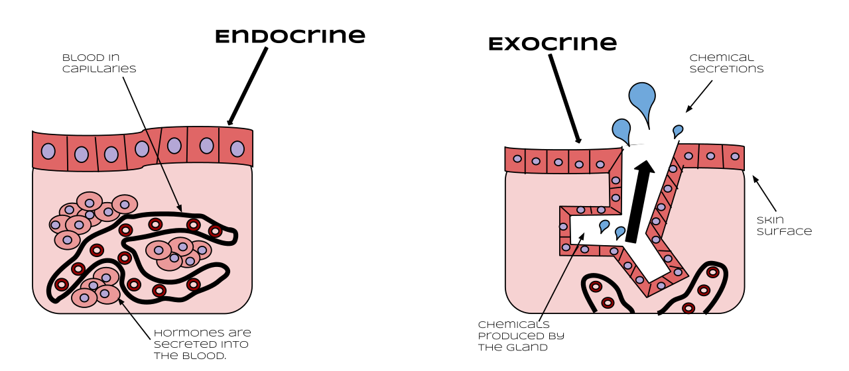
Endocrine gland: The gland that secretes hormones into the surrounding interstitial fluid, which then diffuse into blood and are carried to various organs and tissues within the body
Exocrine glands: Glands that secrete chemicals through ducts that lead outside the gland (not to the blood).

Slide 4
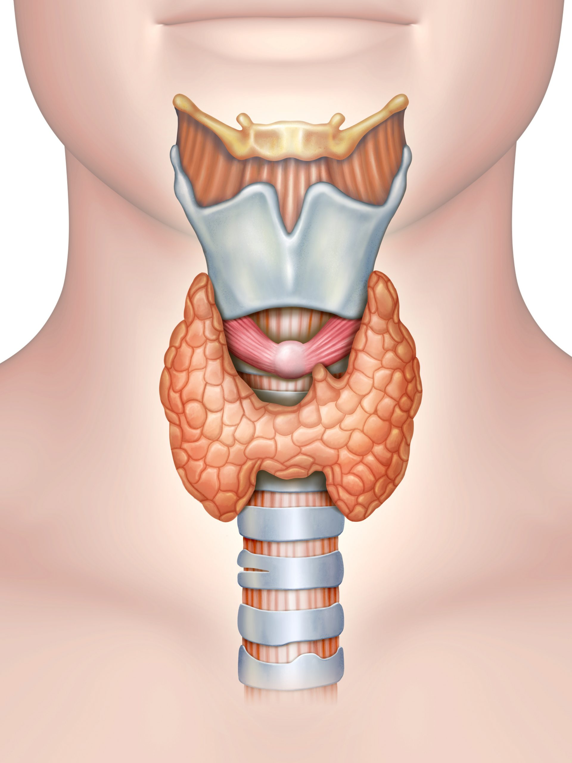
Thyroid gland: An endocrine gland located in the neck that produces thyroid hormones
Hypothyroidism: also called underactive thyroid, is when the thyroid gland doesn't make enough thyroid hormones to meet your body's needs.
Hyperthyroidism: also called overactive thyroid, is when the thyroid gland makes more thyroid hormones than your body needs.

Slide 5
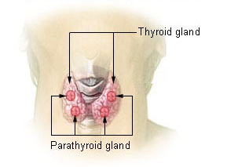
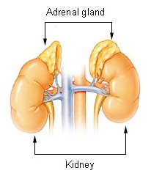
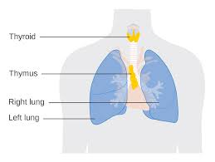
Parathyroid gland: The gland located on the surface of the thyroid that produces parathyroid hormone
Adrenal gland: The endocrine gland associated with the kidneys
Thymus: The gland located behind the sternum that produces thymosin hormones that contribute to the development of the immune system

Slide 6
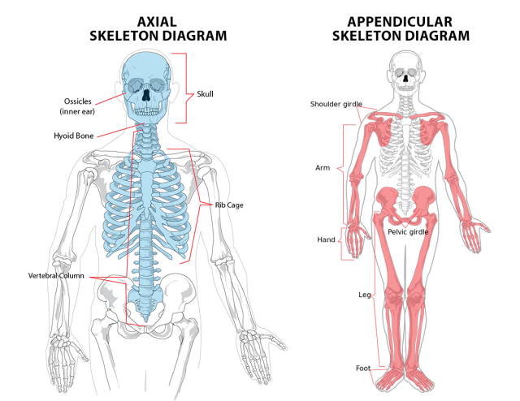
Axial skeleton: Skeleton that forms the central axis of the body and includes the bones of the skull, the ossicles of the middle ear, the hyoid bone of the throat, the vertebral column, and the thoracic cage (ribcage)
Appendicular skeleton: Composed of the bones of the upper and lower limbs.
Pectoral girdle: Consists of the clavicle and the scapula and attaches each upper limb to the axial skeleton.
Pelvic girdle: is formed by the hip bone which serves as the attachment point for each lower limb.

Slide 7
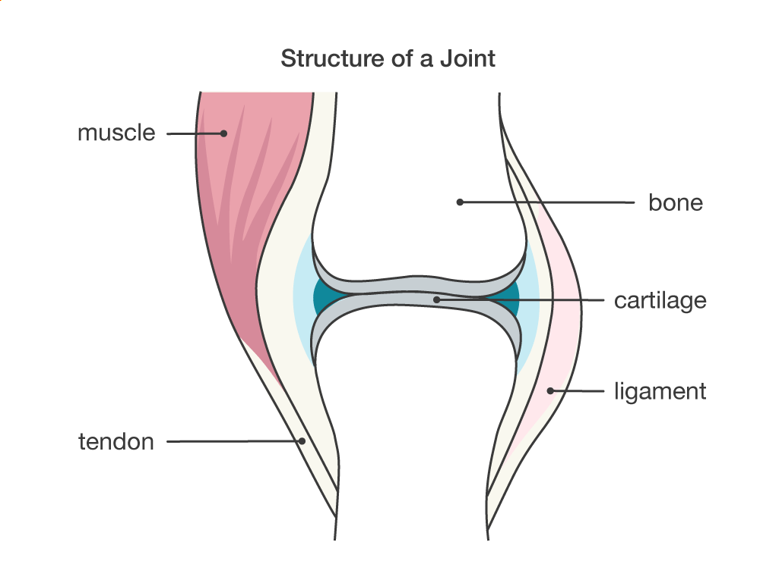
Joint: The point at which two or more bones meet
Cartilage: The tough but flexible tissue that covers the ends of bones at a joint.
Ligament: The fibrous connective tissue that connects bones to other bones.
Tendon: A fibrous connective tissue that attaches muscle to bone.

Slide 8
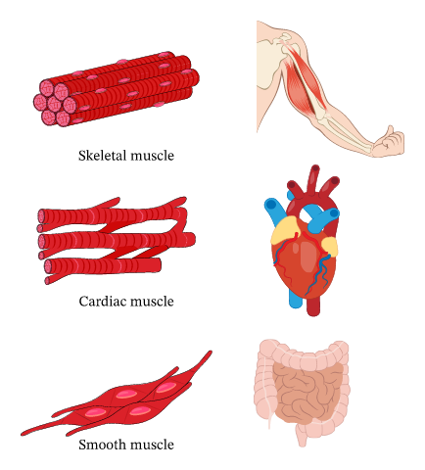
Cardiac muscle: The muscle tissue found only in the heart
Smooth muscle: The muscle that occurs in the walls of hollow organs such as the intestines, stomach, and urinary bladder, and around passages such as the respiratory tract and blood vessels
Skeletal muscle: The muscles that attach to bones and control locomotion and any movement that can be consciously controlled

Slide 9
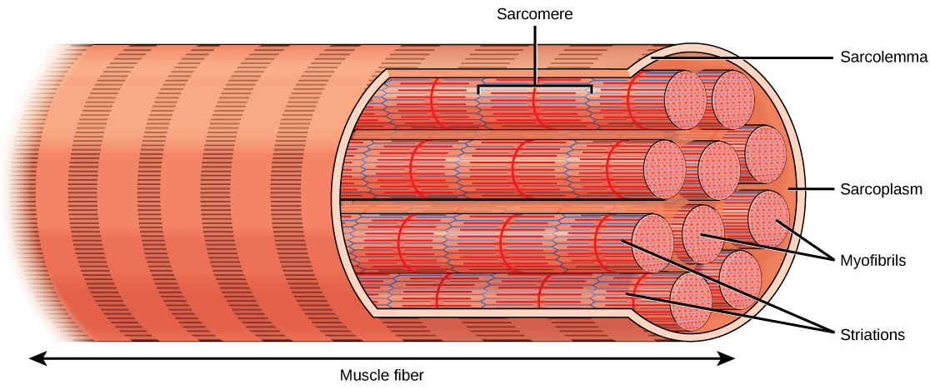
Myofibril: The long cylindrical structures that lie parallel to the muscle fiber
Myofilament: The small structures that make up myofibrils
Sarcolemma: The plasma membrane of a skeletal muscle fiber
Sarcomere: The unit of contraction in a muscle cell.

Slide 10
Neurons: Specialized cells that can receive and transmit chemical or electrical signals
Glia cells: non-neuronal cells that provide support functions for the neurons.
Soma: The cell body of a neuron, which contains the nucleus and various other organelles.
Dendrite: A structure that extends away from the cell body to receive messages from other neurons
Synapse: A junction between two neurons where neuronal signals are communicated
Axon: The part of the neuron that carries impulses away from the cell body.
Myelin sheath: A cellular extension containing a fatty substance produced by glia that surrounds and insulates axons

Slide 11
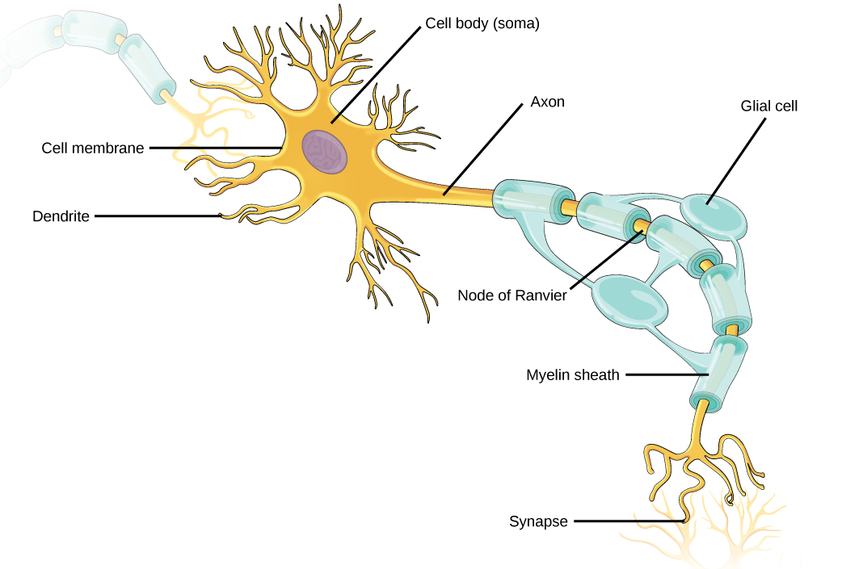

Slide 12
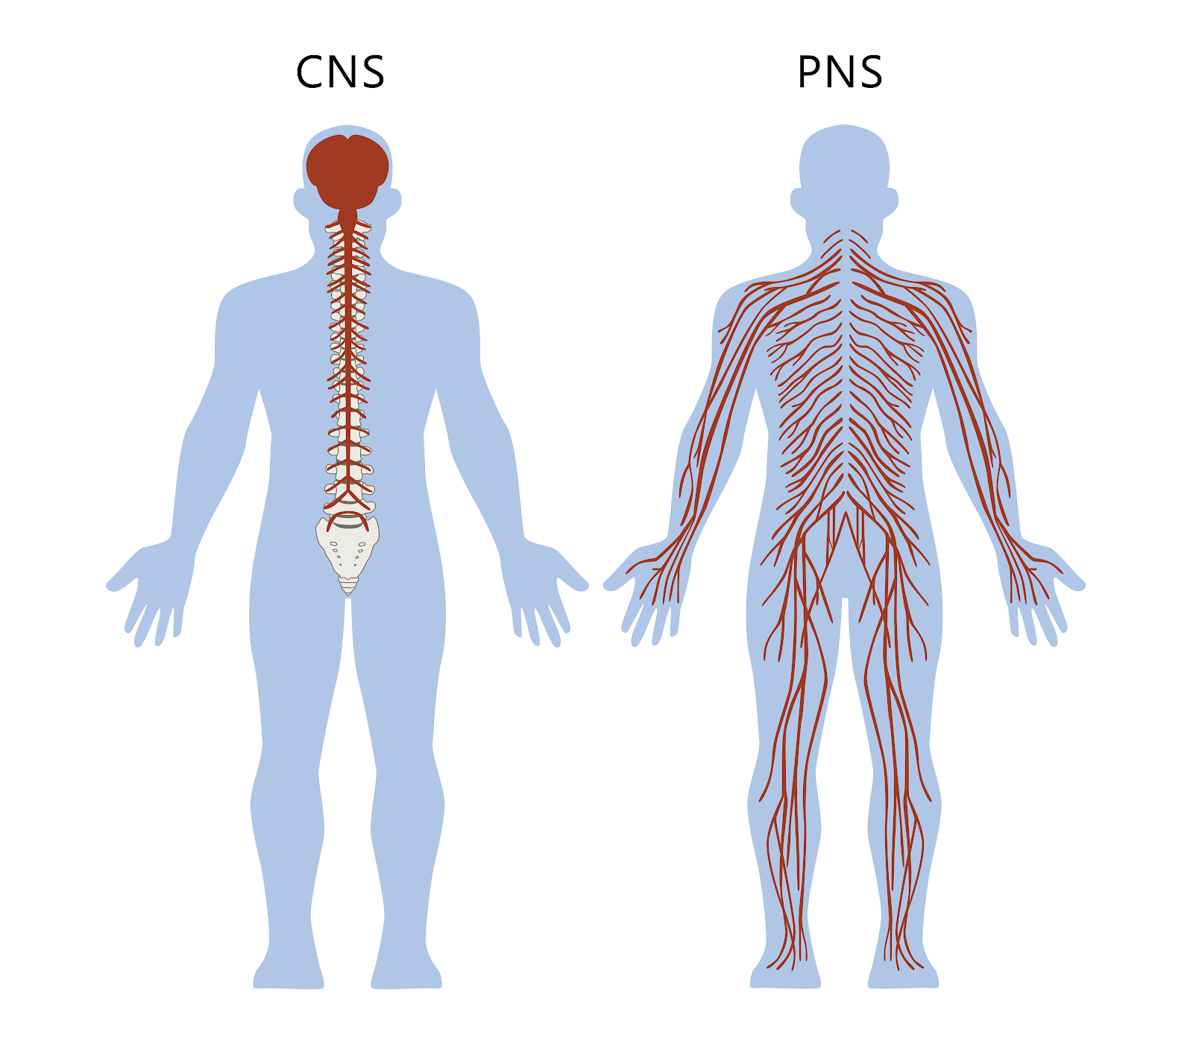
CNS: The Central Nervous System – made up of the brain and spinal cord
PNS: The Peripheral Nervous System – made up of all of the nerves that branch out from the brain and spinal cord and extend to other parts of the body
CSF: Cerebrospinal Fluid - a clear fluid that surrounds the brain and spinal cord.

Slide 13
Assessment
Define the following with your partner:
  Joint
  Cartilage
  Tendon
  Ligament
  Explain the following:
    CNS
    PNS
    CSF

Slide 14
References
Scientific Writing and Communication: Papers, Proposals, and Presentations" by Angelika H. Hofmann.
Writing for Science and Engineering: Papers, Presentations and Reports" by Heather Silyn-Roberts.

