Slide 1

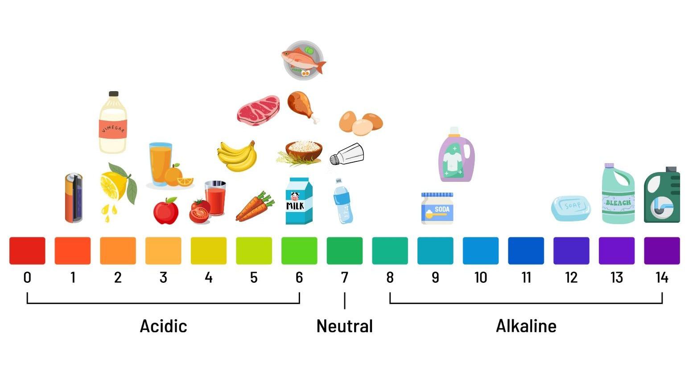
Tishk International University Nutrition and Diet Department Principles of Food Science I
Principles of Food Science Practical
1st Grade
Food pH and Acidity /3rdLab
Assistant Lecturer: Pary Ameer Arsalan

Slide 2
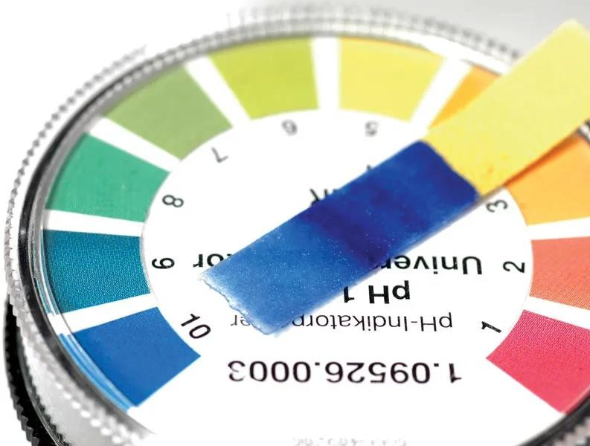
Objectives
pH in Food
pH Determination Methods
Impact of pH on Food Preservation
Acid-Base reactions in Food science
Health Implications

Slide 3
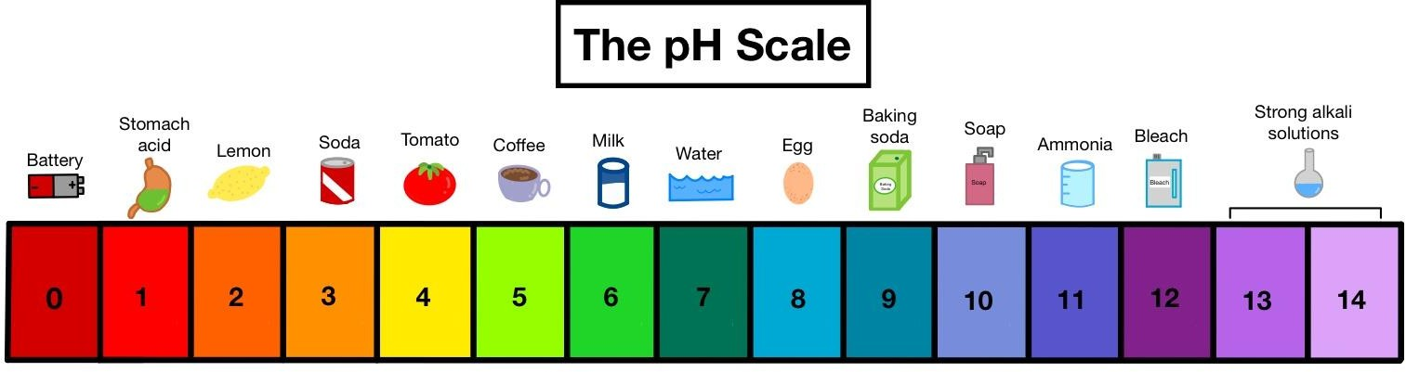
Definition of pH and its measurement scale
pH is a measure of how acidic or basic a solution is, on a scale of 0 to 14.
A pH level of 7 is considered neutral, values below 7 indicate acidity, and values above 7 indicate alkalinity.

Slide 4
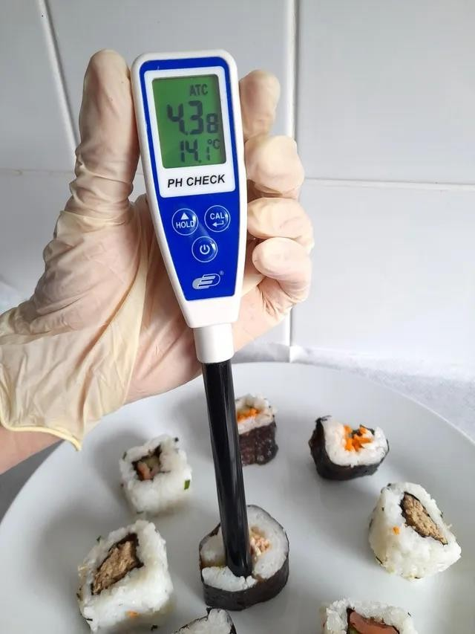
Acidity in Foods
Types of acids commonly found in food (e.g., citric, acetic, lactic)
Common food acids include citric acid in citrus fruits, acetic acid in vinegar, and lactic acid in fermented foods.
These acids contribute to the overall flavor and preservation of food.
Role of acidity in taste and flavor profiling
Acidity enhances flavor and can balance sweetness in food products. It also plays a significant role in how we perceive taste, with different acids providing unique flavor notes.
Geographical and seasonal variations in acidity levels
Acidity levels can vary based on the geographical origin of a food product and seasonal changes.
For example, tomatoes grown in different soils may have different
acidity levels.

Slide 5

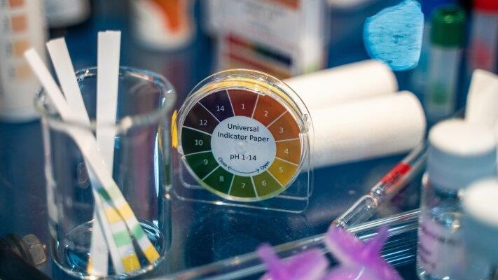
Methods of pH Determination
Common methods for measuring pH in food products:
(e.g., pH meters, litmus tests)
pH meters are popular for their accuracy, while litmus tests provide a quick indication of acidity through color changes.
Both methods have their specific applications in food testing.

Slide 6
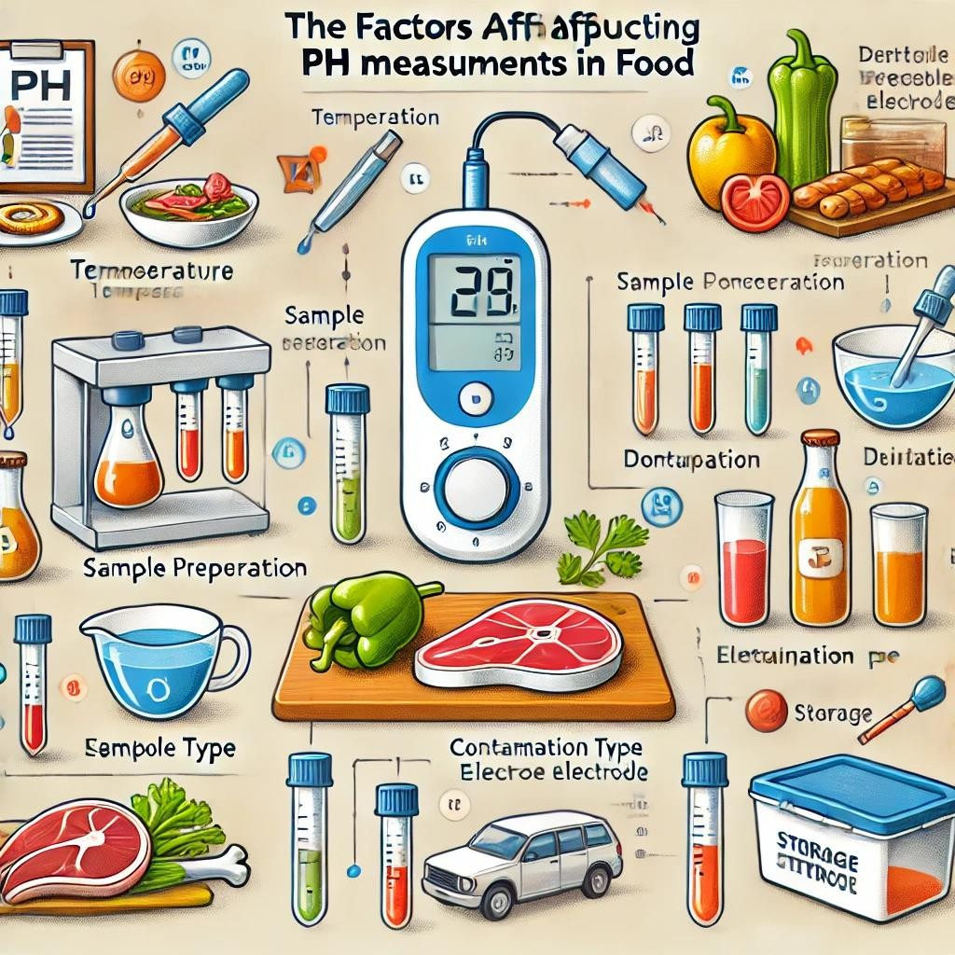
Factors affecting pH measurements
Factors such as temperature, the presence of dissolved salts, and the freshness of the sample can affect pH readings.
Ensuring consistent measurement conditions is vital for reliability.
Laboratory versus field testing techniques
Laboratory methods generally provide more accurate results, while field tests are quicker and suitable.
Choosing the appropriate method depends on the context of testing.

Slide 7

Impact of pH on Food Preservation
Most bacteria prefer neutral pH levels. Lowering pH can inhibit microbial growth, thus enhancing the shelf life of food products.
Role of acidity in preservation methods (pickling, fermentation)
Acidity in methods like pickling and fermentation plays a central role in food preservation by creating an environment that is unfavorable for spoilage organisms.
Examples of pH-sensitive foods and their shelf stability
Foods like dairy products, meats, and certain fruits are pH-sensitive. For instance, high-acid foods typicaly have longer shelf stability compared to low-acid foods.

Slide 8
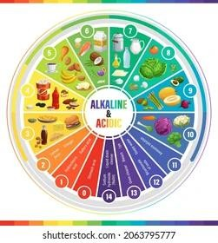
pH in Different Food Products
Comparison of pH levels in various foods (vegetables, fruits, dairy,
meats)
pH levels vary widely across food categories: fruits generally range from 2 to 4, vegetables typically range from 4 to 6, dairy products average around 6 to 7, and meats can range from 5.5 to 6.
Specific case studies highlighting pH relevance in popular foods
For example, the pH of yogurt (around 4.5) contributes to its tangy flavor and ensures safety from pathogenic bacteria during storage.
Influence of processing techniques on food pH
Processing techniques such as heat treatment, fermentation, and chemical additives can alter the pH of food, influencing its safety, taste, and shelf life.

Slide 9
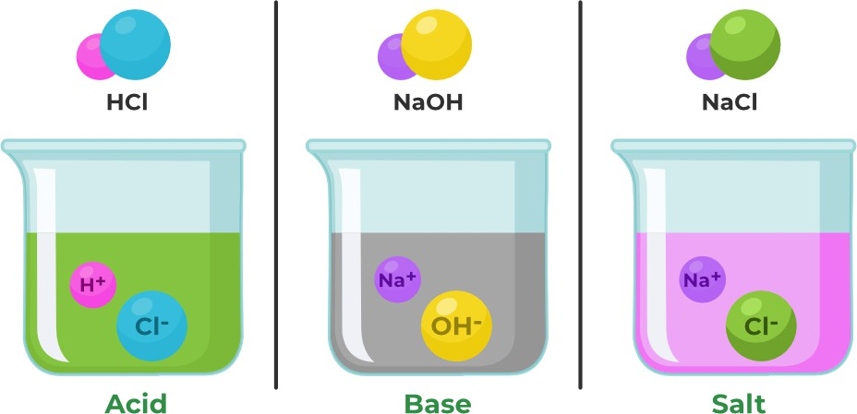
Acid-Base reactions in Food science
Understanding acid-base reactions in culinary applications
Acid-base reactions are crucial in cooking. For example, the reaction between baking soda (a base) and vinegar (an acid) produces carbon dioxide, which helps leaven baked goods.
How pH influences texture and color in food preparation
The pH can affect protein denaturation and pigment stability, influencing the texture of meats and the color of vegetables when cooked.
Examples: baking (baking soda and vinegar reactions)
When baking soda is mixed with an acidic ingredient, such as vinegar, the resultant carbon dioxide gas causes dough to rise, showcasing a practical application of acid-base chemistry in cooking.

Slide 10
Health Implications
Effects of dietary acids and bases on human health
The consumption of acidic or basic foods can influence metabolic processes, potentially
impacting overall health.
Role of balanced pH for digestive health
A balanced dietary pH is essential for optimal digestion. Extremely acidic or alkaline diets can lead to digestive issues and affect nutrient absorption.
Link between acidic diets and certain health conditions
High intake of acidic foods has been linked to conditions like acid reflux and gastrointestinal discomfort, emphasizing the need for pH balance in diet.

Slide 11
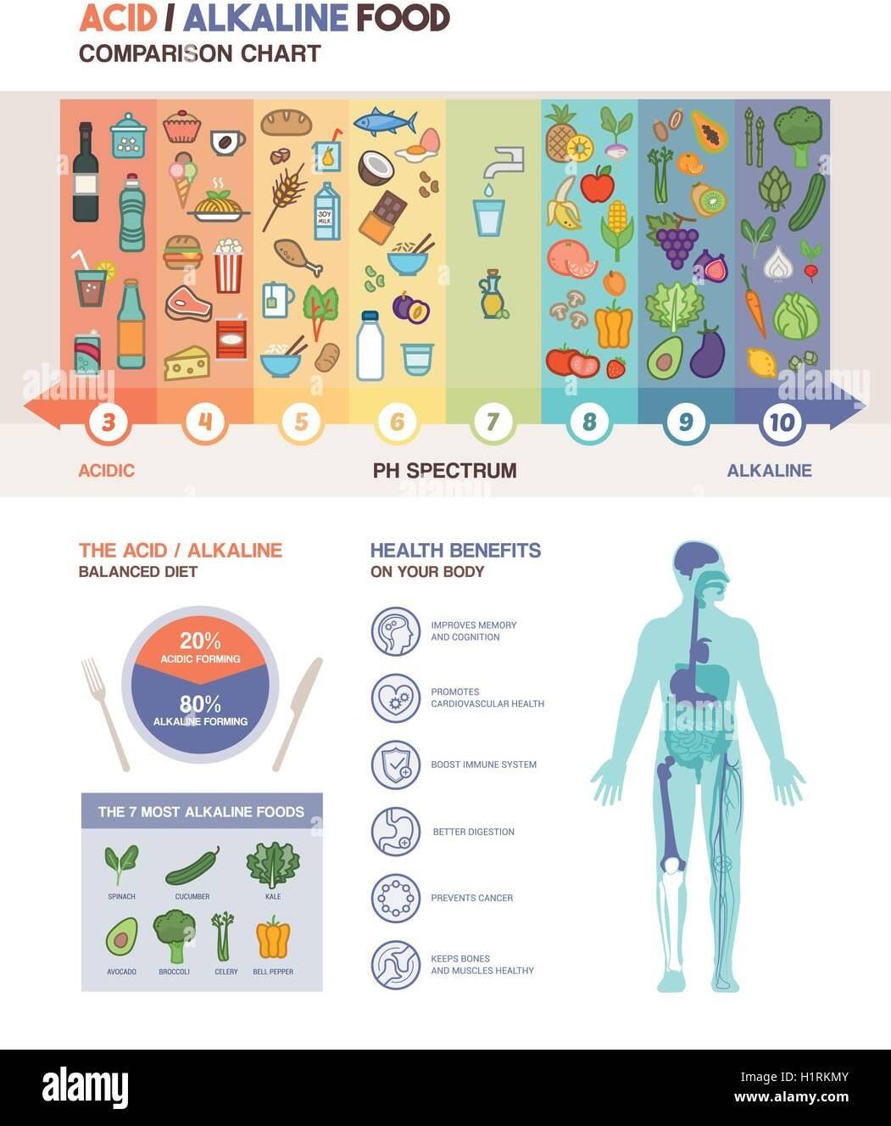

Slide 12
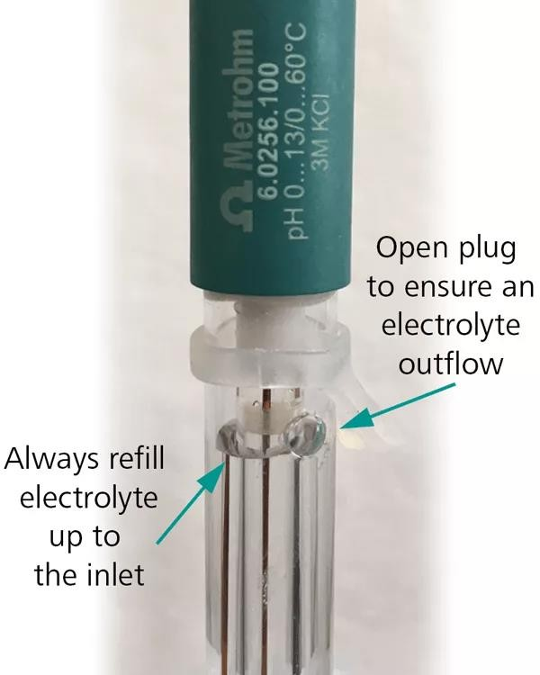
Procedure
Prepare the Equipment
Clean and calibrate the pH meter:
Steps:
Rinse the electrode with distilled water.
Calibrate the pH meter using standard buffer solutions (pH 4.0, 7.0, and/or 10.0).
Follow the manufacturer’s instructions.
Ensure the temperature compensation feature (if available) is adjusted.

Slide 13
2. Prepare the Food Sample
Liquids: Measure directly without dilution.
Semi-solids: Homogenize the sample (e.g., yogurt or sauces) to ensure consistency.
Solids:
Blend or crush the food into a slurry with a small amount of distilled water.
If the sample contains large particles or fibers, filter the mixture to obtain a smooth liquid.
Use a clean container for all sample preparations to avoid contamination.

Slide 14
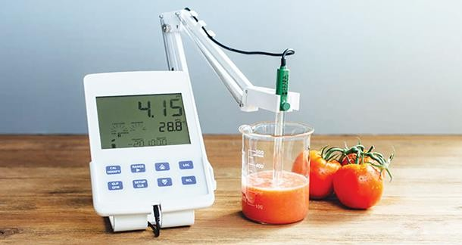
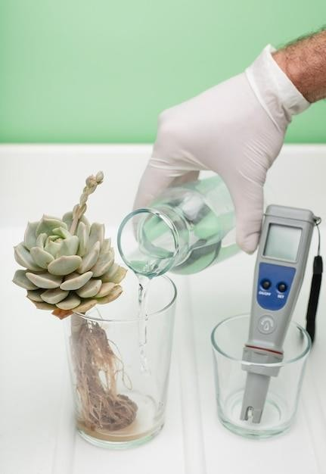

Slide 15
3. Measure the pH
Rinse the electrode with distilled water and gently blot it dry with tissue paper.
Immerse the electrode in the prepared food sample:
For liquids, submerge the electrode directly.
For semi-solid or solid samples, insert the electrode into the homogenized mixture or slurry.
Wait for the pH meter to stabilize. This may take a few seconds to minutes, depending on the device.
Record the pH value.

Slide 16
Rinse and Repeat
After each measurement, rinse the electrode with distilled water to avoid cross- contamination.
If multiple samples are being tested, clean the electrode thoroughly between samples.
Clean and Store the Equipment
Rinse the electrode with distilled water and place it in a storage solution or buffer solution, as recommended by the manufacturer.
Clean all tools and containers used during the procedure.

Slide 17
Procedure: Litmus Test
Take two strips of litmus paper: red litmus and blue litmus.
Pour a small amount of the test solution into a clean container.
Dip the blue litmus paper into the solution for 2–3 seconds and remove it.
Observe any change in color of the blue litmus paper.
Dip the red litmus paper into the solution for 2–3 seconds and remove it.
Observe any change in color of the red litmus paper.
Record the results:
If blue litmus turns red, the solution is acidic.
If red litmus turns blue, the solution is basic (alkaline).
If no color change occurs, the solution is neutral.

Slide 18
Observation
Sample | pH Measure

Slide 19

Q & A

