Slide 1

Introduction to Endocrinology
Zhikal O. Khudhur
Endocrinology BIO
Spring Semester
Week number: 1
Date: 2/ 2026

Slide 2

Objectives
Glands and types of glands
Endocrine system and target tissues
Endocrine glands
Chemistry of hormones
Endocrinology Terms.

Slide 3
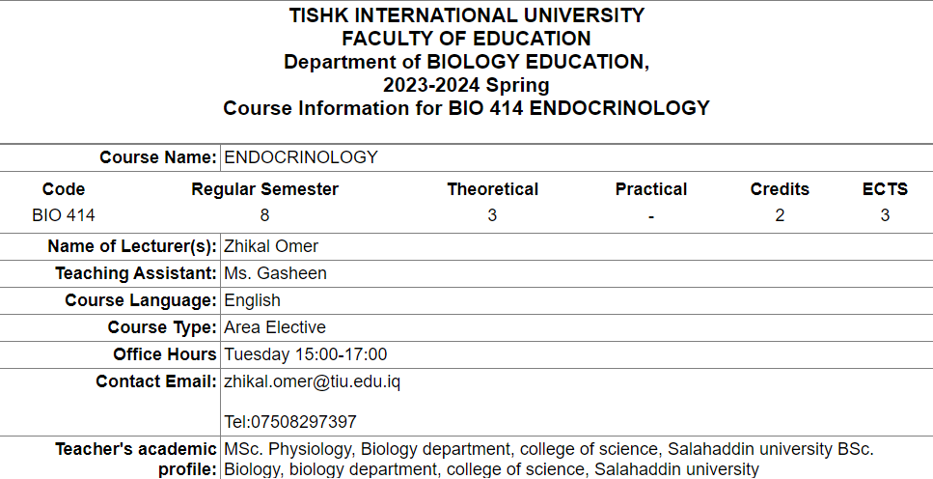

Slide 4
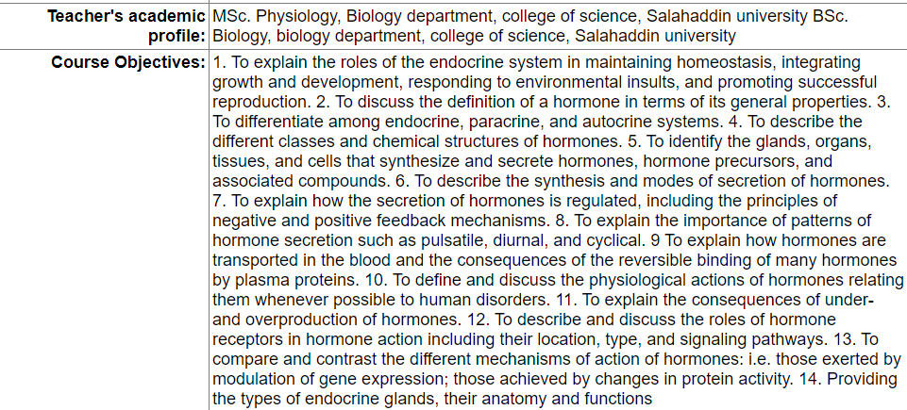

Slide 5
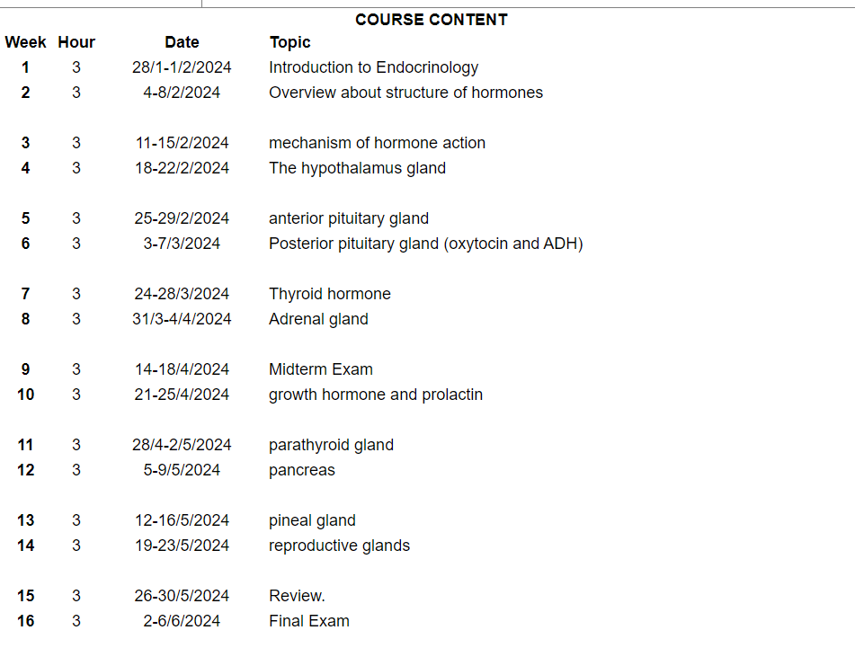

Slide 6
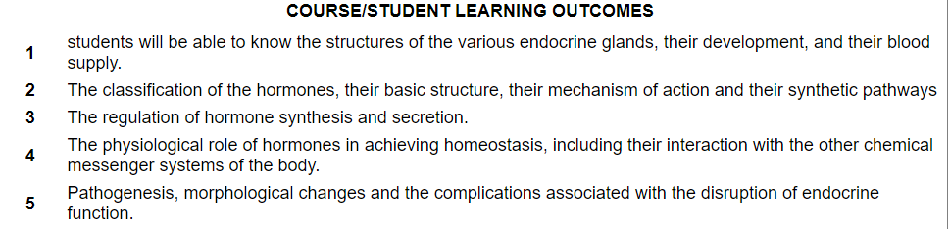

Slide 7
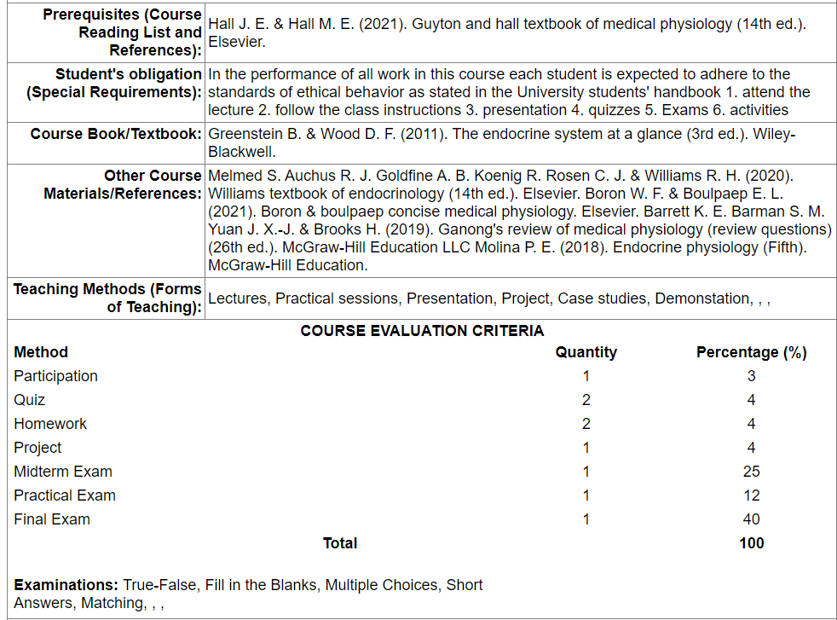

Slide 8
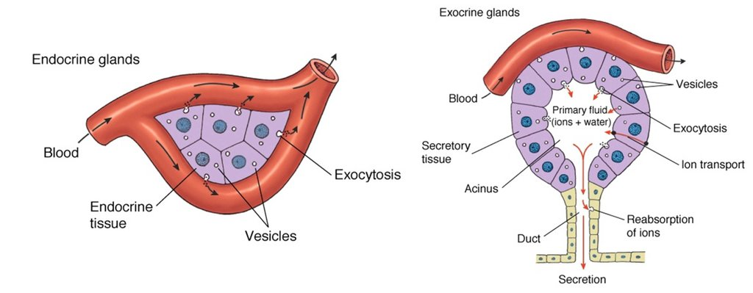
Types of glands
Gland: an organ that makes one or more substances, such as hormones, digestive juices, sweat, tears, saliva, or milk.
Exocrine glands: release their cellular secretions through a duct which empties to the outside or into the lumen (empty internal space) of an organ. These include sweat glands, salivary and pancreatic glands, and mammary glands. They are not considered a part of the endocrine system.
Endocrine glands: are ductless. This means that they do not have ducts to take their secretions to specific sites. Instead, hormones are secreted directly into capillaries and circulate in the blood throughout the body.

Slide 9
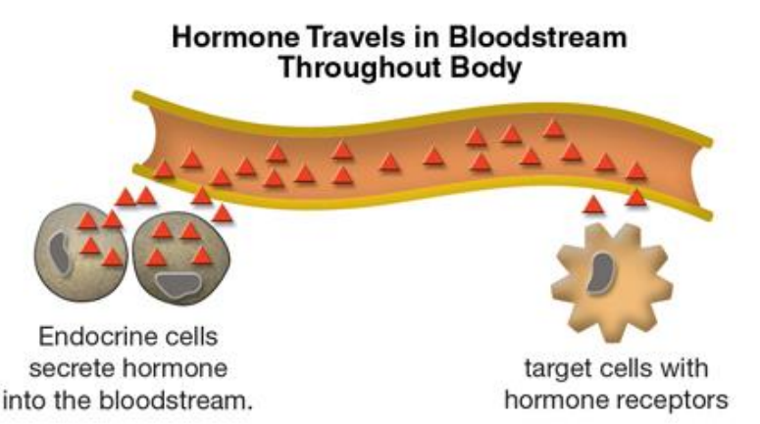
Endocrine system, hormones and target tissues
Endocrine system consists of endocrine glands that secrete chemicals called hormones and produces long-term responses.
Hormones are chemical messengers that stimulate specific cells or tissues into action.
Each hormone exerts very specific effects on certain organs, called target organs or target tissues
Receptor is a molecule inside or on the surface of a cell (target cell) that binds to hormone
Some hormones, such as insulin and thyroxine, have many target
organs. Other hormones, such as calcitonin and some pituitary gland
hormones, have only one or a few target organs.

Slide 10
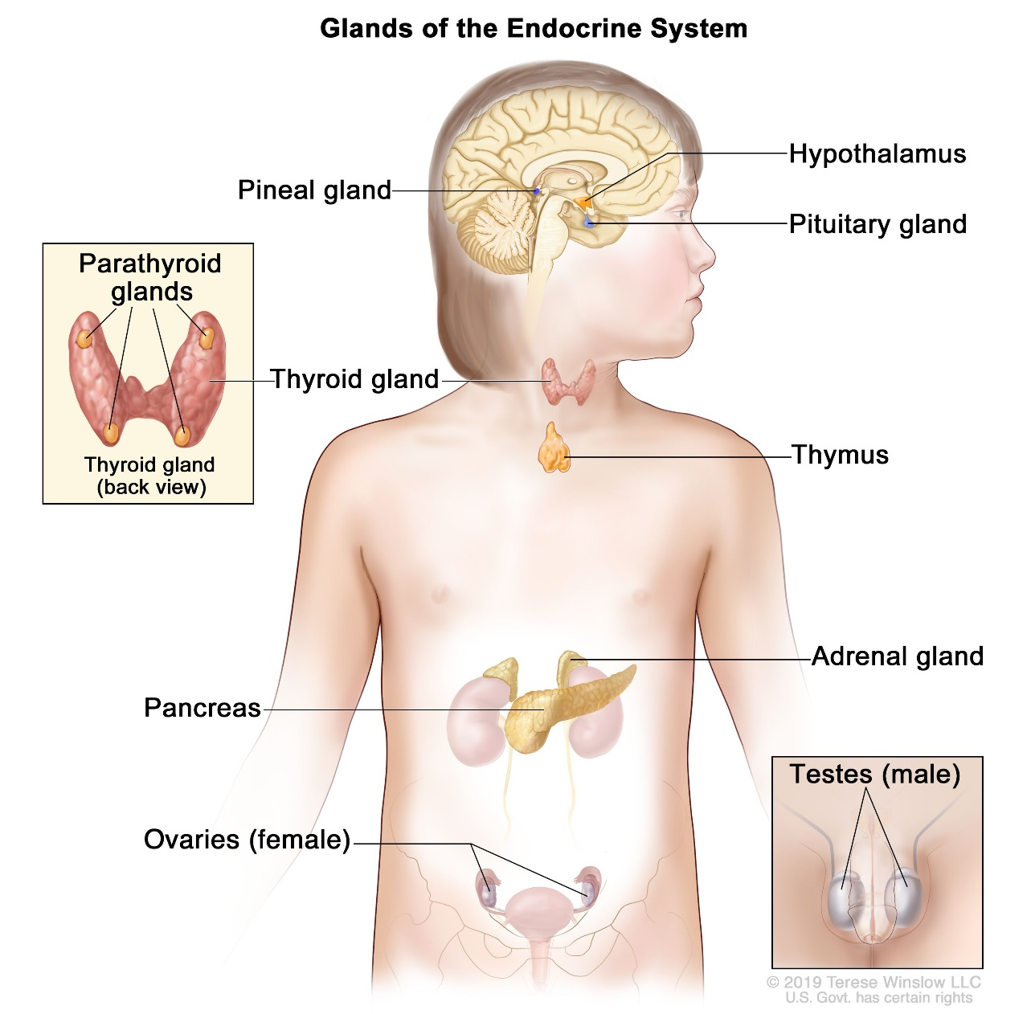
Endocrine glands
Major endocrine glands
hypothalamus.
pituitary.
thyroid.
parathyroids.
adrenals.
pineal body.
the ovaries.
the testes.
Figure 1: The Endocrine System. Location of endocrine glands

Slide 11
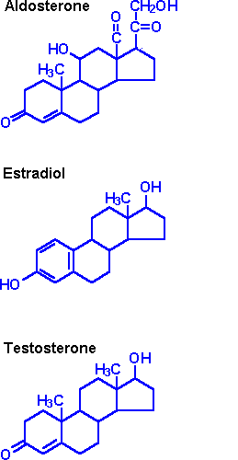
Chemistry of the hormones
Hormones are organized into three main classes based on their chemical structure:
1. Steroid hormones are synthesized from cholesterol
Steroid hormones are lipid-soluble, so they can pass through cell membranes to reach receptor molecules located inside their target cells.
Example of steroid hormones: aldosterone, estrogen, and testosterone.

Slide 12
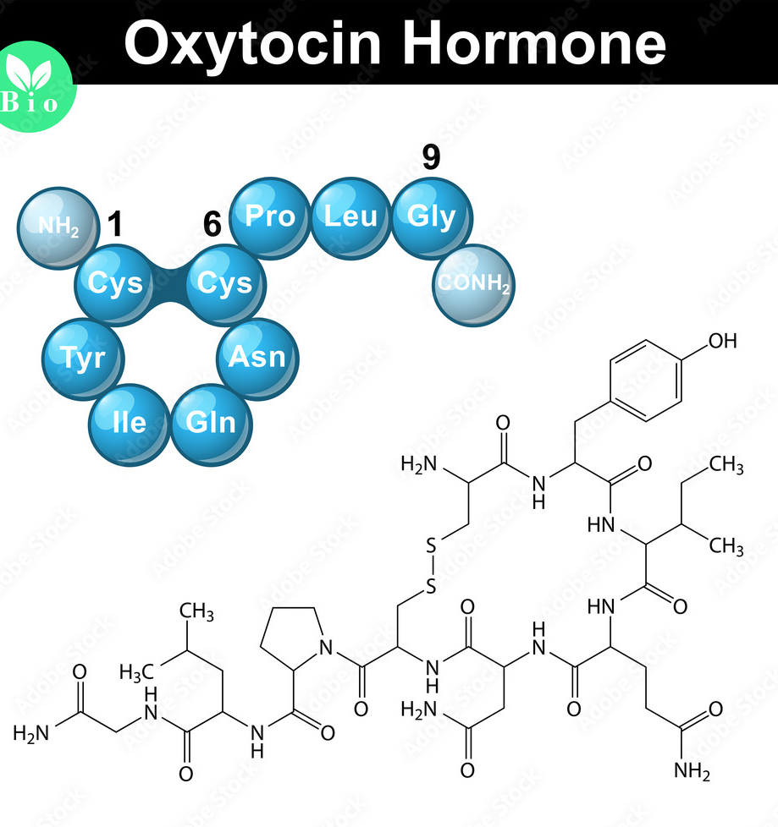
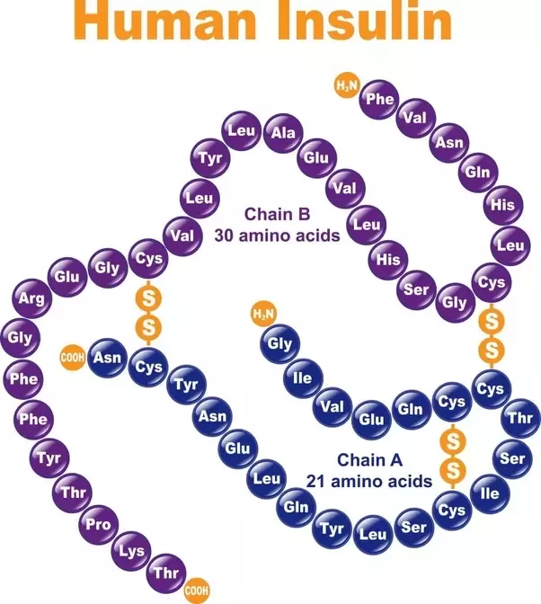
Chemistry of the hormones
2. Peptide and protein hormones are structured from chains of amino acids
These hormones are chains of amino acids
Short chains of amino acids called peptides
Oxytocin is peptide hormone
Long chains of amino acids called proteins.
Insulin is protein hormone.

Slide 13
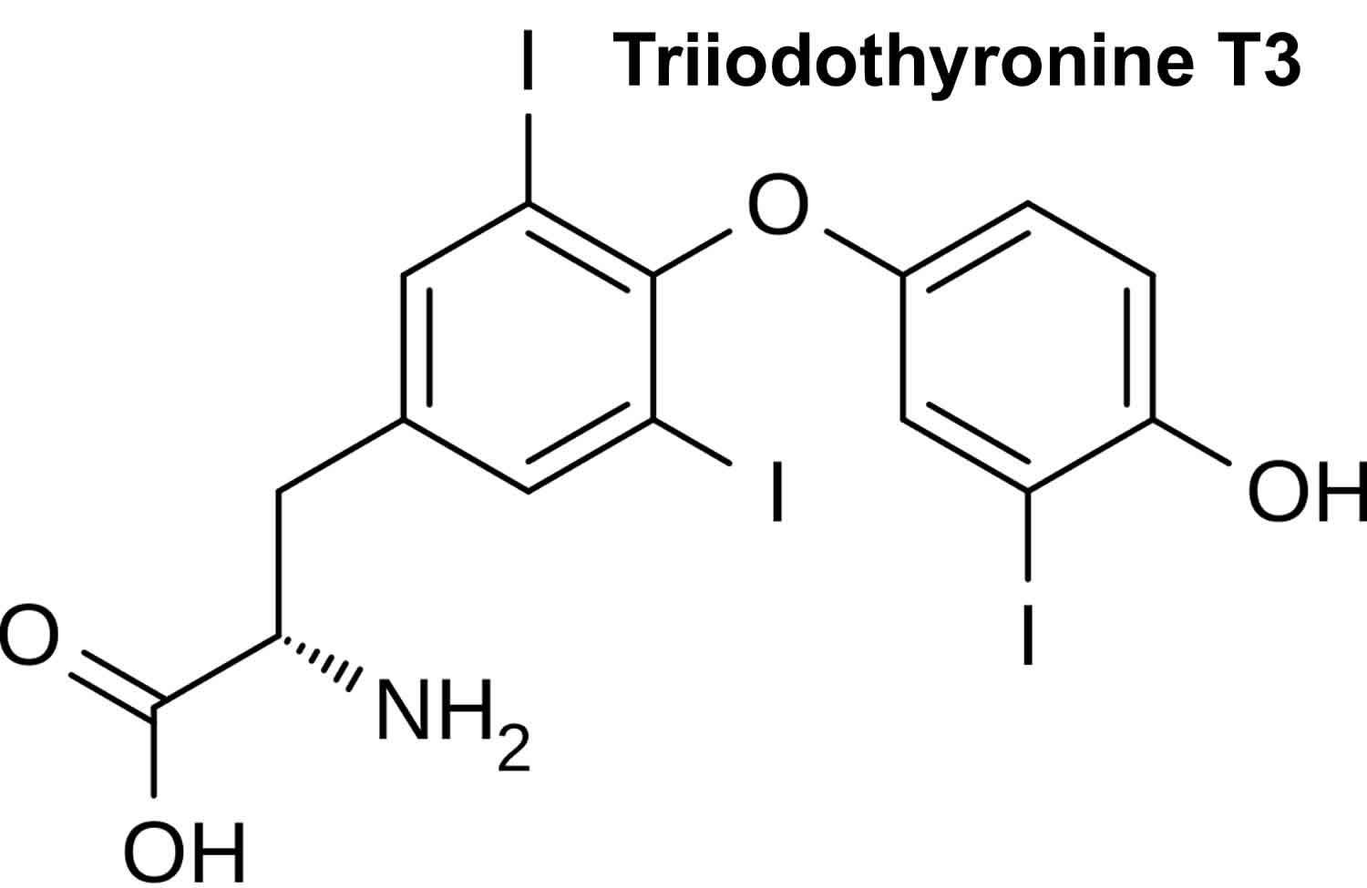
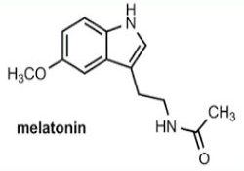
Chemistry of the hormones
3. Amine hormones are modified amino acids (Amino acid derivatives)
These simple hormones are structural variations of the amino acids.
The derivatives of tyrosine, such as the thyroid hormones released by the thyroid gland.
Melatonin, secreted by the pineal gland, is derived from tryptophan.

Slide 14
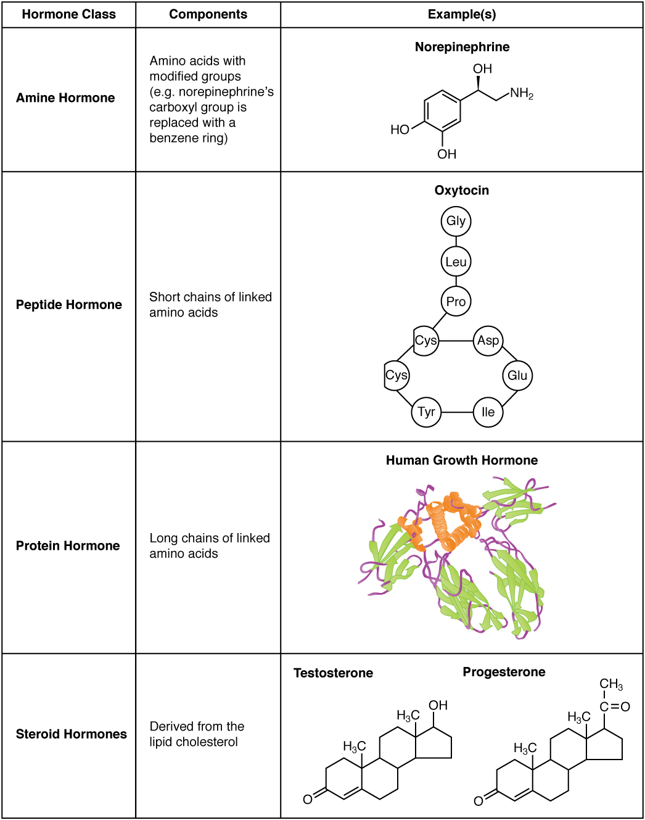
Chemistry of the hormones

Slide 15
Some exciting recent discoveries in endocrinology
A New Hormone That Affects Metabolism 🧬
Scientists found LEAP2, a hormone that helps regulate metabolism and may lead to new obesity treatments.
Fragrances May Trigger Early Puberty 🧴
A study suggests that synthetic perfumes in personal-care products could cause early puberty in girls.
Weight-Loss Drug Prevents Diabetes 💊
The drug Tirzepatide, used for weight loss, also lowers the risk of diabetes in people with prediabetes.
Sex-Specific Effects of Hormones ♀️♂️
Researchers discovered that liver androgen receptors work differently in men and women, affecting metabolism.

Slide 16
References
Greenstein B. & Wood D. F. (2011). The endocrine system at a glance (3rd ed.). Wiley-Blackwell
Melmed S. Auchus R. J. Goldfine A. B. Koenig R. Rosen C. J. & Williams R. H. (2020). Williams textbook of endocrinology (14th ed.). Elsevier. Boron W. F. & Boulpaep E. L. (2021).
Boron & boulpaep concise medical physiology. Elsevier. Barrett K. E. Barman S. M. Yuan J. X.-J. & Brooks H. (2019).
Ganong's review of medical physiology (review questions) (26th ed.). McGraw-Hill Education LLC Molina P. E. (2018). Endocrine physiology (Fifth). McGraw-Hill Education.

Slide 17
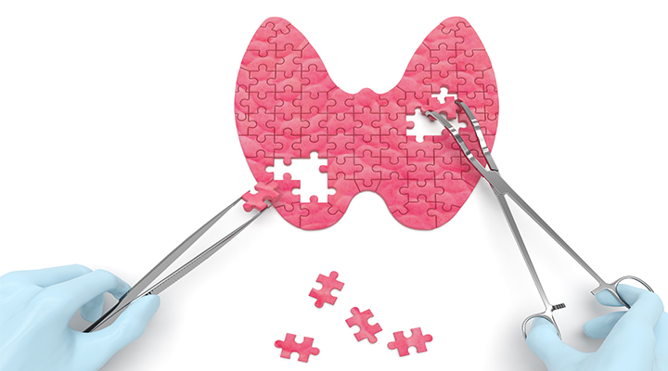
Thank you

