Slide 1

Mechanism of action of hormones
Zhikal O. Khudhur
Endocrinology BIO 414
Spring Semester
Week number: 2
Date: 2/ 2026

Slide 2

Objectives
Regulation of hormone secretion
Location of receptors for hormone
Upregulation and downregulation of receptors
Mechanisms of the hormone action
Response time of target cells to hormones

Slide 3
Homeostasis is coordinating the activities of the various organs and systems throughout the body.
At any given moment, cells of the nervous and endocrine systems are working together, monitoring and adjusting the body's physiological activities through chemical signals.
The chemical signals reach their targets over different distances, ranging from locally secreted autocrine and paracrine signals to endocrines.
Regulation of hormone secretion

Slide 4
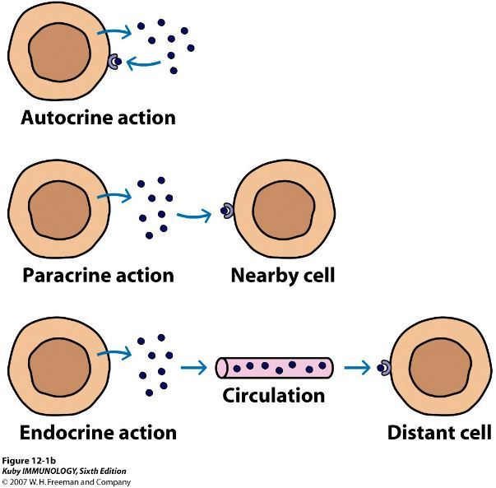
Autocrine, paracrine and endocrine actions
Autocrine is a substance secreted by a cell and acting on surface receptors of the same cell.
Paracrine a hormone which has effect only in the neighborhood of the gland secreting it.
Endocrine refers to tissue that makes and releases hormones that travel in the bloodstream and control the actions of other cells or organs.

Slide 5
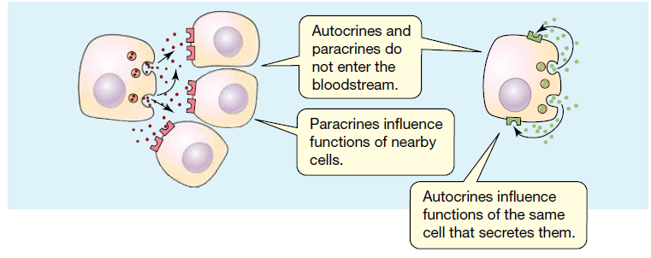
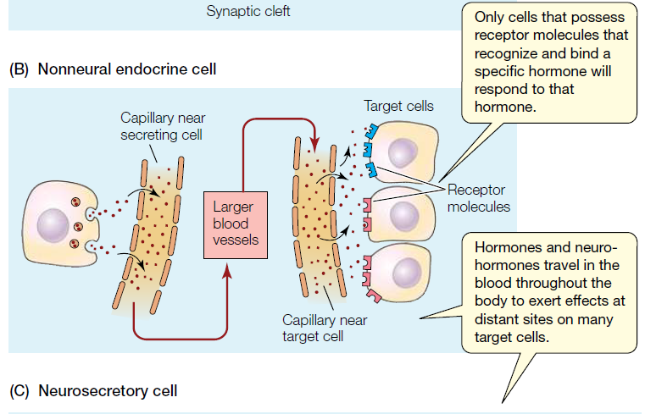
Autocrine, paracrine and endocrine actions

Slide 6
Regulation of hormone secretion
Hormones are secreted by endocrine glands when there is a need for them, that is, for their effects on their target organs. The cells of endocrine glands respond to
Changes in the blood or
Perhaps to other hormones in the blood.
These stimuli are the information that they use to increase or decrease the secretion of hormones.

Slide 7
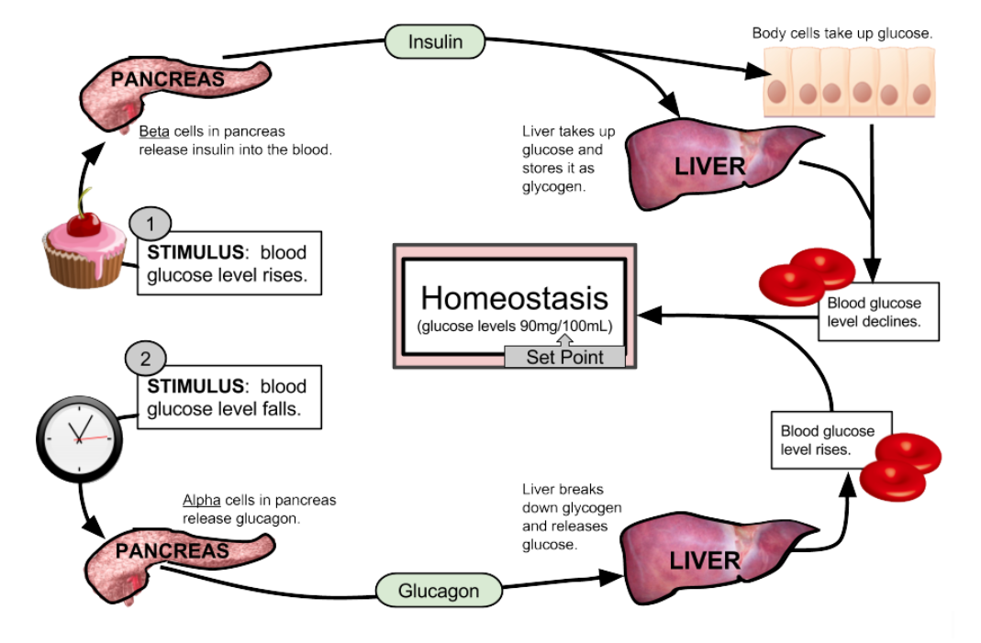
Regulation of blood glucose by insulin and glucagon hormones
Insulin is secreted by the pancreas when the blood glucose level is high; that is, hyperglycemia is the stimulus for the secretion of insulin. Once circulating in the blood, insulin enables cells to remove glucose from the blood so that it can be used for energy production and enables the liver to store glucose as glycogen. As a result of action of insulin, the blood glucose level decreases, reversing the stimulus for secretion of insulin. Insulin secretion then decreases until the blood glucose level increases again.
Figure. Regulation of blood glucose by insulin and glucagon hormones.

Slide 8
Negative feedback inhibition in the pituitary-thyroid axis
Negative feedback to control hormone secretion is explained in following points
The hypothalamus secretes thyrotropin-releasing hormone (TRH).
TRH stimulates the anterior pituitary to secrete thyroid-stimulating hormone (TSH).
TSH stimulates the thyroid gland to secrete the two thyroid hormones, T3 and T4.
T3 and T4 stimulate the metabolism of most cells throughout the body.
T3 and T4 also inhibit the release of TSH by the pituitary.
To a lesser extent, T3 and T4 also inhibit the release of TRH by the hypothalamus

Slide 9
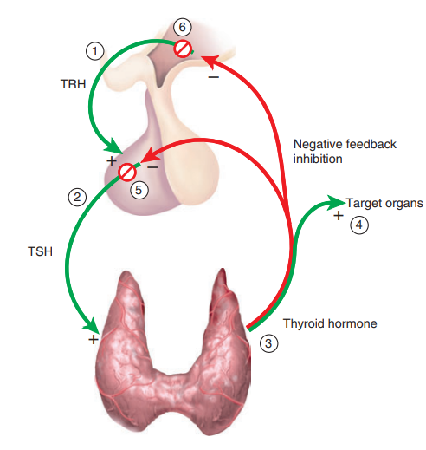
Negative feedback inhibition in the pituitary-thyroid axis
Steps 5 and 6 are negative feedback inhibition of the pituitary and hypothalamus respectively. These steps ensure that when thyroid hormone levels are high, TSH secretion remains low. If thyroid hormone secretion drops, TSH secretion rises and stimulates the thyroid to secrete more hormone. This negative feedback keeps thyroid hormone levels fluctuating around a set point in typical homeostatic fashion.
Figure. Negative feedback inhibition in the pituitary-thyroid axis.

Slide 10
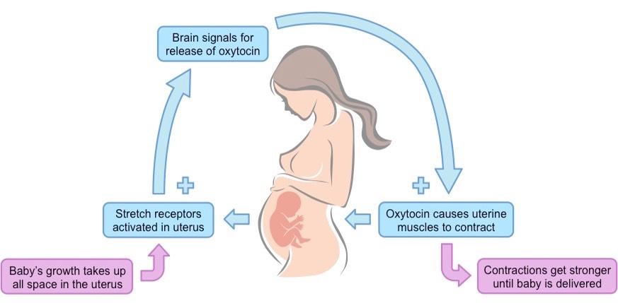
Positive feedback during childbirth

Slide 11
Mechanisms of the hormone action
Each hormone has target cells
Target cells are specific cells that have receptors needed to bind hormones and respond to their presence.
A hormone will affect only those cells that have their specific receptors.
To initiate changes in target cells, hormones first bind to specific receptor molecules.
Receptor is a molecule inside or on the surface of a cell (target cell) that binds to hormone
Hormone receptors are classified depending on their cellular localization into
Cell membrane receptors
Intracellular receptors

Slide 12
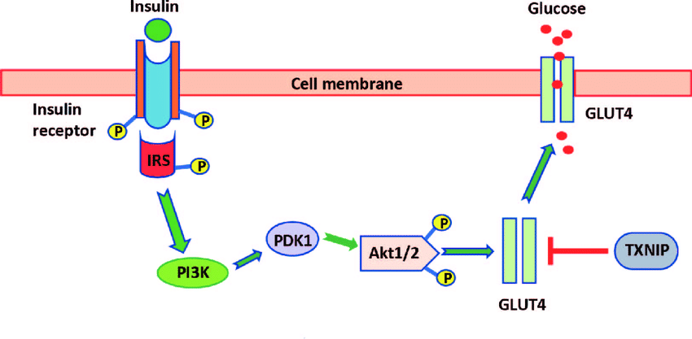
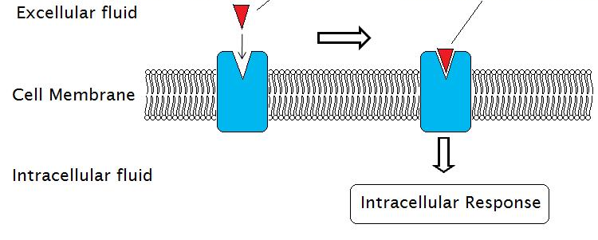
Location of receptors for hormone
Cell membrane receptors
Protein hormone
Hydrophilic hormones bind to cell-surface receptors.
Protein and Peptide hormone are unable to cross the cell membrane lipid bilayer and in general bind to cell membrane receptors.

Slide 13
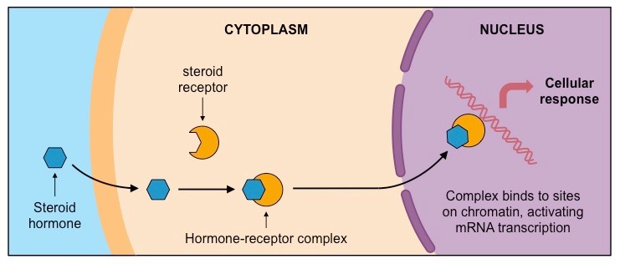
Location of receptors for hormone
2. Intracellular receptors
Hydrophobic hormones bind to intracellular receptors
Steroid hormones are lipid soluble, cross the plasma membrane, and bind to intracellular receptors.

Slide 14
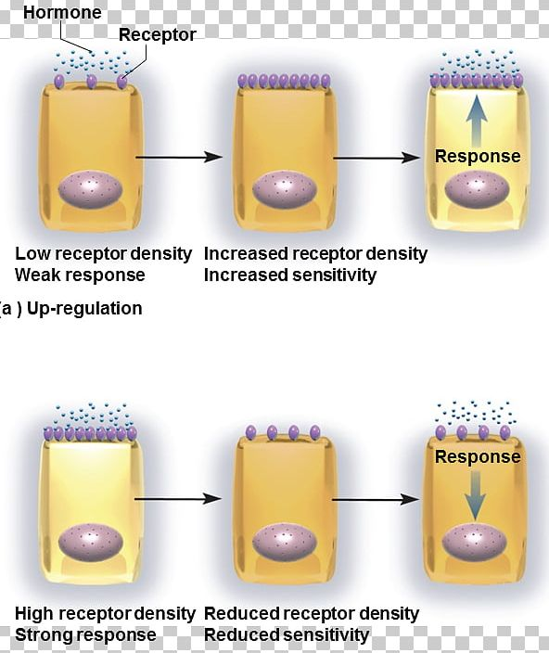
Upregulation and downregulation of receptors
Upregulation is the process by which a cell increases its response to a substance or signal from outside the cell to carry out a specific function. For example, a cell may increase the number or activity of protein receptors or other molecules on its surface to make it more sensitive to a hormone or drug.
Receptor downregulation is characterized by a decrease in total receptor number in the cell due to endocytosis and subsequent degradation of the receptors caused by long-term exposure to hormones

Slide 15
To initiate changes in target cells, hormones first bind to specific receptor molecules.
Hormone molecules exert their effects by producing biochemical changes in target cells
The hormones exert their effects on their target organs involves several complex processes
Enzymes control all cellular activities and metabolic reactions
Hormones influence cellular operations by changing the types, activities, or quantities of key cytoplasmic enzymes.
Mechanisms of the hormone action

Slide 16
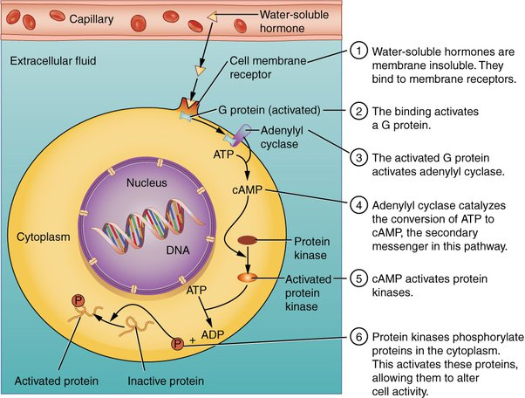
The two-messenger mechanism–protein hormones
Protein and peptide hormones bind to receptors of the cell membrane, and the hormone is called the first messenger
The binding of membrane insoluble hormones activate G proteins
The activated G protein activates adenylate cyclase in cell membrane
Adenylate cyclase synthesizes a substance called cyclic adenosine monophosphate (cyclic AMP or cAMP) from ATP, and cyclic AMP is the second messenger
Cyclic AMP activates specific enzymes within the cell, which bring about the cell’s characteristic response to the hormone.

Slide 17
The two-messenger mechanism–protein hormones
The responses of target cells to hormones include
A change in the permeability of the cell membrane to a specific substance,
An increase in protein synthesis
Activation of other enzymes
Or the secretion of a cellular product.

Slide 18
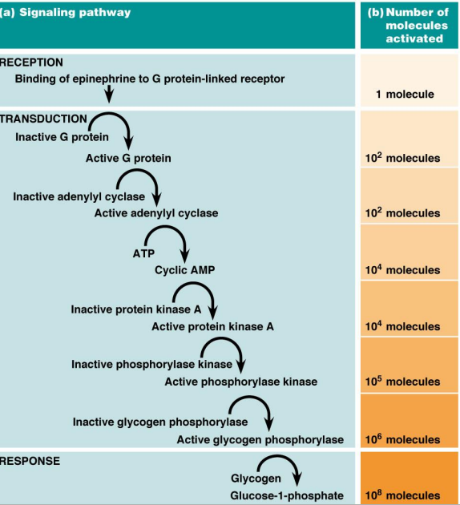
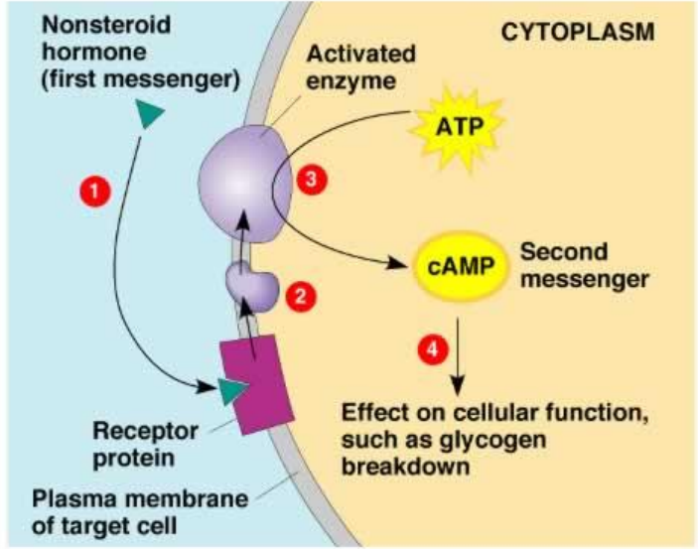
The two-messenger mechanism–protein hormones

Slide 19
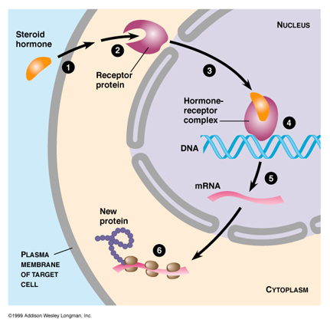
The action of steroid hormones
Steroid hormones are soluble in the lipids of the cell membrane and diffuse easily into a target cell
Once inside the cell, the steroid hormone combines with a protein receptor in the cytoplasm, and
This steroid-protein complex enters the nucleus of the cell.
Within the nucleus, the steroid-protein complex activates specific genes
Which begin the process of mRNA synthesis
And then protein synthesis. The enzymes produced bring about the cell’s characteristic response to the hormone

Slide 20
Response time of target cells to hormones
The responses of target cells to hormones occur with a delay
Two main factors contribute to slowed responses to endocrine signals
hormones require travel time to reach target cells.
Certain hormones control gene transcription and the synthesis of proteins by target cells, so the responses they initiate are exhibited only after a delay, when protein synthesis is accomplished.

Slide 21
References
Greenstein B. & Wood D. F. (2011). The endocrine system at a glance (3rd ed.). Wiley-Blackwell
Melmed S. Auchus R. J. Goldfine A. B. Koenig R. Rosen C. J. & Williams R. H. (2020). Williams textbook of endocrinology (14th ed.). Elsevier. Boron W. F. & Boulpaep E. L. (2021).
Boron & boulpaep concise medical physiology. Elsevier. Barrett K. E. Barman S. M. Yuan J. X.-J. & Brooks H. (2019).
Ganong's review of medical physiology (review questions) (26th ed.). McGraw-Hill Education LLC Molina P. E. (2018). Endocrine physiology (Fifth). McGraw-Hill Education.

Slide 22
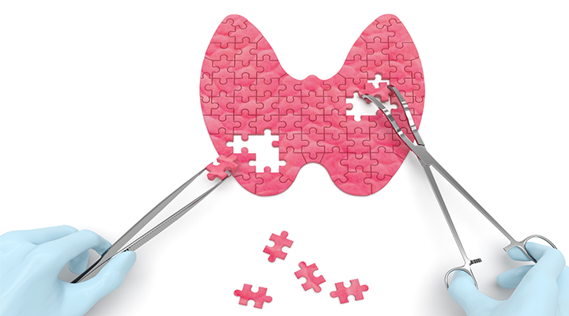
Thank you

