Slide 1

posterior pituitary AND adh
Zhikal O. Khudhur
Endocrinology BIO 414
Spring Semester
Week number: 4
Date: 2/ 2026

Slide 2

Objectives
Posterior pituitary anatomy
Type of hormones that released by pp.
Oxytocin
Mechanism of oxytocin action
Kidney physiology
Antidiuretic hormone
Mechanism of ADH action

Slide 3
Posterior pituitary gland hormone –Oxytocin
Oxytocin stimulates contraction of the uterus at the end of pregnancy and stimulates the release of milk from the mammary glands.
As labor begins, the cervix of the uterus is stretched, which generates sensory impulses to the hypothalamus, which in turn stimulates the posterior pituitary to release oxytocin. Oxytocin then causes strong contractions of the smooth muscle (myometrium) of the uterus to bring about delivery of the baby and the placenta.
In addition, when a baby is breast-fed, the sucking of the baby stimulates sensory impulses from the mother’s nipple to the hypothalamus. Nerve impulses from the hypothalamus to the posterior pituitary cause the release of oxytocin, which stimulates the contraction of the smooth muscle cells around the mammary ducts to release milk.

Slide 4
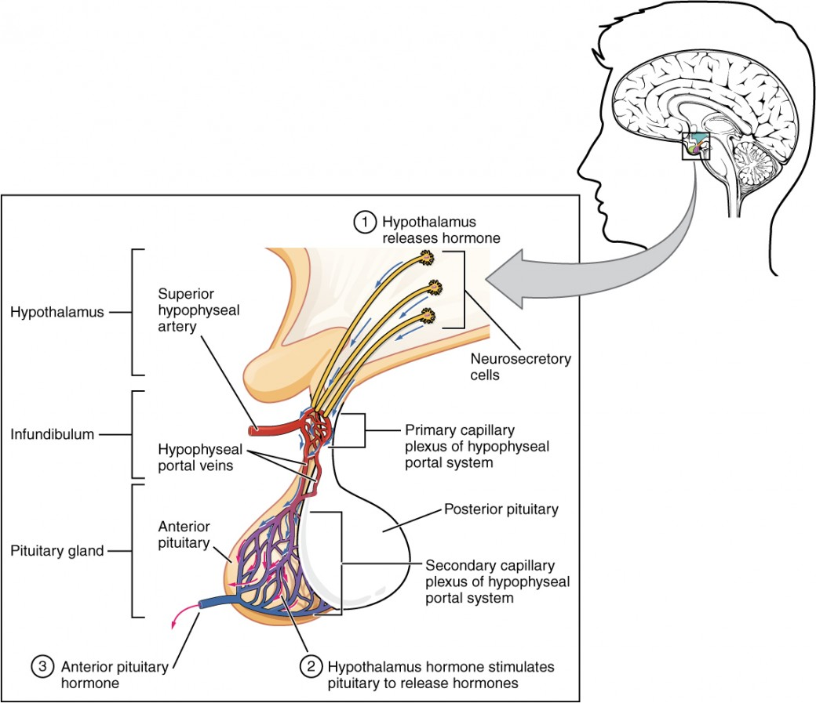
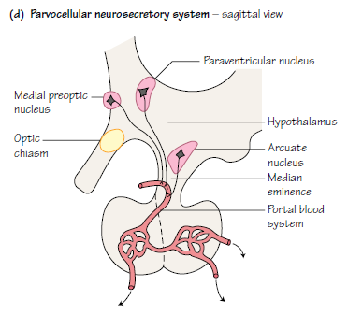

Slide 5
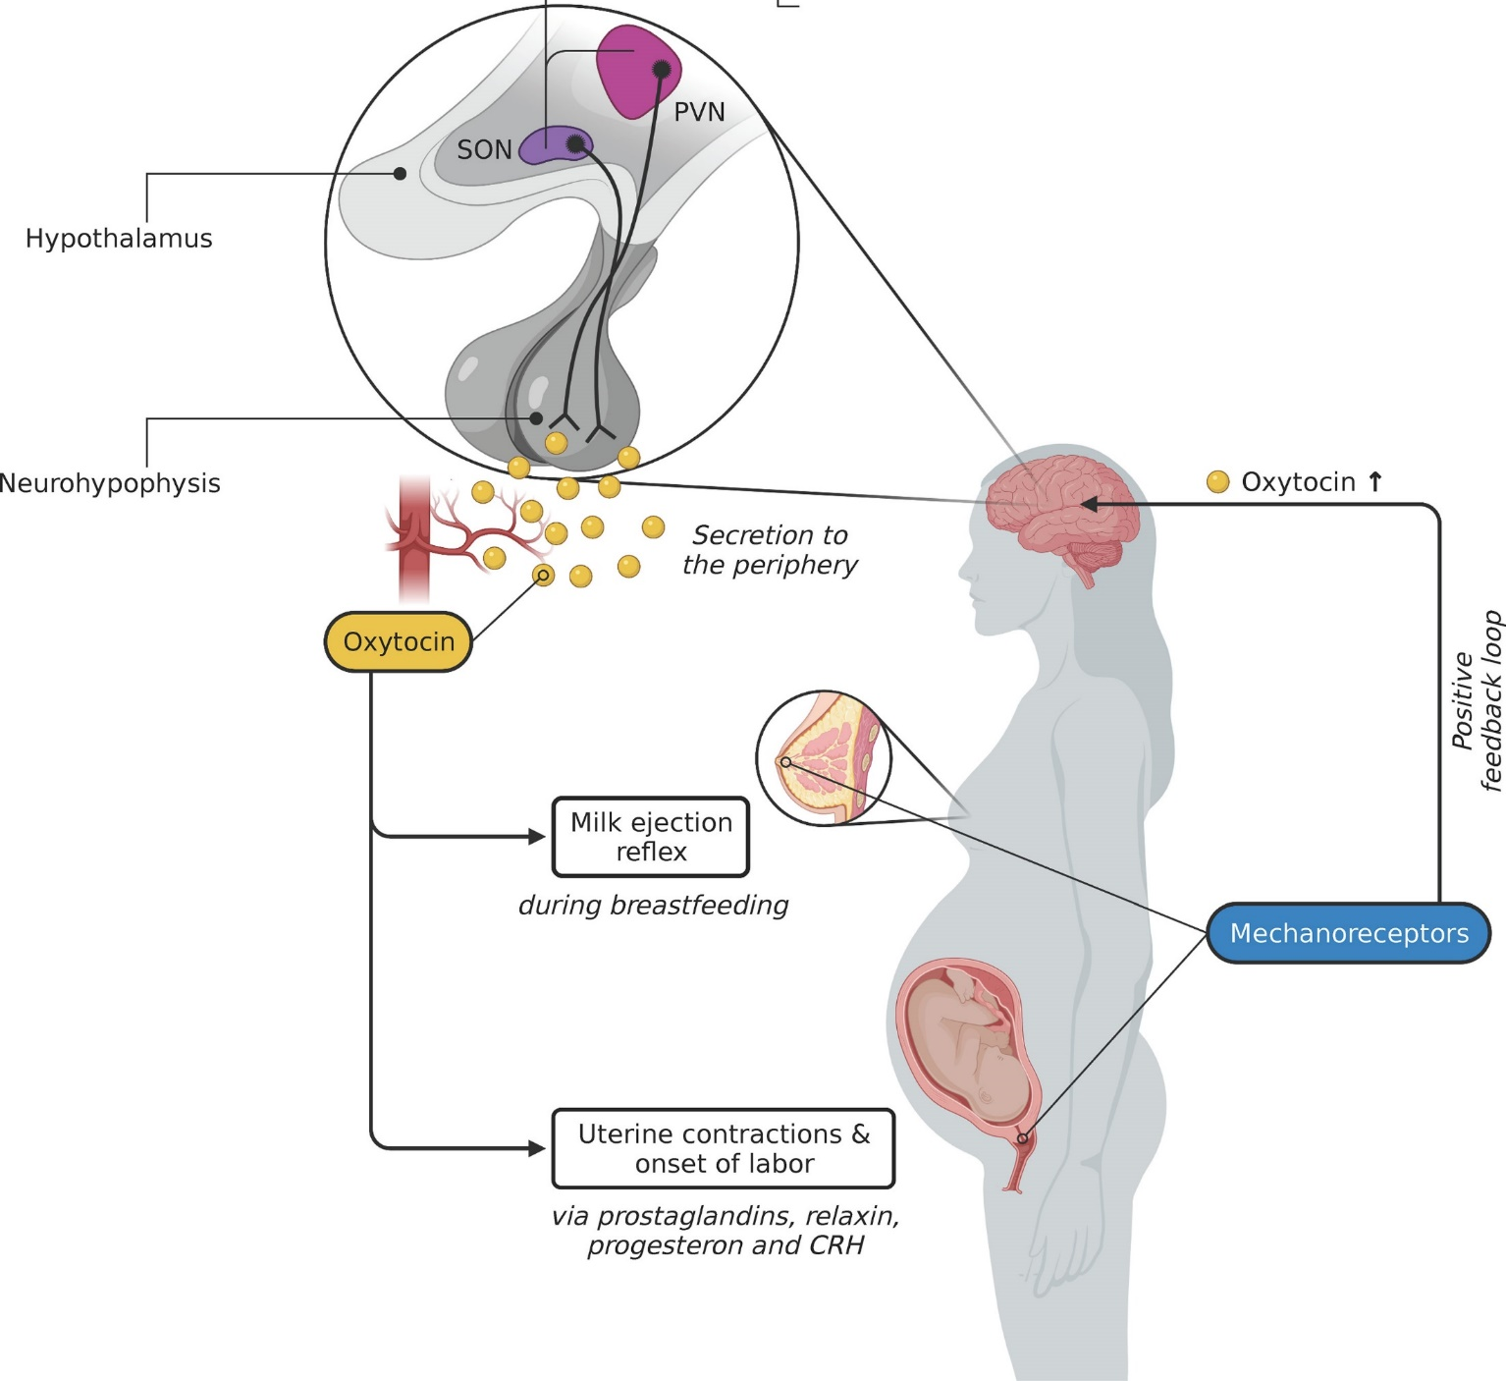
Posterior pituitary gland hormone –Oxytocin

Slide 6
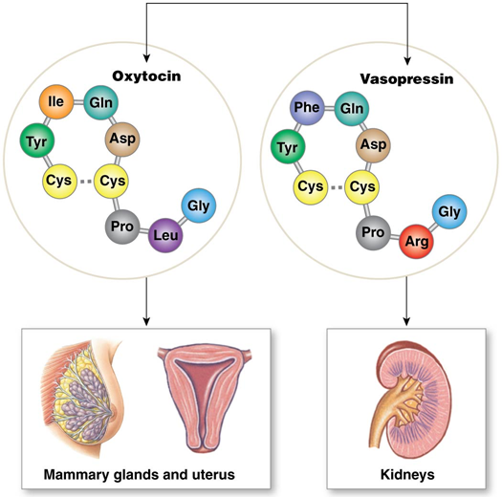
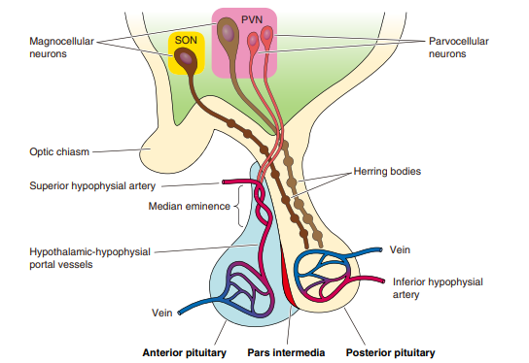

Slide 7
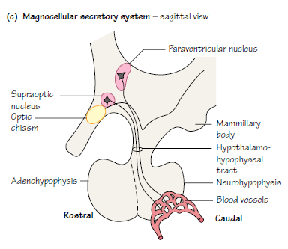
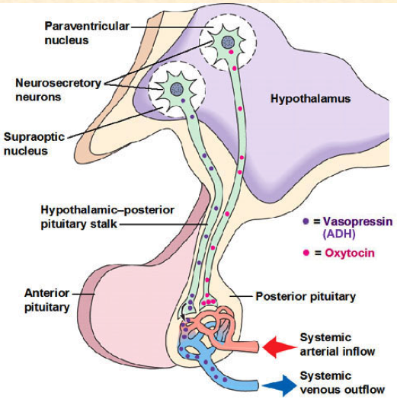
Oxytocin

Slide 8
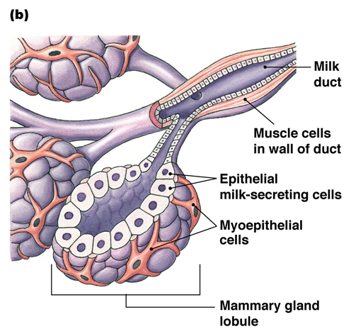
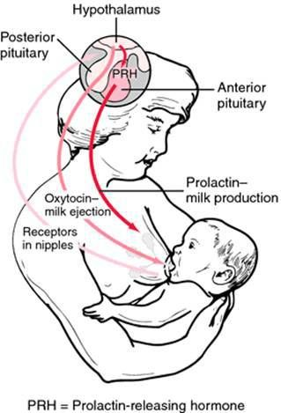
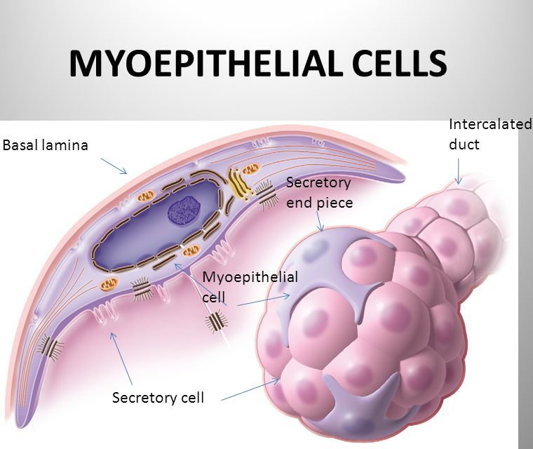
OXYTOCIN

Slide 9
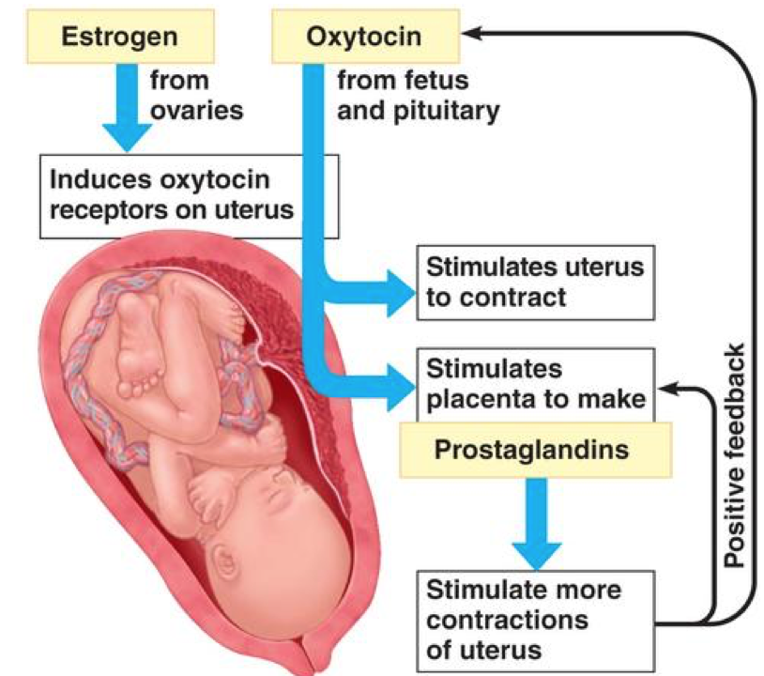
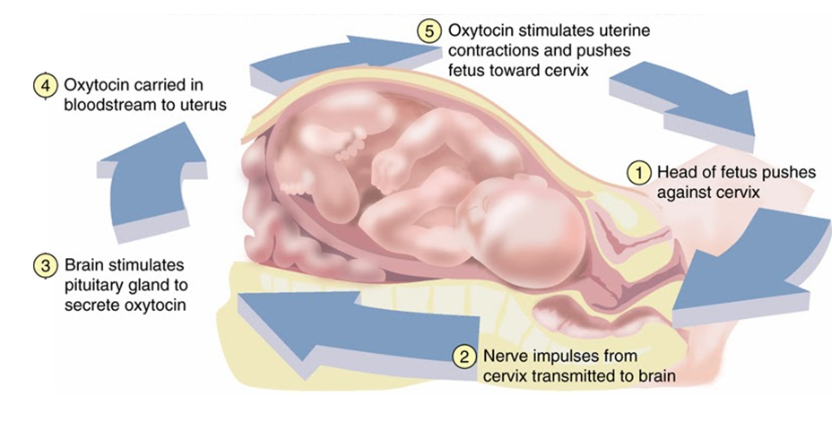

Slide 10
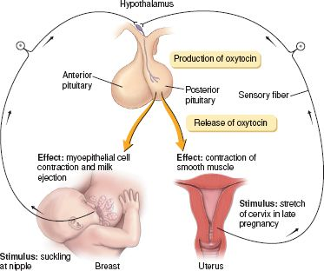

Slide 11
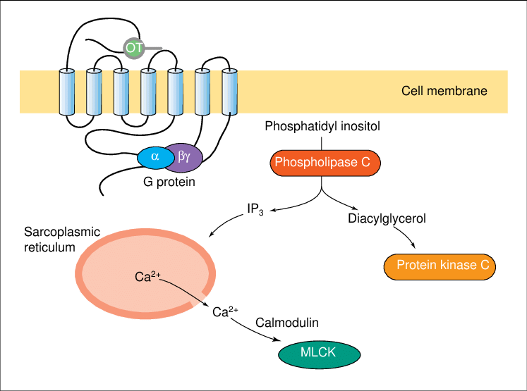
OXYTOCIN RECEPTOR

Slide 12
Posterior pituitary gland hormone –Antidiuretic hormone
Antidiuretic hormone (ADH, also called vasopressin) increases the reabsorption of water by kidney tubules, which decreases the amount of urine formed. The water is reabsorbed into the blood, so as urinary output is decreased, blood volume is increased, which helps maintain normal blood pressure. ADH also decreases sweating, but the amount of water conserved is much less than that conserved by the kidneys.
The stimulus for the secretion of ADH is decreased water content of the body. If too much water is lost through sweating or diarrhea, for example, osmoreceptors in the hypothalamus detect the increased “saltiness” of body fluids. The hypothalamus then transmits impulses to the posterior pituitary to increase the secretion of ADH and decrease the loss of more water in urine.

Slide 13
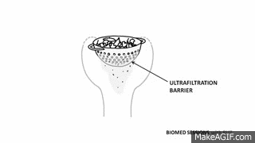
Introduction to the Renal System
The kidneys are vital organs responsible for maintaining fluid balance, regulating blood pressure, and removing waste products from the blood.
Filtration is the first step in urine formation and is crucial for the kidneys' function.

Slide 14
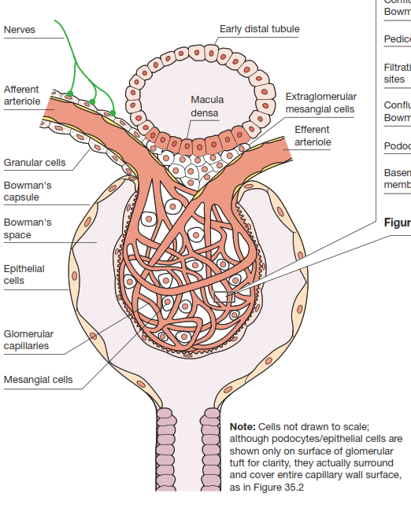
Structure of the Glomerulus
The glomerulus is a network of capillaries surrounded by Bowman's capsule.
Key components include:
Afferent arteriole: brings blood into the glomerulus
Efferent arteriole: carries blood away from the glomerulus
Glomerular capillaries: where filtration occurs
Bowman's capsule: collects the filtered fluid
Mesangial cells: provide structural support and have contractile properties

Slide 15
Glomerular Cells
Granular cells: Located in the walls of the afferent arteriole, they produce renin, an enzyme important in blood pressure regulation.
Podocytes: Specialized epithelial cells that wrap around glomerular capillaries. They have foot processes (pedicels) that form filtration slits.
Mesangial cells: Found between capillary loops, they have phagocytic and contractile properties. They help regulate blood flow and filtration surface area.

Slide 16
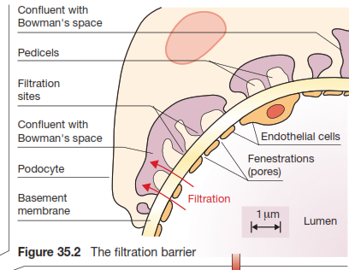
The Filtration Barrier - Overview
The filtration barrier consists of three layers:
Endothelium of glomerular capillaries
Basement membrane
Podocytes (epithelial cells)
Each layer contributes to selective filtration, allowing water and small solutes to pass while retaining larger molecules like proteins.

Slide 17
The Filtration Barrier - Endothelium
The endothelium is the innermost layer of the filtration barrier.
It's characterized by fenestrations (pores) about 70-100 nm in diameter.
These fenestrations make the glomerular endothelium much more permeable than typical capillaries.
The endothelium provides the first level of size selectivity in filtration.

Slide 18
The Filtration Barrier - Basement Membrane
The basement membrane is a thick extracellular matrix between the endothelium and podocytes.
It's composed of type IV collagen, laminin, and proteoglycans.
The basement membrane provides both size and charge selectivity.
Negatively charged molecules are repelled due to the negative charges in the basement membrane.

Slide 19
The Filtration Barrier - Podocytes
Podocytes are highly specialized epithelial cells with interdigitating foot processes (pedicels).
The gaps between pedicels form filtration slits (about 25-60 nm wide).
Filtration slits are bridged by a thin membrane called the slit diaphragm.
Podocytes provide the final barrier to protein filtration and maintain the integrity of the filtration barrier.

Slide 20
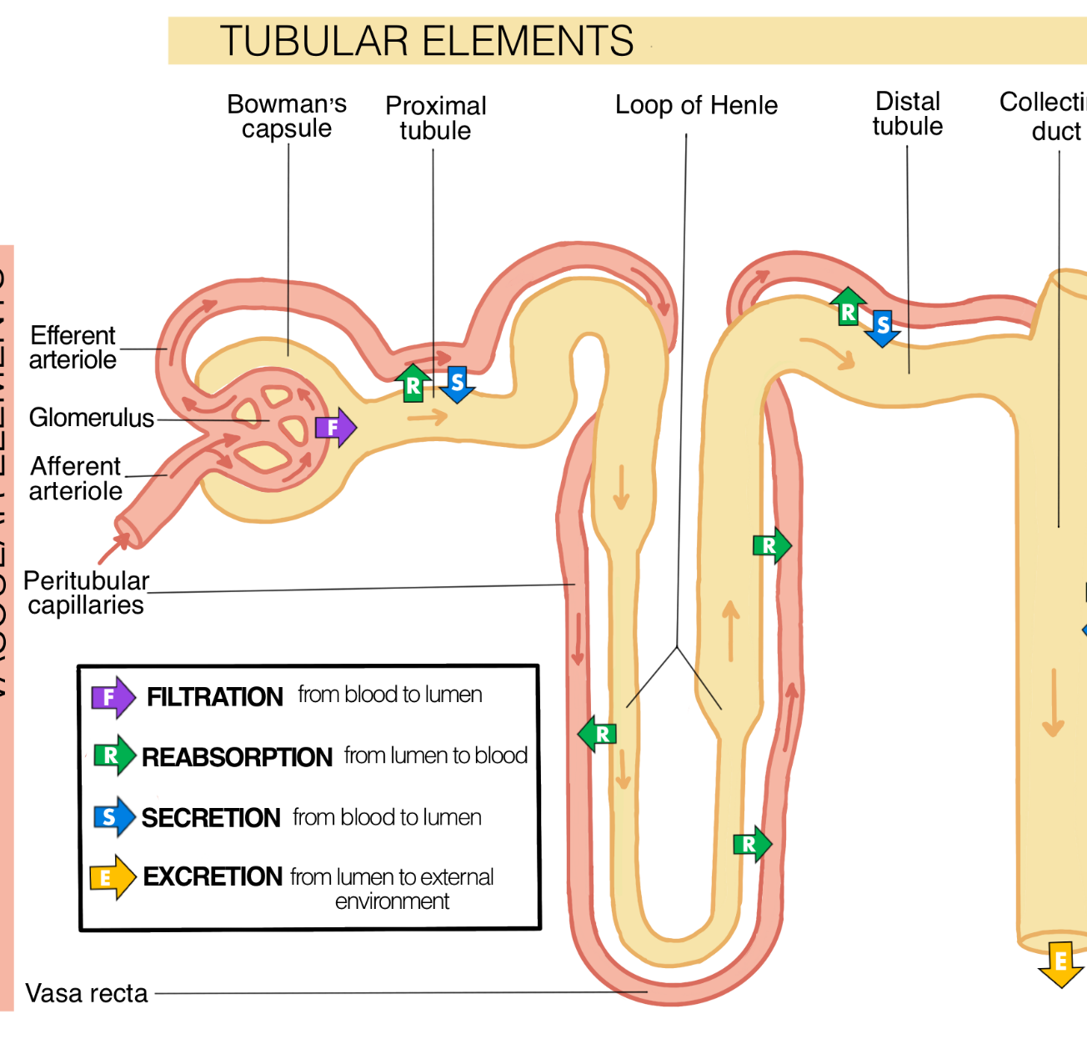
Glomerular Filtration Process
Ultrafiltration is the process by which plasma is filtered across the glomerular capillary wall into Bowman's space.
Glomerular Filtration Rate (GFR) is approximately 125 mL/min in humans.
Renal plasma flow is about 600 mL/min.
The filtration fraction (GFR/renal plasma flow) is roughly 20%, meaning about 20% of the plasma entering the kidney is filtered.

Slide 21
Permeability of the Filtration Barrier
The filtration barrier is selectively permeable based on molecular size and charge.
Substances with molecular weights <7000 Da pass freely.
Molecules between 7000-70,000 Da are increasingly restricted.
Molecules >70,000 Da are rarely filtered.
Negatively charged molecules are further restricted due to the negative charges in the basement membrane.

Slide 22

Factors Determining GFR - Arteriolar Resistance
The resistance of afferent and efferent arterioles significantly influences GFR.
Afferent arteriole: controls blood flow into the glomerulus.
Efferent arteriole: maintains high hydrostatic pressure in glomerular capillaries.
Constriction of the efferent arteriole increases GFR by increasing glomerular capillary pressure.
Dilation of the afferent arteriole increases both renal blood flow and GFR.

Slide 23
Regulation of GFR - Other Factors
Sympathetic nervous system: activation causes vasoconstriction, reducing GFR.
Hormones:
Angiotensin II: constricts efferent arterioles more than afferent, increasing GFR.
Atrial natriuretic peptide: dilates afferent arterioles, increasing GFR.
Renal diseases: can reduce GFR by damaging glomeruli or altering blood flow.

Slide 24
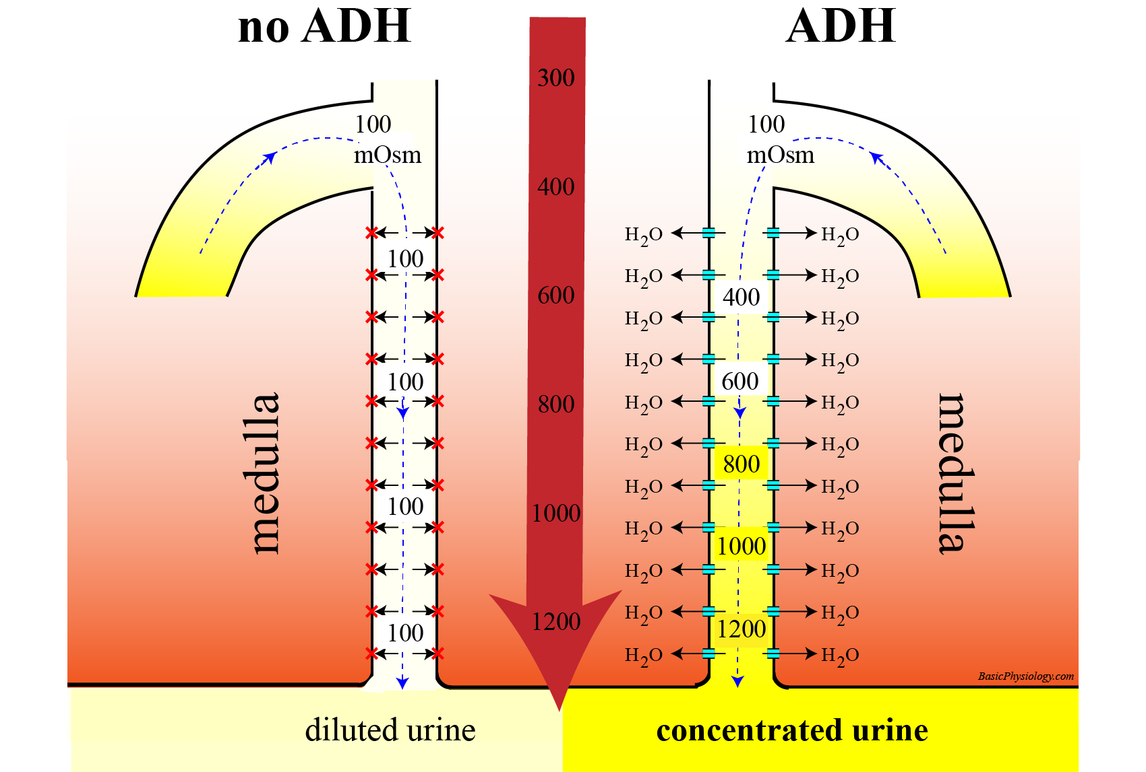
Posterior pituitary gland hormone –Antidiuretic hormone

Slide 25
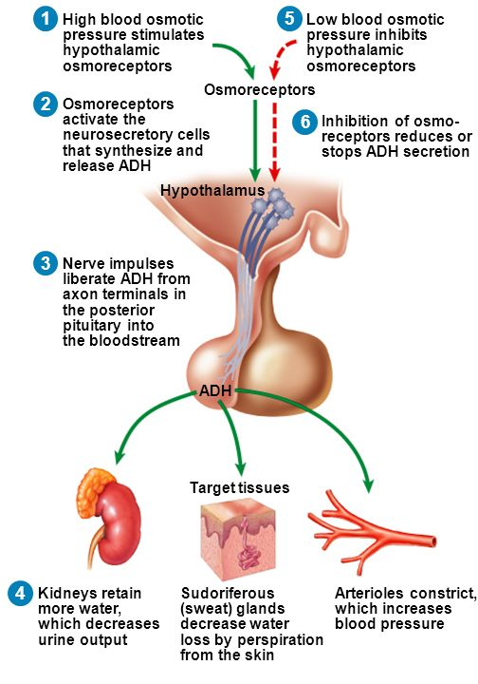
ANTIDIURETIC HORMONE

Slide 26
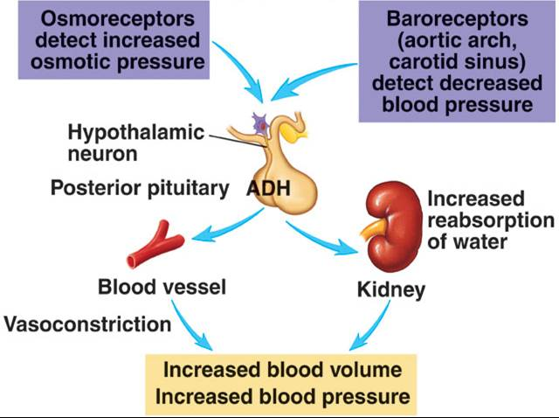
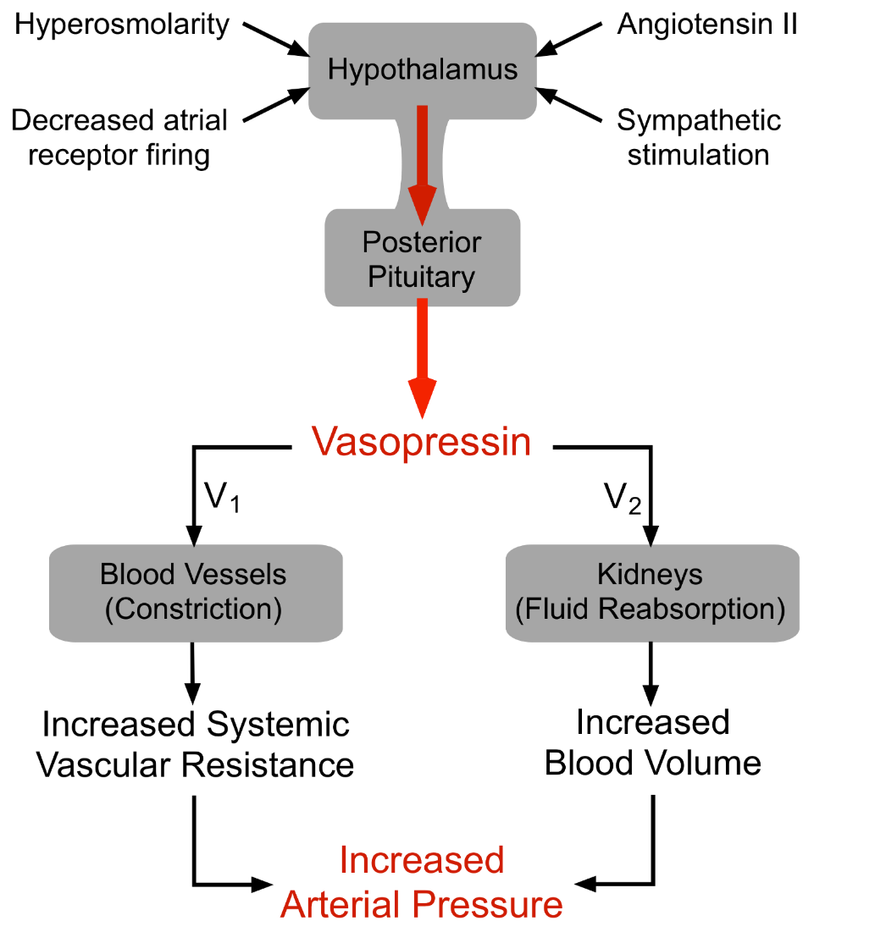
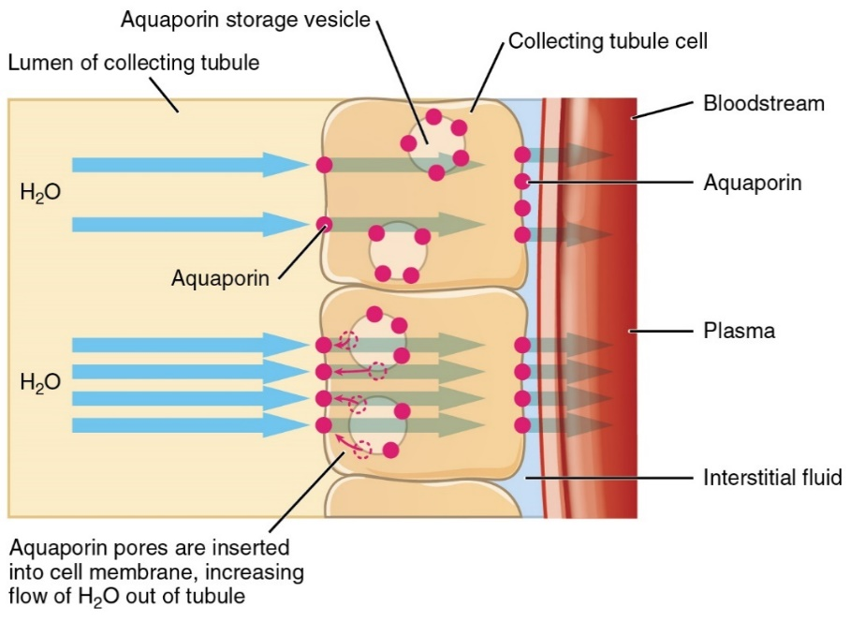

Slide 27
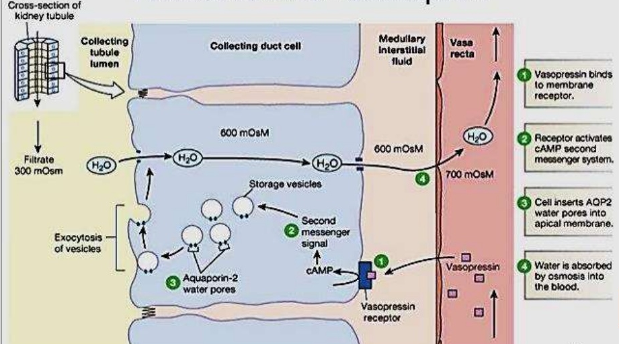
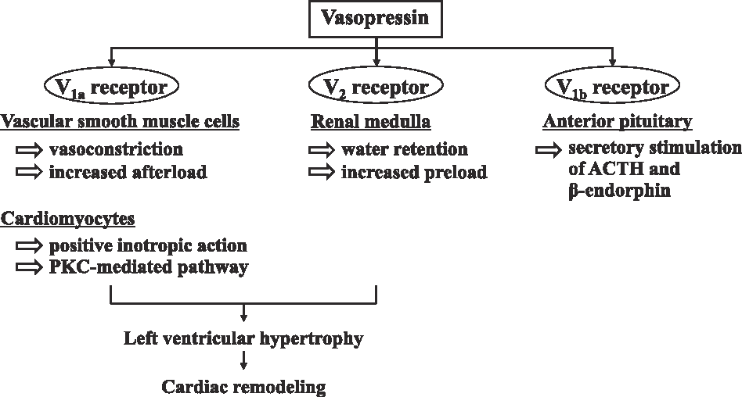
ADH RECEPTOR

Slide 28
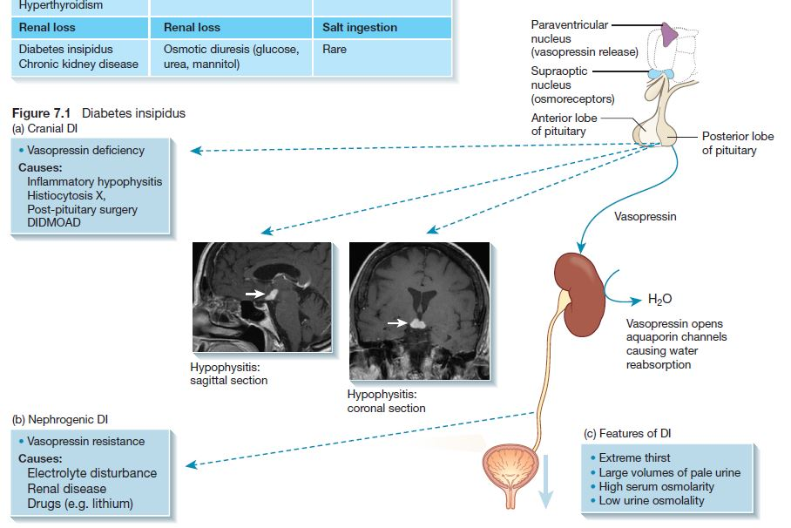

Slide 29
References
Greenstein B. & Wood D. F. (2011). The endocrine system at a glance (3rd ed.). Wiley-Blackwell
Melmed S. Auchus R. J. Goldfine A. B. Koenig R. Rosen C. J. & Williams R. H. (2020). Williams textbook of endocrinology (14th ed.). Elsevier. Boron W. F. & Boulpaep E. L. (2021).
Boron & boulpaep concise medical physiology. Elsevier. Barrett K. E. Barman S. M. Yuan J. X.-J. & Brooks H. (2019).
Ganong's review of medical physiology (review questions) (26th ed.). McGraw-Hill Education LLC Molina P. E. (2018). Endocrine physiology (Fifth). McGraw-Hill Education.

Slide 30
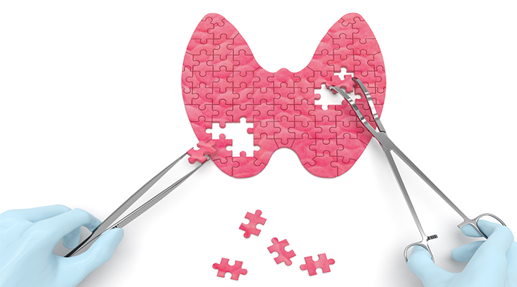
Thank you

