Slide 1
Purchase Discounts
Farhad al-Kake
Farhad.Alkake@tiu.edu.iq

Slide 2
Accounting for Merchandising Operations
Learning Objectives
Describe merchandising operations and inventory systems.
Record purchases under a perpetual inventory system.
Record sales under a perpetual inventory system.
Apply the steps in the accounting cycle to a merchandising company.
Prepare a multiple-step income statement and a comprehensive income statement.

Slide 3
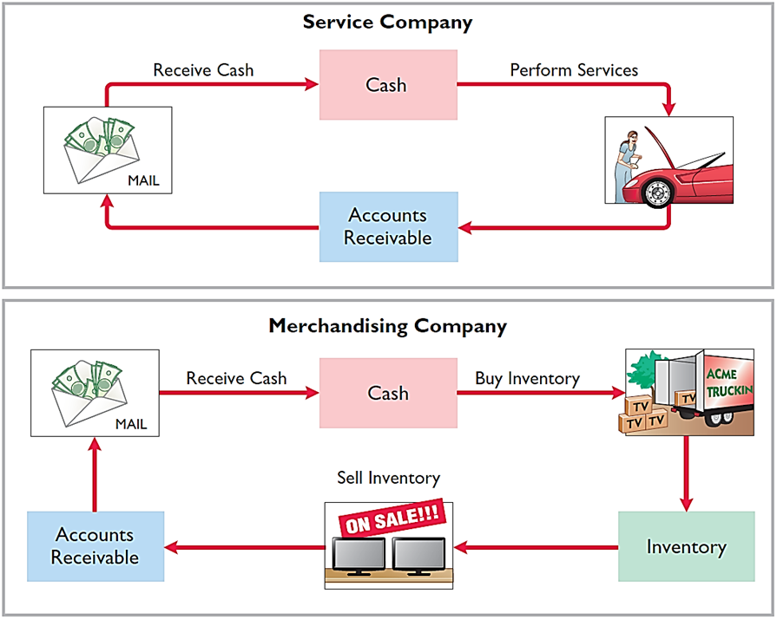
Operating Cycles
The operating cycle of a merchandising company ordinarily is longer than that of a service company.
L O 1

Slide 4
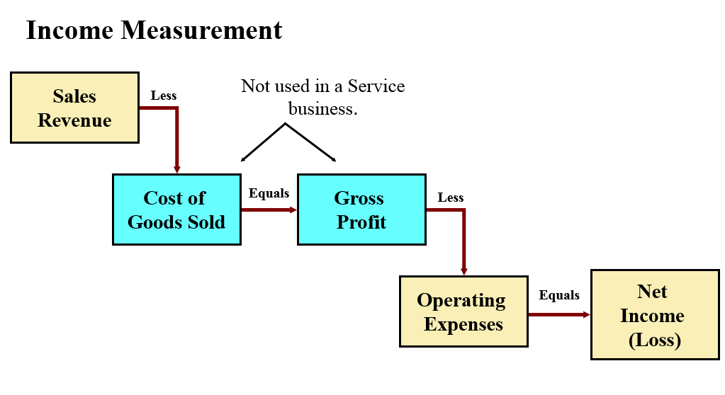
Merchandising Operations
Cost of goods sold is the total cost of merchandise sold during the period.
L O 1

Slide 5
Flow of Costs Perpetual System
Maintain detailed records of the cost of each inventory purchase and sale.
Records continuously show inventory that should be on hand for every item.
Company determines cost of goods sold each time a sale occurs.
L O 1

Slide 6
Flow of Costs Advantages of the Perpetual System
Traditionally used for merchandise with high unit values.
Shows the quantity and cost of the inventory that should be on hand at any time.
Provides better control over inventories than a periodic system.
L O 1

Slide 7
Do It! 1: Merchandising Operations and Inventory Systems
Indicate whether the following statements are true or false:
The primary source of revenue for a merchandising company results from performing services for customers.
False
The operating cycle of a service company is usually shorter than that of a merchandising company.
True
Sales revenue less cost of goods sold equals gross profit.
True
Ending inventory plus the cost of goods purchased equals cost of goods available for sale.
False
L O 1

Slide 8
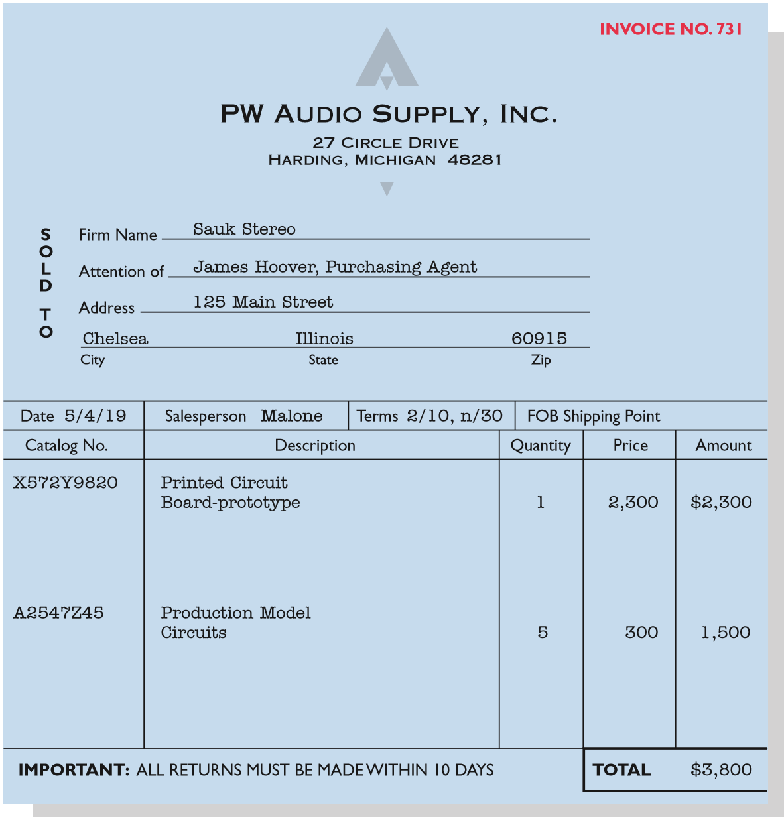
Recording Purchases of Merchandise
Illustration: Sauk Stereo (the buyer) uses as a purchase invoice the sales invoice prepared by PW Audio Supply, Inc. (the seller). Prepare the journal entry for Sauk Stereo for the invoice from PW Audio Supply.
May 4
Inventory
3,800
Accounts Payable
3,800
L O 2

Slide 9
Freight Costs Illustration
Assume upon delivery of the goods on May 6, Sauk Stereo pays Public Freight Company $150 for freight charges, the entry on Sauk Stereo’s books is:
May 6
Inventory
150
Cash
150
Assume the freight terms on the invoice in Illustration 5-6 had required PW Audio Supply to pay the freight charges, the entry by PW Audio Supply would have been:
May 4
Freight-Out
150
Cash
150
L O 2

Slide 10

Purchase Returns and Allowances Answer
In a perpetual inventory system, a return of defective merchandise by a purchaser is recorded by crediting:
a. Purchases
b. Purchase Returns
c. Purchase Allowance
d. Inventory
L O 2

Slide 11
Purchase Discounts Credit Terms
1 over 10 E O M
1% discount if paid within first 10 days of next month.
2 over 10, n over 30
2% discount if paid within 10 days, otherwise net amount due within 30 days.
N over 10 E O M
Net amount due within the first 10 days of the next month.
L O 2

Slide 12
Purchase Discounts Illustration
Assume Sauk Stereo pays the balance due of $3,500 (gross invoice price of $3,800 less purchase returns and allowances of $300) on May 14, the last day of the discount period. Prepare the journal entry Sauk Stereo makes on May 14 to record the payment.
May 14
Accounts Payable
3,500
Cash
3,430
Inventory
70
L O 2

Slide 13
Purchase Discounts Illustration Continued
If Sauk Stereo failed to take the discount, and instead made full payment of $3,500 on June 3, the journal entry would be:
June 3
Accounts Payable
3,500
Cash
3,500
L O 2

Slide 14
Purchase Discounts To take or not?
Should discounts be taken when offered?
Passing up the discount may be viewed as paying interest for use of the money. For example, passing up the discount offered by PW Audio Supply would be comparable to Sauk Stereo paying an interest rate of approximately 36.5%. Remember, the credit terms are 2/10, n/30.
Example: 2% for 20 days = Annual rate of interest of 36.5%
Proof: 2% X 365/20 = 36.5%
L O 2

Slide 15
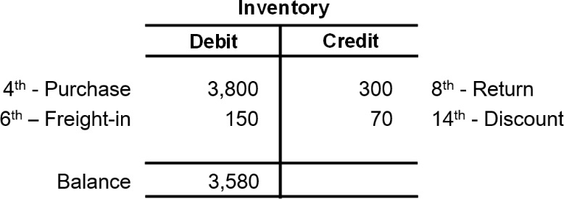
Summary of Purchasing Transactions
L O 2

Slide 16
Sales Discount Illustration
Assume Sauk Stereo pays the balance due of $3,500 (gross invoice price of $3,800 less purchase returns and allowances of $300) on May 14, the last day of the discount period. Prepare the journal entry PW Audio Supply makes to record the receipt on May 14.
May 14
Cash
3,430
Sales Discounts
70 *
Accounts Receivable
3,500
*[($3,800 − $300) × 2%]
L O 3

